Slide 1
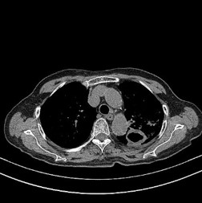
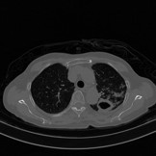

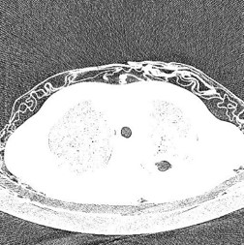
2
Clinical
Information
1
High Attenuation Information
Chief complaints
Lung Window
Information
Multimodal Regression Network
Detection Results
Original CT Images
Low Attenuation Information
3
Age, Gender
Demographic
Information
CT Image Visual Features

