Slide 1
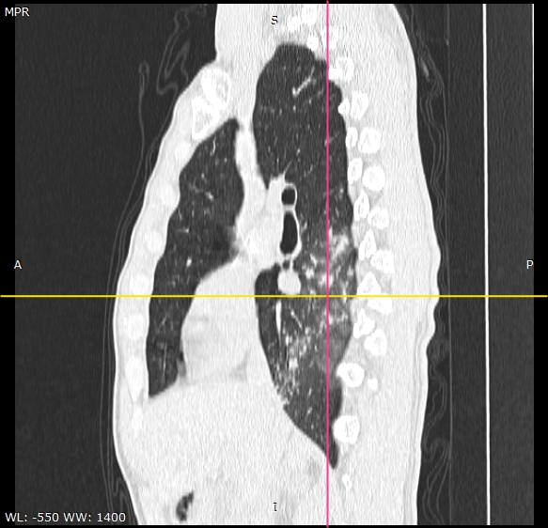
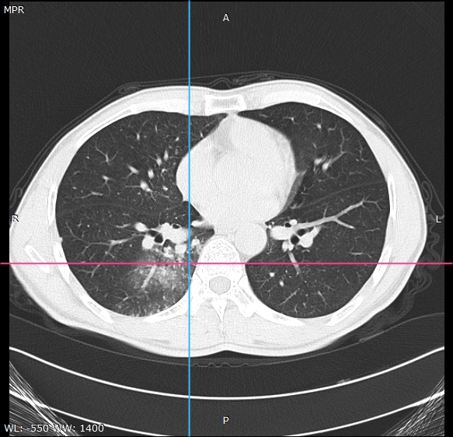
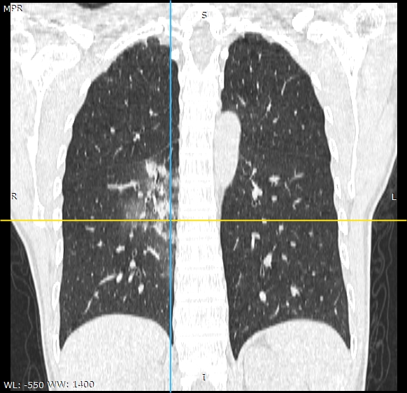
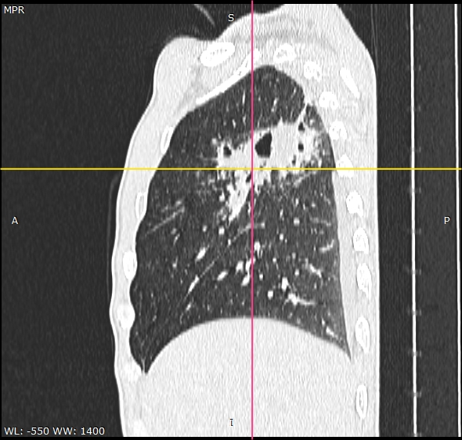
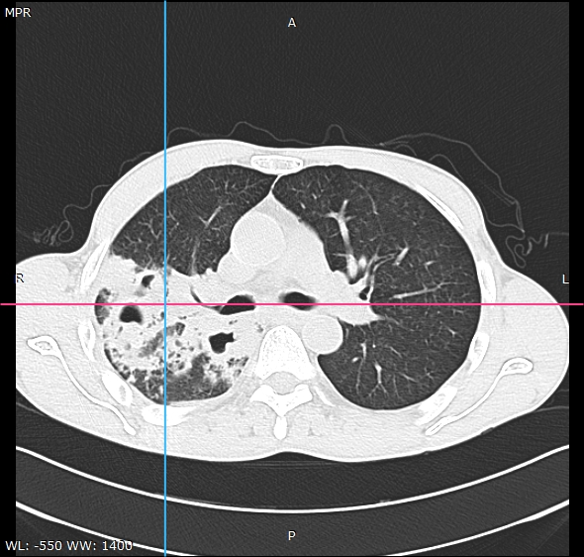
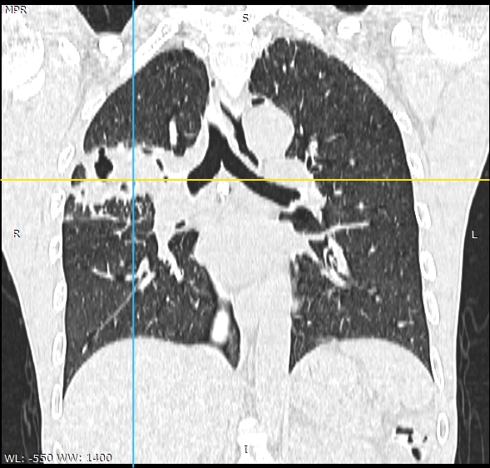
院外检查右下肺阴影，伴咯血，7天。
Has been examined by another hospital, shadow in right lower lung, hemoptysis, 7 days.
反复咳嗽、咳痰伴右胸痛半年，加重1月。
Repeated cough, sputum, pains in right chest for half a year, gets worse by one month.

