Slide 1
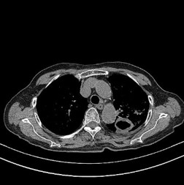
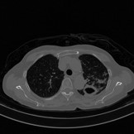

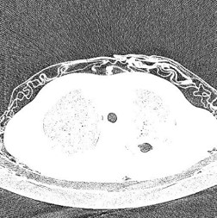
1
Clinical
Information
2
High Attenuation Information
Chief complaints
Lung Window
Information
Multimodal Regression Network
Screening Results
Original CT Images
Low Attenuation Information
3
Age, Gender
Demographic
Information
CT Image Visual Features

