Slide 1
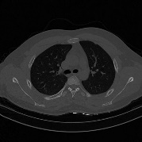
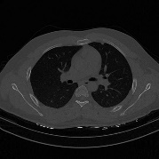
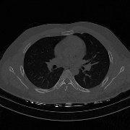
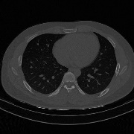
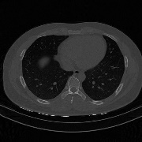
CT
slices
Visual Features
Sequence Learning
Lung window
CNN1
RNN
Concat
Output
Chest window
CNN2
RNN
Lung window
CNN1
RNN
Concat
Output
Chest window
CNN2
RNN
Lung window
CNN1
RNN
Concat
Output
Ignored
Chest window
CNN2
RNN
…
…
…
…
…
…
Lung window
CNN1
RNN
Concat
Output
Chest window
CNN2
RNN
Lung window
CNN1
RNN
Pneumonia
Concat
FC
Chest window
CNN2
RNN
Healthy

