Slide 1
Map Reduce Project Class Memo

Slide 2
Canvas -> Files -> find this slide and updated MRMovie.py

Slide 3
Steps: 1. Get the first step running on the small sample data (local machine, AWS, or GCP) 2. Fill in the missing steps and make it running on the small sample data 3. Run the Python script on the large data set

Slide 4
Step 1
sudo apt update
sudo apt install python-minimal
sudo apt install python-pip
sudo apt install unzip
pip install scipy
pip install mrjob
wget http://files.grouplens.org/datasets/movielens/ml-1m.zip
wget http://files.grouplens.org/datasets/movielens/ml-latest-small.zip
unzip ml-1m.zip
unzip ml-latest-small.zip
cd ml-latest-small

Slide 5
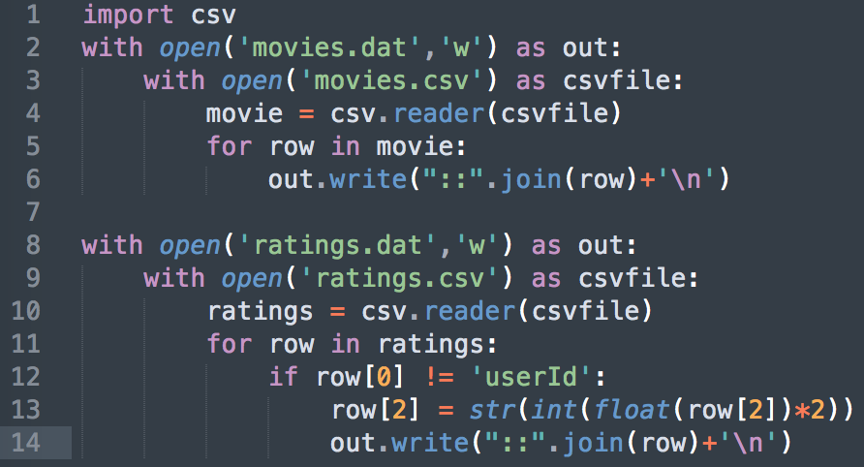
Step 1
Python
Run following:

Slide 6
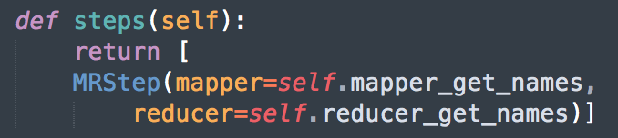
Step 1
nano MRMovie.py
python MRMovie.py ratings.dat movies.dat -m "Jumanji (1995)" -m "Toy Story (1995)"

Slide 7
Steps: 1. Get the first step running on the small sample data (local machine, AWS, or GCP) 2. Fill in the missing steps and make it running on the small sample data 3. Run the Python script on the large data set

Slide 8
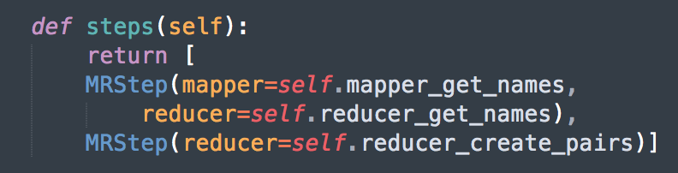
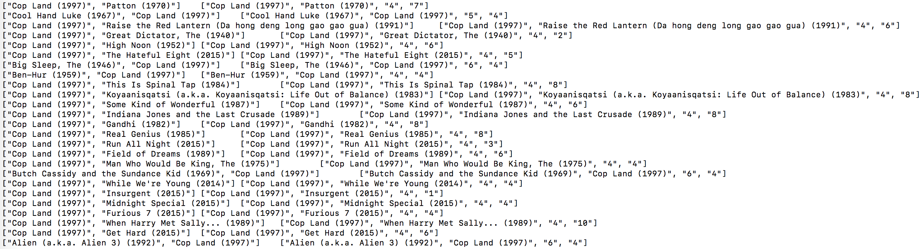
Step 2
nano MRMovie.py (add 2nd MRStep)
Sample output:

Slide 9
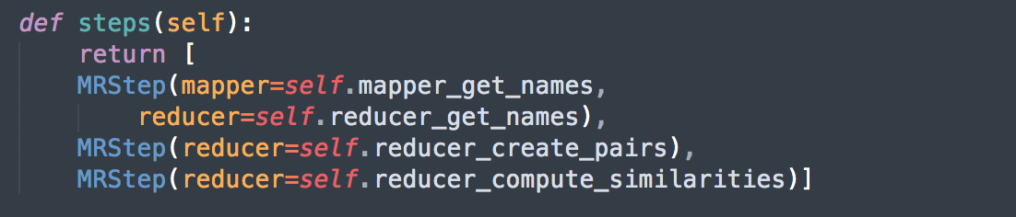
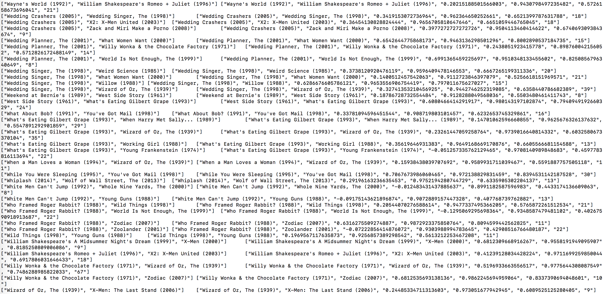
Step 2
nano MRMovie.py (add 3rd MRStep)

Slide 10
Steps: 1. Get the first step running on the small sample data (local machine, AWS, or GCP) 2. Fill in the missing steps and make it running on the small sample data 3. Run the Python script on the large data set

Slide 11
Step 3
AWS: run “nano ~/.mrjob.conf” in command line
runners:
emr:
bootstrap:
- sudo yum install -y python27-numpy
- sudo yum install -y python27-scipy
core_instance_type: m3.xlarge
num_core_instances: 5
aws_access_key_id: [your access key id]
aws_secret_access_key: [your secret access key]
Run the python script
python MRMovie.py ratings.dat movies.dat -r emr -m "Jumanji (1995)" -m "Toy Story (1995)"

Slide 12
Step 3
GCP
A bit more complicated: https://mrjob.readthedocs.io/en/stable/guides/dataproc-quickstart.html
Run the python script
python MRMovie.py ratings.dat movies.dat -r dataproc -m "Jumanji (1995)" -m "Toy Story (1995)"

Slide 13
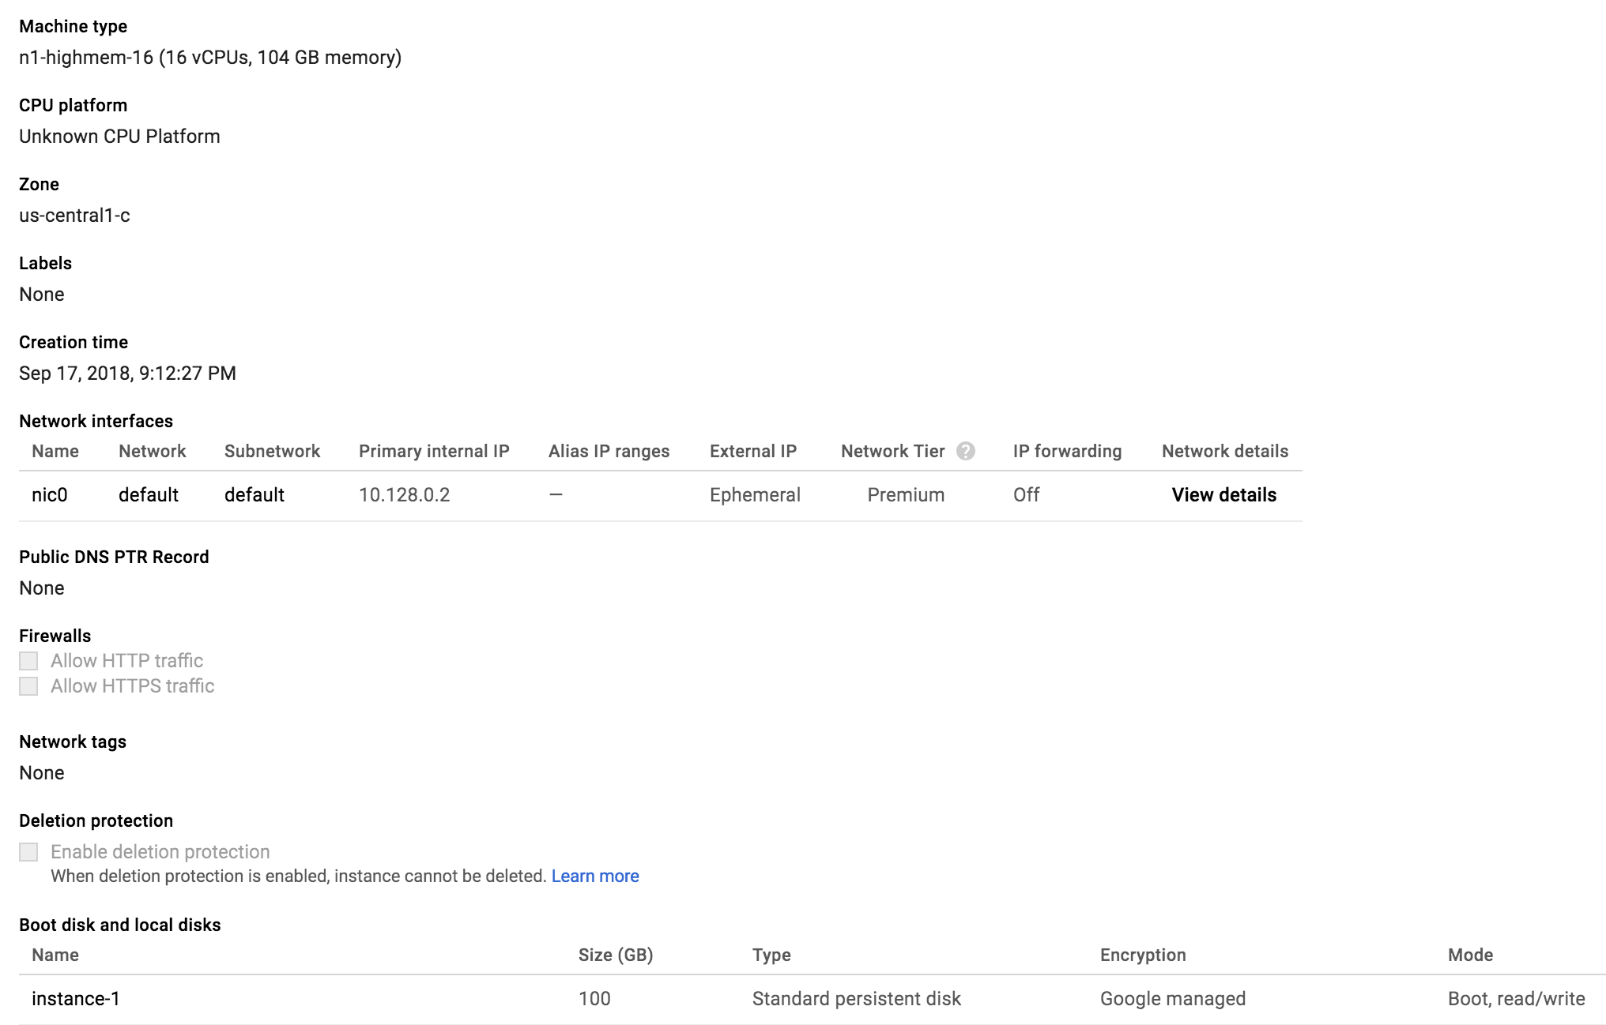
Step 3
GCP (alternative)
Use single instance to run “locally”

