Slide 1

RAG 压缩
硬压缩
软压缩
检索文档
检索文档
……The bounding sea to the West is the Ionian Sea. To the Northwest is the Myrtoan Sea, a subdivision of the Mediterranean Sea that lies between the Cyclades and Peloponnese. To the East-SE is ……
……The bounding sea to the West is the Ionian Sea. To the Northwest is the Myrtoan Sea, a subdivision of the Mediterranean Sea that lies between the Cyclades and Peloponnese. To the East-SE is ……
根据问题选择句子 or 总结
选出的句子 or 摘要
压缩成多个向量
问题
To the Northwest is the Myrtoan Sea, a subdivision of the Mediterranean Sea that lies between the Cyclades and Peloponnese.
What sea is located to the northwest of the Sea of Crete?
The Myrtoan Sea
The Myrtoan Sea

Slide 2
RECOMP: IMPROVING RETRIEVAL-AUGMENTED LMS WITH COMPRESSION AND SELECTIVE AUGMENTATION
……The bounding sea to the West is the Ionian Sea. To the Northwest is the Myrtoan Sea, a subdivision of the Mediterranean Sea that lies between the Cyclades and Peloponnese. To the East-SE is ……
文档：
问题：
The bounding sea to the West is the Ionian Sea.
To the Northwest is the Myrtoan Sea, a subdivision of the Mediterranean Sea that lies between the Cyclades and Peloponnese.
To the East-SE is ……
What sea is located to the northwest of the Sea of Crete?
To the Northwest is the Myrtoan Sea, a subdivision of the Mediterranean Sea that lies between the Cyclades and Peloponnese.

Slide 3
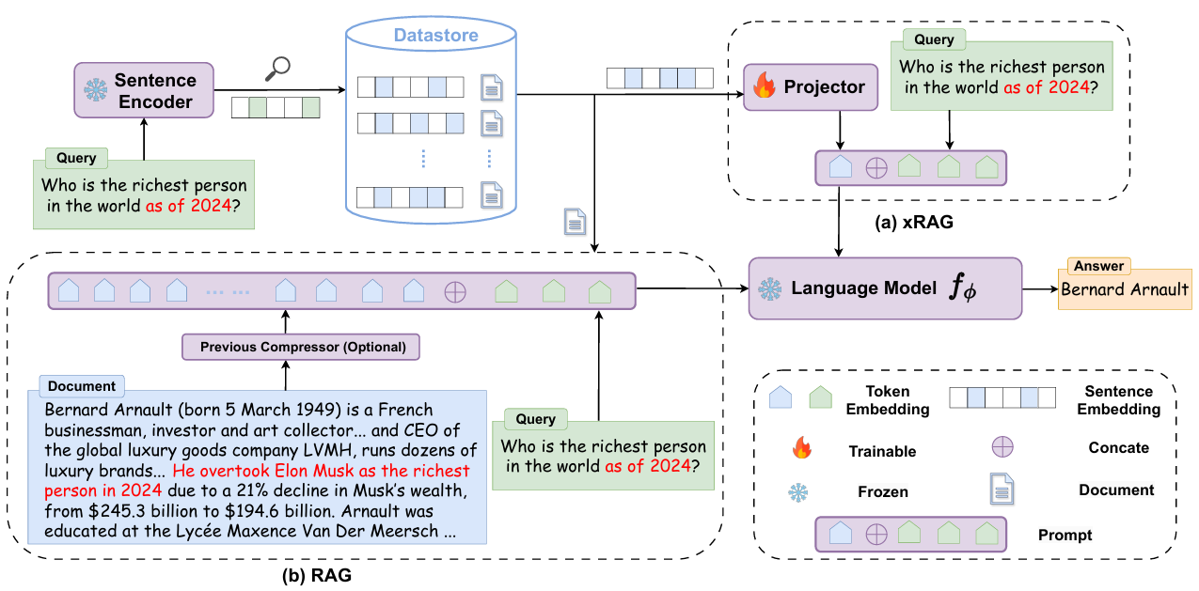
xRAG: Extreme Context Compression for Retrieval-augmented Generation with One Token (NeurIPS 2024)

Slide 4

OSCAR: ONLINE SOFT COMPRESSION FOR RAG (ICLR 2026)
文档
N * [MEM]
……The bounding sea to the West is the Ionian Sea. To the Northwest is the Myrtoan Sea, a subdivision of the Mediterranean Sea that lies between the Cyclades and Peloponnese. To the East-SE is ……
问题
Who is the richest person in the world as of 2024?
Compressor
What sea is located to the northwest of the Sea of Crete?
Generator
The Myrtoan Sea

Slide 5
