Slide 1
 | mbcpp | mbgp |  | mbpp
 | precision
linear | 69.12 | 72.64 | 72.08 | 61.56
draft varify | 91.62 | 93.55 | 93.25 | 89.25

Slide 2
模型 | 方法 | mbcpp |  |  |  |  | mbgp |  |  |  |  | mbjsp |  |  |  |  | mbpp
 |  | 吞吐量 | 加速比 | pass@1 | Acc. Len. | Acc. Rate | 吞吐量 | 加速比 | pass@1 | Acc. Len. | Acc. Rate | 吞吐量 | 加速比 | pass@1 | Acc. Len. | Acc. Rate | 吞吐量 | 加速比 | pass@1 | Acc. Len. | Acc. Rate
CodeLlama-34b | 自回归 | 18.49 | 1.00x |  | - | - | 17.97 | 1.00x |  | - | - | 18.18 | 1.00x | 56 | - | - | 18.30 | 1.00x | 54.2 | - | -
 | REST | 36.43 | 1.97x |  | 1.36 | - | 33.92 | 1.89x |  | 1.24 | - | 34.36 | 1.89x |  | 1.31 | - | 32.93 | 1.79x | 54.2 | 1.13 | -
 | Ditilled self-draft | 43.67 | 2.36x |  |  |  | 43.24 | 2.40x |  |  |  | 44.67 | 2.48x |  |  |  | 40.65 | 2.22x | 54.2
 | Eagle-3 | 40.43 | 2.18x |  | 2.11 | 0.53 | 39.20 | 2.18x |  | 1.94 | 0.46 | 40.96 | 2.25x |  | 2.06 | 0.51 | 36.64 | 2.00x | 54.2 | 1.73 | 0.45
 | ours | 48.22 | 2.60x |  | 5.38 | 0.74 | 47.59 | 2.64x |  | 5.05 | 0.77 | 46.88 | 2.58x |  | 5.07 | 0.75 | 43.76 | 2.39x | 54.2 | 4.43 | 0.71

Slide 3
模型 | 方法 | mbcpp |  |  |  |  | mbgp |  |  |  |  | mbjsp |  |  |  |  | mbpp
 |  | 吞吐量 | 加速比 | pass@1 | Acc. Len. | Acc. Rate | 吞吐量 | 加速比 | pass@1 | Acc. Len. | Acc. Rate | 吞吐量 | 加速比 | pass@1 | Acc. Len. | Acc. Rate | 吞吐量 | 加速比 | pass@1 | Acc. Len. | Acc. Rate
CodeLlama-34b | 自回归 | 18.54 | 1.00x |  | - | - | 18.19 | 1.00x |  | - | - | 18.15 | 1.00x |  | - | - | 18.25 | 1.00x | 47.12 | - | -
 | REST | 35.14 | 1.89x |  | 1.27 | - | 37.70 | 2.07x |  | 1.49 | - | 33.24 | 1.83x |  | 1.18 | - | 33.25 | 1.82x | 47.68 | 1.12 | -
 | Ditilled self-draft | 43.38 | 2.34x |  |  |  | 42.71 | 2.34x |  |  |  | 42.90 | 2.36x |  |  |  | 38.90 | 2.13x | 46.00
 | Eagle-3 | 37.50 | 2.02x |  | 1.87 | 0.48 | 37.58 | 2.06x |  | 1.91 | 0.46 | 36.22 | 1.99x |  | 1.76 | 0.44 | 33.12 | 1.81x | 47.12 | 1.58 | 0.41
 | ours | 46.36 | 2.50x |  | 5.37 | 0.75 | 45.55 | 2.50x |  | 4.81 | 0.75 | 46.02 | 2.53x |  | 5.07 | 0.75 | 41.48 | 2.27x | 46.48 | 4.0 | 0.69

Slide 4
模型 | 方法 | mbcpp |  |  |  |  | mbgp |  |  |  |  | mbjsp |  |  |  |  | mbpp
 |  | 吞吐量 | 加速比 | pass@1 | Acc. Len. | Acc. Rate | 吞吐量 | 加速比 | pass@1 | Acc. Len. | Acc. Rate | 吞吐量 | 加速比 | pass@1 | Acc. Len. | Acc. Rate | 吞吐量 | 加速比 | pass@1 | Acc. Len. | Acc. Rate
deepseek-33b | 自回归 | 14.44 | 1.00x |  | - | - | 14.31 | 1.00x |  | - | - | 14.13 | 1.00x |  | - | - | 14.05 | 1.00x |  | - | -
 | REST | 30.56 | 2.11x |  | 1.51 | - | 28.22 | 1.97x |  | 1.36 | - | 27.21 | 1.92x |  | 1.30 | - | 26.20 | 1.86x |  | 1.14 | -
 | Ditilled self-draft | 34.63 | 2.39x |  |  |  | 32.53 | 2.30x |  |  |  | 33.55 | 2.37x |  |  |  | 29.94 | 2.13x
 | Eagle-3 | 31.52 | 2.18x |  | 1.86 | 0.48 | 29.21 | 2.04x |  | 1.70 | 0.43 | 30.01 | 2.13x |  | 1.70 | 0.44 | 28.05 | 1.99x |  | 1.54 | 0.40
 | ours | 37.69 | 2.61x |  | 6.04 | 0.78 | 36.79 | 2.57x |  | 5.38 | 0.75 | 36.43 | 2.58x |  | 5.47 | 0.76 | 31.86 | 2.26x |  | 4.40 | 0.68

Slide 5
模型 | 方法 | mbcpp |  |  |  |  | mbgp |  |  |  |  | mbjsp |  |  |  |  | mbpp
 |  | 吞吐量 | 加速比 | pass@1 | Acc. Len. | Acc. Rate | 吞吐量 | 加速比 | pass@1 | Acc. Len. | Acc. Rate | 吞吐量 | 加速比 | pass@1 | Acc. Len. | Acc. Rate | 吞吐量 | 加速比 | pass@1 | Acc. Len. | Acc. Rate
deepseek-33b | 自回归 | 14.20 | 1.00x |  | - | - | 14.23 | 1.00x |  | - | - | 14.22 | 1.00x |  | - | - | 14.03 | 1.00x |  | - | -
 | REST | 30.33 | 2.13x |  | 1.46 | - | 27.92 | 1.96x |  | 1.32 | - | 26.36 | 1.85x |  | 1.19 | - | 24.71 | 1.76x |  | 1.06 | -
 | Ditilled self-draft | 34.90 | 2.45x |  |  |  | 32.53 | 2.28x |  |  |  | 32.73 | 2.30x |  |  |  | 29.73 | 2.11x
 | Eagle-3 | 28.37 | 1.99x |  | 1.66 | 0.43 | 27.13 | 1.90x |  | 1.49 | 0.39 | 26.55 | 1.86x |  | 1.49 | 0.38 | 25.59 | 1.82x |  | 1.38 | 0.36
 | ours | 38.60 | 2.71x |  | 6.03 | 0.78 | 34.69 | 2.43x |  | 4.89 | 0.74 | 34.65 | 2.43x |  | 5.29 | 0.75 | 31.86 | 2.23x |  | 4.16 | 0.67

Slide 6
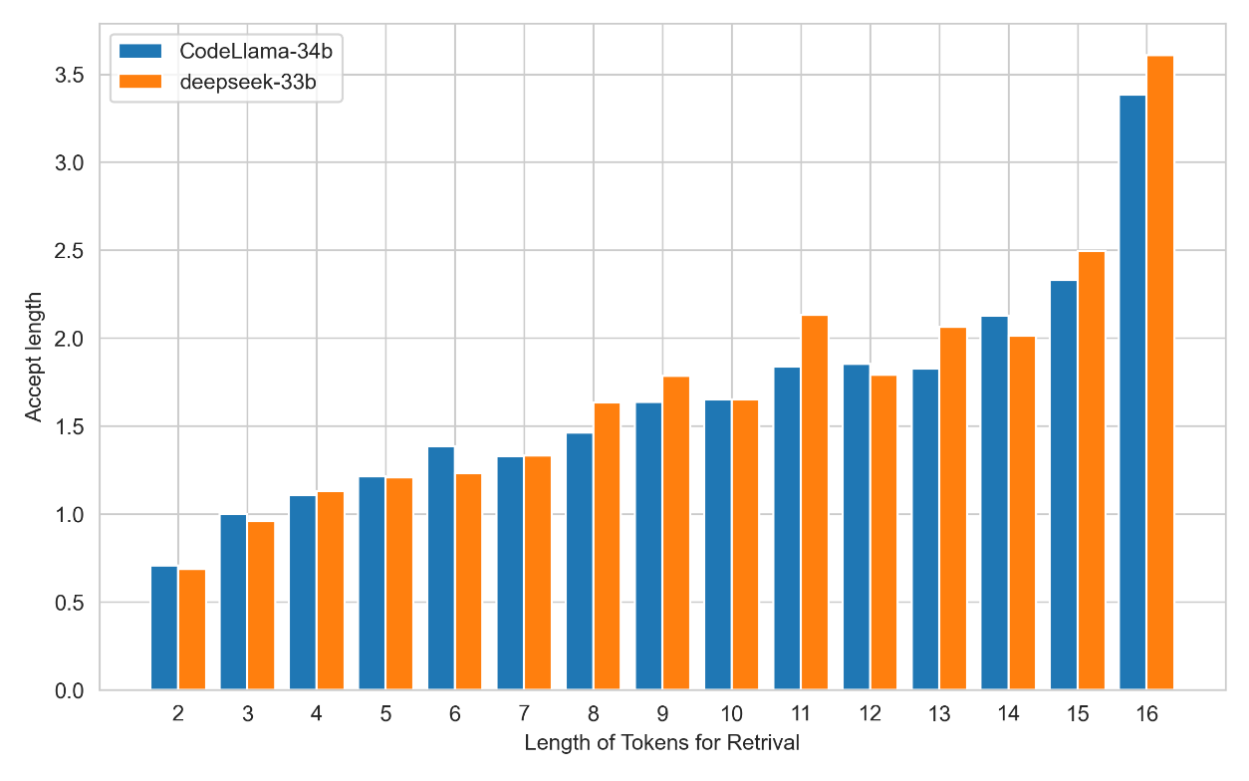
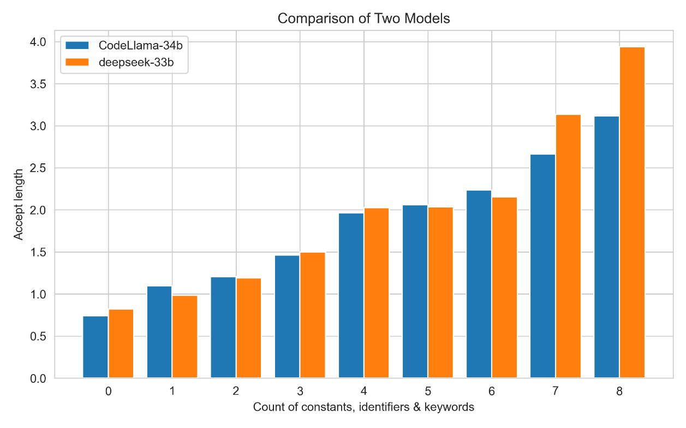
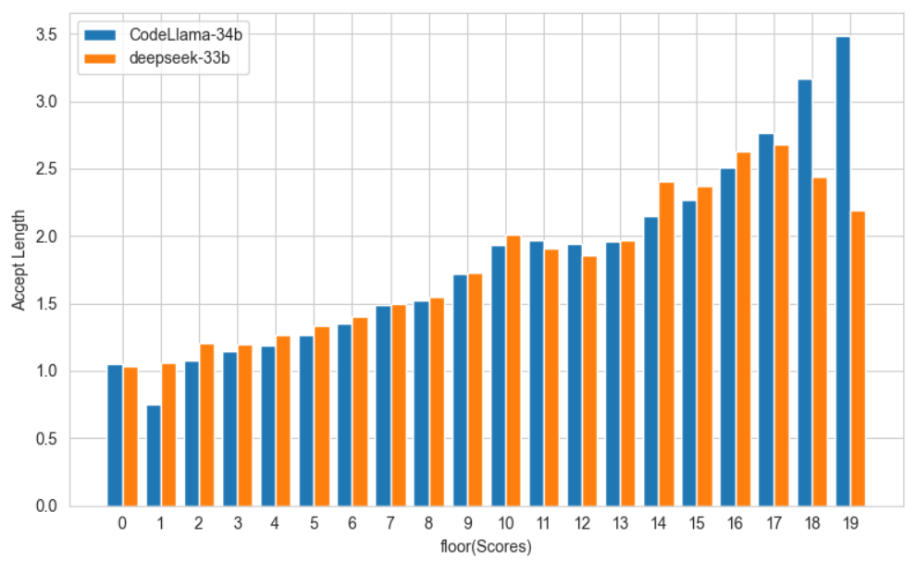

Slide 7
