Slide 1












Code Search
Features for
Features for
after Scaling
Code Sum.
Features for
Vul. Detection
Features for
…
…
Scale
fuse
fuse
Rescale
Exract Feature for
Direct Fusion
Fusion after Scaling
Inference

Slide 2











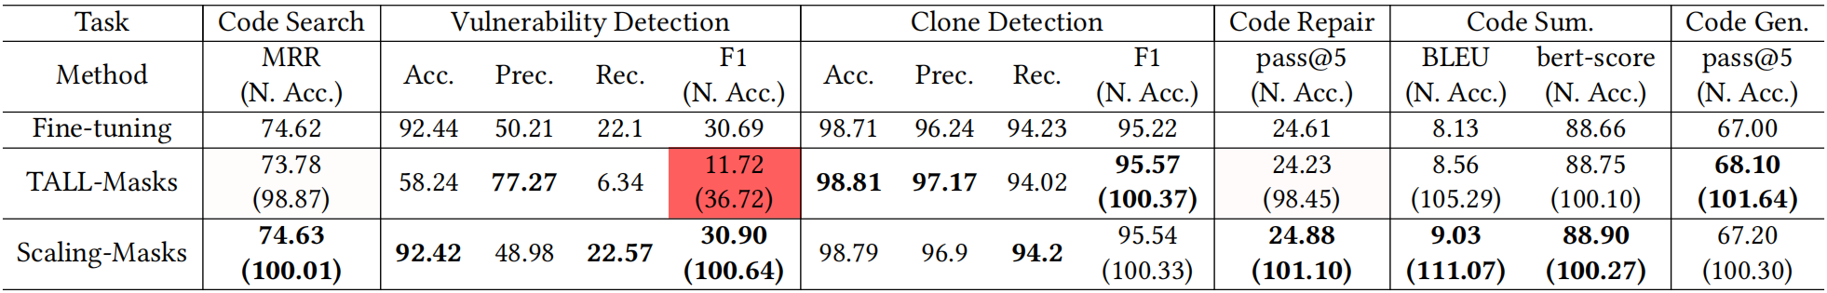
Code Sum.
Features for
Features for
after Scaling
Vul. Detection
Features for
Exract
for
Scale up
Fusion
Rescale
Loss
Maintain
Fusion
Params
1-bit
masks
Direct Max Fusion
融合6个软件工程任务的性能

Slide 3
Vulnerability Detection
Code Summarization
Exract
for
Scale up
Fusion
Rescale
Maintain
Fusion Params
1-bit masks
Direct Max Fusion
融合6个软件工程任务的性能

