Slide 1
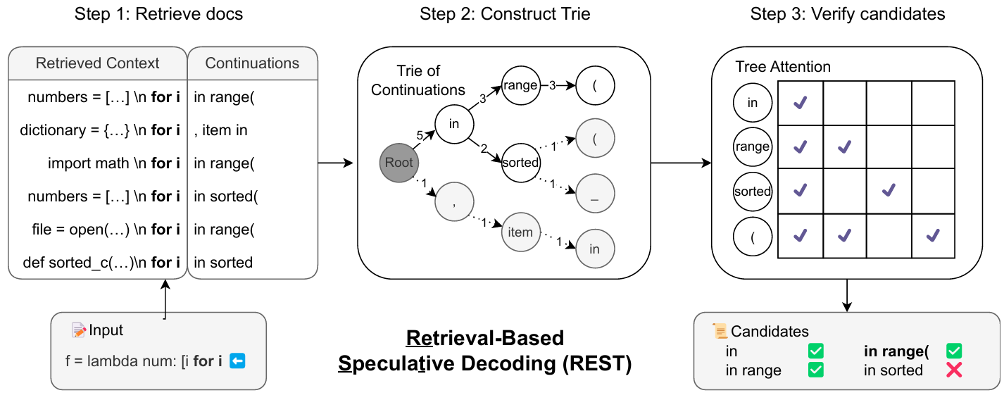
REST: Retrieval-Based Speculative Decoding

