Slide 1
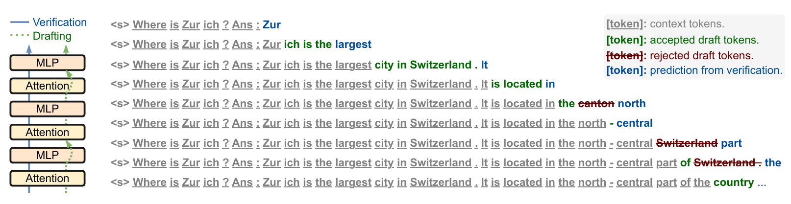
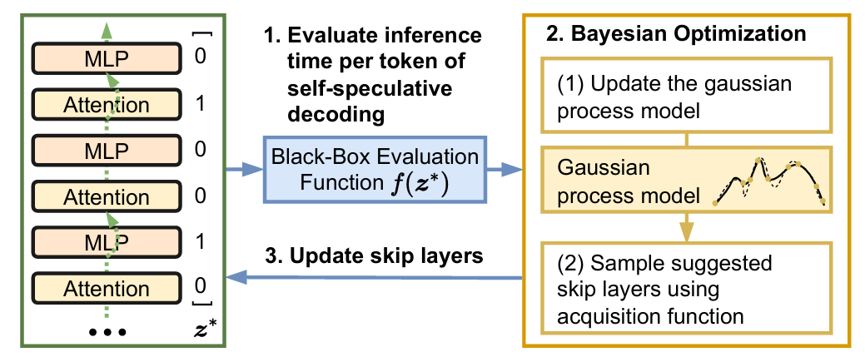
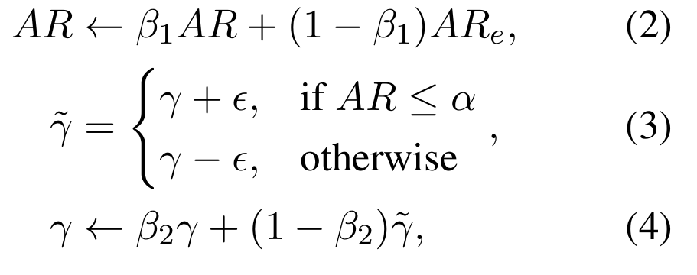
Self-Speculative Decoding

Slide 2
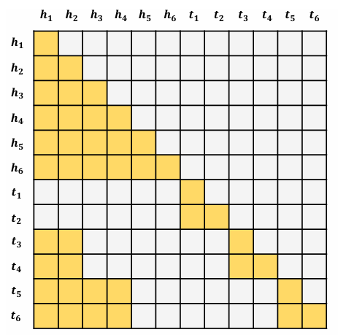
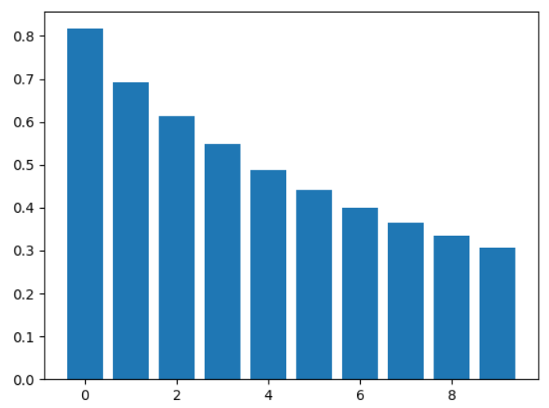

跳过层选择
…attention
每秒输出token数+$λ∗max{\left(0,\left(k_{curr}−k_{target}\right)\right)}^{2}$
权重递增蒸馏

Slide 3
结构化剪枝压缩模型得到草稿模型
Self-Speculative Decoding + LoRA + 领域自适应微调

