Slide 1
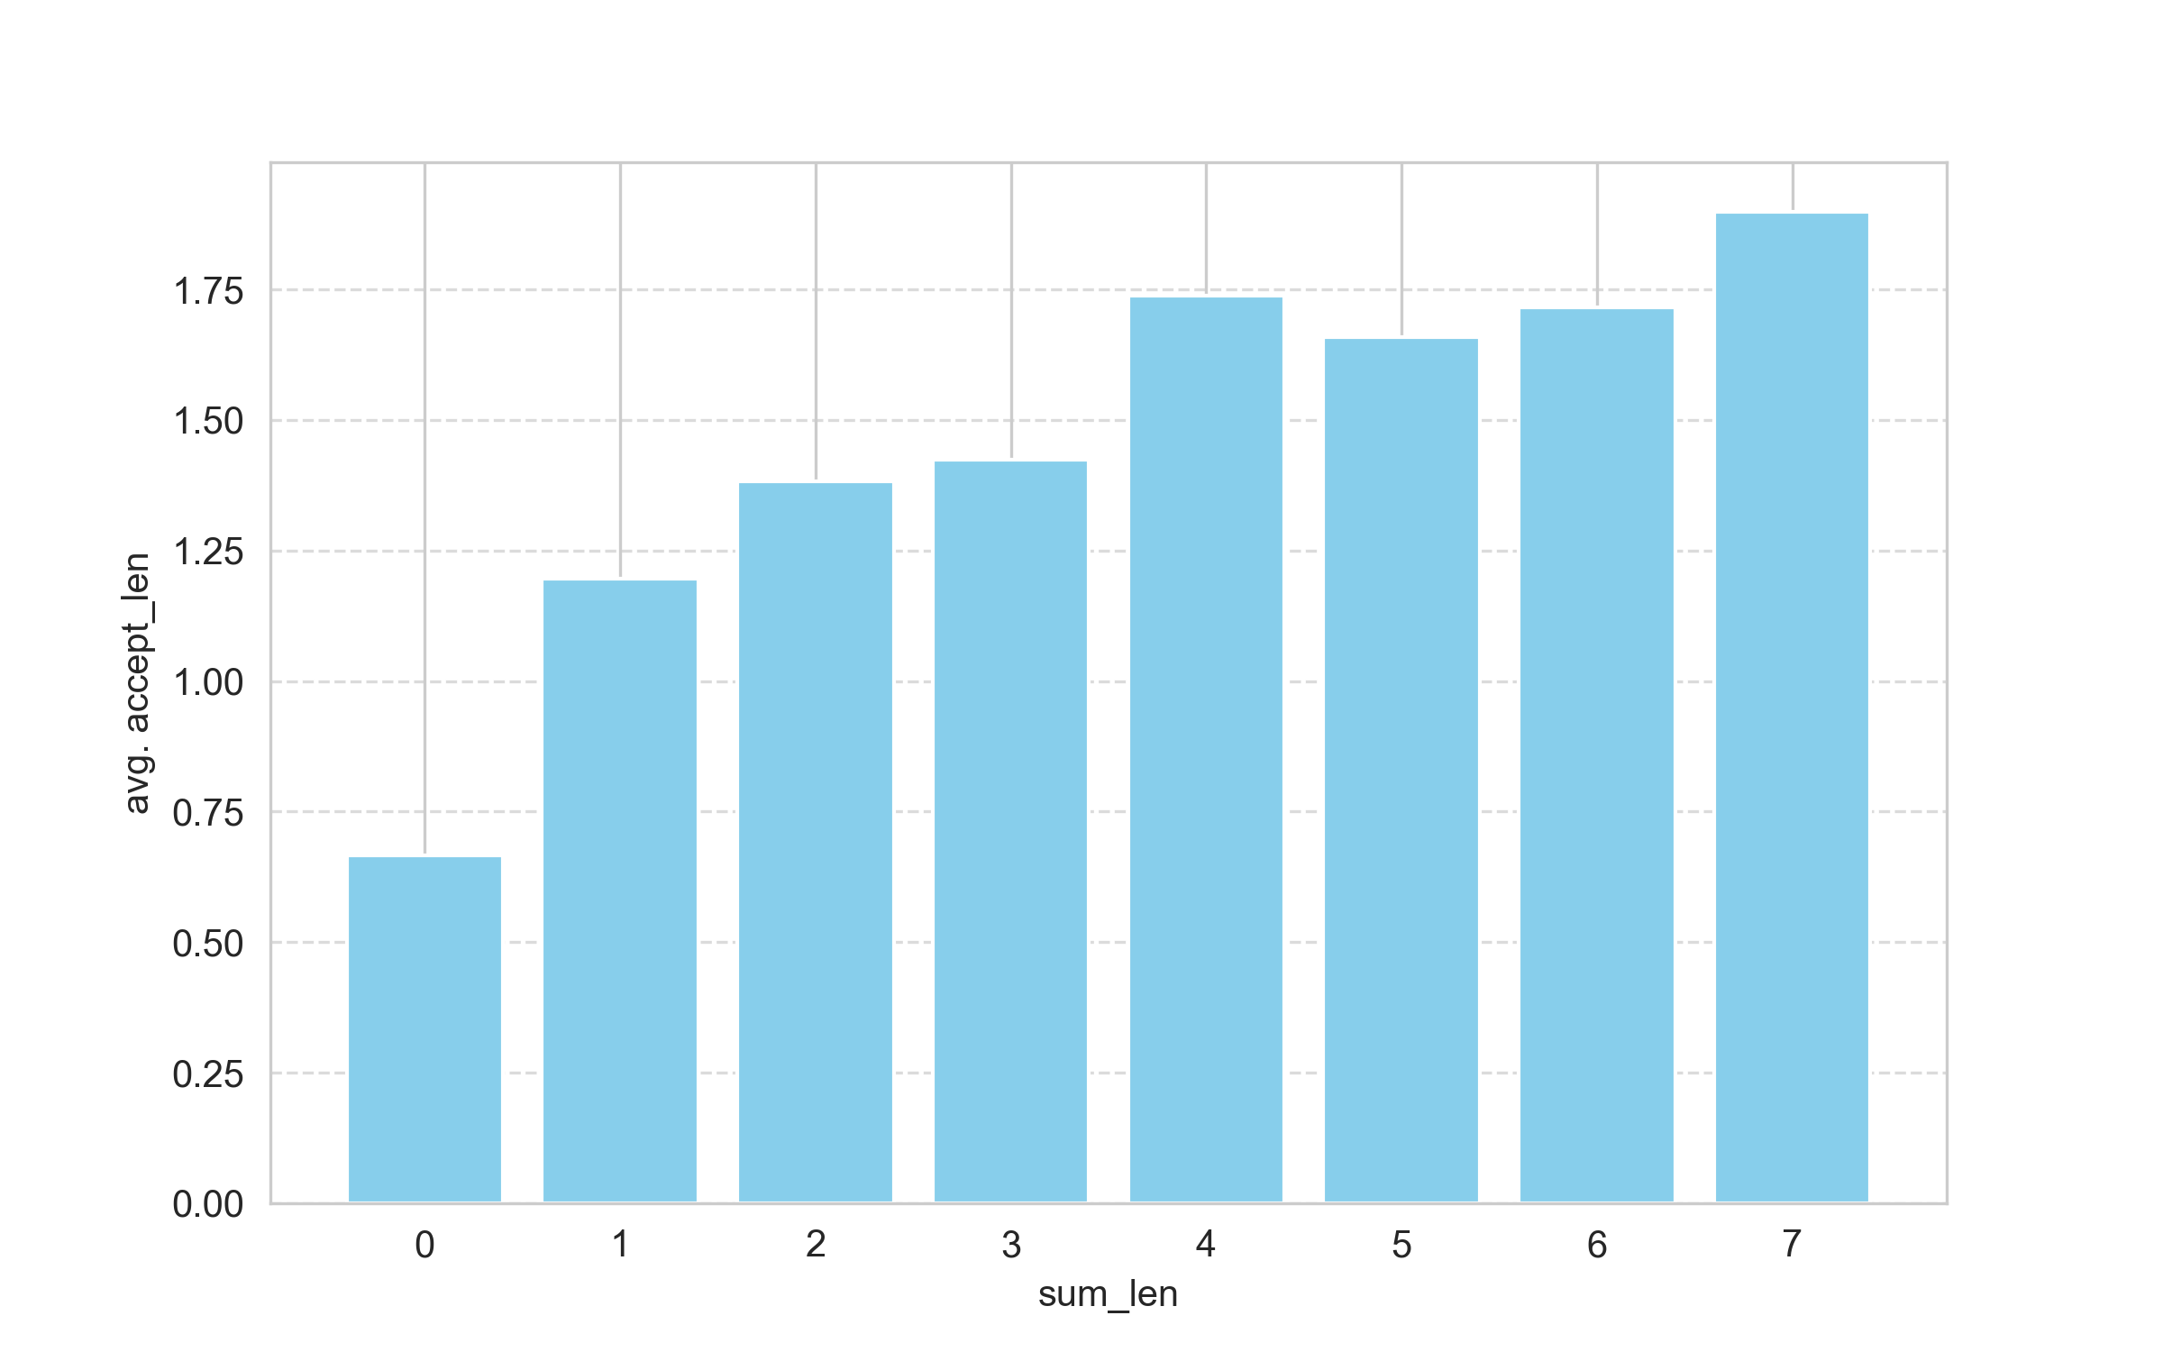
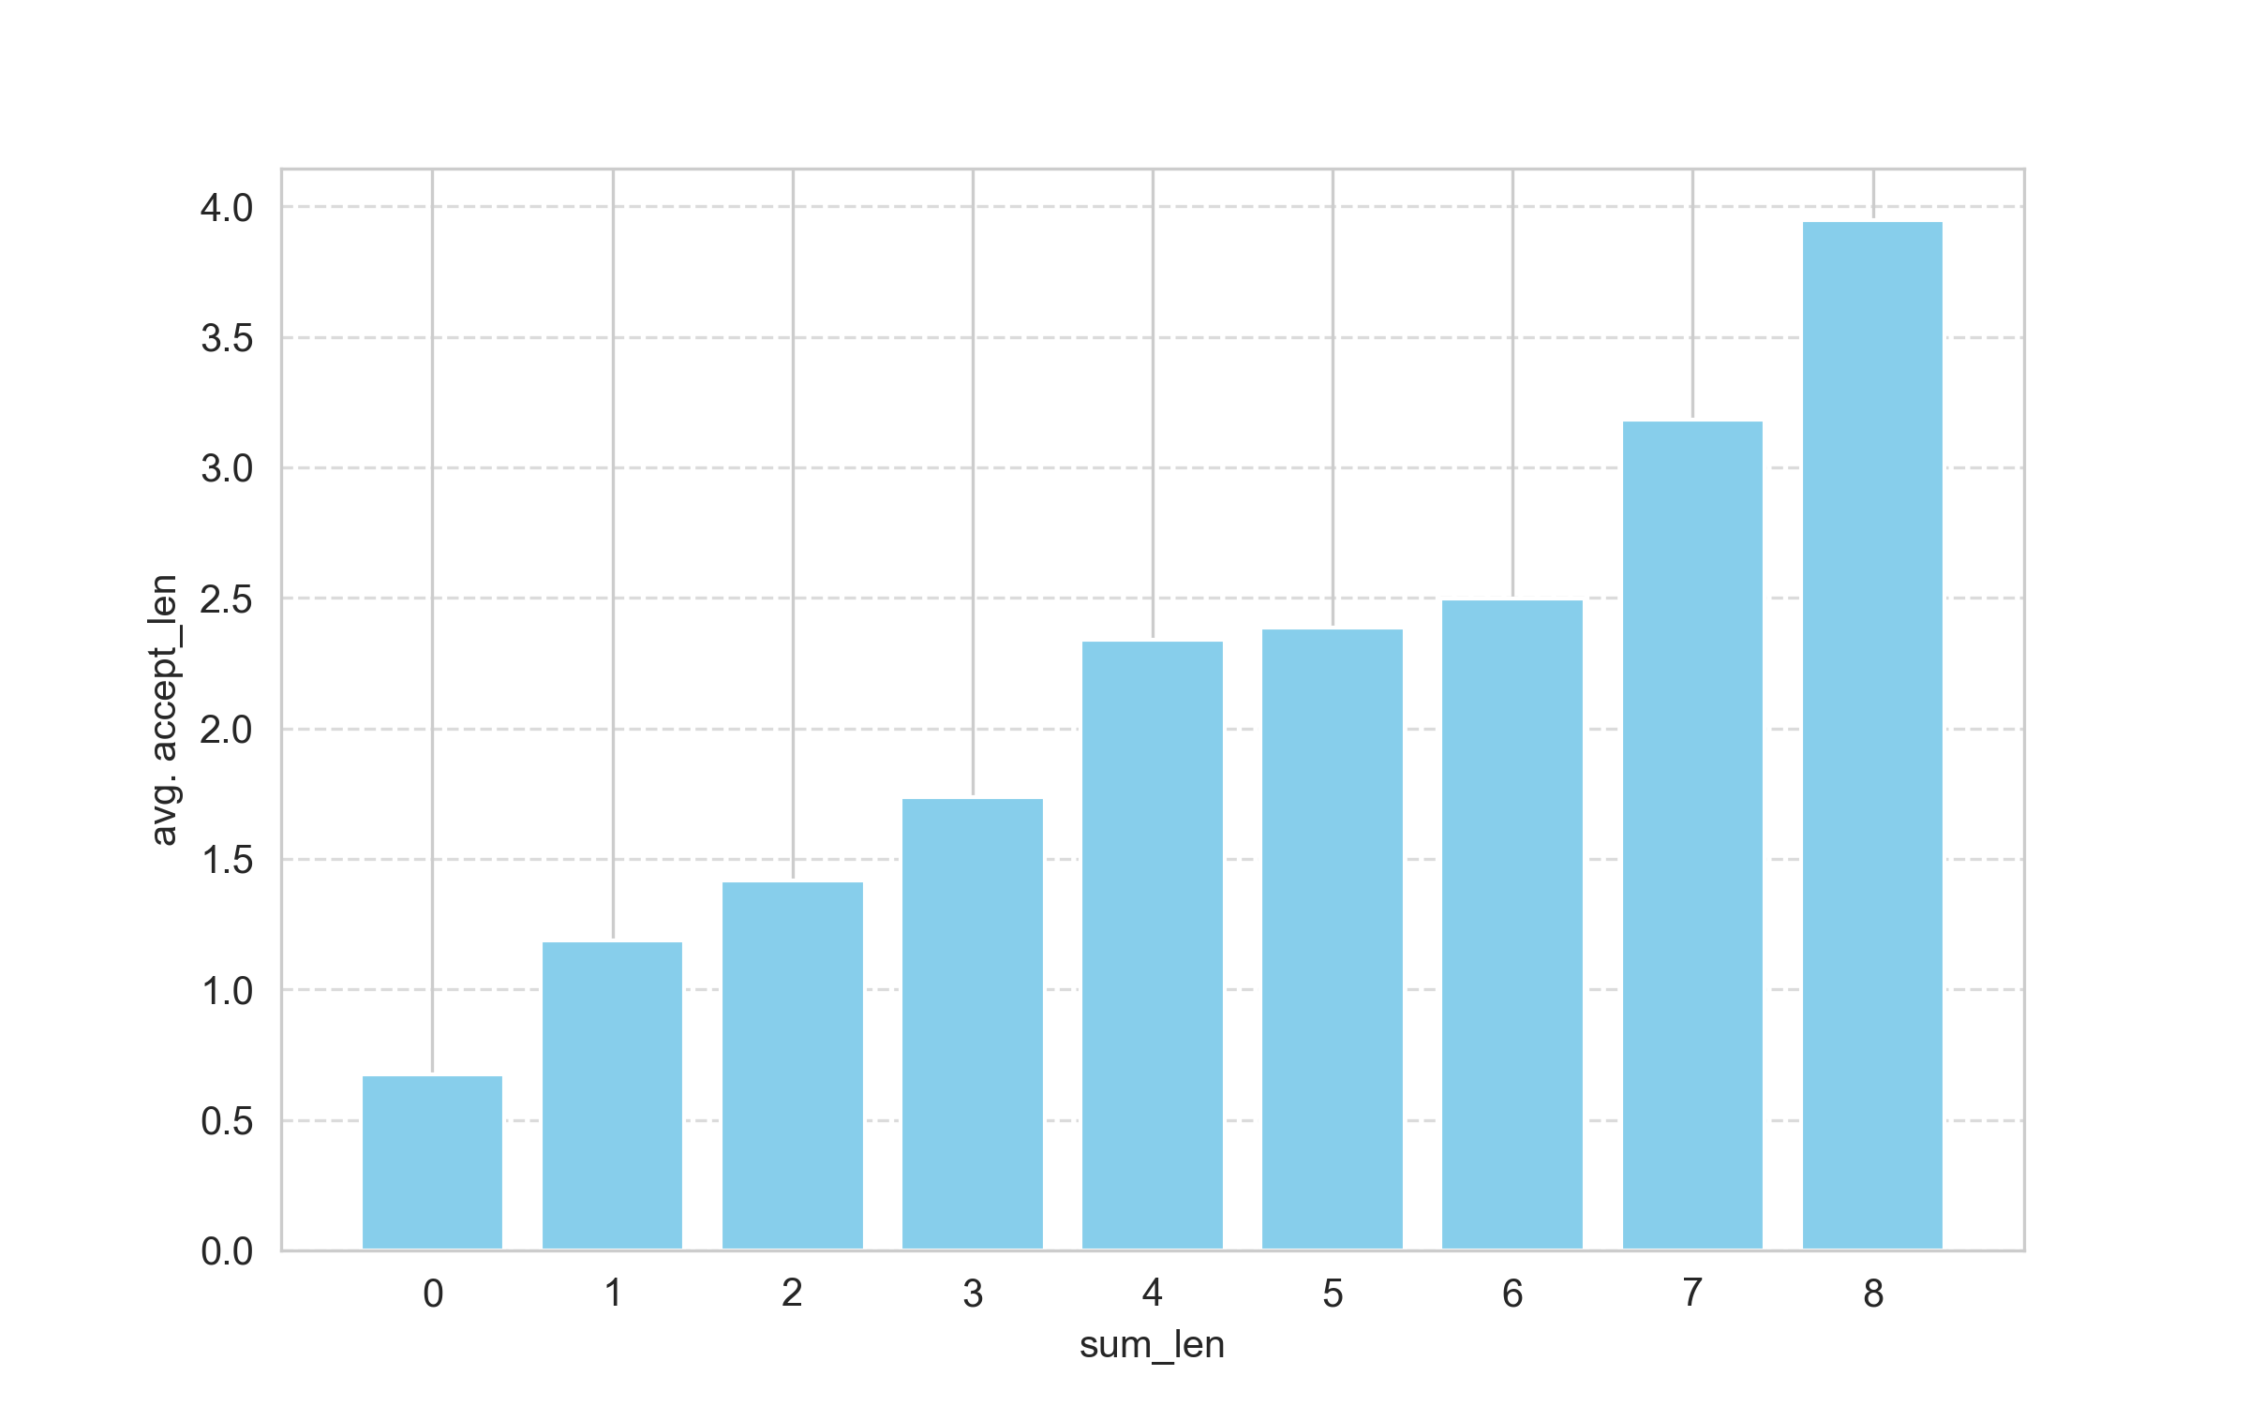
 | MBPP |  | MBCPP |  | MBGP |  | MBJSP
 | Speed | Accept Length | Speed | Accept Length | Speed | Accept Length | Speed | Accept Length
Based | 1.0x | - | 1.0x | - | 1.0x | - | 1.0x | -
REST | 1.70x | 2.15 | 1.86x | 2.31 | 1.84x | 2.36 | 1.89x | 2.37
MBCPP
MBGP

