Slide 1
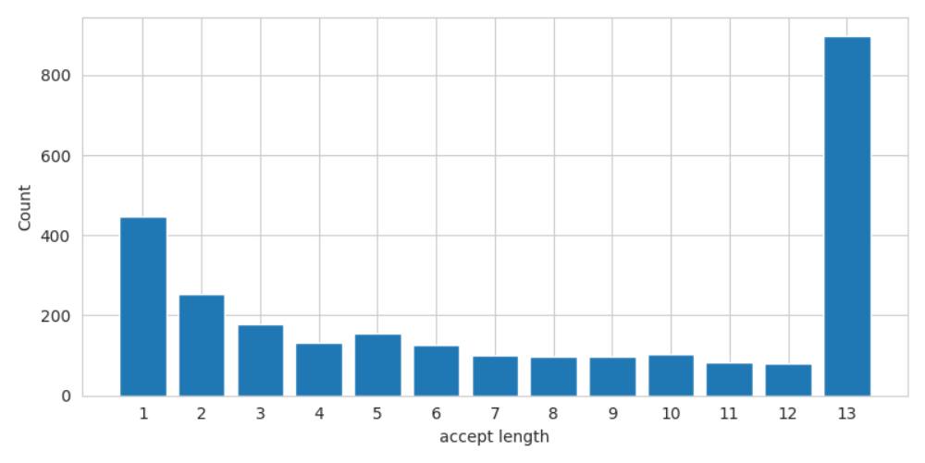
 | HumanEval
 | Speed | Accept Length
Based | 1.0x | 1.00
REST | 1.68x | 2.16
Distilled Self-Speculative Decoding | 1.82x | 4.39

Slide 2
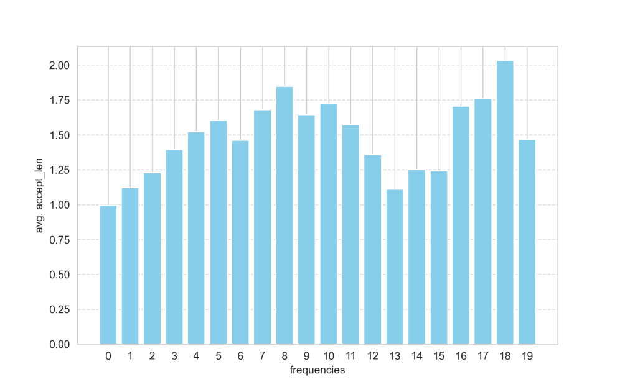
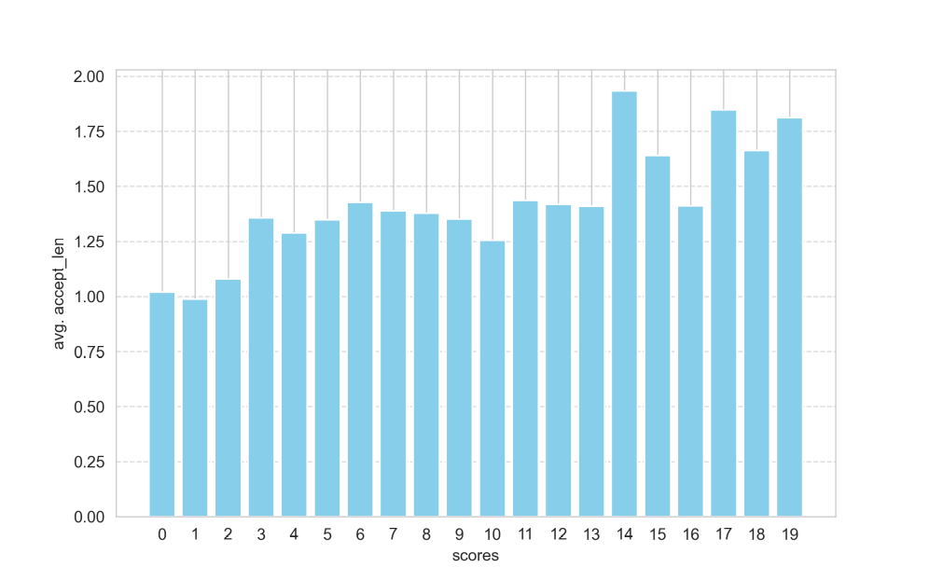
accuracy | precision | recall | f1-score
78.81 | 79.28 | 75.16 | 77.17

