Slide 1
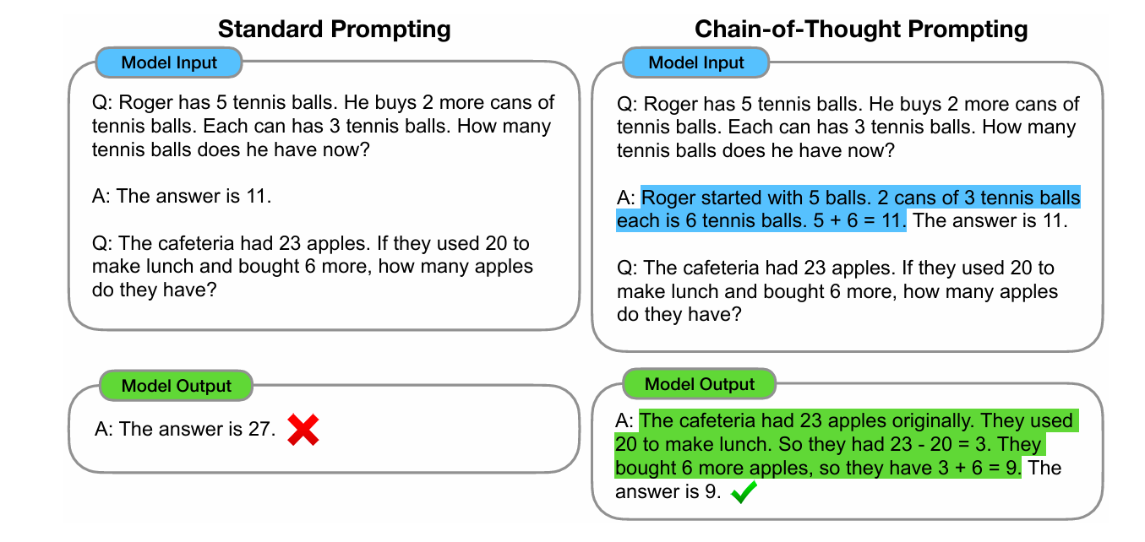
COT

Slide 2
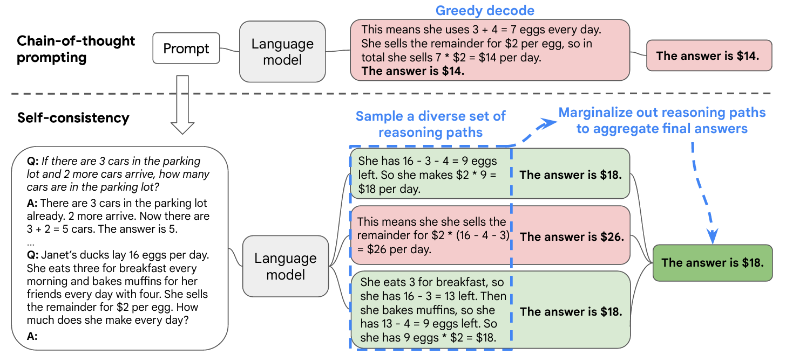
COT-SC (SELF-CONSISTENCY)

Slide 3
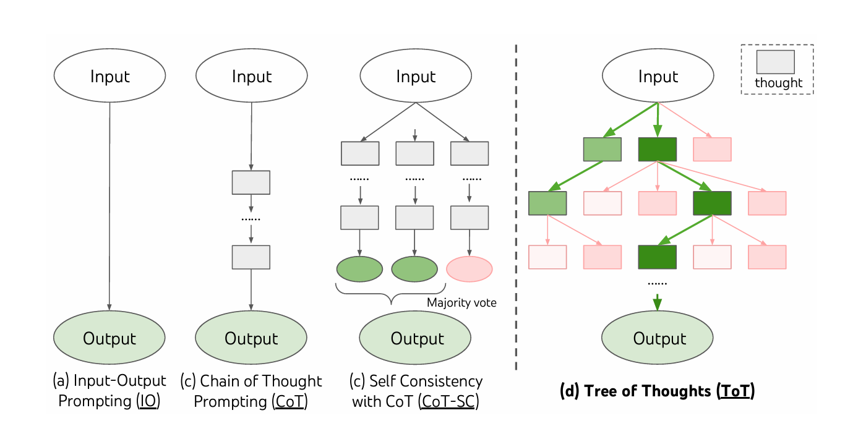
TOT

Slide 4

TOT

Slide 5
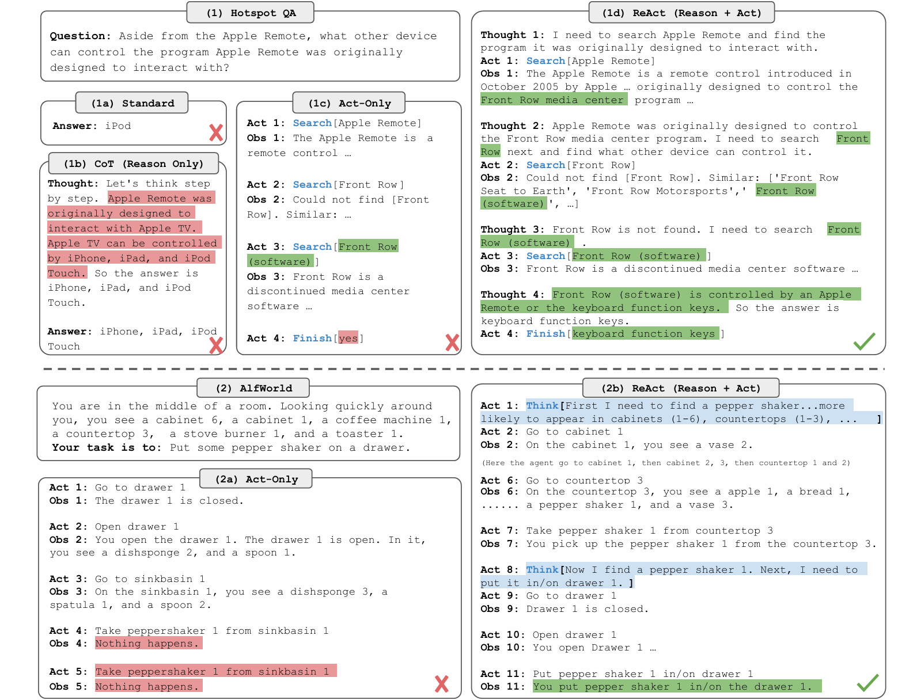
ReAct

Slide 6
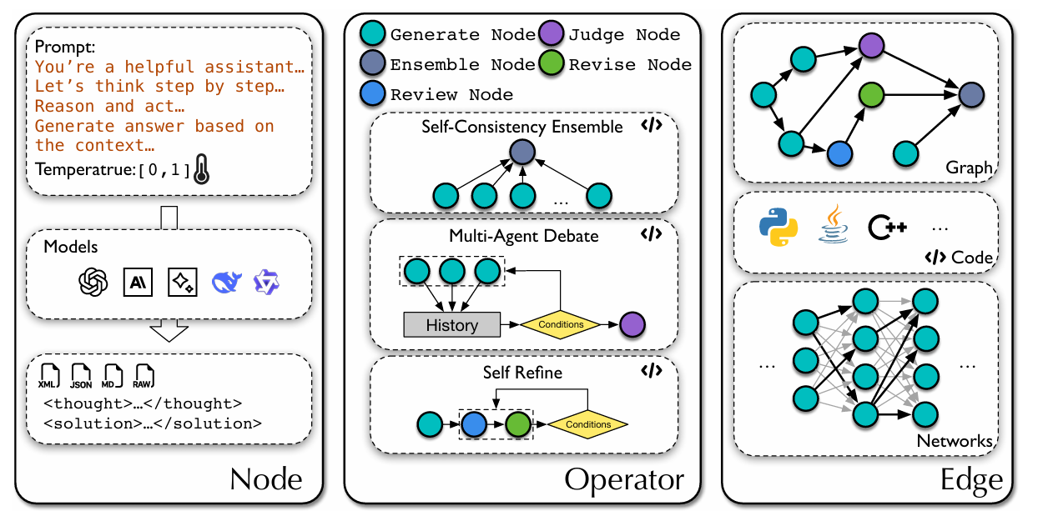
AFlow

Slide 7
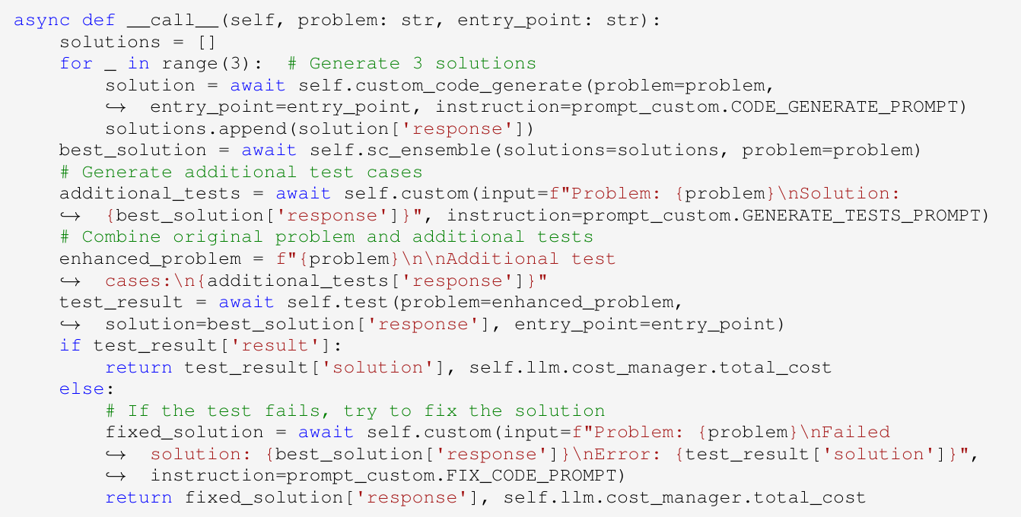
AFlow

Slide 8

AFlow

Slide 9
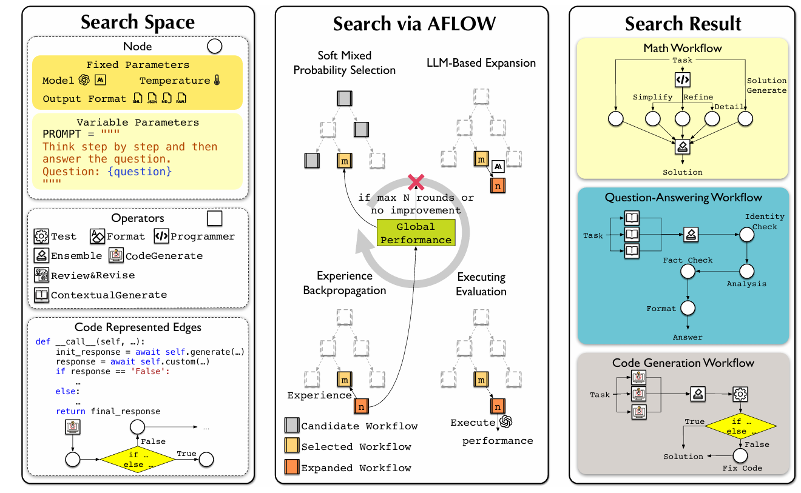
AFlow

Slide 10
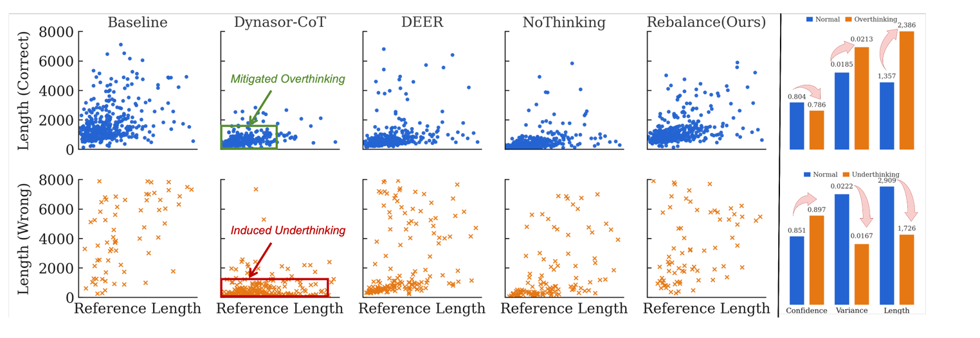


ReBalance

Slide 11
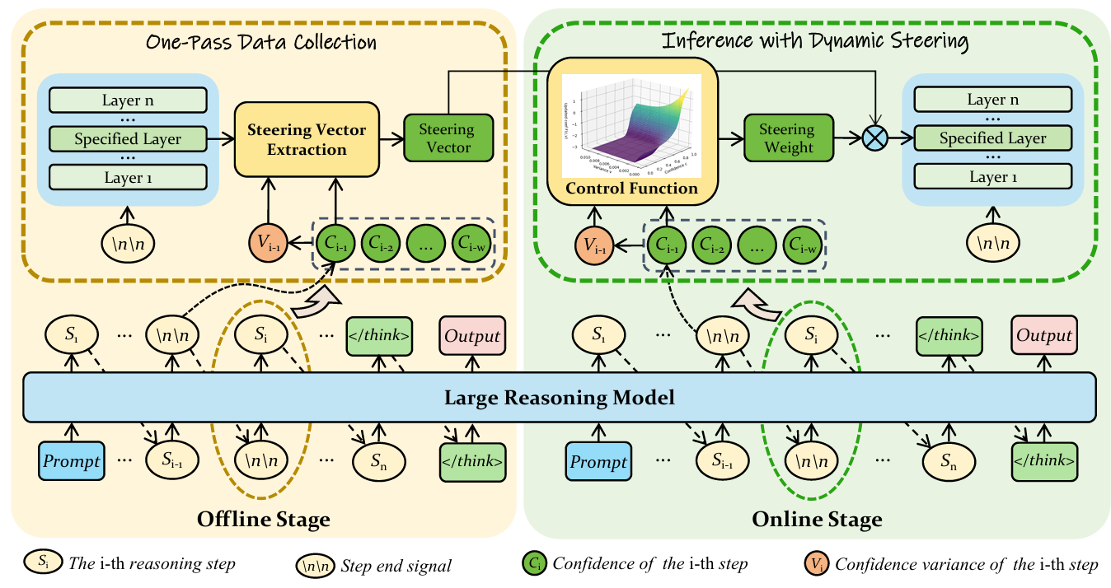
ReBalance

Slide 12

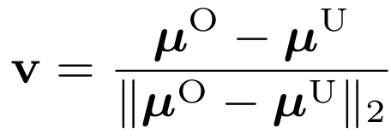
ReBalance

Slide 13

ReBalance

Slide 14

ReBalance

