Slide 1
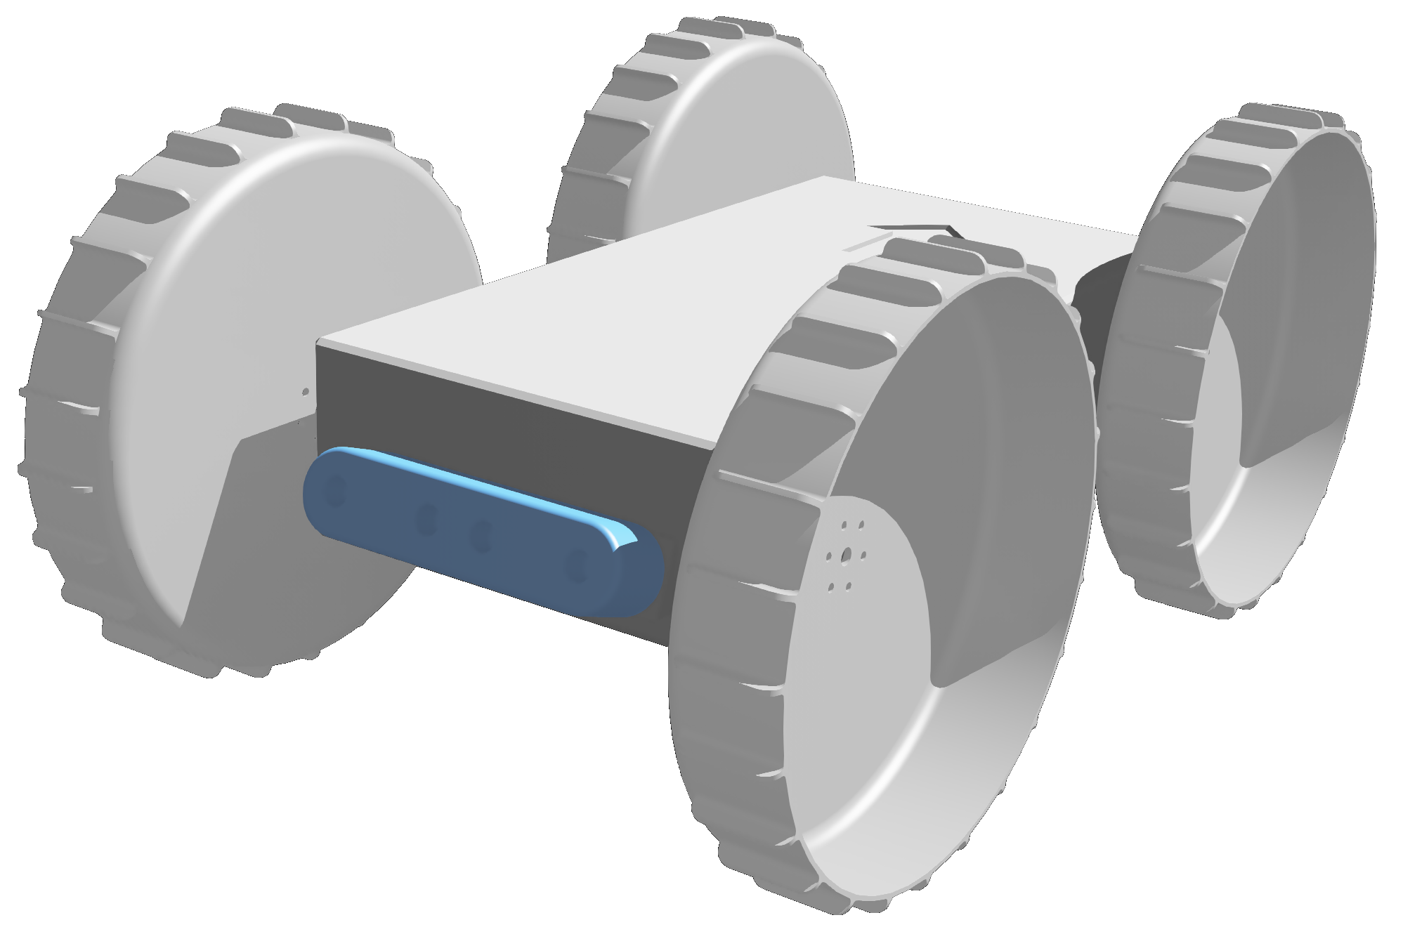
















Z
R₁
Obstacle
Threshold
Obstacle
Zone
Punishment
Zone
Y
X

