Slide 1
Lung segmentation
Initial fissure prediction
Multiscale fissure detection
Training lobe mesh
SSM predicted ROI
Lung extraction: Thresholding operation
Separate lung mesh
Map
Lung SSM
Hessian-based fissure detection
Airway segmentation: Region growing
mode weights
Input
Connected component filters
Lobar SSM
Lung separation: Connected component
Deform
Deformed PCA lobe model
Fissure surface fitting

Slide 2
Training lobe mesh
Separate lung mesh
Map
Lung SSM
mode weights
Input
Lobar SSM
Deform
Deformed PCA lobe model

Slide 3
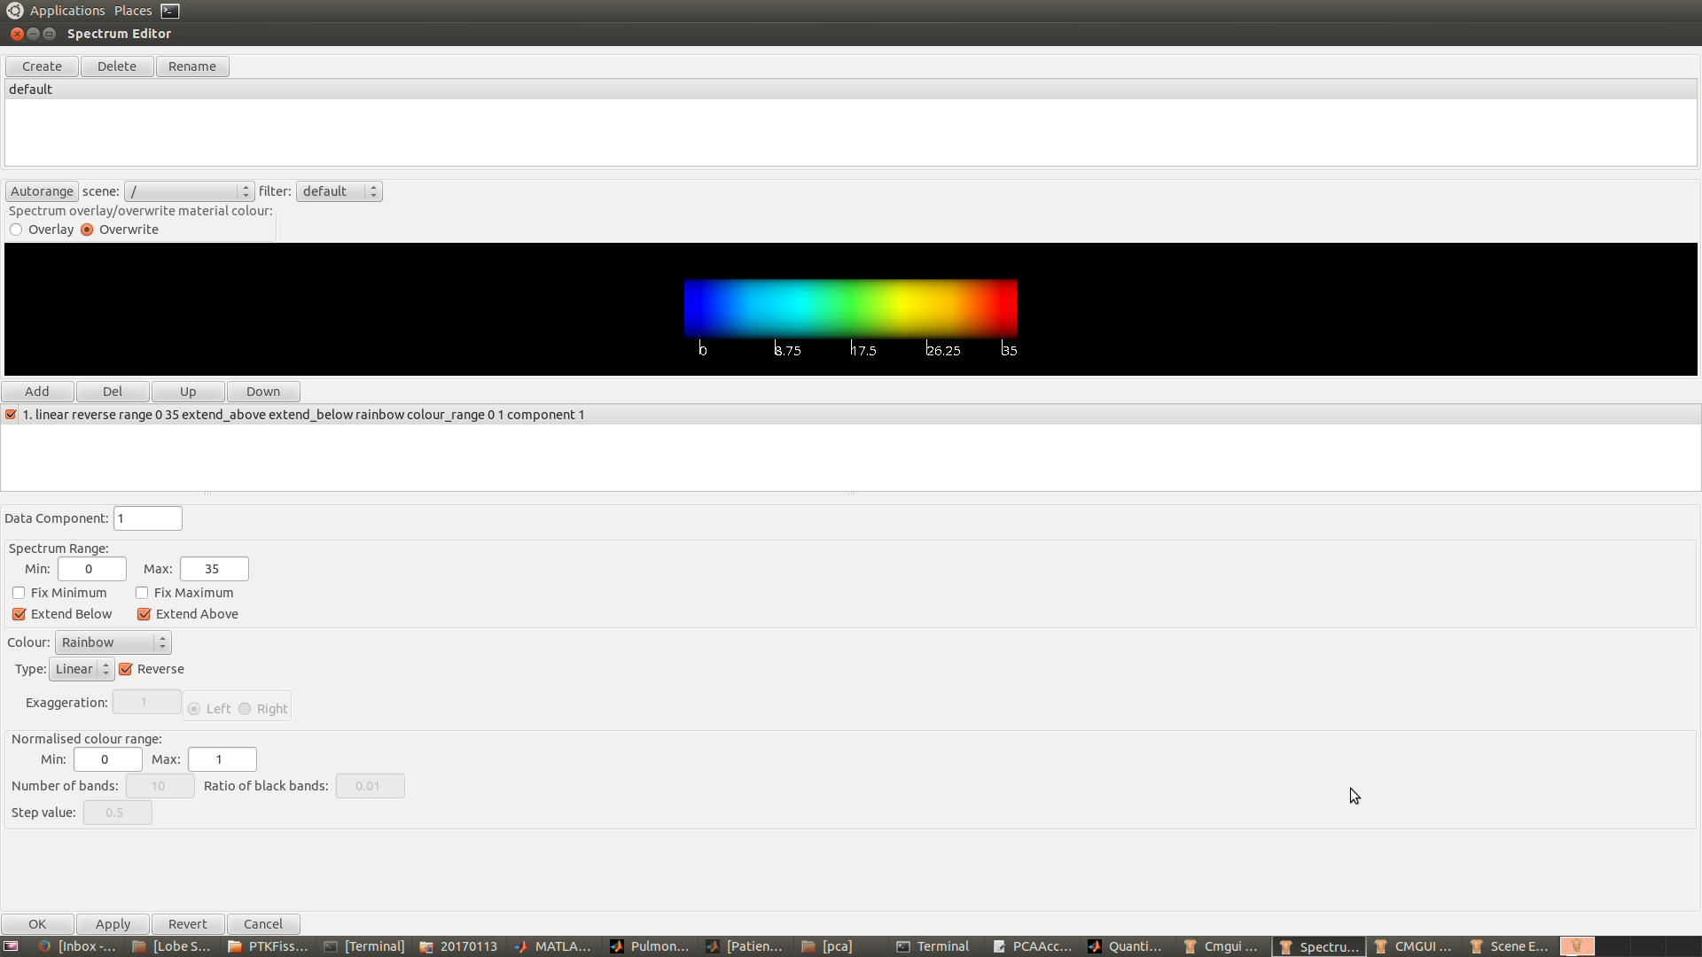
SSM predicted ROI
25
20
15
10
5
0
Hessian-based fissure detection
Connected component filters
Fissure surface fitting

