Slide 1
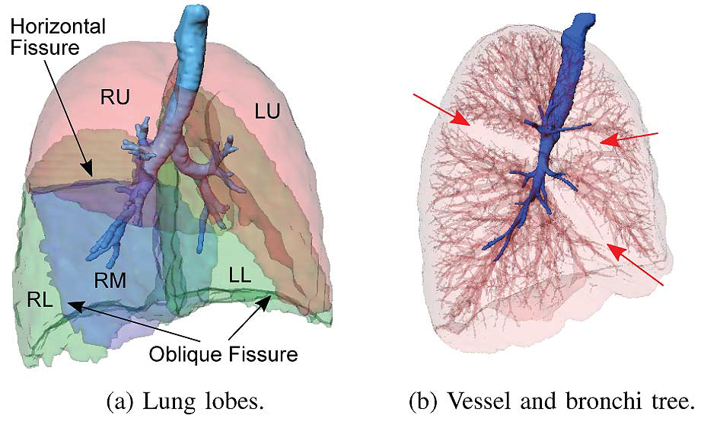
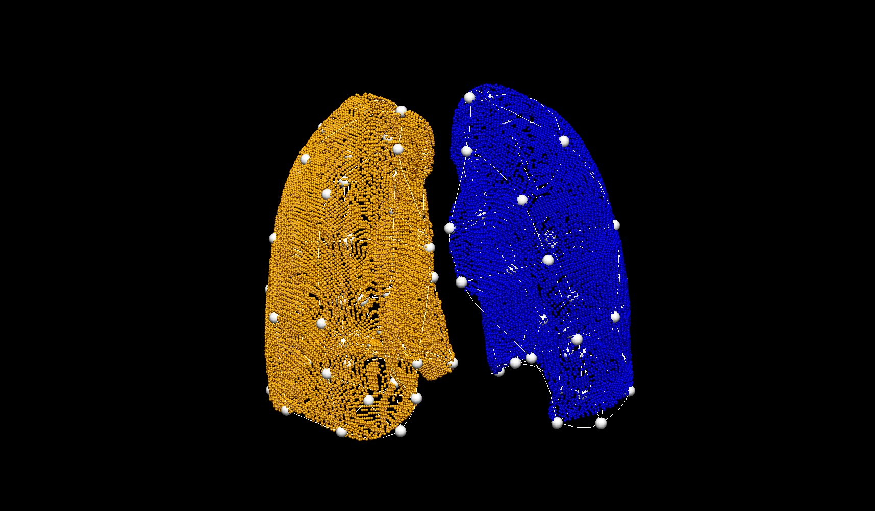
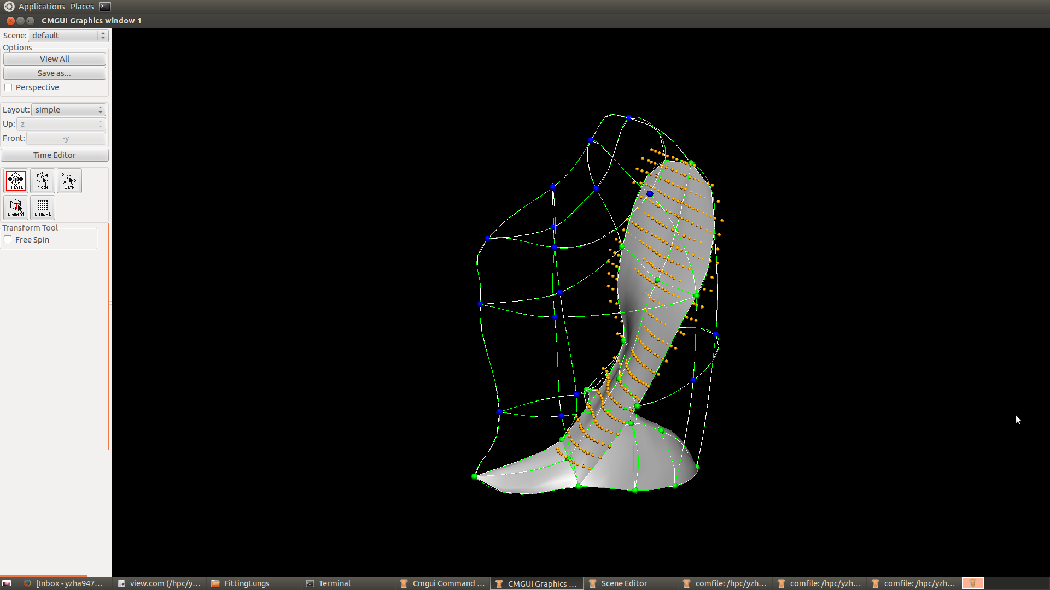
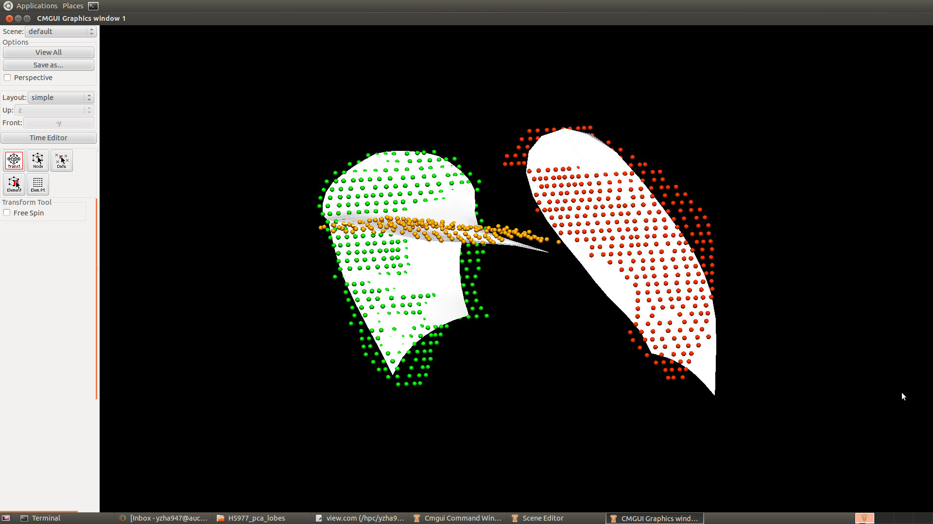
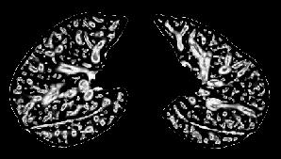
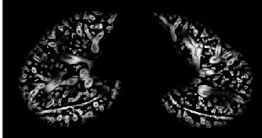
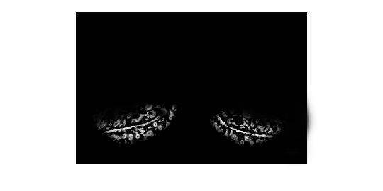
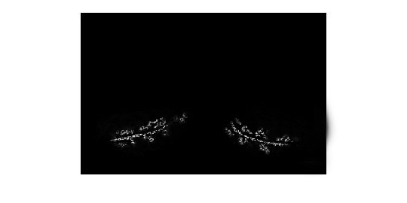
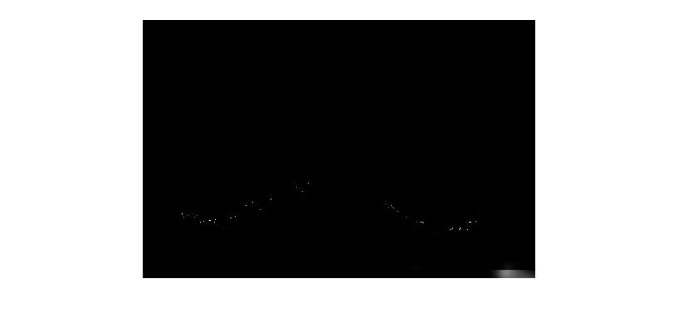
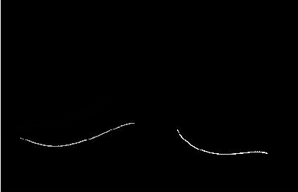
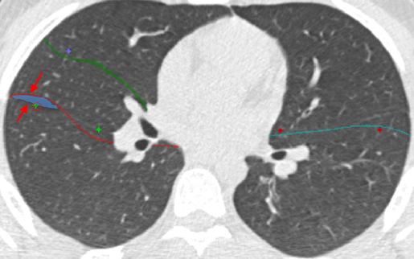
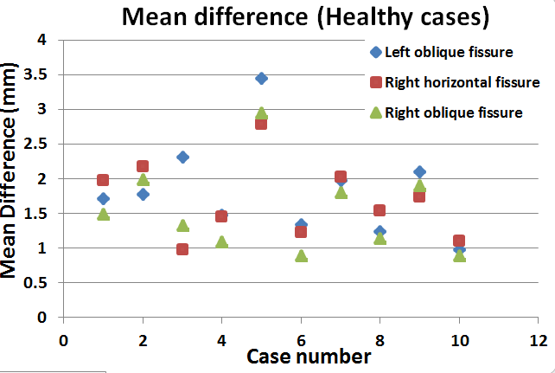
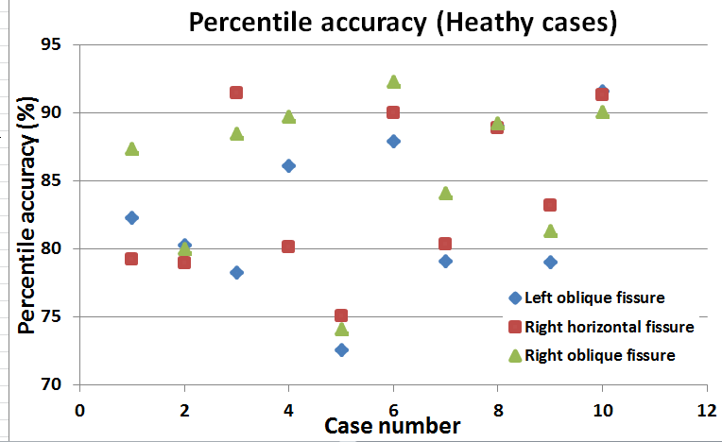
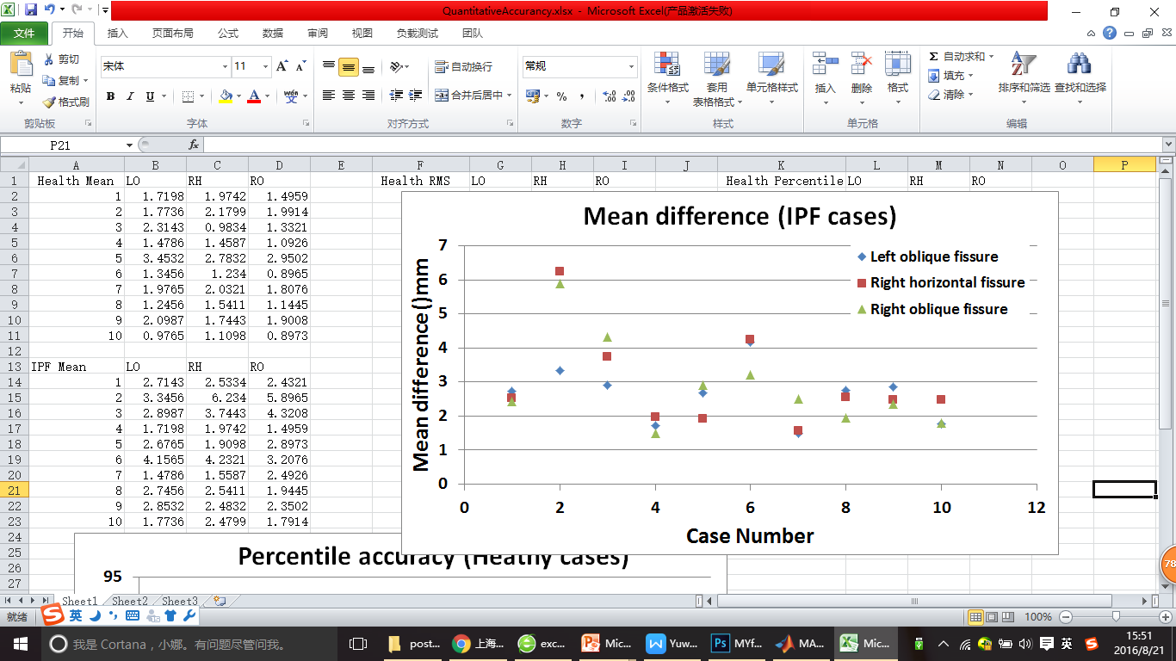
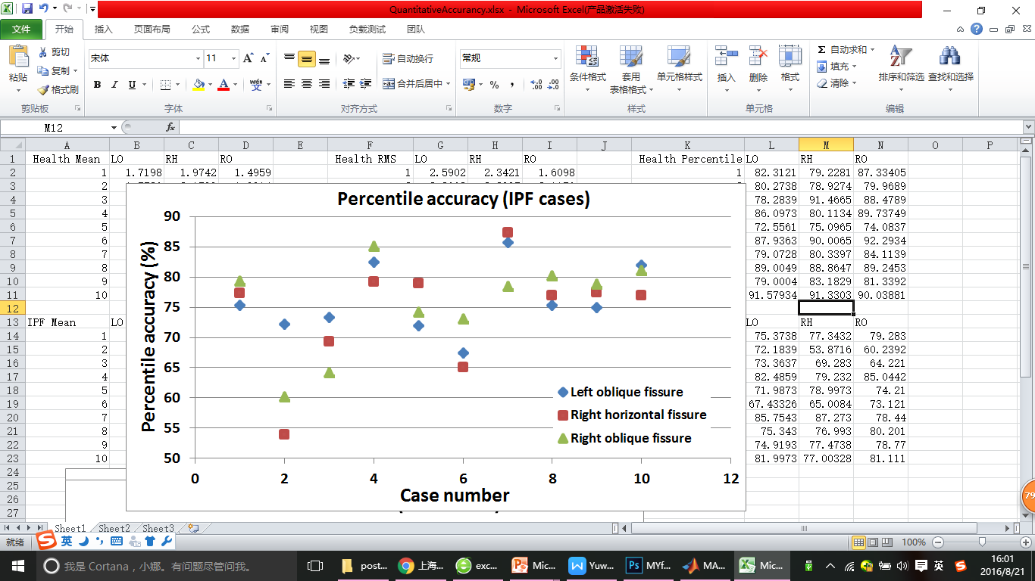
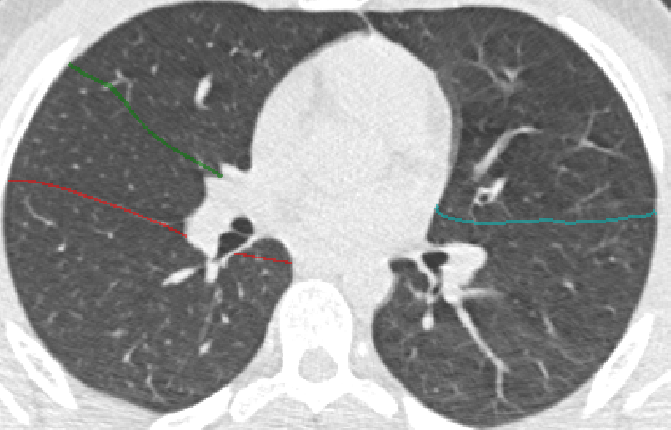
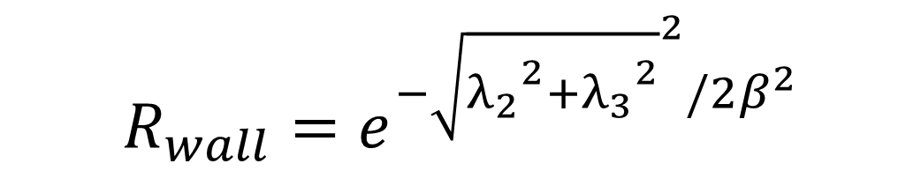


Automatic principal component based lung lobe segmentation from CT scans
Yuwen Zhang¹, Mahyar Osanlouy¹, Alys Clark¹, Eric Hoffman², Merryn Tawhai¹, ¹The University of Auckland, ²University of Iowa
Background
The human lung is divided into five distinct anatomic compartments called lobes. The current lobe segmentation methods usually have some limitations: 1. heavily rely on anatomical knowledge. 2. largely ignore individual variability. 3. sensitive to noise. 4. lead to reconstruction of artifacts.
We plan to segment pulmonary lobes using a PCA-based model. With the help of the average model, we will be able to get rid of the dependence on the segmentation of other anatomic structures such as airway trees which are usually failed to be detected for pathological lungs. In addition, this method allows us to use a successful TLC segmentation to assist with FRC segmentation.
Method
1. Lung Segmentation
2. PCA Weight Mapping Transformation
Thresholding : parenchyma and trachea segmentation
Lung surface data
Region growing: airway segmentation
Training lobe mesh:
Manual fissure digitising and FEM lung surface fitting
Connected component analysis: separate left and right lung
Training lobe mesh
PCA lung average model
Get mapping weights
Input
PCA lobe average model
Deformed PCA model can provide an approximate location of the fissures
Fitted lobe mesh of a new subject
Deformed PCA lobe model
3. Multi-scale Hessian matrix fissure detection
3
1
2
3
$$R_{plane}=e^{{−(λ_{2}/λ_{3})}^{2}/{2α}^{2}}$$
$$R_{wall}=e^{{−\sqrt{{λ_{2}}^{2}+{λ_{3}}^{2}}}^{2}/{2β}^{2}}$$
$$R_{wall}=θ(−λ_{3})R_{plane}R_{wall}$$
Hessian based fissure enhancement
Remove the vessel structures
Fissure ROI based on PCA projection
6
4
2D and 3D eigenvector based connected component filter
5
6
B-spline curve fissure surface fitting
Fissure candidate points
5
3. User-interactive fissure correction
4. Quantitative evaluation
Summary/Future work
Implement a PCA-based lobe segmentation method, this new procedure does not heavily depend on prior segmentation of anatomical structures (airways/vessels) and has promising potential as a clinically useful automatic lobe segmentation procedure
Correction region generation: Gaussian filter and boundary distance detection
Summary/Future work
Use this lobe segmentation method to segment some other kind of pathological lungs and develop some lobar level functional analysis.

