Slide 1
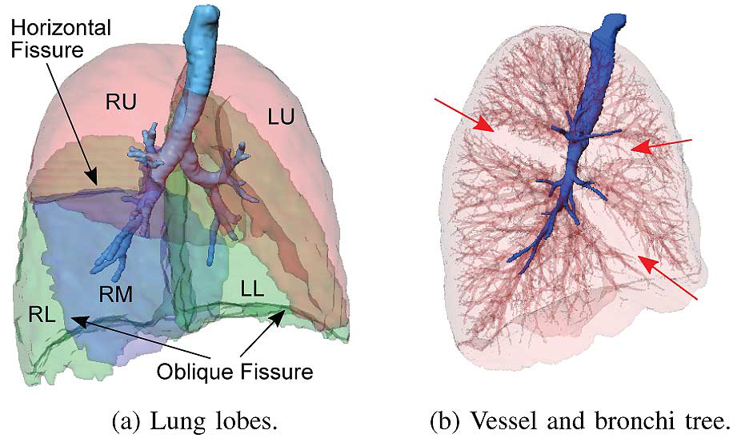
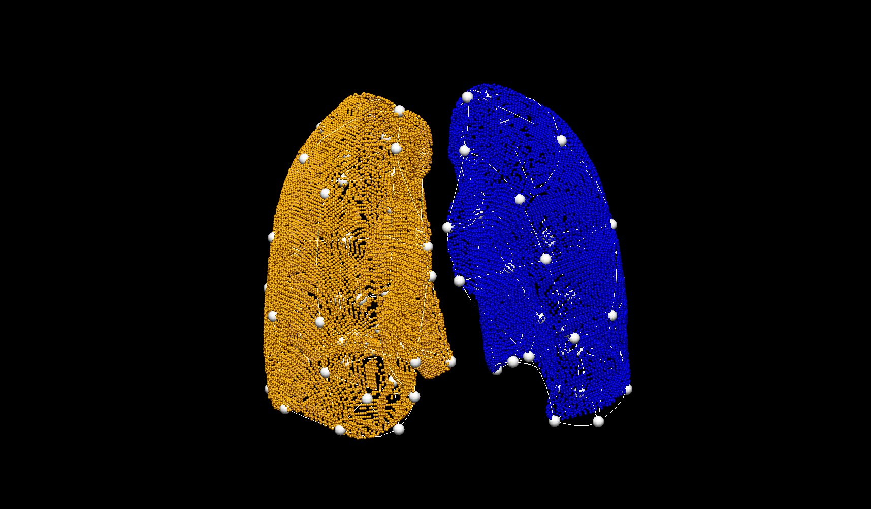
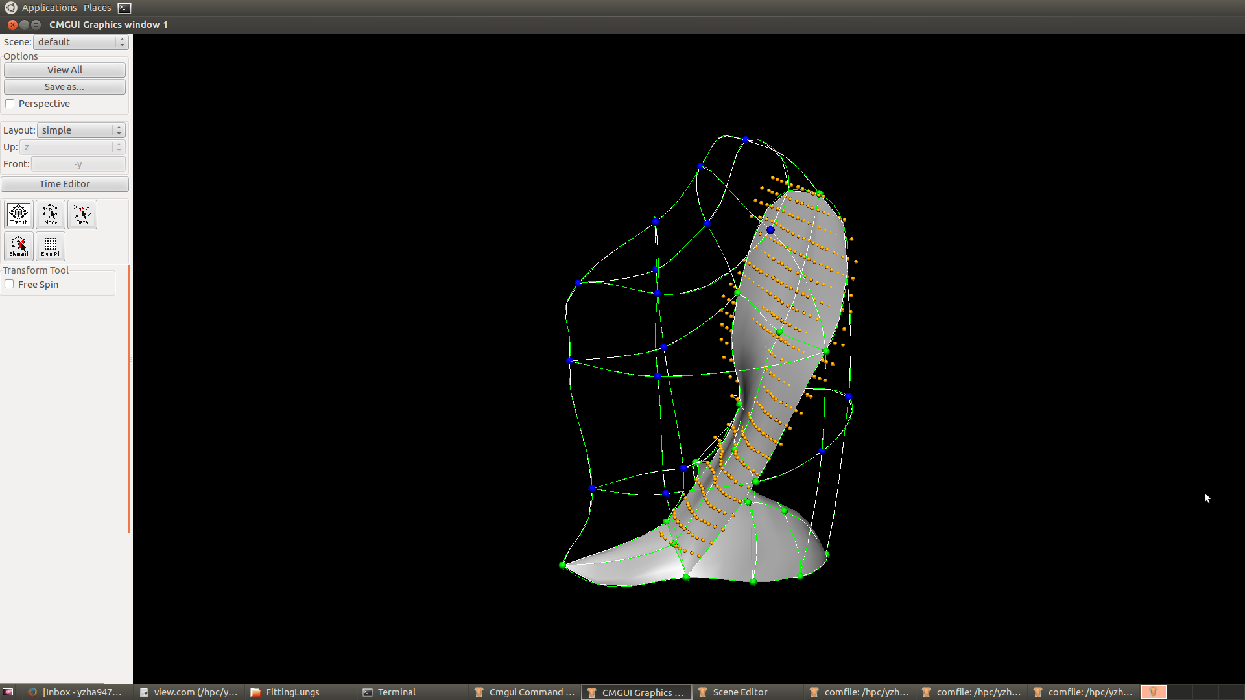
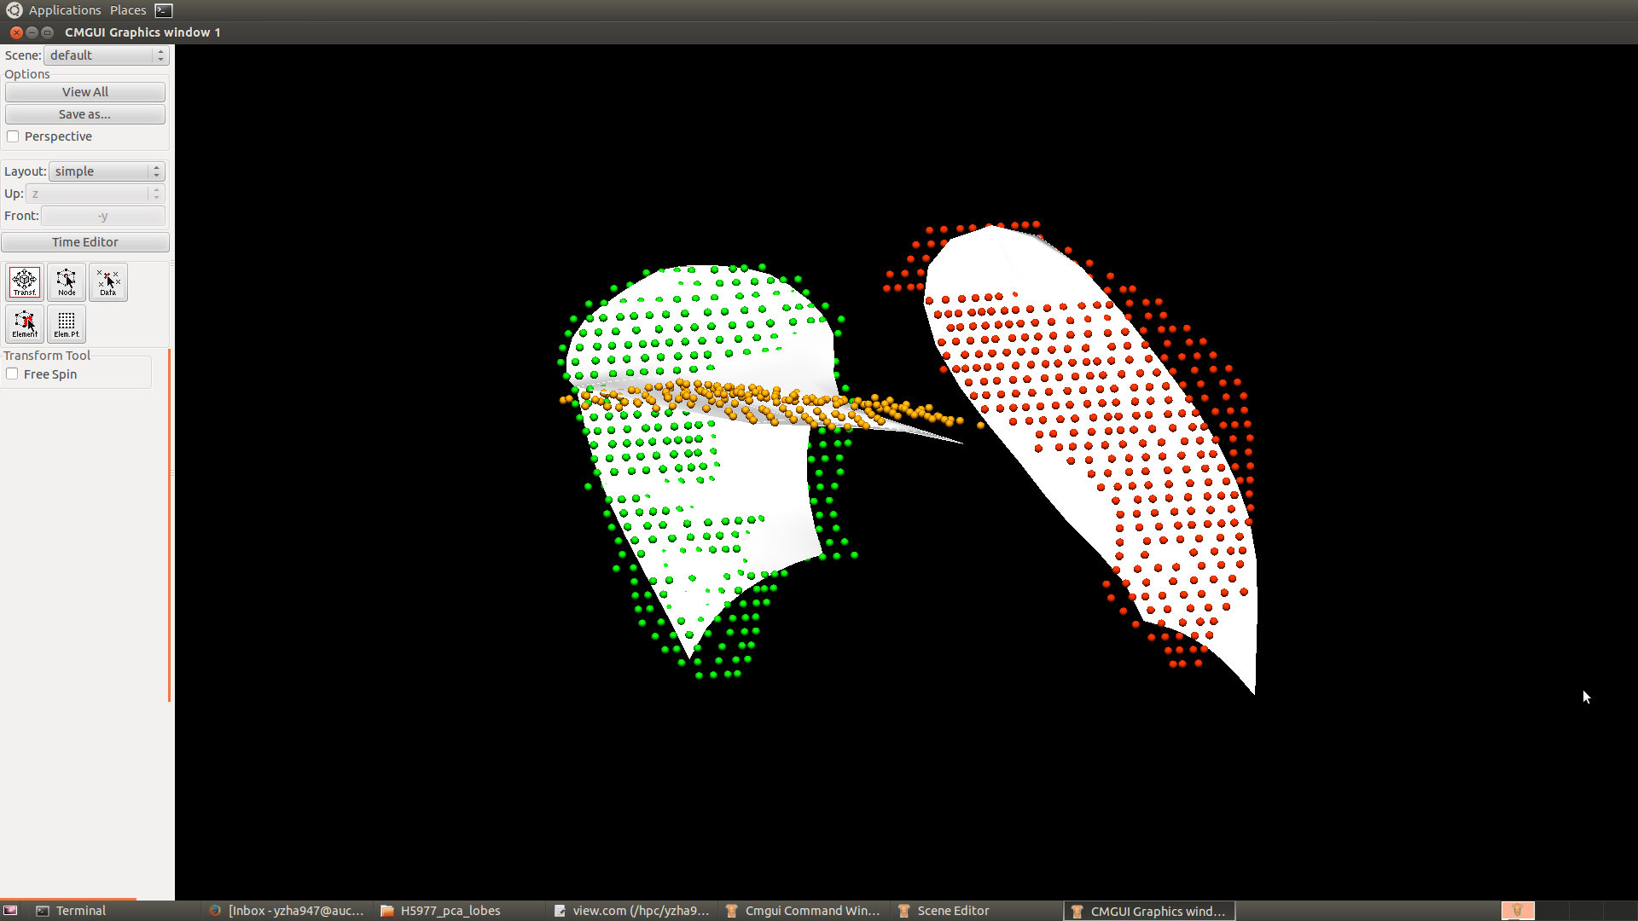
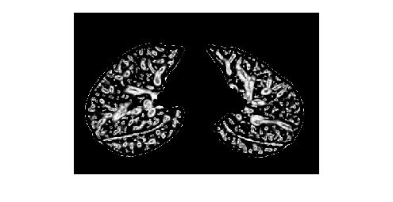
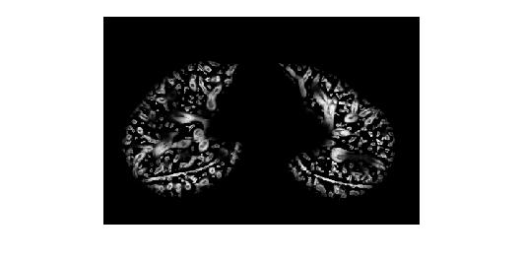
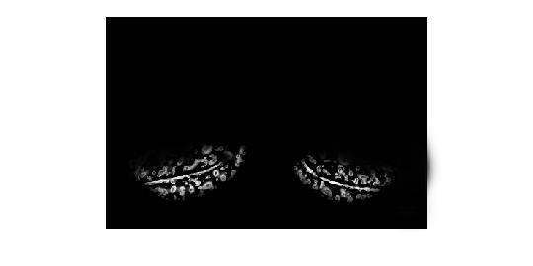
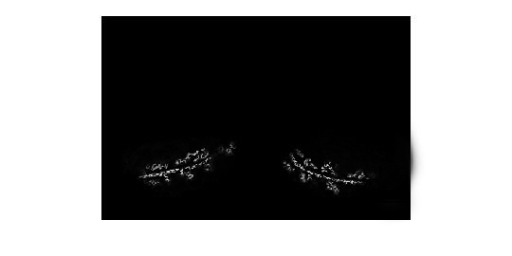
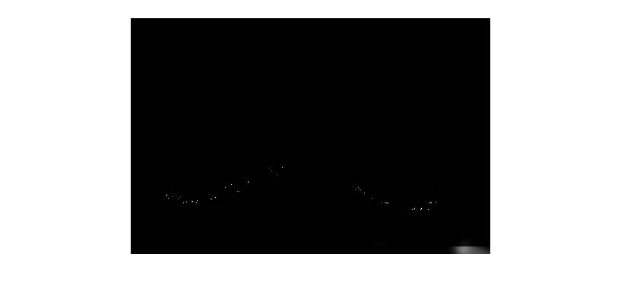
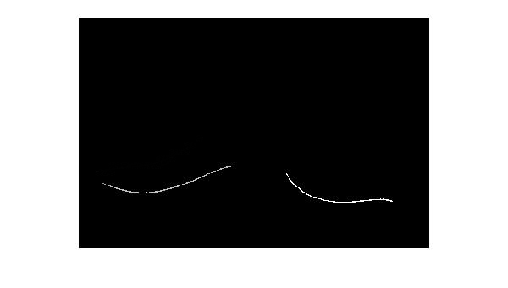
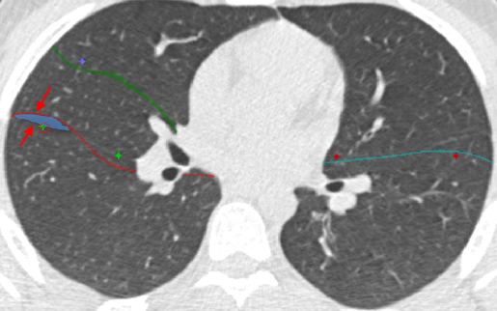
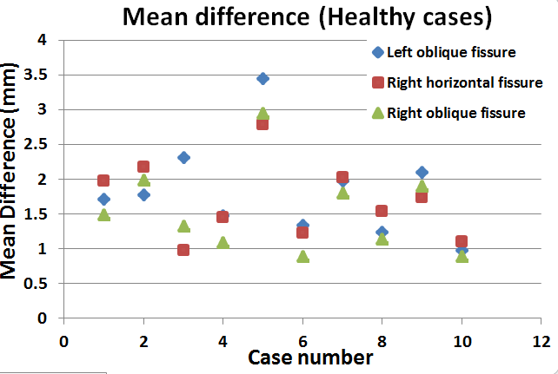
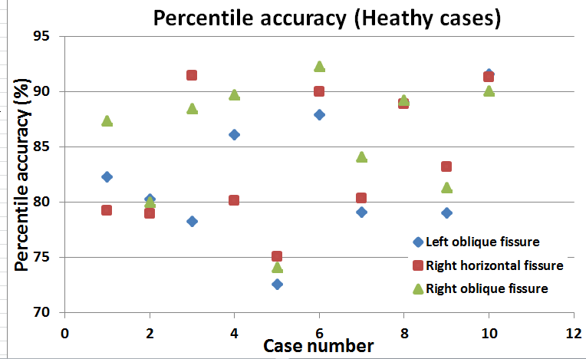
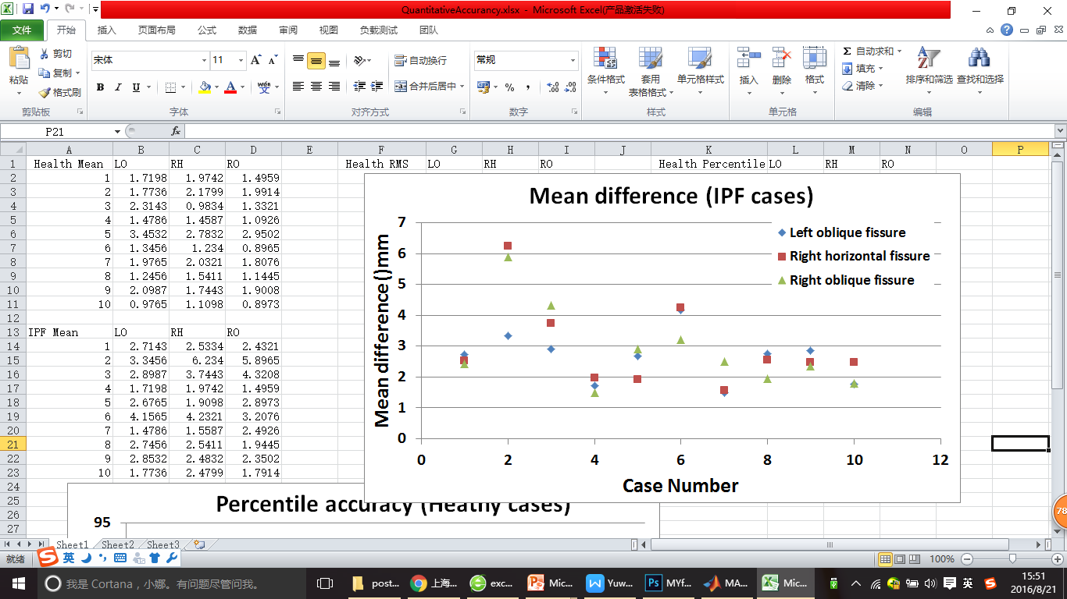
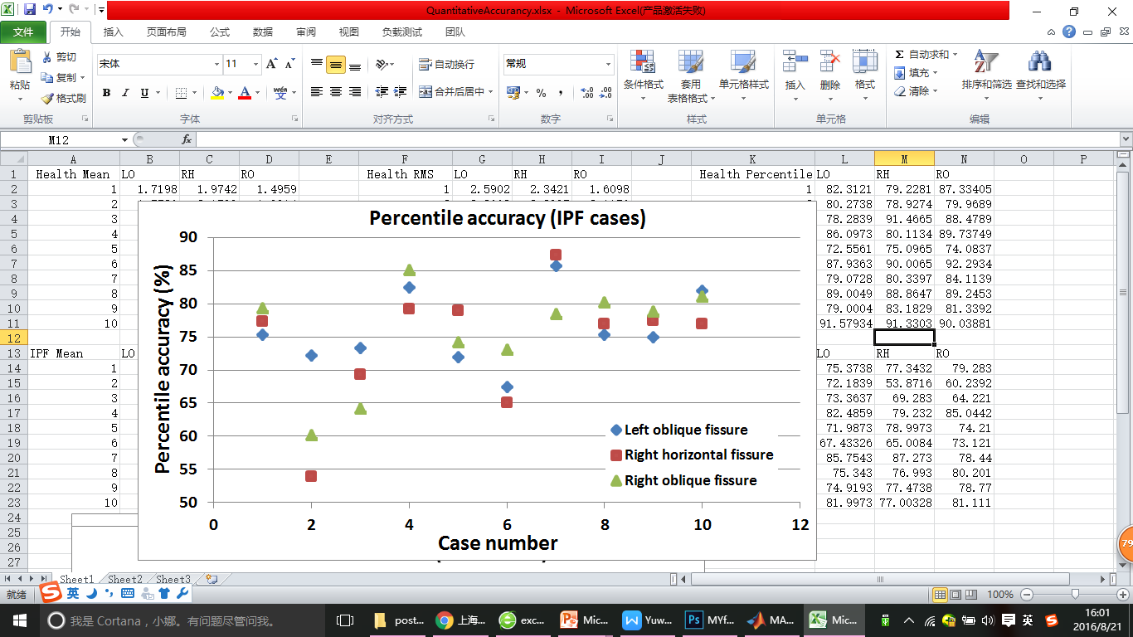
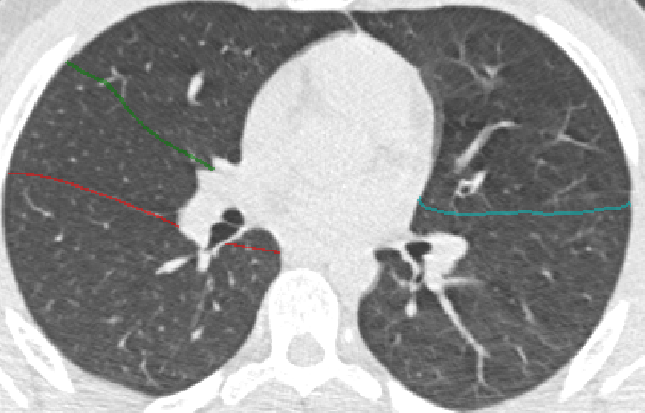
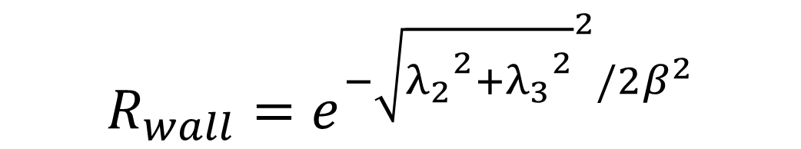


Automatic principal component based lung lobe segmentation from CT scans
Yuwen Zhang¹, Mahyar Osanlouy¹, Alys Clark¹, Eric Hoffman², Merryn Tawhai¹, ¹The University of Auckland, ²University of Iowa
Background
The human lung is divided into five distinct anatomic compartments called lobes. The current lobe segmentation methods usually have some limitations: 1. heavily rely on anatomical knowledge. 2. largely ignore individual variability. 3. sensitive to noise. 4. lead to reconstruction of artifacts.
We plan to segment pulmonary lobes using a PCA-based model. With the help of the average model, we will be able to get rid of the dependence on the segmentation of other anatomic structures such as airway trees which are usually failed to be detected for pathological lungs. In addition, this method allows us to use a successful TLC segmentation to assist with FRC segmentation.
Method
1. Lung Segmentation
2. PCA Weight Mapping Transformation
Thresholding : parenchyma and trachea segmentation
Training lobe mesh
PCA lung average model
Get mapping weights
Input
PCA lobe average model
Region growing: airway segmentation
Fitted lobe mesh of a new subject
Deformed PCA lobe model
Connected component analysis: separate left and right lung
Lung surface data
3. Multi-scale Hessian matrix fissure detection
1
$$R_{plane}=e^{{−(λ_{2}/λ_{3})}^{2}/{2α}^{2}}$$
Training lobe mesh:
Manual fissure digitising and FEM lung surface fitting
$$R_{wall}=θ(−λ_{3})R_{plane}R_{wall}$$
Deformed PCA model can provide an approximate location of the fissures
$$R_{wall}=e^{{−\sqrt{{λ_{2}}^{2}+{λ_{3}}^{2}}}^{2}/{2β}^{2}}$$
Hessian based fissure enhancement
3
Summary
2
4
We implement a PCA-based pulmonary lobe segmentation method, the algorithm has accuracy of 72.5% to 92.6% for healthy cases and an accuracy of 53.8% to 85.7% for pathological cases. Compared to the currently published method, our method has the following advantages:
This new procedure does not heavily depend on prior segmentation of anatomical structures (airways/vessels)
With the help of a friendly user interface, user can control some parameters (e.g. fissure searching size) as inputs to improve the segmentation process. A user-interactive correction of the result is also available.
A multi-scale filter is used when detect the fissure/vessel to make sure a variety of sizes of fissure/vessel can have maximum response.
Remove the vessel structures
Fissure ROI based on PCA projection
2D and 3D eigenvector based connected component filter
5
6
6
Fissure candidate points
B-spline curve fissure surface fitting
4. User-interactive fissure correction
5. Quantitative evaluation
Correction region generation: Gaussian filter and boundary distance detection
Future work
Use this lobe segmentation method to segment some other kind of pathological lungs and develop some lobar level functional analysis.

