Slide 1
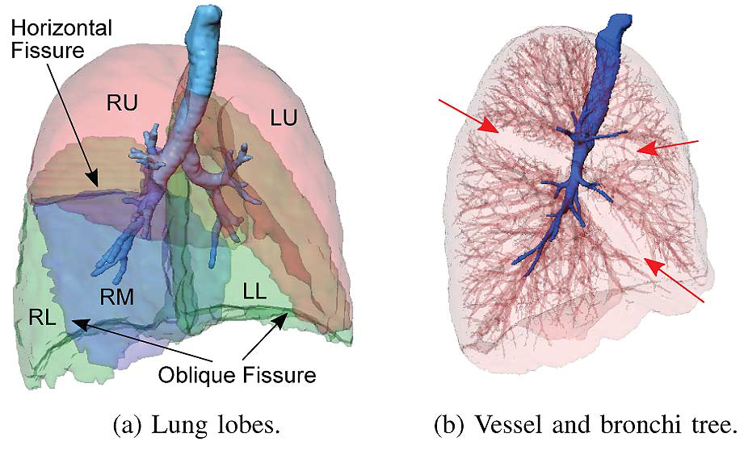
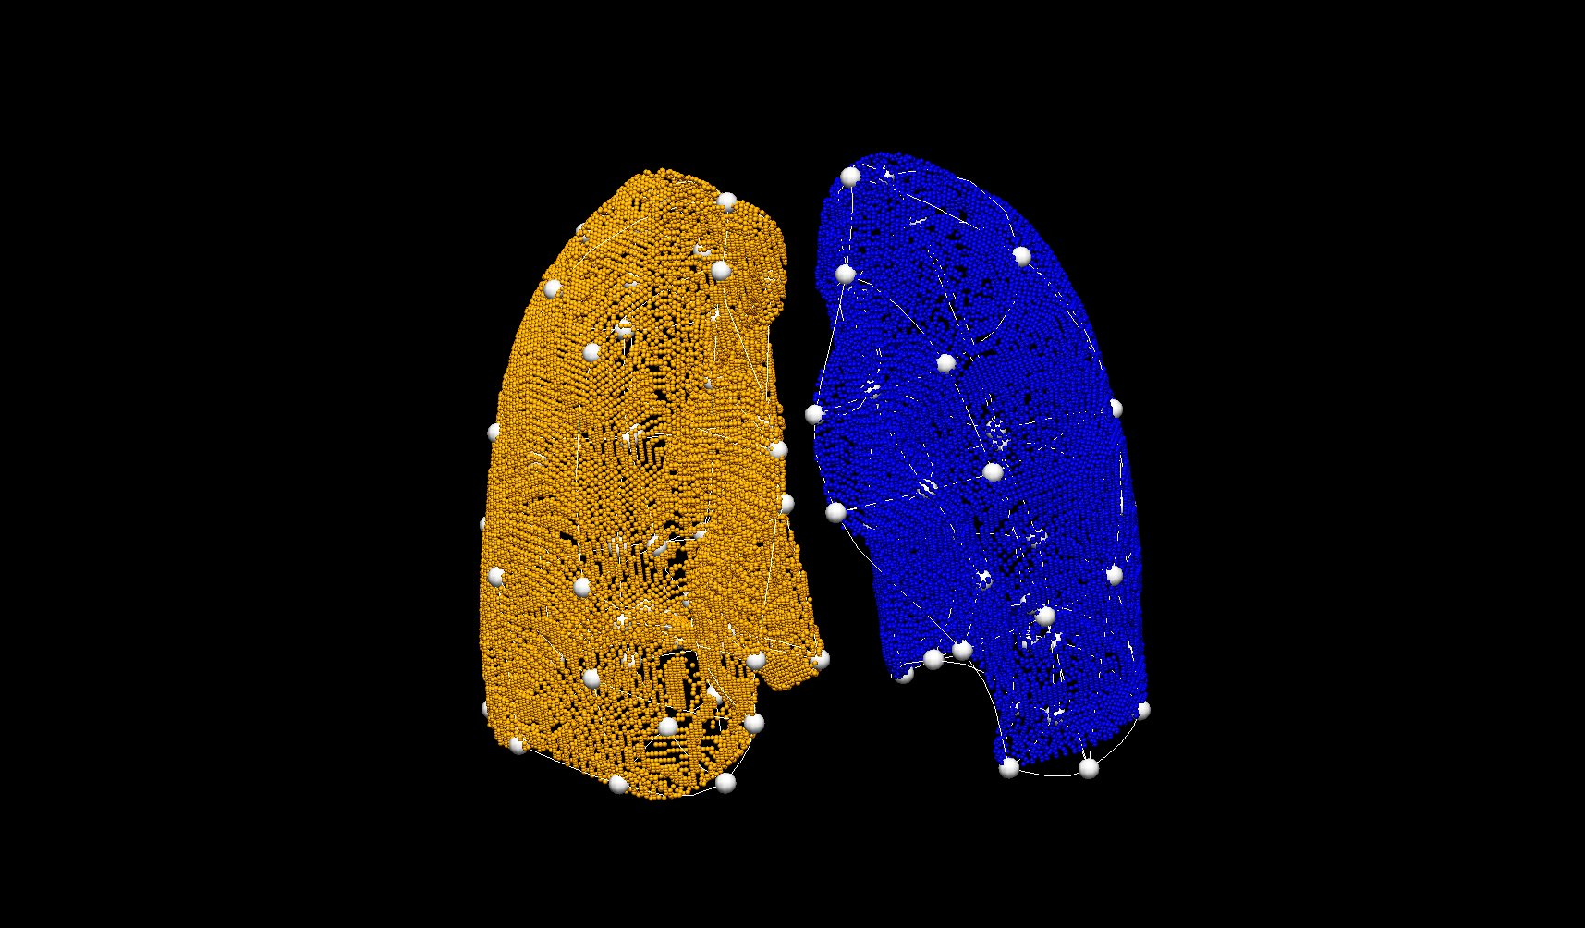
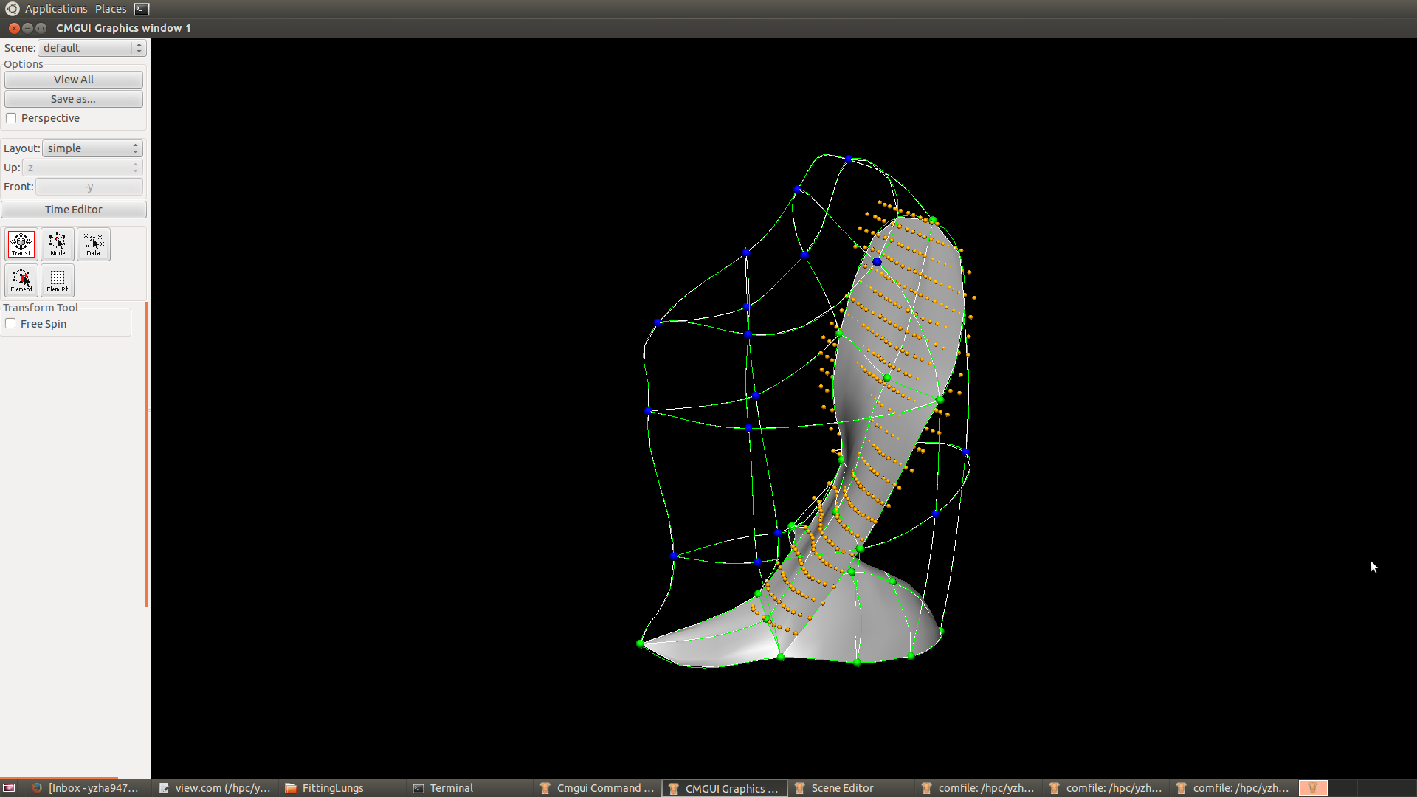
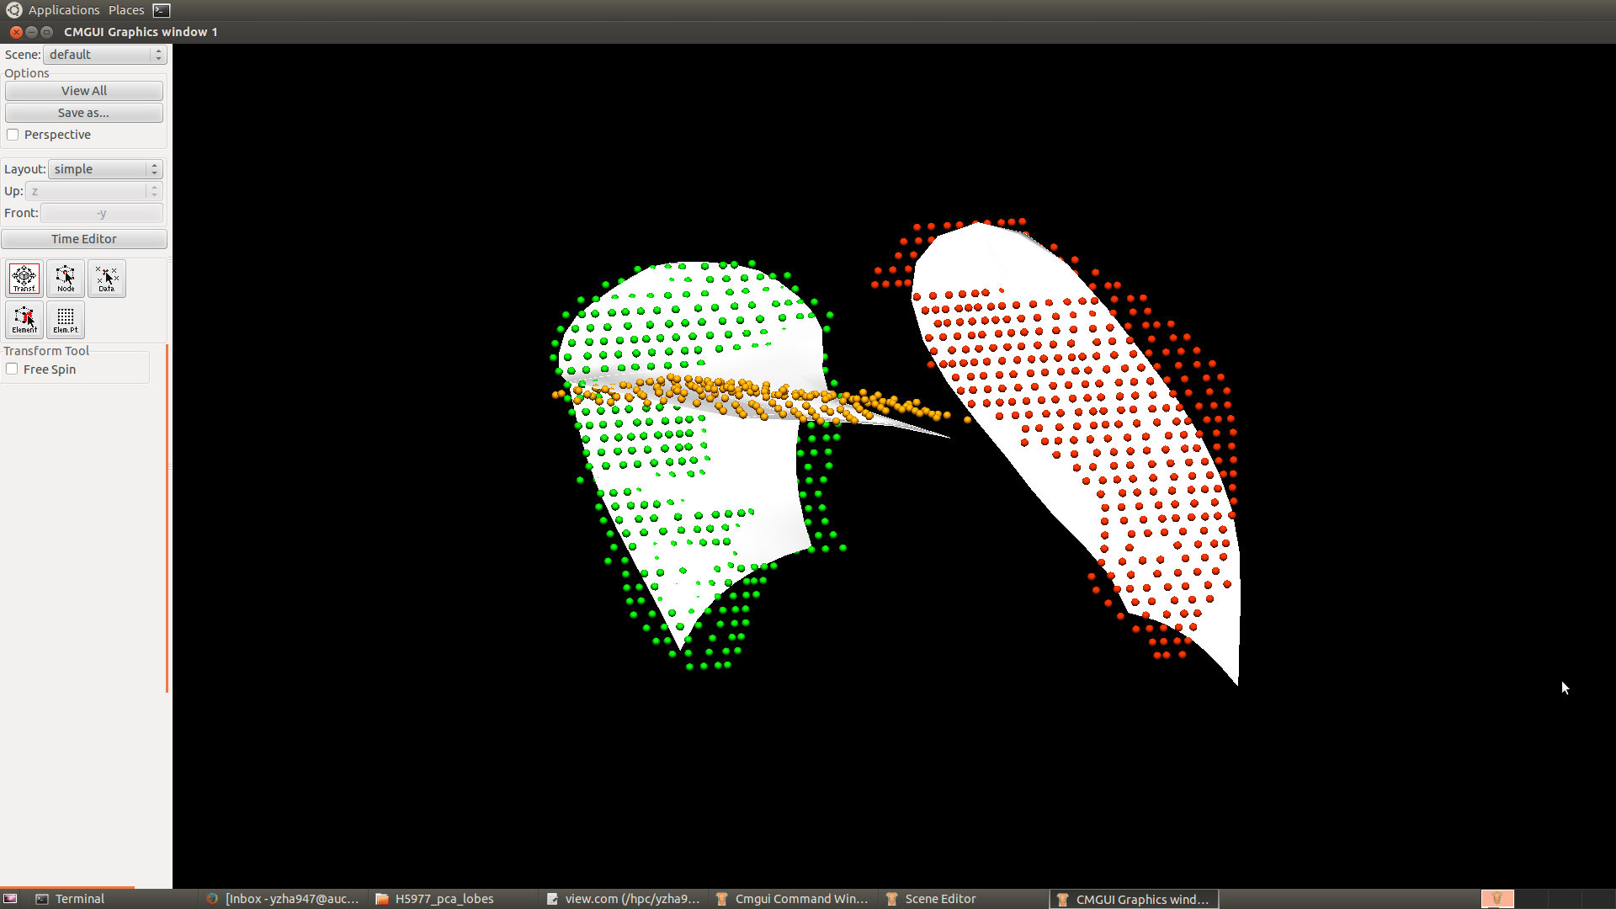
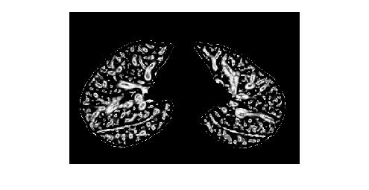
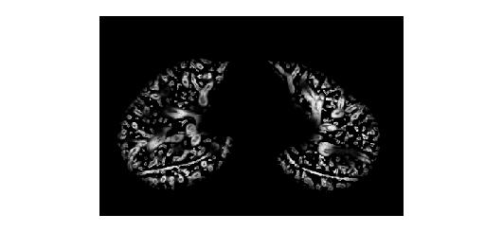
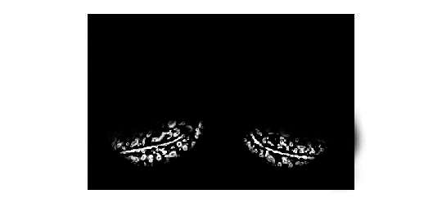
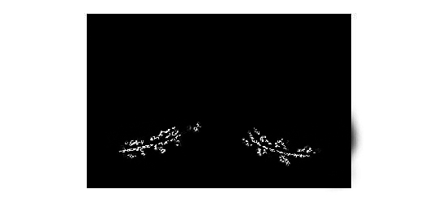
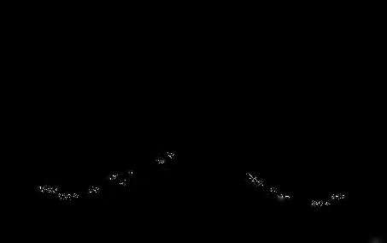
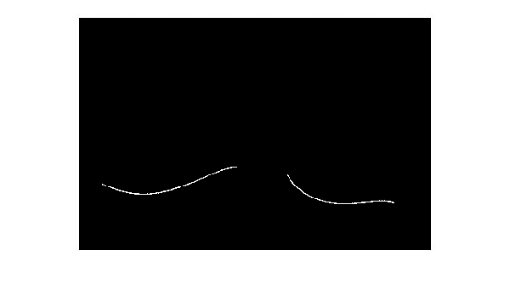
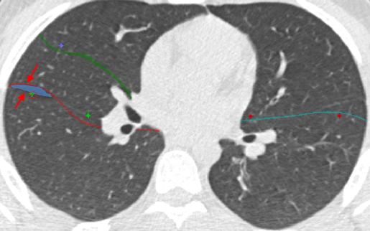
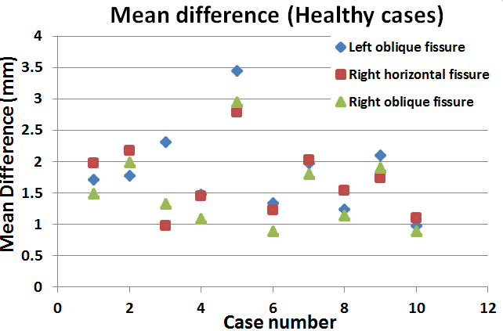
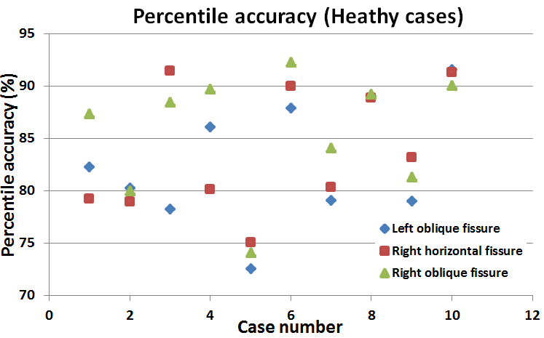
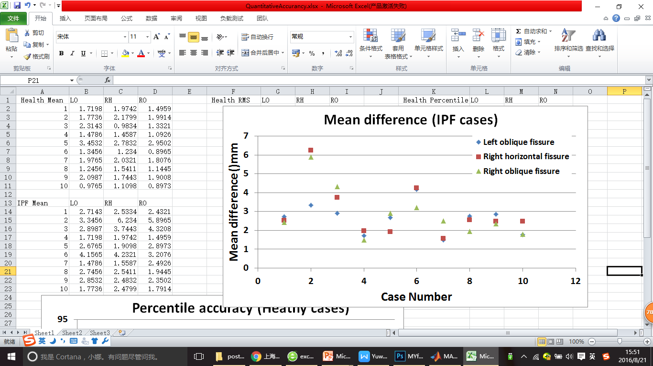
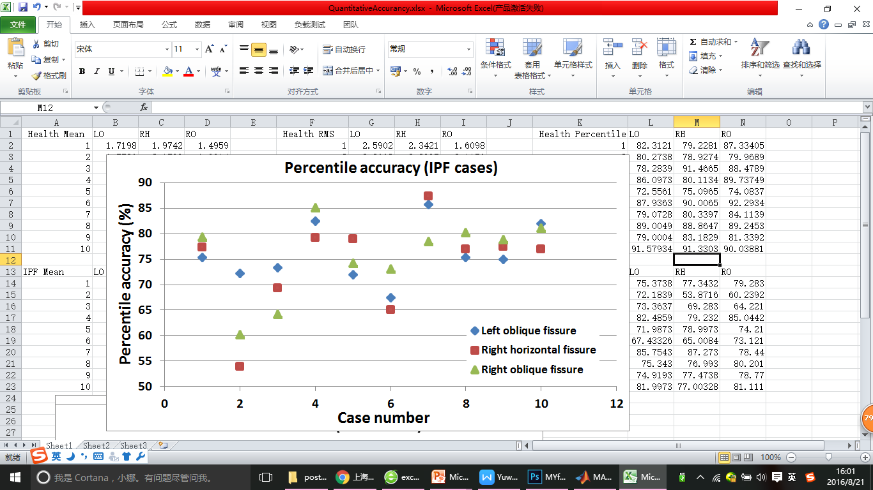
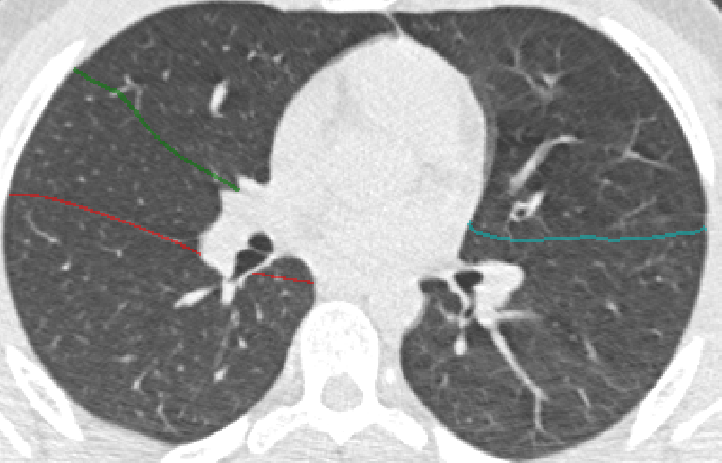
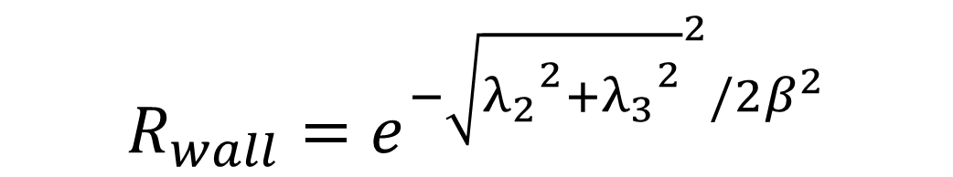


Automatic principal component based lung lobe segmentation from CT scans
Yuwen Zhang¹, Mahyar Osanlouy¹, Alys Clark¹, Eric Hoffman², Merryn Tawhai¹.
¹University of Auckland, ²University of Iowa
Background
The human lung is divided into five distinct anatomic compartments called lobes. Current lobe segmentation methods usually have some limitations. They 1. rely heavily on anatomical knowledge, 2. largely ignore individual variability, 3. are sensitive to noise, 4. lead to reconstruction artifacts.
Using an average shape model, we aim to get rid of the dependence on the segmentation of other anatomic structures such as airway trees, which often fail to be detected for pathological lungs. In addition, this method allows us to use a successful end-inspiratory segmentation to assist with end-expiratory segmentation, which is particularly challenging.
Method
1. Lung segmentation
2. Principle component analysis (PCA) model based weight mapping transformation
Thresholding : parenchyma and trachea segmentation
Training lobe mesh
PCA lung average model
Get mapping weights
Input
PCA lobe average model
Region growing: airway segmentation
Fitted lobe mesh of a new subject
Connected component analysis: separate left and right lung
Deformed PCA lobe model
Lung surface data
3. Multi-scale Hessian matrix fissure detection
Deformed PCA model can provide an approximate location of the fissures
1
$$R_{plane}=e^{{−(λ_{2}/λ_{3})}^{2}/{2α}^{2}}$$
$$R_{wall}=θ(−λ_{3})R_{plane}R_{wall}$$
Training lobe mesh:
Manual fissure digitising and finite element lung surface fitting
$$R_{wall}=e^{{−\sqrt{{λ_{2}}^{2}+{λ_{3}}^{2}}}^{2}/{2β}^{2}}$$
Hessian based fissure enhancement
3
Summary
2
4
We implemented a PCA-based pulmonary lobe segmentation method. The algorithm has accuracy of 72.5% to 92.6% for healthy cases and an accuracy of 53.8% to 85.7% for pathological cases. Compared to currently published methods, our method has the following advantages:
This new procedure does not heavily depend on prior segmentation of anatomical structures (airways/vessels)
With the help of an user-friendly interface, user can control some parameters (e.g. fissure searching size) as inputs to improve the segmentation process. A user-interactive correction of the result is also available.
A multi-scale filter is used when detecting fissure/vessel to make sure a variety of sizes of fissure/vessel can have maximum response.
Remove the vessel structures
Fissure region of interest(ROI) based on PCA projection
2D and 3D eigenvector based connected component filter
5
6
6
Fissure candidate points
B-spline curve fissure surface fitting
4. User-interactive fissure correction
5. Quantitative evaluation
Correction region generation: Gaussian filter and boundary distance detection
Future work
The plan is to use this method to segment imaging of pathological lungs, as a step towards a new quantitative analysis of lung disease.
10 healthy cases and 10 IPF cases were evaluated
IPF: Idiopathic pulmonary fibrosis

