Slide 1
Lung segmentation
Initial fissure prediction
Multiscale fissure detection
A set of training lobe meshes
Map
Extract search regions
Lung mesh of a new subject
Lung extraction: Thresholding operation
PCA analysis
Lung shape model weight of new subject
Hessian-based fissure detection
Lung average SSM
Airway segmentation: Region growing
Input
Connected component filters
Lobe average SSM
Lung separation: Connected component
Predicted lobe mesh of the new subject
Output
Fissure surface fitting

Slide 2
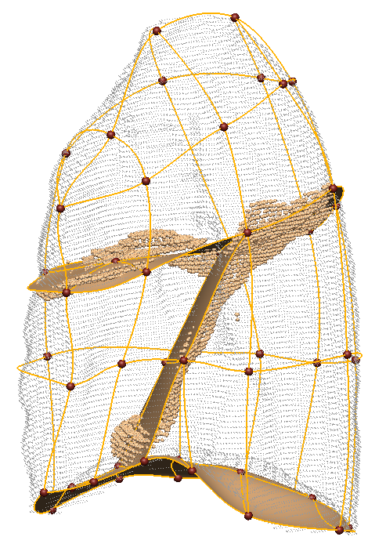
(a)

Slide 3
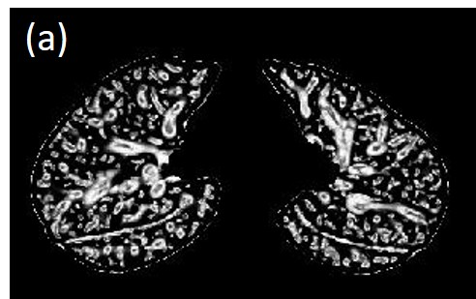
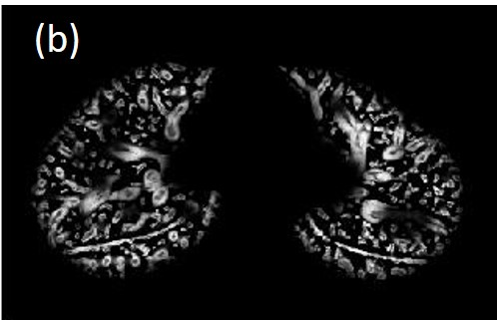
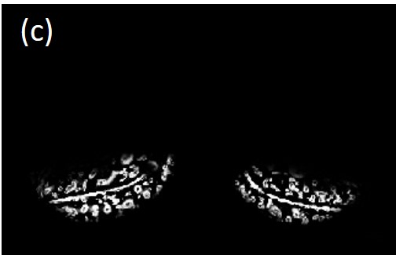
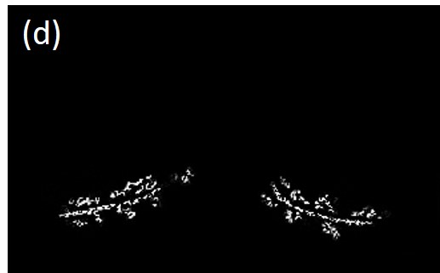
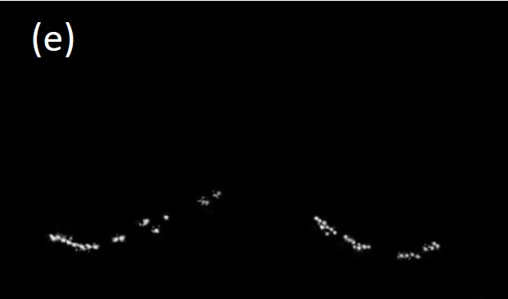
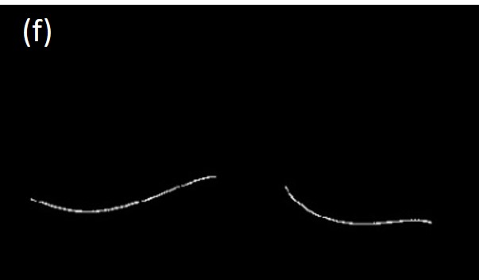

Slide 4
