Slide 1
Lung segmentation
Initial fissure prediction
Multiscale fissure detection
A set of training lobe meshes
Map
Extract search regions
Lung mesh of a new subject
Lung extraction: Thresholding operation
PCA analysis
Lung shape model weight of new subject
Hessian-based fissure detection
Lung average SSM
Airway segmentation: Region growing
Input
Connected component filters
Lobe average SSM
Lung separation: Connected component
Predicted lobe mesh of the new subject
Output
Fissure surface fitting

Slide 2
Training lobe mesh
Separate lung mesh
Map
Lung SSM
mode weights
Input
Lobar SSM
Deform
Deformed PCA lobe model

Slide 3
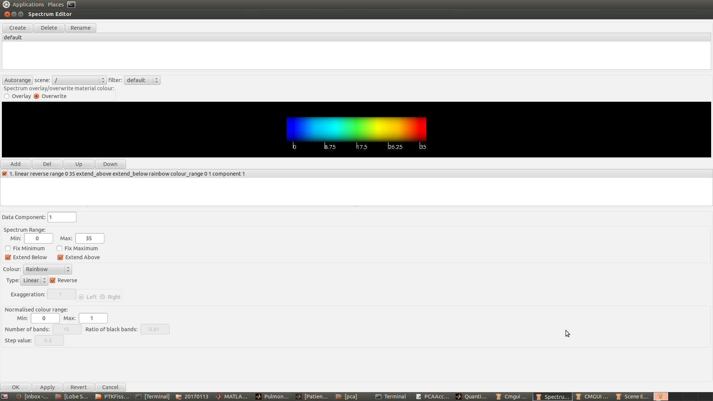
SSM predicted ROI
25
20
15
10
5
0
Hessian-based fissure detection
Connected component filters
Fissure surface fitting

