Slide 1
3D lung geometry
Generate IPF lung lobe mesh
Predict lung lobe shape of old normal
Airway/vasculature geometry
Extract upper airway/vessel tree from HRCT images
Map IPF upper airway to old normal lung mesh
Generate full airway for old normal and map to IPF lung mesh
Generate full vessel tree
Ventilation model
Deep inspiration (fibrosis constricted)—set muscle pressure, average lung compliance
Normal breath—ventilation distribution
Ventilation model
Deep inspiration (fibrosis constricted)—set muscle pressure, average lung compliance
Normal breath—ventilation distribution

Slide 2
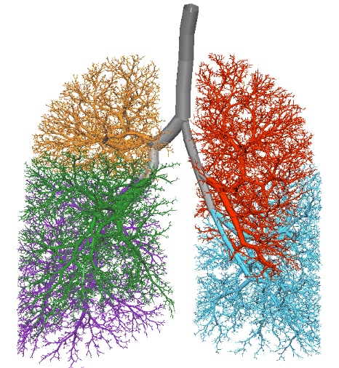
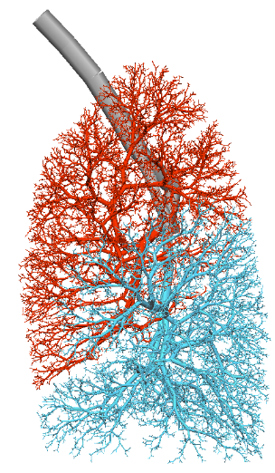
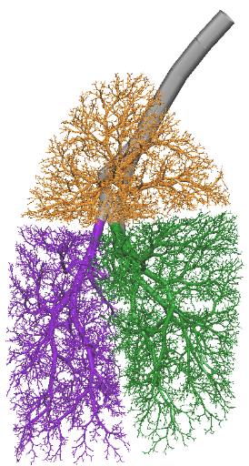
Trachea
Left lower lobe
Left upper lobe
Right lower lobe
Right middle lobe
Right lower lobe

Slide 3
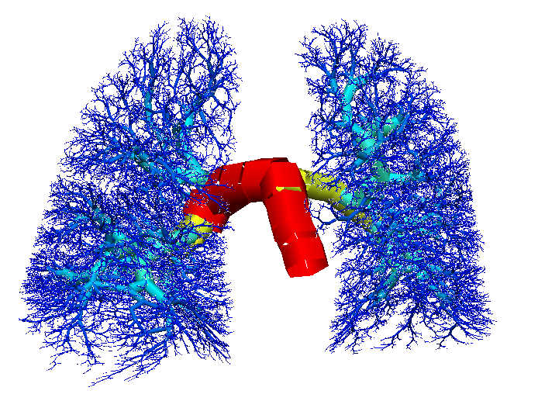
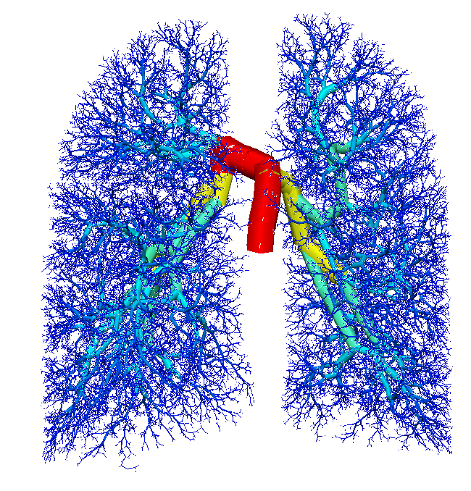
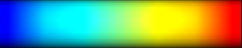
0.13
3.1
6.1
9.1
12
0.13
2.2
4.2
6.3
8.3

Slide 4
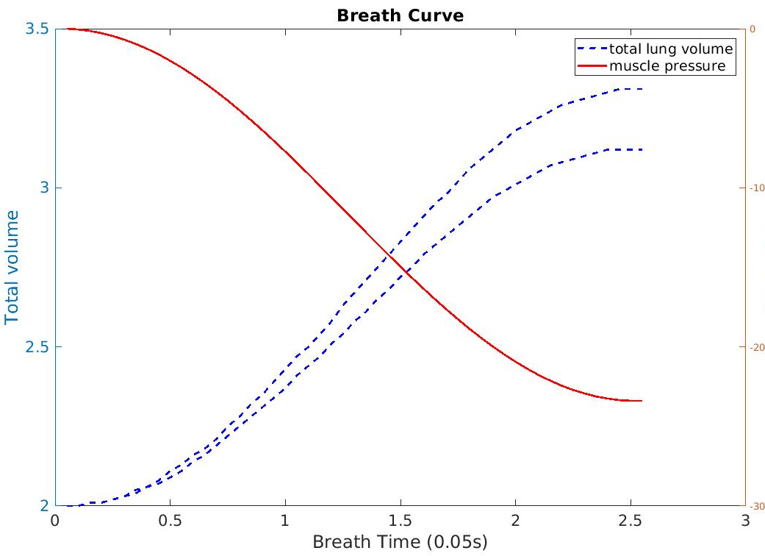
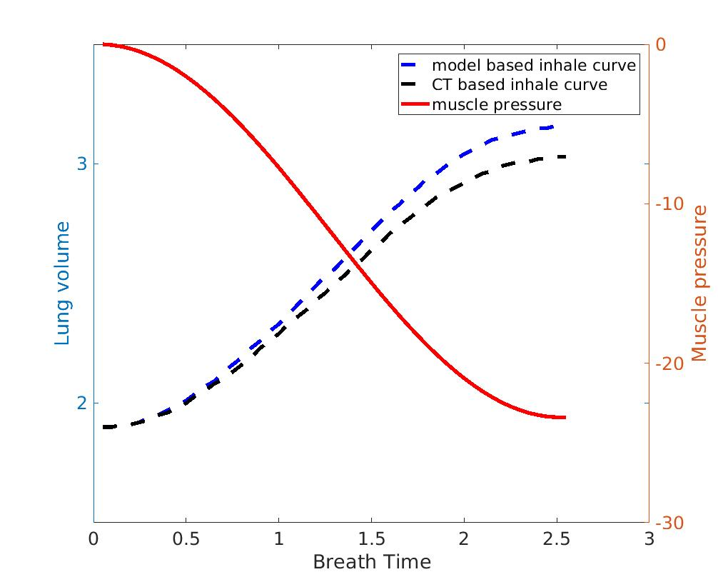
Simulated inspiration curve
Measured inspiration curve

Slide 5
PFT

Slide 6
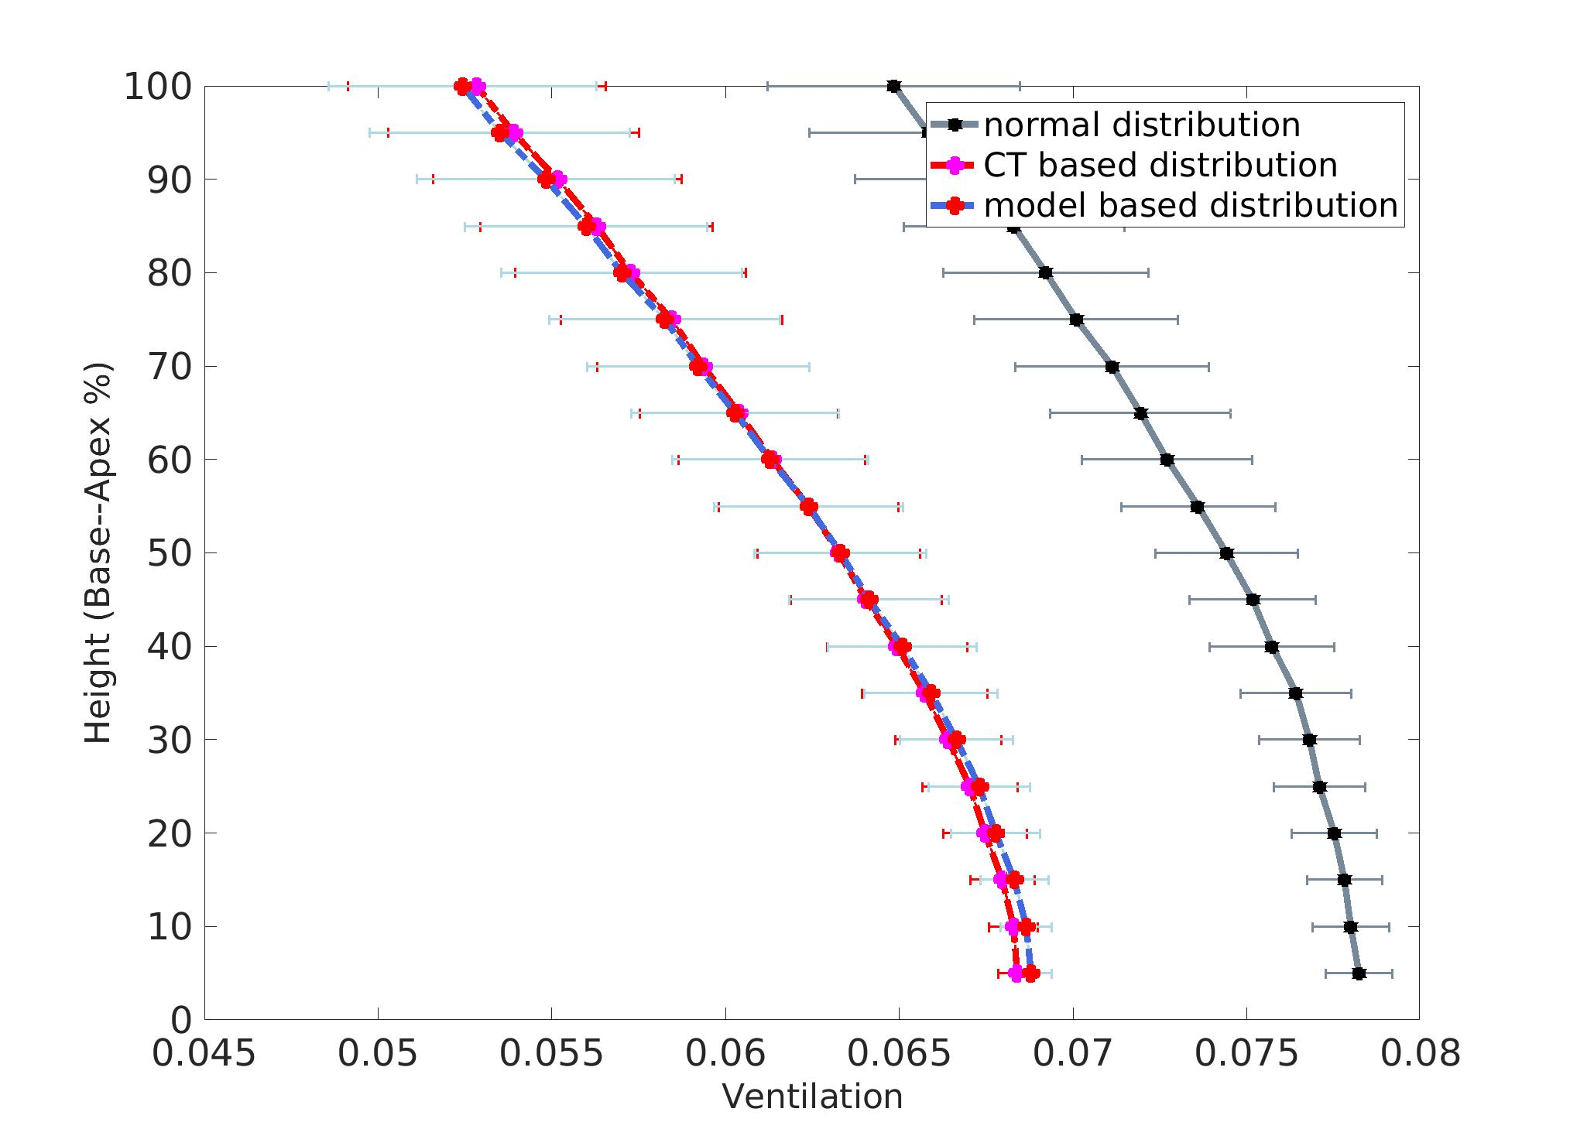
PFT
PFT
PFT

Slide 7
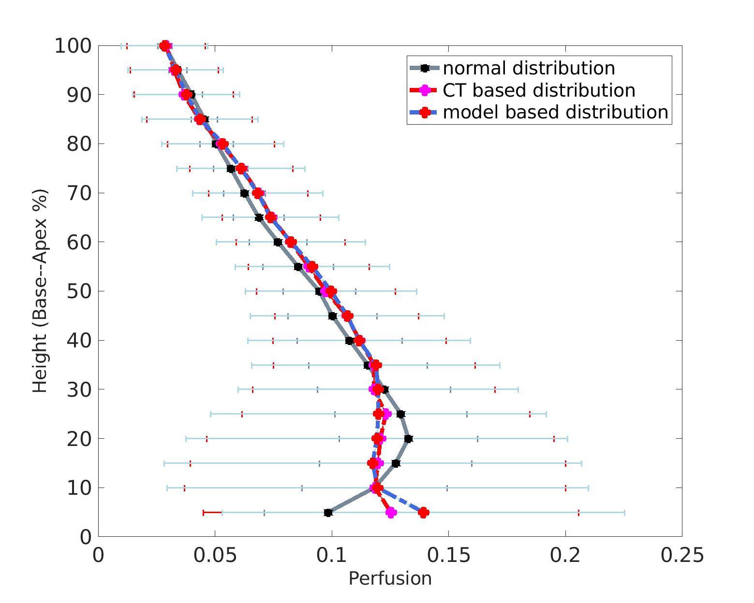
PFT
PFT

Slide 8
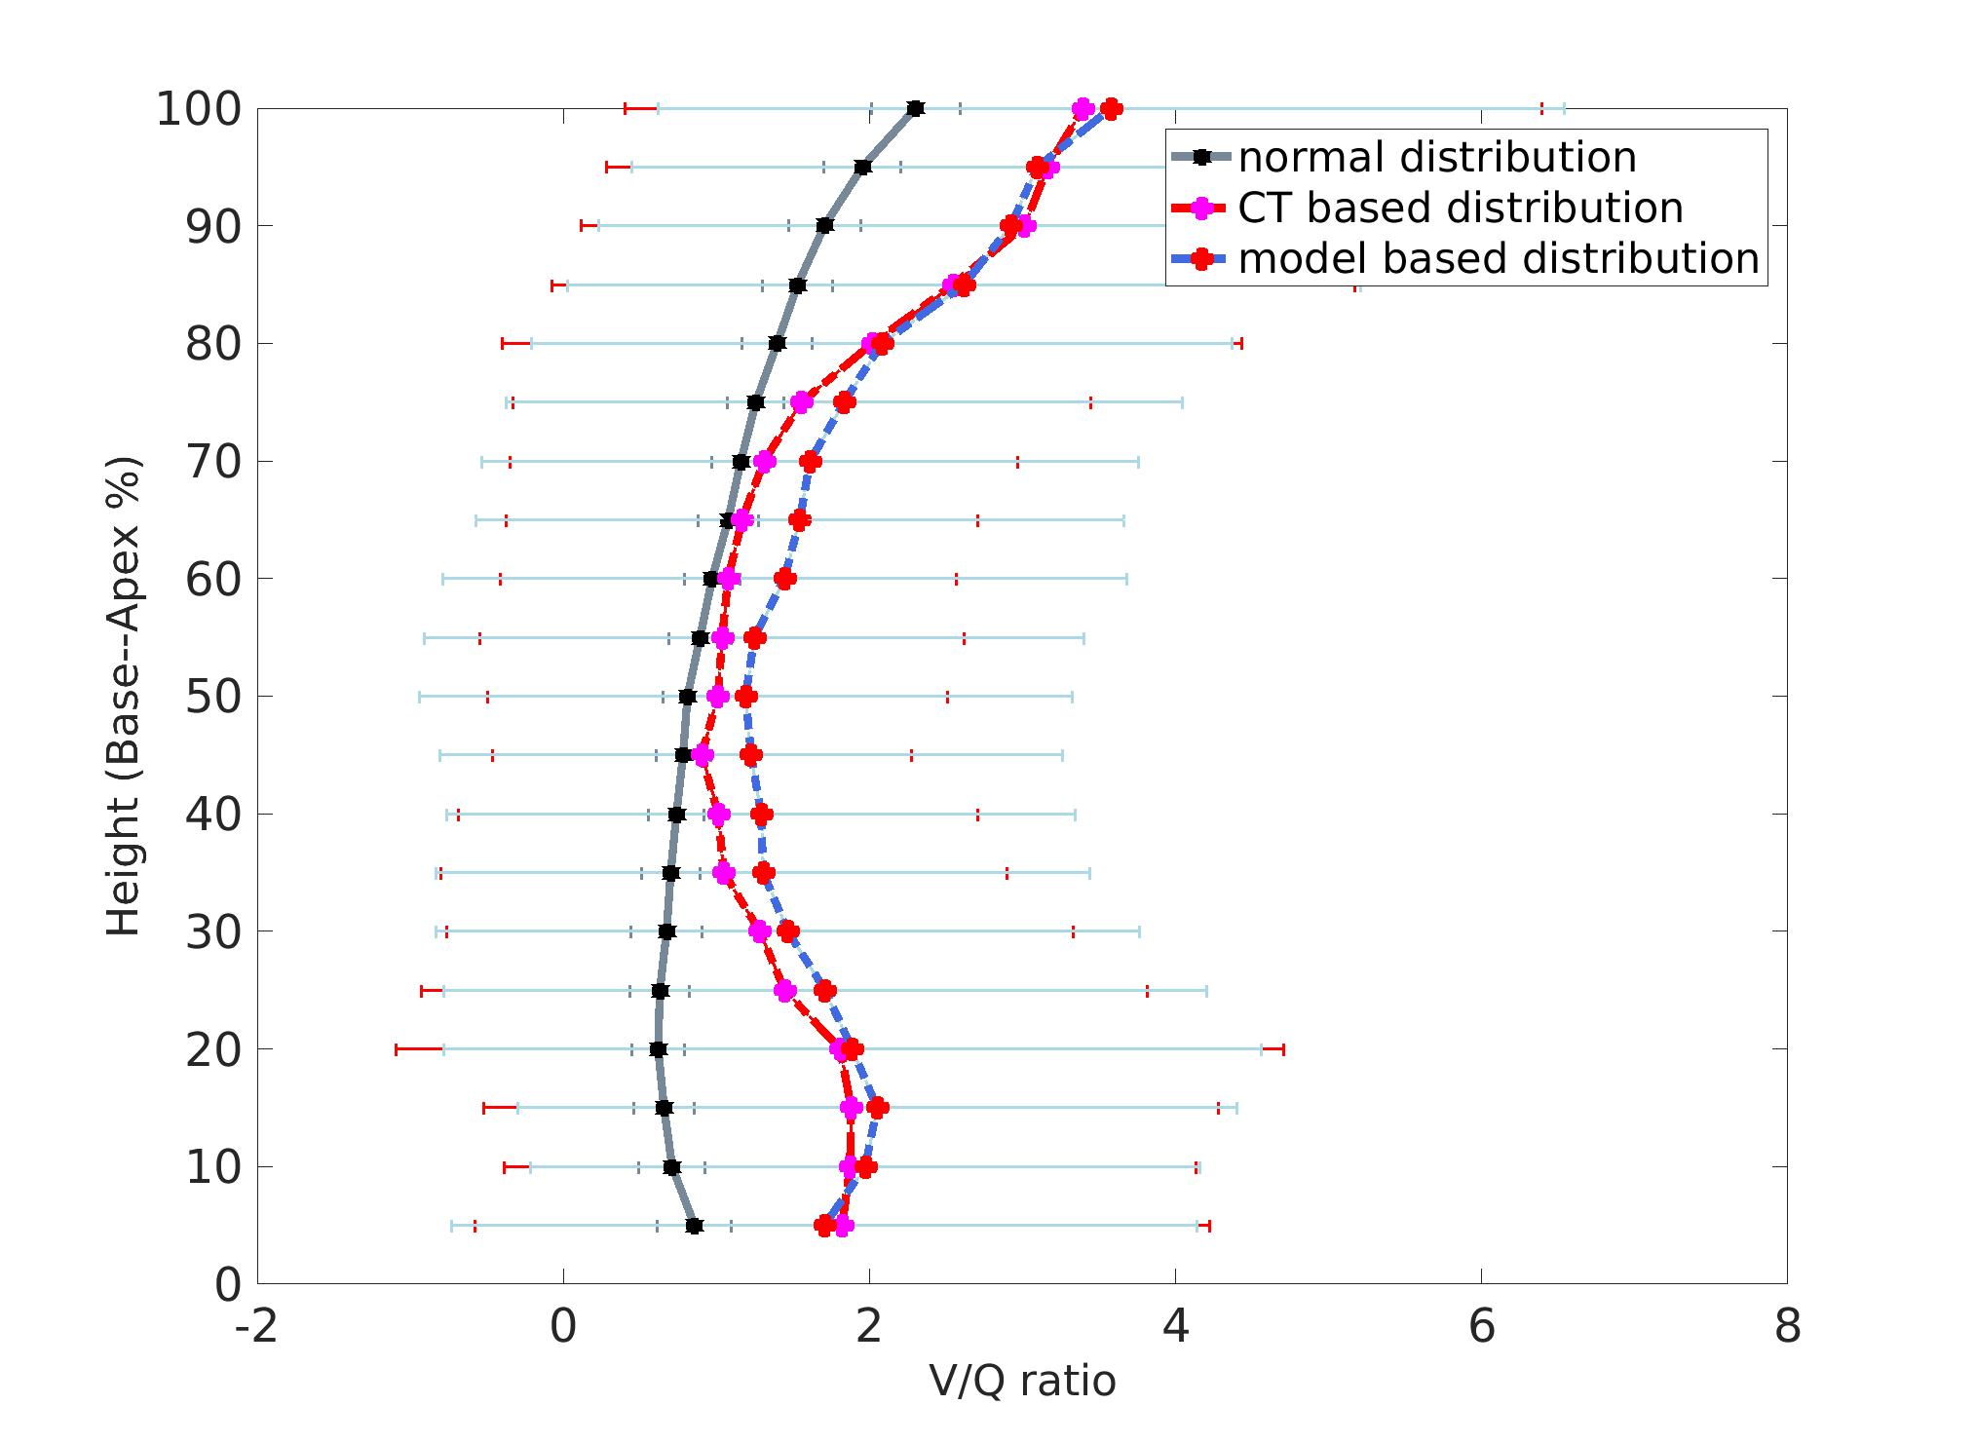
PFT

Slide 9
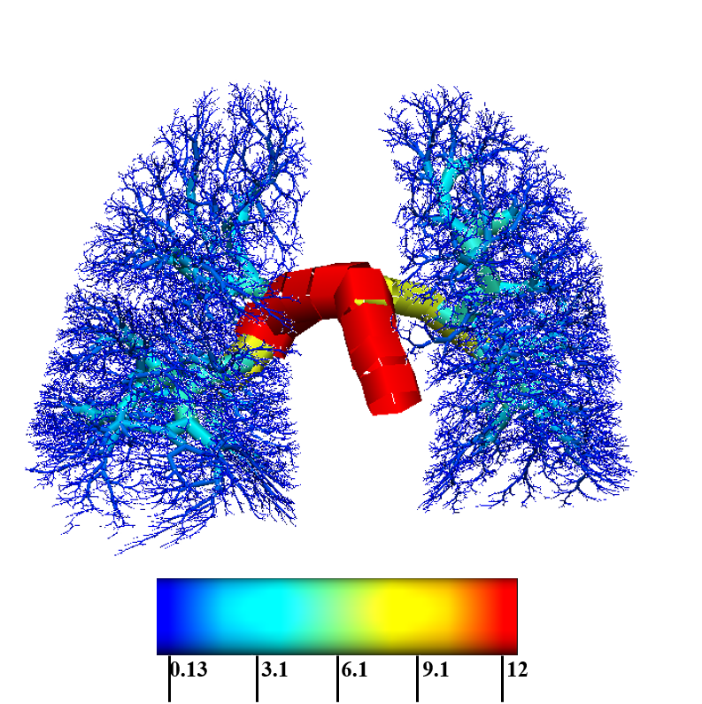
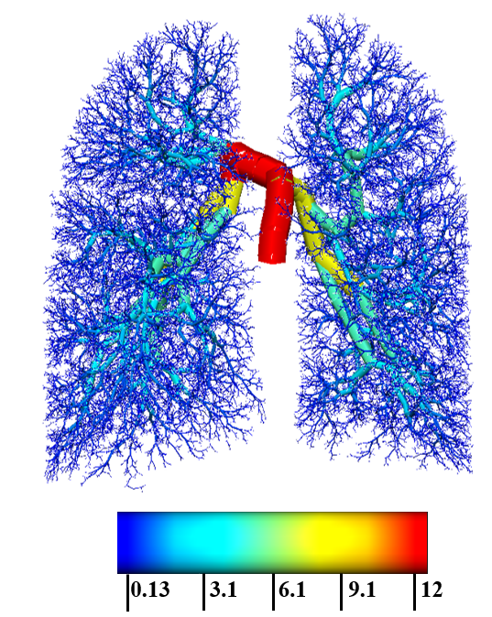
Radii (mm)
Radii (mm)

