Slide 1
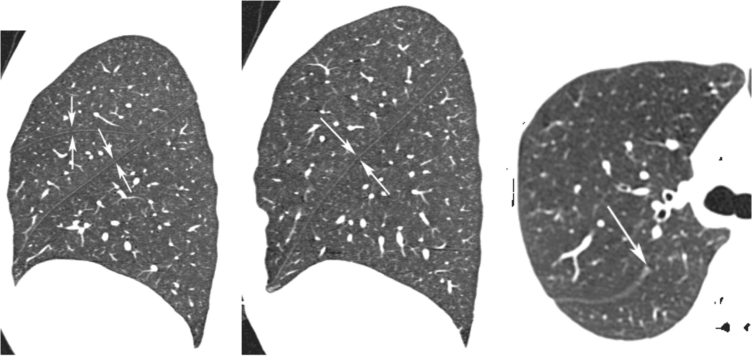
a
b
c

Slide 2
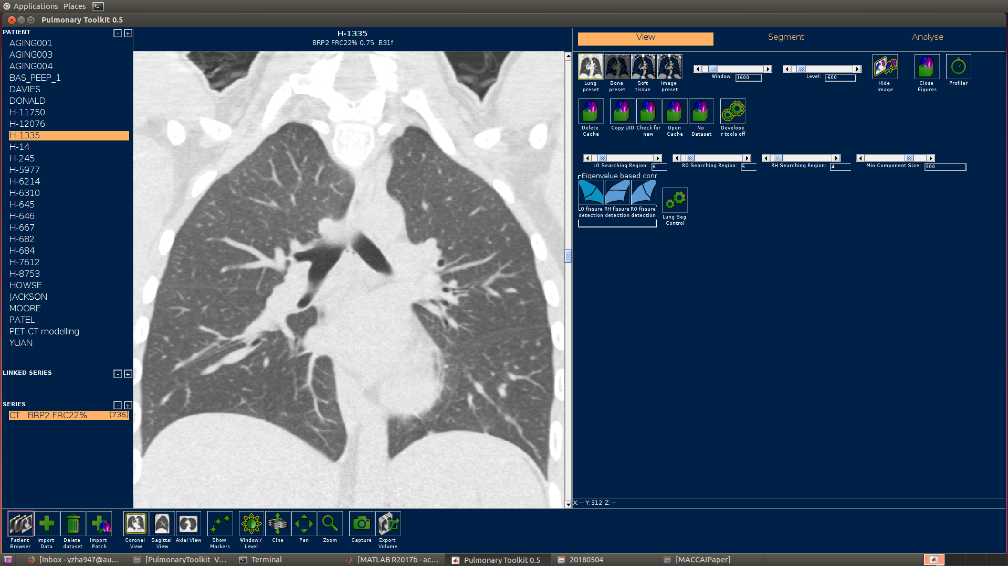
Image visualization section
Data input section
User plugin section
Toolbar section

Slide 3
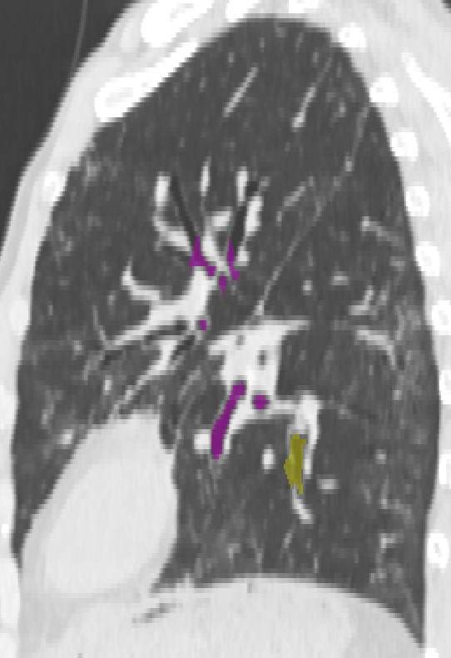
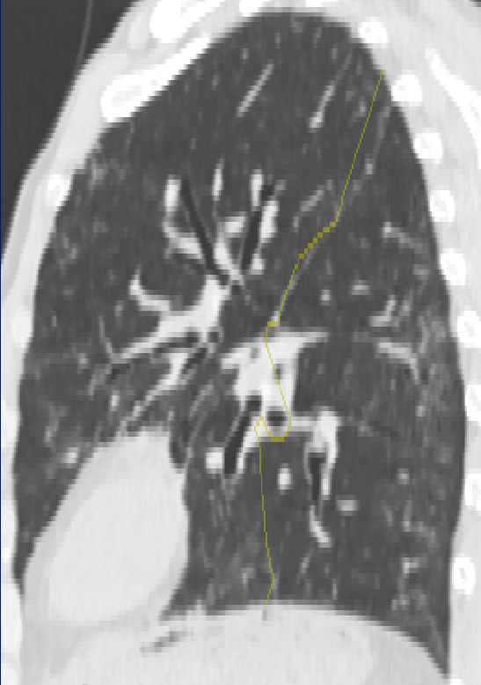

Slide 4
λ₃
Fissure plane
λ₂
λ₁

Slide 5
λ₂
λ₃
λ₁
Vessel tube

Slide 6
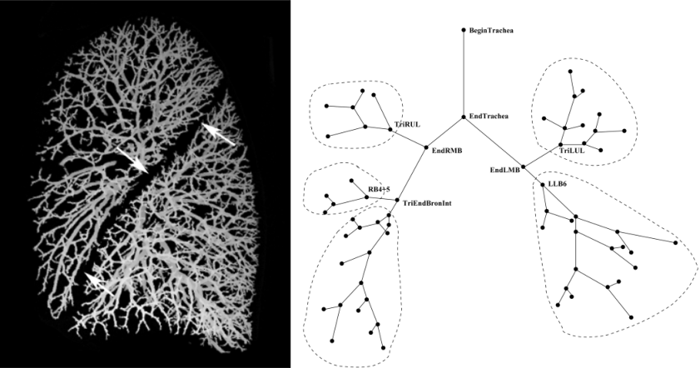

Slide 7


Slide 8
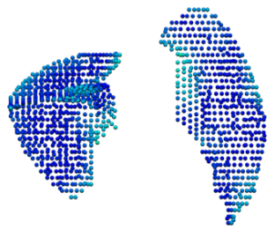
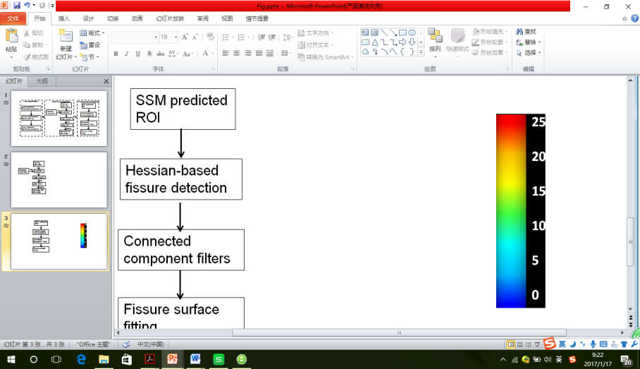
(mm)
25
20
15
10
5
0

