Slide 1
PTK fissure detection instruction
Yuwen
2016.01.11

Slide 2
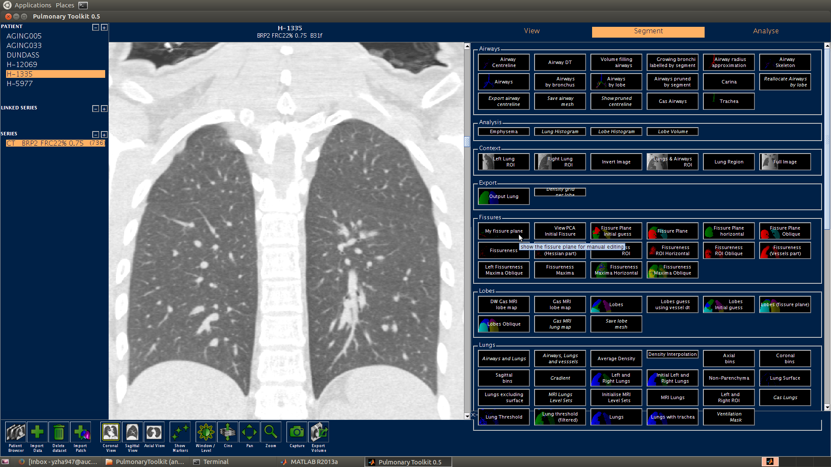
Click the plugin “My Fissure Plane” to run the fissure plane detection algorithm.

Slide 3
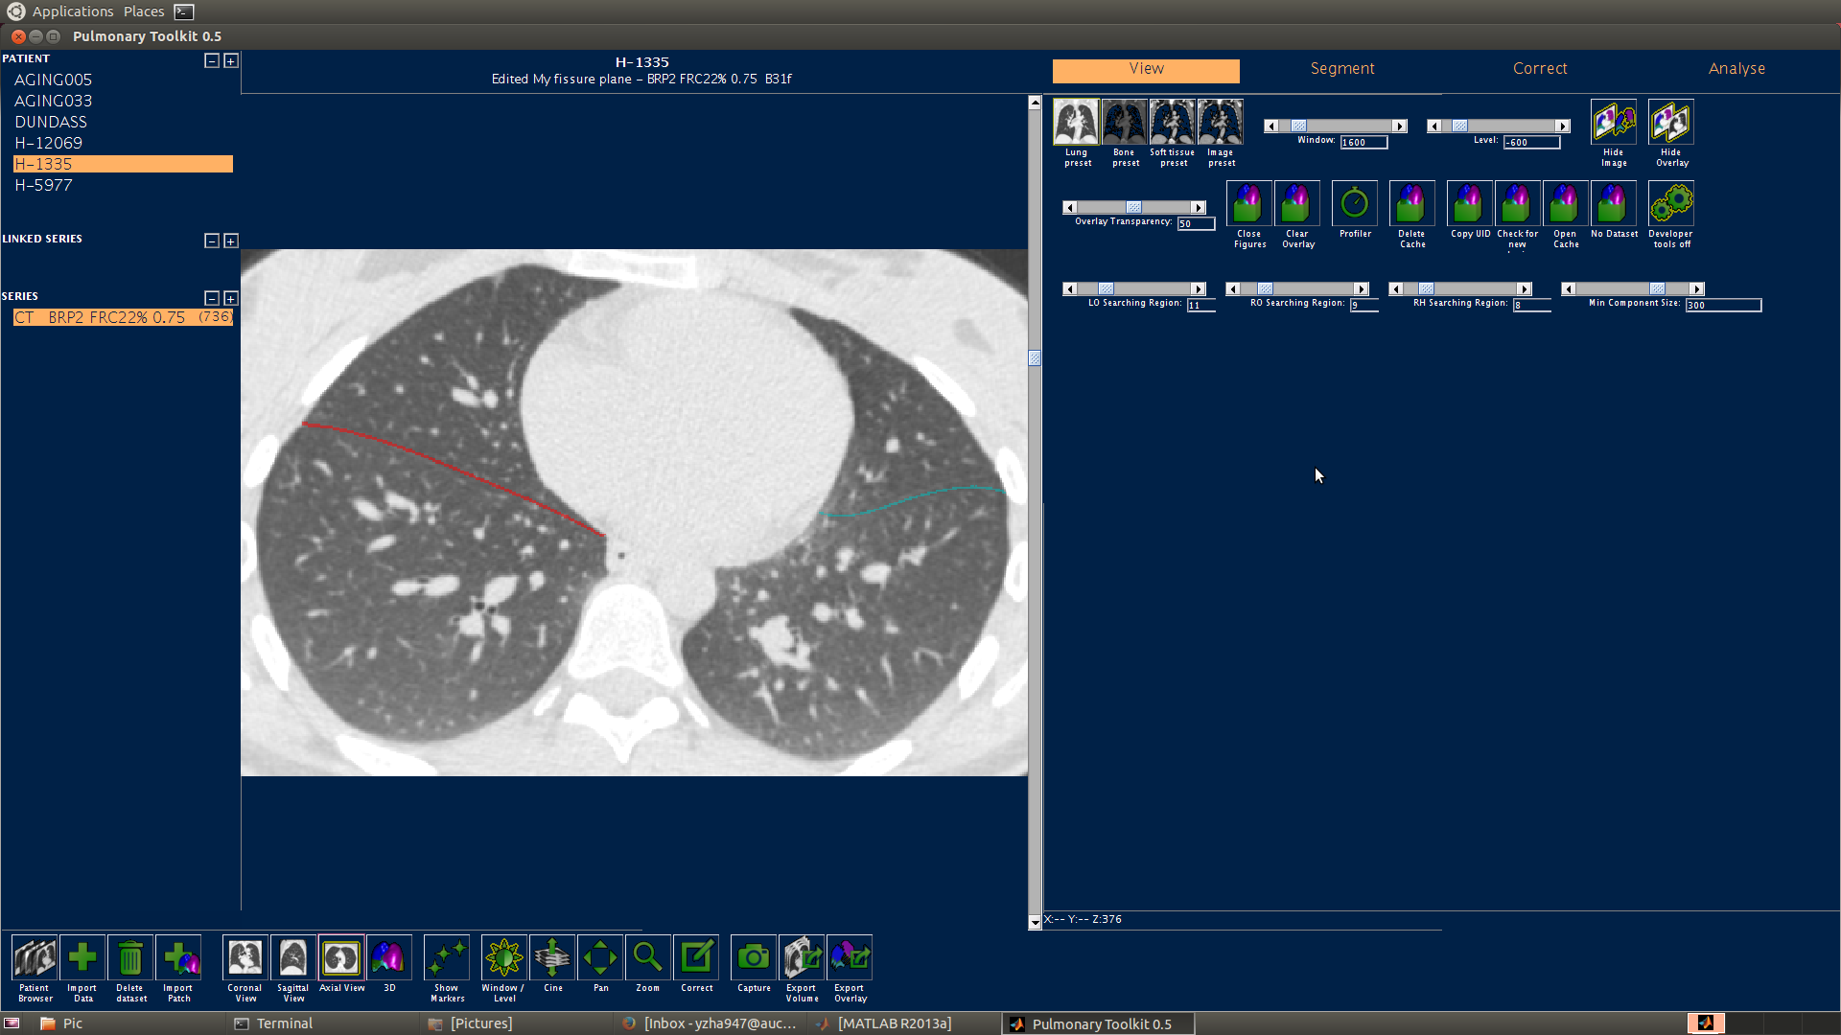
If the fissure detection result is not good enough, e.g. the detected fissure line is far away from the target fissure line, you can try to reduce the values of these three parameters: LO Searching Region, RO Searching Region and RH Searching Region.
Reduce the values of LO Searching Region value and RO searching 5 to 10 each time, reduce the value of RH Searching Region 3 to 8 each time.
Then click the plugin “My Fissure Plane” again to do a second calculation.
4. Also, you can try to reduce the value of the parameter: Min Component Size reduce about 50 each time to see if the result is improved.

Slide 4
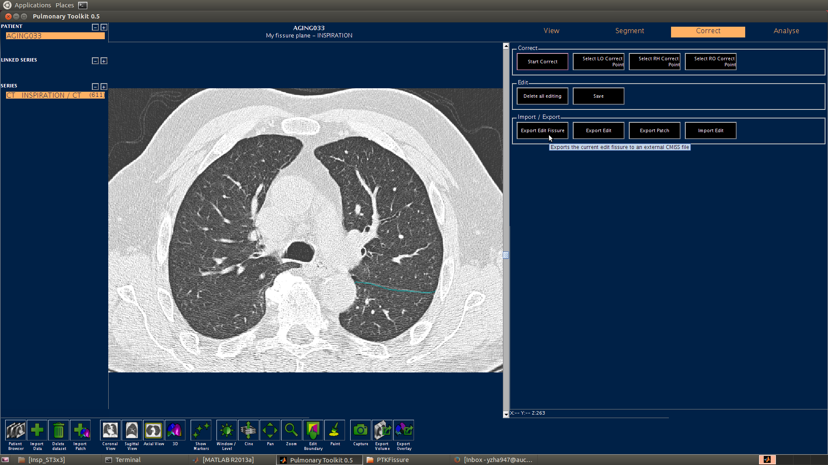
After the fissure detection calculation, you can move on to the correct mode for correcting the result , click the button ‘Correct’ .
You can also right click the mouse and drag the mouse at the same time to zoom in and out the picture.
The software may not find all the three fissures successfully (as show in the picture), in that case, you just need to correct the fissures which can be detected successfully.

Slide 5
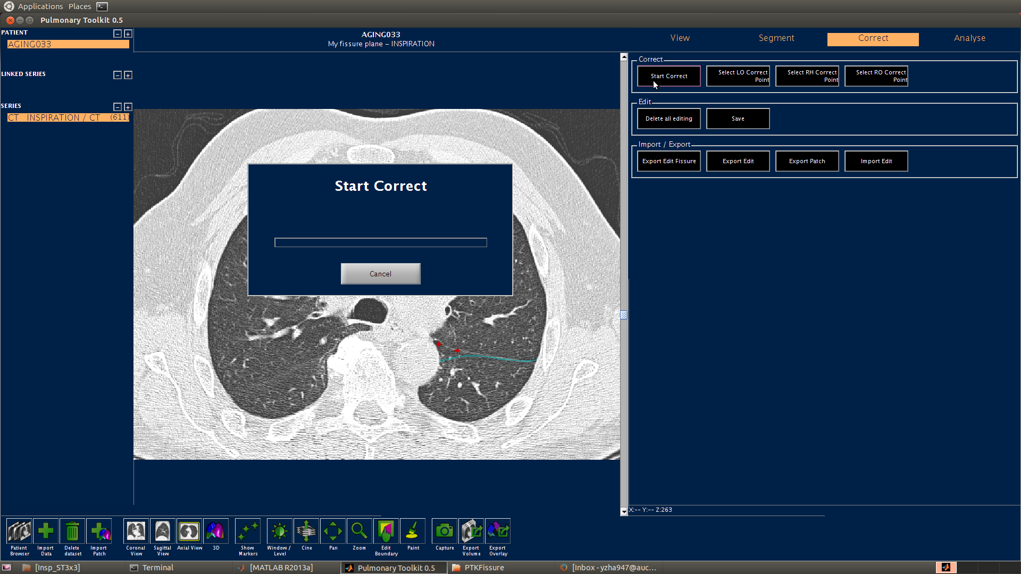
3. After the landmarks are selected, click the plugin ”Start Correct” to start correction.
4. If you select a wrong landmark, right click the landmark and select “delete marker”
1. If you want to correct the fissure e.g. left oblique fissure (pay attention that the lung showed in the right part of the picture is the left lung), you need to click the plugin “Select LO Correct Point”, the mouse will become a “cross”, then you can select some landmarks around the left oblique fissure plane on the picture.
2. Plugin “Select RH Correct Point” is for selecting right horizontal fissure landmarks and plugin “Select RO Correct Point” if for selecting right oblique fissure landmarks.

Slide 6
Some tips
Remember start doing the right horizontal fissure correction after finishing the right oblique fissure correction, because the right oblique fissure is the boundary condition for correcting the horizontal fissure.
Since the correction is calculated around each landmark in 3D, you’d better 1. not make two landmarks too close, 2. not make the landmarks too far away from the fissure line, this may make the correction not accurate enough, 3. do the correction in a single slice for one correction. You will not save too much time if you select a lot of correct points for one correction. After you are familiar with the correction, you can try to select more landmarks in different slices at a time.
You can use sagittal and coronal section to see the fissure plane more clearly.

Slide 7
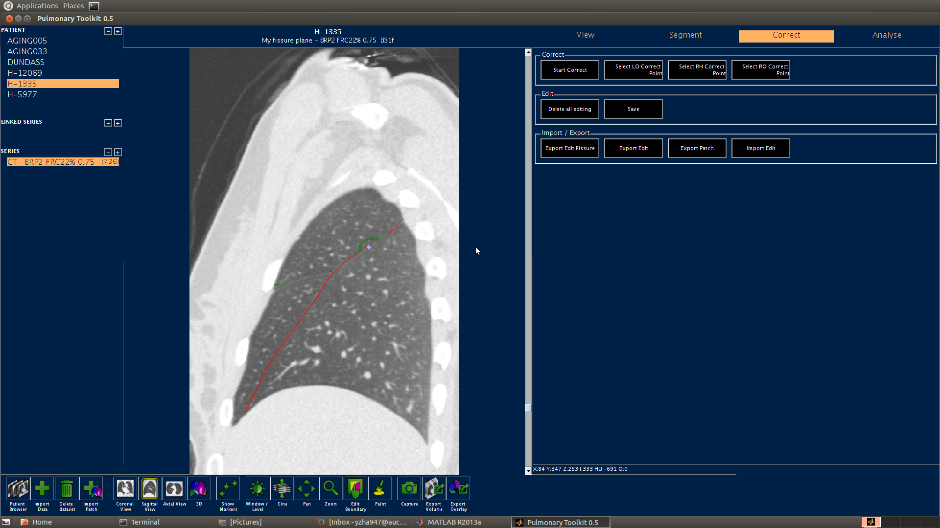

If you want to delete some error lines (as shown in the picture), you can select some landmarks on the boundary or outside the boundary.

Slide 8

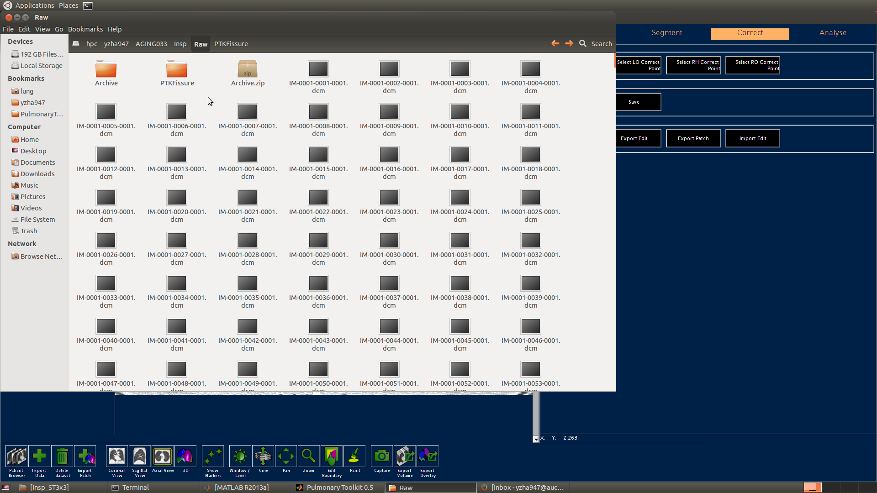
1. After finishing correction, click the plugin “Export Edit Fissure” to output the result. The fissure plane data will be save in .exdata and .ipdata format.
2. The output files will be saved in the folder “PTKFissure” which is created in the path of raw data.
Copy the files to special path to complete the lobe fitting.

