Slide 1

William Stallings
Computer Organization and Architecture
10th Edition

Slide 2
Chapter 3
A Top-Level View of Computer
Function and Interconnection

Slide 3
Computer Components
Contemporary computer designs are based on concepts developed by John von Neumann at the Institute for Advanced Studies, Princeton
Referred to as the von Neumann architecture and is based on three key concepts:
  Data and instructions are stored in a single read-write memory
  The contents of this memory are addressable by location, without regard to the type of data contained there
  Execution occurs in a sequential fashion (unless explicitly modified) from one instruction to the next
  Hardwired program
  The result of the process of connecting the various components in the desired configuration

Slide 4
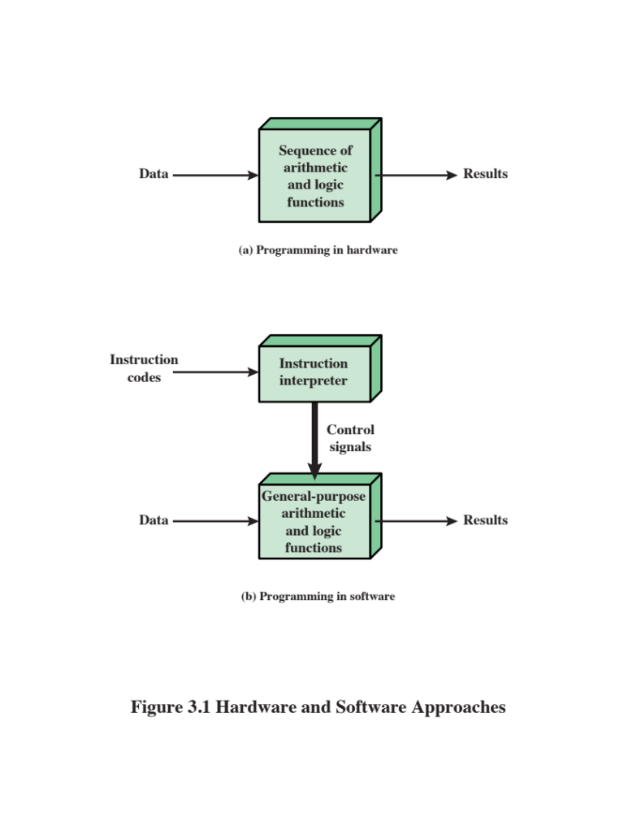
Hardware and Software Approaches

Slide 5

I/O
Components
Software
A sequence of codes or instructions
Part of the hardware interprets each instruction and generates control signals
Provide a new sequence of codes for each new program instead of rewiring the hardware
Major components:
Means of reporting results
Output module
Contains basic components for accepting data and instructions and converting them into an internal form of signals usable by the system
Input module
I/O Components
Module of general-purpose arithmetic and logic functions
Instruction interpreter
CPU
Software

Slide 6
MEMORY
Memory address register (MAR)
Specifies the address in memory for the next read or write
Memory buffer register (MBR)
Contains the data to be written into memory or receives the data read from memory
I/O address register (I/OAR)
Specifies a particular I/O device
I/O buffer register (I/OBR)
Used for the exchange of data between an I/O module and the CPU
MAR
MBR

Slide 7
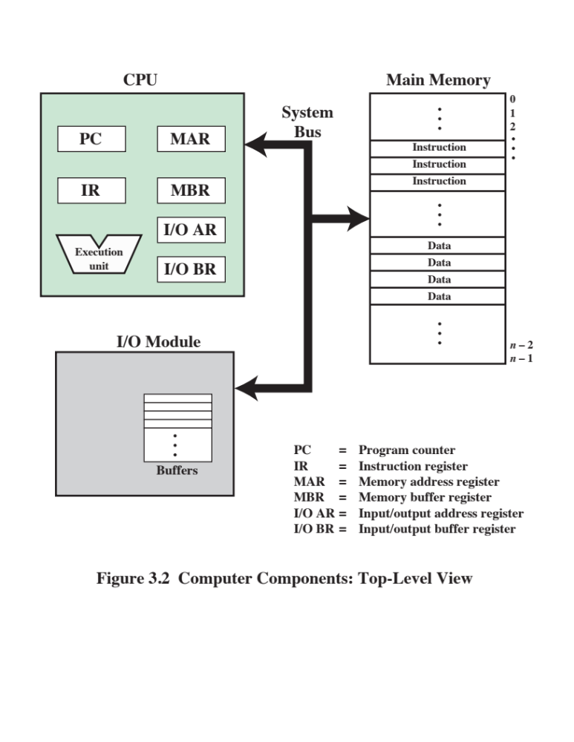

Slide 8
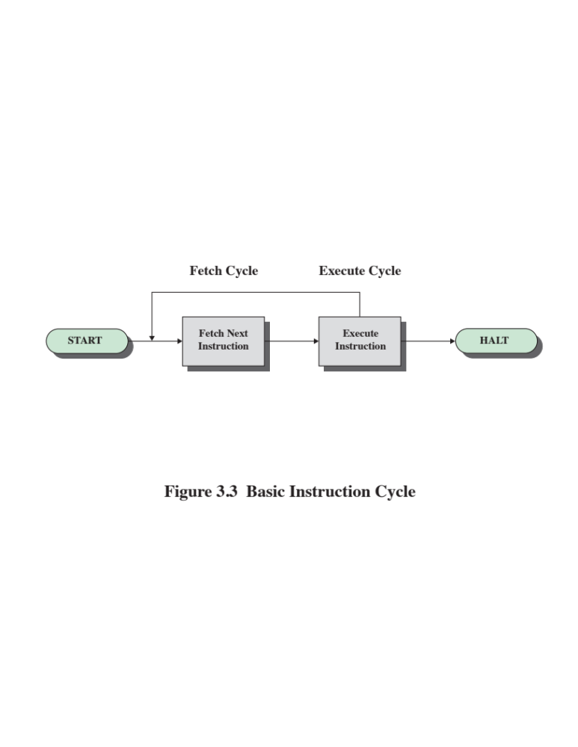

Slide 9

Fetch Cycle
At the beginning of each instruction cycle the processor fetches an instruction from memory
  The program counter (PC) holds the address of the instruction to be fetched next
  The processor increments the PC after each instruction fetch so that it will fetch the next instruction in sequence
The fetched instruction is loaded into the instruction register (IR)
  The processor interprets the instruction and performs the required action

Slide 10
Action Categories
Processor-memory
Data transferred from processor to memory or from memory to processor
Processor-I/O
Data transferred to or from a peripheral device by transferring between the processor and an I/O module
Data processing
The processor may perform some arithmetic or logic operation on data
Control
An instruction may specify that the sequence of execution be altered

Slide 11
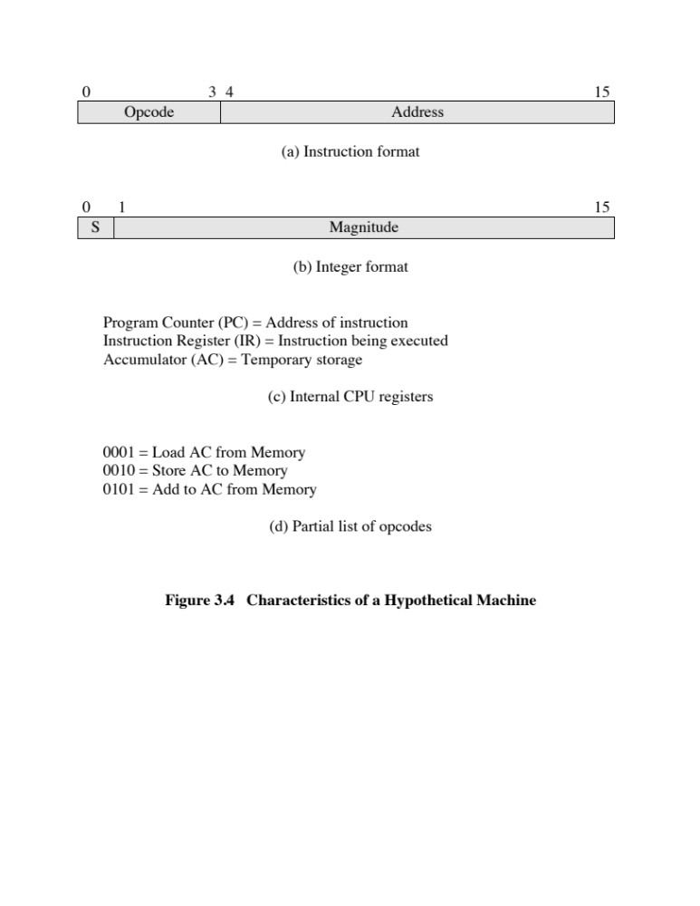

Slide 12
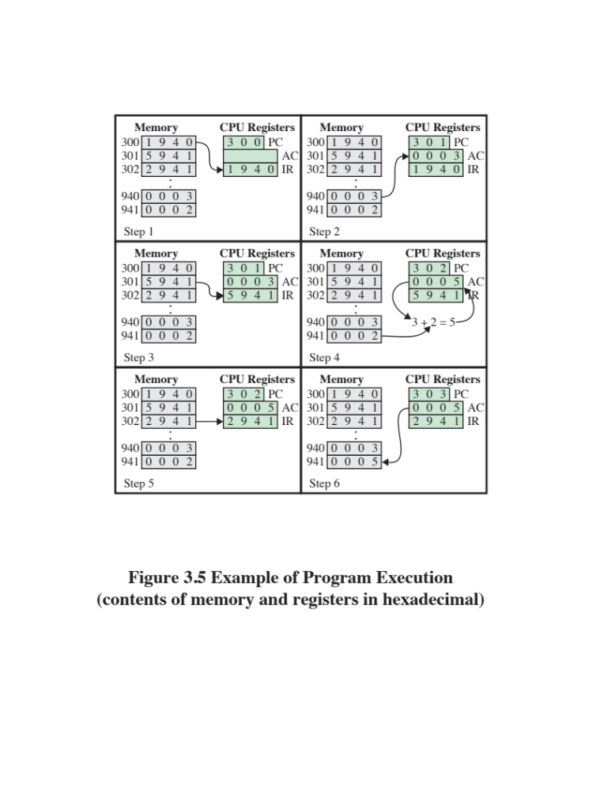

Slide 13
Consider a hypothetical microprocessor generating a 16-bit address (for example, assume that the program counter and the address registers are 16 bits wide) and having a 16-bit data bus.
a. What is the maximum memory address space that the processor can access directly if it is connected to a “16-bit memory”?
b. What is the maximum memory address space that the processor can access directly if it is connected to an “8-bit memory”?

Slide 14
Consider a hypothetical microprocessor generating a 16-bit address (for example, assume that the program counter and the address registers are 16 bits wide) and having a 16-bit data bus.
a. What is the maximum memory address space that the processor can access directly if it is connected to a “16-bit memory”?
b. What is the maximum memory address space that the processor can access directly if it is connected to an “8-bit memory”?
c. What architectural features will allow this microprocessor to access a separate “I/O space”?
d. If an input and an output instruction can specify an 8-bit I/O port number, how many 8-bit I/O ports can the microprocessor support? How many 16-bit I/O ports?
Explain.

Slide 15
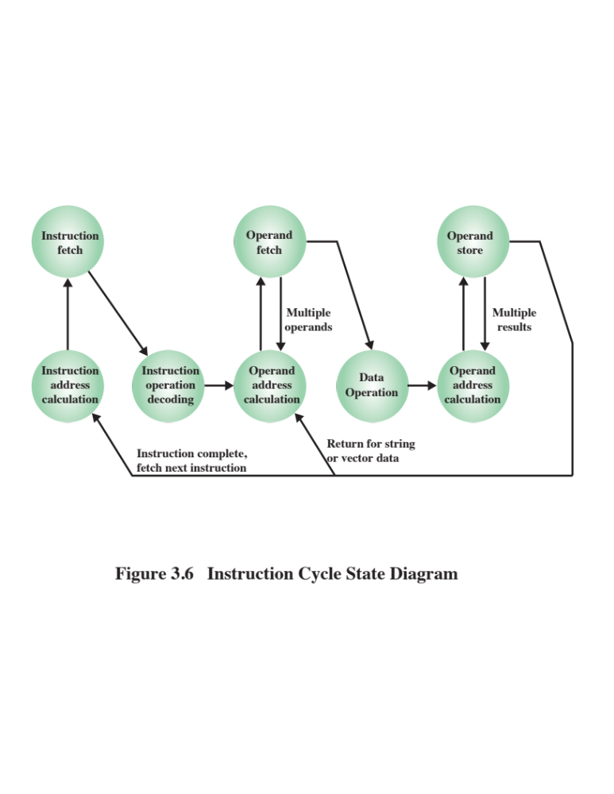

Slide 16
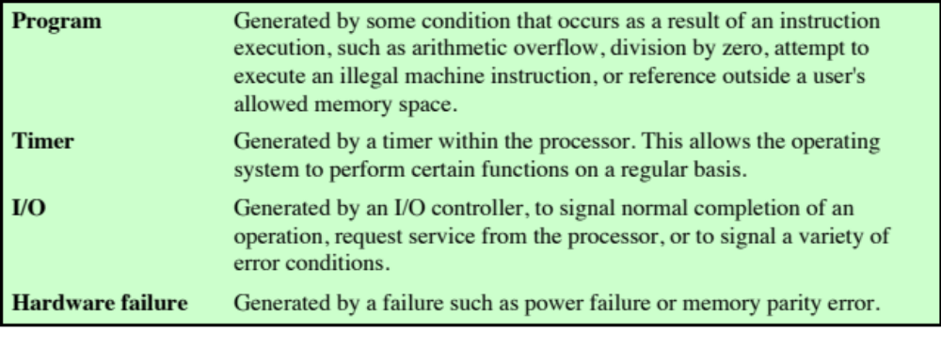
Table 3.1
Classes of Interrupts

Slide 17
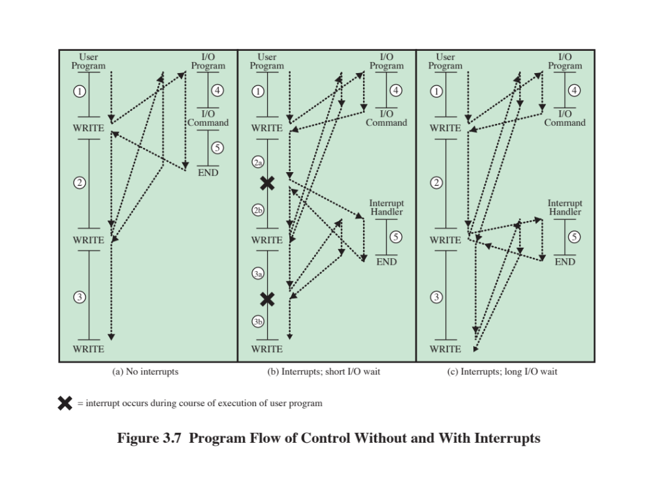

Slide 18
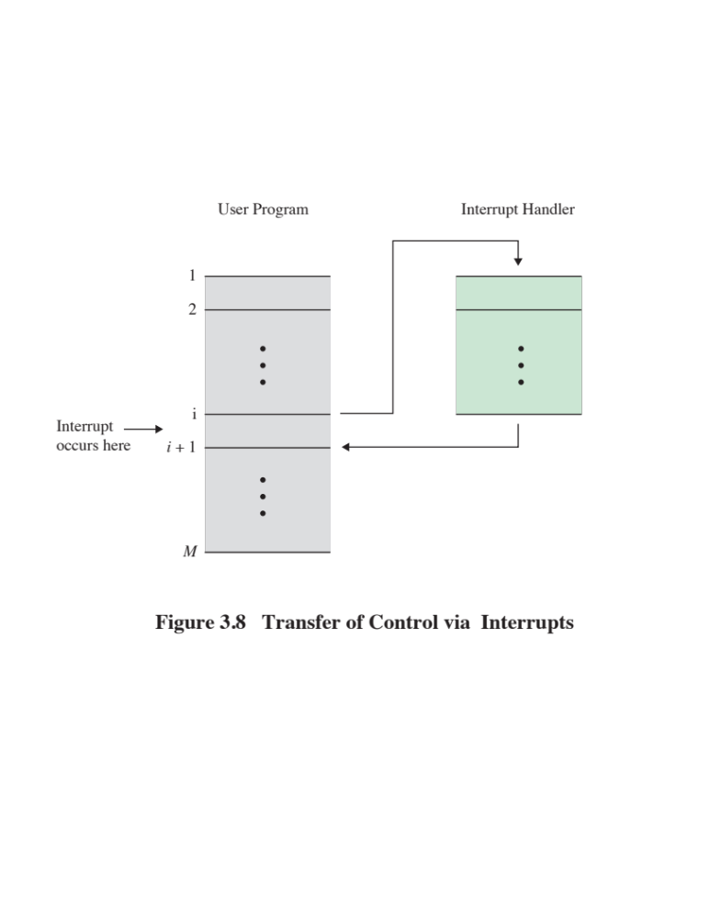

Slide 19
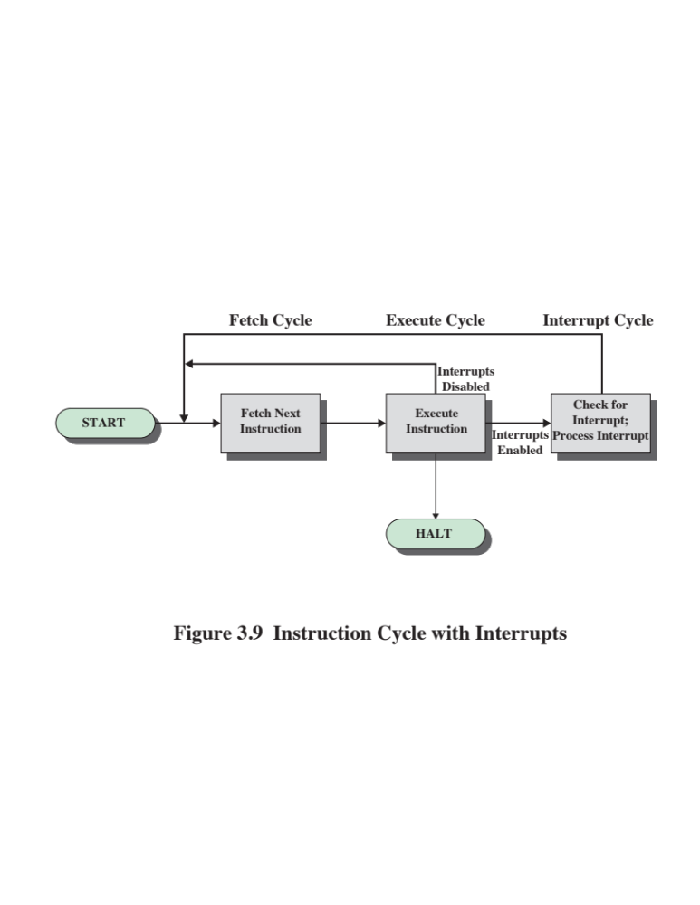

Slide 20
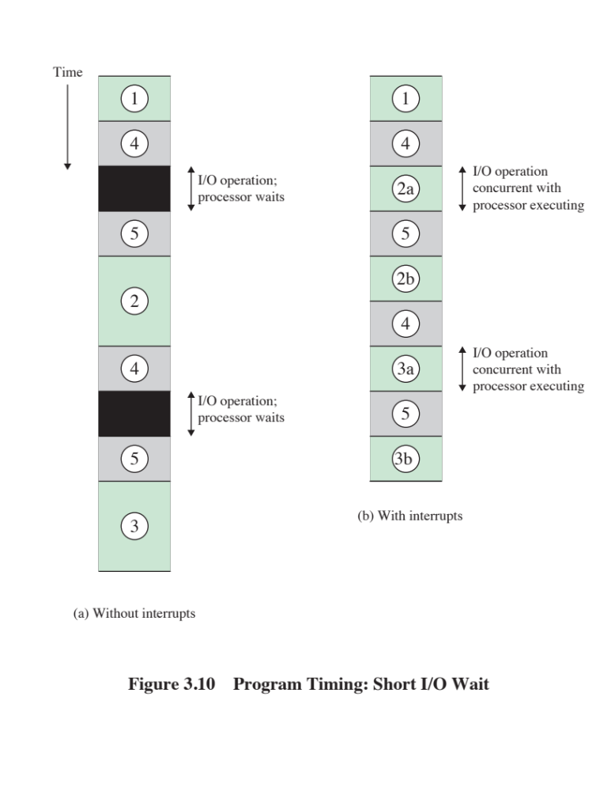

Slide 21
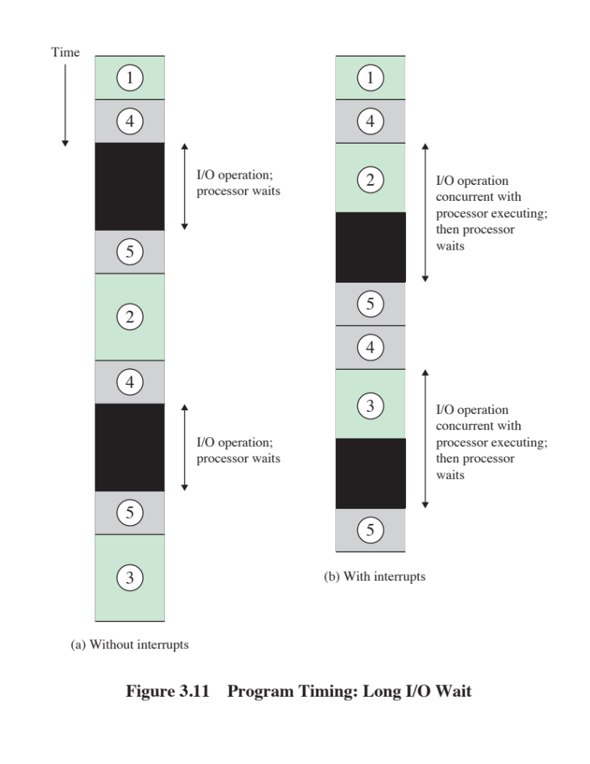

Slide 22
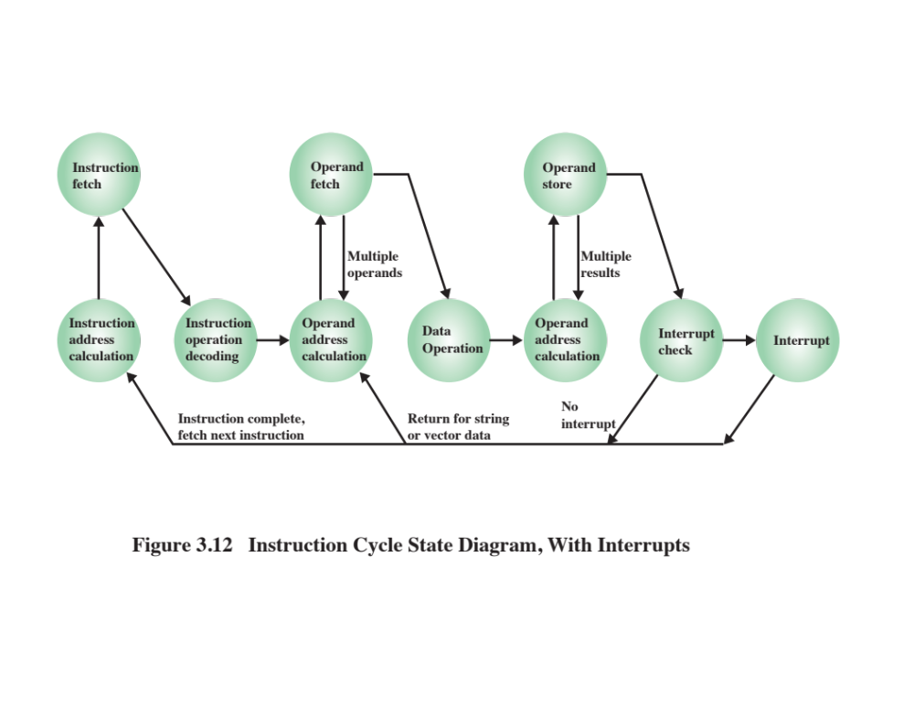

Slide 23
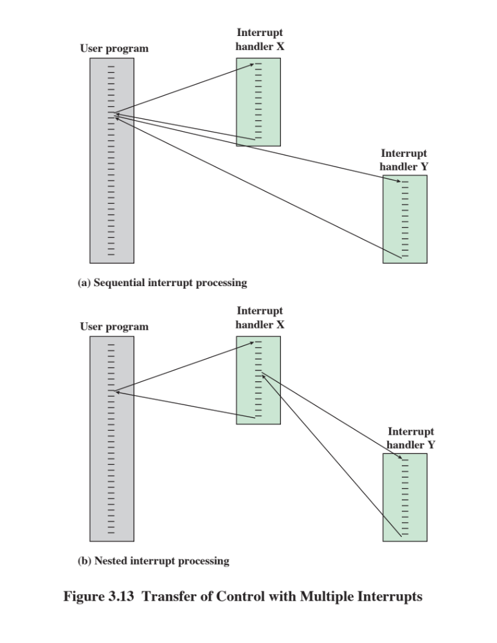

Slide 24
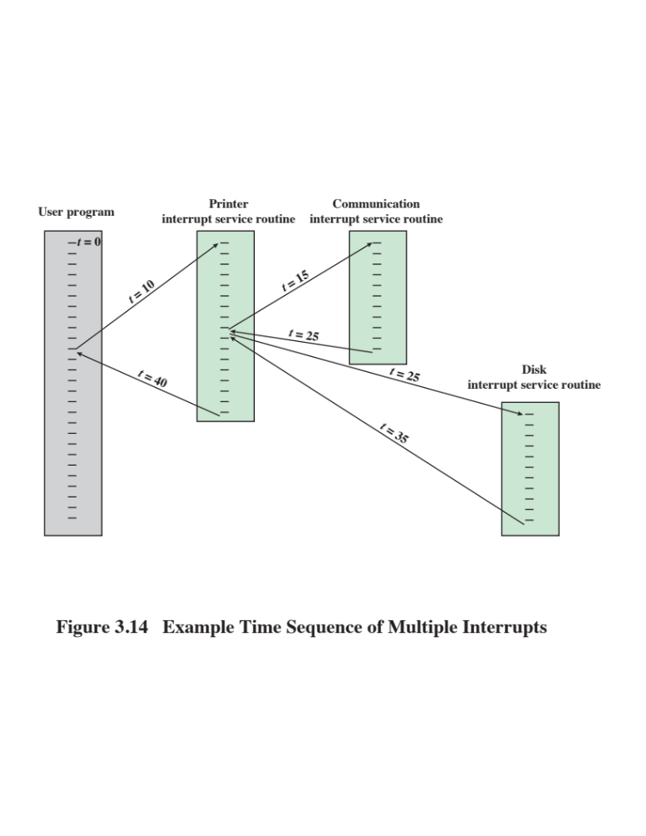

Slide 25
I/O Function
I/O module can exchange data directly with the processor
Processor can read data from or write data to an I/O module
  Processor identifies a specific device that is controlled by a particular I/O module
  I/O instructions rather than memory referencing instructions
In some cases it is desirable to allow I/O exchanges to occur directly with memory
  The processor grants to an I/O module the authority to read from or write to memory so that the I/O memory transfer can occur without tying up the processor
  The I/O module issues read or write commands to memory relieving the processor of responsibility for the exchange
  This operation is known as direct memory access (DMA)

Slide 26
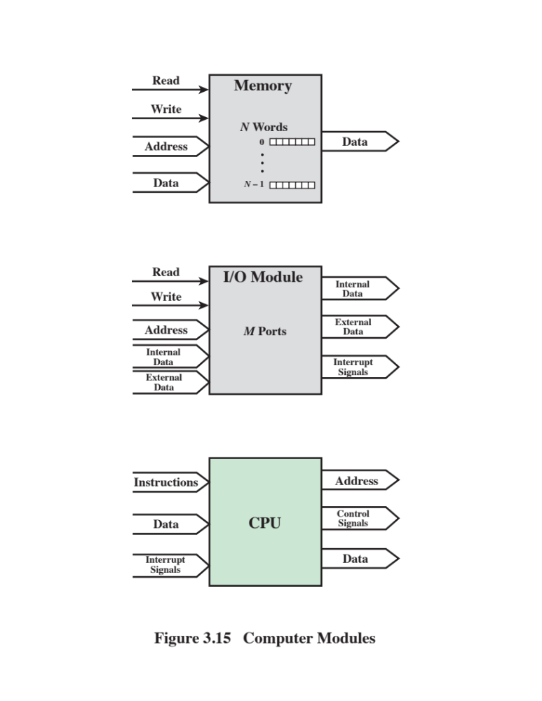

Slide 27
The interconnection structure must support the following types of transfers:
Memory to processor
Processor reads an instruction or a unit of data from memory
Processor to memory
Processor writes a unit of data to memory
I/O to processor
Processor reads data from an I/O device via an I/O module
Processor to I/O
Processor sends data to the I/O device
I/O to or from memory
An I/O module is allowed to exchange data directly with memory without going through the processor using direct memory access

Slide 28

Bus Interconnection
A communication pathway connecting two or more devices
Key characteristic is that it is a shared transmission medium
Signals transmitted by any one device are available for reception by all other devices attached to the bus
If two devices transmit during the same time period their signals will overlap and become garbled
Typically consists of multiple communication lines
Each line is capable of transmitting signals representing binary 1 and binary 0
Computer systems contain a number of different buses that provide pathways between components at various levels of the computer system hierarchy
System bus
A bus that connects major computer components (processor, memory, I/O)
The most common computer interconnection structures are based on the use of one or more system buses

Slide 29

Data Bus
Data lines that provide a path for moving data among system modules
May consist of 32, 64, 128, or more separate lines
The number of lines is referred to as the width of the data bus
The number of lines determines how many bits can be transferred at a time
The width of the data bus
is a key factor in
determining overall
system performance

Slide 30
Address Bus Control Bus
Used to designate the source or destination of the data on the data bus
  If the processor wishes to read a word of data from memory it puts the address of the desired word on the address lines
Width determines the maximum possible memory capacity of the system
Also used to address I/O ports
  The higher order bits are used to select a particular module on the bus and the lower order bits select a memory location or I/O port within the module
Used to control the access and the use of the data and address lines
Because the data and address lines are shared by all components there must be a means of controlling their use
Control signals transmit both command and timing information among system modules
Timing signals indicate the validity of data and address information
Command signals specify operations to be performed

Slide 31
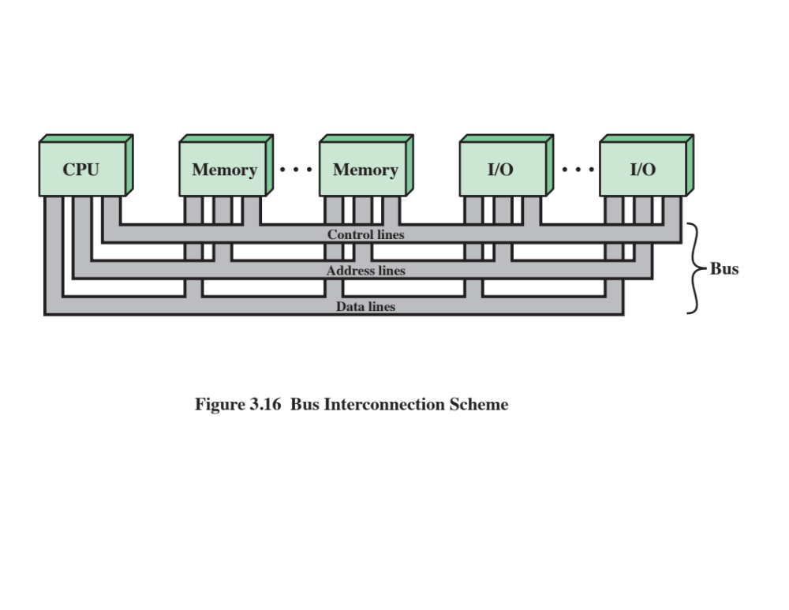

Slide 32
Point-to-Point Interconnect
Principal reason for change was the electrical constraints encountered with increasing the frequency of wide synchronous buses
At higher and higher data rates it becomes increasingly difficult to perform the synchronization and arbitration functions in a timely fashion
A conventional shared bus on the same chip magnified the difficulties of increasing bus data rate and reducing bus latency to keep up with the processors
Has lower latency, higher data rate, and better scalability

Slide 33

Quick Path Interconnect
QPI
Introduced in 2008
Multiple direct connections
    Direct pairwise connections to other components eliminating the need for arbitration found in shared transmission systems
Layered protocol architecture
    These processor level interconnects use a layered protocol architecture rather than the simple use of control signals found in shared bus arrangements
Packetized data transfer
    Data are sent as a sequence of packets each of which includes control headers and error control codes

Slide 34
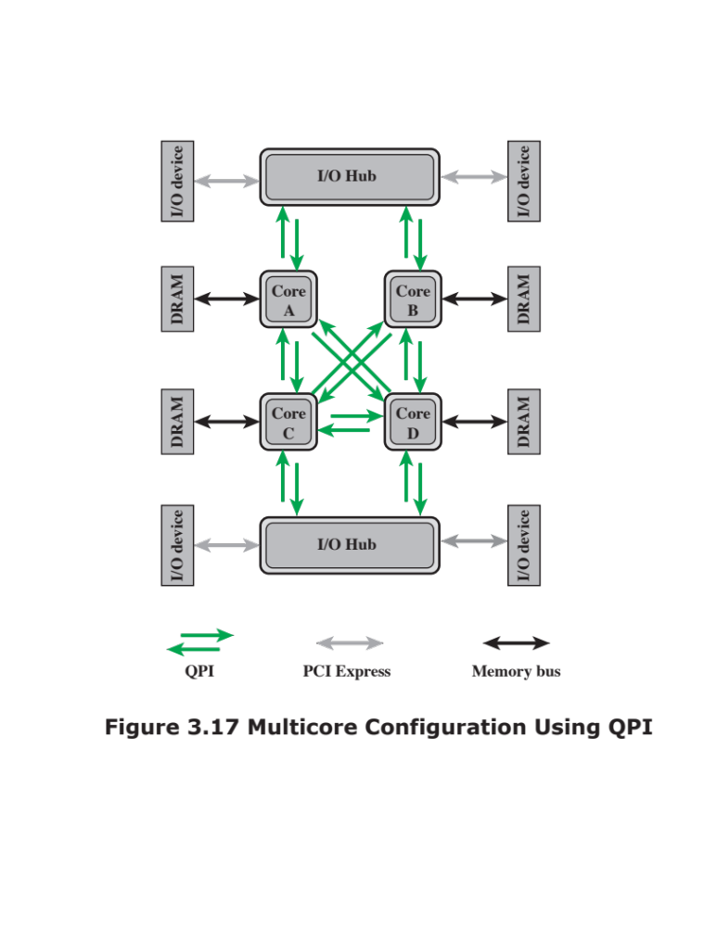

Slide 35
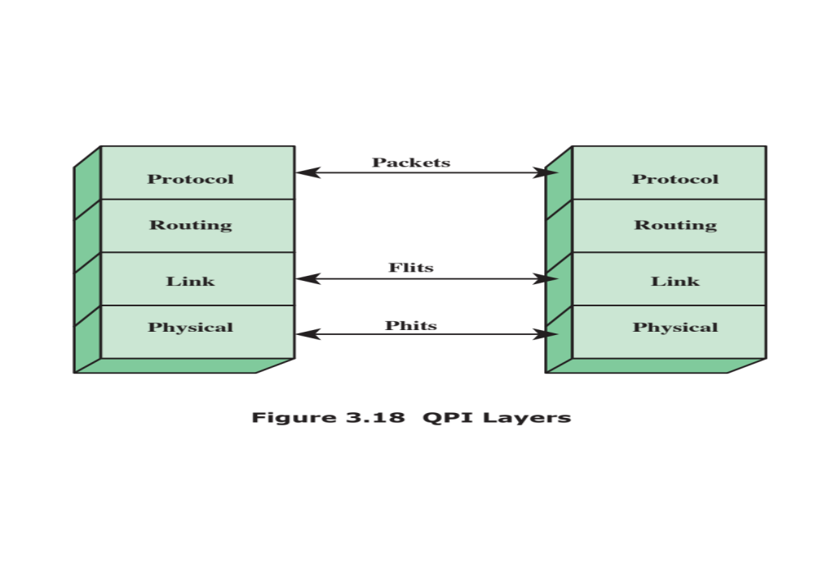

Slide 36
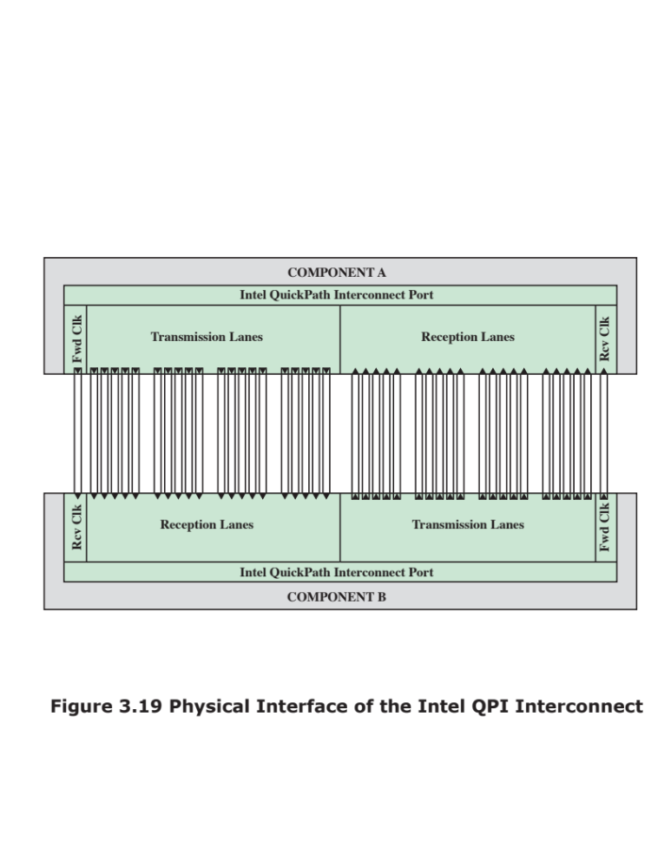

Slide 37
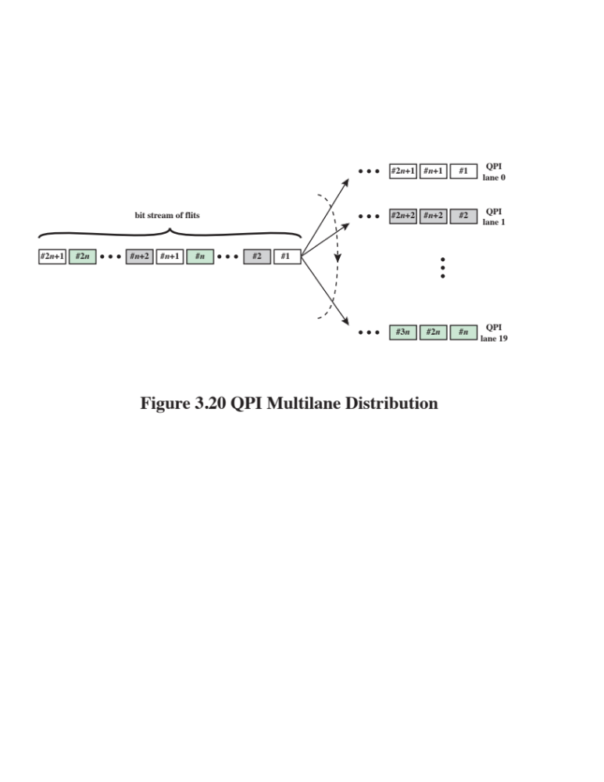

Slide 38
QPI Link Layer
Flow control function
  Needed to ensure that a sending QPI entity does not overwhelm a receiving QPI entity by sending data faster than the receiver can process the data and clear buffers for more incoming data
Performs two key functions: flow control and error control
  Operate on the level of the flit (flow control unit)
  Each flit consists of a 72-bit message payload and an 8-bit error control code called a cyclic redundancy check (CRC)
Error control function
  Detects and recovers from bit errors, and so isolates higher layers from experiencing bit errors

Slide 39
QPI Routing and Protocol Layers
Routing Layer
Protocol Layer
Packet is defined as the unit of transfer
One key function performed at this level is a cache coherency protocol which deals with making sure that main memory values held in multiple caches are consistent
A typical data packet payload is a block of data being sent to or from a cache
Used to determine the course that a packet will traverse across the available system interconnects
Defined by firmware and describe the possible paths that a packet can follow

Slide 40
Peripheral Component Interconnect (PCI)
A popular high bandwidth, processor independent bus that can function as a mezzanine or peripheral bus
Delivers better system performance for high speed I/O subsystems
PCI Special Interest Group (SIG)
  Created to develop further and maintain the compatibility of the PCI specifications
  PCI Express (PCIe)
  Point-to-point interconnect scheme intended to replace bus-based schemes such as PCI
  Key requirement is high capacity to support the needs of higher data rate I/O devices, such as Gigabit Ethernet
  Another requirement deals with the need to support time dependent data streams

Slide 41
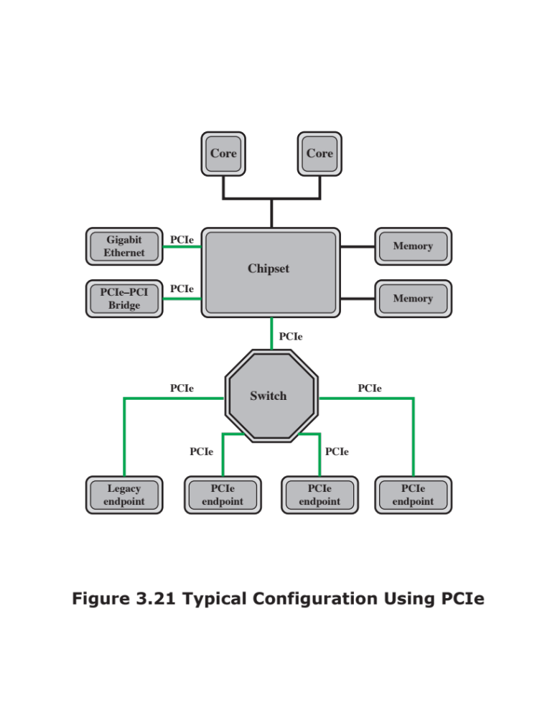

Slide 42
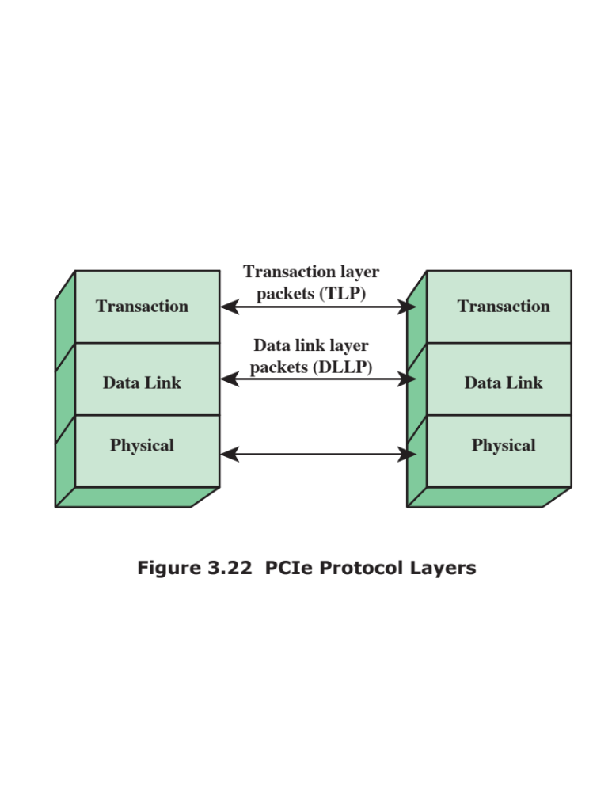

Slide 43
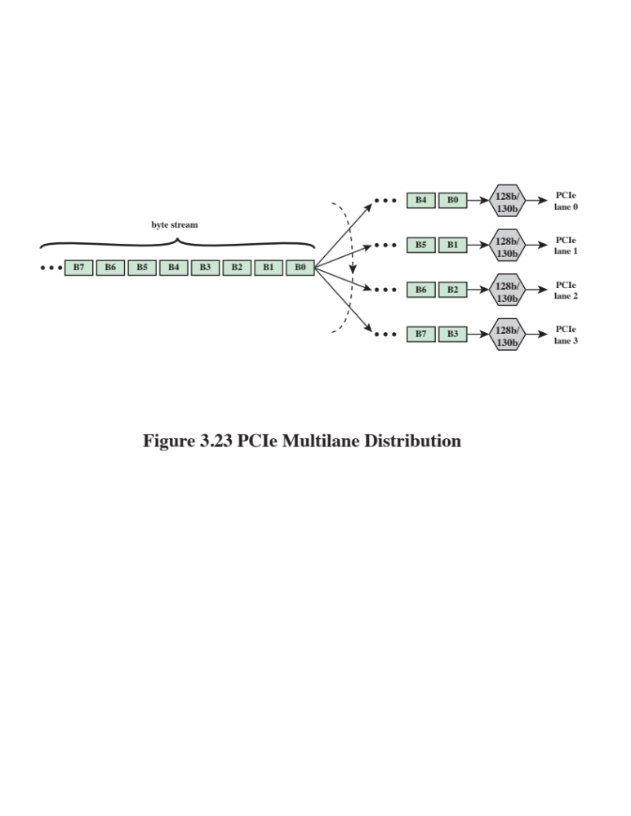

Slide 44
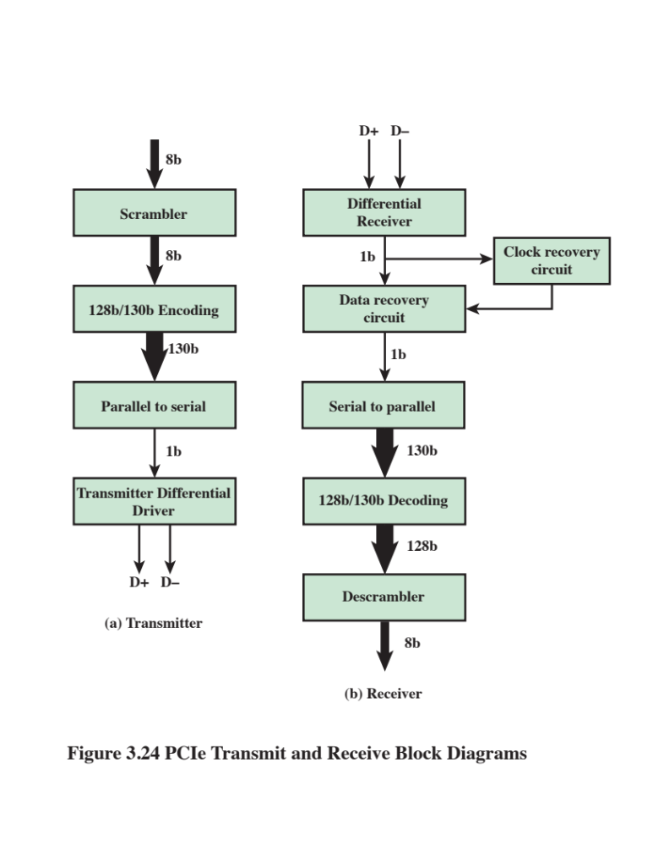

Slide 45

PCIe
Transaction Layer (TL)
Receives read and write requests from the software above the TL and creates request packets for transmission to a destination via the link layer
Most transactions use a split transaction technique
  A request packet is sent out by a source PCIe device which then waits for a response called a completion packet
  TL messages and some write transactions are posted transactions (meaning that no response is expected)
  TL packet format supports 32-bit memory addressing and extended 64-bit memory addressing

Slide 46
The TL supports four address spaces:
Memory
  The memory space includes system main memory and PCIe I/O devices
  Certain ranges of memory addresses map into I/O devices
I/O
  This address space is used for legacy PCI devices, with reserved address ranges used to address legacy I/O devices
Configuration
  This address space enables the TL to read/write configuration registers associated with I/O devices
Message
  This address space is for control signals related to interrupts, error handling, and power management

Slide 47
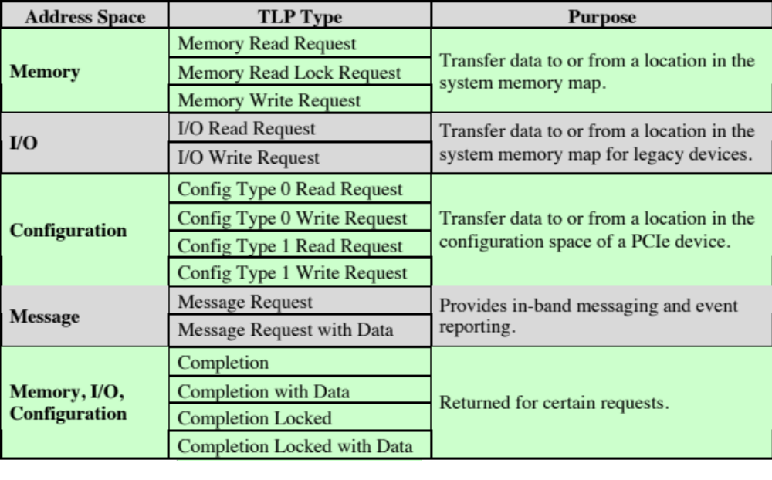
Table 3.2
PCIe TLP Transaction Types

Slide 48
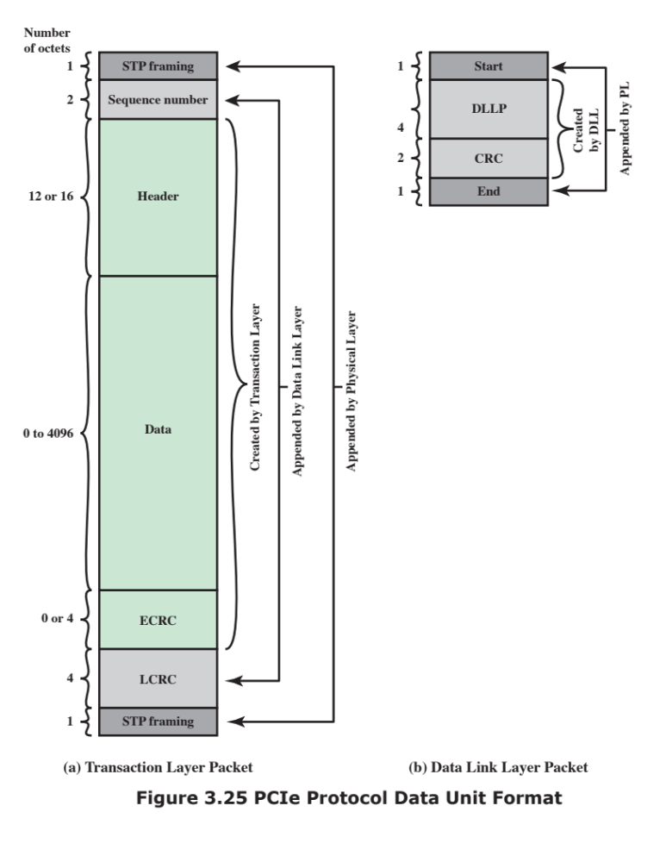

Slide 49
Summary
A Top-Level View of Computer Function and Interconnection
Chapter 3
  Point-to-point interconnect
  QPI physical layer
  QPI link layer
  QPI routing layer
  QPI protocol layer
  PCI express
  PCI physical and logical architecture
  PCIe physical layer
  PCIe transaction layer
  PCIe data link layer
Computer components
Computer function
  Instruction fetch and execute
  Interrupts
  I/O function
Interconnection structures
Bus interconnection

