Slide 1

William Stallings
Computer Organization and Architecture
10th Edition

Slide 2
Chapter 4
Cache Memory

Slide 3
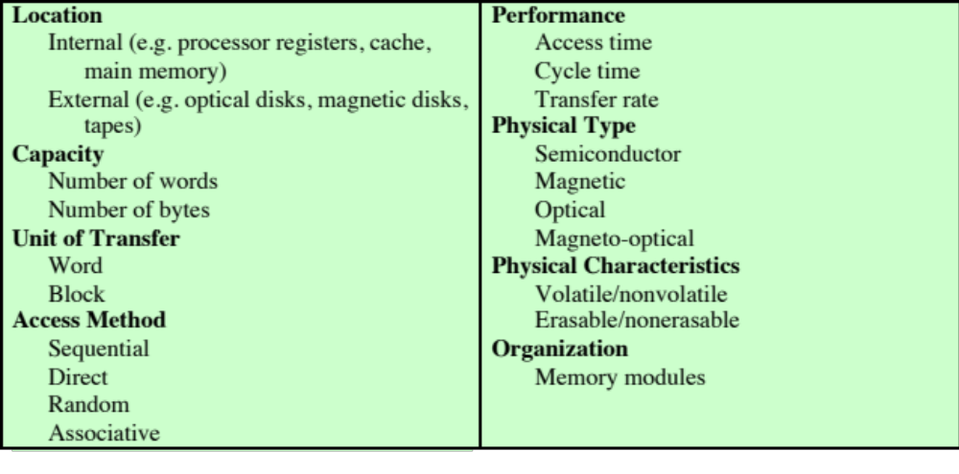
Table 4.1
Key Characteristics of Computer Memory Systems

Slide 4
Characteristics of Memory Systems
Location
  Refers to whether memory is internal and external to the computer
  Internal memory is often equated with main memory
  Processor requires its own local memory, in the form of registers
  Cache is another form of internal memory
  External memory consists of peripheral storage devices that are accessible to the processor via I/O controllers
Capacity
  Memory is typically expressed in terms of bytes
Unit of transfer
  For internal memory the unit of transfer is equal to the number of electrical lines into and out of the memory module

Slide 5
Method of Accessing Units of Data
Sequential access
Direct access
Random access
Associative
Memory is organized into units of data called records
Involves a shared read-write mechanism
Each addressable location in memory has a unique, physically wired-in addressing mechanism
A word is retrieved based on a portion of its contents rather than its address
Access must be made in a specific linear sequence
Individual blocks or records have a unique address based on physical location
The time to access a given location is independent of the sequence of prior accesses and is constant
Each location has its own addressing mechanism and retrieval time is constant independent of location or prior access patterns
Access time is variable
Access time is variable
Any location can be selected at random and directly addressed and accessed
Main memory and some cache systems are random access
Cache memories may employ associative access

Slide 6
Capacity and Performance:
The two most important characteristics of memory
Three performance parameters are used:
Access time (latency)
For random-access memory it is the time it takes to perform a read or write operation
For non-random-access memory it is the time it takes to position the read-write mechanism at the desired location
Memory cycle time
Access time plus any additional time required before second access can commence
Additional time may be required for transients to die out on signal lines or to regenerate data if they are read destructively
Concerned with the system bus, not the processor
Transfer rate
The rate at which data can be transferred into or out of a memory unit
For random-access memory it is equal to 1/(cycle time)

Slide 7

Memory
  The most common forms are:
  Semiconductor memory
  Magnetic surface memory
  Optical
  Magneto-optical
  Several physical characteristics of data storage are important:
  Volatile memory
    Information decays naturally or is lost when electrical power is switched off
  Nonvolatile memory
    Once recorded, information remains without deterioration until deliberately changed
    No electrical power is needed to retain information
  Magnetic-surface memories
    Are nonvolatile
  Semiconductor memory
    May be either volatile or nonvolatile
  Nonerasable memory
    Cannot be altered, except by destroying the storage unit
    Semiconductor memory of this type is known as read-only memory (ROM)
  For random-access memory the organization is a key design issue
  Organization refers to the physical arrangement of bits to form words

Slide 8
Memory Hierarchy
Design constraints on a computer’s memory can be summed up by three questions:
  How much, how fast, how expensive
There is a trade-off among capacity, access time, and cost
  Faster access time, greater cost per bit
  Greater capacity, smaller cost per bit
  Greater capacity, slower access time
The way out of the memory dilemma is not to rely on a single memory component or technology, but to employ a memory hierarchy

Slide 9
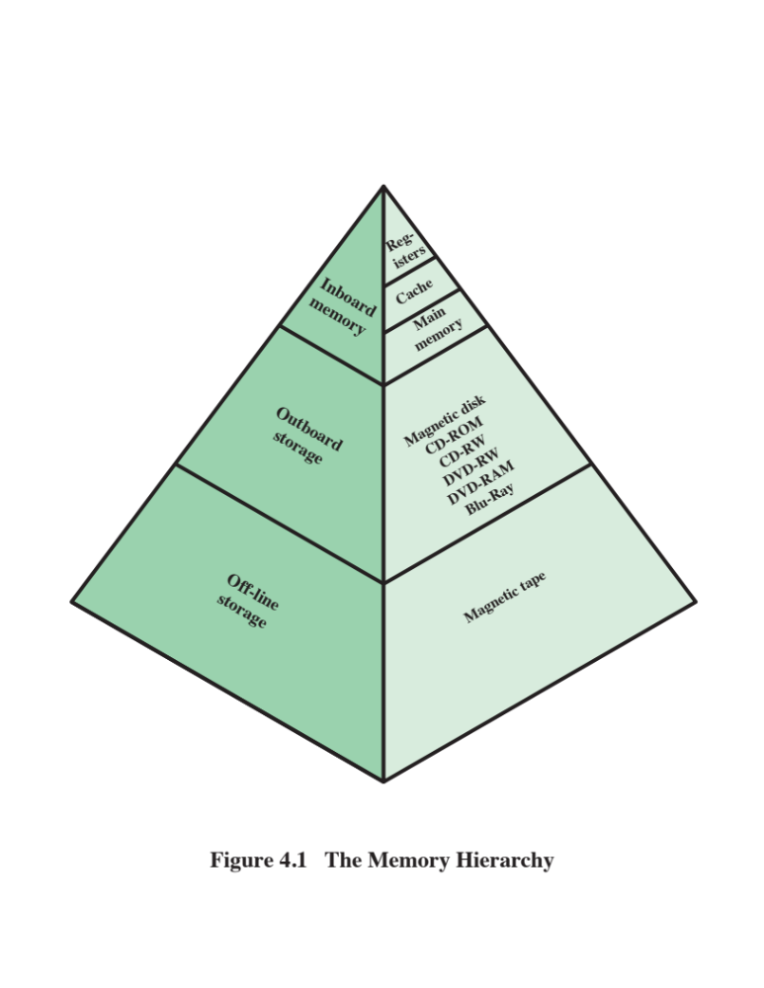
As one goes down the hierarchy, the following occur:
a. Decreasing cost per bit;
b. Increasing capacity;
c. Increasing access time;
d. Decreasing frequency of access of the memory by the processor.

Slide 10
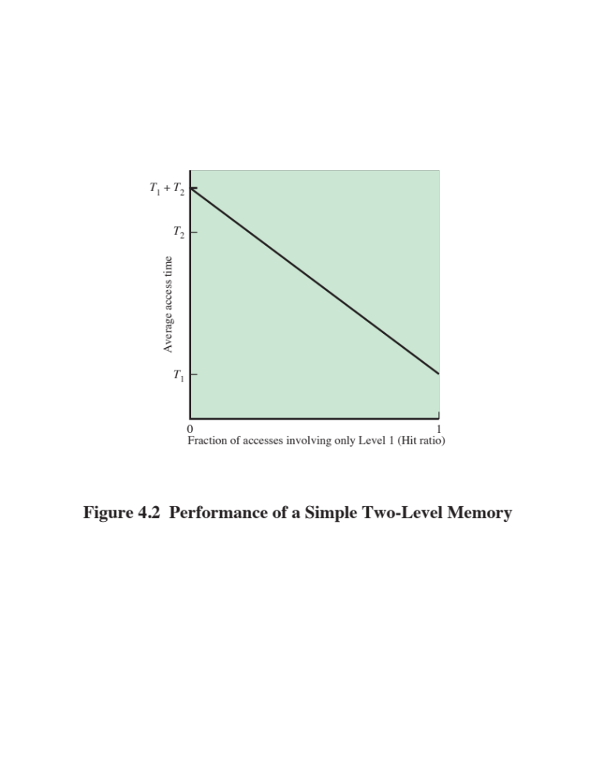

Slide 11
3.3 Consider a hypothetical 32-bit microprocessor having 32-bit instructions composed of two fields: the first byte contains the opcode and the remainder the immediate operand or an operand address.
a. What is the maximum directly addressable memory capacity (in bytes)?
b. Discuss the impact on the system speed if the microprocessor bus has:
1. 32-bit local address bus and a 16-bit local data bus, or
2. 16-bit local address bus and a 16-bit local data bus.
c. How many bits are needed for the program counter and the instruction register?

Slide 12
Memory
The use of three levels exploits the fact that semiconductor memory comes in a variety of types which differ in speed and cost
Data are stored more permanently on external mass storage devices
External, nonvolatile memory is also referred to as secondary memory or auxiliary memory
Disk cache
  A portion of main memory can be used as a buffer to hold data temporarily that is to be read out to disk
  A few large transfers of data can be used instead of many small transfers of data
  Data can be retrieved rapidly from the software cache rather than slowly from the disk

Slide 13
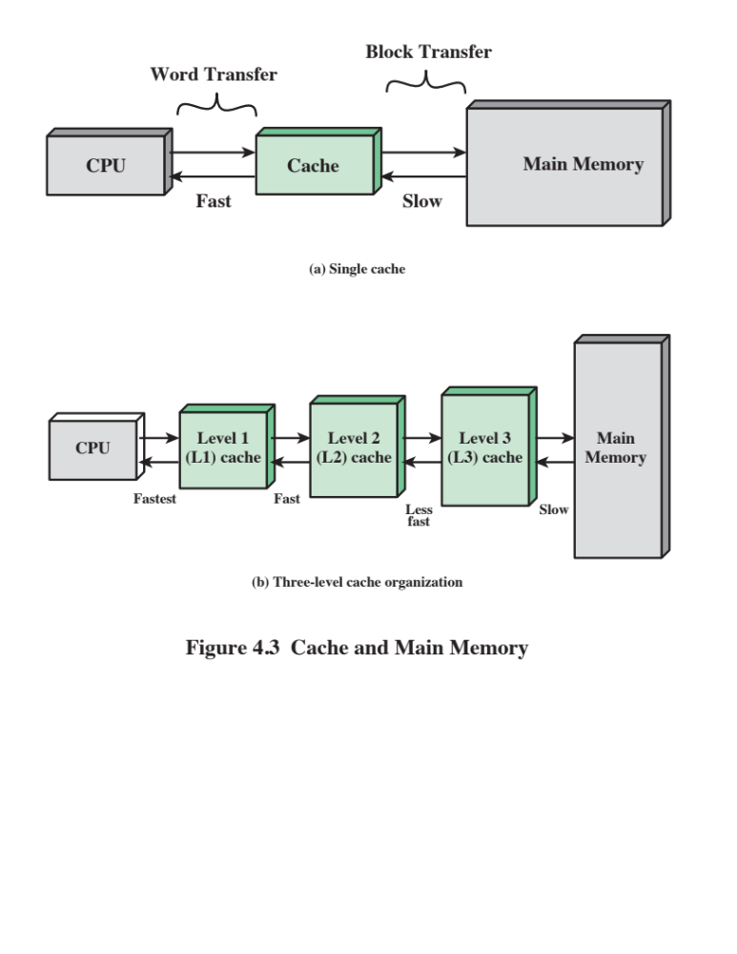

Slide 14
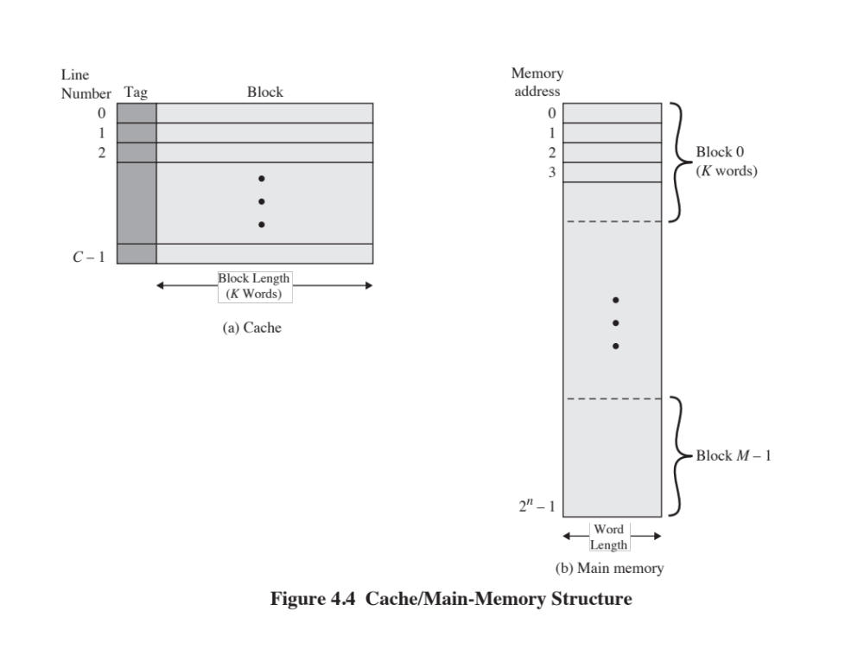

Slide 15
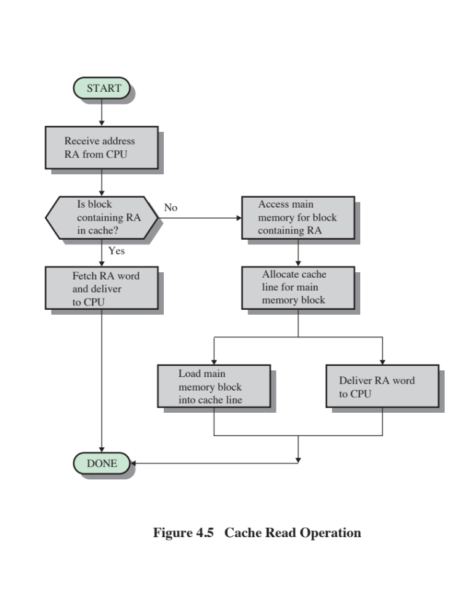

Slide 16
4.1 A set- associative cache consists of 64 lines, or slots, divided into four- line sets. Main
memory contains 4K blocks of 128 words each. Show the format of main memory addresses.

Slide 17
4.1 What are the differences among sequential access, direct access, and random access?
4.2 What is the general relationship among access time, memory cost, and capacity?

Slide 18
4.3 How does the principle of locality relate to the use of multiple memory levels?
4.6 For an associative cache, a main memory address is viewed as consisting of two fields.
List and define the two fields

Slide 19
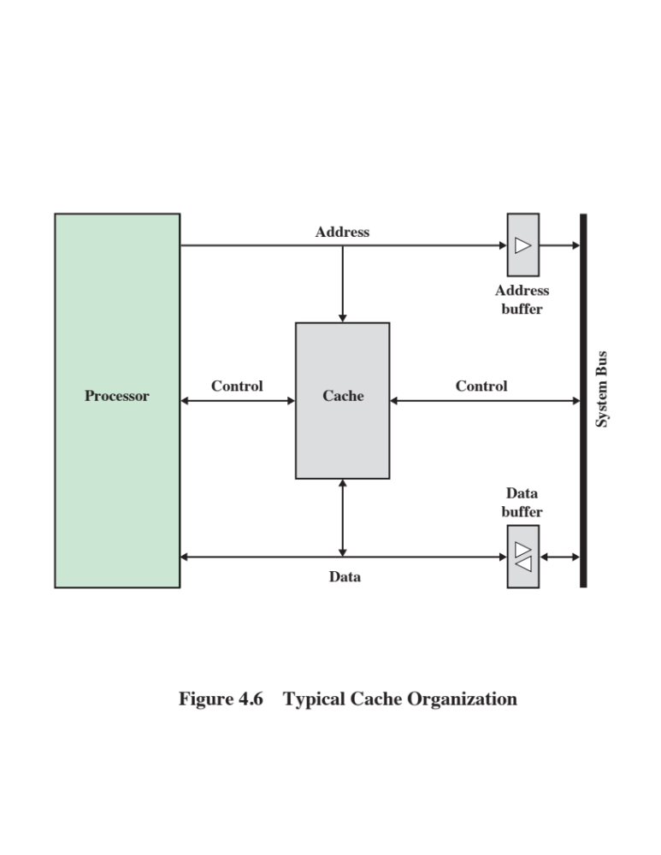

Slide 20
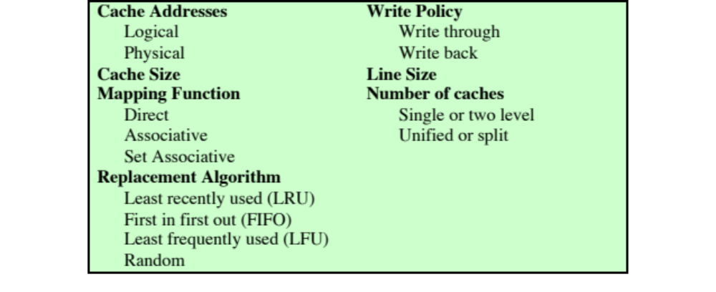
Table 4.2
Elements of Cache Design

Slide 21

Cache Addresses
Virtual Memory
Virtual memory
  Facility that allows programs to address memory from a logical point of view, without regard to the amount of main memory physically available
  When used, the address fields of machine instructions contain virtual addresses
  For reads to and writes from main memory, a hardware memory management unit (MMU) translates each virtual address into a physical address in main memory

Slide 22
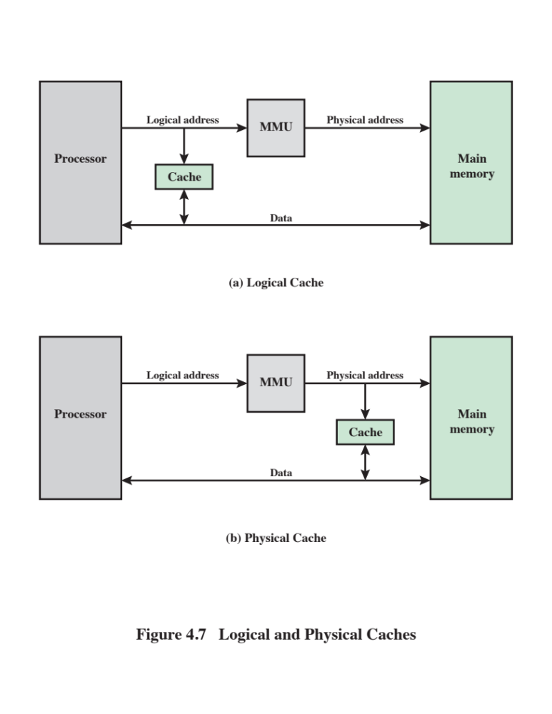

Slide 23
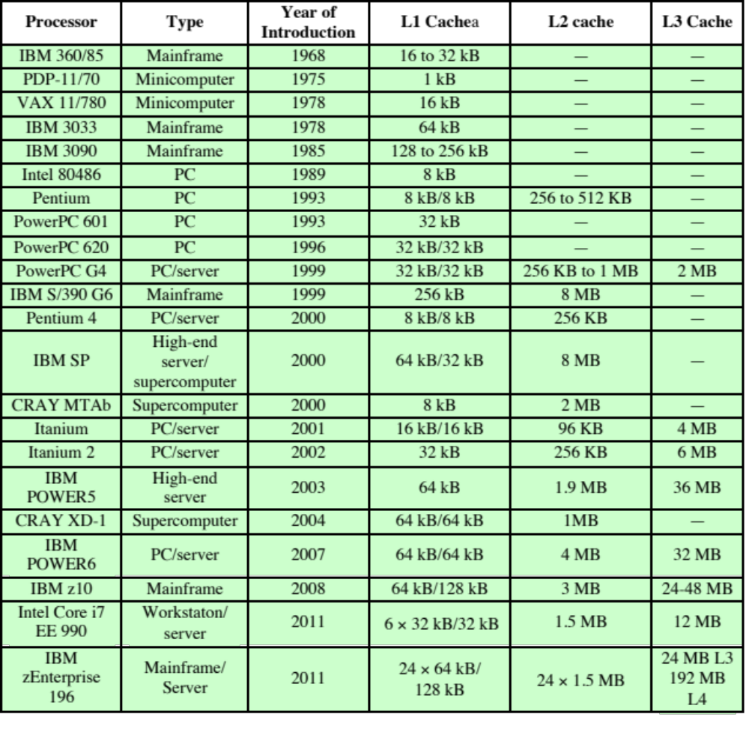
Table 4.3
Cache Sizes of Some Processors
ª Two values separated by a slash refer to instruction and data caches.
^{b} Both caches are instruction only; no data caches.
(Table can be found on page 134 in the textbook.)

Slide 24
Mapping Function
Because there are fewer cache lines than main memory blocks, an algorithm is needed for mapping main memory blocks into cache lines
Three techniques can be used:
Direct
The simplest technique
Maps each block of main memory into only one possible cache line
Associative
Permits each main memory block to be loaded into any line of the cache
The cache control logic interprets a memory address simply as a Tag and a Word field
To determine whether a block is in the cache, the cache control logic must simultaneously examine every line’s Tag for a match
Set Associative
A compromise that exhibits the strengths of both the direct and associative approaches while reducing their disadvantages

Slide 25
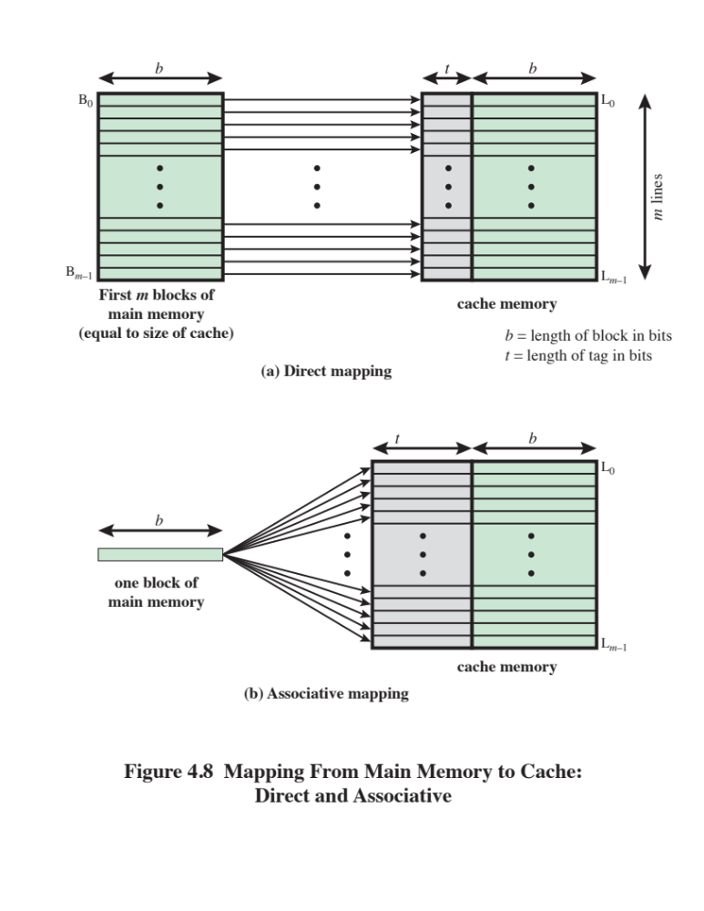

Slide 26
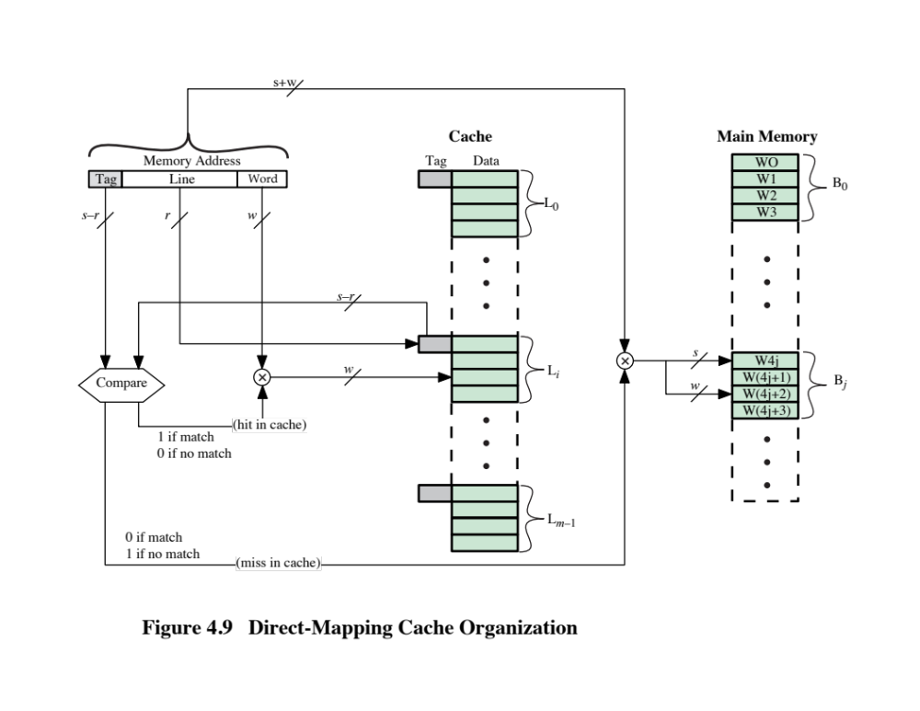

Slide 27
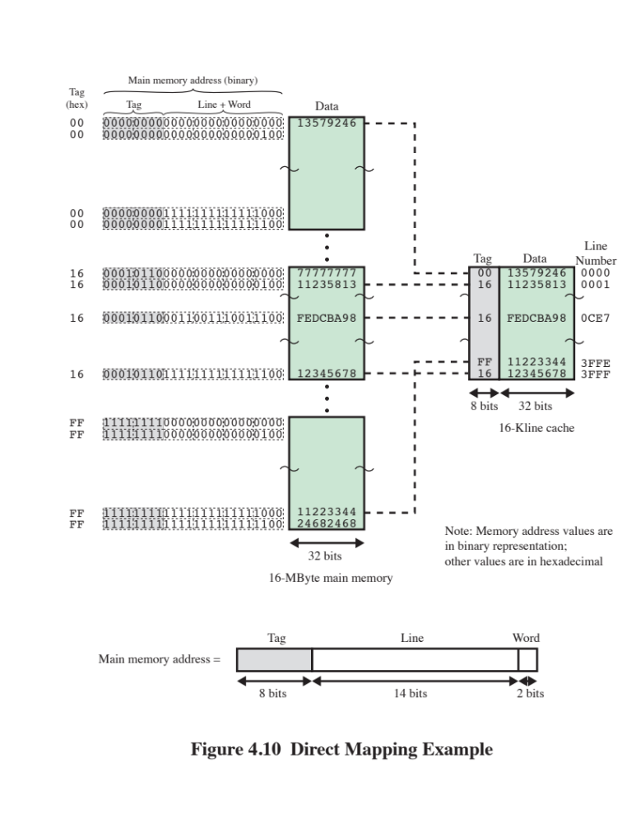

Slide 28

Direct Mapping Summary
Address length = (s + w) bits
Number of addressable units = 2^{s+w} words or bytes
Block size = line size = 2^{w} words or bytes
Number of blocks in main memory = 2^{s+ w}/2^{w} = 2^{s}
Number of lines in cache = m = 2^{r}
Size of tag = (s – r) bits

Slide 29

Victim Cache
  Originally proposed as an approach to reduce the conflict misses of direct mapped caches without affecting its fast access time
Fully associative cache
Typical size is 4 to 16 cache lines
Residing between direct mapped L1 cache and the next level of memory

Slide 30
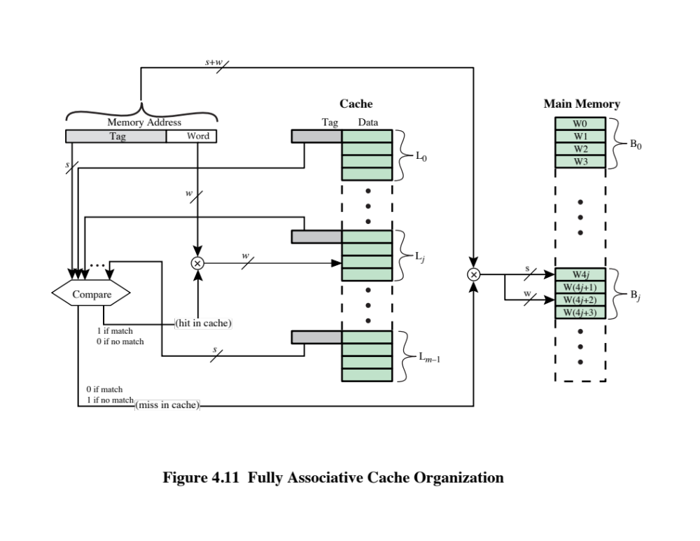

Slide 31
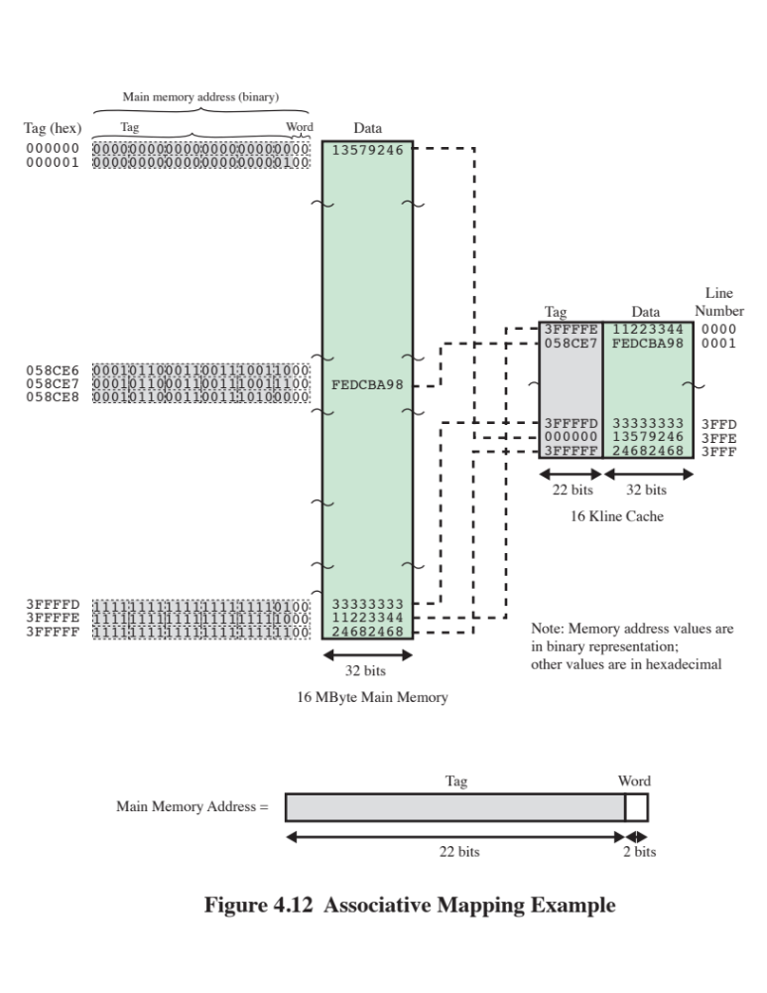

Slide 32
Associative Mapping Summary
Address length = (s + w) bits
Number of addressable units = 2^{s+w} words or bytes
Block size = line size = 2^{w} words or bytes
Number of blocks in main memory = 2^{s+ w}/2^{w} = 2^{s}
Number of lines in cache = undetermined
Size of tag = s bits

Slide 33
Set Associative Mapping
Compromise that exhibits the strengths of both the direct and associative approaches while reducing their disadvantages
Cache consists of a number of sets
Each set contains a number of lines
A given block maps to any line in a given set
e.g. 2 lines per set
  2 way associative mapping
  A given block can be in one of 2 lines in only one set

Slide 34
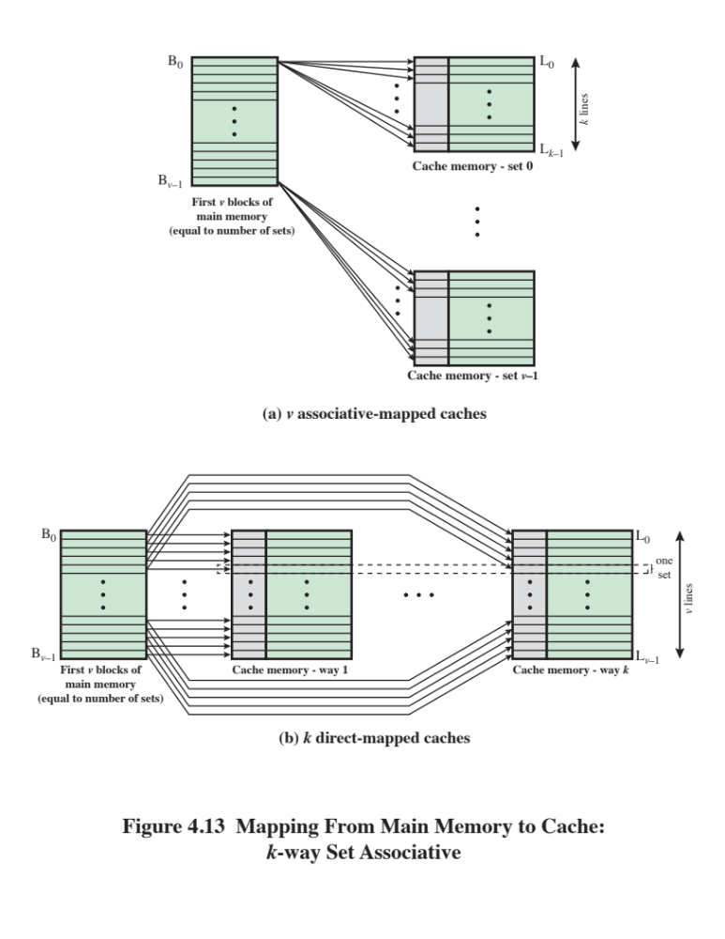

Slide 35
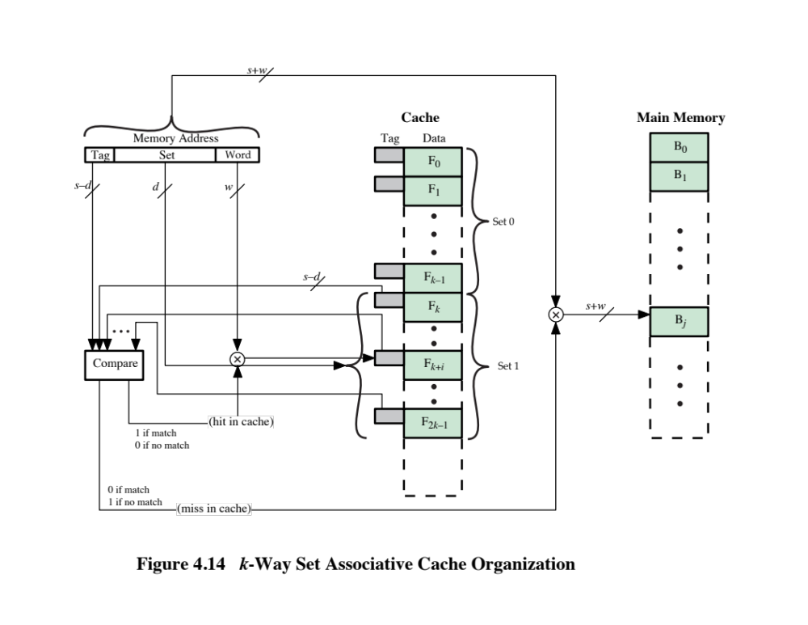

Slide 36
Set Associative Mapping Summary
Address length = (s + w) bits
Number of addressable units = 2^{s+w} words or bytes
Block size = line size = 2^{w} words or bytes
Number of blocks in main memory = 2^{s+w/}2^{w=}2^{s}
Number of lines in set = k
Number of sets = v = 2^{d}
Number of lines in cache = m=kv = k * 2^{d}
Size of cache = k * 2^{d+w} words or bytes
Size of tag = (s – d) bits

Slide 37
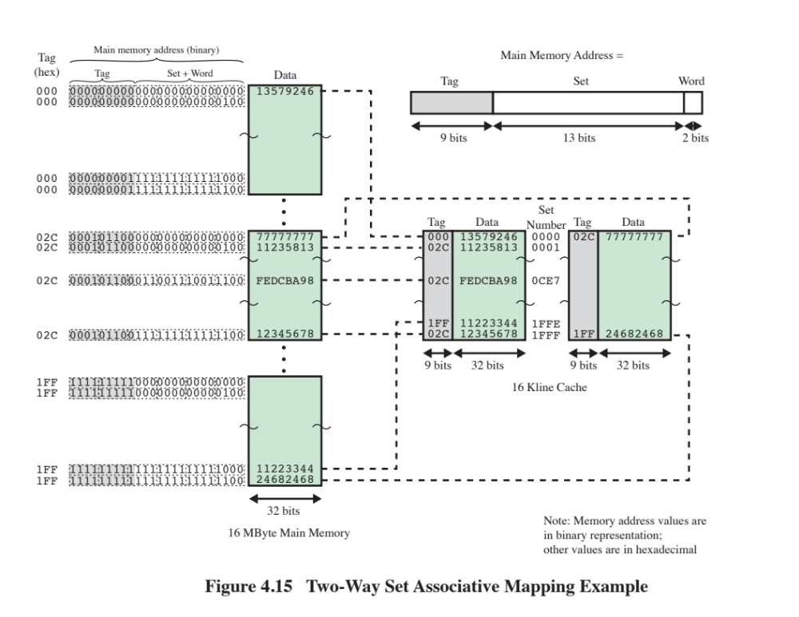

Slide 38
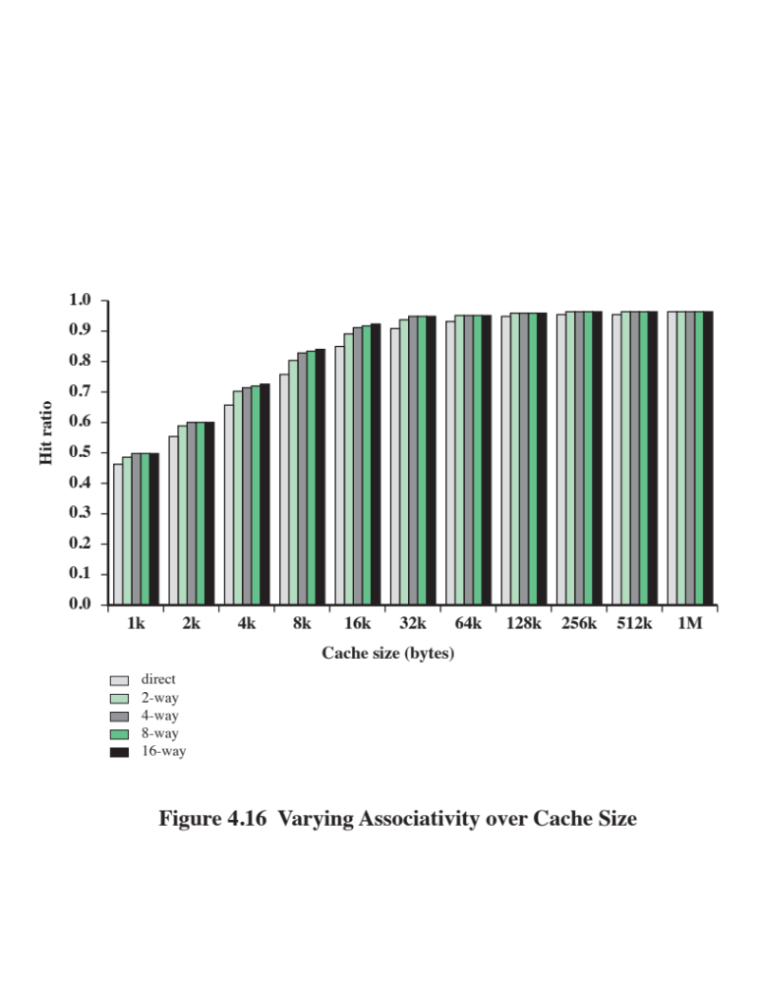

Slide 39

Replacement Algorithms
Once the cache has been filled, when a new block is brought into the cache, one of the existing blocks must be replaced
For direct mapping there is only one possible line for any particular block and no choice is possible
For the associative and set-associative techniques a replacement algorithm is needed
To achieve high speed, an algorithm must be implemented in hardware

Slide 40
The most common replacement algorithms are:
Least recently used (LRU)
  Most effective
  Replace that block in the set that has been in the cache longest with no reference to it
  Because of its simplicity of implementation, LRU is the most popular replacement algorithm
First-in-first-out (FIFO)
  Replace that block in the set that has been in the cache longest
  Easily implemented as a round-robin or circular buffer technique
Least frequently used (LFU)
  Replace that block in the set that has experienced the fewest references
  Could be implemented by associating a counter with each line

Slide 41
Write Policy
When a block that is resident in the cache is to be replaced there are two cases to consider:
If the old block in the cache has not been altered then it may be overwritten with a new block without first writing out the old block
If at least one write operation has been performed on a word in that line of the cache then main memory must be updated by writing the line of cache out to the block of memory before bringing in the new block
There are two problems to contend with:
More than one device may have access to main memory
A more complex problem occurs when multiple processors are attached to the same bus and each processor has its own local cache - if a word is altered in one cache it could conceivably invalidate a word in other caches

Slide 42
Write Through and Write Back
Write through
  Simplest technique
  All write operations are made to main memory as well as to the cache
  The main disadvantage of this technique is that it generates substantial memory traffic and may create a bottleneck
Write back
  Minimizes memory writes
  Updates are made only in the cache
  Portions of main memory are invalid and hence accesses by I/O modules can be allowed only through the cache
  This makes for complex circuitry and a potential bottleneck

Slide 43
Line Size
When a block of data is retrieved and placed in the cache not only the desired word but also some number of adjacent words are retrieved
As the block size increases the hit ratio will at first increase because of the principle of locality
As the block size increases more useful data are brought into the cache
The hit ratio will begin to decrease as the block becomes bigger and the probability of using the newly fetched information becomes less than the probability of reusing the information that has to be replaced
Two specific effects come into play:
Larger blocks reduce the number of blocks that fit into a cache
As a block becomes larger each additional word is farther from the requested word

Slide 44
Multilevel Caches
As logic density has increased it has become possible to have a cache on the same chip as the processor
The on-chip cache reduces the processor’s external bus activity and speeds up execution time and increases overall system performance
  When the requested instruction or data is found in the on-chip cache, the bus access is eliminated
  On-chip cache accesses will complete appreciably faster than would even zero-wait state bus cycles
  During this period the bus is free to support other transfers
Two-level cache:
  Internal cache designated as level 1 (L1)
  External cache designated as level 2 (L2)
Potential savings due to the use of an L2 cache depends on the hit rates in both the L1 and L2 caches
The use of multilevel caches complicates all of the design issues related to caches, including size, replacement algorithm, and write policy

Slide 45
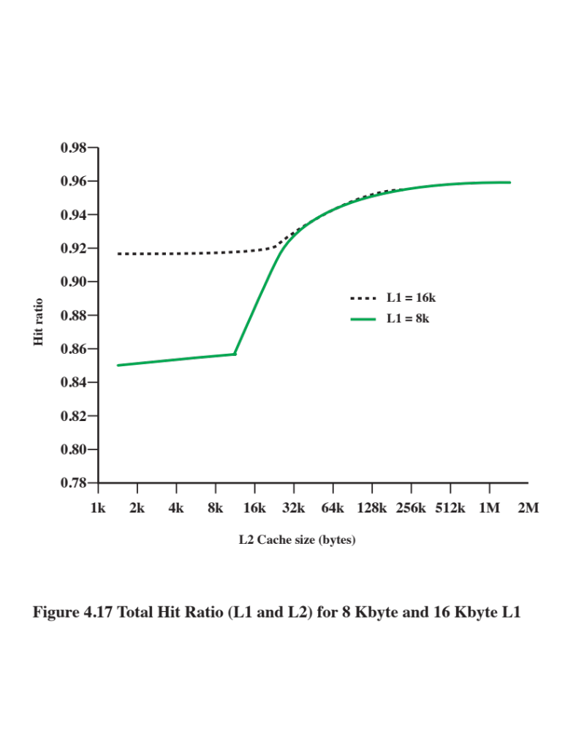

Slide 46
Unified Versus Split Caches
Has become common to split cache:
  One dedicated to instructions
  One dedicated to data
  Both exist at the same level, typically as two L1 caches
Advantages of unified cache:
  Higher hit rate
    Balances load of instruction and data fetches automatically
    Only one cache needs to be designed and implemented
Trend is toward split caches at the L1 and unified caches for higher levels
Advantages of split cache:
  Eliminates cache contention between instruction fetch/decode unit and execution unit
    Important in pipelining

Slide 47
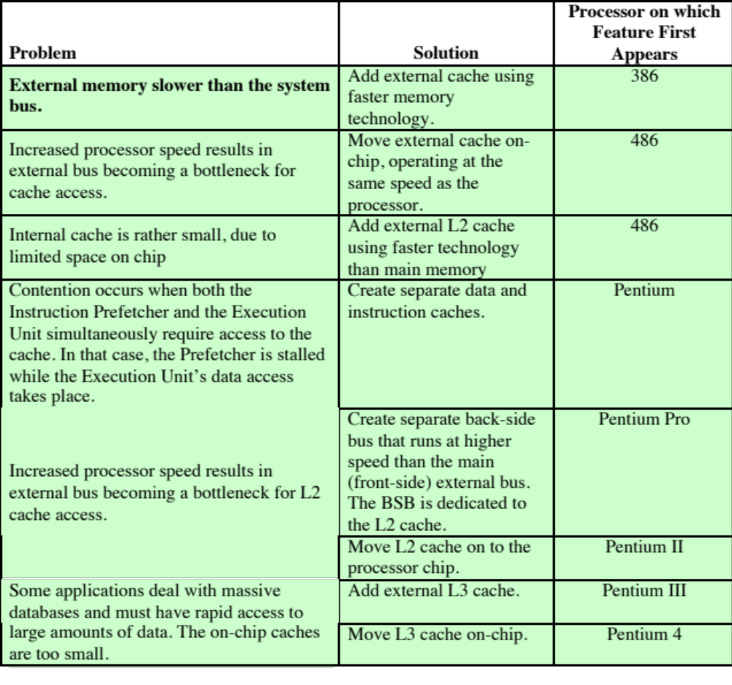
Table 4.4
Intel
Cache Evolution
(Table is on page 150 in the textbook.)

Slide 48
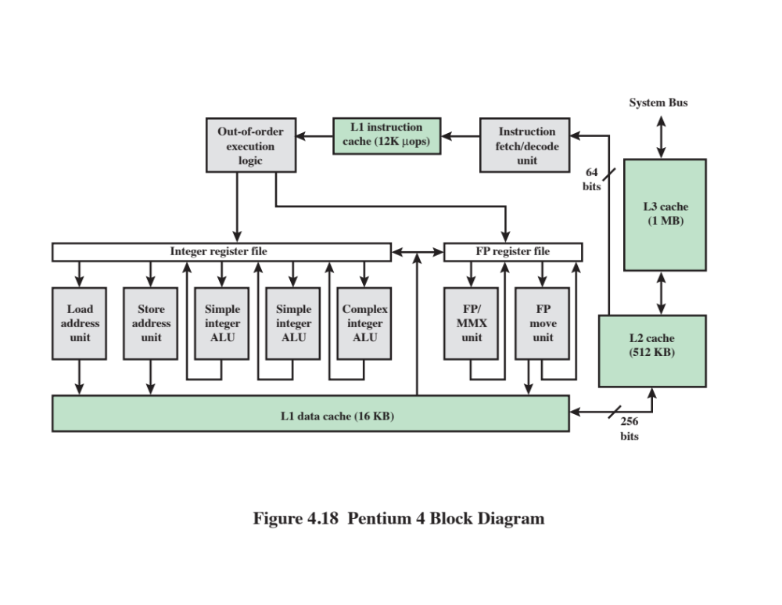

Slide 49
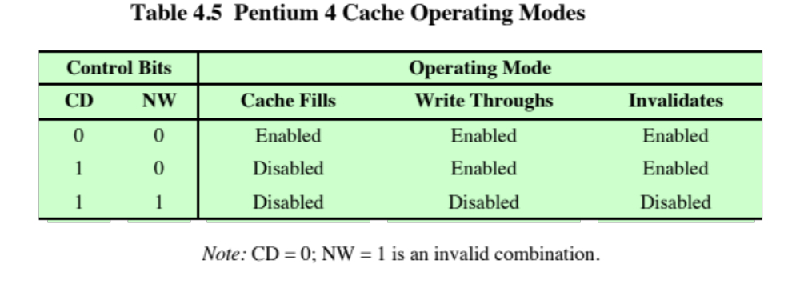

Slide 50
Summary
Cache
Memory
Chapter 4
  Elements of cache design
  Cache addresses
  Cache size
  Mapping function
  Replacement algorithms
  Write policy
  Line size
  Number of caches
Computer memory system overview
  Characteristics of Memory Systems
  Memory Hierarchy
Cache memory principles
  Pentium 4 cache organization

