Slide 1

William Stallings
Computer Organization and Architecture
10th Edition
Notes:
Lecture slides prepared for “Computer Organization and Architecture”, 10/e, by William Stallings, Chapter 15 “Reduced Instruction Set Computers”.

Slide 2
Chapter 15
Reduced Instruction Set Computers (RISC)
Notes:
Since the development of the stored-program computer around 1950, there have been remarkably few true innovations in the areas of computer organization and architecture. The following are some of the major advances since the birth of the computer:
The family concept: Introduced by IBM with its System/360 in 1964, followed shortly thereafter by DEC, with its PDP-8. The family concept decouples the architecture of a machine from its implementation. A set of computers is offered, with different price/performance characteristics, that presents the same architecture to the user. The differences in price and performance are due to different implementations of the same architecture.
Microprogrammed control unit: Suggested by Wilkes in 1951 and introduced by IBM on the S/360 line in 1964. Microprogramming eases the task of designing and implementing the control unit and provides support for the family concept.
Cache memory: First introduced commercially on IBM S/360 Model 85 in 1968. The insertion of this element into the memory hierarchy dramatically improves performance.
Pipelining: A means of introducing parallelism into the essentially sequential nature of a machine-instruction program. Examples are instruction pipelining and vector processing.
Multiple processors: This category covers a number of different organizations and objectives.
Reduced instruction set computer (RISC) architecture: This is the focus of this chapter.
When it appeared, RISC architecture was a dramatic departure from the historical trend in processor architecture. An analysis of the RISC architecture brings into focus many of the important issues in computer organization and architecture.
Although RISC architectures have been defined and designed in a variety of
ways by different groups, the key elements shared by most designs are these:
A large number of general-purpose registers, and/or the use of compiler technology to optimize register usage
A limited and simple instruction set
An emphasis on optimizing the instruction pipeline
We begin this chapter with a brief survey of some results on instruction sets, and then examine each of the three topics just listed. This is followed by a description of two of the best-documented RISC designs.

Slide 3
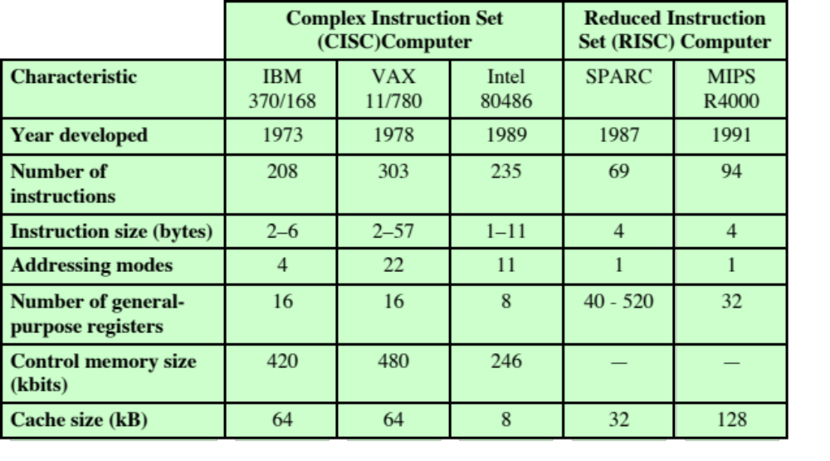
Table 15.1
Characteristics of Some CISCs, RISCs, and Superscalar Processors
(Table can be found on page 538 in the textbook.)
Notes:
Table 15.1 compares several RISC and non-RISC systems.

Slide 4
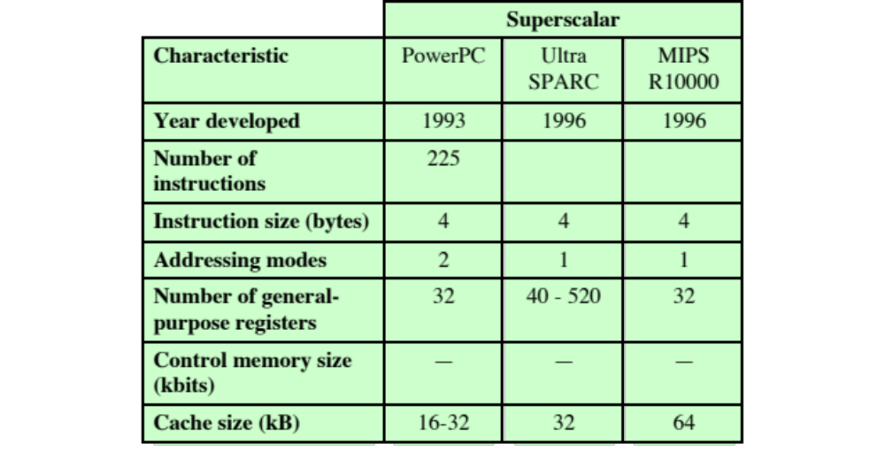
Table 15.1
Characteristics of Some CISCs, RISCs, and Superscalar Processors
(Table can be found on page 538 in the textbook.)
Notes:
Table 15.1 compares several RISC and non-RISC systems.

Slide 5

Instruction Execution Characteristics
High-level languages (HLLs)
Allow the programmer to express algorithms more concisely
Allow the compiler to take care of details that are not important in the programmer’s expression of algorithms
Often support naturally the use of structured programming and/or object-oriented design
Semantic gap
The difference between the operations provided in HLLs and those provided in computer architecture
Operations performed
Determine the functions to be performed by the processor and its interaction with memory
Operands used
The types of operands and the frequency of their use determine the memory organization for storing them and the addressing modes for accessing them
Execution sequencing
Determines the control and pipeline organization
Notes:
One of the most visible forms of evolution associated with computers is that of programming languages. As the cost of hardware has dropped, the relative cost of soft- ware has risen. Along with that, a chronic shortage of programmers has driven up software costs in absolute terms. Thus, the major cost in the life cycle of a system is software, not hardware. Adding to the cost, and to the inconvenience, is the element of unreliability: it is common for programs, both system and application, to continue to exhibit new bugs after years of operation.
The response from researchers and industry has been to develop ever more powerful and complex high-level programming languages. These high-level languages (HLLs): (1) allow the programmer to express algorithms more concisely, (2) allow the compiler to take care of details that are not important in the programmer’s expression of algorithms, and (3) often support naturally the use of structured programming and/or object-oriented design.
Alas, this solution gave rise to a perceived problem, known as the semantic gap, the difference between the operations provided in HLLs and those provided in computer architecture. Symptoms of this gap are alleged to include execution inefficiency, excessive machine program size, and compiler complexity. Designers responded with architectures intended to close this gap. Key features include large instruction sets, dozens of addressing modes, and various HLL statements implemented in hardware. An example of the latter is the CASE machine instruction on the VAX. Such complex instruction sets are intended to
Ease the task of the compiler writer.
Improve execution efficiency, because complex sequences of operations can
be implemented in microcode.
Provide support for even more complex and sophisticated HLLs.
Meanwhile, a number of studies have been done over the years to determine the characteristics and patterns of execution of machine instructions generated from HLL programs. The results of these studies inspired some researchers to look for a different approach: namely, to make the architecture that supports the HLL simpler, rather than more complex.
To understand the line of reasoning of the RISC advocates, we begin with a brief review of instruction execution characteristics. The aspects of computation of interest are as follows:
Operations performed: These determine the functions to be performed by the processor and its interaction with memory.
Operands used: The types of operands and the frequency of their use deter- mine the memory organization for storing them and the addressing modes for accessing them.
Execution sequencing: This determines the control and pipeline organization.
In the remainder of this section, we summarize the results of a number of studies of high-level-language programs. All of the results are based on dynamic measurements. That is, measurements are collected by executing the program and counting the number of times some feature has appeared or a particular property has held true. In contrast, static measurements merely perform these counts on the source text of a program. They give no useful information on performance, because they are not weighted relative to the number of times each statement is executed.

Slide 6
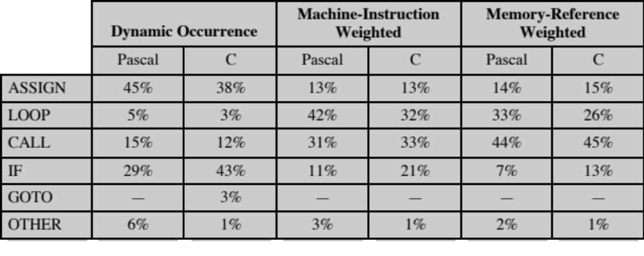
Table 15.2
Weighted Relative Dynamic Frequency of HLL Operations [PATT82a]
(Table can be found on page 540 in the textbook.)
Notes:
A variety of studies have been made to analyze the behavior of HLL programs.
Table 4.7, discussed in Chapter 4, includes key results from a number of studies.
There is quite good agreement in the results of this mixture of languages and applications.
Assignment statements predominate, suggesting that the simple movement
of data is of high importance. There is also a preponderance of conditional
statements (IF, LOOP). These statements are implemented in machine language
with some sort of compare and branch instruction. This suggests that the sequence
control mechanism of the instruction set is important.
These results are instructive to the machine instruction set designer, indicating
which types of statements occur most often and therefore should be supported in
an “optimal” fashion. However, these results do not reveal which statements use
the most time in the execution of a typical program. That is, we want to answer the
question: Given a compiled machine-language program, which statements in the
source language cause the execution of the most machine-language instructions and
what is the execution time of these instructions?
To get at this underlying phenomenon, the Patterson programs [PATT82a], described in Appendix 4A, were compiled on the VAX, PDP-11, and Motorola 68000 to determine the average number of machine instructions and memory references per statement type. The second and third columns in Table 15.2 show the relative frequency of occurrence of various HLL statements in a variety of programs; the data were obtained by observing the occurrences in running programs rather than just the number of times that statements occur in the source code. Hence these metrics capture dynamic behavior. To obtain the data in columns four and five (machine-instruction weighted), each value in the second and third columns is multiplied by the number of machine instructions produced by the compiler. These results are then normalized so that columns four and five show the relative frequency of occurrence, weighted by the number of machine instructions per HLL statement. Similarly, the sixth and seventh columns are obtained by multiplying the frequency of occurrence of each statement type by the relative number of memory references caused by each statement. The data in columns four through seven pro- vide surrogate measures of the actual time spent executing the various statement types. The results suggest that the procedure call/return is the most time-consuming operation in typical HLL programs.
The reader should be clear on the significance of Table 15.2. This table indicates the relative performance impact of various statement types in an HLL, when that HLL is compiled for a typical contemporary instruction set architecture. Some other architecture could conceivably produce different results. However, this study produces results that are representative for contemporary complex instruction set computer (CISC) architectures. Thus, they can provide guidance to those looking for more efficient ways to support HLLs.

Slide 7
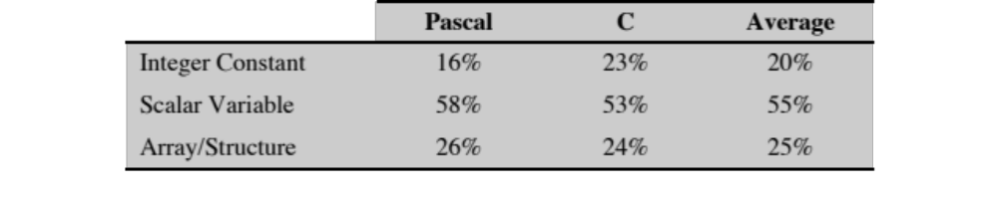
Table 15.3
Dynamic Percentage of Operands
Notes:
Much less work has been done on the occurrence of types of operands, despite the importance of this topic. There are several aspects that are significant.
The Patterson study already referenced [PATT82a] also looked at the dynamic frequency of occurrence of classes of variables (Table 15.3). The results, consistent between Pascal and C programs, show that most references are to simple scalar variables. Further, more than 80% of the scalars were local (to the procedure) variables. In addition, each reference to an array or a structure requires a reference to an index or pointer, which again is usually a local scalar. Thus, there is a preponderance of references to scalars, and these are highly localized.
The Patterson study examined the dynamic behavior of HLL programs, independent of the underlying architecture. As discussed before, it is necessary to deal with actual architectures to examine program behavior more deeply. One study, [LUND77], examined DEC-10 instructions dynamically and found that each instruction on the average references 0.5 operand in memory and 1.4 registers. Similar results are reported in [HUCK83] for C, Pascal, and FORTRAN programs on S/370, PDP-11, and VAX. Of course, these figures depend highly on both the architecture and the compiler, but they do illustrate the frequency of operand accessing.
These latter studies suggest the importance of an architecture that lends itself to fast operand accessing, because this operation is performed so frequently. The Patterson study suggests that a prime candidate for optimization is the mechanism for storing and accessing local scalar variables.

Slide 8
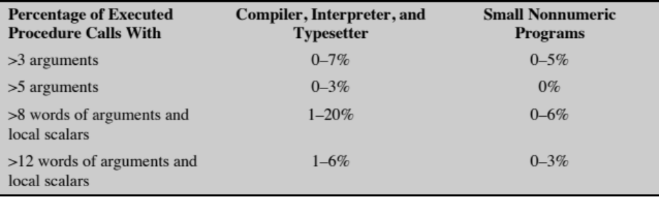
Table 15.4
Procedure Arguments
and Local Scalar Variables
(Table can be found on page 541 in the textbook.)
Notes:
We have seen that procedure calls and returns are an important aspect of HLL programs. The evidence (Table 15.2) suggests that these are the most time-consuming operations in compiled HLL programs. Thus, it will be profitable to consider ways of implementing these operations efficiently. Two aspects are significant: the number of parameters and variables that a procedure deals with, and the depth of nesting.
Tanenbaum’s study [TANE78] found that 98% of dynamically called procedures were passed fewer than six arguments and that 92% of them used fewer than six local scalar variables. Similar results were reported by the Berkeley RISC team [KATE83], as shown in Table 15.4. These results show that the number of words required per procedure activation is not large. The studies reported earlier indicated that a high proportion of operand references is to local scalar variables. These studies show that those references are in fact confined to relatively few variables.
The same Berkeley group also looked at the pattern of procedure calls and returns in HLL programs. They found that it is rare to have a long uninterrupted sequence of procedure calls followed by the corresponding sequence of returns. Rather, they found that a program remains confined to a rather narrow window of procedure-invocation depth. This is illustrated in Figure 4.21, which was discussed in Chapter 4. These results reinforce the conclusion that operand references are highly localized.

Slide 9
Implications
HLLs can best be supported by optimizing performance of the most time-consuming features of typical HLL programs
Three elements characterize RISC architectures:
  Use a large number of registers or use a compiler to optimize register usage
  Careful attention needs to be paid to the design of instruction pipelines
  Instructions should have predictable costs and be consistent with a high-performance implementation
Notes:
A number of groups have looked at results such as those just reported and have concluded that the attempt to make the instruction set architecture close to HLLs is not the most effective design strategy. Rather, the HLLs can best be supported by optimizing performance of the most time-consuming features of typical HLL programs.
Generalizing from the work of a number of researchers, three elements emerge that, by and large, characterize RISC architectures. First, use a large number of registers or use a compiler to optimize register usage. This is intended to optimize operand referencing. The studies just discussed show that there are several references per HLL statement and that there is a high proportion of move (assignment) statements. This, coupled with the locality and predominance of scalar references, suggests that performance can be improved by reducing memory references at the expense of more register references. Because of the locality of these references, an expanded register set seems practical.
Second, careful attention needs to be paid to the design of instruction pipe- lines. Because of the high proportion of conditional branch and procedure call instructions, a straightforward instruction pipeline will be inefficient. This manifests itself as a high proportion of instructions that are prefetched but never executed.
Finally, an instruction set consisting of high-performance primitives is indicated. Instructions should have predictable costs (measured in execution time and code size, and increasingly, in energy dissipation) and be consistent with a high-performance implementation (which harmonizes with predictable execution-time cost).

Slide 10

The Use of a Large Register File
Software Solution
Hardware Solution
  Requires compiler to allocate registers
  Allocates based on most used variables in a given time
  Requires sophisticated program analysis
  More registers
  Thus more variables will be in registers
Notes:
The reason that register storage is indicated is that it is the fastest avail- able storage device, faster than both main memory and cache. The register file is physically small, on the same chip as the ALU and control unit, and employs much shorter addresses than addresses for cache and memory. Thus, a strategy is needed that will allow the most frequently accessed operands to be kept in registers and to minimize register-memory operations.
Two basic approaches are possible, one based on software and the other on hardware. The software approach is to rely on the compiler to maximize register usage. The compiler will attempt to assign registers to those variables that will be used the most in a given time period. This approach requires the use of sophisticated program-analysis algorithms. The hardware approach is simply to use more registers so that more variables can be held in registers for longer periods of time.

Slide 11
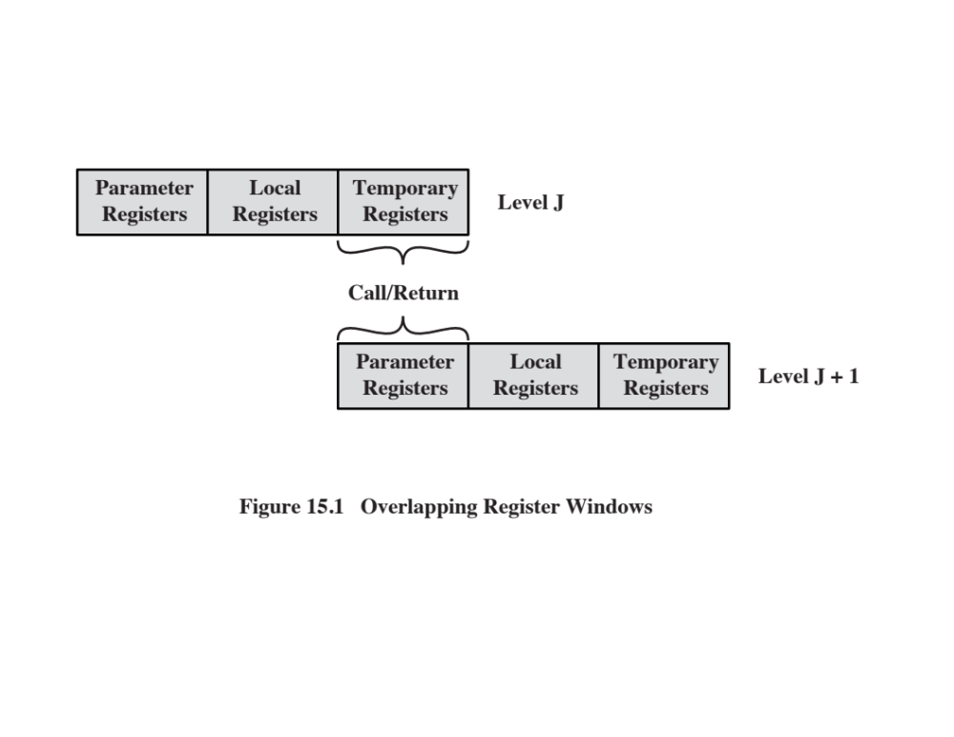
Notes:
On the face of it, the use of a large set of registers should decrease the need to access memory. The design task is to organize the registers in such a fashion that this goal is realized.
Because most operand references are to local scalars, the obvious approach is to store these in registers, with perhaps a few registers reserved for global variables. The problem is that the definition of local changes with each procedure call and return, operations that occur frequently. On every call, local variables must be saved from the registers into memory, so that the registers can be reused by the called procedure. Furthermore, parameters must be passed. On return, the variables of the calling procedure must be restored (loaded back into registers) and results must be passed back to the calling procedure.
The solution is based on two other results reported in Section 15.1. First, a typical procedure employs only a few passed parameters and local variables (Table 15.4). Second, the depth of procedure activation fluctuates within a relatively narrow range (Figure 4.21). To exploit these properties, multiple small sets of registers are used, each assigned to a different procedure. A procedure call automatically switches the processor to use a different fixed-size window of registers, rather than saving registers in memory. Windows for adjacent procedures are overlapped to allow parameter passing.
The concept is illustrated in Figure 15.1. At any time, only one window of registers is visible and is addressable as if it were the only set of registers (e.g., addresses 0 through N - 1). The window is divided into three fixed-size areas. Parameter registers hold parameters passed down from the procedure that called the current procedure and hold results to be passed back up. Local registers are used for local variables, as assigned by the compiler. Temporary registers are used to exchange parameters and results with the next lower level (procedure called by current procedure). The temporary registers at one level are physically the same as the parameter registers at the next lower level. This overlap permits parameters to be passed without the actual movement of data. Keep in mind that, except for the overlap, the registers at two different levels are physically distinct. That is, the parameter and local registers at level J are disjoint from the local and temporary registers at level J + 1.
To handle any possible pattern of calls and returns, the number of register windows would have to be unbounded. Instead, the register windows can be used to hold the few most recent procedure activations. Older activations must be saved
in memory and later restored when the nesting depth decreases. Thus, the actual organization of the register file is as a circular buffer of overlapping windows. Two notable examples of this approach are Sun’s SPARC architecture, described in Section 15.7, and the IA-64 architecture used in Intel’s Itanium processor.

Slide 12
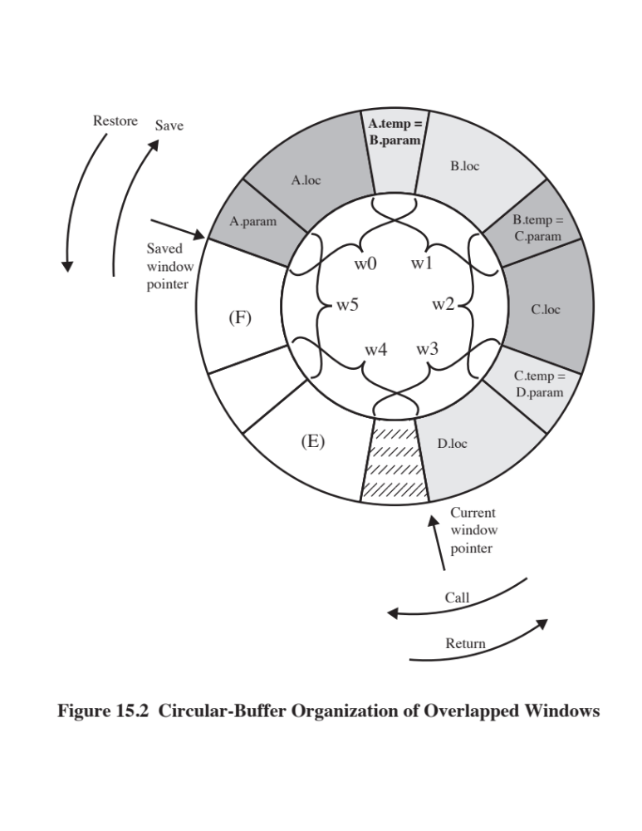
Notes:
The circular organization is shown in Figure 15.2, which depicts a circular buffer of six windows. The buffer is filled to a depth of 4 (A called B; B called C; C called D) with procedure D active. The current-window pointer (CWP) points to the window of the currently active procedure. Register references by a machine instruction are offset by this pointer to determine the actual physical register. The saved-window pointer (SWP) identifies the window most recently saved in memory. If procedure D now calls procedure E, arguments for E are placed in D’s temporary registers (the overlap between w3 and w4) and the CWP is advanced by one window.
If procedure E then makes a call to procedure F, the call cannot be made with the current status of the buffer. This is because F’s window overlaps A’s window. If F begins to load its temporary registers, preparatory to a call, it will overwrite the parameter registers of A (A.in). Thus, when CWP is incremented (modulo 6) so that it becomes equal to SWP, an interrupt occurs, and A’s window is saved. Only the first two portions (A.in and A.loc) need be saved. Then, the SWP is incremented and the call to F proceeds. A similar interrupt can occur on returns. For example, subsequent to the activation of F, when B returns to A, CWP is decremented and becomes equal to SWP. This causes an interrupt that results in the restoration of A’s window.
From the preceding, it can be seen that an N-window register file can hold only N - 1 procedure activations. The value of N need not be large. As was mentioned in Appendix 4A, one study [TAMI83] found that, with 8 windows, a save or restore is needed on only 1% of the calls or returns. The Berkeley RISC computers use 8 windows of 16 registers each. The Pyramid computer employs 16 windows of 32 registers each.

Slide 13
Global Variables
Variables declared as global in an HLL can be assigned memory locations by the compiler and all machine instructions that reference these variables will use memory reference operands
  However, for frequently accessed global variables this scheme is inefficient
  Alternative is to incorporate a set of global registers in the processor
  These registers would be fixed in number and available to all procedures
  A unified numbering scheme can be used to simplify the instruction format
  There is an increased hardware burden to accommodate the split in register addressing
  In addition, the linker must decide which global variables should be assigned to registers
Notes:
The window scheme just described provides an efficient organization for storing local scalar variables in registers. However, this scheme does not address the need to store global variables, those accessed by more than one procedure. Two options suggest themselves. First, variables declared as global in an HLL can be assigned memory locations by the compiler, and all machine instructions that reference these variables will use memory-reference operands. This is straightforward, from both the hardware and software (compiler) points of view. However, for frequently accessed global variables, this scheme is inefficient.
An alternative is to incorporate a set of global registers in the processor. These registers would be fixed in number and available to all procedures. A unified numbering scheme can be used to simplify the instruction format. For example, references to registers 0 through 7 could refer to unique global registers, and references to registers 8 through 31 could be offset to refer to physical registers in the current window. There is an increased hardware burden to accommodate the split in register addressing. In addition, the linker must decide which global variables should be assigned to registers.

Slide 14
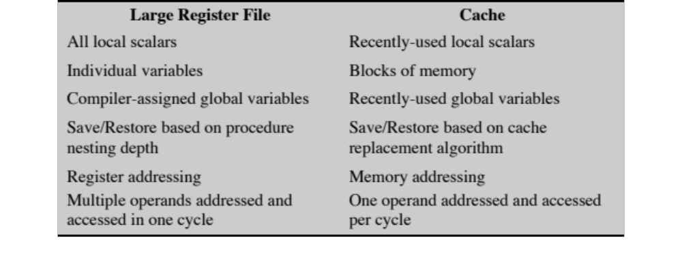
Table 15.5
Characteristics of Large-Register-File
and Cache Organizations
(Table can be found on page 546 in the textbook.)
Notes:
The register file, organized into windows, acts as a small, fast buffer for holding a subset of all variables that are likely to be used the most heavily. From this point of view, the register file acts much like a cache memory, although a much faster memory. The question therefore arises as to whether it would be simpler and better to use a cache and a small traditional register file.
Table 15.5 compares characteristics of the two approaches. The window-based register file holds all the local scalar variables (except in the rare case of window overflow) of the most recent N - 1 procedure activations. The cache holds a selection of recently used scalar variables. The register file should save time, because all local scalar variables are retained. On the other hand, the cache may make more efficient use of space, because it is reacting to the situation dynamically. Furthermore, caches generally treat all memory references alike, including instructions and other types of data. Thus, savings in these other areas are possible with a cache and not a register file.
A register file may make inefficient use of space, because not all procedures will need the full window space allotted to them. On the other hand, the cache suffers from another sort of inefficiency: Data are read into the cache in blocks. Whereas the register file contains only those variables in use, the cache reads in a block of data, some or much of which will not be used.
The cache is capable of handling global as well as local variables. There are usually many global scalars, but only a few of them are heavily used [KATE83]. A cache will dynamically discover these variables and hold them. If the window- based register file is supplemented with global registers, it too can hold some global scalars. However, when program modules are separately compiled, it is impossible for the compiler to assign global values to registers; the linker must perform this task.
With the register file, the movement of data between registers and memory is determined by the procedure nesting depth. Because this depth usually fluctuates within a narrow range, the use of memory is relatively infrequent. Most cache memories are set associative with a small set size. Thus, there is the danger that other data or instructions will compete for cache residency.

Slide 15
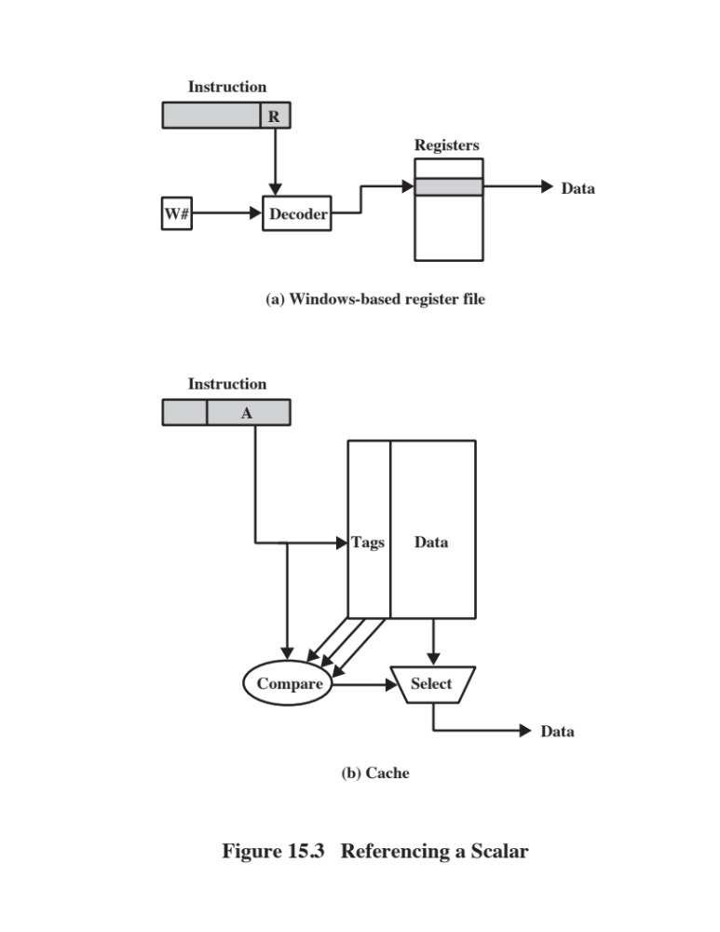
Notes:
Based on the discussion so far, the choice between a large window-based register file and a cache is not clear-cut. There is one characteristic, however, in which the register approach is clearly superior and which suggests that a cache-based sys- tem will be noticeably slower. This distinction shows up in the amount of addressing overhead experienced by the two approaches.
Figure 15.3 illustrates the difference. To reference a local scalar in a window- based register file, a “virtual” register number and a window number are used. These can pass through a relatively simple decoder to select one of the physical registers. To reference a memory location in cache, a full-width memory address must be generated. The complexity of this operation depends on the addressing mode. In a set associative cache, a portion of the address is used to read a number of words and tags equal to the set size. Another portion of the address is compared with the tags, and one of the words that were read is selected. It should be clear that even if the cache is as fast as the register file, the access time will be considerably longer. Thus, from the point of view of performance, the window-based register file is superior for local scalars. Further performance improvement could be achieved by the addition of a cache for instructions only.
The essence of the optimization task is to decide which quantities are to be assigned to registers at any given point in the program. The technique most commonly used in RISC compilers is known as graph coloring, which is a technique borrowed from the discipline of topology [CHAI82, CHOW86, COUT86, CHOW90].
The graph coloring problem is this. Given a graph consisting of nodes and edges, assign colors to nodes such that adjacent nodes have different colors, and do this in such a way as to minimize the number of different colors. This problem is adapted to the compiler problem in the following way. First, the program is ana;yzed to build a register interference graph. The nodes of the graph are the symbolic registers. If two symbolic registers are “live” during the same program fragment, then they are joined by an edge to depict interference. An attempt is then made to color the graph with n colors, where n is the number of registers. Nodes that share the same color can be assigned to the same register. If this process does not fully succeed, then those nodes that cannot be colored must be placed in memory, and loads and stores must be used to make space for the affected quantities when they are needed.

Slide 16
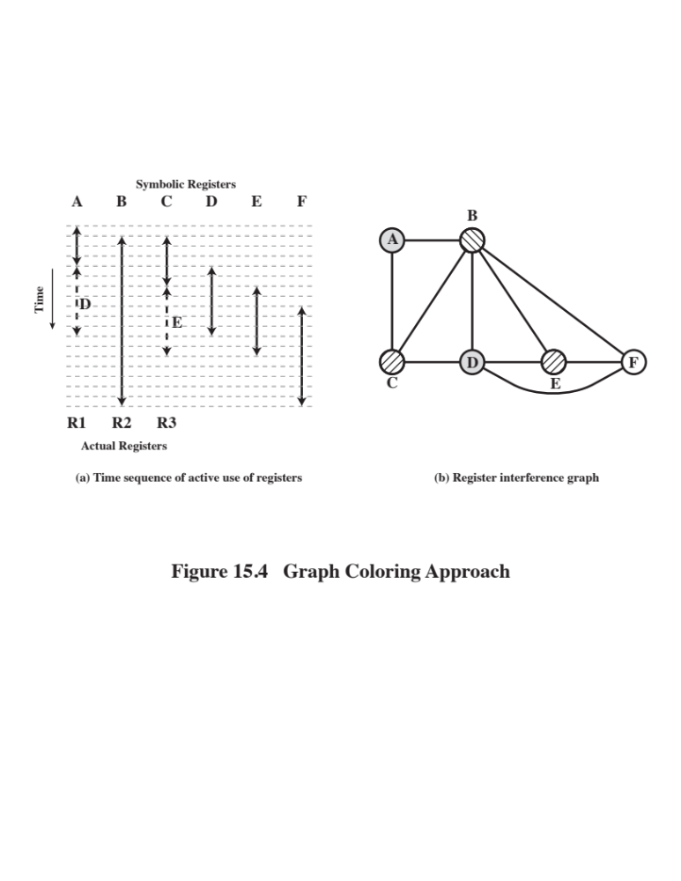
Notes:
Figure 15.4 is a simple example of the process. Assume a program with six symbolic registers to be compiled into three actual registers. Figure 15.4a shows the time sequence of active use of each symbolic register. The dashed horizontal lines indicate successive instruction executions. Figure 15.4b shows the register interference graph (shading and cross-hatching are used instead of colors). A possible coloring with three colors is indicated. Because symbolic registers A and D do not interfere, the compile can assign both of these to physical register R1. Similarly, symbolic registers C and E can be assigned to register R3. One symbolic register, F, is left uncolored and must be dealt with using loads and stores.
In general, there is a trade-off between the use of a large set of registers and compiler-based register optimization. For example, [BRAD91a] reports on a study that modeled a RISC architecture with features similar to the Motorola 88000 and the MIPS R2000. The researchers varied the number of registers from 16 to 128, and they considered both the use of all general-purpose registers and registers split between integer and floating-point use. Their study showed that with even simple register optimization, there is little benefit to the use of more than 64 registers. With reasonably sophisticated register optimization techniques, there is only marginal performance improvement with more than 32 registers. Finally, they noted that with a small number of registers (e.g., 16), a machine with a shared register organization executes faster than one with a split organization. Similar conclusions can be drawn from [HUGU91], which reports on a study that is primarily concerned with optimizing the use of a small number of registers rather than comparing the use of large register sets with optimization efforts.

Slide 17
Why CISC ?
(Complex Instruction Set Computer)
  There is a trend to richer instruction sets which include a larger and more complex number of instructions
  Two principal reasons for this trend:
  A desire to simplify compilers
  A desire to improve performance
  There are two advantages to smaller programs:
  The program takes up less memory
  Should improve performance
    Fewer instructions means fewer instruction bytes to be fetched
    In a paging environment smaller programs occupy fewer pages, reducing page faults
    More instructions fit in cache(s)
Notes:
We have noted the trend to richer instruction sets, which include a larger number of instructions and more complex instructions. Two principal reasons have motivated this trend: a desire to simplify compilers and a desire to improve performance. Underlying both of these reasons was the shift to HLLs on the part of programmers; architects attempted to design machines that provided better support for HLLs.
It is not the intent of this chapter to say that the CISC designers took the wrong direction. Indeed, because technology continues to evolve and because architectures exist along a spectrum rather than in two neat categories, a black-and-white assessment is unlikely ever to emerge. Thus, the comments that follow are simply meant to point out some of the potential pitfalls in the CISC approach and to pro- vide some understanding of the motivation of the RISC adherents.
The first of the reasons cited, compiler simplification, seems obvious, but it is not. The task of the compiler writer is to build a compiler that generates good (fast, small, fast and small) sequences of machine instructions for HLL programs (i.e., the compiler views individual HLL statements in the context of surrounding HLL statements). If there are machine instructions that resemble HLL statements, this task is simplified. This reasoning has been disputed by the RISC researchers ([HENN82], [RADI83], [PATT82b]). They have found that complex machine instructions are often hard to exploit because the compiler must find those cases that exactly fit the construct. The task of optimizing the generated code to minimize code size, reduce instruction execution count, and enhance pipelining is much more difficult with a complex instruction set. As evidence of this, studies cited earlier in this chapter indicate that most of the instructions in a compiled program are the relatively simple ones.
The other major reason cited is the expectation that a CISC will yield smaller, faster programs. Let us examine both aspects of this assertion: that programs will be smaller and that they will execute faster.
There are two advantages to smaller programs. First, because the program takes up less memory, there is a savings in that resource. With memory today being so inexpensive, this potential advantage is no longer compelling. More important, smaller programs should improve performance, and this will happen in three ways. First, fewer instructions means fewer instruction bytes to be fetched. Second, in a paging environment, smaller programs occupy fewer pages, reducing page faults. Third, more instructions fit in cache(s).

Slide 18
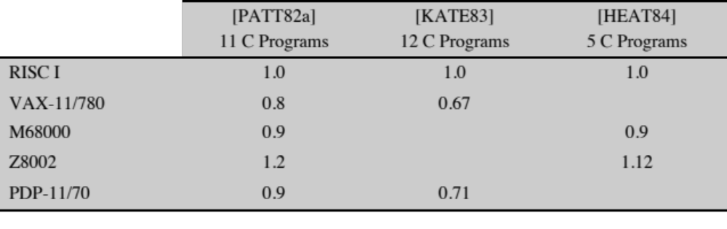
Table 15.6
Code Size Relative to RISC I
(Table can be found on page 550 in the textbook.)
Notes:
The problem with this line of reasoning is that it is far from certain that a CISC program will be smaller than a corresponding RISC program. In many cases, the CISC program, expressed in symbolic machine language, may be shorter (i.e., fewer instructions), but the number of bits of memory occupied may not be noticeably smaller. Table 15.6 shows results from three studies that compared the size of com- piled C programs on a variety of machines, including RISC I, which has a reduced instruction set architecture. Note that there is little or no savings using a CISC over a RISC. It is also interesting to note that the VAX, which has a much more complex instruction set than the PDP-11, achieves very little savings over the latter. These results were confirmed by IBM researchers [RADI83], who found that the IBM 801 (a RISC) produced code that was 0.9 times the size of code on an IBM S/370. The study used a set of PL/I programs.
There are several reasons for these rather surprising results. We have already noted that compilers on CISCs tend to favor simpler instructions, so that the conciseness of the complex instructions seldom comes into play. Also, because there are more instructions on a CISC, longer opcodes are required, producing longer instructions. Finally, RISCs tend to emphasize register rather than memory references, and the former require fewer bits. An example of this last effect is discussed presently.
So the expectation that a CISC will produce smaller programs, with the attend- ant advantages, may not be realized. The second motivating factor for increasingly complex instruction sets was that instruction execution would be faster. It seems to make sense that a complex HLL operation will execute more quickly as a single machine instruction rather than as a series of more primitive instructions. However, because of the bias toward the use of those simpler instructions, this may not be so.
The entire control unit must be made more complex, and/or the microprogram control store must be made larger, to accommodate a richer instruction set. Either factor increases the execution time of the simple instructions.
In fact, some researchers have found that the speedup in the execution of complex functions is due not so much to the power of the complex machine instructions as to their residence in high-speed control store [RADI83]. In effect, the control store acts as an instruction cache. Thus, the hardware architect is in the position of trying to determine which subroutines or functions will be used most frequently and assigning those to the control store by implementing them in microcode. The results have been less than encouraging. On S/390 systems, instructions such as Translate and Extended-Precision-Floating-Point-Divide reside in high-speed storage, while the sequence involved in setting up procedure calls or initiating an interrupt handler are in slower main memory.
Thus, it is far from clear that a trend to increasingly complex instruction sets is appropriate. This has led a number of groups to pursue the opposite path.

Slide 19
Characteristics of Reduced Instruction Set Architectures
One machine instruction per machine cycle
Machine cycle --- the time it takes to fetch two operands from registers, perform an ALU operation, and store the result in a register
Register-to-register operations
Only simple LOAD and STORE operations accessing memory
This simplifies the instruction set and therefore the control unit
Simple addressing modes
Simplifies the instruction set and the control unit
Simple instruction formats
Generally only one or a few formats are used
Instruction length is fixed and aligned on word boundaries
Opcode decoding and register operand accessing can occur simultaneously
Notes:
Although a variety of different approaches to reduced instruction set architecture have been taken, certain characteristics are common to all of them:
• One instruction per cycle
• Register-to-register operations
• Simple addressing modes
• Simple instruction formats
Here, we provide a brief discussion of these characteristics. Specific examples are explored later in this chapter.
The first characteristic listed is that there is one machine instruction per machine cycle. A machine cycle is defined to be the time it takes to fetch two operands from registers, perform an ALU operation, and store the result in a register. Thus, RISC machine instructions should be no more complicated than, and execute about as fast as, microinstructions on CISC machines (discussed in Part Four). With simple, one-cycle instructions, there is little or no need for microcode; the machine instructions can be hardwired. Such instructions should execute faster than comparable machine instructions on other machines, because it is not necessary to access a microprogram control store during instruction execution.
A second characteristic is that most operations should be register to register, with only simple LOAD and STORE operations accessing memory. This design feature simplifies the instruction set and therefore the control unit. For example, a RISC instruction set may include only one or two ADD instructions (e.g., integer add, add with carry); the VAX has 25 different ADD instructions. Another benefit is that such an architecture encourages the optimization of register use, so that frequently accessed operands remain in high-speed storage.
A third characteristic is the use of simple addressing modes. Almost all RISC instructions use simple register addressing. Several additional modes, such as displacement and PC-relative, may be included. Other, more complex modes can be synthesized in software from the simple ones. Again, this design feature simplifies the instruction set and the control unit.
A final common characteristic is the use of simple instruction formats. Generally, only one or a few formats are used. Instruction length is fixed and aligned on word boundaries. Field locations, especially the opcode, are fixed. This design feature has a number of benefits. With fixed fields, opcode decoding and register operand accessing can occur simultaneously. Simplified formats simplify the control unit. Instruction fetching is optimized because word-length units are fetched. Alignment on a word boundary also means that a single instruction does not cross page boundaries.

Slide 20
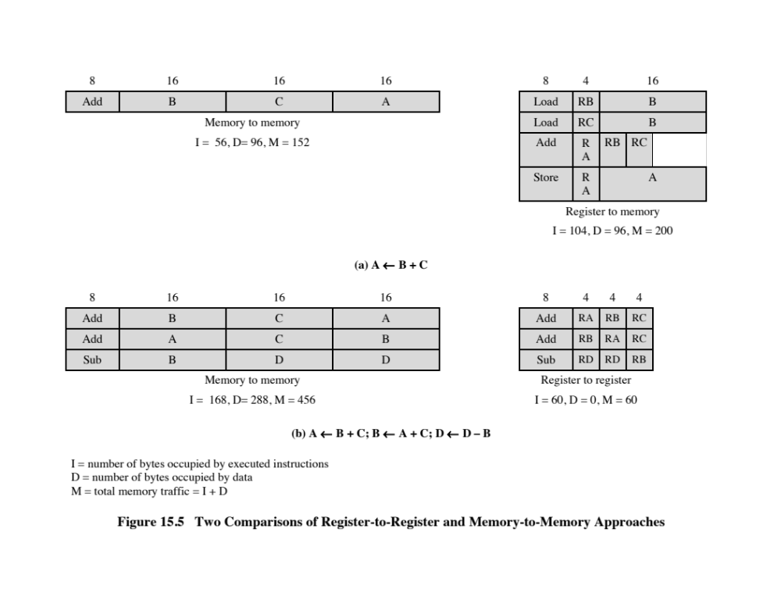
Notes:
This emphasis on register-to-register operations is notable for RISC designs. Contemporary CISC machines provide such instructions but also include memory- to-memory and mixed register/memory operations. Attempts to compare these approaches were made in the 1970s, before the appearance of RISCs. Figure 15.5a illustrates the approach taken. Hypothetical architectures were evaluated on pro- gram size and the number of bits of memory traffic. Results such as this one led one researcher to suggest that future architectures should contain no registers at all [MYER78]. One wonders what he would have thought, at the time, of the RISC machine once produced by Pyramid, which contained no less than 528 registers!
What was missing from those studies was a recognition of the frequent access to a small number of local scalars and that, with a large bank of registers or an optimizing compiler, most operands could be kept in registers for long periods of time. Thus, Figure 15.5b may be a fairer comparison.

Slide 21
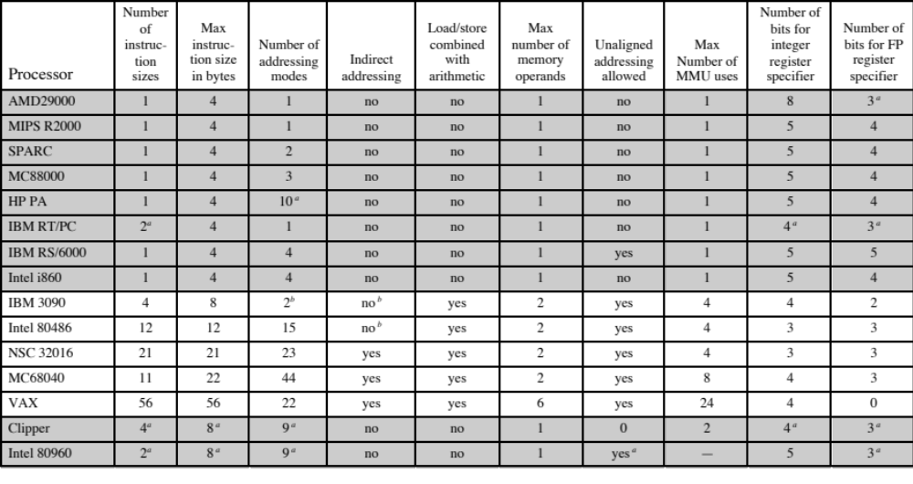
Table 15.7
Characteristics of Some Processors
(Table can be found on page 554 in the textbook.)
Notes:
After the initial enthusiasm for RISC machines, there has been a growing realization
that (1) RISC designs may benefit from the inclusion of some CISC features and that
(2) CISC designs may benefit from the inclusion of some RISC features. The result is
that the more recent RISC designs, notably the PowerPC, are no longer “pure” RISC
and the more recent CISC designs, notably the Pentium II and later Pentium models,
do incorporate some RISC characteristics.
An interesting comparison in [MASH95] provides some insight into this issue. Table 15.7 lists a number of processors and compares them across a number of characteristics. For purposes of this comparison, the following are considered typical of a classic RISC:
A single instruction size.
That size is typically 4 bytes.
A small number of data addressing modes, typically less than five. This parameter is difficult to pin down. In the table, register and literal modes are not counted and different formats with different offset sizes are counted separately.
No indirect addressing that requires you to make one memory access to get
the address of another operand in memory.
No operations that combine load/store with arithmetic (e.g.,add from memory, add to memory).
No more than one memory-addressed operand per instruction.
Does not support arbitrary alignment of data for load/store operations.
Maximum number of uses of the memory management unit (MMU) for a data address in an instruction.
Number of bits for integer register specifier equal to five or more. This means that at least 32 integer registers can be explicitly referenced at a time.
Number of bits for floating-point register specifier equal to four or more. This means that at least 16 floating-point registers can be explicitly referenced at a time.
Items 1 through 3 are an indication of instruction decode complexity. Items 4
through 8 suggest the ease or difficulty of pipelining, especially in the presence of virtual memory requirements. Items 9 and 10 are related to the ability to take good advantage of compilers.
In the table, the first eight processors are clearly RISC architectures, the next five are clearly CISC, and the last two are processors often thought of as RISC that in fact have many CISC characteristics.

Slide 22
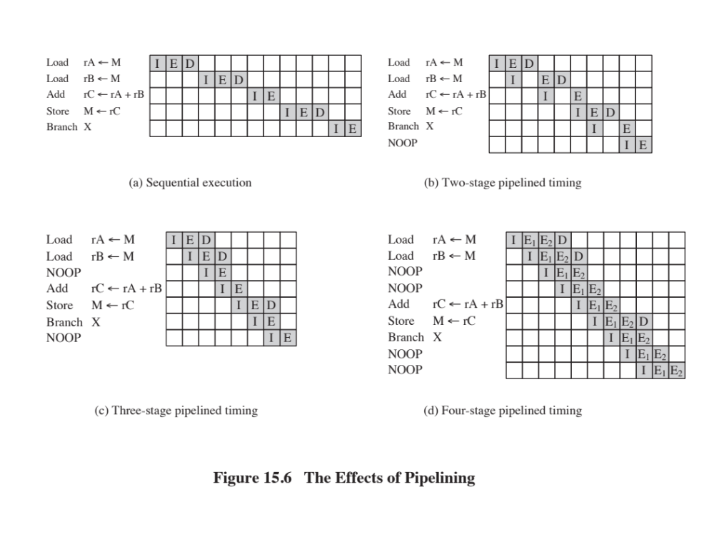
Notes:
As we discussed in Section 12.4, instruction pipelining is often used to enhance performance. Let us reconsider this in the context of a RISC architecture. Most instructions are register to register, and an instruction cycle has the following two stages:
• I: Instruction fetch.
• E: Execute. Performs an ALU operation with register input and output.
For load and store operations, three stages are required:
I: Instruction fetch.
E: Execute. Calculates memory address.
D: Memory. Register-to-memory or memory-to-register operation.
Figure 15.6a depicts the timing of a sequence of instructions using no pipelining. Clearly, this is a wasteful process. Even very simple pipelining can substantially improve performance. Figure 15.6b shows a two-stage pipelining scheme, in which the I and E stages of two different instructions are performed simultaneously. The two stages of the pipeline are an instruction fetch stage, and an exe- cute/memory stage that executes the instruction, including register-to-memory and memory-to-register operations. Thus we see that the instruction fetch stage of the second instruction can be performed in parallel with the first part of the execute/ memory stage. However, the execute/memory stage of the second instruction must be delayed until the first instruction clears the second stage of the pipeline. This scheme can yield up to twice the execution rate of a serial scheme. Two problems prevent the maximum speedup from being achieved. First, we assume that a single- port memory is used and that only one memory access is possible per stage. This requires the insertion of a wait state in some instructions. Second, a branch instruction interrupts the sequential flow of execution. To accommodate this with mini- mum circuitry, a NOOP instruction can be inserted into the instruction stream by the compiler or assembler.
Pipelining can be improved further by permitting two memory accesses per stage. This yields the sequence shown in Figure 15.6c. Now, up to three instructions can be overlapped, and the improvement is as much as a factor of 3. Again, branch instructions cause the speedup to fall short of the maximum possible. Also, note that data dependencies have an effect. If an instruction needs an operand that is altered by the preceding instruction, a delay is required. Again, this can be accomplished by a NOOP.
The pipelining discussed so far works best if the three stages are of approximately equal duration. Because the E stage usually involves an ALU operation, it may be longer. In this case, we can divide into two substages:
• E₁: Register file read
• E₂: ALU operation and register write
Because of the simplicity and regularity of a RISC instruction set, the design of the phasing into three or four stages is easily accomplished. Figure 15.6d shows the result with a four-stage pipeline. Up to four instructions at a time can be under way, and the maximum potential speedup is a factor of 4. Note again the use of NOOPs to account for data and branch delays.

Slide 23
Optimization of Pipelining
Delayed branch
  Does not take effect until after execution of following instruction
  This following instruction is the delay slot
Delayed Load
  Register to be target is locked by processor
  Continue execution of instruction stream until register required
  Idle until load is complete
  Re-arranging instructions can allow useful work while loading
Loop Unrolling
  Replicate body of loop a number of times
  Iterate loop fewer times
  Reduces loop overhead
  Increases instruction parallelism
  Improved register, data cache, or TLB locality
Notes:
Because of the simple and regular nature of RISC instructions, it is easier for a hardware designer to implement a simple, fast pipeline. There are few variations in instruction execution duration, and the pipeline can be tailored to reflect this. However, we have seen that data and branch dependencies reduce the overall execution rate.
To compensate for these dependencies, code reorganization techniques have been developed.

Slide 24
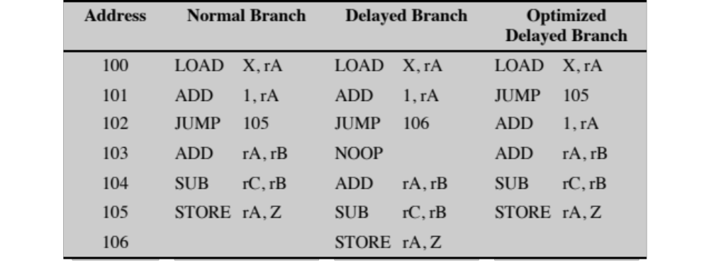
Table 15.8
Normal And Delayed Branch
(Table can be found on page 557 in the textbook.)
Notes:
First, let us consider branching instructions. Delayed branch, a way of increasing the efficiency of the pipeline, makes use of a branch that does not take effect until after execution of the following instruction (hence the term delayed). The instruction location immediately following the branch is referred to as the delay slot. This strange procedure is illustrated in Table 15.8. In the column labeled “normal branch,” we see a normal symbolic instruction machine-language program. After 102 is executed, the next instruction to be executed is 105. To regularize the pipeline, a NOOP is inserted after this branch. However, increased performance is achieved if the instructions at 101 and 102 are interchanged.

Slide 25
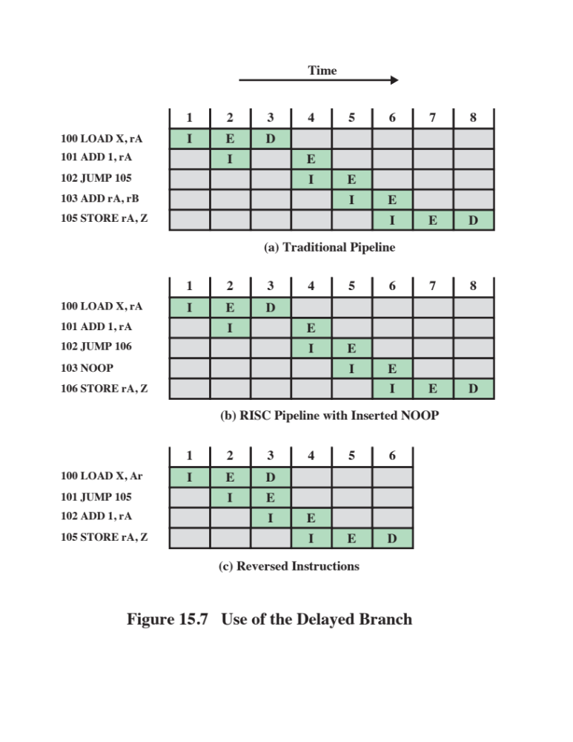
Notes:
Figure 15.7 shows the result. Figure 15.7a shows the traditional approach to pipelining, of the type discussed in Chapter 14 (e.g., see Figures 14.11 and 14.12). The JUMP instruction is fetched at time 3. At time 4, the JUMP instruction is executed at the same time that instruction 103 (ADD instruction) is fetched. Because a JUMP occurs, which updates the program counter, the pipeline must be cleared of instruction 103; at time 5, instruction 105, which is the target of the JUMP, is loaded. Figure 15.7b shows the same pipeline handled by a typical RISC organization. The timing is the same. However, because of the insertion of the NOOP instruction, we do not need special circuitry to clear the pipeline; the NOOP simply executes with no effect. Figure 15.7c shows the use of the delayed branch. The JUMP instruction is fetched at time 2, before the ADD instruction, which is fetched at time 3. Note, however, that the ADD instruction is fetched before the execution of the JUMP instruction has a chance to alter the program counter. Therefore, during time 4, the ADD instruction is executed at the same time that instruction 105 is fetched.
Thus, the original semantics of the program are retained but one less clock cycle is required for execution.
This interchange of instructions will work successfully for unconditional branches, calls, and returns. For conditional branches, this procedure cannot be blindly applied. If the condition that is tested for the branch can be altered by the immediately preceding instruction, then the compiler must refrain from doing the interchange and instead insert a NOOP. Otherwise, the compiler can seek to insert a useful instruction after the branch. The experience with both the Berkeley RISC and IBM 801 systems is that the majority of conditional branch instructions can be optimized in this fashion ([PATT82a], [RADI83]).
A similar sort of tactic, called the delayed load, can be used on LOAD instructions. On LOAD instructions, the register that is to be the target of the load is locked by the processor. The processor then continues execution of the instruction stream until it reaches an instruction requiring that register, at which point it idles until the load is complete. If the compiler can rearrange instructions
so that useful work can be done while the load is in the pipeline, efficiency is
increased.

Slide 26
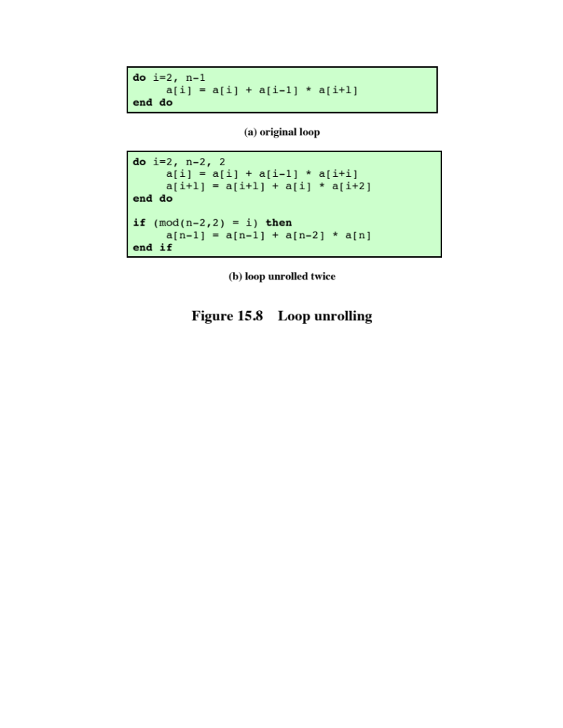
Notes:
Another compiler technique to improve instruction parallelism is loop unrolling [BACO94]. Unrolling replicates the body of a loop some number of times called the unrolling factor (u) and iterates by step u instead of step 1.
Unrolling can improve the performance by
Reducing loop overhead
Increasing instruction parallelism by improving pipeline performance
Improving register, data cache, or TLB locality
Figure 15.8 illustrates all three of these improvements in an example. Loop overhead is cut in half because two iterations are performed before the test and branch at the end of the loop. Instruction parallelism is increased because the second assignment can be performed while the results of the first are being stored and the loop variables are being updated. If array elements are assigned to registers, register locality will improve because a[i] and a[i + 1] are used twice in the loop body, reducing the number of loads per iteration from three to two.
As a final note, we should point out that the design of the instruction pipeline
should not be carried out in isolation from other optimization techniques applied to
the system. For example, [BRAD91b] shows that the scheduling of instructions for
the pipeline and the dynamic allocation of registers should be considered together
to achieve the greatest efficiency.

Slide 27
MIPS R4000
One of the first commercially available RISC chip sets was developed by MIPS Technology Inc.
Inspired by an experimental system developed at Stanford
Has substantially the same architecture and instruction set of the earlier MIPS designs (R2000 and R3000)
Uses 64 bits for all internal and external data paths and for addresses, registers, and the ALU
Is partitioned into two sections, one containing the CPU and the other containing a coprocessor for memory management
Supports thirty-two 64-bit registers
Provides for up to 128 Kbytes of high-speed cache, half each for instructions and data
Notes:
One of the first commercially available RISC chip sets was developed by MIPS Technology Inc. The system was inspired by an experimental system, also using the name MIPS, developed at Stanford [HENN84]. In this section we look at the MIPS R4000. It has substantially the same architecture and instruction set of the earlier MIPS designs: the R2000 and R3000. The most significant difference is that the R4000 uses 64 rather than 32 bits for all internal and external data paths and for addresses, registers, and the ALU.
The use of 64 bits has a number of advantages over a 32-bit architecture. It allows a bigger address space—large enough for an operating system to map more than a terabyte of files directly into virtual memory for easy access. With 1-terabyte and larger disk drives now common, the 4-gigabyte address space of a 32-bit machine becomes limiting. Also, the 64-bit capacity allows the R4000 to process data such as IEEE double-precision floating-point numbers and character strings, up to eight characters in a single action.
The R4000 processor chip is partitioned into two sections, one containing the CPU and the other containing a coprocessor for memory management. The processor has a very simple architecture. The intent was to design a system in which the instruction execution logic was as simple as possible, leaving space available for logic to enhance performance (e.g., the entire memory-management unit).
The processor supports thirty-two 64-bit registers. It also provides for up to 128 Kbytes of high-speed cache, half each for instructions and data. The relatively large cache (the IBM 3090 provides 128 to 256 Kbytes of cache) enables the system to keep large sets of program code and data local to the processor, off-loading the main memory bus and avoiding the need for a large register file with the accompanying windowing logic.

Slide 28
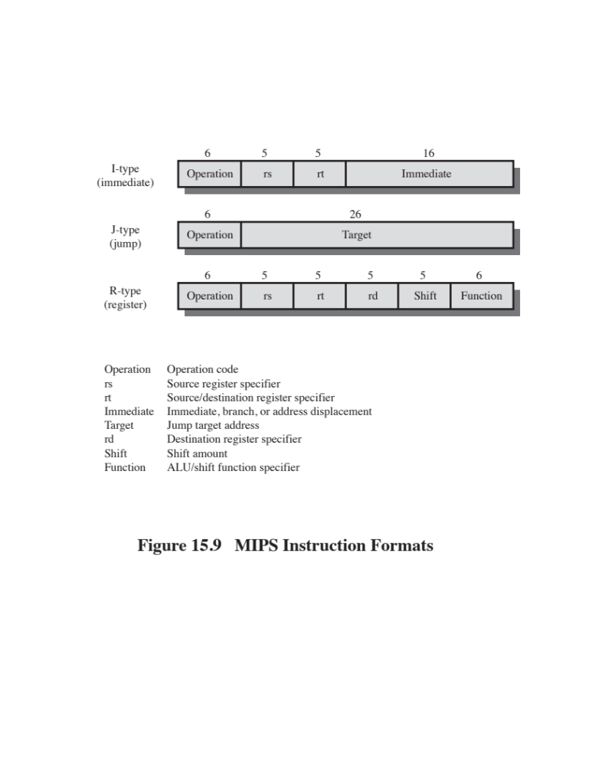
Notes:
All MIPS R series instructions are encoded in a single 32-bit word format. All data
operations are register to register; the only memory references are pure load/store
operations.
The R4000 makes no use of condition codes. If an instruction generates a condition,
the corresponding flags are stored in a general-purpose register. This avoids
the need for special logic to deal with condition codes, as they affect the pipelining
mechanism and the reordering of instructions by the compiler. Instead, the mechanisms
already implemented to deal with register-value dependencies are employed.
Further, conditions mapped onto the register files are subject to the same compile-time
optimizations in allocation and reuse as other values stored in registers.
As with most RISC-based machines, the MIPS uses a single 32-bit instruction
length. This single instruction length simplifies instruction fetch and decode, and
it also simplifies the interaction of instruction fetch with the virtual memory management
unit (i.e., instructions do not cross word or page boundaries). The three
instruction formats (Figure 15.9) share common formatting of opcodes and register
references, simplifying instruction decode. The effect of more complex instructions
can be synthesized at compile time.

Slide 29
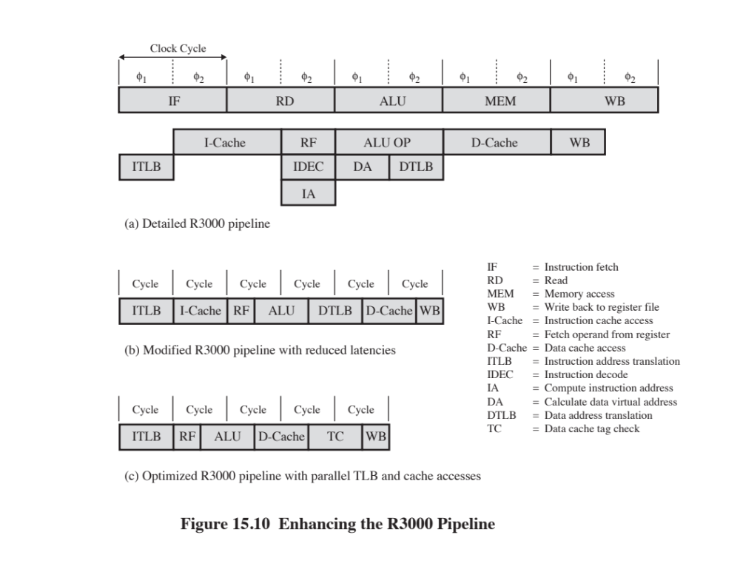
Notes:
Figure 15.10a shows the instruction pipeline of the R3000. In the R3000, the pipeline advances once per clock cycle. The MIPS compiler is able to reorder instructions to fill delay slots with code 70 to 90% of the time. All instructions follow the same sequence of five pipeline stages:
Instruction fetch
Source operand fetch from register file
ALU operation or data operand address generation
Data memory reference
Write back into register file
As illustrated in Figure 15.10a, there is not only parallelism due to pipelining but also parallelism within the execution of a single instruction. The 60-ns clock cycle is divided into two 30-ns stages. The external instruction and data access operations to the cache each require 60 ns, as do the major internal operations (OP, DA, IA). Instruction decode is a simpler operation, requiring only a single 30-ns stage, over- lapped with register fetch in the same instruction. Calculation of an address for a branch instruction also overlaps instruction decode and register fetch, so that a branch at instruction i can address the ICACHE access of instruction i + 2. Similarly, a load at instruction i fetches data that are immediately used by the OP of instruction i + 1, while an ALU/shift result gets passed directly into instruction i + 1 with no delay. This tight coupling between instructions makes for a highly efficient pipeline.
The R4000 incorporates a number of technical advances over the R3000. The use of more advanced technology allows the clock cycle time to be cut in half, to 30 ns, and for the access time to the register file to be cut in half. In addition, there is greater density on the chip, which enables the instruction and data caches to be incorporated on the chip. Before looking at the final R4000 pipeline, let us consider how the R3000 pipeline can be modified to improve performance using R4000 technology.
Figure 15.10b shows a first step. Remember that the cycles in this figure are half as long as those in Figure 15.10a. Because they are on the same chip, the instruction and data cache stages take only half as long; so they still occupy only one clock cycle. Again, because of the speedup of the register file access, register read and write still occupy only half of a clock cycle.
Because the R4000 caches are on-chip, the virtual-to-physical
address translation can delay the cache access. This delay is reduced by implementing virtually
indexed caches and going to a parallel cache access and address translation. Figure
15.10c shows the optimized R3000 pipeline with this improvement. Because of the
compression of events, the data cache tag check is performed separately on the next
cycle after cache access. This check determines whether the data item is in the cache.

Slide 30
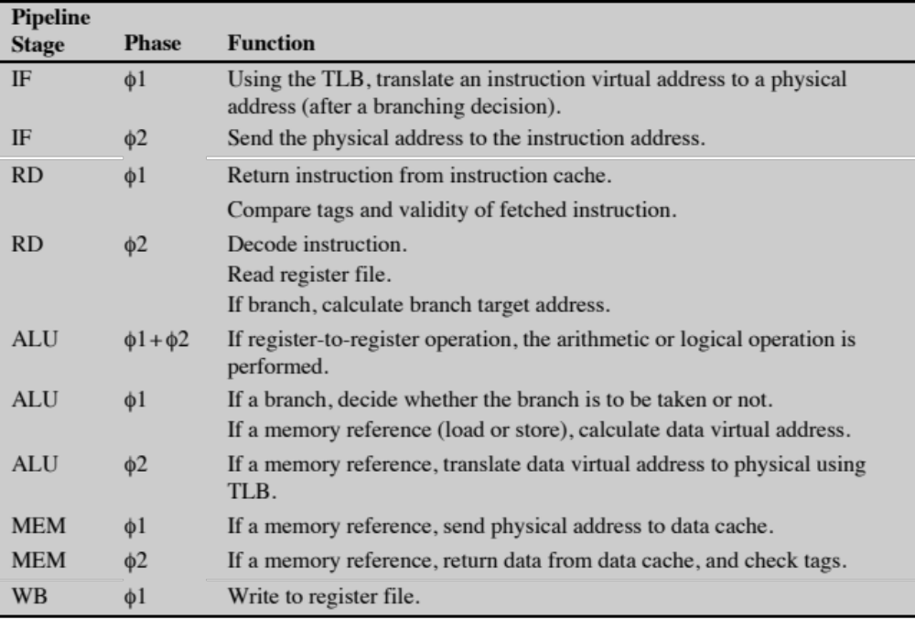
Table 15.9
R3000 Pipeline Stages
(Table can be found on page 563 in the textbook.)
Notes:
In detail, then, each clock cycle is divided into separate stages, denoted as ϕ 1
and ϕ 2. The functions performed in each stage are summarized in Table 15.9.

Slide 31
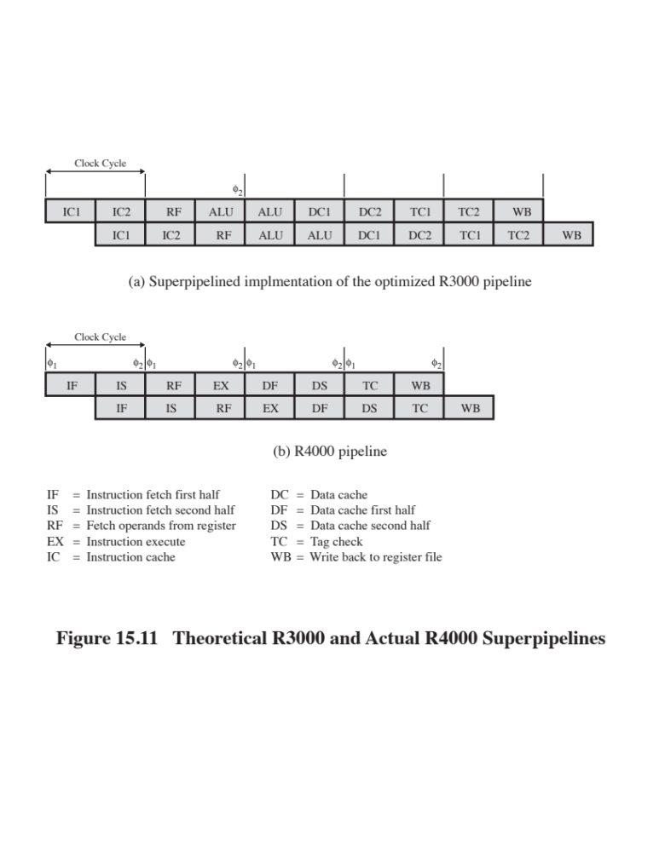
Notes:
In a superpipelined system, existing hardware is used several times per cycle by inserting pipeline registers to split up each pipe stage. Essentially, each superpipeline stage operates at a multiple of the base clock frequency, the multiple depending on the degree of superpipelining. The R4000 technology has the speed and density to permit superpipelining of degree 2. Figure 15.11a shows the optimized R3000 pipeline using this superpipelining. Note that this is essentially the same dynamic structure as Figure 15.10c.
Further improvements can be made. For the R4000, a much larger and specialized adder was designed. This makes it possible to execute ALU operations at twice the rate. Other improvements allow the execution of loads and stores at twice the rate. The resulting pipeline is shown in Figure 15.11b.

Slide 32
R4000 Pipeline Stages
Instruction fetch first half
  Virtual address is presented to the instruction cache and the translation lookaside buffer
Instruction fetch second half
  Instruction cache outputs the instruction and the TLB generates the physical address
Register file
  One of three activities can occur:
    Instruction is decoded and check made for interlock conditions
    Instruction cache tag check is made
    Operands are fetched from the register file
Tag check
  Cache tag checks are performed for loads and stores
Instruction execute
  One of three activities can occur:
    If register-to-register operation the ALU performs the operation
    If a load or store the data virtual address is calculated
    If branch the branch target virtual address is calculated and branch operations checked
Data cache first
  Virtual address is presented to the data cache and TLB
Data cache second
  The TLB generates the physical address and the data cache outputs the data
Write back
  Instruction result is written back to register file
Notes:
The R4000 has eight pipeline stages, meaning that as many as eight instructions can be in the pipeline at the same time. The pipeline advances at the rate of two stages per clock cycle. The eight pipeline stages are as follows:
• Instruction fetch first half: Virtual address is presented to the instruction cache and the translation lookaside buffer.
• Instruction fetch second half: Instruction cache outputs the instruction and the TLB generates the physical address.
Register file: Three activities occur in parallel:
—Instruction is decoded and check made for interlock conditions (i.e., this instruction depends on the result of a preceding instruction).
—Instruction cache tag check is made.
—Operands are fetched from the register file.
Instruction execute: One of three activities can occur:
—If the instruction is a register-to-register operation, the ALU performs the arithmetic or logical operation.
—If the instruction is a load or store, the data virtual address is calculated.
—If the instruction is a branch, the branch target virtual address is calculated and branch conditions are checked.
Data cache first: Virtual address is presented to the data cache and TLB.
Data cache second: The TLB generates the physical address, and the data
cache outputs the data.
Tag check: Cache tag checks are performed for loads and stores.
Write back: Instruction result is written back to register file.

Slide 33

SPARC
Scalable Processor Architecture
Architecture defined by Sun Microsystems
Sun licenses the architecture to other vendors to produce SPARC-compatible machines
Inspired by the Berkeley RISC 1 machine, and its instruction set and register organization is based closely on the Berkeley RISC model
Notes:
SPARC (Scalable Processor Architecture) refers to an architecture defined by Sun Microsystems. Sun developed its own SPARC implementation but also licenses the architecture to other vendors to produce SPARC-compatible machines. The SPARC
architecture is inspired by the Berkeley RISC I machine, and its instruction set and
register organization is based closely on the Berkeley RISC model.

Slide 34
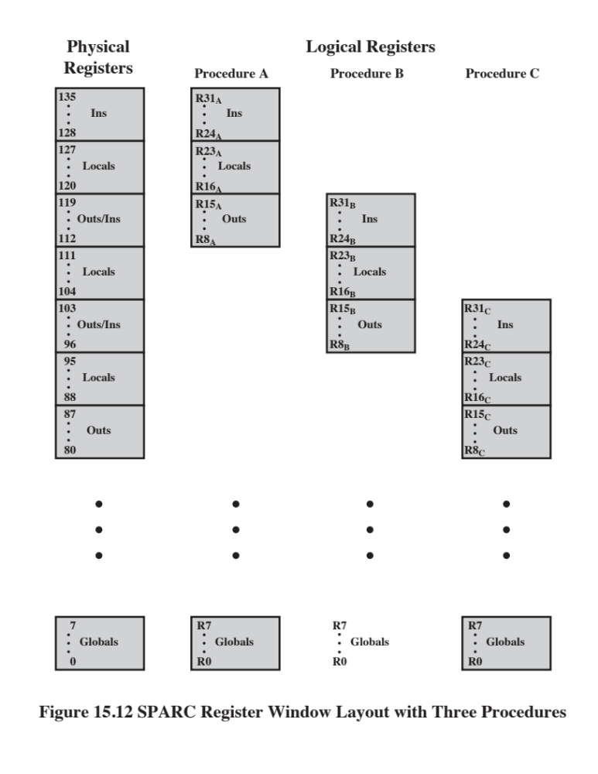
Notes:
As with the Berkeley RISC, the SPARC makes use of register windows. Each window gives addressability to 24 registers, and the total number of windows is implementation dependent and ranges from 2 to 32 windows. Figure 15.12 illustrates an implementation that supports 8 windows, using a total of 136 physical registers; as the discussion in Section 15.2 indicates, this seems a reasonable number of windows. Physical registers 0 through 7 are global registers shared by all procedures. Each procedure sees logical registers 0 through 31. Logical registers 24 through 31, referred to as ins, are shared with the calling (parent) procedure; and logical registers 8 through 15, referred to as outs, are shared with any called (child) procedure. These two portions overlap with other windows. Logical registers 16 through 23, referred to as locals, are not shared and do not overlap with other windows. Again, as the discussion of Section 12.1 indicates, the availability of 8 registers for parameter passing should be adequate in most cases (e.g., see Table 15.4).

Slide 35
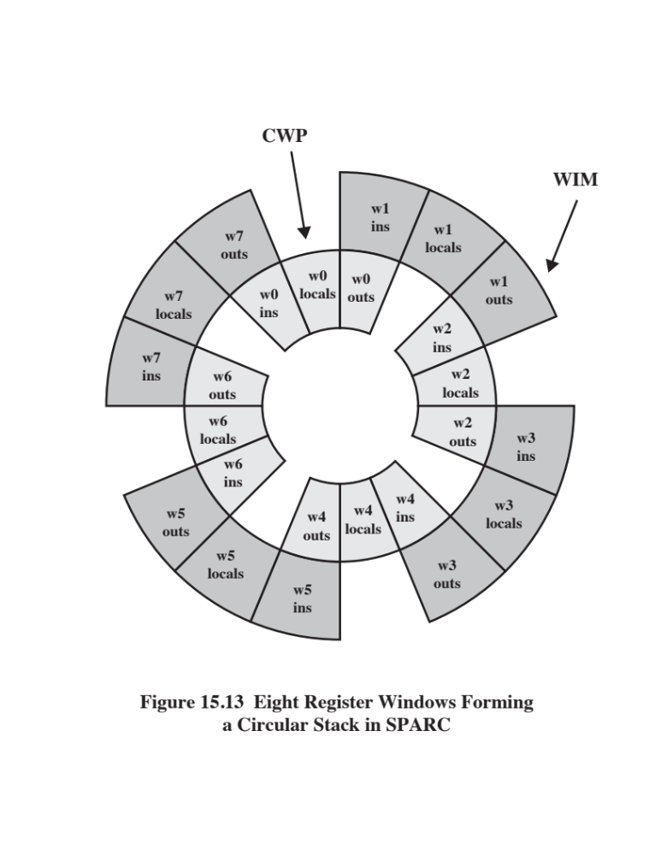
Notes:
Figure 15.13 is another view of the register overlap. The calling procedure places any parameters to be passed in its outs registers; the called procedure treats these same physical registers as it ins registers. The processor maintains a current window pointer (CWP), located in the processor status register (PSR), that points to the window of the currently executing procedure. The window invalid mask (WIM), also in the PSR, indicates which windows are invalid.
With the SPARC register architecture, it is usually not necessary to save and restore registers for a procedure call. The compiler is simplified because the compiler need be concerned only with allocating the local registers for a procedure in an efficient manner and need not be concerned with register allocation between procedures.

Slide 36
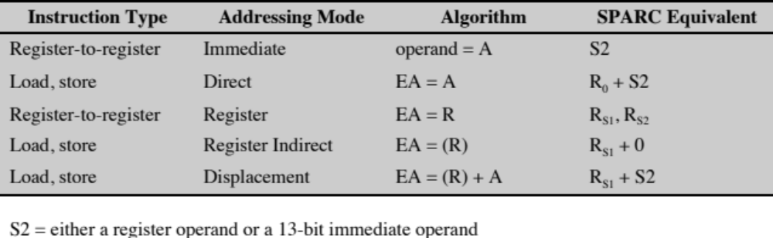
Table 15.10
Synthesizing Other Addressing Modes
with SPARC Addressing Modes
(Table can be found on page 568 in the textbook.)
Notes:
Most of the SPARC instructions reference only register operands. Register-to-register
instructions have three operands and can be expressed in the form
R_{d} ➔ R_{S1} op S2
where R_{d} and R_{S1} are register references; S2 can refer either to a register or to a
13-bit immediate operand. Register zero (R₀ ) is hardwired with the value 0. This
form is well suited to typical programs, which have a high proportion of local scalars
and constants.
The available ALU operations can be grouped as follows:
■ Integer addition (with or without carry).
■ Integer subtraction (with or without carry).
■ Bitwise Boolean AND, OR, XOR and their negations.
■ Shift left logical, right logical, or right arithmetic.
All of these instructions, except the shifts, can optionally set the four condition
codes (ZERO, NEGATIVE, OVERFLOW, CARRY). Signed integers are
represented in 32-bit twos complement form.
Only simple load and store instructions reference memory. There are separate
load and store instructions for word (32 bits), doubleword, halfword, and byte. For
the latter two cases, there are instructions for loading these quantities as signed or
unsigned numbers. Signed numbers are sign extended to fill out the 32-bit destination
register. Unsigned numbers are padded with zeros.
The only available addressing mode, other than register, is a displacement
mode. That is, the effective address (EA) of an operand consists of a displacement
from an address contained in a register:
EA = (R_{S1} ) + S2
or EA = (R_{S1} ) + (R_{S2} )
depending on whether the second operand is immediate or a register reference. To
perform a load or store, an extra stage is added to the instruction cycle. During the
second stage, the memory address is calculated using the ALU; the load or store
occurs in a third stage. This single addressing mode is quite versatile and can be
used to synthesize other addressing modes, as indicated in Table 15.10.
It is instructive to compare the SPARC addressing capability with that of
the MIPS. The MIPS makes use of a 16-bit offset, compared with a 13-bit offset on
the SPARC. On the other hand, the MIPS does not permit an address to be constructed
from the contents of two registers.

Slide 37
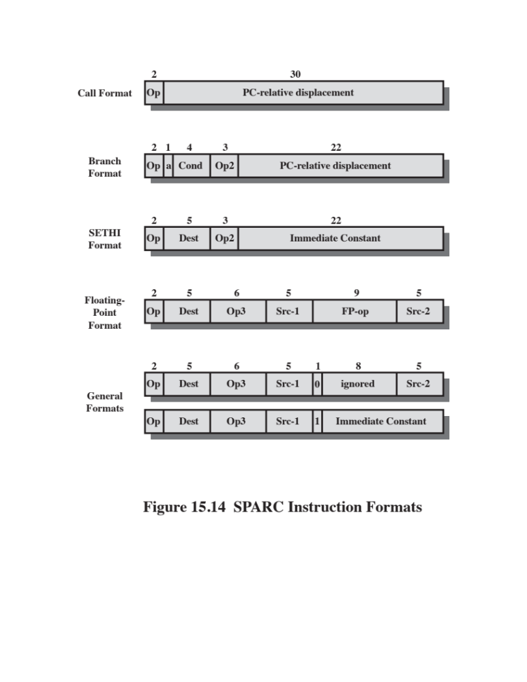
Notes:
As with the MIPS R4000, SPARC uses a simple set of 32-bit instruction formats (Figure 15.14). All instructions begin with a 2-bit opcode. For most instructions, this is extended with additional opcode bits elsewhere in the format. For the Call instruction, a 30-bit immediate operand is extended with two zero bits to the right to form a 32-bit PC-relative address in twos complement form. Instructions are aligned on a 32-bit boundary so that this form of addressing suffices.
The Branch instruction includes a 4-bit condition field that corresponds to the four standard condition code bits, so that any combination of conditions can be tested. The 22-bit PC-relative address is extended with two zero bits on the right to form a 24-bit twos complement relative address. An unusual feature of the Branch instruction is the annul bit. When the annul bit is not set, the instruction after the branch is always executed, regardless of whether the branch is taken. This is the typical delayed branch operation found on many RISC machines and described in Section 15.5 (see Figure 15.7). However, when the annul bit is set, the instruction fol- lowing the branch is executed only if the branch is taken. The processor suppresses the effect of that instruction even though it is already in the pipeline. This annul bit is useful because it makes it easier for the compiler to fill the delay slot following a conditional branch. The instruction that is the target of the branch can always be put in the delay slot, because if the branch is not taken, the instruction can be annulled. The reason this technique is desirable is that conditional branches are generally taken more than half the time.
The SETHI instruction is a special instruction used to form a 32-bit constant. This feature is needed to form large data constants; for example, it can be used to form a large offset for a load or store instruction. The SETHI instruction sets the 22 high-order bits of a register with its 22-bit immediate operand, and zeros out the low-order 10 bits. An immediate constant of up to 13 bits can be specified in one of the general formats, and such an instruction could be used to fill in the remaining 10 bits of the register. A load or store instruction can also be used to achieve a direct addressing mode. To load a value from location K in memory, we could use the following SPARC instructions:
Sethi %hi(K), %r8 ;load high-order 22 bits of address of location
;K into register r8
ld [%r8 + %lo(K)], %r8 ;load contents of location K into r8
The macros %hi and %lo are used to define immediate operands consisting of the appropriate address bits of a location. This use of SETHI is similar to the use of the lui instruction on the MIPS.
The floating-point format is used for floating-point operations. Two source and one destination registers are designated.
Finally, all other operations, including loads, stores, arithmetic, and logical operations use one of the last two formats shown in Figure 15.14. One of the formats makes use of two source registers and a destination register, while the other uses one source register, one 13-bit immediate operand, and one destination register.

Slide 38
RISC versus CISC Controversy
Quantitative
  Compare program sizes and execution speeds of programs on RISC and CISC machines that use comparable technology
Qualitative
  Examine issues of high level language support and use of VLSI real estate
Problems with comparisons:
  No pair of RISC and CISC machines that are comparable in life-cycle cost, level of technology, gate complexity, sophistication of compiler, operating system support, etc.
  No definitive set of test programs exists
  Difficult to separate hardware effects from complier effects
  Most comparisons done on “toy” rather than commercial products
  Most commercial devices advertised as RISC possess a mixture of RISC and CISC characteristics
Notes:
For many years, the general trend in computer architecture and organization has been toward increasing processor complexity: more instructions, more addressing modes, more specialized registers, and so on. The RISC movement represents a fundamental break with the philosophy behind that trend. Naturally, the appearance of RISC systems, and the publication of papers by its proponents extolling RISC virtues, led to a reaction from those involved in the design of CISC architectures.
The work that has been done on assessing merits of the RISC approach can be grouped into two categories:
Quantitative: Attempts to compare program size and execution speed of pro- grams on RISC and CISC machines that use comparable technology
Qualitative: Examines issues such as high-level language support and optimum use of VLSI real estate
Most of the work on quantitative assessment has been done by those working on RISC systems [PATT82b, HEAT84, PATT84], and it has been, by and large, favorable to the RISC approach. Others have examined the issue and come away unconvinced [COLW85a, FLYN87, DAVI87]. There are several problems with attempting such comparisons [SERL86]:
There is no pair of RISC and CISC machines that are comparable in life-cycle cost, level of technology, gate complexity, sophistication of compiler, operating system support, and so on.
No definitive test set of programs exists. Performance varies with the program.
It is difficult to sort out hardware effects from effects due to skill in compiler
writing.
Most of the comparative analysis on RISC has been done on “toy” machines rather than commercial products. Furthermore, most commercially available machines advertised as RISC possess a mixture of RISC and CISC characteristics. Thus, a fair comparison with a commercial, “pure-play” CISC machine (e.g., VAX, Pentium) is difficult.
The qualitative assessment is, almost by definition, subjective. Several researchers
have turned their attention to such an assessment [COLW85a, WALL85], but
the results are, at best, ambiguous, and certainly subject to rebuttal [PATT85b] and,
of course, counterrebuttal [COLW85b].
In more recent years, the RISC versus CISC controversy has died down to
a great extent. This is because there has been a gradual convergence of the technologies.
As chip densities and raw hardware speeds increase, RISC systems have
become more complex. At the same time, in an effort to squeeze out maximum performance,
CISC designs have focused on issues traditionally associated with RISC,
such as an increased number of general-purpose registers and increased emphasis
on instruction pipeline design.

Slide 39
Summary
Reduced Instruction Set Computers
(RISC)
Chapter 15
RISC pipelining
  Pipelining with regular instructions
  Optimization of pipelining
MIPS R4000
  Instruction set
  Instruction pipeline
SPARC
  SPARC register set
  Instruction set
  Instruction format
  Compiler-based register optimization
RISC versus CISC controversy
Instruction execution characteristics
  Operations
  Operands
  Procedure calls
  Implications
The use of a large register file
  Register windows
  Global variables
  Large register file versus cache
Reduced instruction set architecture
  Characteristics of RISC
  CISC versus RISC characteristics
Notes:
Chapter 15 summary.

