Slide 1

William Stallings
Computer Organization and Architecture
10th Edition
Notes:
Lecture slides prepared for “Computer Organization and Architecture”, 10/e, by William Stallings, Chapter 17 “Parallel Processing”.

Slide 2
Chapter 17
Parallel Processing
Notes:
Traditionally, the computer has been viewed as a sequential machine. Most computer programming languages require the programmer to specify algorithms as sequences of instructions. Processors execute programs by executing machine instructions in a sequence and one at a time. Each instruction is executed in a sequence of operations (fetch instruction, fetch operands, perform operation, store results).
This view of the computer has never been entirely true. At the micro-operation level, multiple control signals are generated at the same time. Instruction pipelining, at least to the extent of overlapping fetch and execute operations, has been around for a long time. Both of these are examples of performing functions in parallel. This approach is taken further with superscalar organization, which exploits instruction- level parallelism. With a superscalar machine, there are multiple execution units within a single processor, and these may execute multiple instructions from the same program in parallel.
As computer technology has evolved, and as the cost of computer hardware
has dropped, computer designers have sought more and more opportunities
for parallelism, usually to enhance performance and, in some cases, to increase
availability. After an overview, this chapter looks at some of the most prominent
approaches to parallel organization. First, we examine symmetric multiprocessors
(SMPs), one of the earliest and still the most common example of parallel
organization. In an SMP organization, multiple processors share a common
memory. This organization raises the issue of cache coherence, to which a separate
section is devoted. Next, the chapter examines multithreaded processors
and chip multiprocessors. Then we describe clusters, which consist of multiple
independent computers organized in a cooperative fashion. Clusters have become
increasingly common to support workloads that are beyond the capacity of a
single SMP. Another approach to the use of multiple processors that we examine
is that of nonuniform memory access (NUMA) machines. The NUMA approach
is relatively new and not yet proven in the marketplace, but is often considered as
an alternative to the SMP or cluster approach. Finally, this chapter looks at cloud
computing architecture.

Slide 3
Multiple Processor Organization
Single instruction, single data (SISD) stream
  Single processor executes a single instruction stream to operate on data stored in a single memory
  Uniprocessors fall into this category
Multiple instruction, single data (MISD) stream
  A sequence of data is transmitted to a set of processors, each of which executes a different instruction sequence
  Not commercially implemented
Single instruction, multiple data (SIMD) stream
  A single machine instruction controls the simultaneous execution of a number of processing elements on a lockstep basis
  Vector and array processors fall into this category
Multiple instruction, multiple data (MIMD) stream
  A set of processors simultaneously execute different instruction sequences on different data sets
  SMPs, clusters and NUMA systems fit this category
Notes:
A taxonomy first introduced by Flynn [FLYN72] is still the most common way of categorizing systems with parallel processing capability. Flynn proposed the following categories of computer systems:
Single instruction, single data (SISD) stream: A single processor executes a single instruction stream to operate on data stored in a single memory. Uniprocessors fall into this category.
Single instruction, multiple data (SIMD) stream: A single machine instruction controls the simultaneous execution of a number of processing elements on a lockstep basis. Each processing element has an associated data memory, so that instructions are executed on different sets of data by different processors. Vector and array processors fall into this category, and are discussed in Section 18.7.
Multiple instruction, single data (MISD) stream: A sequence of data is transmitted to a set of processors, each of which executes a different instruction sequence. This structure is not commercially implemented.
Multiple instruction, multiple data (MIMD) stream: A set of processors simultaneously execute different instruction sequences on different data sets. SMPs, clusters, and NUMA systems fit into this category.

Slide 4
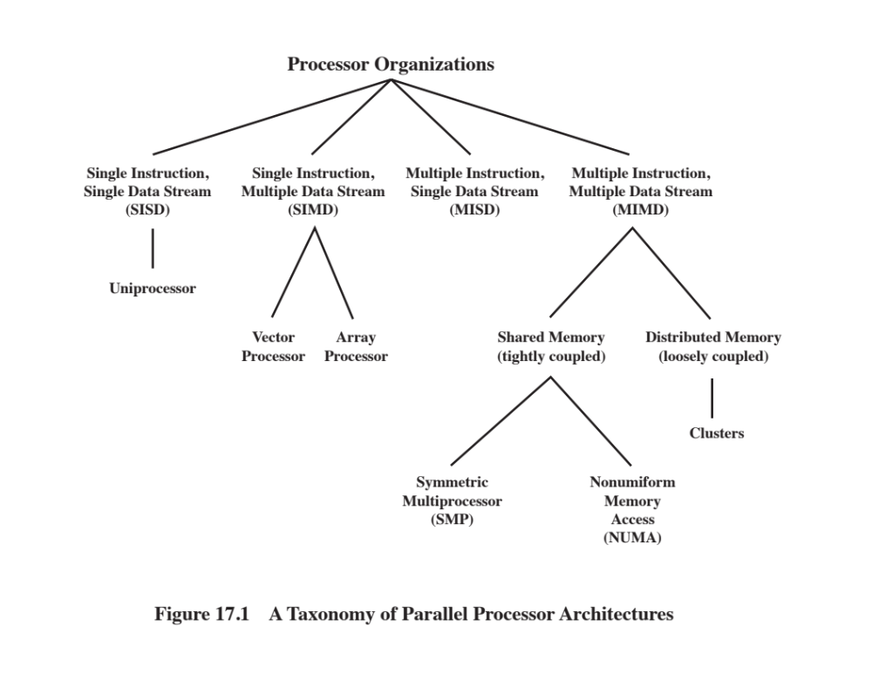
Notes:
With the MIMD organization, the processors are general purpose; each is able to process all of the instructions necessary to perform the appropriate data transformation. MIMDs can be further subdivided by the means in which the processors communicate (Figure 17.1). If the processors share a common memory, then each processor accesses programs and data stored in the shared memory, and processors communicate with each other via that memory. The most common form of such system is known as a symmetric multiprocessor (SMP), which we examine in Section 17.2. In an SMP, multiple processors share a single memory or pool of memory by means of a shared bus or other interconnection mechanism; a distinguishing feature is that the memory access time to any region of memory is approximately the same for each processor. A more recent development is the non-uniform memory access (NUMA) organization, which is described in Section 17.5. As the name suggests, the memory access time to different regions of memory may differ for a NUMA processor.
A collection of independent uniprocessors or SMPs may be interconnected to form a cluster. Communication among the computers is either via fixed paths or via some network facility.

Slide 5
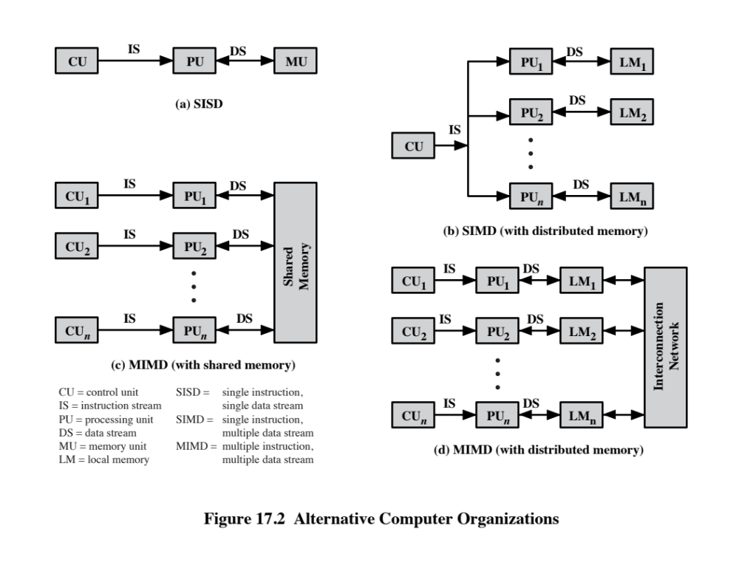
Notes:
Figure 17.2 illustrates the general organization of the taxonomy of Figure 17.1. Figure 17.2a shows the structure of an SISD. There is some sort of control unit (CU) that provides an instruction stream (IS) to a processing unit (PU). The processing unit operates on a single data stream (DS) from a memory unit (MU). With an
SIMD, there is still a single control unit, now feeding a single instruction stream to multiple PUs. Each PU may have its own dedicated memory (illustrated in Figure 17.2b), or there may be a shared memory. Finally, with the MIMD, there are multiple control units, each feeding a separate instruction stream to its own PU. The MIMD may be a shared-memory multiprocessor (Figure 17.2c) or a distributed- memory multicomputer (Figure 17.2d).
The design issues relating to SMPs, clusters, and NUMAs are complex, involving issues relating to physical organization, interconnection structures, inter-processor communication, operating system design, and application software techniques. Our concern here is primarily with organization, although we touch briefly on operating system design issues.

Slide 6
Symmetric Multiprocessor (SMP)
A stand alone computer with the following characteristics:
Two or more similar processors of comparable capacity
Processors share same memory and I/O facilities
Processors are connected by a bus or other internal connection
Memory access time is approximately the same for each processor
All processors share access to I/O devices
Either through same channels or different channels giving paths to same devices
All processors can perform the same functions (hence “symmetric”)
System controlled by integrated operating system
Provides interaction between processors and their programs at job, task, file and data element levels
Notes:
Until fairly recently, virtually all single-user personal computers and most workstations contained a single general-purpose microprocessor. As demands for performance increase and as the cost of microprocessors continues to drop, vendors have introduced systems with an SMP organization. The term SMP refers to a computer hardware architecture and also to the operating system behavior that reflects that architecture. An SMP can be defined as a standalone computer system with the following characteristics:
1. There are two or more similar processors of comparable capability.
2. These processors share the same main memory and I/O facilities and are interconnected by a bus or other internal connection scheme, such that memory access time is approximately the same for each processor.
3. All processors share access to I/O devices, either through the same channels or through different channels that provide paths to the same device.
4. All processors can perform the same functions (hence the term symmetric).
5. The system is controlled by an integrated operating system that provides interaction between processors and their programs at the job, task, file, and data element levels.
Points 1 to 4 should be self-explanatory. Point 5 illustrates one of the contrasts
with a loosely coupled multiprocessing system, such as a cluster. In the latter, the physical unit of interaction is usually a message
or complete file. In an SMP, individual data elements can constitute the level of interaction, and there can be a high degree of cooperation
between processes.

Slide 7
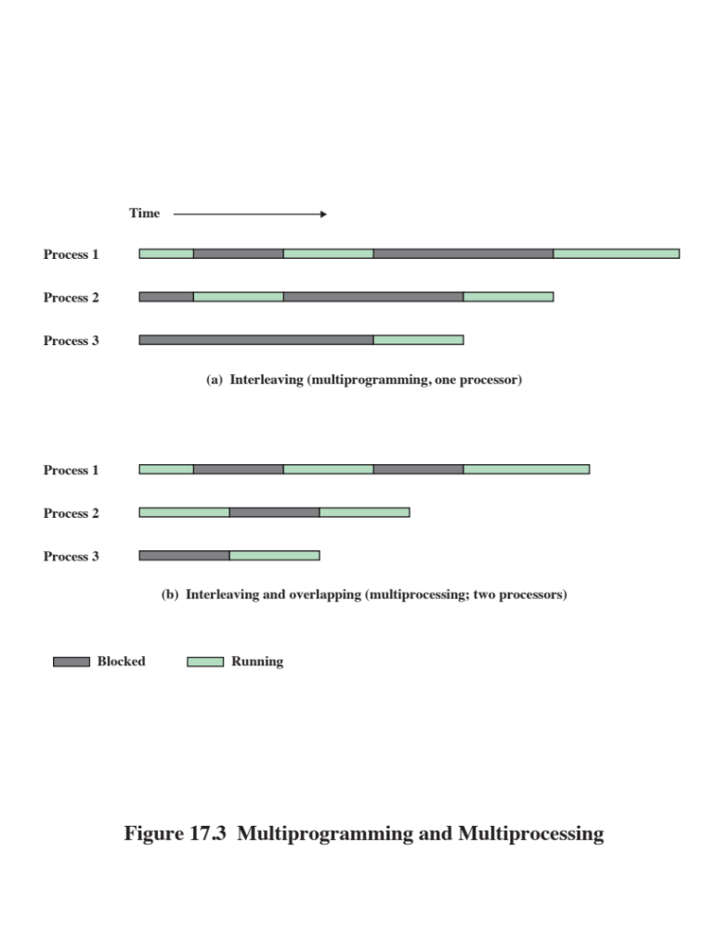
Notes:
The operating system of an SMP schedules processes or threads across all of the processors. An SMP organization has a number of potential advantages over a uniprocessor organization, including the following:
• Performance: If the work to be done by a computer can be organized so that some portions of the work can be done in parallel, then a system with multiple processors will yield greater performance than one with a single processor of the same type (Figure 17.3).
* Availability: In a symmetric multiprocessor, because all processors can perform the same functions, the failure of a single processor
does not halt the machine. Instead, the system can continue to function at reduced performance.
* Incremental growth: A user can enhance the performance of a system by adding an additional processor.
* Scaling: Vendors can offer a range of products with different price and performance characteristics based on the number of processors configured in the system.
It is important to note that these are potential, rather than guaranteed, benefits. The operating system must provide tools and functions to exploit the parallelism in an SMP system.
An attractive feature of an SMP is that the existence of multiple processors is transparent to the user. The operating system takes care of scheduling of threads or processes on individual processors and of synchronization among processors.

Slide 8
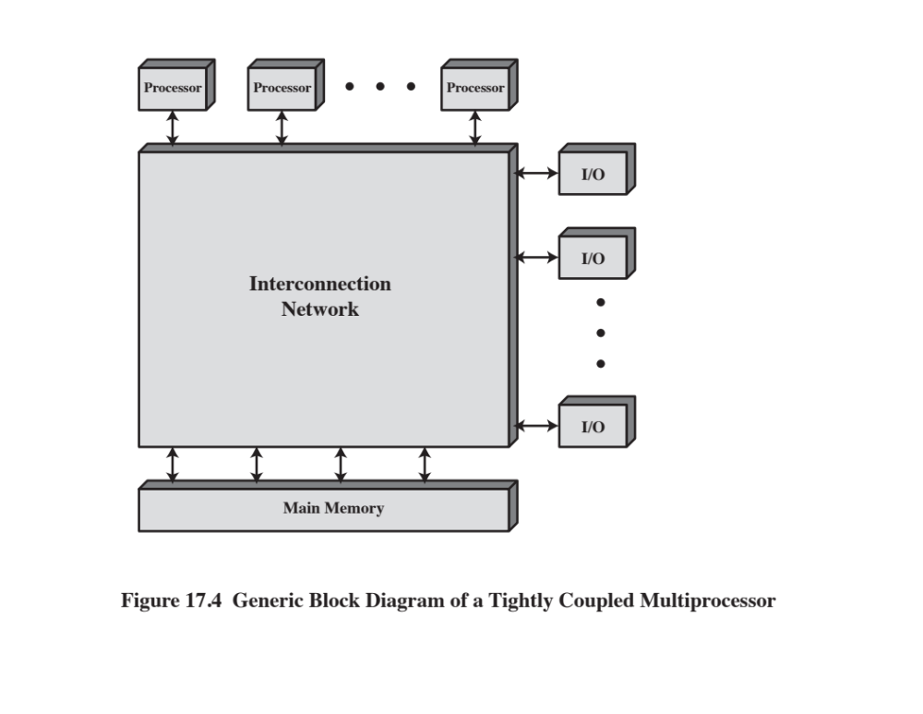
Notes:
Figure 17.4 depicts in general terms the organization of a multiprocessor system. There are two or more processors. Each processor is self-contained, including a control unit, ALU, registers, and, typically, one or more levels of cache. Each processor has access to a shared main memory and the I/O devices through some form of interconnection mechanism. The processors can communicate with each other through memory (messages and status information left in common data areas). It may also be possible for processors to exchange signals directly. The memory is often organized so that multiple simultaneous accesses to separate blocks of memory are possible. In some configurations, each processor may also have its own private main memory and I/O channels in addition to the shared resources.

Slide 9
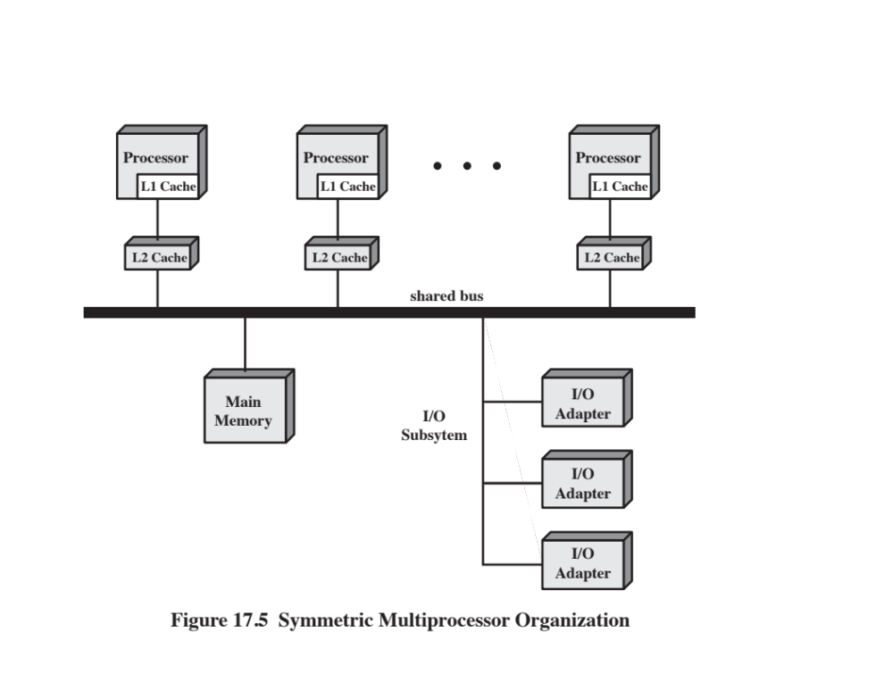
Notes:
The most common organization for personal computers, workstations, and servers is the time-shared bus. The time-shared bus is the simplest mechanism for constructing a multiprocessor system (Figure 17.5). The structure and interfaces are basically the same as for a single-processor system that uses a bus interconnection. The bus consists of control, address, and data lines. To facilitate DMA transfers from I/O subsystems to processors, the following features are provided:
Addressing: It must be possible to distinguish modules on the bus to determine the source and destination of data.
Arbitration: Any I/O module can temporarily function as “master.” A mechanism is provided to arbitrate competing requests for bus control, using some sort of priority scheme.
Time-sharing: When one module is controlling the bus, other modules are locked out and must, if necessary, suspend operation until bus access is achieved.
These uniprocessor features are directly usable in an SMP organization. In this latter case, there are now multiple processors as well as multiple I/O processors all attempting to gain access to one or more memory modules via the bus.

Slide 10


The bus organization has several
attractive features:
Simplicity
  Simplest approach to multiprocessor organization
Flexibility
  Generally easy to expand the system by attaching more processors to the bus
Reliability
  The bus is essentially a passive medium and the failure of any attached device should not cause failure of the whole system
Notes:
The bus organization has several attractive features:
• Simplicity: This is the simplest approach to multiprocessor organization. The physical interface and the addressing, arbitration,
and time-sharing logic of each processor remain the same as in a single-processor system.
• Flexibility: It is generally easy to expand the system by attaching more processors to the bus.
• Reliability: The bus is essentially a passive medium, and the failure of any attached device should not cause failure of the whole system.

Slide 11

Disadvantages of the bus organization:
Main drawback is performance
  All memory references pass through the common bus
  Performance is limited by bus cycle time
Each processor should have cache memory
  Reduces the number of bus accesses
Leads to problems with cache coherence
  If a word is altered in one cache it could conceivably invalidate a word in another cache
    To prevent this the other processors must be alerted that an update has taken place
  Typically addressed in hardware rather than the operating system
Notes:
The main drawback to the bus organization is performance. All memory references pass through the common bus. Thus, the bus cycle time limits the speed of the system. To improve performance, it is desirable to equip each processor with a cache memory. This should reduce the number of bus accesses dramatically. Typically, workstation and PC SMPs have two levels of cache, with the L1 cache internal (same chip as the processor) and the L2 cache either internal or external. Some processors now employ a L3 cache as well.
The use of caches introduces some new design considerations. Because each local cache contains an image of a portion of memory, if a word is altered in one
cache, it could conceivably invalidate a word in another cache. To prevent this, the other processors must be alerted that an update has taken place. This problem is known as the cache coherence problem and is typically addressed in hardware rather than by the operating system.

Slide 12
Multiprocessor Operating System Design Considerations
Simultaneous concurrent processes
  OS routines need to be reentrant to allow several processors to execute the same IS code simultaneously
  OS tables and management structures must be managed properly to avoid deadlock or invalid operations
Scheduling
  Any processor may perform scheduling so conflicts must be avoided
  Scheduler must assign ready processes to available processors
Synchronization
  With multiple active processes having potential access to shared address spaces or I/O resources, care must be taken to provide effective synchronization
  Synchronization is a facility that enforces mutual exclusion and event ordering
Memory management
  In addition to dealing with all of the issues found on uniprocessor machines, the OS needs to exploit the available hardware parallelism to achieve the best performance
  Paging mechanisms on different processors must be coordinated to enforce consistency when several processors share a page or segment and to decide on page replacement
Reliability and fault tolerance
  OS should provide graceful degradation in the face of processor failure
  Scheduler and other portions of the operating system must recognize the loss of a processor and restructure accordingly
Notes:
An SMP operating system manages processor and other computer resources so that the user perceives a single operating system controlling system resources. In fact, such a configuration should appear as a single-processor multiprogramming system. In both the SMP and uniprocessor cases, multiple jobs or processes may be active at one time, and it is the responsibility of the operating system to schedule their execution and to allocate resources. A user may construct applications that use multiple processes or multiple threads within processes without regard to whether a single processor or multiple processors will be available. Thus, a multiprocessor operating system must provide all the functionality of a multiprogramming system plus additional features to accommodate multiple processors. Among the key design issues:
Simultaneous concurrent processes: OS routines need to be reentrant to allow several processors to execute the same IS code simultaneously. With multiple processors executing the same or different parts of the OS, OS tables and management structures must be managed properly to avoid deadlock or invalid operations.
Scheduling: Any processor may perform scheduling, so conflicts must be avoided. The scheduler must assign ready processes to available processors.
Synchronization: With multiple active processes having potential access to shared address spaces or shared I/O resources, care must be taken to provide effective synchronization. Synchronization is a facility that enforces mutual exclusion and event ordering.
Memory management: Memory management on a multiprocessor must deal with all of the issues found on uniprocessor machines, as is discussed in Chapter 8. In addition, the operating system needs to exploit the available hardware parallelism, such as multi-ported memories, to achieve the best performance. The paging mechanisms on different processors must be coordinated to enforce consistency when several processors share a page or segment and to decide on page replacement.
Reliability and fault tolerance: The operating system should provide graceful degradation in the face of processor failure. The scheduler and other portions of the operating system must recognize the loss of a processor and restructure management tables accordingly.

Slide 13

Cache Coherence
Software Solutions
Attempt to avoid the need for additional hardware circuitry and logic by relying on the compiler and operating system to deal with the problem
Attractive because the overhead of detecting potential problems is transferred from run time to compile time, and the design complexity is transferred from hardware to software
  However, compile-time software approaches generally must make conservative decisions, leading to inefficient cache utilization
Notes:
Software cache coherence schemes attempt to avoid the need for additional hard- ware circuitry and logic by relying on the compiler and operating system to deal with the problem. Software approaches are attractive because the overhead of detecting potential problems is transferred from run time to compile time, and the design complexity is transferred from hardware to software. On the other hand, compile- time software approaches generally must make conservative decisions, leading to inefficient cache utilization.
Compiler-based coherence mechanisms perform an analysis on the code to determine which data items may become unsafe for caching, and they mark those items accordingly. The operating system or hardware then prevents non-cacheable items from being cached.
The simplest approach is to prevent any shared data variables from being cached. This is too conservative, because a shared data structure may be exclusively used during some periods and may be effectively read-only during other periods. It is only during periods when at least one process may update the variable and at least one other process may access the variable that cache coherence is an issue.
More efficient approaches analyze the code to determine safe periods for shared variables. The compiler then inserts instructions into the generated code to enforce cache coherence during the critical periods. A number of techniques have been developed for performing the analysis and for enforcing the results; see [LILJ93] and [STEN90] for surveys.

Slide 14

Cache Coherence
Hardware-Based Solutions
Generally referred to as cache coherence protocols
These solutions provide dynamic recognition at run time of potential inconsistency conditions
Because the problem is only dealt with when it actually arises there is more effective use of caches, leading to improved performance over a software approach
Approaches are transparent to the programmer and the compiler, reducing the software development burden
Can be divided into two categories:
  Directory protocols
  Snoopy protocols
Notes:
Hardware-based solutions are generally referred to as cache coherence protocols. These solutions provide dynamic recognition at run time of potential inconsistency conditions. Because the problem is only dealt with when it actually arises, there is more effective use of caches, leading to improved performance over a software approach. In addition, these approaches are transparent to the programmer and the compiler, reducing the software development burden.
Hardware schemes differ in a number of particulars, including where the state information about data lines is held, how that information is organized, where coherence is enforced, and the enforcement mechanisms. In general, hardware schemes can be divided into two categories: directory protocols and snoopy protocols.

Slide 15
Directory Protocols
Collect and maintain information about copies of data in cache
Directory stored in main memory
Requests are checked against directory
Appropriate transfers are performed
Creates central bottleneck
Effective in large scale systems with complex interconnection schemes
Notes:
Directory protocols collect and maintain information about where copies of lines reside. Typically, there is a centralized controller that is part of the main memory controller, and a directory that is stored in main memory. The directory contains global state information about the contents of the various local caches. When an individual cache controller makes a request, the centralized controller checks and issues necessary commands for data transfer between memory and caches or between caches. It is also responsible for keeping the state information up to date; therefore, every local action that can affect the global state of a line must be reported to the central controller.
Typically, the controller maintains information about which processors have a copy of which lines. Before a processor can write to a local copy of a line, it must request exclusive access to the line from the controller. Before granting this exclusive access, the controller sends a message to all processors with a cached copy of this line, forcing each processor to invalidate its copy. After receiving acknowledgments back from each such processor, the controller grants exclusive access to the requesting processor. When another processor tries to read a line that is exclusively granted to another processor, it will send a miss notification to the controller. The controller then issues a command to the processor holding that line that requires the processor to do a write back to main memory. The line may now be shared for reading by the original processor and the requesting processor.
Directory schemes suffer from the drawbacks of a central bottleneck and the overhead of communication between the various cache controllers and the central controller. However, they are effective in large-scale systems that involve multiple buses or some other complex interconnection scheme.

Slide 16

Snoopy Protocols
Distribute the responsibility for maintaining cache coherence among all of the cache controllers in a multiprocessor
  A cache must recognize when a line that it holds is shared with other caches
  When updates are performed on a shared cache line, it must be announced to other caches by a broadcast mechanism
  Each cache controller is able to “snoop” on the network to observe these broadcast notifications and react accordingly
Suited to bus-based multiprocessor because the shared bus provides a simple means for broadcasting and snooping
  Care must be taken that the increased bus traffic required for broadcasting and snooping does not cancel out the gains from the use of local caches
  Two basic approaches have been explored:
  Write invalidate
  Write update (or write broadcast)
Notes:
Snoopy protocols distribute the responsibility for maintaining cache coherence among all of the cache controllers in a multiprocessor. A cache must recognize when a line that it holds is shared with other caches.
When an update action is performed on a shared cache line, it must be announced to all other caches by a broadcast mechanism. Each cache controller is able to “snoop” on the network to observe these broadcasted notifications, and react accordingly.
Snoopy protocols are ideally suited to a bus-based multiprocessor, because the shared bus provides a simple means for broadcasting and snooping. However, because one of the objectives of the use of local caches is to avoid bus accesses, care must be taken that the increased bus traffic required for broadcasting and snooping does not cancel out the gains from the use of local caches.
Two basic approaches to the snoopy protocol have been explored: write invalidate and write update (or write broadcast).

Slide 17
Write Invalidate
Multiple readers, but only one writer at a time
When a write is required, all other caches of the line are invalidated
Writing processor then has exclusive (cheap) access until line is required by another processor
Most widely used in commercial multiprocessor systems such as the x86 architecture
State of every line is marked as modified, exclusive, shared or invalid
  For this reason the write-invalidate protocol is called MESI
Notes:
With a write-invalidate protocol, there can be multiple readers but only one writer at a time. Initially, a line may be shared among several caches for reading purposes. When one of the caches wants to per- form a write to the line, it first issues a notice that invalidates that line in the other caches, making the line exclusive to the writing cache. Once the line is exclusive, the owning processor can make cheap local writes until some other processor requires the same line.
The write-invalidate approach is the most widely used in commercial multi- processor systems, such as the x86 architecture. It marks the state of every cache line (using two extra bits in the cache tag) as modified, exclusive, shared, or invalid. For this reason, the write-invalidate protocol is called MESI. In the remainder of this section, we will look at its use among local caches across a multiprocessor. For simplicity in the presentation, we do not examine the mechanisms involved in coordinating among both level 1 and level 2 locally as well as at the same time coordinating across the distributed multiprocessor. This would not add any new principles but would greatly complicate the discussion.

Slide 18
Write Update
Can be multiple readers and writers
When a processor wishes to update a shared line the word to be updated is distributed to all others and caches containing that line can update it
Some systems use an adaptive mixture of both write-invalidate and write-update mechanisms
Notes:
With a write-update protocol, there can be multiple writers as well as multiple readers. When a processor wishes to update a shared line, the word to be updated is distributed to all others, and caches containing that line can update it.
Neither of these two approaches is superior to the other under all circum- stances. Performance depends on the number of local caches and the pattern of memory reads and writes. Some systems implement adaptive protocols that employ both write-invalidate and write-update mechanisms.

Slide 19
MESI Protocol
To provide cache consistency on an SMP the data cache supports a protocol known as MESI:
Modified
  The line in the cache has been modified and is available only in this cache
Exclusive
  The line in the cache is the same as that in main memory and is not present in any other cache
Shared
  The line in the cache is the same as that in main memory and may be present in another cache
Invalid
  The line in the cache does not contain valid data
Notes:
To provide cache consistency on an SMP, the data cache often supports a protocol known as MESI. For MESI, the data cache includes two status bits per tag, so that each line can be in one of four states:
• Modified: The line in the cache has been modified (different from main memory) and is available only in this cache.
• Exclusive: The line in the cache is the same as that in main memory and is not present in any other cache.
• Shared: The line in the cache is the same as that in main memory and may be present in another cache.
• Invalid: The line in the cache does not contain valid data.

Slide 20
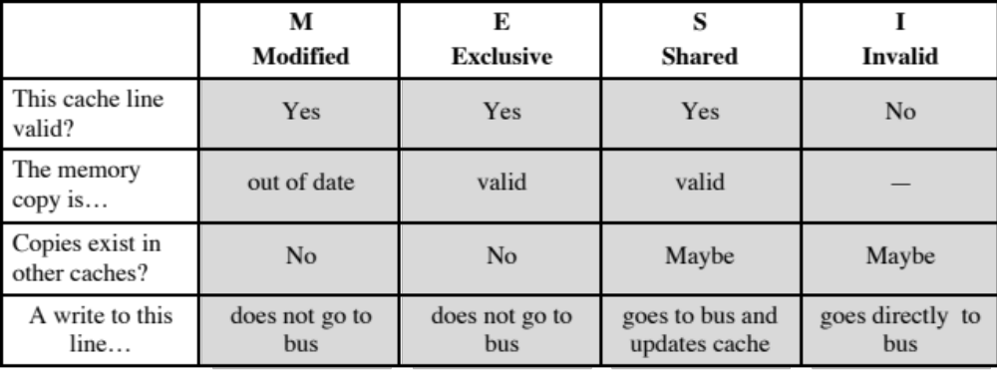
Table 17.1
MESI Cache Line States
Notes:
Table 17.1 summarizes the meaning of the four states.

Slide 21
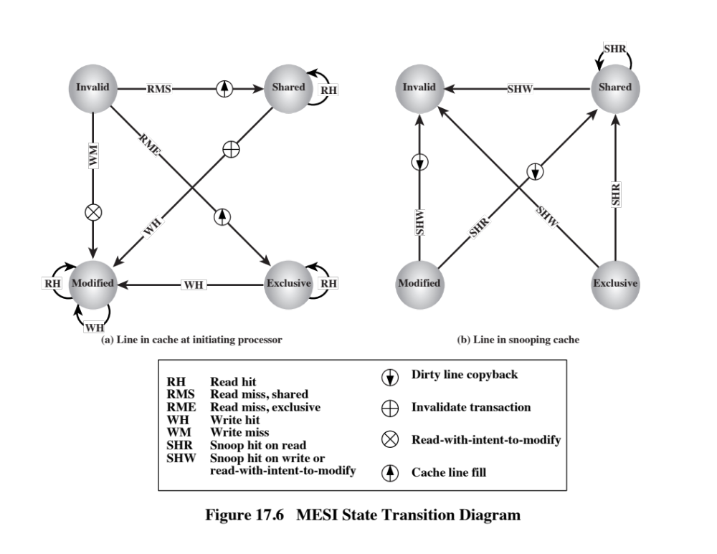
Notes:
Figure 17.6 displays a state diagram for the MESI protocol. Keep in mind that each line of the cache has its own state bits and therefore its own realization of the state diagram. Figure 17.6a shows the transitions that occur due to actions initiated by the processor attached to this cache. Figure 17.6b shows the transitions that occur due to events that are snooped on the common bus. This presentation of separate state diagrams for processor-initiated and bus-initiated actions helps to clarify the logic of the MESI protocol.
At any time a cache line is in a single state. If the next event is from the attached processor, then the transition is dictated by Figure 17.6a and if the next event is from the bus, the transition is dictated by Figure 17.6b.

Slide 22
Multithreading and Chip Multiprocessors
Processor performance can be measured by the rate at which it executes instructions
MIPS rate = f * IPC
  f = processor clock frequency, in MHz
  IPC = average instructions per cycle
Increase performance by increasing clock frequency and increasing instructions that complete during cycle
Multithreading
  Allows for a high degree of instruction-level parallelism without increasing circuit complexity or power consumption
  Instruction stream is divided into several smaller streams, known as threads, that can be executed in parallel
Notes:
The most important measure of performance for a processor is the rate at which it executes instructions. This can be expressed as
MIPS rate = f * IPC
where f is the processor clock frequency, in MHz, and IPC (instructions per cycle) is the average number of instructions executed per cycle. Accordingly, designers have pursued the goal of increased performance on two fronts: increasing clock frequency and increasing the number of instructions executed or, more properly, the number of instructions that complete during a processor cycle. As we have seen in earlier chapters, designers have increased IPC by using an instruction pipeline and then by using multiple parallel instruction pipelines in a superscalar architecture. With pipelined and multiple-pipeline designs, the principal problem is to maximize the utilization of each pipeline stage. To improve throughput, designers have created ever more complex mechanisms, such as executing some instructions in a different order from the way they occur in the instruction stream and beginning execution of instructions that may never be needed. But as was discussed in Section 2.2, this approach may be reaching a limit due to complexity and power consumption concerns.
An alternative approach, which allows for a high degree of instruction-level parallelism without increasing circuit complexity or power consumption, is called multithreading. In essence, the instruction stream is divided into several smaller streams, known as threads, such that the threads can be executed in parallel.
The variety of specific multithreading designs, realized in both commercial systems and experimental systems, is vast. In this section, we give a brief survey of the major concepts.

Slide 23

Definitions of Threads and Processes
Thread in multithreaded processors may or may not be the same as the concept of software threads in a multiprogrammed operating system
Thread is concerned with scheduling and execution, whereas a process is concerned with both scheduling/execution and resource and resource ownership
Process:
An instance of program running on computer
Two key characteristics:
Resource ownership
Scheduling/execution
Process switch
Operation that switches the processor from one process to another by saving all the process control data, registers, and other information for the first and replacing them with the process information for the second
Thread:
Dispatchable unit of work within a process
Includes processor context (which includes the program counter and stack pointer) and data area for stack
Executes sequentially and is interruptible so that the processor can turn to another thread
Thread switch
The act of switching processor control between threads within the same process
Typically less costly than process switch
Notes:
The concept of thread used in discussing multithreaded processors may or may not be the same as the concept of software threads in a multiprogrammed operating system. It will be useful to define terms briefly:
• Process: An instance of a program running on a computer. A process embodies two key characteristics:
—Resource ownership: A process includes a virtual address space to hold the process image; the process image is the collection of program, data, stack, and attributes that define the process. From time to time, a process may be allocated control or ownership of resources, such as main memory, I/O channels, I/O devices, and files.
—Scheduling/execution: The execution of a process follows an execution path (trace) through one or more programs. This execution may be inter- leaved with that of other processes. Thus, a process has an execution state (Running, Ready, etc.) and a dispatching priority and is the entity that is scheduled and dispatched by the operating system.
Process switch: An operation that switches the processor from one process to another, by saving all the process control data, registers, and other information for the first and replacing them with the process information for the second.2
Thread: A dispatchable unit of work within a process. It includes a processor context (which includes the program counter and stack pointer) and its own data area for a stack (to enable subroutine branching). A thread executes sequentially and is interruptible so that the processor can turn to another thread.
Thread switch: The act of switching processor control from one thread to an- other within the same process. Typically, this type of switch is much less costly than a process switch.
Thus, a thread is concerned with scheduling and execution, whereas a process is concerned with both scheduling/execution and resource ownership. The multiple threads within a process share the same resources. This is why a thread switch is much less time consuming than a process switch. Traditional operating systems, such as earlier versions of UNIX, did not support threads. Most modern operating systems, such as Linux, other versions of UNIX, and Windows, do support thread. A distinction is made between user-level threads, which are visible to the application program, and kernel-level threads, which are visible only to the operating sys- tem. Both of these may be referred to as explicit threads, defined in software.

Slide 24
Implicit and Explicit Multithreading
All commercial processors and most experimental ones use explicit multithreading
  Concurrently execute instructions from different explicit threads
  Interleave instructions from different threads on shared pipelines or parallel execution on parallel pipelines
Implicit multithreading is concurrent execution of multiple threads extracted from single sequential program
  Implicit threads defined statically by compiler or dynamically by hardware
Notes:
All of the commercial processors and most of the experimental processors so far have used explicit multithreading. These systems concurrently execute instructions from different explicit threads, either by interleaving instructions from different threads on shared pipelines or by parallel execution on parallel pipelines. Implicit multithreading refers to the concurrent execution of multiple threads extracted from a single sequential program. These implicit threads may be defined either statically by the compiler or dynamically by the hardware. In the remainder of this section we consider explicit multithreading.

Slide 25
Approaches to Explicit Multithreading
Interleaved
  Fine-grained
  Processor deals with two or more thread contexts at a time
  Switching thread at each clock cycle
  If thread is blocked it is skipped
Simultaneous (SMT)
  Instructions are simultaneously issued from multiple threads to execution units of superscalar processor
Blocked
  Coarse-grained
  Thread executed until event causes delay
  Effective on in-order processor
  Avoids pipeline stall
Chip multiprocessing
  Processor is replicated on a single chip
  Each processor handles separate threads
  Advantage is that the available logic area on a chip is used effectively
Notes:
Broadly speaking, there are four principal approaches to multithreading:
• Interleaved multithreading: This is also known as fine-grained multithreading. The processor deals with two or more thread contexts at a time, switching from one thread to another at each clock cycle. If a thread is blocked because of data dependencies or memory latencies, that thread is skipped and a ready
thread is executed.
Blocked multithreading: This is also known as coarse-grained multithreading. The instructions of a thread are executed successively until an event occurs that may cause delay, such as a cache miss. This event induces a switch to another thread. This approach is effective on an in-order processor that would stall the pipeline for a delay event such as a cache miss.
Simultaneous multithreading (SMT): Instructions are simultaneously issued from multiple threads to the execution units of a superscalar processor. This combines the wide superscalar instruction issue capability with the use of multiple thread contexts.
Chip multiprocessing: In this case, the entire processor is replicated on a single chip and each processor handles separate threads. The advantage of this approach is that the available logic area on a chip is used effectively without depending on ever-increasing complexity in pipeline design.

Slide 26
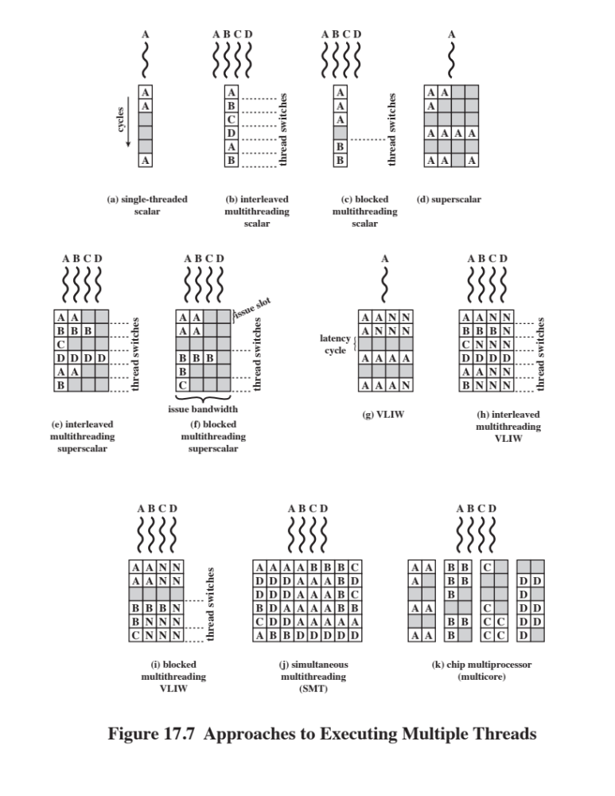
Notes:
For the first two approaches, instructions from different threads are not executed simultaneously. Instead, the processor is able to rapidly switch from one thread to another, using a different set of registers and other context information. This results in a better utilization of the processor’s execution resources and avoids a large penalty due to cache misses and other latency events. The SMT approach involves true simultaneous execution of instructions from different threads, using replicated execution resources. Chip multiprocessing also enables simultaneous execution of instructions from different threads.
Figure 17.7, based on one in [UNGE02], illustrates some of the possible pipe- line architectures that involve multithreading and contrasts these with approaches that do not use multithreading. Each horizontal row represents the potential issue slot or slots for a single execution cycle; that is, the width of each row corresponds to the maximum number of instructions that can be issued in a single clock cycle. The vertical dimension represents the time sequence of clock cycles. An empty (shaded) slot represents an unused execution slot in one pipeline. A no-op is indicated by N.
The first three illustrations in Figure 17.7 show different approaches with a scalar (i.e., single-issue) processor:
Single-threaded scalar: This is the simple pipeline found in traditional RISC and CISC machines, with no multithreading.
Interleaved multithreaded scalar: This is the easiest multithreading approach to implement. By switching from one thread to another at each clock cycle, the pipeline stages can be kept fully occupied, or close to fully occupied. The hardware must be capable of switching from one thread context to another between cycles.
• Blocked multithreaded scalar: In this case, a single thread is executed until a latency event occurs that would stop the pipeline, at which time the processor
switches to another thread.
In the case of interleaved multithreading, it is assumed that there are no control or data dependencies between threads, which simplifies the pipeline design and there- fore should allow a thread switch with no delay. However, depending on the specific design and implementation, block multithreading may require a clock cycle to per- form a thread switch, as illustrated in Figure 17.7. This is true if a fetched instruction triggers the thread switch and must be discarded from the pipeline [UNGE03].
Although interleaved multithreading appears to offer better processor utilization than blocked multithreading, it does so at the sacrifice of single-thread performance. The multiple threads compete for cache resources, which raises the probability of a cache miss for a given thread.
More opportunities for parallel execution are available if the processor can
issue multiple instructions per cycle. Figures 17.7d through 17.7i illustrate a number
of variations among processors that have hardware for issuing four instructions per
cycle. In all these cases, only instructions from a single thread are issued in a single
cycle. The following alternatives are illustrated:
■ Superscalar: This is the basic superscalar approach with no multithreading.
Until relatively recently, this was the most powerful approach to providing
parallelism within a processor. Note that during some cycles, not all of the
available issue slots are used. During these cycles, less than the maximum number
of instructions is issued; this is referred to as horizontal loss . During other
instruction cycles, no issue slots are used; these are cycles when no instructions
can be issued; this is referred to as vertical loss .
■ Interleaved multithreading superscalar: During each cycle, as many instructions
as possible are issued from a single thread. With this technique, potential
delays due to thread switches are eliminated, as previously discussed. However,
the number of instructions issued in any given cycle is still limited by
dependencies that exist within any given thread.
■ Blocked multithreaded superscalar: Again, instructions from only one thread
may be issued during any cycle, and blocked multithreading is used.
■ Very long instruction word (VLIW): A VLIW architecture, such as IA-
64, places multiple instructions in a single word. Typically, a VLIW is constructed by the
compiler, which places operations that may be executed in parallel in the same
word. In a simple VLIW machine (Figure 17.7g), if it is not possible to completely
fill the word with instructions to be issued in parallel, no-ops are used.
■ Interleaved multithreading VLIW: This approach should provide similar
efficiencies to those provided by interleaved multithreading on a superscalar
architecture.
■ Blocked multithreaded VLIW: This approach should provide similar efficiencies
to those provided by blocked multithreading on a superscalar architecture.
The final two approaches illustrated in Figure 17.7 enable the parallel, simultaneous
execution of multiple threads:
■ Simultaneous multithreading: Figure 17.7j shows a system capable of issuing
8 instructions at a time. If one thread has a high degree of instruction-
level parallelism, it may on some cycles be able fill all of the horizontal slots. On
other cycles, instructions from two or more threads may be issued. If sufficient
threads are active, it should usually be possible to issue the maximum number
of instructions on each cycle, providing a high level of efficiency.
■ Chip multiprocessor (multicore): Figure 17.7k shows a chip containing four
cores, each of which has a two-issue superscalar processor. Each core is
assigned a thread, from which it can issue up to two instructions per cycle. We
discuss multicore computers in Chapter 18.
Comparing Figures 17.7j and 17.7k, we see that a chip multiprocessor with
the same instruction issue capability as an SMT cannot achieve the same degree of
Instruction-level parallelism. This is because the chip multiprocessor is not able to
hide latencies by issuing instructions from other threads. On the other hand, the chip
multiprocessor should outperform a superscalar processor with the same instruction
issue capability, because the horizontal losses will be greater for the superscalar
processor. In addition, it is possible to use multithreading within each of the cores
on a chip multiprocessor, and this is done on some contemporary machines.

Slide 27
Clusters
Alternative to SMP as an approach to providing high performance and high availability
Particularly attractive for server applications
Defined as:
  A group of interconnected whole computers working together as a unified computing resource that can create the illusion of being one machine
  (The term whole computer means a system that can run on its own, apart from the cluster)
Each computer in a cluster is called a node
Benefits:
  Absolute scalability
  Incremental scalability
  High availability
  Superior price/performance
Notes:
An important and relatively recent development computer system design is clustering. Clustering is an alternative to symmetric multiprocessing as an approach to providing high performance and high availability and is particularly attractive for server applications. We can define a cluster as a group of interconnected, whole computers working together as a unified computing resource that can create the illusion of being one machine. The term whole computer means a system that can run on its own, apart from the cluster; in the literature, each computer in a cluster is typically referred to as a node.
[BREW97] lists four benefits that can be achieved with clustering. These can also be thought of as objectives or design requirements:
• Absolute scalability: It is possible to create large clusters that far surpass the power of even the largest standalone machines. A cluster can have tens, hundreds, or even thousands of machines, each of which is a multiprocessor.
• Incremental scalability: A cluster is configured in such a way that it is possible to add new systems to the cluster in small increments. Thus, a user can start out with a modest system and expand it as needs grow, without having to go through a major upgrade in which an existing small system is replaced with a larger system.
• High availability: Because each node in a cluster is a standalone computer, the failure of one node does not mean loss of service. In many products, fault tolerance is handled automatically in software.
• Superior price/performance: By using commodity building blocks, it is possible to put together a cluster with equal or greater computing power than a single large machine, at much lower cost.

Slide 28
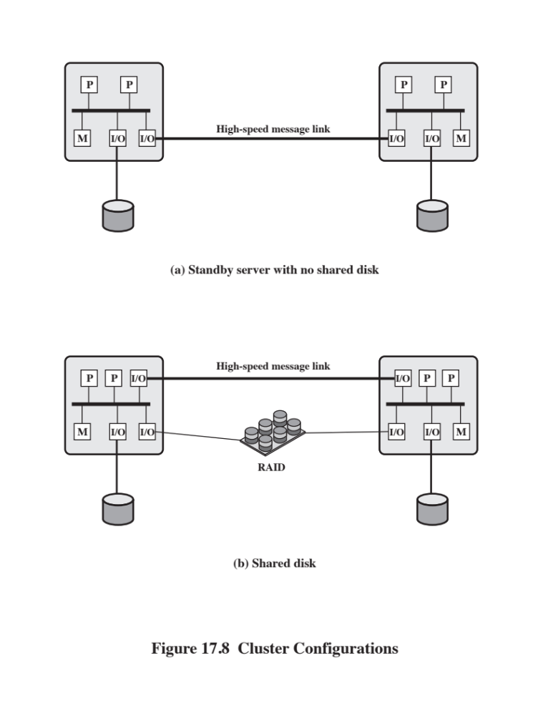
Notes:
In the literature, clusters are classified in a number of different ways. Perhaps the simplest classification is based on whether the computers in a cluster share access to the same disks. Figure 17.8a shows a two-node cluster in which the only interconnection is by means of a high-speed link that can be used for message exchange to coordinate cluster activity. The link can be a LAN that is shared with other computers that are not part of the cluster or the link can be a dedicated interconnection facility. In the latter case, one or more of the computers in the cluster will have a link to a LAN or WAN so that there is a connection between the server cluster and remote client systems. Note that in the figure, each computer is depicted as being a multiprocessor. This is not necessary but does enhance both performance and availability.
In the simple classification depicted in Figure 17.8, the other alternative is a shared-disk cluster. In this case, there generally is still a message link between
nodes. In addition, there is a disk subsystem that is directly linked to multiple computers within the cluster. In this figure, the common disk subsystem is a RAID system. The use of RAID or some similar redundant disk technology is common in clusters so that the high availability achieved by the presence of multiple computers is not compromised by a shared disk that is a single point of failure.
A common, older method, known as passive standby , is simply to have one
computer handle all of the processing load while the other computer remains
inactive, standing by to take over in the event of a failure of the primary. To coordinate
the machines, the active, or primary, system periodically sends a “heartbeat”
message to the standby machine. Should these messages stop arriving, the standby
assumes that the primary server has failed and puts itself into operation. This
approach increases availability but does not improve performance. Further, if the
only information that is exchanged between the two systems is a heartbeat message,
and if the two systems do not share common disks, then the standby provides a
functional backup but has no access to the databases managed by the primary.
The passive standby is generally not referred to as a cluster. The term cluster
is reserved for multiple interconnected computers that are all actively doing processing
while maintaining the image of a single system to the outside world. The
term active secondary is often used in referring to this configuration. Three classifications
of clustering can be identified: separate servers, shared nothing, and shared
memory.
In one approach to clustering, each computer is a separate server with its own
disks and there are no disks shared between systems (Figure 17.8a). This arrangement
provides high performance as well as high availability. In this case, some type
of management or scheduling software is needed to assign incoming client requests
to servers so that the load is balanced and high utilization is achieved. It is desirable
to have a failover capability, which means that if a computer fails while executing
an application, another computer in the cluster can pick up and complete
the application. For this to happen, data must constantly be copied among systems
so that each system has access to the current data of the other systems. The overhead
of this data exchange ensures high availability at the cost of a performance
penalty.
To reduce the communications overhead, most clusters now consist of servers
connected to common disks (Figure 17.8b). In one variation on this approach, called
shared nothing , the common disks are partitioned into volumes, and each volume is
owned by a single computer. If that computer fails, the cluster must be reconfigured
so that some other computer has ownership of the volumes of the failed computer.
It is also possible to have multiple computers share the same disks at the same
time (called the shared disk approach), so that each computer has access to all of the
volumes on all of the disks. This approach requires the use of some type of locking
facility to ensure that data can only be accessed by one computer at a time.

Slide 29
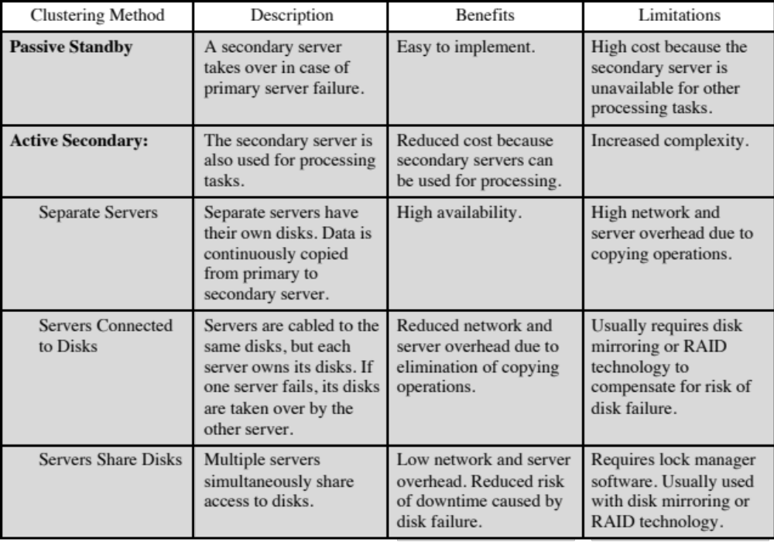
Table 17.2
Clustering Methods: Benefits and Limitations
Notes:
A clearer picture of the range of cluster options can be gained by looking at functional alternatives. Table 17.2 provides a useful classification along functional lines.

Slide 30
Operating System Design Issues
How failures are managed depends on the clustering method used
Two approaches:
  Highly available clusters
  Fault tolerant clusters
  Failover
  The function of switching applications and data resources over from a failed system to an alternative system in the cluster
  Failback
  Restoration of applications and data resources to the original system once it has been fixed
Load balancing
  Incremental scalability
  Automatically include new computers in scheduling
  Middleware needs to recognize that processes may switch between machines
Notes:
How failures are managed by a cluster depends on the clustering method used (Table 17.2). In general, two approaches can be taken to dealing with failures: highly available clusters and fault-tolerant clusters. A highly available cluster offers a high probability that all resources will be in service. If a failure occurs, such as a system goes down or a disk volume is lost, then the queries in progress are lost. Any lost query, if retried, will be serviced by a different computer in the cluster. However, the cluster operating system makes no guarantee about the state of partially executed transactions. This would need to be handled at the application level.
A fault-tolerant cluster ensures that all resources are always available. This is achieved by the use of redundant shared disks and mechanisms for backing out uncommitted transactions and committing completed transactions.
The function of switching applications and data resources over from a failed system to an alternative system in the cluster is referred to as failover. A related function is the restoration of applications and data resources to the original system once it has been fixed; this is referred to as failback. Failback can be automated, but this is desirable only if the problem is truly fixed and unlikely to recur. If not, automatic failback can cause subsequently failed resources to bounce back and forth between computers, resulting in performance and recovery problems.
A cluster requires an effective capability for balancing the load among available computers. This includes the requirement that the cluster be incrementally scalable. When a new computer is added to the cluster, the load-balancing facility should automatically include this computer in scheduling applications. Middleware mechanisms need to recognize that services can appear on different members of the cluster and may migrate from one member to another.

Slide 31
Parallelizing Computation
Effective use of a cluster requires executing software from a single application in parallel
Three approaches are:
Parallelizing complier
Determines at compile time which parts of an application can be executed in parallel
These are then split off to be assigned to different computers in the cluster
Parallelized application
Application written from the outset to run on a cluster and uses message passing to move data between cluster nodes
Parametric computing
Can be used if the essence of the application is an algorithm or program that must be executed a large number of times, each time with a different set of starting conditions or parameters
Notes:
In some cases, effective use of a cluster requires executing software from a single application in parallel. [KAPP00] lists three general approaches to the problem:
• Parallelizing compiler: A parallelizing compiler determines, at compile time, which parts of an application can be executed in parallel. These are then split off to be assigned to different computers in the cluster. Performance depends on the nature of the problem and how well the compiler is designed. In general, such compilers are difficult to develop.
• Parallelized application: In this approach, the programmer writes the application from the outset to run on a cluster, and uses message passing to move data, as required, between cluster nodes. This places a high burden on the programmer but may be the best approach for exploiting clusters for some applications.
• Parametric computing: This approach can be used if the essence of the application is an algorithm or program that must be executed a large number of times, each time with a different set of starting conditions or parameters. A good example is a simulation model, which will run a large number of different scenarios and then develop statistical summaries of the results. For this approach to be effective, parametric processing tools are needed to organize, run, and manage the jobs in an effective manner.

Slide 32
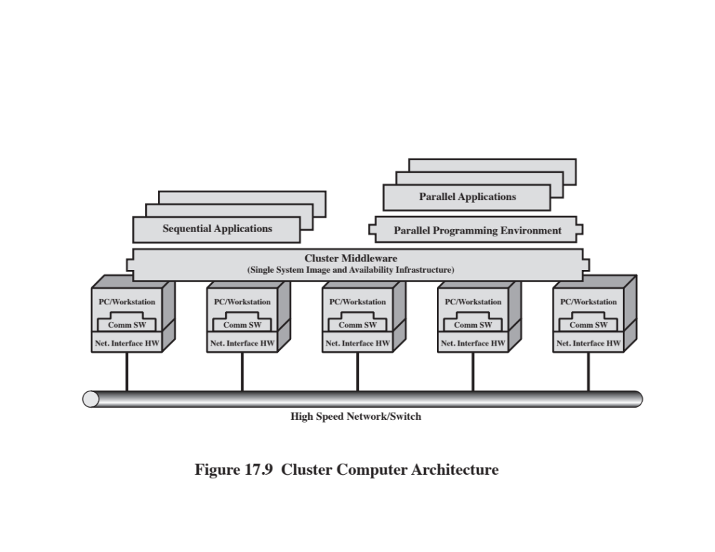
Notes:
Figure 17.9 shows a typical cluster architecture. The individual computers are connected
by some high-speed LAN or switch hardware. Each computer is capable of
operating independently. In addition, a middleware layer of software is installed
in each computer to enable cluster operation. The cluster middleware provides a
unified system image to the user, known as a single-system image. The middleware
is also responsible for providing high availability, by means of load balancing and
responding to failures in individual components. [HWAN99] lists the following as
desirable cluster middleware services and functions:
■ Single entry point: A user logs onto the cluster rather than to an individual
computer.
■ Single file hierarchy: The user sees a single hierarchy of file directories under
the same root directory.
■ Single control point: There is a default workstation used for cluster management
and control.
■ Single virtual networking: Any node can access any other point in the cluster,
even though the actual cluster configuration may consist of multiple interconnected
networks. There is a single virtual network operation.
■ Single memory space: Distributed shared memory enables programs to share
variables.
■ Single job-management system: Under a cluster job scheduler, a user can submit
a job without specifying the host computer to execute the job.
■ Single user interface: A common graphic interface supports all users, regardless
of the workstation from which they enter the cluster.
■ Single I/O space: Any node can remotely access any I/O peripheral or disk
device without knowledge of its physical location.
■ Single process space: A uniform process-identification scheme is used. A
process on any node can create or communicate with any other process on a
remote node.
■ Checkpointing: This function periodically saves the process state and intermediate
computing results, to allow rollback recovery after a failure.
■ Process migration: This function enables load balancing.
The last four items on the preceding list enhance the availability of the cluster.
The remaining items are concerned with providing a single system image.
Returning to Figure 17.9, a cluster will also include software tools for enabling
the efficient execution of programs that are capable of parallel execution.

Slide 33
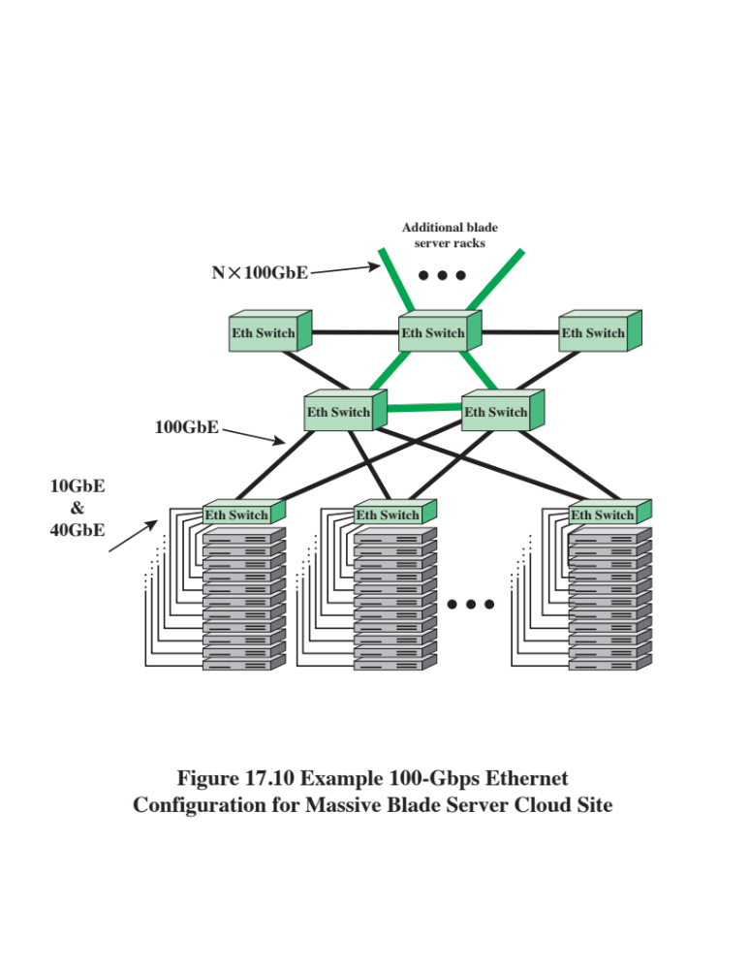
Notes:
A common implementation of the cluster approach is the blade server. A blade
server is a server architecture that houses multiple server modules (“blades”) in
a single chassis. It is widely used in data centers to save space and improve system
management. Either self-standing or rack mounted, the chassis provides the power
supply, and each blade has its own processor, memory, and hard disk.
An example of the application is shown in Figure 17.10. The trend at
large data centers, with substantial banks of blade servers, is the deployment
of 10-Gbps ports on individual servers to handle the massive multimedia traffic
provided by these servers. Such arrangements are stressing the on-site Ethernet
switches needed to interconnect large numbers of servers. A 100-Gbps rate provides
the bandwidth required to handle the increased traffic load. The 100-Gbps
Ethernet switches are deployed in switch uplinks inside the data center as well
as providing interbuilding, intercampus, wide area connections for enterprise
networks.

Slide 34
Clusters Compared to SMP
Both provide a configuration with multiple processors to support high demand applications
Both solutions are available commercially
SMP
Clustering
Easier to manage and configure
Much closer to the original single processor model for which nearly all applications are written
  Less physical space and lower power consumption
  Well established and stable
Far superior in terms of incremental and absolute scalability
Superior in terms of availability
All components of the system can readily be made highly redundant
Notes:
Both clusters and symmetric multiprocessors provide a configuration with multiple processors to support high-demand applications. Both solutions are commercially available, although SMP schemes have been around far longer.
The main strength of the SMP approach is that an SMP is easier to manage and configure than a cluster. The SMP is much closer to the original single-processor
model for which nearly all applications are written. The principal change required in going from a uniprocessor to an SMP is to the scheduler function. Another benefit of the SMP is that it usually takes up less physical space and draws less power than a comparable cluster. A final important benefit is that the SMP products are well established and stable.
Over the long run, however, the advantages of the cluster approach are likely to result in clusters dominating the high-performance server market. Clusters are far superior to SMPs in terms of incremental and absolute scalability. Clusters are also superior in terms of availability, because all components of the system can readily be made highly redundant.

Slide 35
Nonuniform Memory Access (NUMA)
Alternative to SMP and clustering
Uniform memory access (UMA)
  All processors have access to all parts of main memory using loads and stores
  Access time to all regions of memory is the same
  Access time to memory for different processors is the same
Nonuniform memory access (NUMA)
  All processors have access to all parts of main memory using loads and stores
  Access time of processor differs depending on which region of main memory is being accessed
  Different processors access different regions of memory at different speeds
Cache-coherent NUMA (CC-NUMA)
  A NUMA system in which cache coherence is maintained among the caches of the various processors
Notes:
In terms of commercial products, the two common approaches to providing a multiple-processor system to support applications are SMPs and clusters. For some years, another approach, known as nonuniform memory access (NUMA), has been the subject of research and commercial NUMA products are now available.
Before proceeding, we should define some terms often found in the NUMA literature.
• Uniform memory access (UMA): All processors have access to all parts of main memory using loads and stores. The memory access time of a processor to all regions of memory is the same. The access times experienced by different processors are the same. The SMP organization discussed in Sections 17.2 and 17.3 is UMA.
• Nonuniform memory access (NUMA): All processors have access to all parts of main memory using loads and stores. The memory access time of a processor differs depending on which region of main memory is accessed. The last statement is true for all processors; however, for different processors, which memory regions are slower and which are faster differ.
• Cache-coherent NUMA (CC-NUMA): A NUMA system in which cache coherence is maintained among the caches of the various processors.
A NUMA system without cache coherence is more or less equivalent to a cluster. The commercial products that have received much attention recently are CC-NUMA systems, which are quite distinct from both SMPs and clusters. Usually, but unfortunately not always, such systems are in fact referred to in the commercial literature as CC-NUMA systems.

Slide 36
Motivation
SMP has practical limit to number of processors that can be used
Bus traffic limits to between 16 and 64 processors
In clusters each node has its own private main memory
Applications do not see a large global memory
Coherency is maintained by software rather than hardware
NUMA retains SMP flavor while giving large scale multiprocessing
Objective with NUMA is to maintain a transparent system wide memory while permitting multiple multiprocessor nodes, each with its own bus or internal interconnect system
Notes:
With an SMP system, there is a practical limit to the number of processors that can be used. An effective cache scheme reduces the bus traffic between any one processor and main memory. As the number of processors increases, this bus traffic also increases. Also, the bus is used to exchange cache-coherence signals, further adding to the burden. At some point, the bus becomes a performance bottleneck. Performance degradation seems to limit the number of processors in an SMP configuration to somewhere between 16 and 64 processors. For example, Silicon Graphics’ Power Challenge SMP is limited to 64 R10000 processors in a single system; beyond this number performance degrades substantially.
The processor limit in an SMP is one of the driving motivations behind the
development of cluster systems. However, with a cluster, each node has its own
private main memory; applications do not see a large global memory. In effect,
coherency is maintained in software rather than hardware. This memory granularity
affects performance and, to achieve maximum performance, software must be tailored
to this environment. One approach to achieving large-scale multiprocessing
while retaining the flavor of SMP is NUMA.
The objective with NUMA is to maintain a transparent system wide memory
while permitting multiple multiprocessor nodes, each with its own bus or other
internal interconnect system.

Slide 37
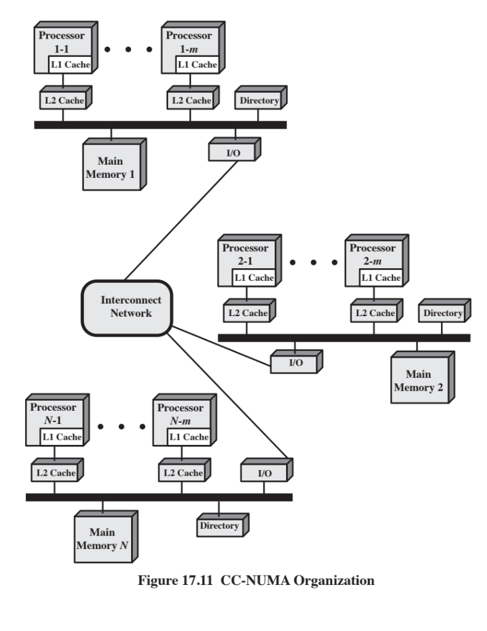
Notes:
Figure 17.11 depicts a typical CC-NUMA organization. There are multiple independent nodes, each of which is, in effect, an SMP organization. Thus, each node contains multiple processors, each with its own L1 and L2 caches, plus main memory. The node is the basic building block of the overall CC-NUMA organization. For example, each Silicon Graphics Origin node includes two MIPS R10000 processors; each Sequent NUMA-Q node includes four Pentium II processors. The nodes are interconnected by means of some communications facility, which could be a switching mechanism, a ring, or some other networking facility.
Each node in the CC-NUMA system includes some main memory. From the point of view of the processors, however, there is only a single addressable memory, with each location having a unique system wide address. When a processor initiates a memory access, if the requested memory location is not in that processor’s cache, then the L2 cache initiates a fetch operation. If the desired line is in the local portion of the main memory, the line is fetched across the local bus. If the desired line is in a remote portion of the main memory, then an automatic request is sent out to fetch that line across the interconnection network, deliver it to the local bus, and then deliver it to the requesting cache on that bus. All of this activity is automatic and transparent to the processor and its cache.
In this configuration, cache coherence is a central concern. Although implementations differ as to details, in general terms we can say that each node must maintain some sort of directory that gives it an indication of the location of various portions of memory and also cache status information.

Slide 38
NUMA Pros and Cons
Main advantage of a CC-NUMA system is that it can deliver effective performance at higher levels of parallelism than SMP without requiring major software changes
Bus traffic on any individual node is limited to a demand that the bus can handle
If many of the memory accesses are to remote nodes, performance begins to break down
Does not transparently look like an SMP
Software changes will be required to move an operating system and applications from an SMP to a CC-NUMA system
Concern with availability
Notes:
The main advantage of a CC-NUMA system is that it can deliver effective performance at higher levels of parallelism than SMP, without requiring major software changes. With multiple NUMA nodes, the bus traffic on any individual node is limited to a demand that the bus can handle. However, if many of the memory accesses are to remote nodes, performance begins to break down. There is reason to believe that this performance breakdown can be avoided. First, the use of L1 and L2 caches is designed to minimize all memory accesses, including remote ones. If much of the software has good temporal locality, then remote memory accesses should not be excessive. Second, if the software has good spatial locality, and if virtual memory is in use, then the data needed for an application will reside on a limited number of frequently used pages that can be initially loaded into the memory local to the running application. The Sequent designers report that such spatial locality does appear in representative applications [LOVE96]. Finally, the virtual memory scheme can be enhanced by including in the operating system a page migration mechanism that will move a virtual memory page to a node that is frequently using it; the Silicon Graphics designers report success with this approach [WHIT97].
Even if the performance breakdown due to remote access is addressed, there are two other disadvantages for the CC-NUMA approach [PFIS98]. First, a CC-NUMA does not transparently look like an SMP; software changes will be required to move an operating system and applications from an SMP to a CC-NUMA system. These include page allocation, already mentioned, process allocation, and load balancing by the operating system. A second concern is that of availability. This is a rather complex issue and depends on the exact implementation of the CC-NUMA system; the interested reader is referred to [PFIS98].

Slide 39
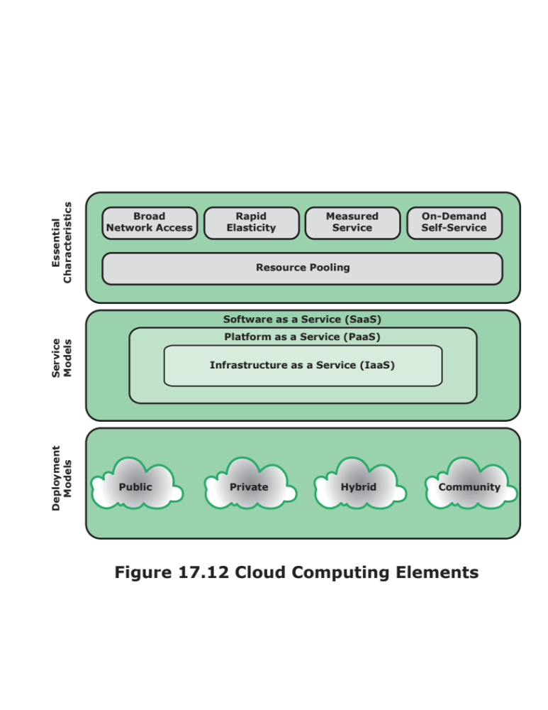
Notes:
NIST SP-800-145 (The NIST Definition of Cloud Computing ) specifies that cloud
computing is composed of five essential characteristics, three service models, and
four deployment models. Figure 17.12 illustrates the relationship among these concepts.
The essential characteristics of cloud computing include the following:
■ Broad network access: Capabilities are available over the network and
accessed through standard mechanisms that promote use by heterogeneous
thin or thick client platforms (e.g., mobile phones, laptops, and tablets) as well
as other traditional or cloud-based software services.
■ Rapid elasticity: Cloud computing gives you the ability to expand and reduce
resources according to your specific service requirement. For example, you
may need a large number of server resources for the duration of a specific
task. You can then release these resources upon completion of the task.
■ Measured service: Cloud systems automatically control and optimize resource
use by leveraging a metering capability at some level of abstraction appropriate
to the type of service (e.g., storage, processing, bandwidth, and active
user accounts). Resource usage can be monitored, controlled, and reported,
providing transparency for both the provider and consumer of the utilized
service.
■ On-demand self-service: A consumer can unilaterally provision computing
capabilities, such as server time and network storage, as needed automatically
without requiring human interaction with each service provider. Because
the service is on demand, the resources are not permanent parts of your IT
infrastructure.
■ Resource pooling: The provider’s computing resources are pooled to serve
multiple consumers using a multi-tenant model, with different physical and
virtual resources dynamically assigned and reassigned according to consumer
demand. There is a degree of location independence in that the customer generally
has no control or knowledge over the exact location of the provided
resources, but may be able to specify location at a higher level of abstraction
(e.g., country, state, or datacenter). Examples of resources include storage,
processing, memory, network bandwidth, and virtual machines. Even private
clouds tend to pool resources between different parts of the same organization.

Slide 40
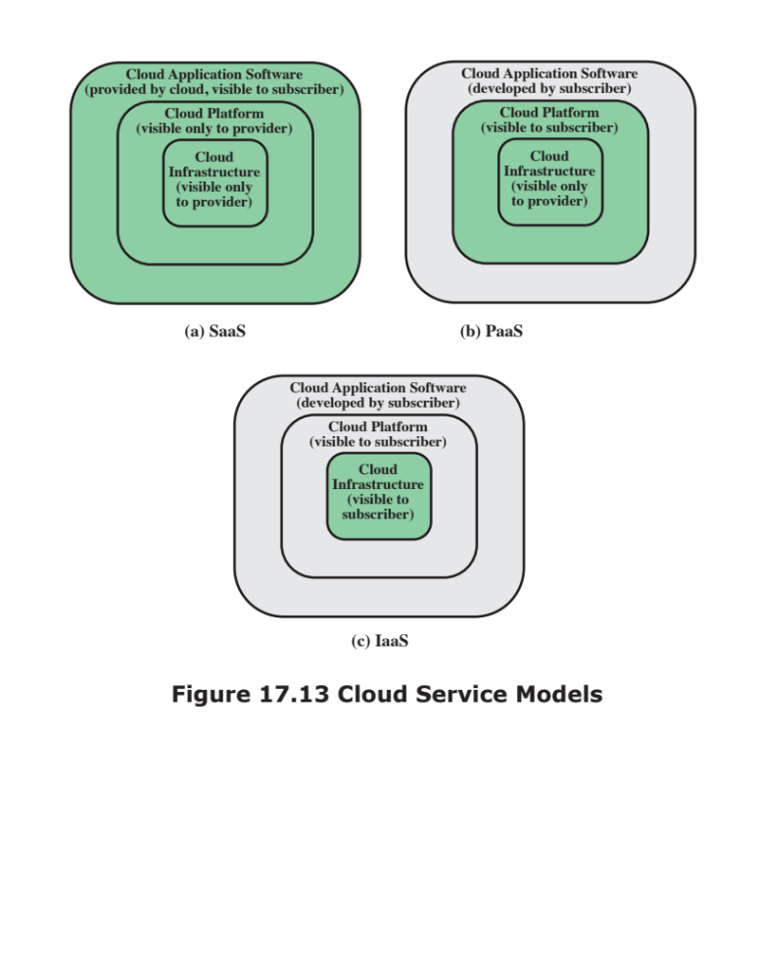
Notes:
NIST defines three service models , which can be viewed as nested service
alternatives (Figure 17.13). These were defined in Chapter 1, and can be briefly
summarized as follows:
■ Software as a service (SaaS): Provides service to customers in the form of software,
specifically application software, running on and accessible in the cloud.
■ Platform as a service (PaaS): Provides service to customers in the form of a
platform on which the customer's applications can run.
■ Infrastructure as a service (IaaS): Provides the customer access to the underlying
cloud infrastructure.

Slide 41
Deployment Models
Community cloud
  Like a private cloud it is not open to any subscriber
  Like a public cloud the resources are shared among a number of independent orgaizations
  Hybrid cloud
  The cloud infrastructure is a composition of two or more clouds that remain unique entities but are bound together by standardized or proprietary technology that enables data and application portability
  Sensitive information can be placed in a private area of the cloud and less sensitive data can take advantage of the cost benefits of the public cloud
Public cloud
  The cloud infrastructure is made available to the general public or a large industry group and is owned by an organization selling cloud services
  Major advantage is cost
Private cloud
  A cloud infrastructure implemented within the internal IT environment of the organization
  A key motivation for opting for a private cloud is security
Notes:
NIST defines four deployment models :
■ Public cloud: The cloud infrastructure is made available to the general public
or a large industry group and is owned by an organization selling cloud services.
The cloud provider is responsible both for the cloud infrastructure and
for the control of data and operations within the cloud. The major advantage
of the public cloud is cost. A subscribing organization only pays for the services
and resources it needs and can adjust these as needed. Further, the subscriber
has greatly reduced management overhead. The principal concern is security.
However, there are a number of public cloud providers that have demonstrated
strong security controls and, in fact, such providers may have more resources
and expertise to devote to security that would be available in a private cloud.
■ Private cloud: A private cloud is a cloud infrastructure implemented within
the internal IT environment of the organization. The organization may choose
to manage the cloud in house or contract the management function to a third
party. Additionally, the cloud servers and storage devices may exist on premise
or off premise. A key motivation for opting for a private cloud is security.
A private cloud infrastructure offers tighter controls over the geographic location
of data storage and other aspects of security.
■ Community cloud: A community cloud shares characteristics of private and
public clouds. Like a private cloud, a community cloud is not open to any subscriber.
Like a public cloud, the cloud resources are shared among a number of
independent organizations. The organizations that share the community cloud
have similar requirements and, typically, a need to exchange data with each
other. One example of an industry that is employing the community cloud
concept is the health care industry. A community cloud can be implemented
to comply with government privacy and other regulations. The community
participants can exchange data in a controlled fashion. The cloud infrastructure
may be managed by the participating organizations or a third party and
may exist on premise or off premise. In this deployment model, the costs are
spread over fewer users than a public cloud (but more than a private cloud), so
only some of the cost savings potential of cloud computing are realized.
■ Hybrid cloud: The cloud infrastructure is a composition of two or more clouds (private,
community, or public) that remain unique entities but are bound together by
standardized or proprietary technology that enables data and application portability
(e.g., cloud bursting for load balancing between clouds). With a hybrid cloud
solution, sensitive information can be placed in a private area of the cloud, and
less sensitive data can take advantage of the cost benefits of the public cloud.

Slide 42
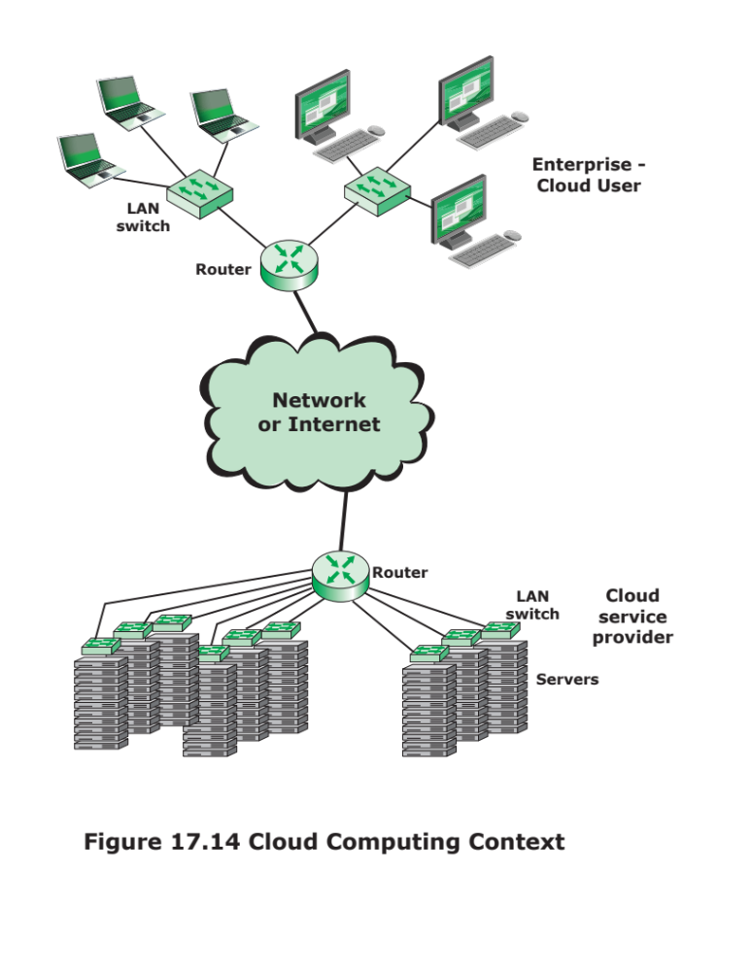
Notes:
Figure 17.14 illustrates the typical cloud service context. An enterprise maintains
workstations within an enterprise LAN or set of LANs, which are connected by a
router through a network or the Internet to the cloud service provider. The cloud service
provider maintains a massive collection of servers, which it manages with a variety
of network management, redundancy, and security tools. In the figure, the cloud infrastructure
is shown as a collection of blade servers, which is a common architecture.

Slide 43
Cloud Computing Reference Architecture
NIST SP 500-292 establishes a reference architecture, described as:
“The NIST cloud computing reference architecture focuses on the requirements of “what” cloud services provide, not a “how to” design solution and implementation. The reference architecture is intended to facilitate the understanding of the operational intricacies in cloud computing. It does not represent the system architecture of a specific
cloud computing system; instead it is a tool for describing, discussing, and developing a system-specific
architecture using a common framework of reference.”
Notes:
The NIST cloud computing reference architecture focuses on the requirements of
“what” cloud services provide, not a “how to” design solution and implementation. The
reference architecture is intended to facilitate the understanding of the operational
intricacies in cloud computing. It does not represent the system architecture of a specific
cloud computing system; instead it is a tool for describing, discussing, and developing a
system-specific architecture using a common framework of reference.
NIST developed the reference architecture with the following objectives in mind:
■ To illustrate and understand the various cloud services in the context of an
overall cloud computing conceptual model.
■ To provide a technical reference for consumers to understand, discuss, categorize,
and compare cloud services.
■ To facilitate the analysis of candidate standards for security, interoperability,
and portability and reference implementations.

Slide 44
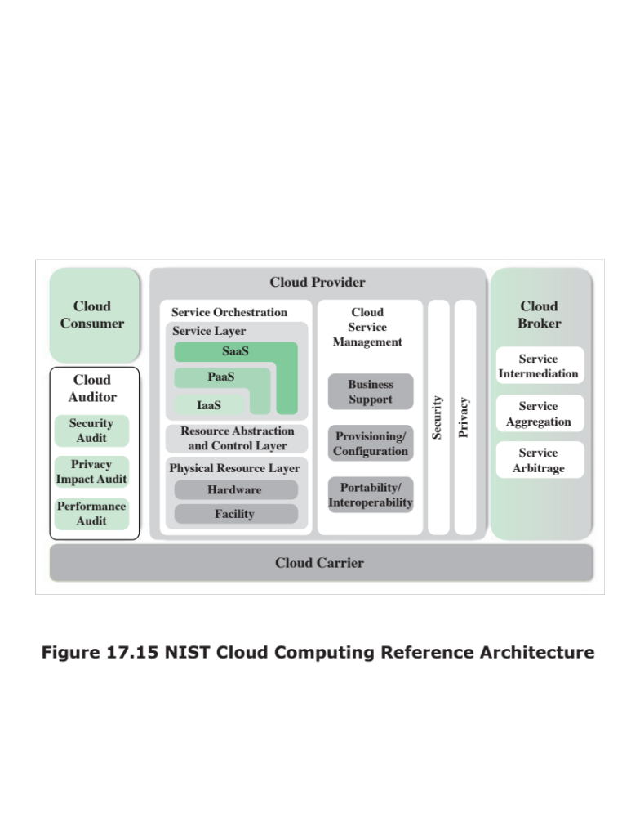
Notes:
The reference architecture, depicted in Figure 17.15, defines five major actors
in terms of the roles and responsibilities:
■ Cloud consumer: A person or organization that maintains a business relationship
with, and uses service from, cloud providers.
■ Cloud provider (CP): A person, organization, or entity responsible for making
a service available to interested parties.
■ Cloud auditor: A party that can conduct independent assessment of cloud services,
information system operations, performance, and security of the cloud
implementation.
■ Cloud broker: An entity that manages the use, performance, and delivery
of cloud services, and negotiates relationships between CPs and cloud
consumers.
■ Cloud carrier: An intermediary that provides connectivity and transport of
cloud services from CPs to cloud consumers.
The cloud carrier is a networking facility that provides connectivity and
transport of cloud services between cloud consumers and CPs. Typically, a CP will
set up service level agreements (SLAs) with a cloud carrier to provide services
consistent with the level of SLAs offered to cloud consumers, and may require the
cloud carrier to provide dedicated and secure connections between cloud consumers
and CPs.
A cloud broker is useful when cloud services are too complex for a cloud consumer
to easily manage. A cloud broker can offer three areas of support:
■ Service intermediation: These are value-
added services, such as identity management,
performance reporting, and enhanced security.
■ Service aggregation: The broker combines multiple cloud services to meet
consumer needs not specifically addressed by a single CP, or to optimize performance
or minimize cost.
■ Service arbitrage: This is similar to service aggregation except that the services
being aggregated are not fixed. Service arbitrage means a broker has the
flexibility to choose services from multiple agencies. The cloud broker, for
example, can use a credit-scoring service to measure and select an agency with
the best score.
A cloud auditor can evaluate the services provided by a CP in terms of security
controls, privacy impact, performance, and so on. The auditor is an independent
entity that can assure that the CP conforms to a set of standards.

Slide 45
Summary
Parallel
Processing
Chapter 17
  Multithreading and chip multiprocessors
  Implicit and explicit multithreading
  Approaches to explicit multithreading
  Clusters
  Cluster configurations
  Operating system design issues
  Cluster computer architecture
  Blade servers
  Clusters compared to SMP
  Nonuniform memory access
  Motivation
  Organization
  NUMA Pros and cons
  Cloud computing
  Cloud computing elements
  Cloud computing reference architecture
  Multiple processor organizations
  Types of parallel processor systems
  Parallel organizations
  Symmetric multiprocessors
  Organization
  Multiprocessor operating system design considerations
  Cache coherence and the MESI protocol
  Software solutions
  Hardware solutions
  The MESI protocol
Notes:
Chapter 17 summary.

