Slide 1

William Stallings
Computer Organization and Architecture
10th Edition
Notes:
Lecture slides prepared for “Computer Organization and Architecture”, 10/e, by William Stallings, Chapter 19 “General-Purpose Graphic Processing Units”. (Contributed by Peter Zeno, Ph.D Candidate, University of Bridgeport)

Slide 2
Chapter 19
General-Purpose Graphic Processing Units
Notes:
The graphics processor unit (GPU) is designed specifically to be optimized for fast
three-dimensional (3D) graphics rendering and video processing. GPUs can be found
in almost all of today’s workstations, laptops, tablets, and smartphones [OWEN08].
The GPU comes in many sizes. The larger units have several hundred to thousands
of parallel processor cores on a single integrated circuit (IC). These can be found
as separate coprocessor cards, usually PCIe- based, in workstations, gaming systems,
and even supercomputers [SLAV12]. The smallest GPUs are found in embedded
systems, such as tablets and smartphones, where the GPU is composed of only a
single--digit number of cores, and are typically combined with a number of conventional
cores, referred to as central processing units (CPUs) on the same silicon IC.
Over the past several years, the GPU has found its way into massively parallel
programming environments for a wide range of applications, such as bioinformatics,
molecular dynamics, oil and gas exploration, computational finance, signal and
audio processing, statistical modeling, computer vision, and medical imaging. This
is where the term general-purpose computing using a GPU (GPGPU) is derived
from. The main reasons for the migration of highly parallelizable applications to
the GPU are due to the advent of programmer friendly GPGPU languages, such as
NVIDIA’s CUDA and the Khronos Group’s OpenCL, some slight modifications
to the GPU architecture to facilitate general-purpose computing [SAND10] (from
here on known as GPGPU architecture), along with the low cost and high performance
of GPUs. For example, for about $200, one can purchase a GPU with 960
parallel processor cores for your workstation (e.g., NVIDIA’s GeForce GTX 660).
We begin this chapter with an overview of the CUDA model, which is essential
for understanding the design and use of GPUs. Next, the chapter contrasts
GPUs and CPUs. This is followed by a detailed look at GPU architecture. Then,
Intel’s GPU is examined. Finally, the chapter discusses when to use a GPU as a
coprocessor.

Slide 3
Compute Unified Device Architecture (CUDA)
A parallel computing platform and programming model created by NVIDIA and implemented by the graphics processing units (GPUs) that they produce
CUDA C is a C/C++ based language
Program can be divided into three general sections
  Code to be run on the host (CPU)
  Code to be run on the device (GPU)
  The code related to the transfer of data between the host and the device
  The data-parallel code to be run on the GPU is called a kernel
  Typically will have few to no branching statements
  Branching statements in the kernel result in serial execution of the threads in the GPU hardware
  A thread is a single instance of the kernel function
  The programmer defines the number of threads launched when the kernel function is called
  The total number of threads defined is typically in the thousands to maximize the utilization of the GPU processor cores, as well as maximize the available speedup
  The programmer specifies how these threads are to be bundled
Notes:
CUDA (Compute Unified Device Architecture) is a parallel computing platform and
programming model created by NVIDIA and implemented by the graphics processing
units (GPUs) that they produce. To adequately describe the GPGPU architecture,
several CUDA software terms and concepts need to be covered first. This is by no
means a comprehensive introduction to the CUDA programming language, particularly
since the focus of this chapter and book is on computer architecture. However, it
is difficult to describe the hardware portion of the GPGPU system without first laying
the foundation with CUDA software terminology and its programming framework.
These concepts will carry over into the GPU/GPGPU architecture domain.
CUDA C is a C/C++ based language. A CUDA program can be divided into
three general sections: (1) code to be run on the host (CPU); (2) code to be run on
the device (GPU); and (3) the code related to the transfer of data between the host
and the device. The code to be run on the host is of course serial code that can’t, or
isn’t worth, parallelizing. The data-parallel code to be run on the GPU is called a
kernel , while a thread is a single instance of this kernel function. The kernel typically
will have few to no branching statements. Branching statements in the kernel
result in serial execution of the threads in the GPU hardware. More about this will
be covered in Section 19.3.
The programmer defines the number of threads launched when the kernel
function is called. The total number of threads defined is typically in the thousands
to maximize the utilization of the GPU processor cores (also known as CUDA
cores ), as well as maximize the available speedup. Additionally, the programmer
specifies how these threads are to be bundled.

Slide 4
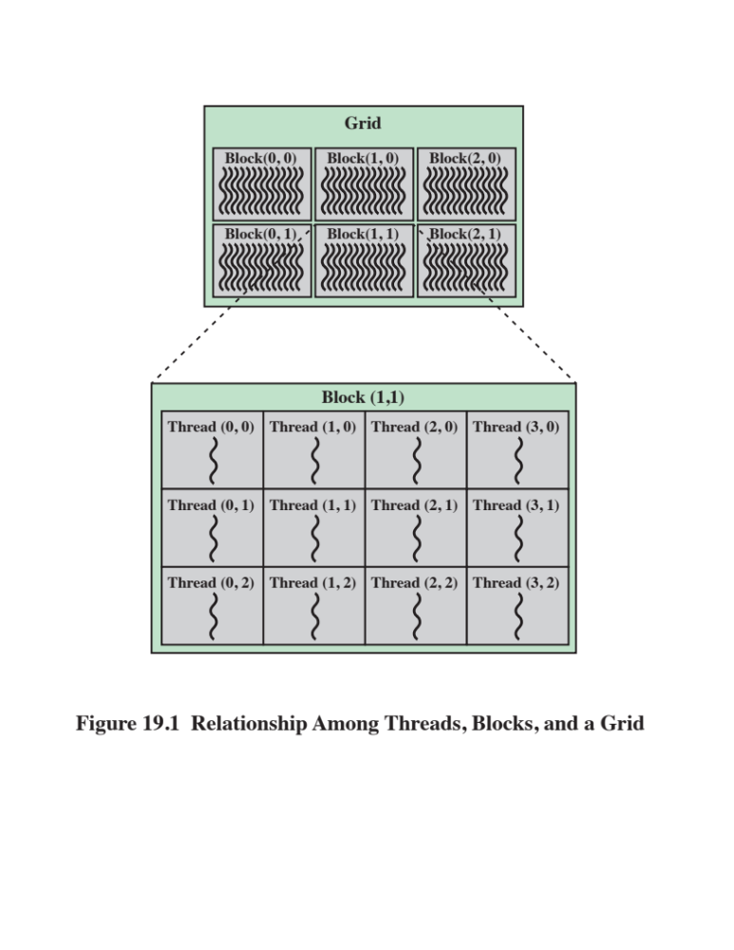
Notes:
To be more specific, threads are uniformly
bundled in blocks , and the number of blocks (also known as thread blocks )
per kernel launch is called a grid (see Figure 19.1).
Figure 19.1 illustrates a two-dimensional grid of two-dimensional thread
blocks. Both the grid and block dimensions can be either one, two, or three dimensions.
They need not have the same dimensions. For example, the grid could be
set to one dimension, and the thread block could be set to three dimensions. However,
as we will see shortly, this configuration can’t fully utilize the GPU processors,
because a block is assigned to only one of the several GPU streaming multiprocessors
(SMs) . A block is never split between SMs. Thus, all but one set of GPU processor
cores will be idle, while one SM is bearing the full processing load. Additionally,
there is a maximum number of threads that an SM will accept. If this number is surpassed,
then the code won’t compile. Therefore, it is up to the programmer to use
the specification data of the GPU to be used, and distribute the load as uniformly as
possible. At minimum, the number of thread blocks launched should be no less than
the number of SMs on the GPU. However, finding the optimum configuration can
be a very time consuming and daunting process.

Slide 5
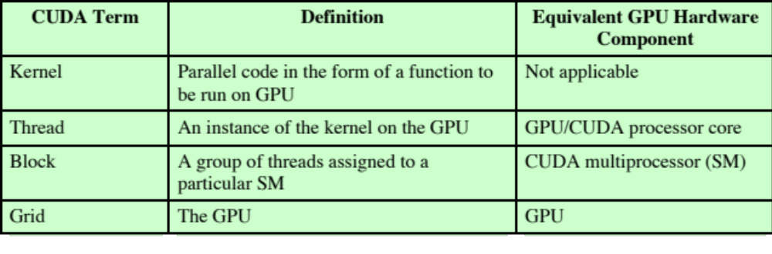
Table 19.1
CUDA Terms to GPU’s Hardware Components
Equivalence Mapping
Notes:
Table 19.1 gives a summary of
the CUDA terms just defined.

Slide 6
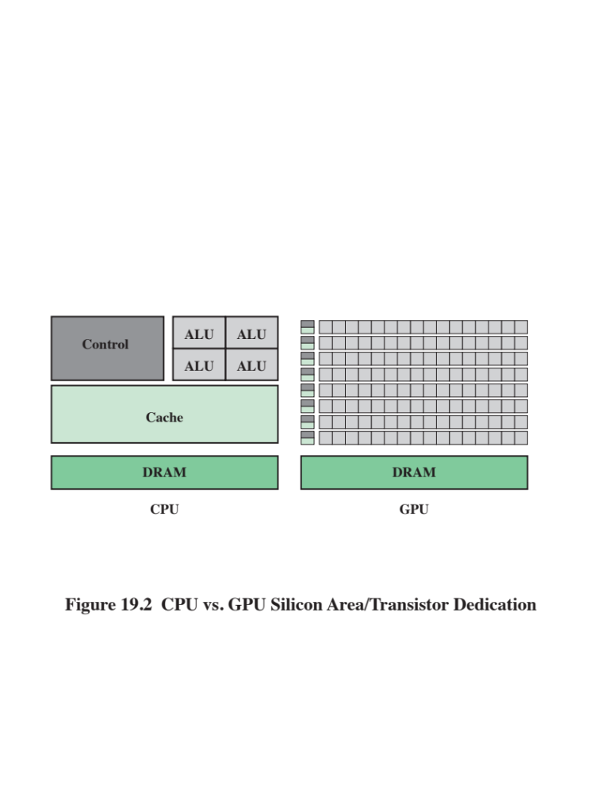
Notes:
Because the GPU and the CPU are designed and optimized for two significantly different
types of applications, their architectures differ significantly. This can be seen
by comparing the relative amount of die area (transistor count) that is dedicated to
cache, control logic, and processing logic for the two types of processor technologies
(see Figure 19.2). In the CPU, as discussed in Chapter 18, the control logic and cache
memory make up the majority of the CPU’s real estate. This is as expected for an
architecture which is tuned to process sequential code as quickly as possible. On the
other hand, a GPU uses a massively parallel SIMD (single instruction multiple data)
architecture to perform mainly mathematical operations. As such, a GPU doesn’t
require the same complex capabilities of the CPU’s control logic (i.e., out of order
execution, branch prediction, data hazards, etc.). Nor does it require large amounts of
cache memory. GPUs simply run the same thread of code on large amounts of data
and are able to hide memory latency by managing the execution of more threads
than available processor cores.

Slide 7
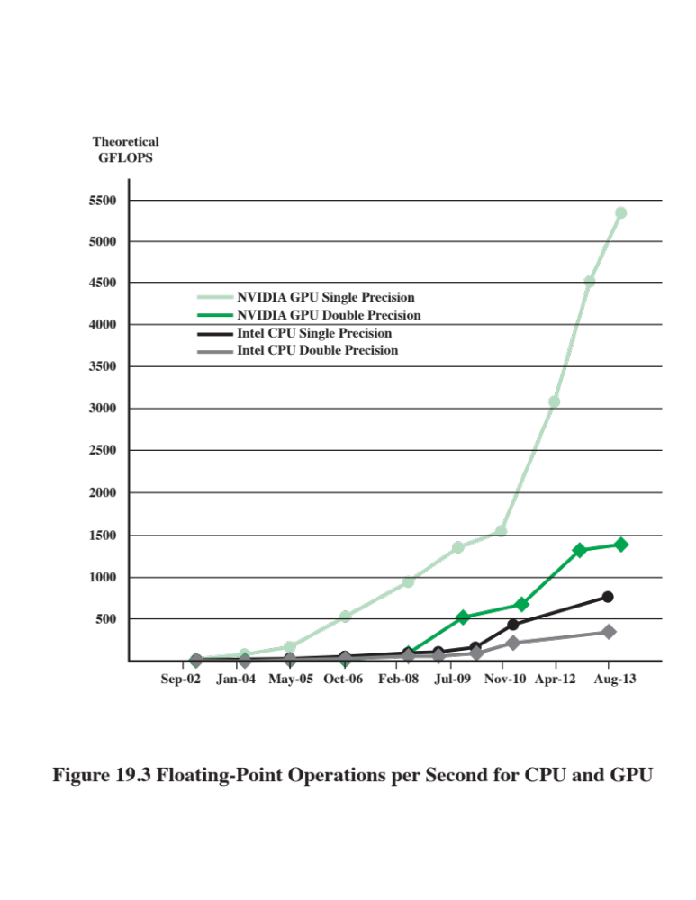
Notes:
The video game market has driven the need for ever-increasing real-time graphics
realism. This translates into more parallel GPU processor cores with greater
floating-point capabilities. As a result, the GPU is designed to maximize the number
of floating-point operations per second (FLOPs) it can perform. Additionally,
newer NVIDIA architectures, such as the Kepler and Maxwell architectures, have
focused on increasing the performance per watt ratio (FLOPs/watt) over previous
GPU architectures by decreasing the power required by each GPU processor core.
This was accomplished with Kepler by decreasing its processor cores’ clock, while
increasing the number of on-chip transistors (following Moore’s Law) allowing for a
positive net gain of 3x the performance per watt over the Fermi architecture. Additionally,
the Maxwell architecture has improved execution efficiency. This trend of
increasing FLOPs that a GPU can perform versus a multicore CPU has diverged at
an exponential rate (see Figure 19.3 [NVID14]), thus creating a large performance
gap. Similar can be said about the performance per watt gap between these two different
processing technologies.

Slide 8
GPU Architecture Overview
The historical evolution can be divided up into three major phases:
The first phase would cover early 1980s to late 1990s, where the GPU was composed of fixed, nonprogrammable, specialized processing stages
The second phase would cover the iterative modification of the resulting Phase I GPU architecture from a fixed, specialized, hardware pipeline to a fully programmable processor (early to mid-2000s)
The third phase covers how the GPU/GPGPU architecture makes an excellent and affordable highly parallelized SIMD coprocessor for accelerating the run times of some nongraphics-related programs, along with how a GPGPU language maps to this architecture
Notes:
The historical evolution of the GPU architecture can be divided up into three major
phases or eras. The first phase would cover the early days of the GPU architecture
(early 1980s to late 1990s), where the GPU was composed of fixed, nonprogrammable,
specialized processing stages (e.g., vertex, raster, shader, etc.). Additionally,
the continued technology advancements during this period, allowing for a dramatic
decrease in the size and cost of a graphics system, in turn brought graphics processors
to the PC in the mid-to late-1990s. The second phase would cover the iterative
modification of the resulting Phase I GPU architecture from a fixed, specialized,
hardware pipeline to a fully programmable processor (approximately during the
early to mid-2000s). The general, final modification, introduced by NVIDIA in
2006, facilitated the use of its new GPGPU language, CUDA. The third phase picks
up where the second one leaves off and covers how the GPU/GPGPU architecture
makes an excellent and affordable highly parallelized SIMD coprocessor for
accelerating the run times of some nongraphics-related programs, along with how a
GPGPU language (CUDA in this case) maps to this architecture. The focus of this
chapter follows this third phase or era of the GPU.
The first NVIDIA GPU with added GPGPU support hardware was the
GeForce 8800 GTX. To enable the GPU to be used by programmers for general-purpose
parallel computing applications, a true cache hierarchy and a user-addressable
shared memory was added. Additionally, arrays of the programmable
GPU processor cores are equally divided up into scalable SMs. The benefit of such
an architecture is the scalability of GPU processor cores, as well as SMs in new generations
or different models of GPUs without requiring modification to the CUDA
programming language.

Slide 9
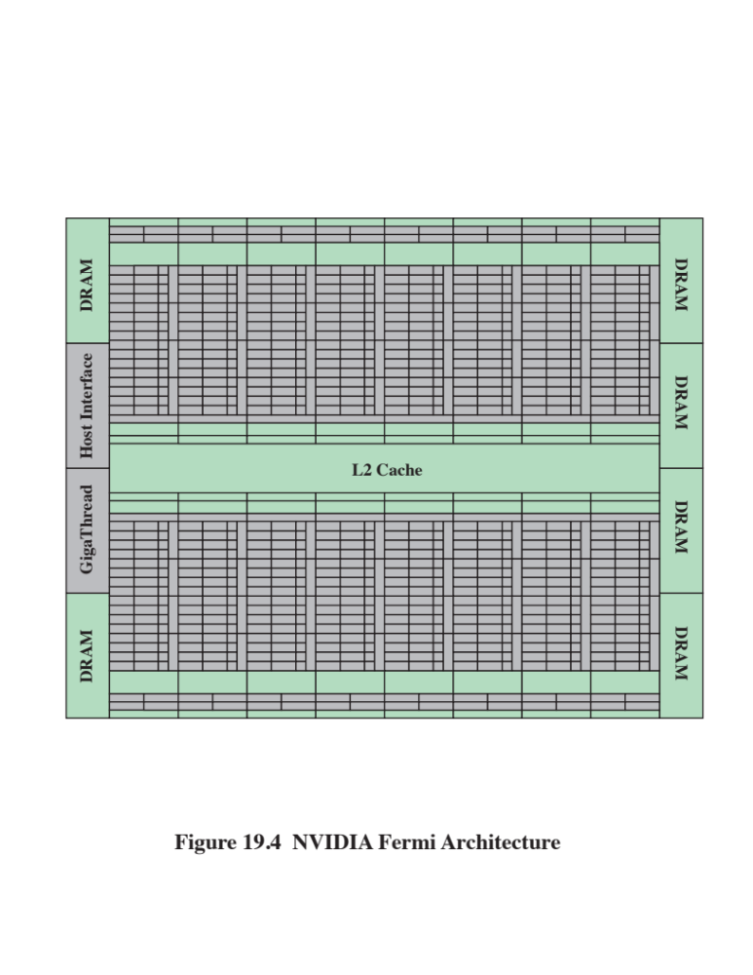
Notes:
Figure 19.4 illustrates the general layout of the NVIDIA Fermi architecture GPU. As
can be seen in this figure, the L2 cache is centrally located to the 16 SMs (8 SMs
above and below). Each SM is represented by the 2 adjacent columns and 16 rows
of rectangles (GPU processor cores), along with a column of 16 load/store units and
a column of 4 special function units (SFUs). The rectangles at the head and foot of the
SMs in Figure 19.4 are where the registers and L1/shared memory are located. Each
of the six DRAM I/O interfaces has a 64-bit memory interface (the DRAM interface
circuitry is show in dark blue rectangles on the outermost left and right sides). Thus,
collectively, there is a 384-bit interface to the GPU’s GDDR5 (graphic double data
rate, a DDR memory designed specifically for graphic processing) DRAM, allowing
for support of up to a total of 6 GB of SM off-chip memory (i.e., global, constant,
texture, and local). More specifics about these different memory types will be discussed
in the next section. Also, illustrated in Figure 19.4 is the host interface, which
can be found on the left-hand side of the GPU layout diagram. The host interface
allows for PCIe connectivity between the GPU and the CPU.

Slide 10
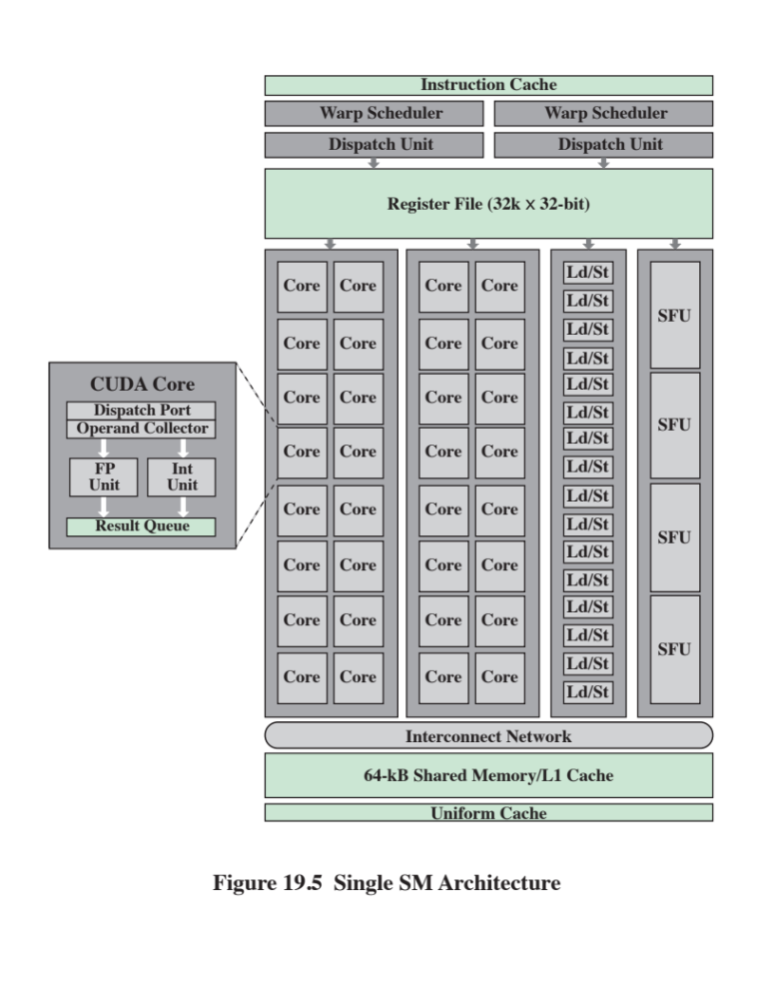
Notes:
A more detailed illustration of the SM
module is shown in Figure 19.5 [NIVD09].
Lastly, the GigaThread
global scheduler, in orange and located next to the host interface, is responsible for
the distribution of thread blocks to all of the SM’s warp schedulers (see Figure 19.5).
The right-hand side of Figure 19.5 breaks down the NVIDIA Fermi architecture into
its basic components for a single SM. These components are
■ GPU processor cores (total of 32 CUDA cores)
■ Warp scheduler and dispatch port
■ Sixteen load/store units
■ Four SFUs
■ 32k * 32-bit registers
■ Shared memory and L1 cache (64 kB in total)

Slide 11
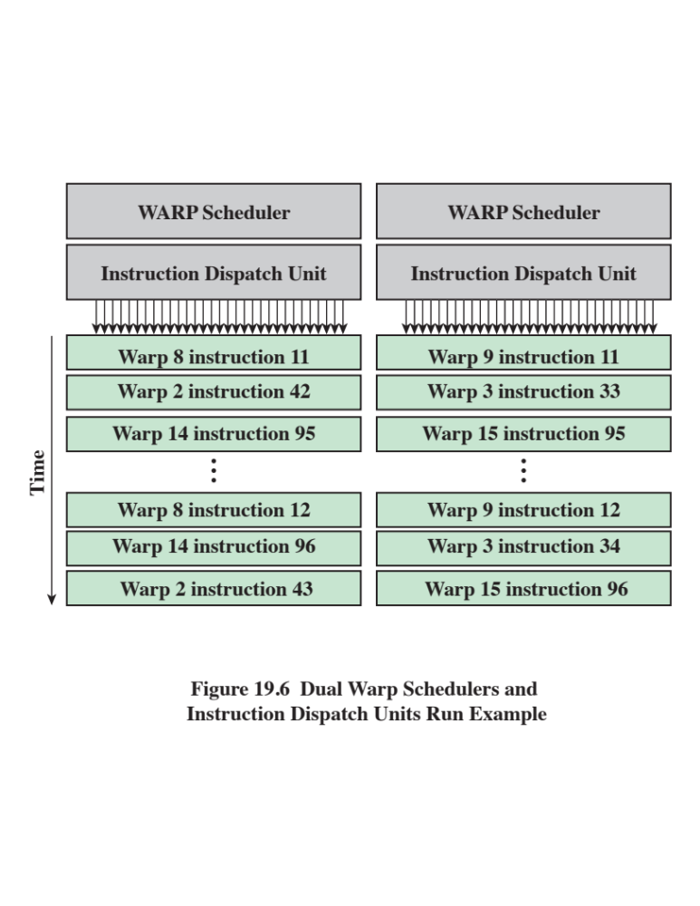
Notes:
As covered previously, the GigaThread global scheduler
unit on the GPU chip distributes the thread blocks to the SMs. The dual warp
scheduler will then break up each thread block it is processing into warps , where
a warp is a bundle of 32 threads that start at the same starting address and their
thread IDs are consecutive. Once a warp is issued, each thread will have its own
instruction address counter and register set. This allows for independent branching
and execution of each thread in the SM.
The GPU is most efficient when it is processing as many warps as possible to
keep the CUDA cores maximally utilized. As illustrated in Figure 19.6, maximum
SM hardware utilization will occur when the dual warp schedulers and instruction
dispatch units are able to issue two warps every two clock cycles (Fermi architecture).
As explained next, structural hazards are the main source of an SM falling
short of achieving this maximum processing rate, while off-chip memory access
latency can be more easily hidden.
Each divided column of 16 CUDA cores (* 2), 16 load/store units, and 4 SFUs
(see Figure 19.5) is eligible to be assigned half a warp (16 threads) to process from
each of the two warp scheduler/dispatch units per clock cycle, given that the component
column isn’t experiencing a structural hazard. Structural hazards are caused by
limited SFUs, double-precision multiplication, and branching. However, the warp
schedulers have a built-in scoreboard to track warps that are available for execution,
as well as structural hazards. This allows for the SM to both work around
structural hazards and help hide off-chip memory access latency as optimally as
possible.
Therefore, it is important for the programmer to set the thread block size
greater than the total number of CUDA cores in an SM, but less than the maximum
allowable threads per block, and to make sure the thread block size (in the x and/
or y dimensions) is a multiple of 32 (warp size) to achieve near-optimal utilization
of the SMs.

Slide 12
CUDA Cores
The NVIDIA GPU processor cores are also known as CUDA cores
There are a total of 32 CUDA cores dedicated to each SM in the Fermi architecture
Each CUDA core has two separate pipelines or data paths
  An integer (INT) unit pipeline
    Is capable of 32-bit, 64-bit, and extended precision for integer and logic/bitwise operations
  Floating-point (FP) unit pipeline
    Can perform a single-precision FP operation, while a double-precision FP operation requires two CUDA cores
Notes:
As mentioned in the CUDA Basics section, the NVIDIA GPU
processor cores are also known as CUDA cores (see Figure 19.5). Also defined
earlier, and as can be seen in Figure 19.4, there are a total of 32 CUDA cores
dedicated to each SM in the Fermi architecture. Each CUDA core has two separate
pipelines or data paths: an integer (INT) unit pipeline and a floating-point (FP)
unit pipeline (see Figure 19.5). Only one of these data paths can be used during a
single clock period. The INT unit is capable of 32-bit, 64-bit, and extended precision
for integer and logic/bitwise operations. The FP unit can perform a single-precision
FP operation, while a double-precision FP operation requires two CUDA cores.
Therefore, threads that perform only double-precision FP operations will take twice
as long to run compared to a single-precision FP thread. This performance impact
of double-precision FP arithmetic is addressed in the Kepler architecture by the
inclusion of dedicated double-precision units in each SM, as well as a majority of
Single-precision units. Fortunately, the management of thread-level FP single-
And double-precision operations is hidden from the CUDA programmer. However,
the programmer should be aware of the potential performance impact that can be
incurred between using the two precision types based on the GPU used.
The Fermi architecture added an improvement to the CUDA core’s FP unit
over its predecessors. It upgraded from the IEEE 754-1985 floating-point arithmetic
standard to the IEEE 754-2008 standard. This was accomplished by improving
on the accuracy of the multiply-add instruction (MAD) with a fused multiply-add
(FMA) instruction. The FMA instruction is valid for both single-and double-precision
arithmetic. The Fermi architecture performs only a single rounding at the
end of an FMA instruction. Not only is the accuracy of the result improved, but also
performing an FMA instruction is compressed into a single processor clock cycle.
Therefore, 32 single-precision or 16 double-precision FMA operations can occur in
a single processor clock cycle per SM.

Slide 13
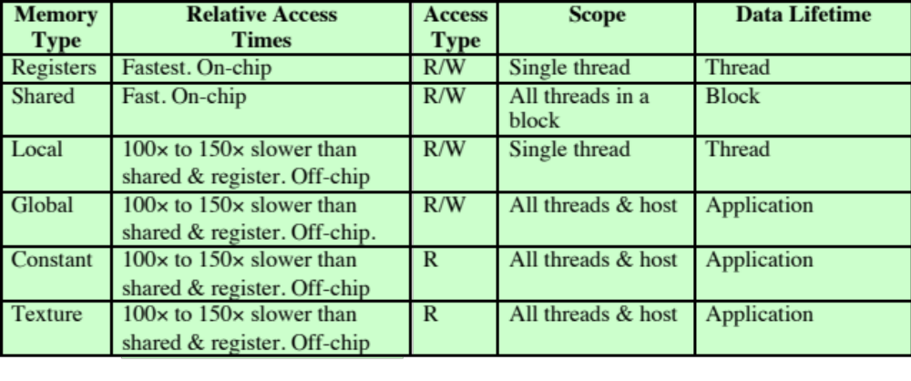
Table 19.2
GPU’s Memory Hierarchy Attributes
Notes:
Although the Fermi architecture has an impressive 32k * 32-bit registers per
SM, each thread has a maximum of 64 * 32-bit registers allocated to it as defined by
CUDA compute capability version 2.x, which is a function of the maximum number
of active warps allowed per SM, as well as the number of registers per SM. As shown
in Table 19.2, the registers, along with shared memory, have the fastest access times
of only several nanoseconds (ns).

Slide 14
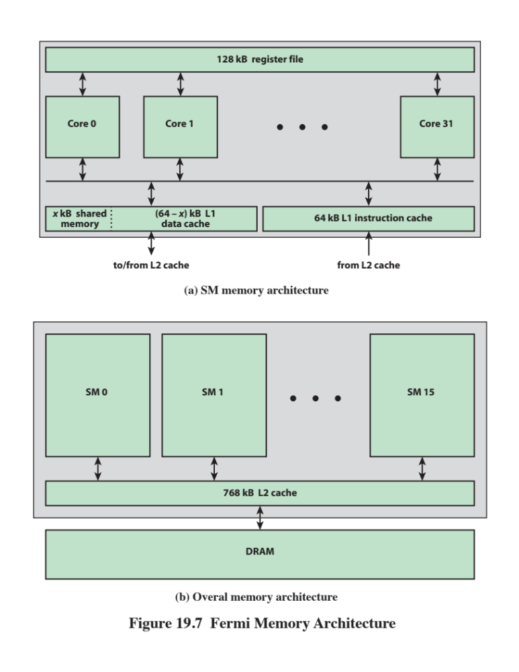
Notes:
If there is any temporary register spillage, the
data will first get moved to L1 cache before being sent to L2 cache, then long access
latency local memory (see Figure 19.7a). The use of L1 cache helps prevent data
read/write hazards from occurring. The lifetime of the data in the registers assigned
to a thread is therefore only as long as the life of the thread.
The addressable, on-chip shared memory dedicated to the GPU processor
cores of an SM is a unique configuration when compared to contemporary multicore
microprocessors, such as the CPU. These contemporary architectures, as covered in
Chapter 18 and illustrated in Figure 18.6, have a dedicated on-chip L1 cache and a set
of registers per core. However, they typically do not have on-chip addressable memory.
Instead, dedicated memory management hardware regulates the movement of
data between the cache and main memory without control from the programmer.
This is significantly different from the GPU architecture (see Figure 19.5).
As discussed at the beginning of this chapter, shared memory was added to
the GPU architecture specifically to assist with GPGPU applications. Optimizing
the use of shared memory can significantly improve the speedup and performance
of a GPGPU application by eliminating unneeded long latency accesses to off-chip
memory. Despite the shared memory being small in size for each SM (48 kB at
maximum configuration), it has a very low access latency of 100 * to 150 * less
than global memory (see Table 19.2). Thus, there are three major ways that shared
memory can accelerate the parallel processing tasks: (1) multiple repeated use of
shared memory data by all threads of a block (e.g., blocks of data used for matrix–
matrix multiplication); (2) select threads of a block (based on specific IDs) are used
to transfer data from the global memory to the shared memory, thus redundant
reads and writes to the same memory locations are removed; and (3) the user can
optimize data accesses to global memory by making sure the accesses are coalesced,
when possible. All of these points also aid in reducing off-chip memory bandwidth
constraint issues. The lifetime of the data in an SM’s shared memory is as long as the
life of the thread block being processed on it. So, once all of the threads of the block
have completed, the data in the SM’s shared memory is no longer valid.
Although the use of shared memory will give the optimum run times, in some
applications the memory accesses are not known during the programming phase.
This is where having more L1 cache available (maximum setting of 48 kB) will
give the optimal results. Additionally, the L1 cache helps with aiding register spills,
instead of going straight to local (off-chip) DRAM memory. The two-level cache
Hierarchy—single L1 cache per SM, and the across chip, SM shared L2 cache—
gives the same benefits as those found in conventional multicore microprocessors.

Slide 15
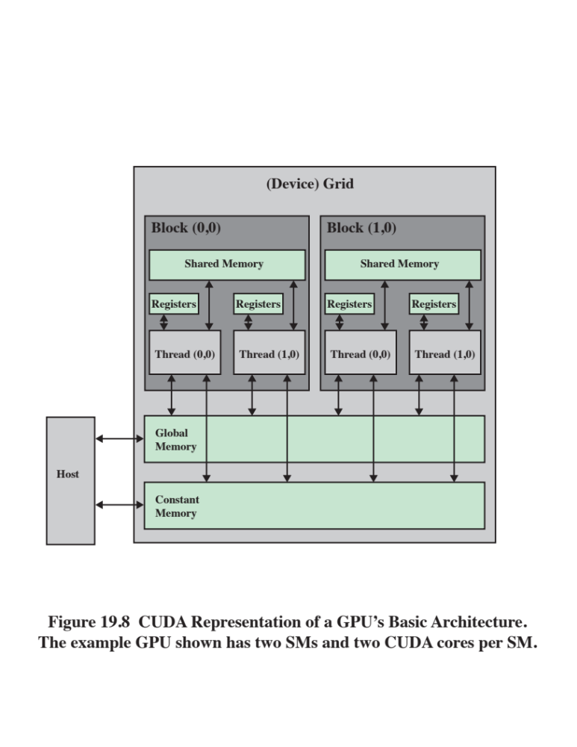
Notes:
It is important for the programmer to understand the nuances of the various GPU
memories, particularly the sizes available for each memory type, their relative access
times, and accessibility limitations, to enable correct and efficient code development
using CUDA. As one can see from the CUDA Basics section covered at the beginning
of the chapter, the SM level memories just covered, and the terminology and
parameters listed in Table 19.2, a much different approach is required for GPGPU
programming than program development targeted for a CPU, where the specific
data storage hardware used (other than file I/O) is hidden from the programmer.
For example, with the GPU architecture, each thread assigned to a CUDA
core has its own set of registers, such that one thread cannot access another thread’s
registers, whether in the same SM or not. The only way threads within a particular
SM can cooperate with each other (via data sharing) is through the shared memory
(see Figure 19.8). This is typically accomplished by the programmer assigning only
certain threads of an SM to write to specific locations of its shared memory, thus
preventing write hazards or wasted cycles (e.g., many threads reading the same data
from global memory and writing it to the same shared memory address). Before all
of the threads of a particular SM are allowed to read from the shared memory that
has just been written to, synchronization of all the threads of that SM needs to take
place to prevent a read-after-write (RAW) data hazard.

Slide 16
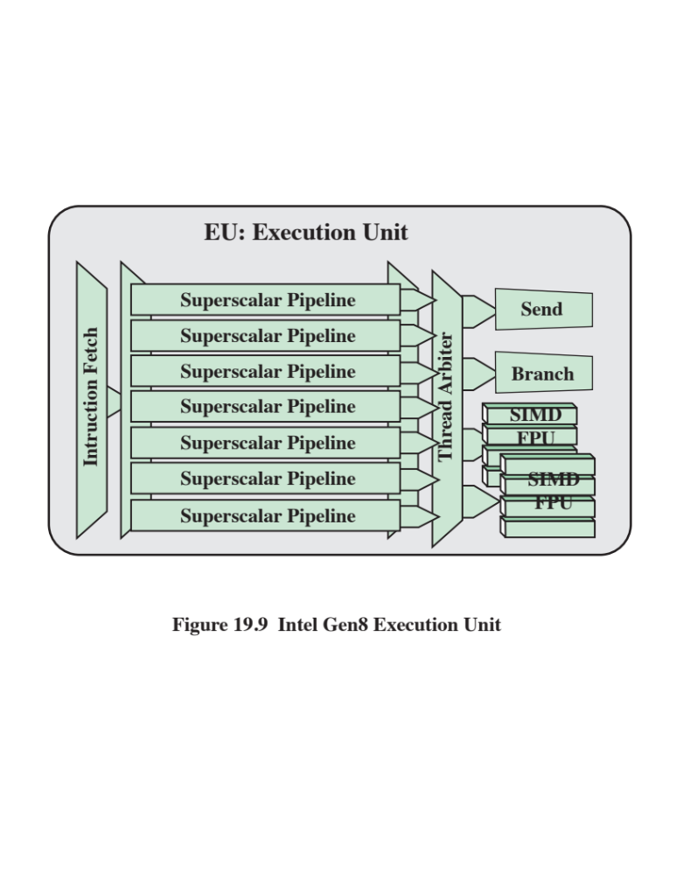
Notes:
As another example of a GPGPU architecture, this section provides an overview of
the Gen8 processor graphics architecture [INTE14, PEDD14].
The fundamental building block of the Gen8 architecture is the execution unit
(EU) shown in Figure 19.9. The EU is a simultaneous multithreading (SMT) architecture
with seven threads. Recall from Chapters 17 and 18 that in an SMT architecture,
register banks are expanded so that multiple threads can share the use of
pipeline resources. The EU has seven threads and is implemented as a superscalar
pipeline architecture. Each thread includes 128 general-purpose registers. Within
each EU, the primary computation units are two SIMD floating-point units that support
both floating-point and integer computation. Each SIMD FPU can complete
simultaneous add and multiply floating-point instructions every cycle. There is also a
branch unit dedicated to branch instructions and a send unit for memory operations.
Each register stores 32 bytes, accessible as an SIMD 8-element vector of 32-bit
data elements. Thus each Gen8 thread has 4 kB of general-purpose register file
(GRF), for a total of 28 kB of GRF per EU. Flexible addressing modes permit registers
to be addressed together to build effectively wider registers, or even to represent
strided rectangular block data structures.2 Per thread architectural state is
maintained in a separate dedicated architecture register file (ARF).

Slide 17
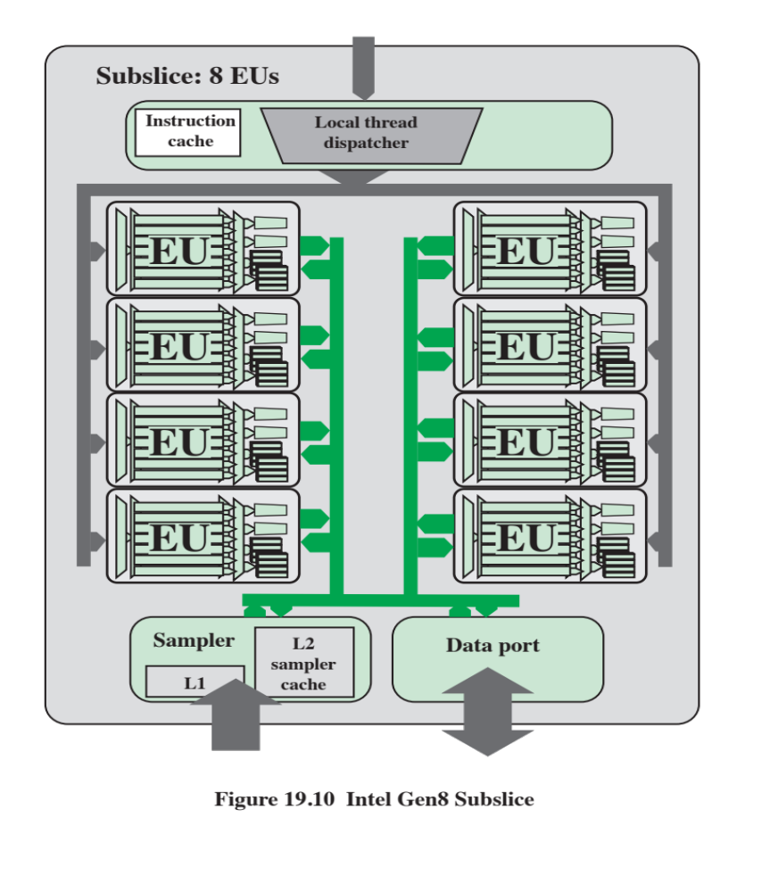
Notes:
The EU can issue up to four different instructions simultaneously from different
threads. The thread arbiter dispatches each instruction to one of the four
functional units for execution.
EUs are organized into a subslice (Figure 19.10), which may contain up to
eight EUs. Each subslice contains its own local thread dispatcher unit and its own
supporting instruction caches. Thus, a single subslice has dedicated hardware
resources and register files for a total of 56 simultaneous threads.
A subslice also includes a unit called the sampler, with its own local L1 and
L2 cache. The sampler is used for sampling texture and image surfaces. The sampler
includes logic to support dynamic decompression of block compression texture
formats. The sampler also includes fixed-function logic that enables address conversion
of image (u,v ) coordinates and address clamping modes such as mirror, wrap,
border, and clamp. The sampler supports a variety of sampling filtering modes such
as point, bilinear, trilinear, and anisotropic. The data port provides efficient read/
write operations that attempt to take advantage of cache line size to consolidate
read operations from different threads.

Slide 18
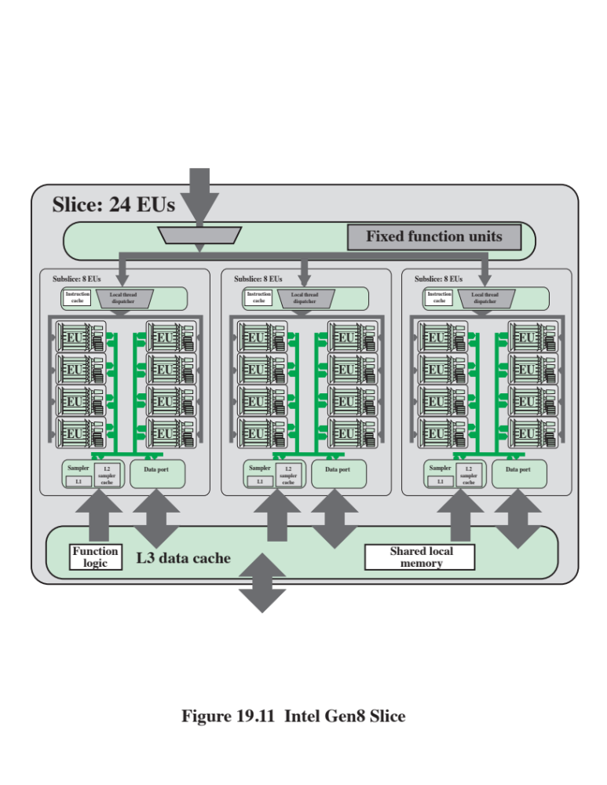
Notes:
To create product variants, subslices may be clustered into groups called slices
(Figure 19.11). Currently, up to three subslices may be organized into a single slice
for a total of 24 EUs. In addition to the subslices, the slice includes logic for thread
dispatch routing, other function logic to optimize graphic data processing, a shared
L3 cache, and a smaller shared local memory structure. The latter is visible (addressable
memory) to the EUs and is useful for sharing temporary variables.
To enhance performance a technique known as cache banking is used for the
shared L3 data cache. To achieve high bandwidth, the cache is divided into equalsize
memory modules, called banks, which can be accessed simultaneously. Any
memory read or write request made of n addresses that fall in n distinct memory
banks can therefore be serviced simultaneously, yielding an overall bandwidth that
is n times as high as the bandwidth of a single module. However, if two addresses
of a memory request fall in the same memory bank, there is a bank conflict and the
access has to be serialized. The hardware splits a memory request with bank conflicts
into as many separate conflict-free requests as necessary, decreasing throughput
by a factor equal to the number of separate memory requests. If the number of
separate memory requests is n , the initial memory request is said to cause n-way
bank conflicts. To get maximum performance, it is therefore important to understand
how memory addresses map to memory banks in order to schedule the memory
requests so as to minimize bank conflicts.
Finally, an SoC product architect can create product families or a specific
product within a family by placing a single slice or multiple slices on an SoC chip.
These slices are combined with additional front-end logic to manage command
submission, as well as fixed-function logic to support 3D rendering and media pipelines.
Additionally, the entire Gen8 compute architecture interfaces to the rest of
the SoC components via a dedicated unit called the graphics technology interface
(GTI).

Slide 19
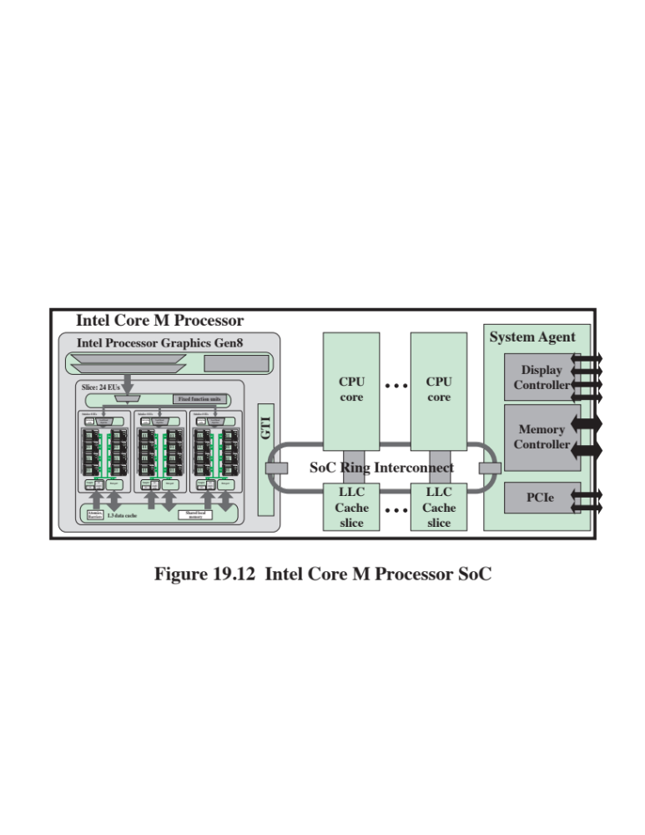
Notes:
An example of such an SoC is the Intel Core M Processor with Intel HD
Graphics 5300 Gen8 (Figure 19.12). In addition to the GPU portion, the chip contains
multiple CPU cores, an LLC cache and a system agent. The system agent
includes controllers for DRAM memory, display, and PCIe devices. The Processor
Graphics Gen8, CPUs, LLC cache, and system agent are interconnected with a ring
structure, such as we saw for the Xeon processor (Figure 7.16).

Slide 20
Summary
General-Purpose Graphic Processing Units
Chapter 19
GPU architecture overview
  Baseline GPU architecture
  Full chip layout
  Streaming multiprocessor architecture details
  Importance of knowing and programming to your memory types
CUDA basics
GPU versus CPU
  Basic differences between CPU and GPU architectures
  Performance and performance per watt comparison
Intel’s Gen8 GPU
Notes:
Chapter 19 summary.

