Slide 1


TEAM 4
NOV 2025
FIRST COME, FIRST SERVED (FCFS)
HO CHI MINH CITY UNIVERSITY OF TRANSPORT
PAGE 1

Slide 2
NOV 2025
member
NGUYỄN TẤN LỘC
ĐÀM TRIỆU VỸ
NGUYỄN VĂN HIỆP
NGUYỄN VĂN KHƯƠNG
HỒ VĂN PHÁT
NGUYỄN NHẬT TRƯỜNG
HOÀNG VIỆT QUANG
HO CHI MINH CITY UNIVERSITY OF TRANSPORT
PAGE 2

Slide 3
TEAM 4
NOV 2025
1. Introduction
1.1 THE CONTEXT AND IMPORTANCE OF CPU SCHEDULING
In modern multiprogramming operating systems, it is common for multiple processes to reside in memory simultaneously, ready for execution
The primary objective of CPU scheduling is to optimize system performance by balancing factors such as throughput, waiting time, turnaround time, and response time, while also ensuring fairness to all processes
HO CHI MINH CITY UNIVERSITY OF TRANSPORT
PAGE 3

Slide 4
NOV 2025
1.2 The First-Come, First-Served (FCFS) Algorithm
Among the foundational scheduling algorithms, First-Come, First-Served (FCFS) is the most basic and intuitive. As its name implies, FCFS operates exactly like a real-world queue: the process that requests the CPU first is allocated the CPU first.
The core advantage of FCFS lies in its simplicity; it is very easy to understand and straightforward to implement using a basic FIFO (First-In, First-Out) queue. Furthermore, FCFS is considered perfectly fair according to arrival order,
However, this simplicity comes at a significant performance cost. The algorithm's greatest weakness is its poor average response time
HO CHI MINH CITY UNIVERSITY OF TRANSPORT
PAGE 4

Slide 5
NOV 2025
1.3 Report Objectives
IMPLEMENTATION
ILLUSTRATION
COMPARISON
To build a simulator that correctly implements the FCFS scheduling algorithm
to use specific examples and scenarios to clearly demonstrate how FCFS operates, paying special attention to illustrating the convoy effect in the presence of long jobs.
To conduct a quick comparison of FCFS against more advanced scheduling algorithms, such as Round Robin (RR) and Shortest Job First (SJF/SRTF),
HO CHI MINH CITY UNIVERSITY OF TRANSPORT
PAGE 5

Slide 6

NOV 2025
2. THEORETICAL BACKGROUND
2.1 First-Come, First-Served (FCFS) Scheduling
First-Come, First-Served (FCFS) is the most straightforward CPU scheduling policy: processes are placed in a FIFO (first-in, first-out) queue and are dispatched in the order they arrive. FCFS is non-preemptive — once a process starts it runs to completion — which makes the algorithm easy to reason about and simple to implement
PAGE 6
NOV 2025
HO CHI MINH CITY UNIVERSITY OF TRANSPORT

Slide 7

NOV 2025
2.2 KEY METRICS AND FORMULAE
To compare scheduling algorithms we rely on a small set of standard metrics that capture latency and service fairness. These are typically expressed as:
Waiting time (WT) = Turnaround Time (TAT) - Burst time (BT)
Turnaround Time (TAT) = Completion Time (CT) - Arrival Time (AT)
Response Time = Start of First Run - Arrival Time (AT)
PAGE 7
NOV 2025
HO CHI MINH CITY UNIVERSITY OF TRANSPORT

Slide 8
NOV 2025
2.3 Short Comparisons and Practical Trade-offs
IT IS USEFUL TO POSITION FCFS AGAINST A COUPLE OF OTHER COMMON POLICIES TO UNDERSTAND ITS PRACTICAL TRADE-OFFS:
SJF / SRTF (Shortest Job First / Shortest Remaining Time First): By preferring shorter jobs, these policies can minimize average waiting time in idealized scenarios.
Round Robin (RR): RR introduces a fixed time quantum so that each runnable process receives CPU time in turn. If the quantum is very large, RR tends toward FCFS behavior; if it is very small, context switching overhead rises and overall throughput may fall, though responsiveness improves for interactive tasks.
HO CHI MINH CITY UNIVERSITY OF TRANSPORT
PAGE 8

Slide 9
NOV 2025
3. Algorithm & Implementation
3.1 ALGORITHM DESCRIPTION
The First Come First Serve (FCFS) scheduling algorithm is one of the simplest CPU scheduling techniques, operating on the principle of “first in, first out” (FIFO).
Processes are executed in the order of their arrival time (AT) — the process that arrives first is allocated the CPU first.
FCFS is a non-preemptive algorithm, meaning once a process starts execution, it runs until completion without interruption.
HO CHI MINH CITY UNIVERSITY OF TRANSPORT
PAGE 9

Slide 10
NOV 2025
3.2 PSEUDOCODE
Start
Sort all processes by Arrival_Time
Time = 0
For each process P in sorted order:
If Time < P.Arrival_Time → Time = P.Arrival_Time
P.Start = Time
P.Completion = Time + P.Burst
Time = P.Completion
End
PAGE 10
NOV 2025
HO CHI MINH CITY UNIVERSITY OF TRANSPORT

Slide 11
NOV 2025
3.2.1 EXPLANATION
Processes are sorted by arrival time.
If the CPU is idle (Time < Arrival Time), an IDLE period is inserted.
Start time (ST) and completion time (CT) are assigned for each process.
The following performance metrics are calculated:
Turnaround Time (TAT) = CT – AT
Waiting Time (WT) = TAT – BT
Response Time = ST – AT
PAGE 11
NOV 2025
HO CHI MINH CITY UNIVERSITY OF TRANSPORT

Slide 12
NOV 2025
3.3 Process Flow (5 Steps)
INPUT DATA
SORT BY ARRIVAL TIME
ENTER THE NUMBER OF PROCESSES AND THEIR ARRIVAL TIME (AT) AND BURST TIME (BT).
ARRANGE PROCESSES IN ORDER OF ARRIVAL.
TIME SIMULATION
COMPUTE RESULTS
RUN EACH PROCESS SEQUENTIALLY; INSERT IDLE if the CPU is free.
CALCULATE CT, TAT, WT, AND RESPONSE TIME FOR EACH PROCESS.
OUTPUT RESULTS
DISPLAY PROCESS TABLE AND GANTT CHART (DETAILS SHOWN IN Experiment & Results section).
PAGE 12
HO CHI MINH CITY UNIVERSITY OF TRANSPORT

Slide 13
NOV 2025
3.4 Discussion
The FCFS algorithm is simple, intuitive, and easy to implement. However, it suffers from the convoy effect, where a long-running process delays all subsequent ones.
References
[1] R. H. Arpaci-Dusseau and A. C. Arpaci-Dusseau, Operating Systems: Three Easy Pieces. Arpaci-Dusseau Books, 2018.
[2] A. Silberschatz, P. B. Galvin, and G. Gagne, Operating System Concepts, 10th ed. Hoboken, NJ: John Wiley & Sons, 2018.
[3] H. K. Omar and Z. Jumamil, "Comparative analysis of the essential CPU scheduling algorithms," in Proc. Int. Conf. Adv. Sci. Eng. (ICOASE), 2018, pp. 125-130.
[4] A. P. U. Siahaan, "Comparison analysis of CPU scheduling: FCFS, SJF and round robin," Int. J. Eng. Dev. Res., vol. 4, no. 3, pp. 124-132, 2016.
[5] S. Mohammadjafari et al., "Optimizing task scheduling in heterogeneous multi-core systems," IEEE Access, vol. 9, pp. 48080-48091, 2021.
[6] W. Li et al., "Advances in CPU scheduling algorithms: A comprehensive review," J. Syst. Archit., vol. 118, 102221, 2021.
HO CHI MINH CITY UNIVERSITY OF TRANSPORT
PAGE 13

Slide 14
NOV 2025
4.EXPERIMENTAL RESULTS
4.1. CALCULATION FORMULAS FOR TIME METRICS
COMPLETION TIME (CT)
TURNAROUND TIME (TAT)
CTi​=max(CTi−1​,ATi​)+BTi
Completion Time is a process finishes its execution
TATi​=CTi​−ATi
Turnaround Time is the total time taken for a process to complete after its arrival. Where CT is the Completion Time and AT is the Arrival Time of process i.
WAITING TIME (WT)
RESPONSE TIME (RT)
WTi​=TATi​−BTi​
Waiting Time is the total time a process spends waiting in the ready queue before execution.
RTi​=ST i​−ATi​
The time interval between the process arrival and the first CPU allocation.
HO CHI MINH CITY UNIVERSITY OF TRANSPORT
PAGE 14

Slide 15
NOV 2025
Key Performance Metrics and Formulas in CPU Scheduling
WAITING TIME (W):
TURNAROUND TIME (T):
RESPONSE TIME (R):
Time a process waits in the ready queue before execution.
W = Start Time − Arrival Time
Total time from process arrival to completion.
T = End Time − Arrival Time
Time from arrival until the process gets CPU for the first time.
R = First CPU Start Time − Arrival Time
HO CHI MINH CITY UNIVERSITY OF TRANSPORT
PAGE 15

Slide 16
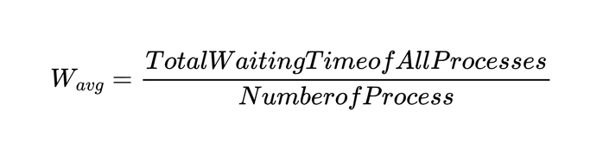
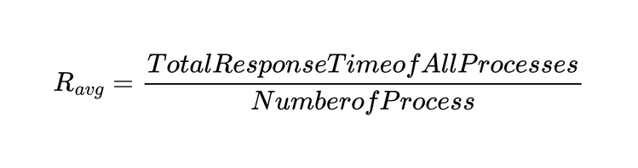
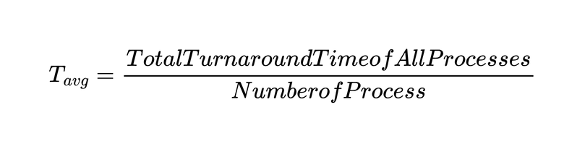
NOV 2025
Key Performance Metrics and Formulas in CPU Scheduling
AVERAGE WAITING TIME ( ):
AVERAGE RESPONSE TIME ( )
AVERAGE TURNAROUND TIME ( ):
Wavg, Tavg, and Ravg are key metrics for evaluating CPU scheduling performance.
HO CHI MINH CITY UNIVERSITY OF TRANSPORT
PAGE 16

Slide 17
NOV 2025
4.1.1 DESCRIPTION
In this dataset, the processes all have short burst times and are almost similar. The processes arrive at almost the same time, thereby creating a uniform workload environment. Through this dataset, we can see that the CPU operates almost continuously without idle time
PAGE 17
NOV 2025
HO CHI MINH CITY UNIVERSITY OF TRANSPORT

Slide 18
NOV 2025
4.1.2 Results and Observations
Process | ARRIVAL TIME (AT) | BURST TIME (BT) | COMPLETION TIME (CT) | TURNAROUND TIME (TAT) | Waiting Time (WT)
P00 | 0 | 1 | 1 | 1 | 0
P01 | 2 | 3 | 5 | 3 | 0
P04 | 2 | 2 | 7 | 5 | 3
P02 | 3 | 2 | 9 | 6 | 4
P05 | 3 | 1 | 10 | 7 | 6
P03 | 9 | 4 | 14 | 5 | 1
PAGE 18

Slide 19
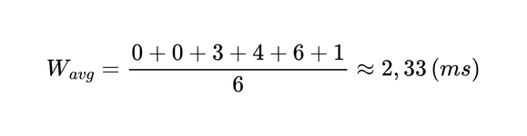
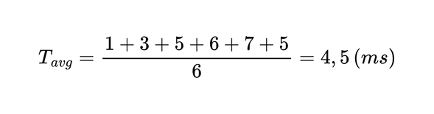

NOV 2025
Gantt Chart of FCFS Scheduling (Short Burst Time – Uniform Workload)
 | 0 | 1 | 2 | 3 | 4 | 5 | 6 | 7 | 8 | 9 | 10 | 11 | 12 | 13 | 14
P00
P01
P04
P02
P05
P03
BT0
INDLE
BT1 = 3ms
WT4 = 3ms
BT2 = 2ms
WT2 = 4ms
BT2 = 2ms
WT5 = 6ms
BT5
WT3
BT3 = 4ms
From Gantt chart:
PAGE 19

Slide 20
NOV 2025
4.2 DESCRIPTION
In this dataset, the workload is intentionally designed to be unfavorable to the FCFS algorithm. This reveals some of its limitations. The main disadvantage is process P04. It has a much longer burst time than the other processes.
PAGE 20
NOV 2025
HO CHI MINH CITY UNIVERSITY OF TRANSPORT

Slide 21
NOV 2025
4.2.2 Results and Observations
Process | ARRIVAL TIME (AT) | BURST TIME (BT) | COMPLETION TIME (CT) | TURNAROUND TIME (TAT) | Waiting Time (WT)
P00 | 0 | 1 | 1 | 1 | 0
P04 | 2 | 20 | 20 | 20 | 0
P01 | 3 | 3 | 25 | 22 | 19
P02 | 5 | 2 | 27 | 22 | 20
P05 | 5 | 1 | 28 | 23 | 22
P03 | 9 | 1 | 29 | 20 | 19
PAGE 21

Slide 22
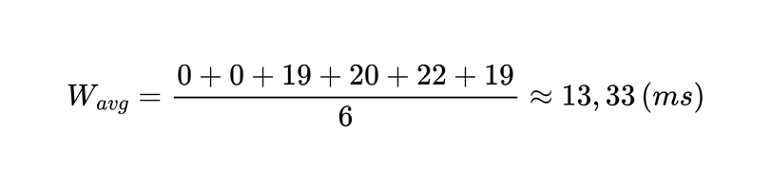
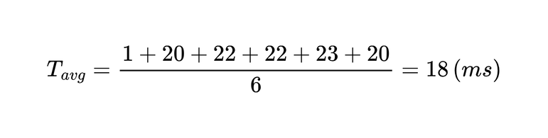

NOV 2025
Gantt Chart of FCFS Scheduling (Long Burst Time – Unbalanced Workload)
 | 25 | 26 | 27 | 28 | 29 | 0 | 1 | 2 | 3 | 4 | 5 | 6 | 7 | 8 | 9 | 10 | 11 | 12 | 13 | 14 | 15 | 16 | 17 | 18 | 19 | 20 | 21 | 22 | 23 | 24
P00
P04
P01
P02
P05
P03
BT0
INDLE
BT4= 20ms
WT1 = 19ms
BT1 = 3ms
WT2 = 20ms
BT2
WT5 = 22ms
BT5
WT3 = 19ms
BT3
From Gantt chart:
PAGE 22

Slide 23
TEAM 4
NOV 2025
4.3 Summary of Findings
The simulation program operates exactly according to the principle of the algorithm, non-preemptive and calculates the time indicators correctly.
IFor the Uniform Workload environment, FCFS has stable and optimal results, low average waiting time, and maximum utilization of CPU performance.
In contrast to the Unbalanced Workload environment, FCFS clearly shows inefficiency due to the convoy effect, when long processes delay the short processes that come later.
These two results show the typical trade-offs of FCFS
HO CHI MINH CITY UNIVERSITY OF TRANSPORT
PAGE 23

Slide 24
NOV 2025
5.1 Evaluation of the FCFS Scheduling Algorithm
5.1.1 WAITING TIME
DEFINITION
ANALYSIS OF FCFS
Waiting time is the amount of time a process spends waiting in the ready queue before it gets CPU service
In the First-Come, First-Served (FCFS) scheduling algorithm, processes are executed in the order of their arrival without any preemption.
EXAMPLE
EVALUATION
Assume there are three processes P1, P2, and P3 with burst times of 5, 3, and 1 time units, respectively. The order of arrival is P1 first, then P2, and finally P3
The FCFS algorithm may cause long waiting times for later processes, especially if an early process has a long burst time.
HO CHI MINH CITY UNIVERSITY OF TRANSPORT
PAGE 24

Slide 25
NOV 2025
5.1.2 Turnaround Time
DEFINITION
ANALYSIS OF FCFS
Turnaround time is the total amount of time taken from the submission of a process until its completion.
The turnaround time in FCFS scheduling is directly affected by the waiting time
EXAMPLE
EVALUATION
For the same processes P1, P2, and P3 with burst times 5, 3, and 1, the turnaround times are:
The FCFS algorithm does not optimize turnaround time.
HO CHI MINH CITY UNIVERSITY OF TRANSPORT
PAGE 25

Slide 26
NOV 2025
5.1.3 Characteristics of FCFS
FAIRNESS
EFFICIENCY
EFFECT
FCFS is considered fair since all processes are served in the order they arrive, with no process being preempted or starved.
FCFS suffers from low efficiency when there is a large variation in burst times among processes.
Although simple and easy to implement, FCFS is not suitable for time-sharing systems or interactive environments.
HO CHI MINH CITY UNIVERSITY OF TRANSPORT
PAGE 26

Slide 27
NOV 2025
5.2 COMPARISON BETWEEN FCFS AND OTHER SCHEDULING ALGORITHMS
FCFS is the simplest scheduling algorithm; however, its performance is significantly different compared to more advanced scheduling algorithms. The following section compares FCFS with the more common scheduling algorithms.
PAGE 27
NOV 2025
HO CHI MINH CITY UNIVERSITY OF TRANSPORT

Slide 28
TEAM 4
NOV 2025
5.2.1 FCFS vs Round Robin
Criterion | FCFS | ROUND ROBIN
Principle | Processes are executed in the order of their arrival | Each process is assigned a fixed time quantum
Preemptive Mechanism | None (Non-preemptive) | Yes (Preemptive)
Waiting Time | High for processes arriving later | Fairer, as each process gets CPU time in turns
Response Time | Poor for processes arriving later | Better, especially for interactive systems
Process Switching | Rarely occurs | Frequent due to time quantum expiration
Convoy Effect | Occurs | Does not occur
Complexity | Simple | More complex
Suitability | Suitable for batch systems | Suitable for time-sharing and interactive systems
HO CHI MINH CITY UNIVERSITY OF TRANSPORT
PAGE 28

Slide 29
NOV 2025
5.2.2 FCFS vs Shortest Job First (SJF)
Criterion | FCFS | SHORTEST JOB FIRST (SJF)
Principle | Processes are executed in the order of arrival | Processes with the shortest burst time are executed first
Preemptive Mechanism | None | Can be non-preemptive or preemptive depending on the version
Average Waiting Time | Higher | Lower, especially when many short jobs exist
Turnaround Time | Not optimal | Optimal in theory
Fairness | Fair by order of arrival | Favors short jobs
Resource Utilization | Not high | May increase efficiency but could starve long jobs
Implementation | Simple | Requires estimation or knowledge of process burst time
Performance on Mixed Workloads | Poor for systems with varied workloads | Effective when there are many short processes
MONTHLY CLIENT REPORT
PAGE 29

Slide 30
5.2.3 FCFS vs Shortest Remaining Time (SRT)
NOV 2025
Criterion | FCFS | SHORTEST REMAINING TIME (SRT)
Principle | Processes are executed in the order of arrival | The process with the shortest remaining burst time is executed first
Preemptive Mechanism | None | Yes (preemptive)
Response Time | Poor for later-arriving processes | Very good for short and newly arriving processes
Waiting Time | High for later processes | Low for short processes, high for long ones
Process Switching | Rare | Frequent due to preemption
Convoy Effect | Can occur | Reduced compared to FCFS or SJF
Complexity | Simple | Requires accurate burst time estimation and more complex implementation
Predictability | Stable and predictable | Less predictable due to frequent preemptions
CPU Utilization | High | Very high, as CPU is used more efficiently
PAGE 30

Slide 31
NOV 2025
THANK YOU
HO CHI MINH CITY UNIVERSITY OF TRANSPORT
Please get in touch if you have any questions or concerns about this report.
PAGE 31

Slide 32


Key Performance Metrics and Formulas in CPU Scheduling
Waiting Time (W): Time a process waits in the ready queue before execution.
W = Start Time − Arrival Time
Turnaround Time (T): Total time from process arrival to completion.
T = End Time − Arrival Time
Response Time (R): Time from arrival until the process gets CPU for the first time.
R = First CPU Start Time − Arrival Time
PAGE 32

Slide 33


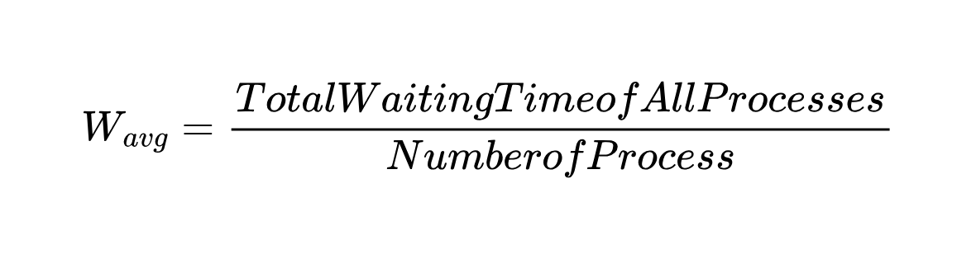
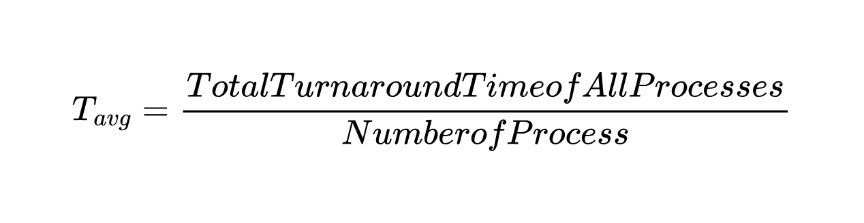


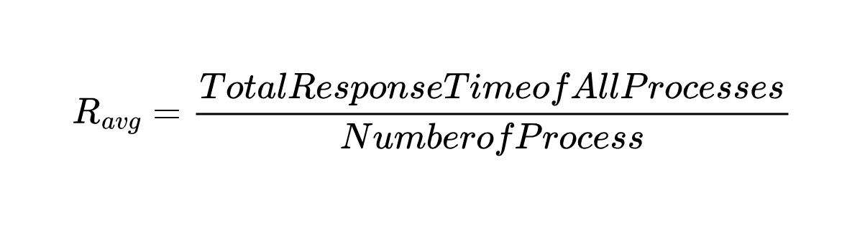

Key Performance Metrics and Formulas in CPU Scheduling
Average Waiting Time ( ):
Average Turnaround Time ( ):
Average Response Time ( )
Wavg, Tavg, and Ravg are key metrics for evaluating CPU scheduling performance.
PAGE 33

Slide 34
Gantt Chart of FCFS Scheduling (Short Burst Time – Uniform Workload)
 | 0 | 1 | 2 | 3 | 4 | 5 | 6 | 7 | 8 | 9 | 10 | 11 | 12 | 13 | 14
P00
P01
P04
P02
P05
P03
BT0
INDLE
PAGE 34

Slide 35
Criteria | Case 1 – Short Burst (Uniform Workload) | Case 2 – Long Burst (Unbalanced Workload)
Description | Processes have short and similar burst times, arriving almost simultaneously. | One process (P04) has a much longer burst time, creating an unbalanced workload.
CPU Behavior | CPU runs continuously with almost no idle time. | CPU is blocked by the long process, forcing others to wait.
Key Phenomenon | Negligible queuing delay. | Convoy effect occurs — short processes wait for the long one.
Average Waiting Time (WT) | ~2.33 ms (very low). | ~13.33 ms (significantly higher).
CPU Utilization | High and stable. | Reduced due to long waiting times.
System Throughput | Stable and efficient. | Decreases as the long process dominates CPU time.
Conclusion | FCFS performs efficiently in uniform, short-burst environments. | FCFS performs poorly in unbalanced workloads, showing reduced responsiveness.
PAGE 35

