Slide 1
Bot or Not? Detecting Twitter Bot
Qiwei Zhou
Jiao Wu

Slide 2

Overview of Problem
Twitter bot: Automated programs that utilizes Twitter API to produce contents automatically.
The number of bots is rising fast as the popularity of social networking grows.
Bad bots spread rumors, spams and phishing links across the network.
Adopt machine learning approach to distinguish bots from humans

Slide 3
Overview of Dataset
Data collected via Twitter API.
Saved in CSV format.
1 | 2 | 3 | 4 | 5 | 6 | 7 | 8 | 9 | 10
id | id_str | screen_name | locaion | description | url | followers_count | friends_count | listed_count | created_at
11 | 12 | 13 | 14 | 15 | 16 | 17 | 18 | 19 | 20
favourites_count | verified | statuses_count | lang | stauts | default_profile | default_profile_image | has_extended_profile | name | bot

Slide 4
Implementation
Python 2.7
Scikit-learn for machine learning algorithms
Panda and Numpy for data manipulation
Matplotlib for graphing and visualization
ipython notebook to write and run our code

Slide 5
Model Used - Preprocessing
Our data is dirty:
Lots of NaN values
Incompatible Encoding
Several value types not supported by sklearn and numpy
Preprocess data:
fillna() function to deal with NaN values
Decode and encode data with UTF-8 encoding
Convert fields to numeral values

Slide 6
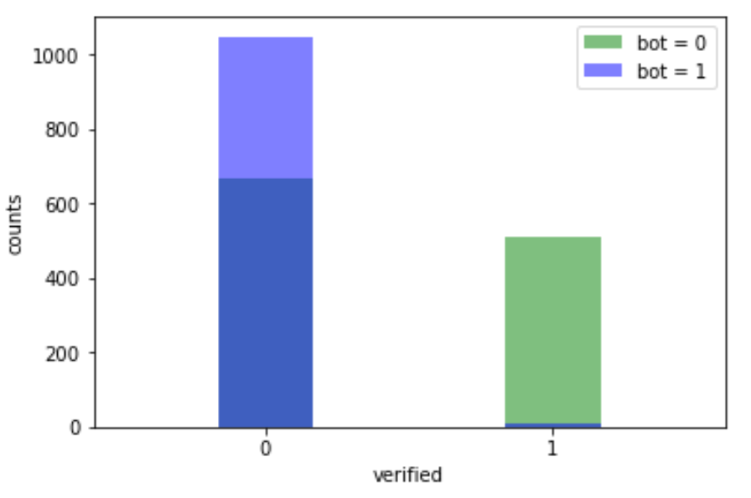
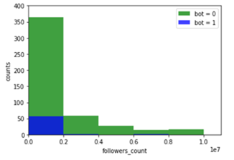
Model Used – Analysis
First, we analyze the data we have.
With the help of numpy, we can acquire and visualize the statistics of our data easily.
Counts of verified or non-verified in bots and nonbots.
Number of more than 10000 followers in bots and nonbots.
Number of listed_count in bots and nonbots.

Slide 7
Model Used – Logistic Regression
Logistic Regression is a regression model in which the value we are using is categorical. Therefore, logistic regression is a useful classification method. Since we are interested in distinguishing bots from non-bots, we will be using binary logistic regression in our project.
In our implementation, we run logistic regression on description and status fields. We also apply this method on the four true-or-false fields.
Further test shows that with l1 penalty and regularization value of C=1, logistic regression yields a better result on our dataset.

Slide 8
Model Used – Random Forest
Random Forest is an ensemble learning method. Single decision trees are likely to overfit on the training set. Random Forest is designed to handle this issue by growing base decision trees in a random effect. Each tree is constructed on a bootstrapped dataset and at each split, only a limited number of random features are considered. In this way, Random Forest is less vulnerable to overfitting.
In our implementation, we run random forest on description and status fields as well. Then we compare its performance with logistic regression.

Slide 9
Model Used – Naïve Bayes
Naïve Bayes is a classification method using probability calculation. It is based on the (strong) assumption that all attributes are independent from each other. Although this assumption is not true in most cases, Naïve Bayes does give good results. There are several different implementations of Naïve Bayes. In this project, we used both Bernoulli and Multinomial Naïve Bayes algorithms.
In our implementation, we run Naïve Bayes mainly on followers_count, friends_count, favourites_count and listed_count fields. We also try this method on description and status fields to compare it with the other two models.

Slide 10
Result and Conclusion
 | Logistic Regression | Random Forest | Bernoulli NB | Multinomial NB
Description | 73.29% | 69.71% | 73.42% | 71.71%
Status | 82.28% | 77.85% | 74.42% | 70.57%
True-or-false fields | 74.42% | 74.28% | 72.14% | 73.00%
We can see that logistic regression gives the best result for our dataset.
We choose the prediction for status fields as a basis for our submission in Kaggle contest, and make further adjustment according to the previous analysis of followers_count, friends_count, verified fields, etc..
The final result in the training data set gives a 88% accuracy.

Slide 11

Future Work
Detecting Twitter bots is an interesting work.
If we have more time on this project, we would:
Develop a more efficient and general way to clean data
Try to find a way to further improve the accuracy of our models
Try other models, e.g., SVM, and compare its performance with ours

Slide 12
Thank you!
Qiwei Zhou
Jiao Wu

