Slide 1
Introduction of C++ Programming
Qi Wang
wangqi03@bu.edu

Slide 2
Today’s Topic
Labs

Slide 3
Constants
A constant is an expressions with a fixed value:
Literals: used to express particular values within the source code; can be integers, floating points, characters, strings, booleans
Defined constants(#define): user-defined named constants that do not require memory-consuming variables
Example: Define.cpp
Declared constants (const): user defined constants with const prefix with a specific type that are declared the same way as variables. The value of a const variable cannot be modified.

Slide 4
L-values
lvalue is short for “left hand side value” of an assignment. Examples of non-lvalue expressions:
3+3 // you can’t assign 3+3 to something
"str" // the literal "str" can’t take on another value
const int i = 3 // can’t change the value of const variable
Examples of lvalue expressions:
int var // var is an lvalue because we can assign it with some value
float x

Slide 5
R-values
rvalue is short for “right hand side value” because rvalues can appear on the right hand side of an assignment.
Anything with a well-defined value can be an rvalue, including an assignment: (x = 5) can be used as an rvalue whose value is 5, e.g. y = (x=5);.

Slide 6
++ , --
a++ and ++a are shorthand for a=a+1 with a big warning sign:
++a will increment a and then return the value (so it will return one greater than the original value)
a++ will return the current value and then increment
--a will decrement a and then return the value (so it will return one less than the original value)
a--will return the current value and then decrement

Slide 7
++, --
// this code outputs 0 to 9
for(int i = 0; i < 10;) {
cout << i++ << "\n";
}
// this code outputs 1 to 10
for(int i = 0; i < 10;) {
cout << ++i << "\n";
}

Slide 8
Assignment operators
+=
-=
*=
/=
%=
a += 5 is equivalent to a = a + 5

Slide 9
Type Conversions
Change between data types, casts.
Usually change from smaller data type to a bigger data type or data type of same size (e.g. float to double or int to float)
Change from bigger datatype to smaller datatype or when there could be a loss of accuracy (e.g. int to short or float to int), but implicitly converting from a double to an int will not generate a compiler error (the compiler will give a warning, though).

Slide 10
Type Conversions - Examples
int x = (int)5.0; // float should be explicitly cast to int
short s = 3;
long l = s; // does not need explicit cast, but long l =
// (long)s is also valid
float y = s + 3.4; // compiler implicitly converts s to
// float for addition

Slide 11
Ternary operator (?:)
if(a > b)
result = x;
else
result = y;
Is equivalent to
Result = a > b ? x : y;

Slide 12
Break
Used for breaking out of a loop or switch statement.
int i= 1;
while (true ){
if(i > 10)
break;
cout << i << "\n";
++i;
}

Slide 13
Continue
Used for skipping the rest of a loop body and continuing to the next iteration.
for (int i = 0; i <= 10; ++i) {
if(i % 2 != 0)
continue; // skips all odd numbers
cout << i << “\n”;
}

Slide 14
Default Arguments
C++ allows default arguments to be defined for a function:
void printNTimes(char *msg, int n = 1) {
for (int i = 0; i < n; ++i) {
cout << msg;
}
}
Declaringthefunction argumentas int n = 1 allows usto call the function with printNTimes("Some message");. The compiler automatically inserts 1 as the second argument.

Slide 15
Constant Arguments
Declare function arguments to be const:
void print(const int n) {
cout << n;
}

Slide 16
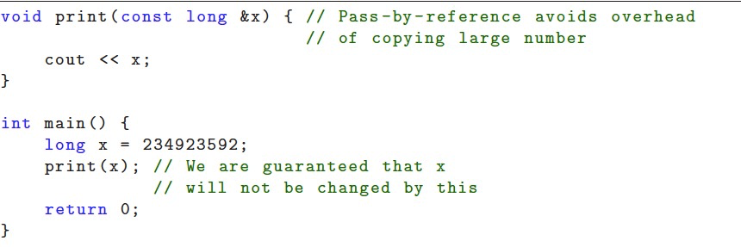
Constant Arguments
Useful for passing values by reference to a function, but not allow the function to make any changes to the original value.

Slide 17
Exercises
Look at ASimpleFunction.cpp. What would it print out?
Identify the errors in FixFunction0.cpp, FixFunction1.cpp, FixFunction2.cpp, FixFunction3.cpp and FixFunction4.cpp, and explain how you would correct them to make them do what they were apparently meant to do.

Slide 18
Exercises
3. Write a single sum function that returns the sum of two integers. Also write the equivalent function for taking the sum of two doubles.
4. Write 2 more functions such that you can find the sum of anywhere between 2 and 4 integers by writing sum(num1, num2, ...).
5. Write a single sum function capable of handling an arbitrary number of integers. It should take two arguments, include a loop, and return an integer. (Hint: What data types can you use to represent an arbitrarily large set of integers in two arguments?)

Slide 19
Exercises
6. Write a function printArray to print the contents of an integer array with the string ", " between elements(but not after the last element). Your function should return nothing.
7. Write a reverse function that takes an integer array and its length as arguments. Your function should reverse the contents of the array, leaving the reversed values in the original array, and return nothing.

