Slide 1
Introduction of C++ Programming
Qi Wang
wangqi03@bu.edu

Slide 2
Overview
Syllabus
Introduction of C++
The Compilation Process
Editor
Installation
hello_world.cpp

Slide 3
Requirements
Attendance
Participation
Final Project

Slide 4
Final Project
Present on May 11th
Design and implement your own choice of project in C++
Work in a team of two or three
Project ideas: Hang Man Game, Tic-Tac-Toe Game, helper apps like to-do lists

Slide 5
Introduction of C++
C is a programming language developed in the 1970’s alongside the UNIX operating system.
C provides a comprehensive set of features for handling a wide variety of applications, such as systems development and scientific computation.
C++ is an “extension” of the C language, in that most C programs are also c++ programs.
C++, as opposed to C, supports “object-oriented programming”. Easier large scale projects, reusability.

Slide 6
Important Definition
Algorithm: Ordered set of actions to accomplish a certain task
Program: Implementation of algorithms.
Compiler, function, library, bug
Variables, constants
Keywords (if, while, for)
Data Types (long, int)

Slide 7
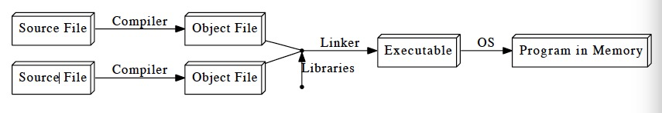
The Compilation Process
A compiler is a system software that converts source code written in a programming language (source language) into another computer language (target language).
Some other languages compilation process:

Slide 8
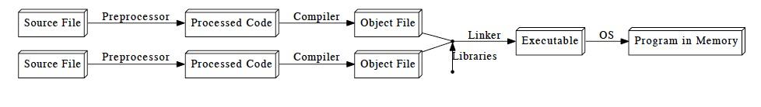
The Compilation Process
Preprocessor applies some modifications to the source code, before being fed to the compiler.
Far faster.
C++ compilation process:

Slide 9
Editor
Extension: .cpp(default), .cp or .c
Editors: text editor, xemacs, emacs, pico, vim, sublime

Slide 10
Installation
Linux or UNIX: check if have gcc installed g++ -v
Install: https://gcc.gnu.org/install
Mac OS X: check if have gcc installed g++ -v
Xcode Install: developer.apple.com/technologies/tools/
Windows: check if have gcc installed gcc
MinGW Install: www.mingw.org you must install gcc-core, gcc-g++, binutils, and the MinGW runtime
https://www.youtube.com/watch?v=DHekr3EtDOA

Slide 11
hello_world.cpp
// A Hello World program
#include <iostream>
int main() {
Std :: cout << “Hello, world!\n”;
return 0;
}

Slide 12
Compiling with C++: g++
To compile a file to an executable called hello:
g++ hello_world.cpp -o hello
To run the executable output:
./hello
To compile a file with warnings:
g++ hello_world.cpp -Wall -o hello

Slide 13
Explanation
//: indicates that everything following it until the end of the line is a comment: it is ignored by the compiler.
Another way to comment may span multiple lines: /* …… */
#: preprocessor commands, change what code is actually being compiled, #include tells the preprocessor to dump in the contents of another file, here the iostream file, which defines the procedures for input/output.
int main() { …} defines the code that should execute when the program starts up.
a. cout <<: syntax for outputting some piece of text to the screen.

Slide 14
Explanation
b. Namespaces: identifiers defined within a context. When we want to access an identifier defined in a namespace, we tell the compiler to look for it in that namespace using the scope resolution operator (::). Here, we’re telling the compiler to look for cout in the std namespace, in which many standard C++ identifiers are defined. A cleaner alternative is to add the following line below line 2:
using namespace std;
If we do this, we can omit the std:: prefix when writing cout. Recommend

Slide 15
Explanation
c. Strings: A sequence of characters.
d. Escape sequences: \n indicates a new line character.
\a: System bell (beep sound) \t: Tab
\b: Backspace \\: Backslash
\f: Formfeed (page break) \’: Single quote character
\n: Newline (line break) \”: Double quote character
\r: “Carriage return” (returns cursor to start of line) \int x: x represented character

Slide 16
Explanation
7. return 0: the program should tell the operating system it has completed successfully. Include it as the last line in the main block.
Note: every statement ends with a semicolon (except preprocessor commands and blocks using {}).

Slide 17
Values and Statements
Statement: a unit of code that does something - a basic building block of a program.
Expression: a statement that has a value - for instance, a number, a string, the sum of two numbers, etc. 4 + 2, x - 1, and "Hello, world!\n" are all expressions.
Not every statement is an expression.

Slide 18
Operators
Operators act on expressions to form a new expression. Replace “Hello, world!\n” with (4 + 2)/3, the program would print the number 2. The + operator acts on the expressions 4 and 2.
Types:
Mathematical: +, -, *, /, % and parentheses.
Logical: and, or and so on.
Bitwise: used to manipulate the binary representations of numbers.

Slide 19
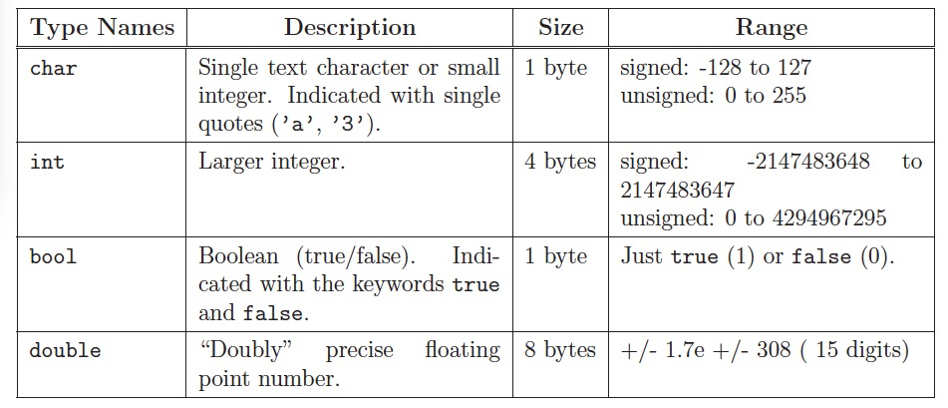
Data Types
Every expression has a type – a formal description of what kind of data its value is.

Slide 20
Variables
We give a value a name so we can refer to it later using variables.
A variable is a named location in memory.
The name of a variable is an identifier token. It may contain numbers, letters, and underscores(_), and may not start with a number.

Slide 21
Variables Example
#include <iostream>
using namespace std;
int main() { int x; // the declaration of the variable x
X = 4 + 2; // the initialization of x, initial value
cout << x / 3 << ‘ ‘ << x * 2;
return 0;
}

Slide 22
Variables
A single statement that does both declaration and initialization
int X = 4 + 2;

Slide 23
Data Types
A data type is a template for
how a particular set of values is represented in memory, and
what operations can be performed on those values.
In C++ a type is the same as a class.
There are
predefined data types
system-defined types
user-defined types

Slide 24
Data Types
Predefined data types are part of the C++ language definition.
Examples: float, double - real. int - integer. char
We denote char literals with single quotes, for example: ‘A’ ‘*’ ‘2’
A string literal is a sequence of characters in double quotes:
“ABCDE”
“127” (not the same as int 127)
“true” (not the same as bool true)

Slide 25
Data Types
System-defined types - part of the C++ class libraries. Not part of the original C++ language definition but added when the compiler is written.
The standard I/O stream objects cin and cout are defined in iostream library
Also there is a string class (type) and classes for input and output files.
To declare an output file: ofstream cprint (“file.txt”);
User-defined types - e.g., enum type, classes

Slide 26
Declarations
Declarations inform the compiler that it will need to set aside space in memory to hold an object of a particular type (class) with a particular name.
Constant declarations
Used to associate meaningful names with constants -- items that will never change throughout the execution of the program.
One convention is to use all uppercase letters for constant identifiers.
const float PI=3.14159;
const float METERS_TO_YARDS=1.196;

Slide 27
Declarations
Variable declarations:
Used to associate identifiers of a given type with memory cells used to store values of this type. - the values stored in the data cells are changeable.
char letter;
char letter1, letter2;
float x, y;

Slide 28
Data Types
Primitive Data Types:
Integer
Character
Boolean
Floating Point
Double Floating Point
Valueless or Void
Wide Character

Slide 29
Input
Outputting values: cout <<
Inputting values: cin >>

Slide 30
Input
#include <iostream>
using namespace std;
int main() { int x;
cin >> x;
cout << x / 3 << ‘ ‘ << x * 2;
Return 0;
}

Slide 31
Debugging
Compilation errors: problems raised by the compiler, generally resulting from violations of the syntax rules or misuse of types.
Runtime errors: problems that you only spot when you run the program: you did specify a legal program, but it doesn’t do what you wanted it to. More tricky to catch.

Slide 32
Questions?

