Slide 1
Introduction of C++ Programming
Qi Wang
wangqi03@bu.edu

Slide 2
Today’s Topic
Flow of Control

Slide 3
Motivation
Normally, a program executes statements from first to last.
The first statement is executed, then the second, then the third, and so on, until the program reaches its end and terminates.
It would be nice to be able to change which statements ran and when, depending on the circumstances.

Slide 4
Motivation
For example, if a program checks a file for the number of times a certain word appears, it should be able to give the correct count no matter what file and word are given to it.
Or, a computer game should move the player's character around when the player wants.
We need to be able to alter the order in which a program's statements are executed, the control flow.

Slide 5
Control Structures
Control structures are portions of program code that contain statements within them and, depending on the circumstances, execute these statements in a certain way.
There are typically two kinds: conditionals and loops.

Slide 6
Conditionals
In order for a program to change its behavior depending on the input, there must a way to test that input.
Conditionals allow the program to check the values of variables and to execute (or not execute) certain statements.
C++ has if and switch-case conditional structures.

Slide 7
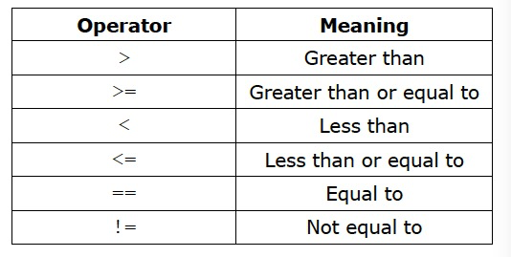
Operators
Relational operators and logical operators: used to determine whether some condition is true or false.
The relational operators are used to test a relation between two expressions:

Slide 8
Relational Operators
They work the same as the arithmetic operators (e.g., a > b)
but return a Boolean value of either true or false, indicating whether the relation tested for holds.

Slide 9
Logical Operators
The logical operators are often used to combine relational expressions into more complicated Boolean expressions.
The operators return true or false, according to the rules of logic.

Slide 10
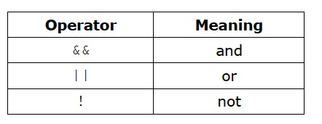
Logical Operators

Slide 11
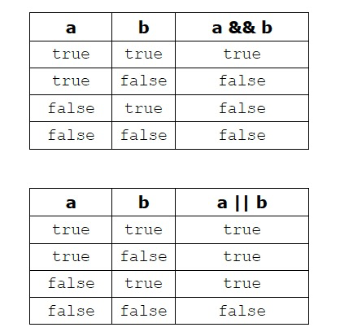
Rules of Logic

Slide 12
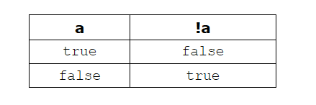
! Operator
The ! operator is a unary operator, taking only one argument and negating its value:

Slide 13
Logical Operators Examples
assume x = 6 and y = 2:
!(x > 2) → false
(x > y) && (y > 0) → true
(x < y) && (y > 0) → false
(x < y) || (y > 0) → true

Slide 14
Boolean Variables
Boolean variables can be used directly in these expressions, since they hold true and false values.
In fact, any kind of value can be used in a Boolean expression.
C++ has: false is represented by a value of 0 and anything that is not 0 is true. So, “Hello, world!” is true, 2 is true, and any int variable holding a non-zero value is true.
This means !x returns false and x && y returns true!

Slide 15
Selections
The C++ selection constructs are used to execute one of the possible alternatives, based on the outcome of a conditional expression.
The following are some structured statements used for selection.
if
if/else
nested if
switch/case

Slide 16
If
if(condition)
{
statement1
statement2
…
}

Slide 17
If
Condition: some expression whose value is being tested.
If the condition resolves to a value of true, then the statements are executed before the program continues on. Otherwise, the statements are ignored.
If there is only one statement, the curly braces may be omitted, giving the form:
if(condition)
statement

Slide 18
If Else
if(condition)
{ statementA1
…
}
else
{ statementB1
…
}

Slide 19
If Else
If the condition is met, the block corresponding to the if is executed. Otherwise, the block corresponding to the else is executed.
Because the condition is either satisfied or not, one of the blocks in an if-else must execute.
If there is only one statement for any of the blocks, the curly braces for that block may be omitted:
if(condition) statementA1
else statementB1

Slide 20
If Else
The else if is used to decide between two or more blocks based on multiple conditions:
if(condition1)
{ statementA1
statementA2
…
}else if(condition2)
{ statementB1
…
}

Slide 21
If Else
If condition1 is met, the block corresponding to the if is executed. If not, then only if condition2 is met is the block corresponding to the else if executed. There may be more than one else if, each with its own condition. Once a block whose condition was met is executed, any else ifs after it are ignored. Therefore, in an if-else-if structure, either one or no block is executed.
An else may be added to the end of an if-else-if. If none of the previous conditions are met, the else block is executed. In this structure, one of the blocks must execute, as in a normal if-else.
Example: If_Else.cpp

Slide 22
Switch-case
The switch-case is another conditional structure that may or may not execute certain statements.
However, the switch-case has peculiar syntax and behavior:

Slide 23
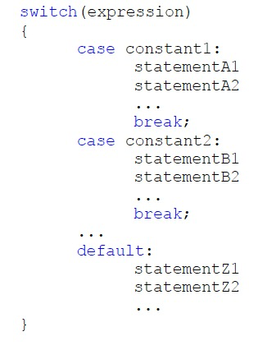
Switch-case

Slide 24
Switch-case
The switch evaluates expression and, if expression is equal to constant1, then the statements beneath case constant 1: are executed until a break is encountered.
If expression is not equal to constant1, then it is compared to constant2. If these are equal, then the statements beneath case constant 2: are executed until a break is encountered. If not, then the same process repeats for each of the constants, in turn. If none of the constants match, then the statements beneath default: are executed.

Slide 25
Switch-case
Due to the peculiar behavior of switch-cases, curly braces are not necessary for cases where there is more than one statement (but they are necessary to enclose the entire switch-case).
switch-cases generally have if-else equivalents but can often be a cleaner way of expressing the same behavior.
Example: Switch_case.cpp

Slide 26
Loops
Conditionals execute certain statements if certain conditions are met; loops execute certain statements while certain conditions are met.
C++ has three kinds of loops: while, do-while, and for.

Slide 27
While
while(condition)
{ statement1
statement2
…
}
As long as condition holds, the block of statements will be repeatedly executed. If there is only one statement, the curly braces may be omitted.
Example: While.cpp

Slide 28
Do-while
The do-while loop is a variation that guarantees the block of statements will be executed at least once:
do
{
Statement1
Statement2
…
}
while(condition);

Slide 29
Do-While
The block of statements is executed and then, if the condition holds, the program returns to the top of the block.
Curly braces are always required.
The semicolon after the while condition.

Slide 30
For loop
for(initialization; condition; incrementation)
{
statement1
statement2
…
}

Slide 31
For loop
Allow a counter variable initialized at the beginning of the loop and incremented (or decremented) on each iteration of the loop.
Curly braces may be omitted if there is only one statement.
Example: For.cpp

Slide 32
For loop and While
we can write an equivalent while loop as
initialization
while(condition){
statement1
statement2
…
incrementation
} Example: For_While.cpp

Slide 33
Nested Control Structures
It is possible to place ifs inside of ifs and loops inside of loops by simply placing these structures inside the statement blocks.
This allows for more complicated program behavior.
Example: If_If.cpp, For_For.cpp

Slide 34
Question & Experiment

