Slide 1
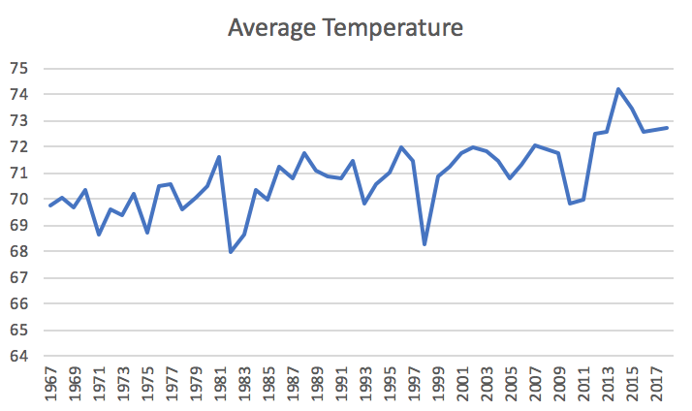
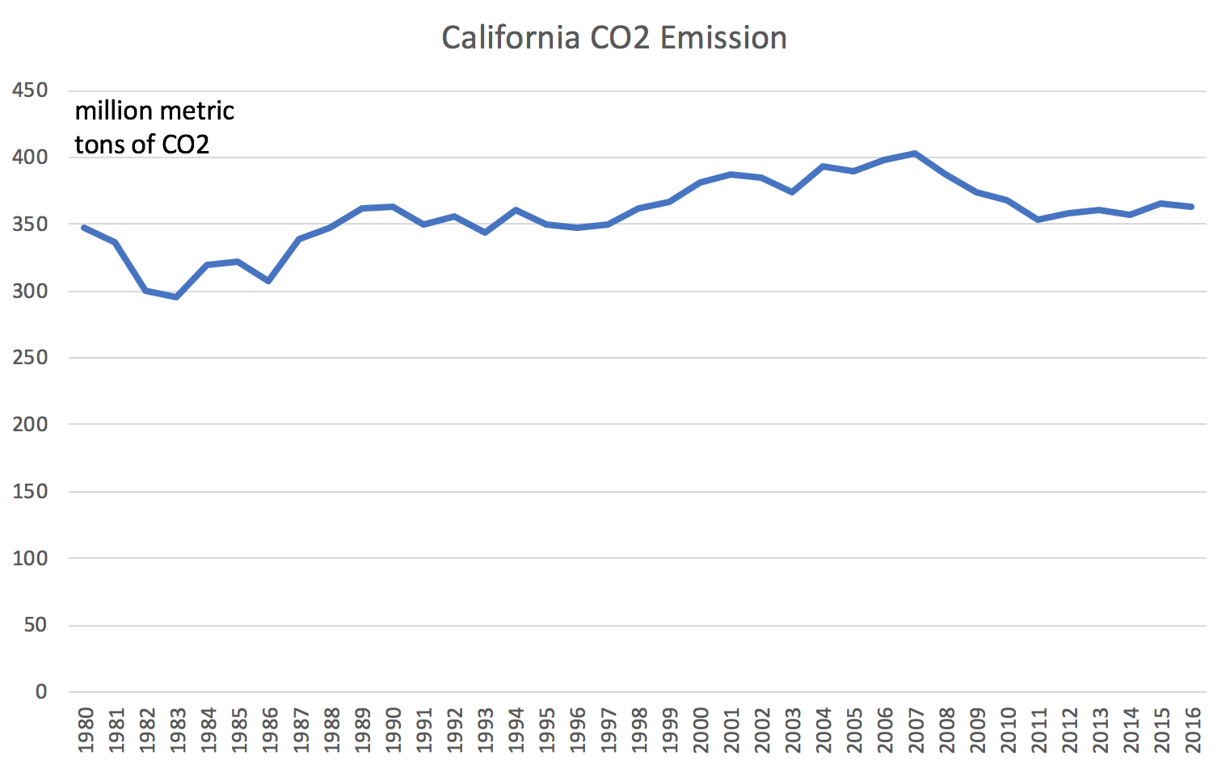
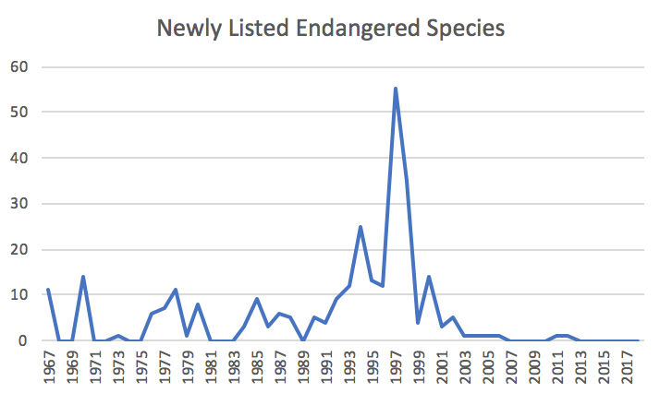
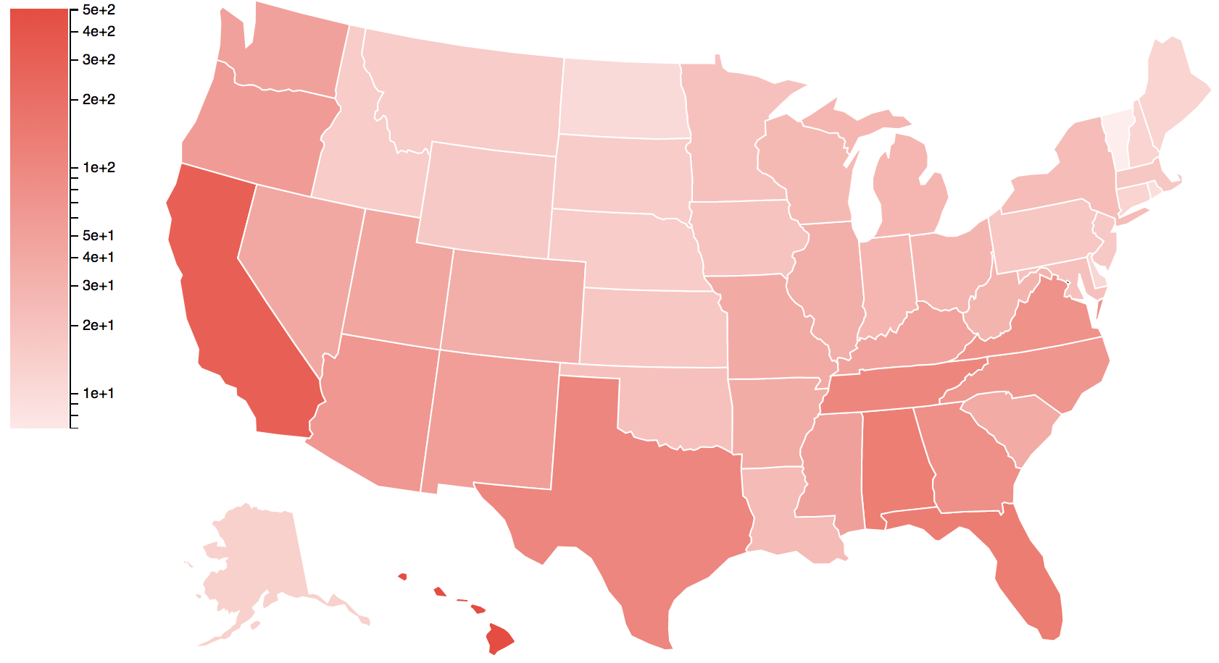
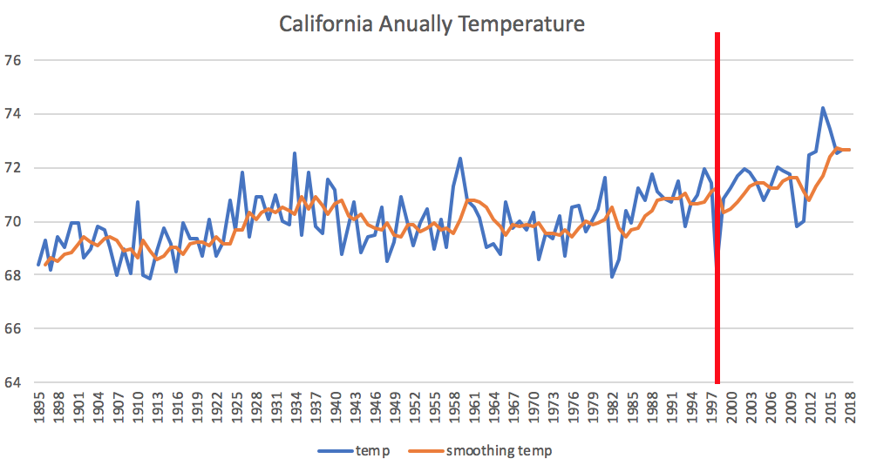
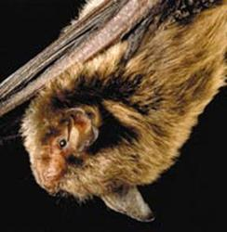
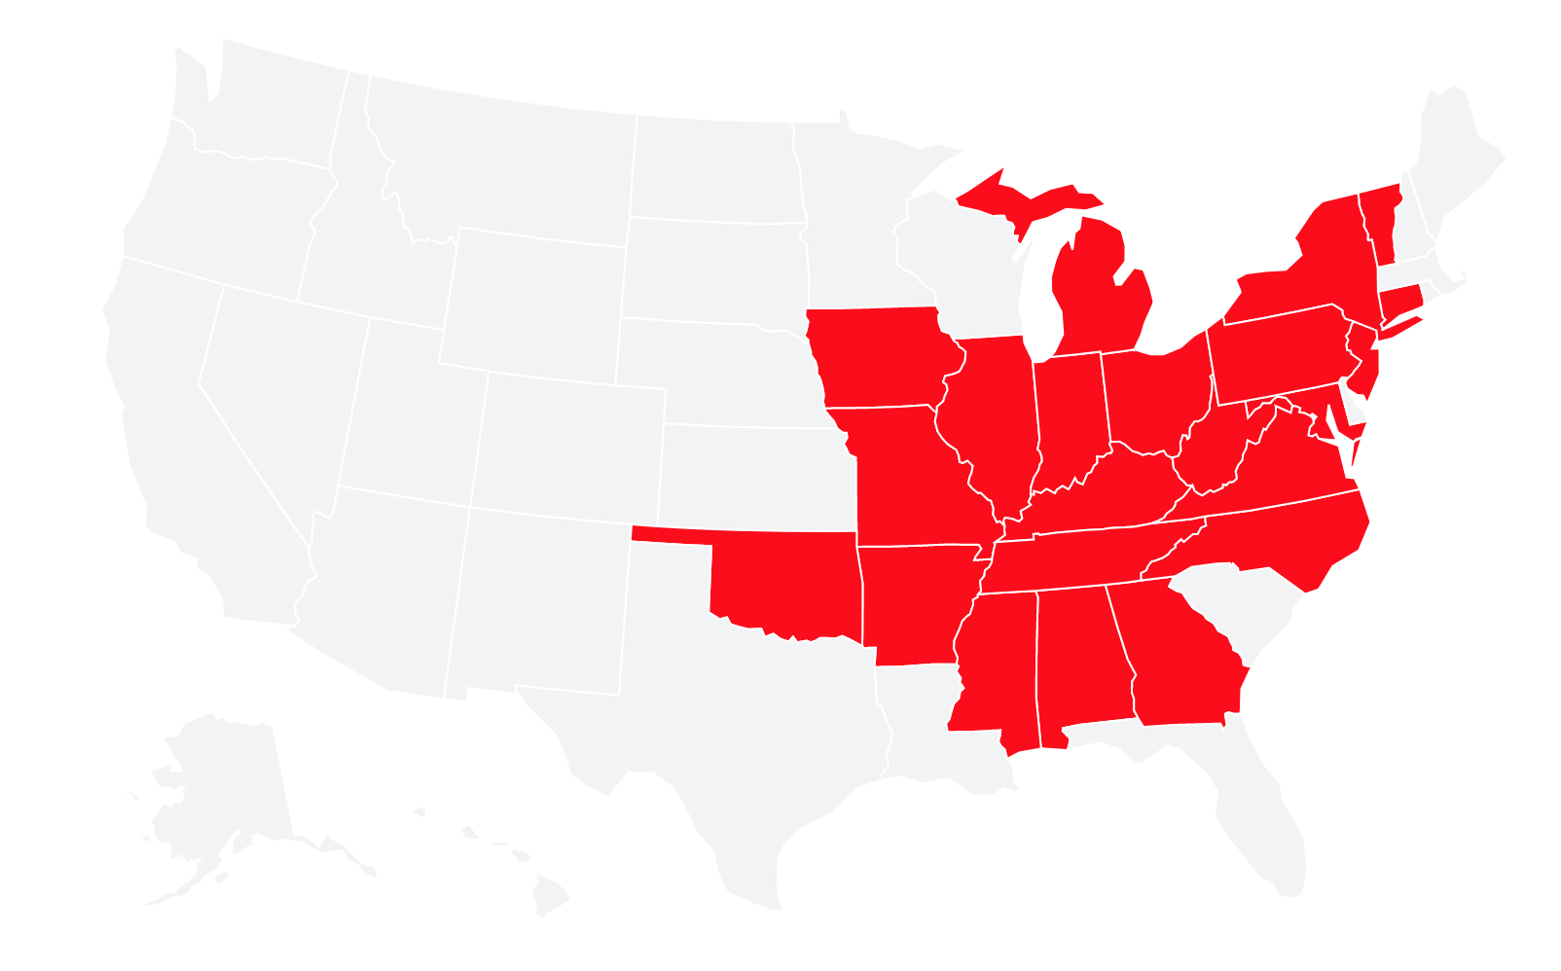
the Effect of Global Warming on Wildlife
Karthik Chigurupati, Man Basnet, Qixuan Hou,
Archit Rede, Justin Rezende
Team 76
INTRODUCTION
Visualization. Time series information is presented via line chart.
Impacts of global warming on wildlife and their ecosystems is evident through data collected and studies done by various government, science, and engineering agencies worldwide. Understanding the impact of global warming and rapid climate changes on species can play a crucial role in predicting endangerment and extinction patterns. In our project, we are studying weather data with various features such as temperatures, precipitation, wind speed, humidity, CO2, etc., together with number of species being extinct and endangered with their other details.
Fig. 3. Average temperature shows yearly average temperature of California from 1967 to 2017. CO2 Emission indicates average CO2 emission in California.
EXPERIMENT
Data collection. Our project joins two major data sets.
Weather data set shows monthly temperature by state from 1895 to 2018 and yearly CO2 emission from 1980 to 2016. Data is collected through API service.
Endangered species data set indicates when the species is listed as endangered or threatened and which state the species is being seen in the past. The data set ranges from 1967 to 2018. Data is collected by web crawler.
Visualization. Since both data sets contain time series and geography information, we mainly use US map and timeline to visualize our data.
Fig. 4. The line chart show the count of newly listed endangered/threatened species in California by year.
Data Analysis. In Fig. 3 above, temperature and CO2 emission seem to have upward trends. In order to confirm our observation, we have performed time series analysis. Holt-Winters is used to run single/double/triple exponential smoothing. CUSUM (Cumulative Sum Control Chart) is used to detect changes. If there is a upward trend detected, we will refer to Fig. 4, the count of listed endangered/threatened species, to check if there is a peak in the corresponding period.
Fig. 1. The choropleth map is a thematic map in which areas are shaded or patterned in proportion to the count of the endangered species reported in each state.
Fig. 5. The blue indicates annually average temperature, the orange line shows the data after smoothing with factor as 0.6, and the red line signifies the change detection result. The red line lies on 2000 and if we refer to Fig. 4, we can find the peak is around 1998, which is close to 2000.
Evaluation. We run the above analysis for each state and do find about 60% of states have raising temperature and CO2 emission in the past several years. Among the 60% of states, there are about 34.5% of states indicating a matching period between the peak of listed endangered species and the upward trend of temperature or CO2 emission.
Fig. 2. The U.S states map represents where Indiana bat (Myotis sodalis) has been recorded. It was listed as endangered animal since 1967.

