Slide 1
Feature Squeezing: Detecting Adversarial Examples in Deep Neural Networks
Weilin Xu David Evans Yanjun Qi
Notes:
20 minutes in total. ~17 mins of presentation and ~3 mins for Q&A.

Slide 2
Background: Classifiers are Easily Fooled
+
=
“4”
100%
BIM
+
=
“2”
99.9%
“1”
100% confidence
CW₂
+
=
“2”
83.8%
Original
Example
JSMA
Adversarial
Examples
Perturbations
C Szegedy et al., Intriguing Properties of Deep Neural Networks. In ICLR 2014.
Notes:
As we all know, deep learning has been extremely successful on the image classification problems. We initially believed deep learning might have found a good way to duplicate human vision. However, researchers have discovered that deep learning models behave very differently on adversarial examples.
Starting from the hand-written digit 1 on the left, an adversary is able to craft some perturbations that force a state-of-the-art classifier to produce arbitrary predictions. This could be a huge concern if the deep learning models are used in security-sensitive tasks, because they would not produce reliable predictions under attack.

Slide 3
Solution Strategy
Solution Strategy 1: Train a perfect vision model.
Infeasible yet.
Solution Strategy 2: Make it harder to find adversarial examples.
Arms race!
Feature Squeezing: A general framework that reduces the search space available for an adversary and detects adversarial examples.
Notes:
If we could train a model that perfectly duplicates human vision, it would have solved the problem. But cognitive scientists and computer vision experts tell us that we are still far from there.
Instead, researchers have developed some techniques making it harder to find adversarial examples. However, subsequent studies pointed out that most of the existing defense techniques could be effectively bypassed. The arms race may never end.
In this work, we propose to change this game with Feature Squeezing, a general framework that reduces the search space available for an adversary and detects adversarial examples.

Slide 4
Roadmap
Feature Squeezing Detection Framework
Feature Squeezers
Bit Depth Reduction
Spatial Smoothing
Detection Evaluation
Oblivious adversary
Adaptive adversary
Notes:
In this talk, I will first introduce the general framework of feature squeezing, followed by the two squeezers we explored in our paper: bit-depth reduction and spatial smoothing. We evaluate the detection performance under two different threat models: the oblivious adversary and the adaptive adversary.

Slide 5
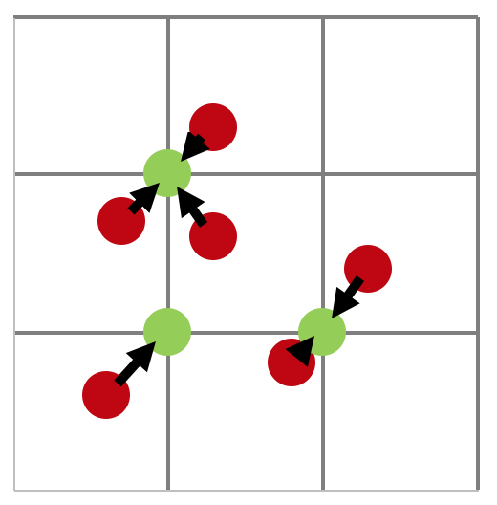
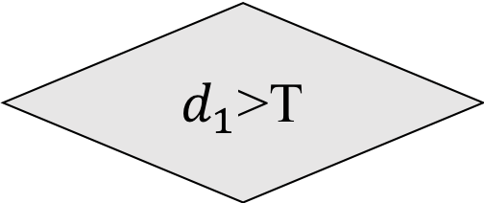



Detection Framework
Model
Prediction₀
Adversarial
Yes
$$d_{1}$$
$d_{1}$>T
Model
Squeezer₁
$$L_{1}$$
Prediction$1$
No
Input
Feature Squeezer coalesces similar samples into a single one.
Barely change legitimate input.
Destruct adversarial perturbations.
Legitimate
Notes:
First, let me introduce the general framework of feature squeezing. Initially without any defense technique, we would directly take the prediction output from a deep learning model. In the feature squeezing framework, we would pre-process the input with a feature squeezer and get a second prediction.
The feature squeezer coalesces similar samples into a single one. It barely changes the image semantics, so the two predictions should be similar for a legitimate input. However, the adversarial perturbations might be destructed by feature squeezing. As a result, the two predictions of an adversarial example are likely to be different.
We employ the L1 distance metric to model the difference between the two predictions. If the L1 distance is larger than a specific value T, the framework raises an alert that the input is likely to be adversarial.
The current framework is simple and straightforward. However, we haven't found any single squeezer that is universally effective on all existing adversarial methods.

Slide 6




Detection Framework: Multiple Squeezers
Adversarial
Model
Prediction₀
Yes
$$\max\left(d_{1},d_{2}\right)>T$$
Model
$$d_{1}$$
Squeezer₁
$$L_{1}$$
Prediction$1$
No
Legitimate
Input
Model
Squeezer₂
$$L_{1}$$
Prediction$2$
$$d_{2}$$
Bit Depth Reduction
Spatial Smoothing
Notes:
Therefore, we add multiple squeezers in the framework which generates multiple L1 scores. We use a max function to aggregate these L1 scores. If the maximum L1 score is larger than a threshold, the framework raises an alert.
Next, I will introduce the feature squeezers we explored in the paper. They are Bit depth reduction and spatial smoothing. Let's start with bit depth reduction.

Slide 7
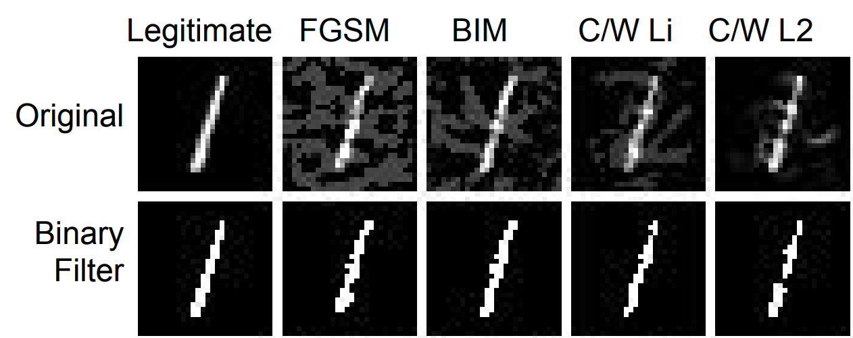


Bit Depth Reduction
1-bit
[0.012 0.571 …… 0.159 0.951]
X
Reduce to 1-bit
$$f_{i}=round(f_{i}×2)/2$$
3-bit
Target value
[0. 1. …… 0. 1. ]
8-bit
[0. 0. …… 0. 1. ]
Reduce to 1-bit
$$f_{i}=round(f_{i}×2)/2$$
Original value
[0.312 0.271 …… 0.159 0.351]
Signal Quantization
X_adv
Notes:
In the signal processing field, the continuous natural signals are typically quantized into discrete representations. For images, we often use 8-bit integers to encode each pixel, which contains 256 levels. We have found that we don't have to use the 8-bit encoding for many image classification tasks. Using fewer bits would do the same thing, but it reduces the search space available for an adversary.
Here we show an example on the right side. Starting with a hand-written digit "1" at the top, we have generated an adversarial example at the bottom. If we reduce the encoding bits from 8 to 1, we will find that the resulting image is very similar to the original one. On the other hand, a lot of perturbations are filtered for the adversarial image, resulting in more reliable prediction.

Slide 8
Bit Depth Reduction
Eliminating adversarial perturbations while preserving semantics.
Legitimate FGSM BIM CW∞ CW₂
1
1
4
2
2
1
1
1
1
1
Notes:
We give more examples of bit depth reduction on this page. We have four different adversarial examples, respectively generated by Fast Gradient Sign Method, Basic Iterative Method, and the two Carlini & Wagner attacks. It is obvious that reducing the encoding bits to 1 effectively eliminates adversarial perturbations while preserving the image semantics.

Slide 9
Accuracy with Bit Depth Reduction
Dataset | Squeezer | Adversarial Examples (FGSM, BIM, CW∞, Deep Fool, CW₂, CW₀, JSMA) | Legitimate Images
MNIST | None | 13.0% | 99.43%
 | 1-bit Depth | 62.7% | 99.33%
ImageNet | None | 2.78% | 69.70%
 | 4-bit Depth | 52.11% | 68.00%
Baseline
Notes:
The model accuracy results further confirm this observation. Let's take a look at the MNIST dataset. Without feature squeezing, the accuracy on adversarial examples is 13%. By contrast, the accuracy is increased to 62% if we transform the images with the 1-bit-depth filter. On the other hand, the accuracy on legitimate examples doesn't change much. The results on ImageNet are similar to this.

Slide 10
Spatial Smoothing: Median Filter
Replace a pixel with median of its neighbors.
Effective in eliminating ”salt-and-pepper” noise.
3x3 Median Filter
* Image from https://sultanofswing90.wordpress.com/tag/image-processing/
Notes:
The second feature squeezing technique we have investigated is spatial smoothing, which includes the median filter and the non-local means. The median filter is a well-known smoothing technique in the image processing field. It runs a sliding window over each pixel, and the centering pixel is replaced with the median value of its neighbors. Many studies have confirmed that it is effective in eliminating salt-and-pepper noise, as is shown by the example on the right side.

Slide 11
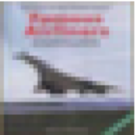
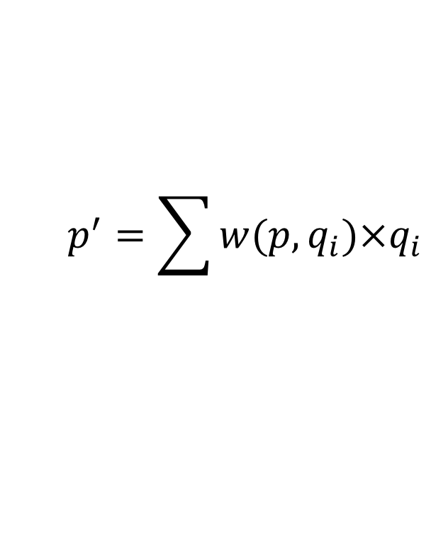



Spatial Smoothing: Non-local Means
Replace a patch with weighted mean of similar patches.
Preserve more edges.
$$p^{′}=\sum{w(p,q_{i})×q_{i}}$$
$$p$$
$$q_{1}$$
$$q_{2}$$
Notes:
The second smoothing technique is non-local means. There are two major differences compared with the median filter. First, it operates on a patch of pixels instead of a single pixel. Second, it makes use of the similar patches even if they are not neighbors. The center patch is replaced with the weighted mean of the similar patches.
We use an airplane image from the CIFAR-10 dataset to explain this method. We want to smooth the square patch p and we have got two reference patches q1 and q2. Because the patch q1 is more similar to the target patch p, its weight will be larger than that of q2. Since there could be many reference patches, we often limit the search to a smaller region. Although the method is not global, it is indeed non-local.

Slide 12
Original BIM (L∞) JSMA (L₀)
Airplane
94.4%
Truck
99.9%
Automobile
56.5%
Median Filter
(2*2)
Airplane
98.4%
Ship
46.0%
Airplane
99.9%
Non-local Means
(13-3-4)
Airplane
98.3%
Airplane
80.8%
Airplane
70.0%
Notes:
We use the same image to demonstrate the effect of the two smoothing methods. We have generated two adversarial examples, using Basic Iterative Method and JSMA. Even though the three images are different due to adversarial perturbations, median filter blurs them into similar results. Particularly, it eliminates most of the JSMA perturbations, because they are similar to salt-and-pepper noise. Non-local Means also smooths the images. We can tell that it preserves more edges and creates a smoother background.

Slide 13
Accuracy with Spatial Smoothing
Dataset | Squeezer | Adversarial Examples (FGSM, BIM, CW∞, Deep Fool, CW₂, CW₀) | Legitimate Images
ImageNet | None | 2.78% | 69.70%
 | Median Filter 2*2 | 68.11% | 65.40%
 | Non-local Means 11-3-4 | 57.11% | 65.40%
Baseline
Notes:
The model accuracy also confirms our observation. Here we present the accuracy on the ImageNet dataset. Comparing the baseline accuracy without feature squeezing, we can tell that the two squeezers increase the accuracy on adversarial examples a lot, from 2 percent to over 50%, while there is only a little drop on the accuracy of legitimate images.

Slide 14
Other Potential Squeezers
Thermometer Encoding (learnable bit depth reduction)
J Buckman, et al. Thermometer Encoding: One Hot Way To Resist Adversarial Examples ,
to appear in ICLR 2018.
Image denoising using bilateral filter, autoencoder, wavelet, etc.
D Meng and H Chen, MagNet: a Two-Pronged Defense against Adversarial Examples, in CCS 2017.
F Liao, et al. Defense against Adversarial Attacks Using High-Level Representation Guided Denoiser,
arXiv 1712.02976.
A Prakash, et al. Deflecting Adversarial Attacks with Pixel Deflection, arXiv 1801.08926.
Image resizing
C Xie, et al. Mitigating Adversarial Effects Through Randomization, to appear in ICLR 2018.
Notes:
There are other potential feature squeezing methods that could fit in our general framework, which will be interesting to investigate in the future.

Slide 15
Experimental Setup
Datasets and Models
MNIST, 7-layer-CNN
CIFAR-10, DenseNet
ImageNet, MobileNet
Attacks (100 examples for each attack)
Untargeted: FGSM, BIM, DeepFool
Targeted (Next/Least-Likely): JSMA, Carlini-Wagner L₂/L∞/L₀
Detection Datasets
A balanced dataset with legitimate examples.
50% for training the detector, the remaining for validation.
Notes:
Next, I will present the evaluation results on detection using the three feature squeezers which I introduced earlier. We conducted the experiment on three image datasets. We considered seven different attacks, both untargeted and targeted attacks. The detector is trained on a balanced dataset and we report the validation results.

Slide 16
Threat Models
Oblivious adversary: The adversary has full knowledge of the target model, but is not aware of the detector.
Adaptive adversary: The adversary has full knowledge of the target model and the detector.
Notes:
We first consider a threat model that the adversary knows everything about the target model but is not aware of our detector.

Slide 17
Train a detector (MNIST)
Select a threshold value with FPR 5%.
Maximum L₁ Distance
Notes:
We run the feature squeezers and aggregate the L1 scores using the max function. The histogram represents the distribution of the maximum L1 score on MNIST. We can roughly tell that adversarial examples have higher L1 scores. The training process is to select a threshold value according to some constraints. Here we select a threshold so that the false positive rate is below 5% on the training dataset.

Slide 18
Detect Successful Adv. Examples (MNIST)
Bit Depth Reduction is more effective on L∞ and L₂ attacks.
Median Smoothing is more effective on L₀ attacks.
Squeezer | L∞ Attacks |  |  | L₂ Attacks | L₀ Attacks
 | FGSM | BIM | CW∞ | CW₂ | CW₀ | JSMA
1-bit Depth | 100% | 97.9% | 100% | 100% | 55.6% | 100%
Median 2*2 | 73.1% | 27.7% | 100% | 94.4% | 82.2% | 100%
[Best Single] | 100% | 97.9% | 100% | 100% | 82.2% | 100%
Joint | 100% | 97.9% | 100% | 100% | 91.1% | 100%
Joint detection improves performance.
Notes:
We report the detection rates of each attack on the MNIST dataset. We found that bit depth reduction if more effective on L_infinity and L2 attacks, while the median filter is more effective on L_0 attacks. Combining the two squeezers generates a detection rate that is higher than any single squeezer.

Slide 19
Aggregated Detection Results
Dataset | Squeezers | Threshold | False Positive Rate | Detection Rate (SAEs) | ROC-AUC Exclude FAEs
MNIST | Bit Depth (1-bit), Median (2x2) | 0.0029 | 3.98% | 98.2% | 99.44%
CIFAR-10 | Bit Depth (5-bit), Median (2x2), Non-local Mean (13-3-2) | 1.1402 | 4.93% | 84.5% | 95.74%
ImageNet | Bit Depth (5-bit), Median (2x2), Non-local Mean (11-3-4) | 1.2128 | 8.33% | 85.9% | 94.24%
Best Result
Notes:
The aggregated results on all three datasets are available on this table. We report the threshold values, the false positive rates, the detection rates and the ROC-AUC scores. We can tell that the detection result on MNIST is the best among all datasets, with a ROC-AUC score very close to 1. We might be able to increase the results on CIFAR-10 and ImageNet using other squeezers in the future.

Slide 20
Threat Models
Oblivious attack: The adversary has full knowledge of the target model, but is not aware of the detector.
Adaptive attack: The adversary has full knowledge of the target model and the detector.
Notes:
Next, we will explore if a feature-squeezing-based detector is robust against an adaptive adversary who knows everything about the target model as well as our detector.

Slide 21
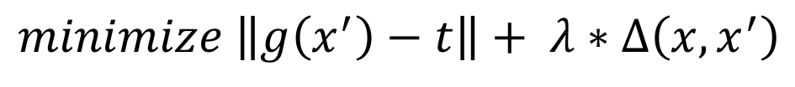
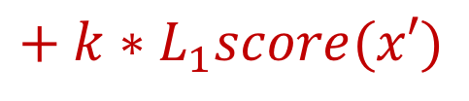
Adaptive Adversary
Adaptive CW₂ attack, unbounded adversary.
$$minimize \left\|g\left(x^{′}\right)−t\right\|+ λ∗Δ\left(x,x^{′}\right)$$
$$+ k∗L_{1}score(x′)$$
Misclassification term
Distance term
Detection term
Warren He, James Wei, Xinyun Chen, Nicholas Carlini, Dawn Song,
Adversarial Example Defense: Ensembles of Weak Defenses are not Strong, USENIX WOOT’17.
Notes:
We introduce the adaptive CW2 attack. The original CW2 attack basically has two terms in the objective function: the misclassification term and the distance term. A modern solver is used to search a perturbation that minimizes the objective function. The adaptive CW2 attack adds one more term, which is the detection score given by the target detector. To the best of our knowledge, this is the state-of-the-art adaptive adversary technique against feature squeezing.

Slide 22
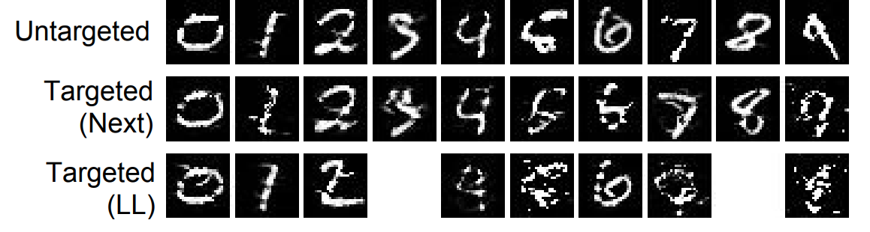
Adaptive Adversarial Examples
Mean L₂
2.80
4.14
4.67
No successful adversarial examples were found for images originally labeled as 3 or 8.
Notes:
We ran the attack against our detector and found that it often generates adversarial examples that both fool the target model and evade our detector. It is not surprising because the CW attack is unbounded on the perturbation amount. If we take a look at the images, we would find that some of them are unrecognizable to human eyes.

Slide 23

Adaptive Adversary Success Rates
Unbounded
Untargeted
Common $ε$
Targeted
(Next)
Targeted (LL)
Notes:
In order to understand the success rate of an adaptive adversary in a more practical setting, we clip the perturbations and report the actual success rates. We found that even with unbounded perturbations, the success rates are much lower than 100%. If we clip the perburbations with a common epsilon value 0.3, the success rates would not be higher than 1%.

Slide 24

Counter Measure: Randomization
Binary filter threshold := 0.5 threshold := $𝒩\left(0.5, 0.0625\right)$
Strengthen the adaptive adversary
Attack an ensemble of 3 detectors with thresholds := [0.4, 0.5, 0.6]
Notes:
Our further investigation shows that randomization helps defend against the adaptive adversary. We replace the deterministic binary filter with a randomized one, in which the threshold value follows a normal distribution. Accordingly, we strength the adaptive adversary by attacking an ensemble of 3 detectors with three different thresholds: .4, .5 and .6.

Slide 25
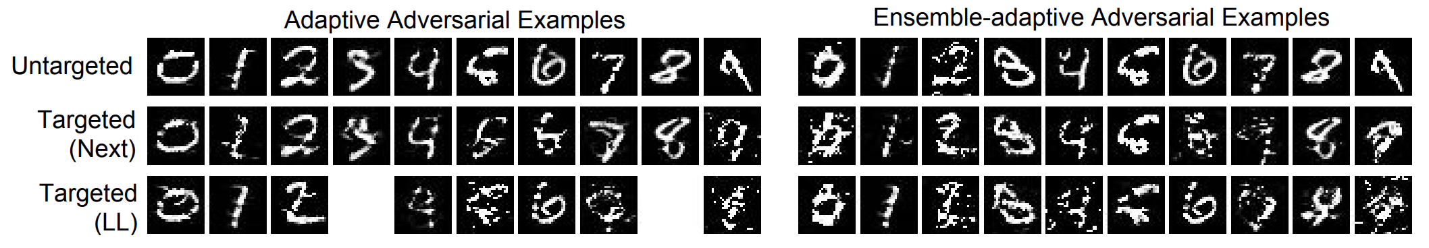
Attack Deterministic Detector
Mean L₂
2.80, Untargeted
4.14, Targeted-Next
4.67, Targeted-LL
3.63, Untargeted
5.48, Targeted-Next
5.76, Targeted-LL
Attack Randomized Detector
Notes:
The results show that randomization makes the adversary more difficult to generate adversarial examples. The adversary has to introduce larger perturbations for evading the detector.

Slide 26
Conclusion
Feature Squeezing hardens deep learning models.
Feature Squeezing gives advantages to the defense side in the arms race with adaptive adversary.
Notes:
In conclusion. Feature squeezing hardens deep learning models by reducing the search space available to an adversary. It gives advantages to the defense side in the arms race with the adaptive adversary. You can read more details on our paper.

Slide 27
Thank you!
Reproduce our results using EvadeML-Zoo: https://evadeML.org/zoo
Notes:
Thanks for listening to the talk. I am ready to take your questions

Slide 29
Backup Slides

Slide 30
NIPS’17 AML Defense Challenge
Different threat model: Unknown target model and defense.
Top 4 defense submissions:
 | Username | Basic Idea | Score
1 | liaofz | Denoise autoencoder trained with adv. examples + model ensemble | 95.32
2 | cihangxie | Random resizing + random padding. | 92.35
3 | anlthms | JPEG compression + random affine transformation + model ensemble. | 91.48
4 | erkowa | 2x2 Median filter + model ensemble. | 91.20
None of them is robust against adaptive adversary.

