Slide 1

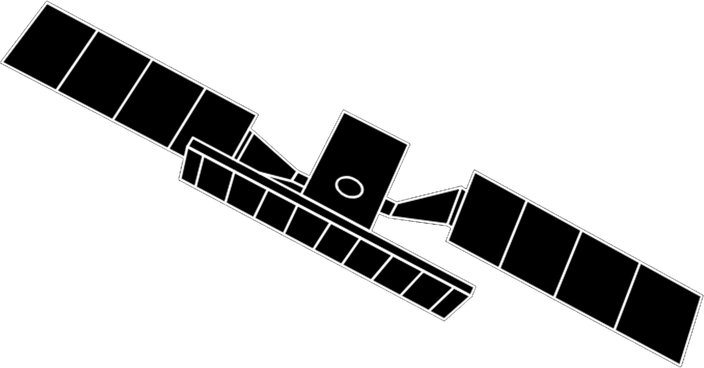
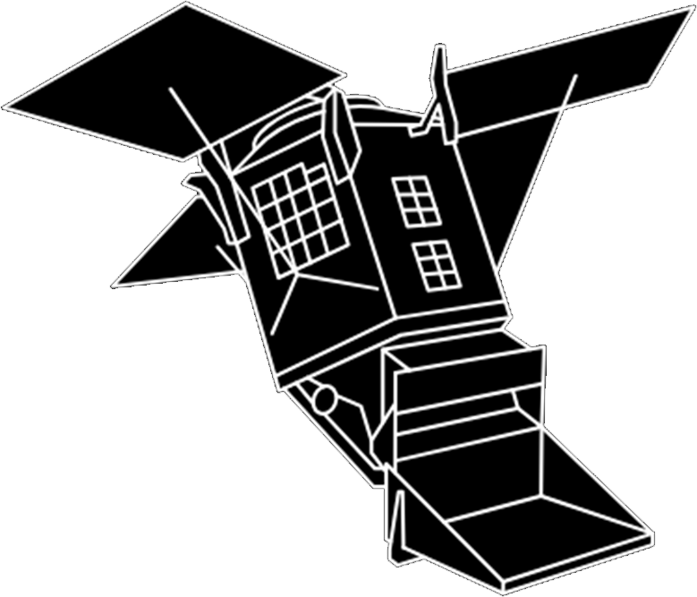
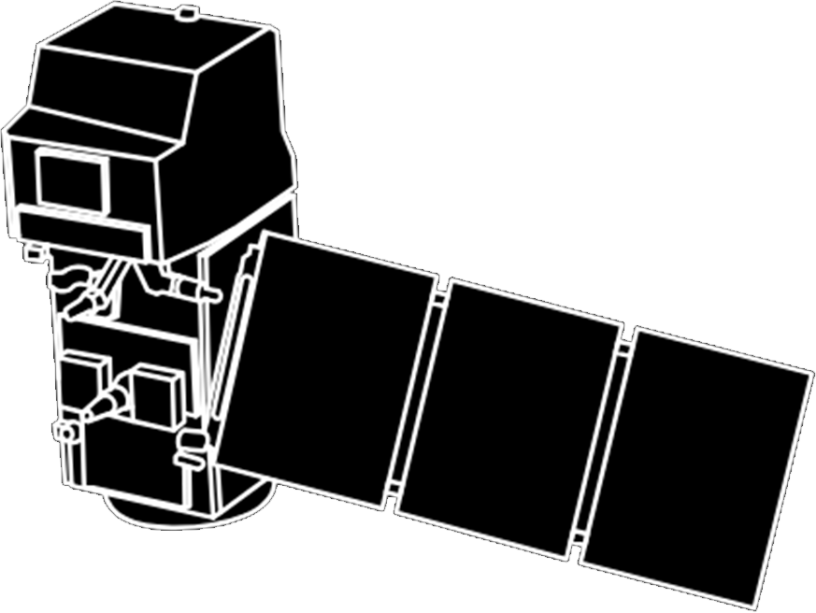
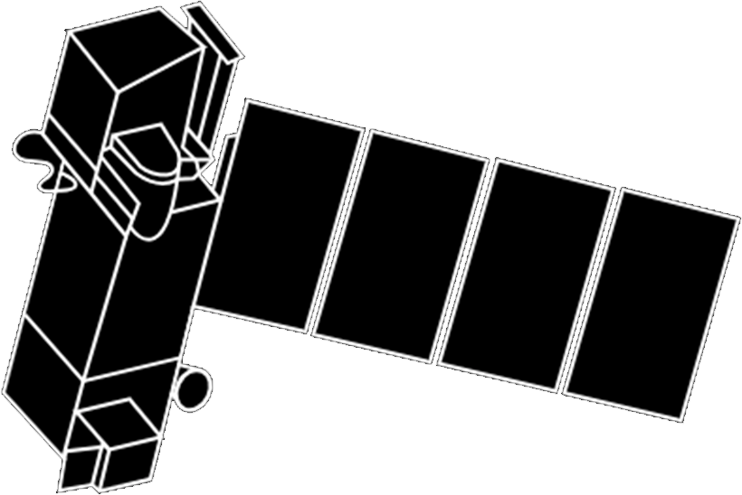
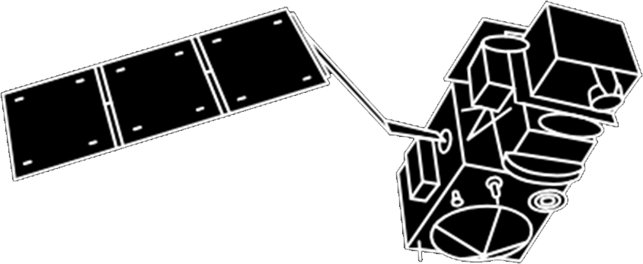

Sentinel-1
Sentinel-6
launched in 2014 and 2016 respectively.
The all-weather, day and night radar images for land and ocean observation.
Instruments: C-band Synthetic Aperture Radar (SAR).
Launched in 2020.
Sea-surface height measurements.
Poseidon-4 radar altimeter and Advanced Microwave Radiometer for Climate (AMR-C).
Sentinel-5P
launched in 2017.
The forerunner to the Sentinel-5 satellite.
Monitoring European air quality from geostationary orbits.
Instruments: TROPOspheric Monitoring Instrument (TROPOMI).
Sentinel-2
launched in 2015 and 2017 respectively.
High-resolution optical images for land surface monitoring.
Instruments: High-resolution Multispectral Imager (MSI).
The family of Sentinel Satellites
Sentinel-5
Sentinel-5A is expected for 2025.
Monitoring European air quality from geostationary orbits.
Instruments: a UV-VIS-NIR-SWIR spectrometer.
Sentinel-3
launched in 2016 and 2018 respectively.
Marine observation
Instruments: SLSTR, OLCI, SRAL, DORIS, and MWR.
Sentinel-4
Sentinel-4 is expected for 2024.
Monitoring global air quality from polar orbit.
Instruments: The MTG-S satellite equipped with an ultraviolet-visible-near-infrared. (UVN) light

Slide 2
