Slide 1
EMF Query Processing Engine
Qiyun Lu

Slide 2
What’s my project for?
Standard SQL performs poorly on simple Ad-hoc OLAP queries involving multiple groupings and aggregations.
Two frameworks called multi-feature queries (MF queries) and extended multi-feature queries (EMF queries) are proposed by Damianos Chatziantoniou to solve the problem mentioned above.
My java project builds a query processing engine for Ad-Hoc OLAP queries based on the EMF framework. It reads in a query in the specified format, then generates a file called “Query.java”. By compiling and running “Query.java”, the result of Ad-Hoc OLAP query is presented.

Slide 3
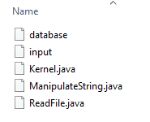

The items I will cover
Source code in the folder “src”
Library in the folder “lib”

Slide 4
The high-level architecture of the project
Kernel
Read database information from file “database”. Then connect to the database and get the column names and data types. Translate SQL data types to Java data types and store them in the variables (tableStruct, TAT).
Read 6 operands from file “input” and store them in 6 variables (SA, NGV, GA, FV, SCV, HC). Replace avg aggregation with sum and count aggregations (FV, SCV, HC). Translate SQL such that clauses to Java conditions (SCV). Translate SQL having clause also to Java condition (HC).
In the memory, properly embed the parameters (data types and variables) in the model of file “Query.java”.
Create file “Query.java” in the current folder and write the model into it.

Slide 5
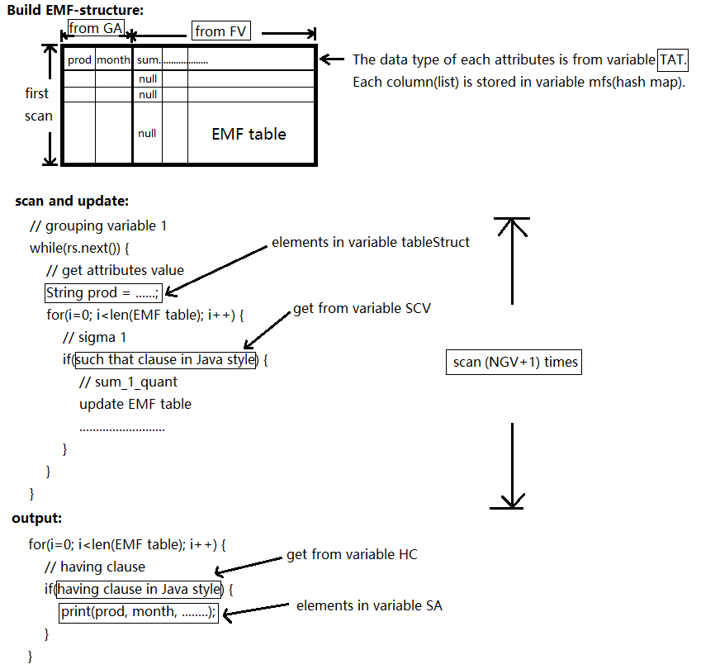
Model

Slide 6
The description of the query structure
1
2
3
4
5
6
7
8
9
10
11
12
// SELECT ATTRIBUTE(S):
prod, month, count_3_quant
// NUMBER OF GROUPING VARIABLES(n):
3
// GROUPING ATTRIBUTES(V):
prod, month
// F-VECT([F]):
; avg_1_quant; avg_2_quant; count_3_quant
// SELECT CONDITION-VECT([Sigma]):
; 1.prod = prod and 1.month = month - 1; 2.prod = prod and 2.month = month + 1; 3.prod = prod and 3.month = month and 3.quant > avg_1_quant and 3.quant < avg_2_quant
// HAVING CONDITION(G):

Slide 7
The description of the technology
Windows 10 Pro, 64-bit Operating System, x64-based processor
Java(TM) SE Runtime Environment (build 1.8.0_161-b12)
PostgreSQL 10.5, compiled by Visual C++ build 1800, 64-bit
JDBC Driver Version 42.2.5
Except for JDBC library, all functions and data structures used in this project are native in Java.

Slide 8
Technical limitations
Multi-table query is not supported.
Where clause is not supported.
Standard SQL input is not supported.
No optimization.
Results are not sorted.
Null values cannot be omitted when displayed.

Slide 9
Summary
To express complex OLAP queries in Standard SQL, a high degree of redundancy (multiple self-joins, correlated subqueries, and repeated group-bys) is required. This leads to complicated queries, difficult to write, understand and optimize. This leads to severe speed drop, memory occupancy, and disk I/O.
Use my project. Make queries to be expressed in a compact, intuitive and simple manner.
Use my project. Run queries faster by using efficient algorithms with less memory cost and disk I/O.
Use my project. Save money, time and your own ass.

