Slide 1
Sentiment Analysis on Public Momentum
Predicting Stock Trends (ABNB) using FinBERT & Python
Qiyun Lu | Trine University | IS 5803 Capstone

Slide 2

Why This Project?
It's Magic
The Money
Challenges
Machine Learning feels like wizardry. I wanted to cast some spells.
Let's be honest. Who doesn't want to predict the future and profit?
Turning messy internet text into clean, tradable math.

Slide 3
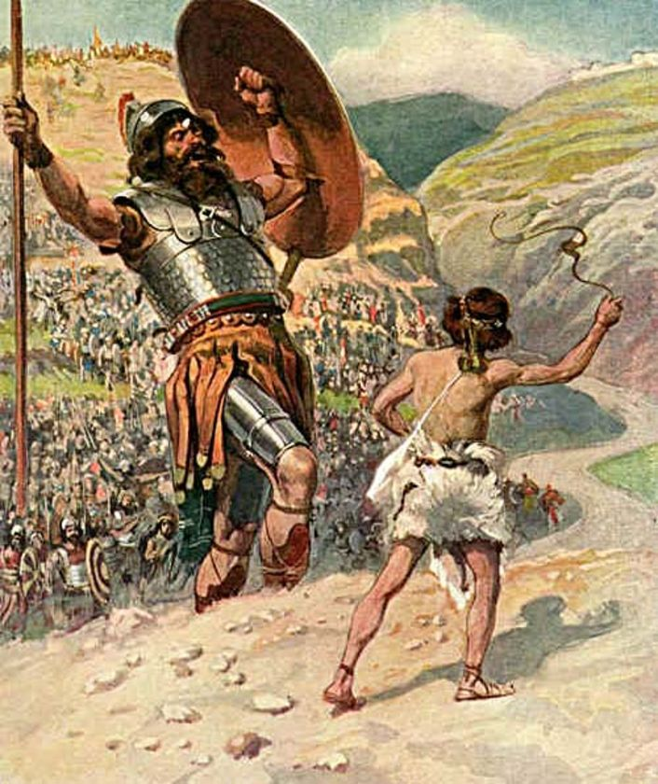
The David vs. Goliath Problem
The Reality
Hedge funds have supercomputers and army of PhDs.
Retail investors (us) usually just have Reddit and a gut feeling.
My Goal: Build a low-overhead, "poor man's Bloomberg" that fits on a laptop.
Notes:
Image Source: https://www.esotericmeanings.com/wp-content/uploads/2016/02/david-and-goliath.jpg

Slide 4

Standing on the Shoulders of Giants
I didn't guess. I followed the literature.
Why Simple Math?
Why FinBERT?
Why 7 Days?
Jiang & Zeng (2023)
Boyd (2019)
Lundberg & Lee (2017)
Standard NLP fails on finance words like "liability" or "risk". FinBERT is domain-adapted to understand them.
News doesn't vanish instantly. It has a "decay curve." A 7-day rolling window captures the momentum tail.
Retail investors need trust. Logistic Regression is transparent; Neural Networks are black boxes.
Notes:
Boyd, P.-J. (2019, February 19). How Long Does a News Story Last?. Vuelio. https://www.vuelio.com/uk/blog/how-long-does-a-news-story-last/
Jiang, T., & Zeng, Q. (2023). Financial Sentiment Analysis using FinBERT with Application in Predicting Stock Movement. arXiv. https://doi.org/10.48550/arXiv.2306.02136
Lundberg, S., & Lee, S. (2017, May 22). A Unified Approach to Interpreting Model Predictions. Advances in Neural Information Processing Systems. https://arxiv.org/abs/1705.07874

Slide 5

The Pipeline
1. Scrape
Google News, Yahoo Finance, Blogs.
(Python + GDELT)
2. Sense
Classify Title & Content.
(HuggingFace Transformers)
3. Solve
Logistic Regression. Predict "Up" or "Down".
(Scikit-Learn)

Slide 6

The Struggle Was Real
My PC is Dying: Running BERT on an old CPU is... a patience builder.
Sparse Data: Some days, nobody talks about Airbnb. I had to use "Forward Fill" to plug the gaps.
Environment Hell: PyTorch vs. TensorFlow compatibility issues on Mac.
Notes:
Image Source: https://media.istockphoto.com/id/2007594847/photo/sisyphean-task-under-a-fiery-sky.jpg?s=612x612&w=0&k=20&c=SEj18nvCF771LdEAU3LDaGaVkfkXPWKXnx1OZqGCumY=

Slide 7
Live Execution
Let's tempt the demo gods...
o

Slide 8
Finding #1: Headline Risk
-1.12
Coefficient for Negative Titles
Panic Selling is Real
This was the strongest weight in the entire model. It proves that retail investors react impulsively to scary headlines before they even read the article.
"Bad news travels fast."

Slide 9
Finding #2: The Anomaly
"Positive Content predicts a Price Drop?"
Yes. My model found a negative correlation (-0.14) for positive article bodies.
"Buy the Rumor, Sell the News."

Slide 10
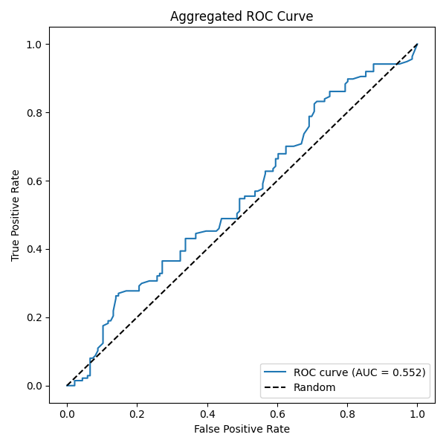
The Results
AUC: 0.55
Is it a crystal ball? No.
Is it better than a random coin flip? Yes.
We found a measurable signal in the noise. For a retail-level project with limited data, this is a win.

Slide 11



Room for Improvement
Build a Real App
New Hardware
More Data
Move away from APIs to a proper .exe with a spinning loading screen.
Seriously, I need a GPU. Training models on a laptop CPU is painful.
Scrape Reddit & Twitter. That's where the real volatility lives.
Notes:
Image Source: https://t3.ftcdn.net/jpg/18/12/60/18/240_F_1812601844_PsUCri06VsFV21NgjtJwQxyFvIeqhmhy.jpg

Slide 12
Gratitude
Thank You!
Mina Balasubramanian (Instructor)
Trine University

Slide 13
Questions?
Qiyun Lu | qlu24@my.trine.edu

