Slide 1
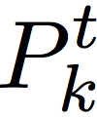
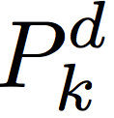
0
N_{c}-1
0
N_{t’}-1
N_{t}-1
C_{k}
0
N_{c}-1
Header
Payload
packet_len
packet_num
tcm_type
crc

Slide 2
0
0
0
N-1
k

Slide 3
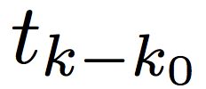
0
N_{c}-1
0
N_{c}-1
0
N_{c}-1

Slide 4
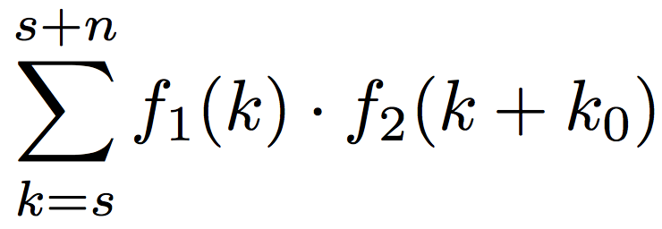
f₁
k₀
s₁
s₂
z
t₁
s
n
f₂

Slide 5
010100111010

Slide 6
Destination
Source
Unpackaging
Packaging
Decoding
Turbo Coding
Cov
Decimation
Training Seq
Package Align
+1, -1, …, -1
DS
…

Slide 7
auto(c, c)
0
Δt
cor(c₁, c₂)
0
Δt

