Slide 1
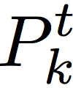
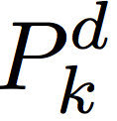
0
N_{c}-1
0
N_{t’}-1
N_{t}-1
C_{k}
0
N_{c}-1
Header
Payload
packet_len
packet_num
tcm_type
crc

Slide 2
0
0
0
N-1
k

Slide 3
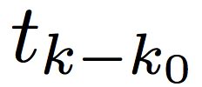
0
N_{c}-1
0
N_{c}-1
0
N_{c}-1

Slide 4
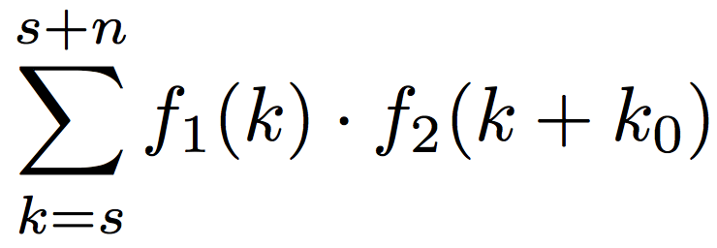
f₁
k₀
s₁
s₂
z
t₁
s
n
f₂

Slide 5
Freq & Timing
Estimator
Amp & Var
Estimator
Input
Pulse-wise
Matched Filter
VCO
×(-1)
Decimator
for training seq
Chopper
Decimator
for data seq
Chopper Correlator
Packet Info
Header Parser
Constellation
Decoder
Get Header
Payload
CRC32
Decoder
Constellation
Decoder
Get Payload

Slide 6
Redundant Bits
Spread Code for Data
Payload
Packet Header Formatter
Tag Mixer
Convoluion
CRC32
Encoder
Repack Bits
Data String Power
Training Seq
Convoluion
Spread Code for Training
Training String Power
Root Raise-Cosine Filter
Output

Slide 7
Auto-corr(f1)
Auto-corr(f1)
0
δ
0
δ
Matched Filter
MAX
f₁
Find corresponding frequency
Matched Filter
f₂
……
Peak Detector
Matched Filter
f_{n}

