Slide 1
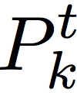
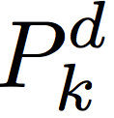
0
N_{c}-1
0
N_{t’}-1
N_{t}-1
C_{k}
0
N_{c}-1
Header
Payload
packet_len
packet_num
tcm_type
crc

Slide 2
0
0
0
N-1
k

Slide 3
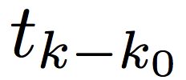
0
N_{c}-1
0
N_{c}-1
0
N_{c}-1

Slide 4
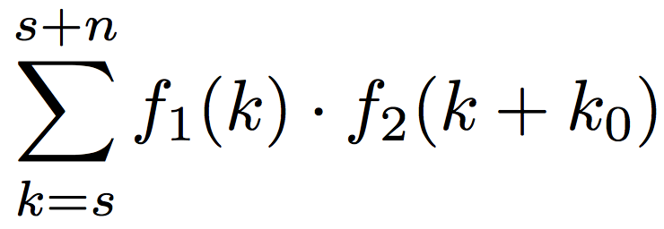
f₁
k₀
s₁
s₂
z
t₁
s
n
f₂

Slide 5
Freq & Timing
Estimator
Amp & Var
Estimator
Input
Pulse-wise
Matched Filter
VCO
×(-1)
Decimator
for training seq
Chopper
Decimator
for data seq
Chopper Correlator
Packet Info
Header Parser
Constellation
Decoder
Get Header
Payload
CRC32
Decoder
Constellation
Decoder
Get Payload

Slide 6
Packet Header Formatter
Payload
CRC32
Encoder
Repack Bits
Tag Mixer
Convoluion
Redundant Bits
Convoluion
Data String Power
Training Seq
Convoluion
Training String Power
Root Raise-Cosine Filter

