Slide 1

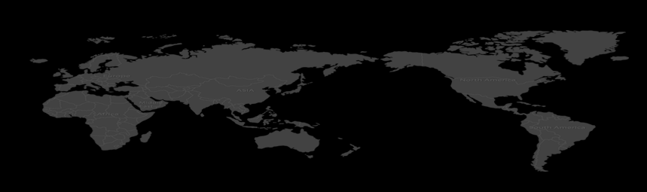

Opportunistic Admissibility and Resource Allocation For Slicing-based Radio Access Networks
Zihao Qi, Bin Cao*, Long Zhang, Wei Hong, Zhongyuan Zhao, Jie Tong, Xiang Bai
Conrresponding author: Bin Cao caobin65@163.com

Slide 2

Opportunistic Admissibility and Resource Allocation For Slicing-based Radio Access Networks
Networking slicing:
a promising technology to meet the service requirements for future mobile networks.
Question: a dynamic environment
Random arrivals and departures
Uncertain resource availability
Multi-dimensional resource allocation
Resource allocation become more complicated
In summary, there are three important questions:
“whether” to admit immediately
“how” to admit
“when” to admit
Notes:
Network slicing (NS) is a promising technology to meet the service requirements for future mobile networks. In radio access network slicing, the service providers (SPs) can rent network slicing instances from the infrastructure provider (InP) to meet the requirements of network services. However, both SPs and InP face the challenges of maintaining the quality of user experience in a dynamic environment, arising from random arrivals and departures of slice requests, uncertain resource availability, and multi-dimensional resource allocation. Therefore, admissibility and resource allocation become more complicated. In the former case, “how” to admit is the main problem in network slicing. Nevertheless, “whether” to admit immediately should be answered first. If yes, multi-dimensional resources allocation should be performed in “how” to admit. and, “when” to admit should be considered in future

Slide 3
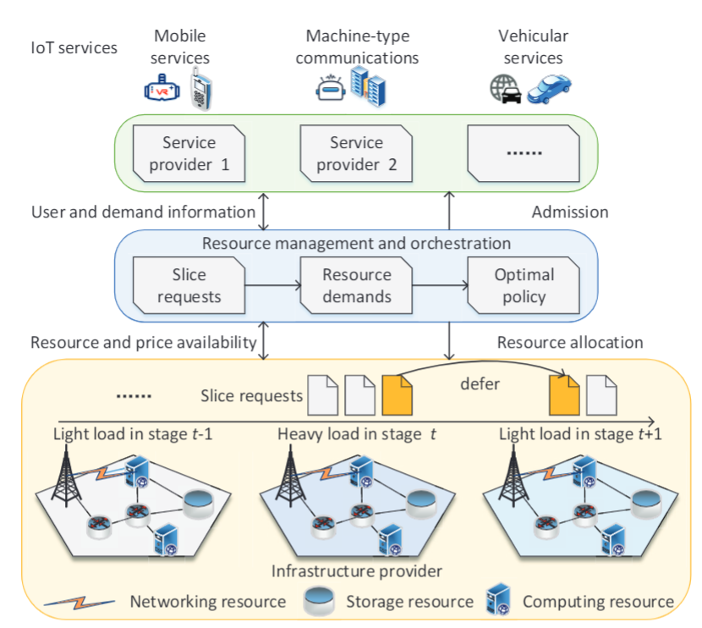
Opportunistic Admissibility and Resource Allocation For Slicing-based Radio Access Networks
Solution
This paper proposes an opportunistic admissibility and resource allocation (OAR) policy
Markov Decision Process (MDP)
To solve the MDP, the optimal admission policy is made to decide "whether" (admit immediately) and "when" (defer to admit) to admit slicing requests.
Buyer-seller game model
To solve the game, we can obtain the optimal resources allocation and price policy
Notes:
In this paper, we design an opportunistic admissibility and resource allocation (called OAR) policy to answer “whether”, “when” and “how” to admit. We formulate the original problem as a Markov Decision Process (MDP) problem and get the optimal admission policy to decide “whether” and “when” (iii) To answer “how”, we reformulate the MDP problem as a buyer-seller game. Through this game, we can get the optimal resource allocation and price policy.

Slide 4
Opportunistic Admissibility and Resource Allocation For Slicing-based Radio Access Networks
System model
composition
Service providers (SPs)
Resource management and orchestration (RMO)
Infrastructure provider (InP)
Different resource types
Networking resource
Storage resource
Computing resource
Notes:
We consider a general network model which consists of SPs, resource management and orchestration (RMO), and InP. SPs are responsible for requesting and leasing resources according to the arrival and departing slice requests. By acting admission and negotiation of resource and price, RMO can deal with the three fundamental problems, i.e., whether a slice request is accepted, how much resources are allocated and how much price is paid for the accepted slice requests. Based on the accepted requests, InP rents networking, storage and computing resources for SPs.

Slide 5
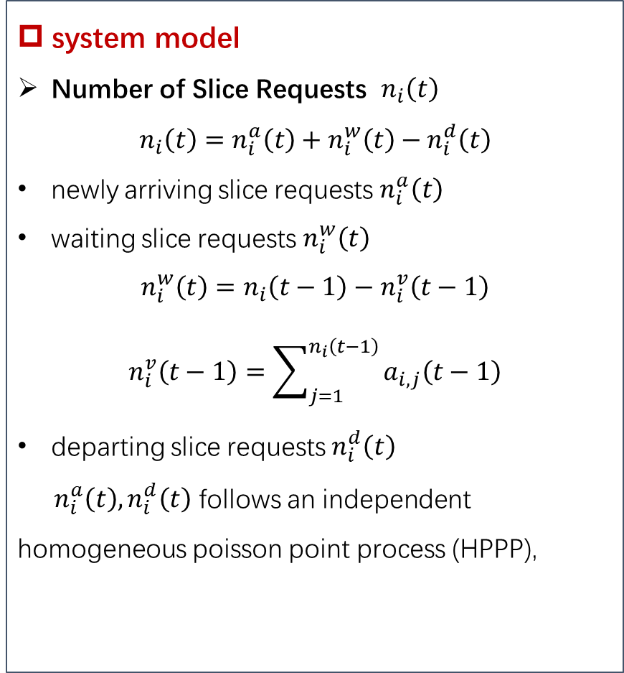
Opportunistic Admissibility and Resource Allocation For Slicing-based Radio Access Networks
system model
Number of Slice Requests $n_{i}\left(t\right)$
$$n_{i}\left(t\right)=n_{i}^{a}\left(t\right)+n_{i}^{w}\left(t\right)−n_{i}^{d}\left(t\right)$$
newly arriving slice requests $n_{i}^{a}\left(t\right)$
waiting slice requests $n_{i}^{w}\left(t\right)$
$$n_{i}^{w}\left(t\right)=n_{i}\left(t−1\right)−n_{i}^{v}\left(t−1\right)$$
$$n_{i}^{v}\left(t−1\right)=\sum_{j=1}^{n_{i}\left(t−1\right)}{a_{i,j}\left(t−1\right)}$$
departing slice requests $n_{i}^{d}\left(t\right)$
$n_{i}^{a}\left(t\right), n_{i}^{d}\left(t\right)$ follows an independent homogeneous poisson point process (HPPP),
system model
Utility Function
Effect: evaluate the satisfactory of slice request Resource Cost Function
Effect: evaluate the resource unit cost
Waiting Cost Function
Effect: evaluate the waiting unit cost
Immediate Reward Function
Effect: be regarded as feedback from slice requests executing a set of actions.
Notes:
Next, we will describe these functions of this model in details
First, the number of slice requests $n_{i}\left(t\right)$ in the $t$-th stage consists of newly arriving slice requests $n_{i}^{a}\left(t\right)$, waiting slice requests $n_{i}^{w}\left(t\right)$ and departing slice requests $n_{i}^{d}\left(t\right)$
we assume that newly arriving slice requests$n_{i}^{a}\left(t\right)$and departing slice requests follows an independent homogeneous poisson point process (HPPP)
1. We use Utility function to evaluate the satisfactory of slice request.
2. Since available resource units is limited and dynamic, the corresponding resource cost should be considered.
3. The waiting cost should be considered.
4. Based on the above descriptions, we can obtain an immediate reward function. It can be regarded as feedback from slice requests after a set of actions. The immediate reward function can be calculated as the utility function minus resource cost and waiting cost

Slide 6
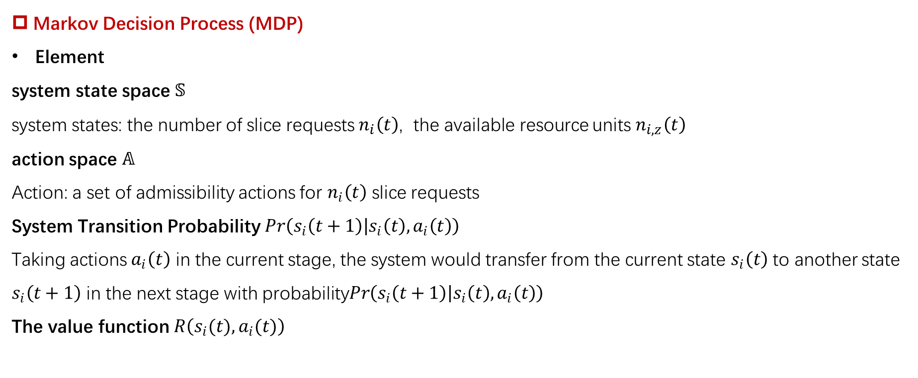
Opportunistic Admissibility and Resource Allocation For Slicing-based Radio Access Networks
Markov Decision Process (MDP)
Element
system state space $𝕊$
system states: the number of slice requests $n_{i}\left(t\right)$, the available resource units $n_{i,z}\left(t\right)$
action space $𝔸$
Action: a set of admissibility actions for $n_{i}\left(t\right)$ slice requests
System Transition Probability$Pr\left(s_{i}\left(t+1\right) | s_{i}\left(t\right),a_{i}\left(t\right)\right)$
Taking actions $a_{i}\left(t\right)$ in the current stage, the system would transfer from the current state $s_{i}\left(t\right)$ to another state $s_{i}\left(t+1\right)$ in the next stage with probability$Pr\left(s_{i}\left(t+1\right) | s_{i}\left(t\right),a_{i}\left(t\right)\right)$
The value function $R\left(s_{i}(t),a_{i}(t)\right)$
Notes:
Our policy should consider both the current and future stages simultaneously. To this end, we formulate this issue as a MDP optimization problem
The system states include the number of slice requests $n_{i}\left(t\right)$ and the available resource units $n_{i,z}\left(t\right)$.
Action: a set of admissibility actions for $n_{i}\left(t\right)$ slice requests
Taking actions $a_{i}\left(t\right)$ in the current stage, the system would transfer from the current state $s_{i}\left(t\right)$ to another state $s_{i}\left(t+1\right)$ in the next stage with System Transition probability$Pr\left(s_{i}\left(t+1\right) | s_{i}\left(t\right),a_{i}\left(t\right)\right)$.
The value function R

Slide 7
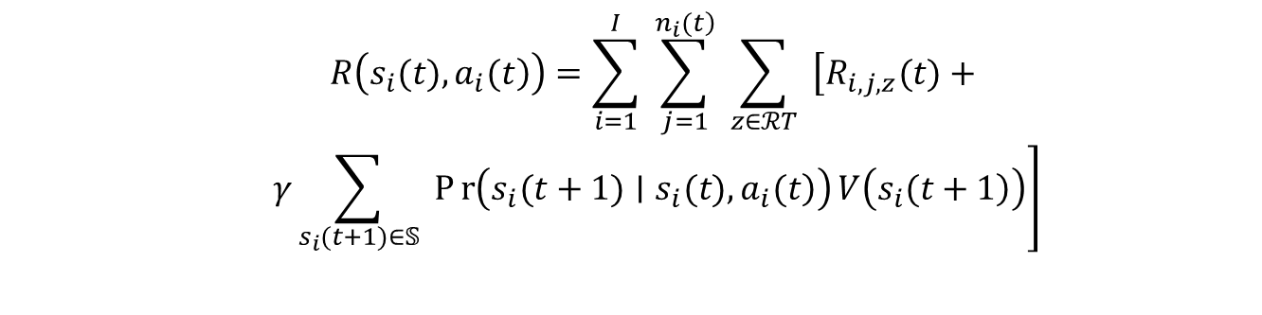

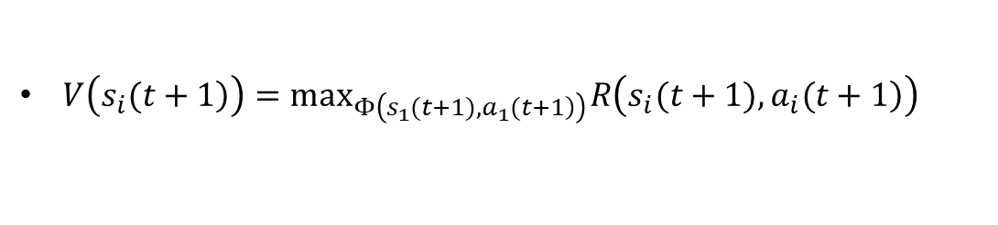
Opportunistic Admissibility and Resource Allocation For Slicing-based Radio Access Networks
Optimal Admissibility Policy in MDP Model
The value function $R\left(s_{i}(t),a_{i}(t)\right)$ is defined as follows:
$$\begin{matrix} & R\left(\left.s_{i}(t),a_{i}(t\right)\right)=\sum_{i=1}^{I}{ } \sum_{j=1}^{\left.n_{i}(t\right)}{ } \sum_{z∈ℛT}{ } \left[R_{i,j,z}(t)+\right. \\ & \left. \begin{matrix}γ\sum_{s_{i}(t+1)∈𝕊}{ } Pr\left(\left.s_{i}(t+1)∣s_{i}(t),a_{i}(t\right)\right)V\left(\left.s_{i}(t+1\right)\right)\end{matrix}\right] \\ & \\ & \end{matrix}$$
Immediate reward
future reward with discount factor
$γ$
$V\left(\left.s_{i}(t+1\right)\right)=\max_{Φ\left(\left.s_{1}(t+1),a_{1}(t+1\right)\right)} R\left(\left.s_{i}(t+1),a_{i}(t+1\right)\right)$
We can obtain the optimal admissibility based on the MDP model.
Answer “whether” to admit
“when” to admit.
Notes:
The value function R is composed with two parts.
The first part is represented as the optimal reward of current stage/
The second part is the reward functions in the future stage associated with discount factor γ, and γ is used to determine the weight of immediate and future rewards
In the MDP model, the policy is denoted as $Φ\left(s_{i}(t),a_{i}(t)\right)$
We can obtain the optimal admissibility based on the MDP model.
Answer “whether” to admit
“when” to admit.

Slide 8
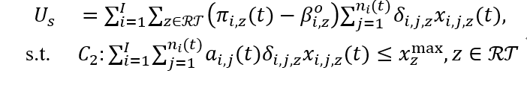
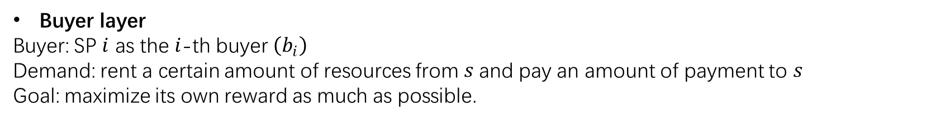
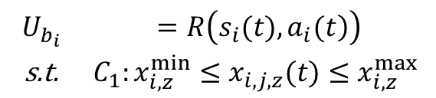
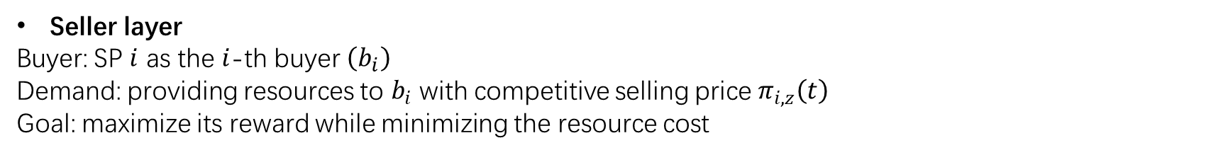
Opportunistic Admissibility and Resource Allocation For Slicing-based Radio Access Networks
Buyer-Seller Game
Buyer layer
Buyer: SP $i$ as the $i$-th buyer $\left(b_{i}\right)$
Demand: rent a certain amount of resources from $s$and pay an amount of payment to $s$
Goal: maximize its own reward as much as possible.
$$\begin{matrix}U_{b_{i}} & =R\left(\left.s_{i}(t),a_{i}(t\right)\right) \\ \text{s}\text{.}\text{t}\text{. } & C_{1}:x_{i,z}^{min}≤x_{i,j,z}(t)≤x_{i,z}^{max}\end{matrix}$$
Seller layer
Buyer: SP $i$ as the $i$-th buyer $\left(b_{i}\right)$
Demand: providing resources to $b_{i}$ with competitive selling price $π_{i,z}\left(t\right)$
Goal: maximize its reward while minimizing the resource cost
Notes:
we reformulate this MDP optimization problem as a buyer-seller game to maximize the individual reward to make resource allocation policy in a distributed manner.
We define SP $i$ as the $i$-th buyer $\left(b_{i}\right)$, and InP is defined as the seller $s$. To satisfy various QoS requirements, $b_{i}$ needs to rent a certain amount of resources from $s_{i}$. Meanwhile, $b_{i}$ needs to pay an amount of payment to $s$. Due to rationality and selfishness, $b_{i}$ aims to maximize its reward as much as possible.
Due to rationality and selfishness, $s$ also aims to maximize its reward by providing resources to $b_{i}$ with selling price $π_{i,z}\left(t\right)$, while minimizing the resource cost as little as possible.

Slide 9
Opportunistic Admissibility and Resource Allocation For Slicing-based Radio Access Networks
Buyer-Seller Game
Notes:
The buyer-seller game begins to execute negotiation process, such as exchanging negotiation information With information exchanging, the buyer and the seller update their own reward function and iterate until equilibrium |ˌiːkwɪˈlɪbriəm| is got.
And we can get the optimal resources allocation and price policy

Slide 10
Opportunistic Admissibility and Resource Allocation For Slicing-based Radio Access Networks
performance evaluation
To validate the performance of the proposed policy, we introduce the classical Greedy scheme, and Max-Min Fairness (MMF) scheme as the benchmark.
Fig. 1 shows the iteration process of the value function for a concrete state.
From Fig. 2 and Fig. 3, we can observe that the game process of resource and selling price can reach equilibrium after about eight iterations.
Fig. 4 shows the performance in term of reward by varying the number of slice requests.
Fig. 1Iteration process of value
Fig.2 Iteration process of resource.
Fig. 3 Iteration process of price
Fig. 4 Reward comparisons
Notes:
Next, we design experiments to evaluate the effectiveness and performance of the proposed OAR policy. To validate the performance of the proposed policy, we introduce the classical Greedy scheme, and Max-Min Fairness (MMF) scheme as the benchmark.
Fig. 1 shows the iteration process of the value function for a concrete state. We can see that the value function eventually converges to a stable value after about 15 iterations
From Fig. 2 and Fig. 3, we can observe that the game process of resource and selling price can reach equilibrium after about eight iterations.
Fig. 4 shows the performance in term of reward by varying the number of slice requests. We can see that the reward of the OAR scheme outperforms compared with that of other baseline schemes. That is because the proposed OAR scheme considers the impact of slice requests and available resources on decision-making and makes a more reasonable admission and resource allocation policy. //In contrast, the greedy scheme only satisfies the maximum resource requirements for the partial slice requests, hindering the admission for more slice requests. MMF scheme admits all slice requests to be accepted by SPs, while the accepted slice requests obtain fewer resources. Therefore, the proposed OAR scheme can make a trade-off between slicing numbers and resource allocation.

Slide 11
Opportunistic Admissibility and Resource Allocation For Slicing-based Radio Access Networks
Conclusion
In this paper, we investigate the issue of “whether” and “when” to admit slicing requests and “how” to allocate multi-dimensional resource types.
To get the optimal admission policy, we formulate the optimization problem as a Markov Decision Process problem.
buyer-seller game is introduced to get the optimal resource allocation and price between SPs and InP
Simulation results show that the proposed OAR strategy makes reasonable decisions and outperforms the baseline schemes.
Notes:
In this paper, we investigate the issue of “whether” and “when” to admit slicing requests and “how” to allocate multi-dimensional resource types. Considering random arrivals and departures of slicing requests, we design an opportunistic admissibility and resource allocation (OAR) strategy to answer the above issue. To get the optimal admission policy, we formulate the optimization problem as a Markov Decision Process problem to maximize system reward. Then, a buyer-seller game is introduced to get the optimal resource allocation and price between SPs and InP. Simulation results show that the proposed OAR strategy makes reasonable decisions and outperforms the baseline schemes.

Slide 12
Thank You
thanks

