Slide 1
I
N S
P E C T
E L E M E N T
TABLE OF CONTENTS
Motivation
Plan
Features
Current State of System
Alternative Implementations
SAAM Analysis
Conceptual Architecture
Limitations
Lessons Learned
Conclusion
1
2
3
4
1
2
3
4

Slide 2
MOTIVATION
Motivation — 1.
> 1.5 billion people suffer from refractive errors
> 300 million people suffer from color blindness
> 90% of people over 65 have cataracts
Google Chrome does not currently service these people
Accessibility features not included in system by default

Slide 3
PLAN
Plan — 2.
Our plan is to implement an accessibility subsystem that provides Google Chrome with the ability to improve the web-browsing experience for those with farsightedness, cataracts, and various color blindness.
Other accessibility features may be added in the future, consolidated under this subsystem

Slide 4
FEATURES (all)
Features — 3.
FARSIGHTEDNESS
Zoom image on hover
Increased cursor size
Enlarged Font
COLOUR BLINDNESS
Site and image colours filtered for distinguishability
CATARACTS
Text/background contrast increased
Image contrast increased
READABILITY
Font replacement
Dyslexic and standard
Notes:
Print this one, but hide it for the presentation

Slide 5
CURRENT STATE OF THE SYSTEM
Current State — 4.
Current State:
No accessibility features
Lots of dependencies
Enhancement:
Built-in accessibility features
One new dependency

Slide 6
EFFECTS ON THE SYSTEM
Current State — 4.
Maintainability, testability, and evolvability are a concern
Features with UI elements must be tested with and without accessibility features
Performance will take a minor hit
Colour correcting when drawing every window
Adjustments would have to work within the current concurrency system

Slide 7
ALTERNATIVE
IMPLEMENTATIONS
Implement — 5.
Create a new component in Utilities
Would not change the overall architecture much
Would be a cohesive addition to the Utilities subsystem
Build it directly into the UI subsystem
Would unfortunately require large changes to the UI subsystem
Harder to test and evolve
Entirely new subsystem
Would not require the modification of any other subsystems
Easier to evolve and maintain
Would create more dependencies throughout the system

Slide 8
STAKEHOLDERS
SAAM — 6.
Alphabet inc
Chromium Development Team
Chrome Users
Chrome Users with Vision Impairment
Web Developers
Team Inspect Element

Slide 9
ADVANTAGES AND DISADVANTAGES
SAAM — 6.
New Component in Utilities
Would not change existing architecture
Changes to feature may require alterations to Utilities architecture
Build it directly into the UI subsystem
Would not change existing architecture
Large changes to UI that may affect dependencies
New subsystem
Does not demand modification of other subsystems
New dependencies created in architecture

Slide 10
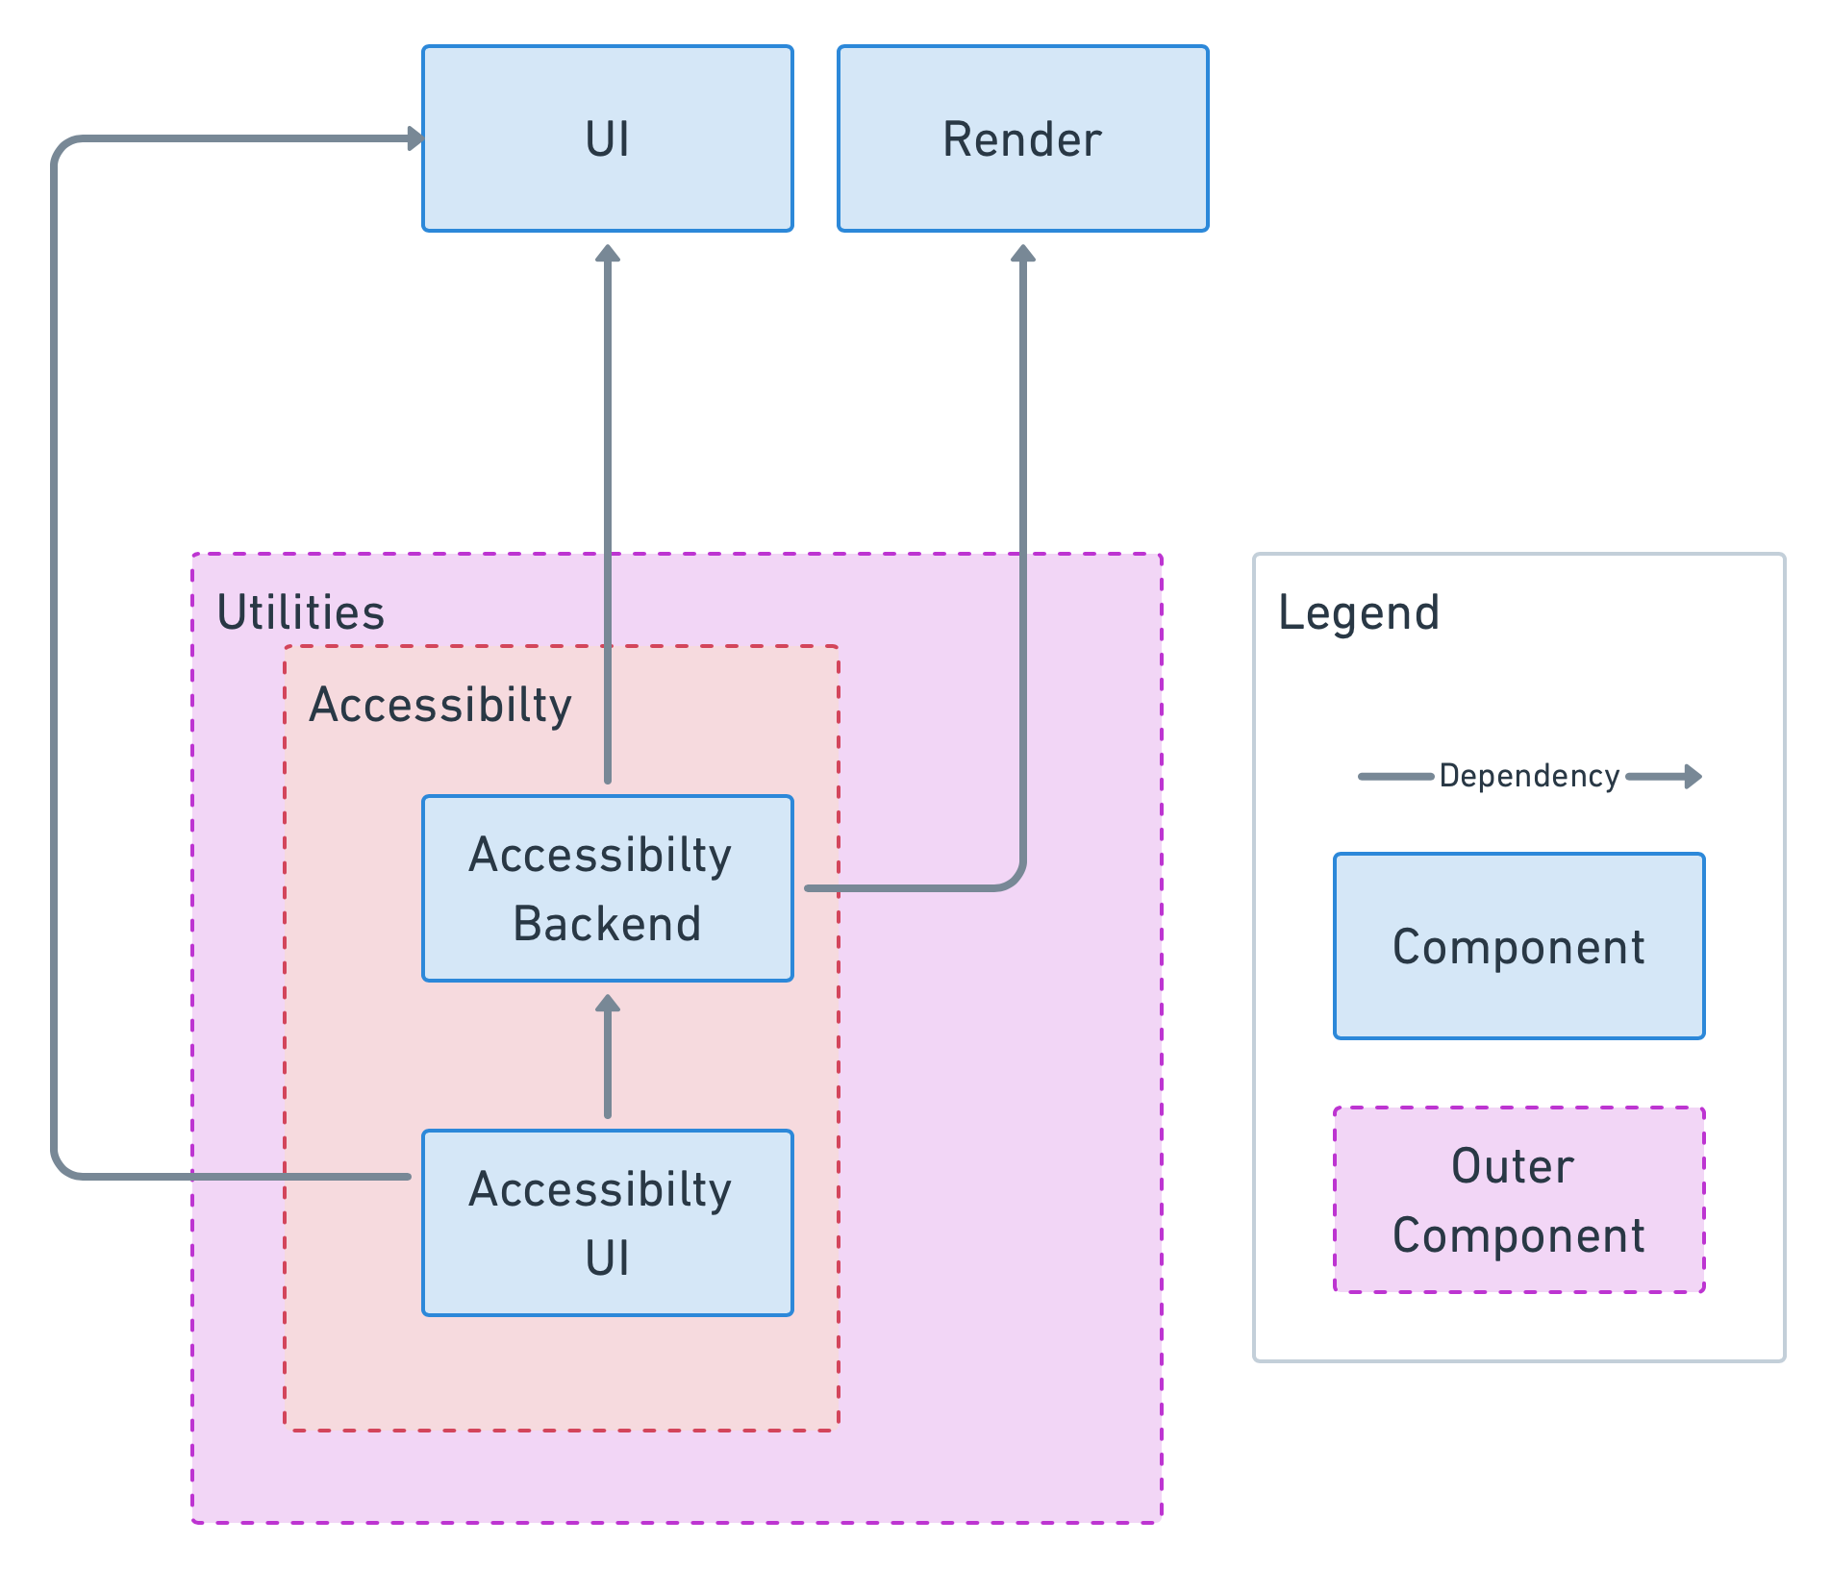
ARCHITECTURE OF FEATURE
Architecture — 7.
Contained inside Utilities Component
Accessibility Backend handles the management of the DOM Tree and uses the object created by Render and changes things in the UI
Accessibility UI handles the changing of the actual UI to make it more accessible

Slide 11
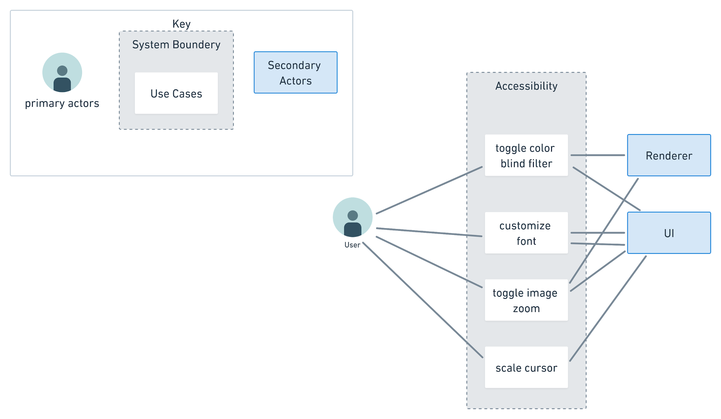
USE CASE DIAGRAM
Architecture — 7.

Slide 12
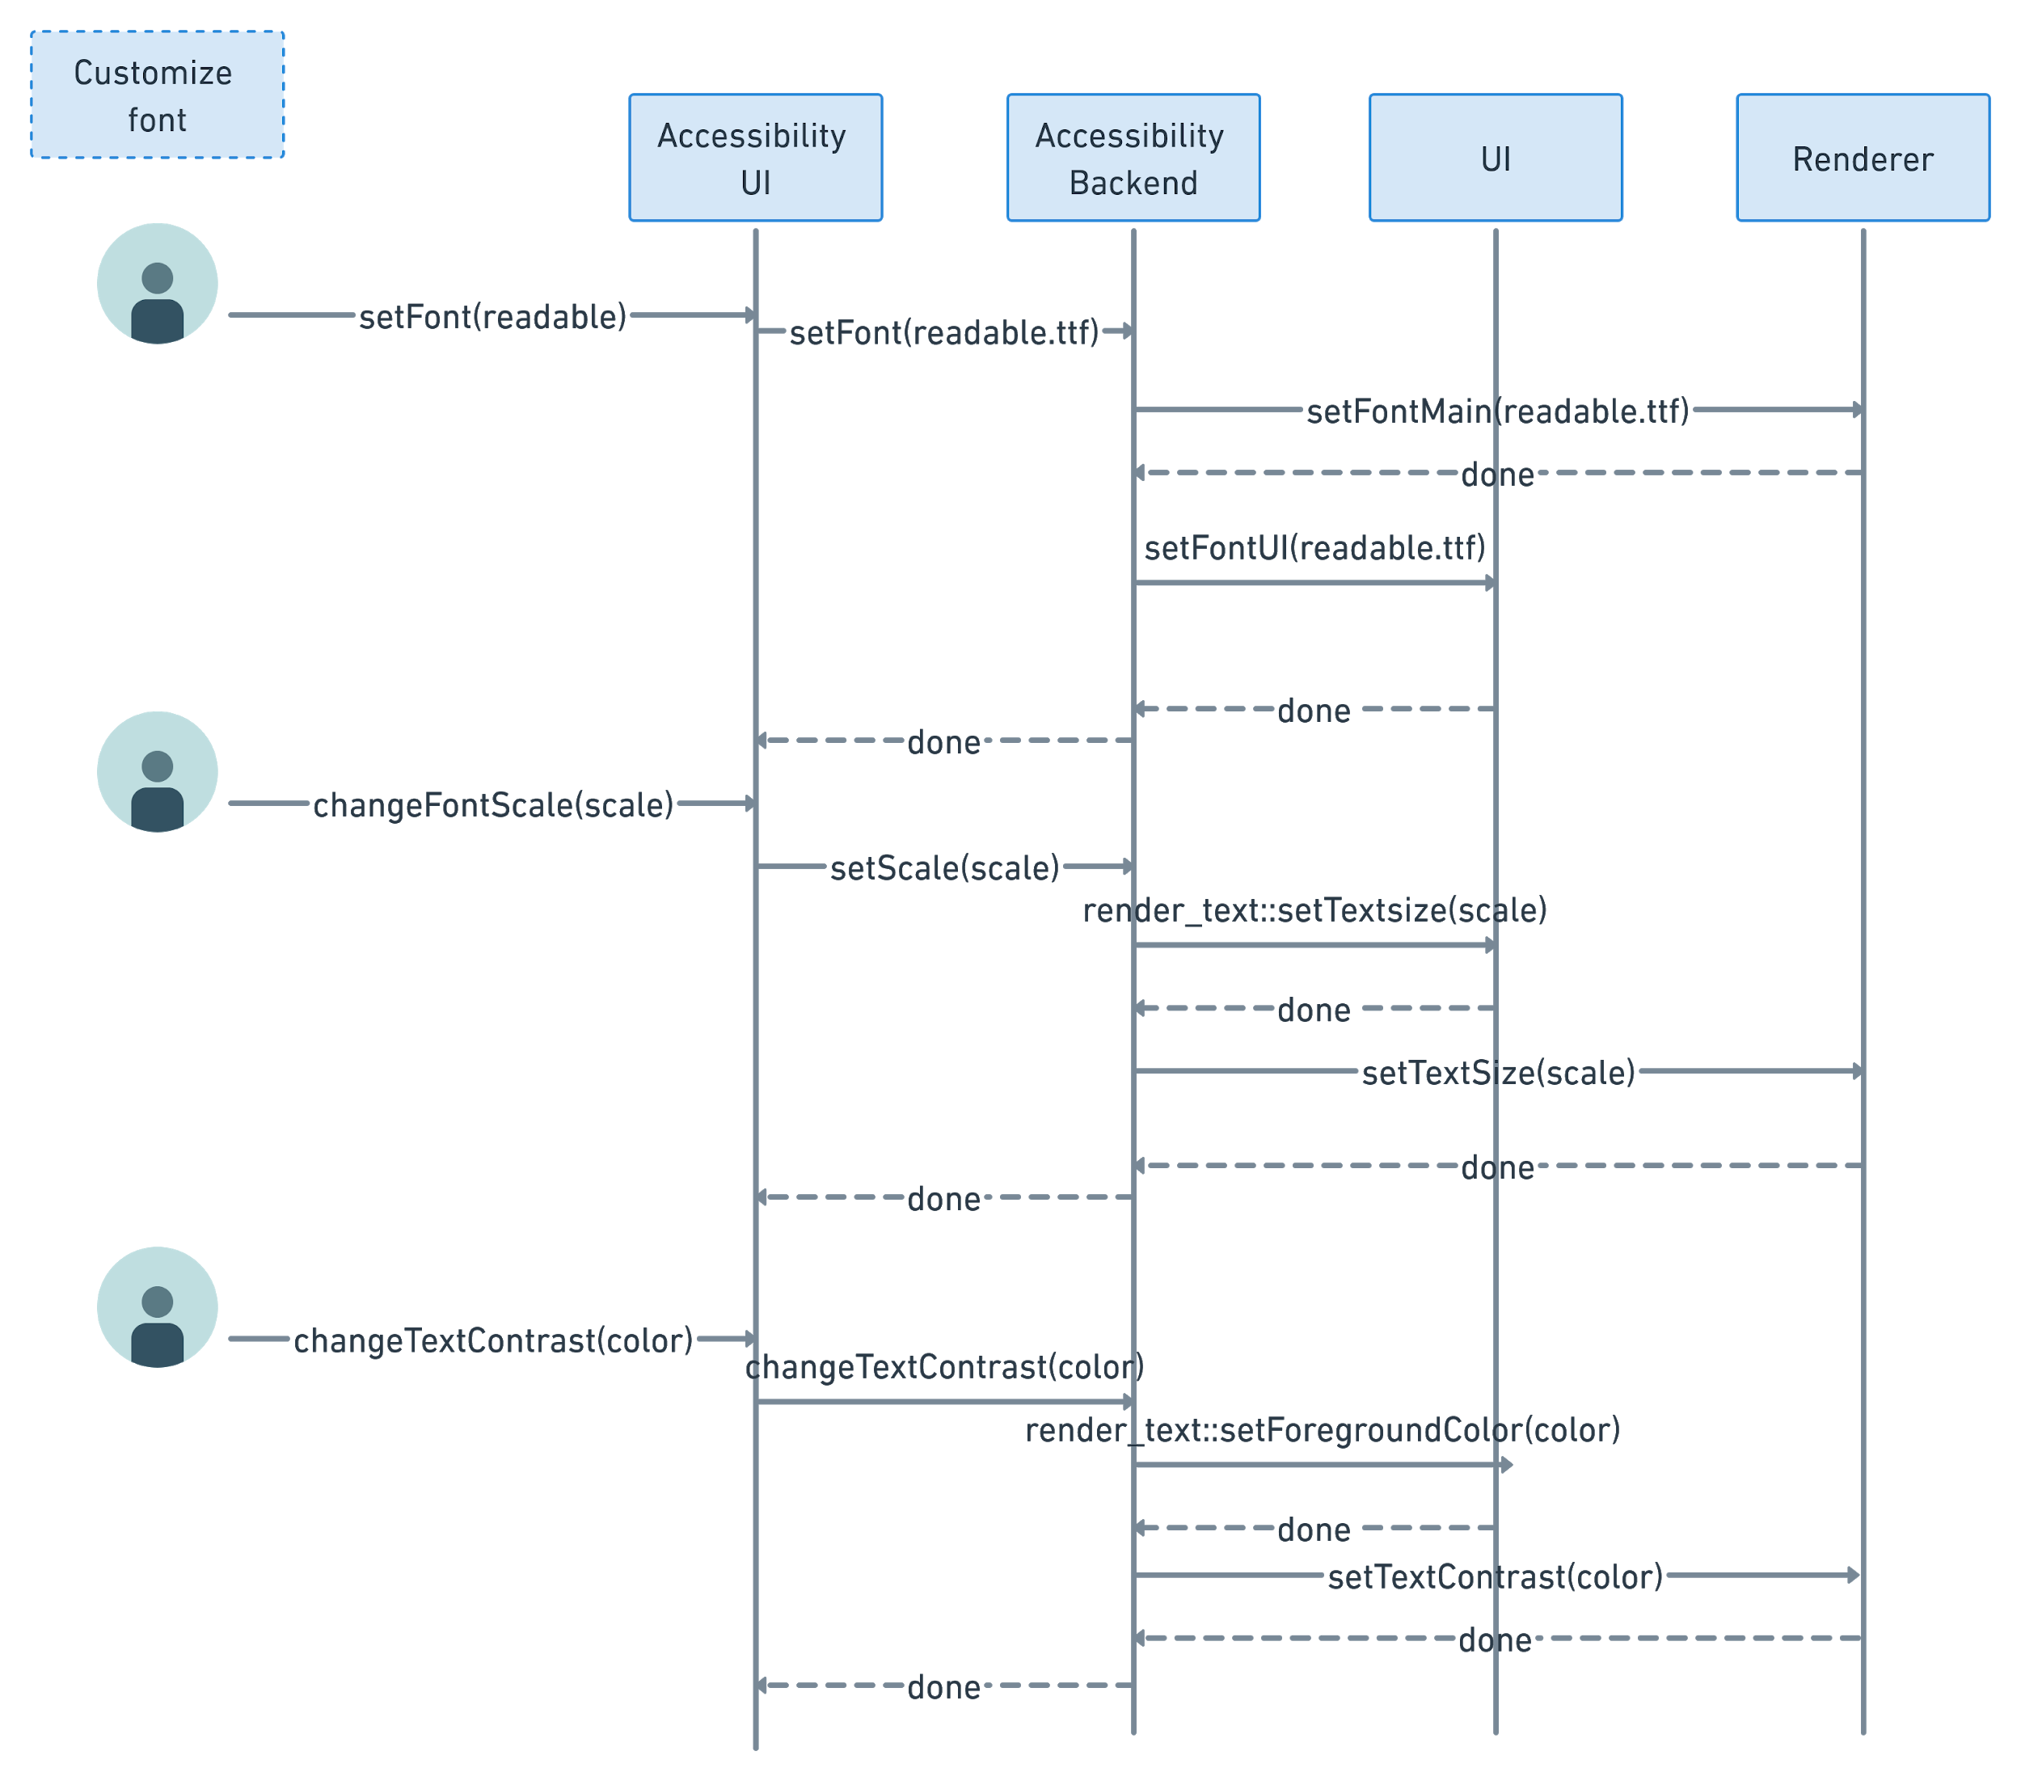
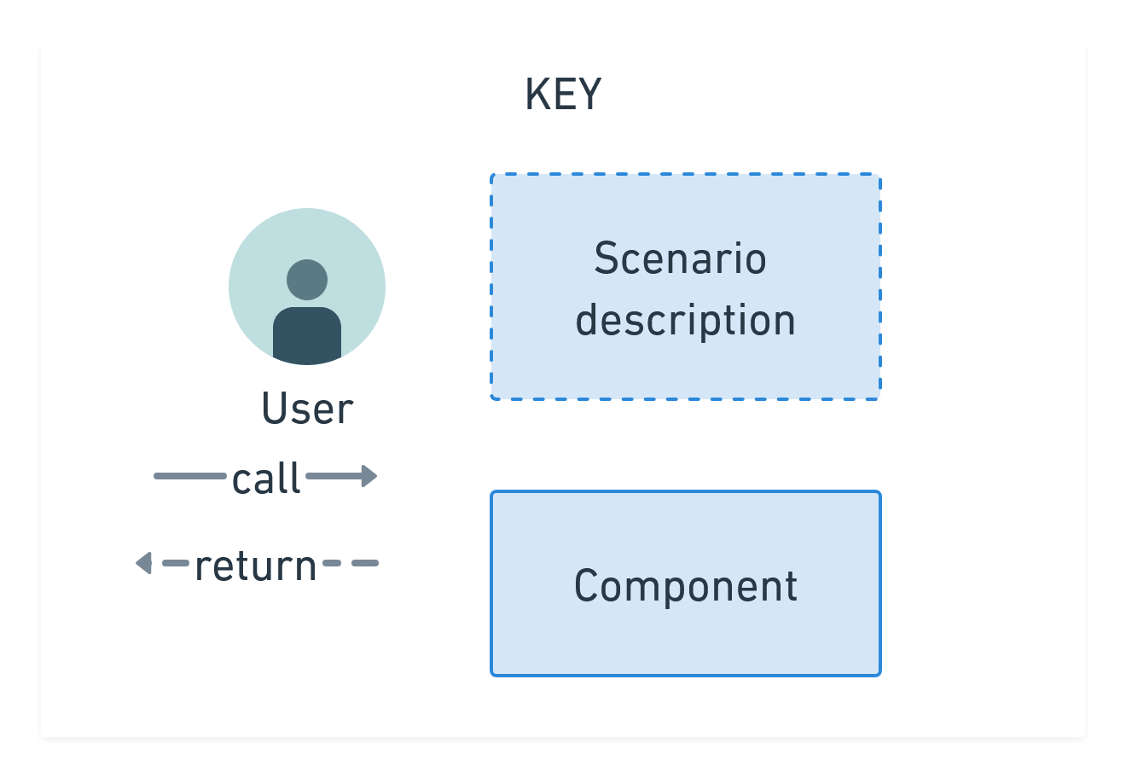
Architecture — 7.

Slide 13
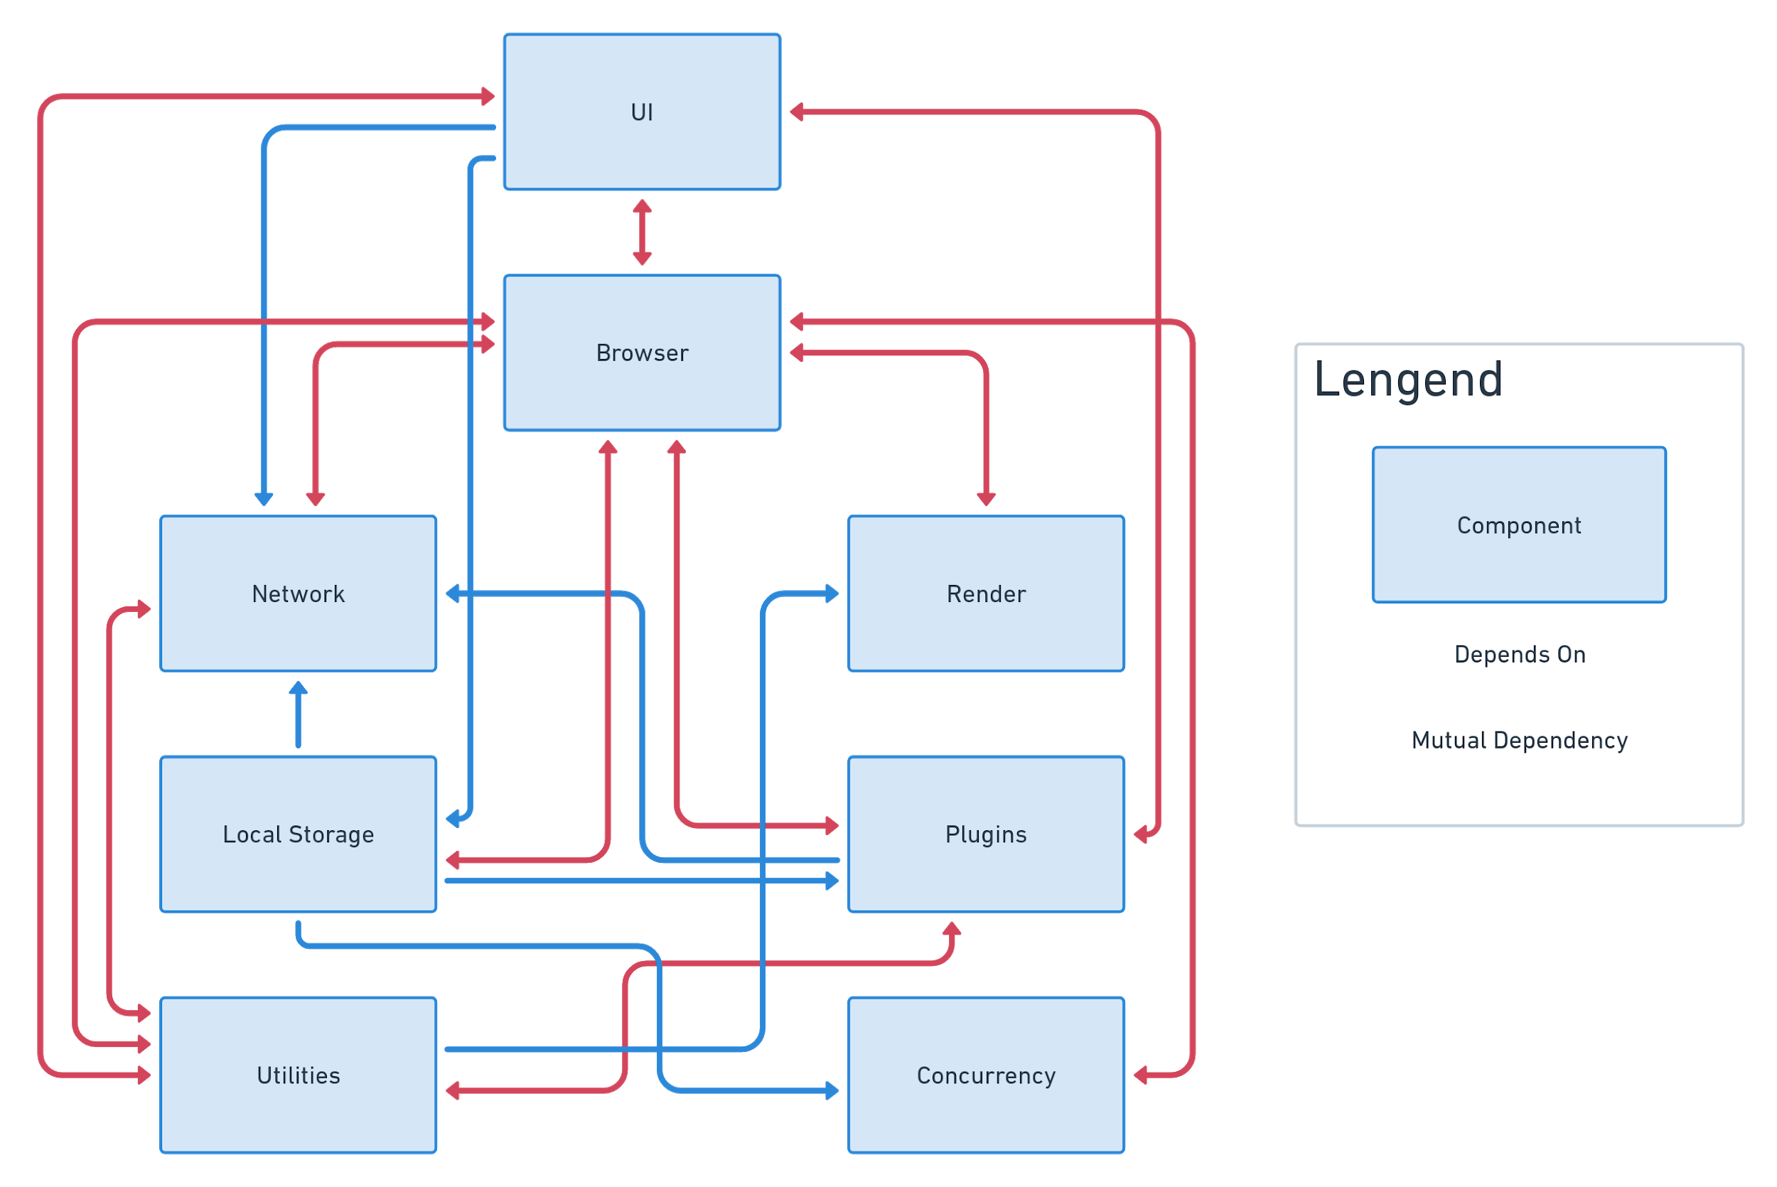
Architecture — 7.

Slide 14
LIMITATIONS
Limitations — 8.
By default, chrome does not let you change the font of UI element
Performance drawback from color correction
In order to maintain consistency in the color correction we would have to correct css, images, videos, canvas, etc, all at the same time
Notes:
The limitations imposed by our enhancement come from making changes to the UI and changing colors. By default, chrome does not let you change the font of UI elements, so we will have to fiddle with the graphics subsystem in UI. There will also be a slight performance hit from changing the browser’s colors. In order to maintain consistency in the color correction we would have to correct css, images, videos, canvas, etc, all at the same time. Since drawing is not necessarily centralized, making sure that no piece of code is drawing before correcting the color being drawn is not trivial.

Slide 15
LESSONS LEARNED
Lessons Learned — 9.
Eye degradation and how to avoid it
Vision technologies
SAAM approach
Feature testing
Notes:
Researching into the topic of optics, we learned a lot about different ways people perceive the world with damaged or degraded eyesight. This research showed us how the eye can degrade over time and develop certain eye diseases from just normal computer use. Glaucoma is developed from having higher pressure in the eyes, which occurs when you strain your sight. This eye strain happens when people stare at screens for prolonged periods of time, especially when reading hard to read text. To counteract this effect, using larger text and contrasting colors aids in reading text.

Slide 16
CONCLUSION
Conclusion — 10.
Google Chrome needs more accessibility features built in
Service different visual impairments
Features would be implemented inside the Utilities or UI or separate component entirely
Affects all the stakeholders in varying degrees
Beneficial for people who don’t currently suffer from vision impairment

