Slide 1
英语论文写作
Presented by 乔杰

Slide 2
为什么要学习写作?
As a scientist, you are a professional writer.

Slide 3
Style
“Have something to say, and say it as clearly as you can. That is the only secret of style. ”
---- Matthew Arnold

Slide 4
目录
Clarity
Nominalization
Useful Nominalization
Noun+Noun+Noun
Cohesion
Concision
Length
Elegance
Writing science

Slide 5
Clarity如何清晰地写一句话?
句子的两个元素：主角(character)和主角的动作(action)。
举个简单的例子：
We discussed the problem.
在这句子里，we是character, discussed是action

Slide 6
清晰的两个原则
character应该放在主语的位置上
(The subjects of the sentences name the cast of characters.)
伴随character的动词一定要是character的actions
(The verbs that go with those subjects name the crucial actions those characters are part of.)
不满足会怎样？
We discussed the problem.
The problem was the topic of our discussion.

Slide 7
目录
Clarity
Nominalization
Useful Nominalization
Noun+Noun+Noun
Cohesion
Concision
Length
Elegance
Writing science

Slide 8
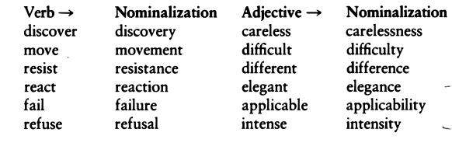
什么情况有可能会违反原则：Nominalization(名词化)

Slide 9
将词语变成nominalization会怎样？
I SUGGEST that we DISCUSS the issue CAREFULLY.
主语：I
动词：suggest
从句主语：we
从句动词：discuss
My suggestion is that our discussion of the issue be done with care.
主语： My suggestion
动词：is
从句主语： our discussion
从句动词： be
suggest->suggestion
discuss->discussion
carefully->care

Slide 10
将词语变成nominalization会怎样？
The police investigated the matter.
主语： police
动词： investigated
The police conducted an investigation into the matter.
主语： police
动词： conducted
The floods considerably eroded the land.主语： police
主语： floods
动词： eroded
There was considerable erosion of the land from the floods.

Slide 11
目录
Clarity
Nominalization
Useful Nominalization
Noun+Noun+Noun
Cohesion
Concision
Length
Elegance
Writing science

Slide 12
Useful Nominalization
当他链接了上一个句子时:
These arguments all depend on a single unproven claim.
This decision can lead to costly consequences.

Slide 13
Useful Nominalization
当nominalization可以替换掉the fact that时:
The fact that I denied what he accused me of impressed the jury. My denial of his accusations impressed the jury.

Slide 14
Useful Nominalization
当它指代一个约定成俗的概念时:
Few issues have so divided Americans as abortion on demand.

Slide 15
目录
Clarity
Nominalization
Useful Nominalization
Noun+Noun+Noun
Cohesion
Concision
Length
Elegance
Writing science

Slide 16
小心 Noun+Noun+Noun
Early childhood thought disorder misdiagnosis often occurs because of unfamiliarity with recent research literature describing such conditions. This paper reviews seven recent studies of particular relevance to preteen hyperactivity diagnosis and to treatment modalities involving medication maintenance level evaluation procedures.
修改方法，找到nominalization改回动词或形容词：
Early childhood thought disorder(n.) misdiagnosis(n.)
misdiagnose(v.) disordered(adj.) thought in early childhood

Slide 17
小结
两个原则：
character应该放在主语的位置上
(The subjects of the sentences name the cast of characters.)
伴随character的动词一定要是character的actions
(The verbs that go with those subjects name the crucial actions those characters are part of.)

Slide 18
目录
Clarity
Cohesion
Topic
Stress
Theme
Point
Concision
Length
Elegance
Writing science

Slide 19
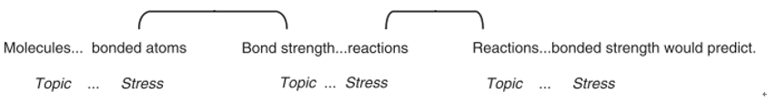
Cohesion(衔接):如何清晰地写出一段话
每句话都懂，但是合在一起就不懂。
一个秘诀：旧信息开头，新信息结尾
Molecules are comprised of covalently bonded atoms. Bond strength controls a molecule’s reactions. Sometimes however, those reactions are slower than bond strength would predict.

Slide 20
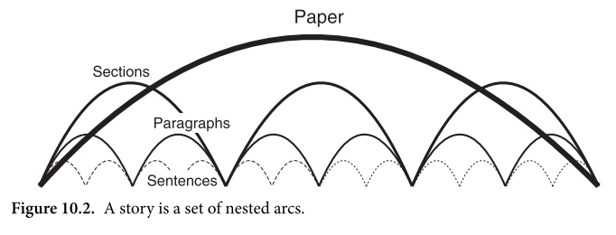
Cohesion

Slide 21
句子衔接好，就算好吗？
Sayner, Wisconsin, is the snowmobile capital of the world. The buzzing of snowmobile engines fills the air, and their tank-like tracks crisscross the snow. The snow reminds me of Mom’s mashed potatoes, covered with furrows I would draw with my fork. Her mashed potatoes usually make me sick—that’s why I play with them. I like to make a hole in the middle of the potatoes and fill it with melted butter. This behavior has been the subject of long chats between me and my analyst.

Slide 22
句子衔接好，就算好吗？
Sayner, Wisconsin, is the snowmobile capital of the world. The buzzing of snowmobile engines fills the air, and their tank-like tracks crisscross the snow. The snow reminds me of Mom’s mashed potatoes, covered with furrows I would draw with my fork. Her mashed potatoes usually make me sick—that’s why I play with them. I like to make a hole in the middle of the potatoes and fill it with melted butter. This behavior has been the subject of long chats between me and my analyst.
What's the point?
句子中的主语，其实是毫无关系的（没有相关的topic(话题)）
句子之间没有一个统一的主题（themes）或观点（ideas）
3段落中缺少一个介绍这个段落的句子（Point）

Slide 23
句子衔接好，就算好吗？
Sayner, Wisconsin, is the snowmobile capital of the world. The buzzing of snowmobile engines fills the air, and their tank-like tracks crisscross the snow. The snow reminds me of Mom’s mashed potatoes, covered with furrows I would draw with my fork. Her mashed potatoes usually make me sick—that’s why I play with them. I like to make a hole in the middle of the potatoes and fill it with melted butter. This behavior has been the subject of long chats between me and my analyst.
What's the point?
句子中的主语，其实是毫无关系的（没有相关的topic(话题)）
句子之间没有一个统一的主题（themes）或观点（ideas）
3段落中缺少一个介绍这个段落的句子（Point）

Slide 24
Cohesion的5个原则
Principle 1: A cohesive paragraph has consistent topic strings.
Principle 2: A cohesive paragraph has another set of strings running through it that we will call thematic strings.
Principle 3: A cohesive paragraph introduces new topic and thematic strings in a predictable location: at the end of the sentence(s) that introduce the paragraph.
Principle 4: A coherent paragraph will usually have a single sentence that clearly articulates its point.
Principle 5: A coherent paragraph will typically locate that point sentence in one of two places.

Slide 25
Topics
Principle 1: A cohesive paragraph has consistent topic strings.
topic通常会出现在主语中，但有时候并不一定是句子的主语
It is impossible for your claim to be proved.
In regard to this question, I believe more research is needed.
It is likely that our proposal will be accepted.

Slide 26
Topic
黑体表示topic
Particular ideas toward the beginning of each clause define what a passage is centrally "about" for a reader, so a sense of coherence crucially depends on topics. Cumulatively, the thematic signposts that are provided by these ideas should focus the reader's attention toward a well-defined and limited set of connected a paragraph from a cumulatively coherent Moving through view is made possible by a sequence of topics that seem to constitute this coherent sequence of topicalized idea. A seeming absence of context for each sentence is one consequence of making random shifts in topics. Feelings of dislocation, disorientation, and lack of focus will occur when that happens. The seeming coherence of whole sections will turn on a reader's point of view as a result of topic announcement.

Slide 27
Topic
黑体表示topic
Particular ideas toward the beginning of each clause define what a passage is centrally "about" for a reader, so a sense of coherence crucially depends on topics. Cumulatively, the thematic signposts that are provided by these ideas should focus the reader's attention toward a well-defined and limited set of connected a paragraph from a cumulatively coherent Moving through view is made possible by a sequence of topics that seem to constitute this coherent sequence of topicalized idea. A seeming absence of context for each sentence is one consequence of making random shifts in topics. Feelings of dislocation, disorientation, and lack of focus will occur when that happens. The seeming coherence of whole sections will turn on a reader's point of view as a result of topic announcement.
黑体部分看起来毫不相关

Slide 28
Topic
修正前
Particular ideas toward the beginning of each clause define what a passage is centrally "about" for a reader, so a sense of coherence crucially depends on topics. Cumulatively, the thematic signposts that are provided by these ideas should focus the reader's attention toward a well-defined and limited set of connected a paragraph from a cumulatively coherent Moving through view is made possible by a sequence of topics that seem to constitute this coherent sequence of topicalized idea. A seeming absence of context for each sentence is one consequence of making random shifts in topics. Feelings of dislocation, disorientation, and lack of focus will occur when that happens. The seeming coherence of whole sections will turn on a reader's point of view as a result of topic announcement.
修正后
In this paragraph, I have boldfaced the topics of every clause. Topics are crucial for a reader because they focus the reader's attention on a particular idea toward the beginning of every clause . Topics thereby notify a reader what a clause is "about". Topics thereby crucially determine whether the reader will feel a passage is coherent. Cumulatively, through a series of sentences, these topicalized ideas provide thematic signposts that focus the reader's attention on a well-defined set of connected ideas. If a sequence of topics seems coherent, that consistent sequence will move the reader through a paragraph from a cumulatively coherent point of view. But if through that paragraph topics shift randomly, then the reader has to begin each sentence out of context, from no coherent point of view. When that happens, the reader will feel dislocated, disoriented, out of focus. Whatever the writer announces as a topic, then, will fix the reader's point of view, not just toward the rest of the sentence, but toward whole sections.

Slide 29
Topic: 两个原则
把旧信息放在句子的主语/话题中。
让句子间的话题有连贯性。
两个额外结果：
主动与被动的平衡，因为使用被动有助于你保证句子的cohesion
你会发现你会使用nominalizations来进行开头，因为这正是上一个句子的内容，而这也是nominalizations最重要的作用：总结回顾你提到过的东西。如：this decision… this assumption…

Slide 30
Metadiscourse
使用metadiscourse来衔接句子：
your thinking and act of writing: We/I will explain, show, argue, claim, deny, suggest, contrast, add, expand, summarize . . .
your readers’ actions: consider now, as you recall, look at the next example . . .
the logic and form of what you have written: first, second; to begin; therefore, however, consequently . . .

Slide 31
小结
开头是旧信息，结尾是新信息。
每句话的开头，肯定有以下几个元素是先于其他的话出现的（优先级1最优，直到4）：
为了与上一句话建立联系，开头可以选择使用过渡的metadiscourse: and, but, therefore, as a result: And therefore
为了让读者清楚接下来的话将会是什么可以用： fortunately, perhaps, allegedly, it is important to note, for the most part, under these circumstances, from a practical point of view, politically speaking
动作所发生的时间与地点：then, later, on May 23, in Europe.
最重要的是，我们要在开头给出这个句子的话题（topic）。

Slide 32
目录
Clarity
Cohesion
Topic
Stress
Theme
Point
Concision
Length
Elegance
Writing science

Slide 33
Stress: 如何结尾
一个原则：把最重要，最“新”的信息放到结尾处
Global warming could raise sea levels to a point where much of the world’s low-lying coastal areas would disappear, according to most atmospheric scientists.
✓ According to most atmospheric scientists, global warming could raise sea levels to a point where much of the world’s low-lying coastal areas would disappear.

Slide 34
目录
Clarity
Cohesion
Topic
Stress
Theme
Point
Concision
Length
Elegance
Writing science

Slide 35
Theme
Principle 2: A cohesive paragraph has another set of strings running through it that we will call thematic strings.
只有topic一致是不够的，stress也应该“一致”，这些一致称为：Theme.
一个段落应该有一致的主题。

Slide 36
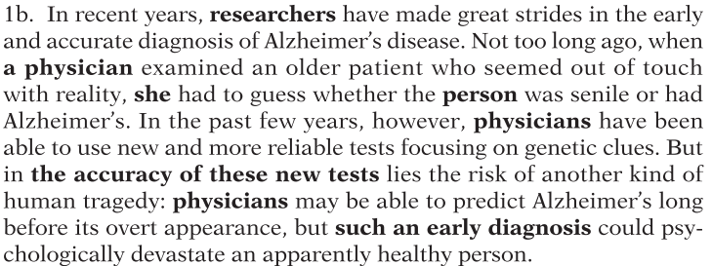
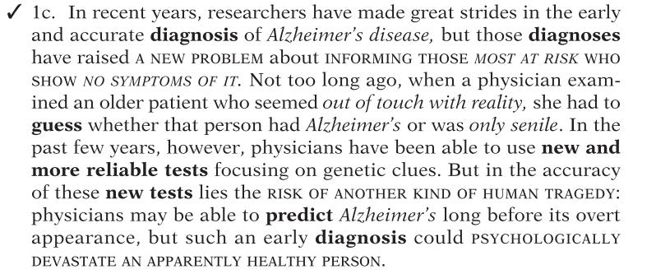
Theme
一个只有topic一致的例子：
黑体是topic，他们都是关于researchers/physicians 和testing/diagnosis的。
修改后：黑体，斜体，大写表示3类主题: testing, mental states, new problem
Topic: diagnosis， physicians
Theme: testing, mental states, new problem
特别注意第一句话的stress处，他给出了整个段落的主题（斜体+大写）

Slide 37
目录
Clarity
Cohesion
Topic
Stress
Theme
Point
Concision
Length
Elegance
Writing science

Slide 38
Point
Principle 3: A cohesive paragraph introduces new topic and thematic strings in a predictable location: at the end of the sentence(s) that introduce the paragraph.
Principle 4: A coherent paragraph will usually have a single sentence that clearly articulates its point.
Principle 5: A coherent paragraph will typically locate that point sentence in one of two places.

Slide 39
Point
原则3：在某些固定的位置中介绍新主题和新的主题词组。这些固定地方：句子的末尾，在段落，章节，或整个论文的开头。
主题词是有固定的位置的，如果放错地方，这段文字就会很让人迷惑

Slide 40
Point:迷惑的主题
Seven out of eight reigns of the Romanov line after Peter the Great were plagued by some sort of palace revolt or popular revolution. In 1722, Peter the Great passed a law of succession that terminated the principle of heredity. He proclaimed that the sovereign could appoint a successor in order to accompany his idea of achievement by merit. This resulted in many tsars not appointing a successor before dying. Even Peter the Great failed to choose someone before he died. Ivan VI was appointed by Czarina Anna,but was only two months old at his coronation in 1740. Elizabeth, daughter of Peter the Great, defeated Anna, and she ascended to the throne in 1741.Succession not dependent upon authority resulted in boyars' regularly disputing who was to become sovereign. It was not until 1797 that Paul I codified the law of succession: male primogeniture. But Paul I was strangled by conspirators,one of whom was probably his son, Alexander I.
除了最后一段以外，根本就没说到反抗和革命。

Slide 41
Point:迷惑的主题
这一段的主题应该是关于，继承，任命，动乱的。作者没有把主题放在正确的位置，违反了原则3。
Seven out of eight reigns of the Romanov line after Peter the Great were plagued by some sort of palace revolt or popular revolution.
修改:
After Peter the Great died, seven out of eight reigns of the Romanov line were plagued by turmoil over disputed succession to the throne.
典型的topic sentence: 在第一句话的末尾介绍了整个段落的内容

Slide 42
目录
Clarity
Cohesion
Topic
Stress
Theme
Point
Paragraph=Issue+Discussion
Points in issues
Points at the end of discussions
Points in the whole documents
Concision
Length
Elegance
Writing science

Slide 43
Paragraph=Issue+Discussion
段落划分为两个阶段：
一个简短的开头部分。在这一部分的末尾放着主题，该主题是下面的段落将要讨论的。（issue）
一个长的跟随的部分--剩余的段落。这个部分作者会进行详细论述（discussion）
事实上， issue+discussion 可以看做是subject+verb, topic+stress的推广。

Slide 44
段落不集中可能的问题
1. 在issue的结束之处，你给出了一个主题，但是在discussion中没有讨论这个主题。比如上面的palace revolt or popular revolution的例子。
2. 在issues处没有给出你要discussion的主题
3. issue的结束部分并不是你要讨论的主题
4. 你在issue中介绍了主题，但没有放到结尾处。

Slide 45
Point
Principle 4: A reader will feel that a paragraph is coherent if she can read a sentence that specifically articulates its point.
一个段落需要一个point

Slide 46
Point
一个没有point的例子：
As you know, Abco is contemplating the possibility of entering into a cooperative venture with Janeway to develop an electronically controlled steering mechanism for our new line. Janeway has a long history of developing highly efficient hydraulic components including brake systems, frontend systems, and various types of stabilizing systems. We have found them entirely reliable and cost-effective. So far as I know, Janeway's experience in developing electronic systems has primarily involved ignition and other engine components, not steering. The development of an electronic steering mechanism will depend on an innovative marriage of electronics and hydraulics. Edwards has recently marketed a hydraulic lift system that depends on electronic sensors to read terrain features and compensate for them. Their systems appear to have many of the features we will require in our steering mechanisms.
看完之后其实你不知道他想说什么。what's the point?
Point: Abco should not cooperate with Janeway in developing a new steering system because Edwards has more technical expertise.

Slide 47
why point?
读者≠作者
读者无法得知作者脑子里的意图。

Slide 48
Point
Principle 5: A reader will feel that a paragraph is coherent if he finds the POINT sentence in one of two predictable places in a paragraph:
(1) at the end of its issue, or
(2) at the end of its discussion; i.e., at the end of the paragraph (or section or whole document).
原则5：point的位置应该放在issue结束处或discussion的结尾处。

Slide 49
目录
Clarity
Cohesion
Topic
Stress
Theme
Point
Paragraph=Issue+Discussion
Points in issues
Points at the end of discussions
Points in the whole documents
Concision
Length
Elegance
Writing science

Slide 50
POINTS in Issues
Point应放在issue的结束处，而且issues不能太长，否则读者容易把靠前的句子当成point。

Slide 51
POINTS in Issues
黑体部分就是issue的point：
Though most economists believe that business decisions are guided by a simple law of maximum profits, in fact they result from a vector of influences acting from many directions. When an advertiser selects a particular layout, for example, he depend snot only on sales expectations or possible profit but also on what the present fad is. He is concerned with what colleagues and competitors will think,beliefs about the actions of the FTC, concerns about Catholics or the American Legion, whether Chicanos or Italian-Americans will be offended, how the"silent majority" will react. He might even be worried about whether the wife or secretary of the decision maker will approve.

Slide 52
POINTS in Issues
黑体部分就是issue的point：
Our main concern was to empirically test the theory that forms the background for this work. To a great extent, we have succeeded in showing our theory is valid. Chapter Two reports a study which shows that the rate of perceiving variations in length relates directly to the number of connectives in the base structure of the text. In chapter Three, we report a study that found that subjects perceive as variable units only what the theory claims is a unit. Another series of crucial studies is the comparison and contrast experiments reported in Chapter Three, which show that we do not distinguish complex concepts of different lengths as some current theories do.

Slide 53
POINTS in Issues
黑体部分就是issue的point：
The United States is at present the world's largest exporter of agricultural products. Its agricultural net balance of payments in recent years has exceeded 10 billion a year. As rising costs of imported petroleum and other goods have increased the U.S. trade deficit, this agricultural surplus has taken on great financial importance in both the domestic and international markets. First, agricultural exports maintain profitable market prices for the American farmer and bolster the national economy by providing over one million jobs. The income from farm exports alone is used to purchase about 9 billion worth of domestic farm machinery and equipment annually. Exports of U.S. agricultural products also reduce price-depressing surpluses. Without exports, the government would be subsidizing American farmers by more than $10 billion a year over the current rate. Finally, agricultural exports provide an entry to foreign markets that can be exploited by other industries.

Slide 54
POINTS in Issues
point前面的句子的作用是什么？
从前一段中过渡，给出一个general claim，然后在point中narrow it
先给一个初步的claim，然后在point的反驳

Slide 55
POINTS in Issues: 微观角度
point前面的句子的作用是什么？
从前一段中过渡，给出一个general claim，然后在point中narrow it
先给一个初步的claim，然后在point的反驳
例子：(1) We can put this abstract notion of issue in simpler terms. (2) Think of an issue as the overture to an opera, in which the composer announces the themes that he will repeat, modulate, combine, and develop in a variety of interesting ways.
句子（1）是一个general的claim，然后在第二句是point给出一个更具体的claim。

Slide 56
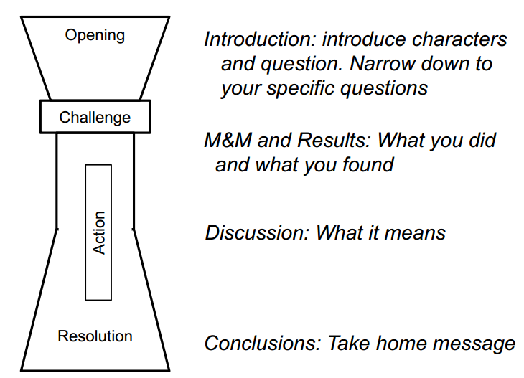
POINTS in Issues: 宏观角度

Slide 57
目录
Clarity
Cohesion
Topic
Stress
Theme
Point
Paragraph=Issue+Discussion
Points in issues
Points at the end of discussions
Points in the whole documents
Concision
Length
Elegance
Writing science

Slide 58
POINTS at the ends of discussions.
适合用于统领全文的段落: Introductory Paragraphs
Man's fascination with that move under their own power and control is at least as old as recorded history.In Aristotle's Greece, plays of several acts are said to have been performed entirely by automatic puppets driven by weights hung on twisted cords. Much later European royalties were enthralled by lifelike automata that could write,draw, and play musical instruments. In recent years most of the magical aura surrounding mechanical automata has been dispelled. Today automatic machines and industrial robots are used in factories throughout the world to perform tasks that are too hazardous, too onerous, too boring or simply too uneconomic for human beings to undertake.
第一句给出话题和主题: history fascination machines move under their own power
最后一句话，给出了整段的point

Slide 59
小结：
如果你的段落是中间的段落，那么point可以在issue结尾处，也可以在段落最后。
如果你的段落是整个section甚至是整个论文的Introductory Paragraphs，那么你的point一定要放在段落的最后。

Slide 60
目录
Clarity
Cohesion
Topic
Stress
Theme
Point
Paragraph=Issue+Discussion
Points in issues
Points at the end of discussions
Points in the whole documents
Concision
Length
Elegance
Writing science

Slide 61
POINTS in Whole Documents
如果把point放在全文结尾会怎样？
原则：如果你要在全文结尾放一个point，那么，你一定至少要给读者提供一个anticipatory point.
You have asked me to determine the matter of Abco's potential liability for the plaintiff's injuries claimed as a result of his climbing Abco's scaffolding. To determine Abco's potential liability we must analyze four factors. They are (1) did Abco construct the scaffolding negligently; (2) did Abco provide adequate assembly instructions; (3) did plaintiff assemble the scaffolding according to the instructions; and (4) did the plaintiff use the scaffolding in a manner prescribed in the instructions?
讨论原告因为爬Abco的脚手架而受伤，Abco要付多少的责任
这段最后一句不是全文的point，但是一个anticipatory point

Slide 62
POINTS in Whole Documents
很少把point放在最后，例外：
timidity or politeness，宣告坏消息或出于礼貌时，可以把结论放最后（如讨论五一放假）
discovery： 推理point的过程与point一样重要时
convention： 约定成俗
注意在英语写作中，point很少会放到最后的。

Slide 63
目录
Clarity
Cohesion
Concision
删掉无意义的词
删掉重复的词
删掉重复含义的词
替换短语
Not the negative
Metadiscourse冗余
Hedges and Emphatics
Length
Elegance
Writing science

Slide 64
Concision(简明)
6个原则：
1. 删掉无意义的词 Delete words that mean little or nothing.
2. 删掉重复的词 Delete words that repeat the meaning of other words.
3. 删掉重复含义的词 Delete words implied by other words.
4. 将短语替换成单词 Replace a phrase with a word.
5. 否定换成肯定 Change negatives to affirmatives.
6. 删掉无意义的形容词和副词 Delete useless adjectives and adverbs.

Slide 65
删掉无意义的词
Productivity actually depends on certain factors that basically involve psychology more than any particular technology.
Productivity depends on psychology more than on technology.

Slide 66
删掉重复的词
full and complete,
hope and trust,
true and accurate,
each and every,
hopes and desires,
first and foremost,
any and all,
basic and fundamental,
various and sundry.

Slide 67
删掉重复含义的词
In my personal opinion, we must listen to and think over in a punctilious manner each and every suggestion that is offered to us.
观点肯定是personal的。
任何叙述默认都是opinion。
listen to and think over => consider.
in a punctilious manner=> punctiliously =>carefully.
Suggestion本来就能包括offer。
we must carefully consider every suggestion.

Slide 68
将短语替换成单词
As you carefully read what you have written to improve wording and catch errors of spelling and punctuation, the thing to do before anything else is to see whether you could use sequences of subjects and verbs instead of the same ideas expressed in nouns.
As you edit, first replace nominalizations with clauses.
carefully read what you have written => edit
the thing to do before anything else => first
use X instead of Y => replace
nouns instead of verbs => nominalizations
sequences of subjects and verbs => clauses

Slide 69
目录
Clarity
Cohesion
Concision
删掉无意义的词
删掉重复的词
删掉重复含义的词
替换短语
Not the negative
Metadiscourse冗余
Hedges and Emphatics
Length
Elegance
Writing science

Slide 70
Not the negative
Don't write in the negative.
Write in the affirmative
尽量不要用否定：
Disengagement of the gears is not possible without locking mechanism release.
To disengage the gears, first release the locking mechanism.

Slide 71
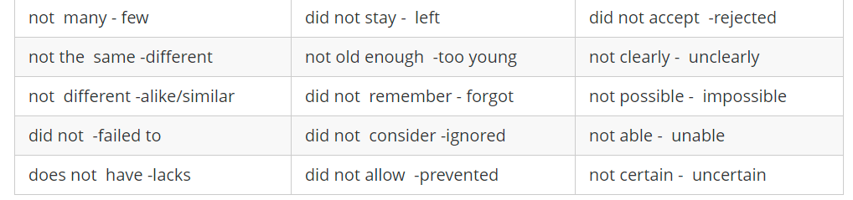
Not the negative

Slide 72
目录
Clarity
Cohesion
Concision
删掉无意义的词
删掉重复的词
删掉重复含义的词
替换短语
Not the negative
Metadiscourse冗余
Hedges and Emphatics
Length
Elegance
Writing science

Slide 73
Metadiscourse冗余
metadiscourse 不宜太多
The last point I would like to make here is that in regard to men-women relationships, it is important to keep in mind that the greatest change shave probably occurred in the way men and women seem to be working next to one another.
黑体部分全都是废话，删掉之后：
Men and women have changed their relationships most in the way they work together.

Slide 74
目录
Clarity
Cohesion
Concision
删掉无意义的词
删掉重复的词
删掉重复含义的词
替换短语
Not the negative
Metadiscourse冗余
Hedges and Emphatics
Length
Elegance
Writing science

Slide 75
Hedge
Hedge也是metadiscourse的一种，写作要求不能夸大事实，hedge就是这么一种描述信心的词。
hedge常用的词：
usually, often,sometimes, almost, virtually, possibly, perhaps, apparently, seemingly,in some ways, to a certain extent, sort of, somewhat, more or less, for the most part, for all intents and purposes, in some respects, in my opinion at least, may, might, can, could, seem, tend, try, attempt, seek, hope.

Slide 76
Emphatics
强调常用的词：
as everyone knows,it is generally agreed that, it is quite true that, it's clear that, it is obvious that, the fact is, as we can plainly see, literally, clearly,obviously, undoubtedly, certainly, of course, indeed, inevitably, very,invariably, always, key, central, crucial, basic, fundamental, major, cardinal,primary, principal, essential.
Hedge和emphatics的平衡要把握好。

Slide 77
目录
Clarity
Cohesion
Concision
Length
Long Openings
Movement and Momentum
Coordination
Resumptive Modifiers
Summative Modifiers
Free Modifiers
Dangling Modifiers
Elegance
Writing science

Slide 78
Length
一个作家不会写长句，那跟咸鱼有什么区别？

Slide 79
目录
Clarity
Cohesion
Concision
Length
Long Openings
Movement and Momentum
Coordination
Resumptive Modifiers
Summative Modifiers
Free Modifiers
Dangling Modifiers
Elegance
Writing science

Slide 80
Long Openings
开头太长，句子快读完了，才能到达这个句子主从句的动词should not load up
Since most undergraduate students change their fields of study at least once during their college careers, many more than once, first-year students who are not certain about their program of studies should not load up their schedules to meet requirements for a particular program.
建议1：句子尽快到达从句，如果不得不用since，because等词开头，那就写得尽可能短。
First-year students SHOULD NOT LOAD UP their schedules with requirements for a particular program if they are not certain about the program of studies they want to pursue, because most CHANGE their major fields of study at least once during their col- lege careers.

Slide 81
Long Openings
建议2：同时句子也应该尽快到达动词和宾语。避免过长的主语，和避免打断 subject-verb&verb-object
如果主语过长（超过7,8个词），把主语的nominalization变成动词：
Abco Inc.’s understanding of the drivers of its profitability in the Asian market for small electronics helped it pursue opportunities in Africa.
✓ Abco Inc. was able to pursue opportunities in Africa because it understood what drove profitability in the Asian market for small electronics.

Slide 82
目录
Clarity
Cohesion
Concision
Length
Long Openings
Movement and Momentum
Coordination
Resumptive Modifiers
Summative Modifiers
Free Modifiers
Dangling Modifiers
Elegance
Writing science

Slide 83
Movement and Momentum
写一个句子，应该尽可能让他不要被"打断”，也就是要保证 subject-verb, verb-object这样的结构是连贯的
A semantic theory, if it is to represent in real-time terms on-line cognitive behavior must propose more neutrally plausible psychological processes than those described here.
被打断了3次，还没读完就断气。
分别打断了subject-verb，verb-object，verb-object

Slide 84
Movement and Momentum
A semantic theory, if it is to represent in real-time terms on-line cognitive behavior must propose more neutrally plausible psychological processes than those described here.
If a semantic theory is to represent online cognitive behavior in real-time terms, it must propose psychological processes more neutrally plausible than those described here.

Slide 85
Movement and Momentum
当你看到下面这些形容词就要小心了，因为他们很可能会打断
more ... than, less ... than, other ...than, as ... as, similar ... to, equal ... to, identical ... to, same ... as,different ... from, such ... as, separate ... from, distant ... from, related... to, close ... to, next ... to, difficult ... to, easy ... to, necessary ...to.

Slide 86
目录
Clarity
Cohesion
Concision
Length
Long Openings
Movement and Momentum
Coordination
Resumptive Modifiers
Summative Modifiers
Free Modifiers
Dangling Modifiers
Elegance
Writing science

Slide 87
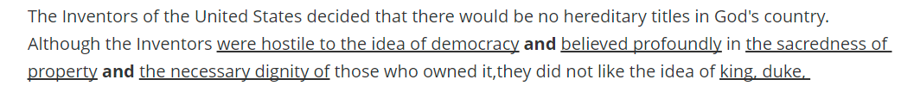
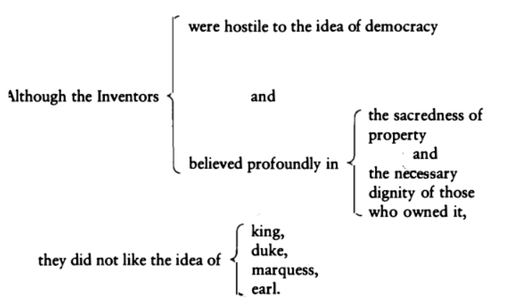
Coordination(排比)

Slide 88
目录
Clarity
Cohesion
Concision
Length
Long Openings
Movement and Momentum
Coordination
Resumptive Modifiers
Summative Modifiers
Free Modifiers
Dangling Modifiers
Elegance
Writing science

Slide 89
写长句技巧：Resumptive Modifiers
先说下，modifier(修饰语)是什么
This is a red ball.
red就是modifier, 如果去掉red，This is a ball.句子还是完整的。
Resumptive Modifiers，可以理解为根据前文，重复一个的词，然后把这词后面的句子变成这个词的modifier：

Slide 90
Resumptive Modifiers
Resumptive Modifiers，可以理解为根据前文，重复一个的词，然后把这词后面的句子变成这个词的modifier：
For several years the Columbia Broadcasting System created and developed situation comedies that were the best that American TV had to offer, such as "The Mary Tyler Moore Show“ and "All in the Family" that sparkled with wit and invention.
For several years, the Columbia Broadcasting System created and developed situation comedies that were the best that American TV had to offer, comedies such as "The Mary Tyler Moore Show" and "All in the Family," comedies that sparkled with wit and invention.

Slide 91
Resumptive Modifiers
It was American writers who found a voice that was both true and lyrical, true to the rhythms of the working man’s speech and lyrical in its celebration of his labor.
这里true和lyrical也是重复了之前的元素

Slide 92
目录
Clarity
Cohesion
Concision
Length
Long Openings
Movement and Momentum
Coordination
Resumptive Modifiers
Summative Modifiers
Free Modifiers
Dangling Modifiers
Elegance
Writing science

Slide 93
Summative Modifiers
如果没有可以重复的元素，我们还可以自己总结一个元素，即Summative Modifiers。
In the last five years, European population growth has dropped to almost zero, which in years to come will have profound social implications.
In the last five years, European population growth has dropped to almost zero, a demographic event that in years to come will have profound social implications.

Slide 94
目录
Clarity
Cohesion
Concision
Length
Long Openings
Movement and Momentum
Coordination
Resumptive Modifiers
Summative Modifiers
Free Modifiers
Dangling Modifiers
Elegance
Writing science

Slide 95
Free Modifiers
free modifier中的"free"他比较“自由”，既可以在开头也可以在结尾。
用V+ing或V+ed来引导后面的从句，常用V+ing
Free modifiers resemble resumptive and summative modifiers, letting you extend the line of a sentence while avoiding a train of ungainly phrases and clauses.

Slide 96
Free Modifiers
V+ed引导
Leonardo da Vinci was a man of powerful intellect,
driven by an insatiable curiosity and
haunted by a vision of artistic expression.

Slide 97
目录
Clarity
Cohesion
Concision
Length
Long Openings
Movement and Momentum
Coordination
Resumptive Modifiers
Summative Modifiers
Free Modifiers
Dangling Modifiers
Elegance
Writing science

Slide 98
Dangling Modifiers
这是个英文上的歧义问题。看下面的句子：
At the age of eight, my family finally bought a dog
家庭8岁还是这只狗8岁？
my family, at the age of eight, finally bought a dog

Slide 99
目录
Clarity
Cohesion
Concision
Length
Elegance
Balance and sumetry
Emphasis and thythm
Writing science

Slide 100
Elegance
优雅，这里并不能帮你写得优雅，但可以给你看看优雅是怎样的。

Slide 101
Balance and symmetry
The national unity of a free people depends upon a sufficiently even balance of political power to make it impracticable for the administration to be arbitrary and for the opposition to be revolutionary and irreconcilable. Where that balance no longer exists, democracy perishes. For unless all the citizens of a state are forced by circumstances to compromise, unless they feel that they can affect policy but that no one can wholly dominate it, unless by habit and necessity they have to give and take, freedom cannot be maintained.
—Walter Lippmann

Slide 102
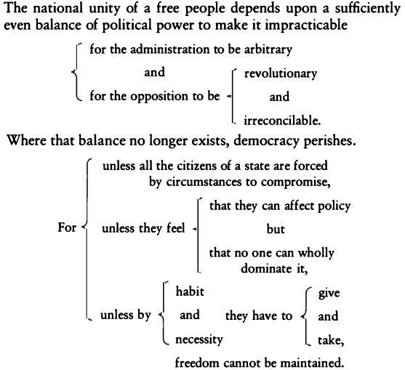
Balance and symmetry

Slide 103
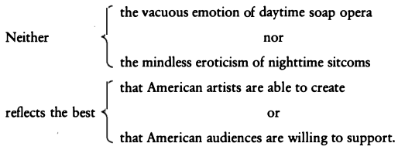
Balance and symmetry
一个小技巧是，你可以用both X and Y,not only X but also Y, neither X nor Y 来帮助你形成这样的排比句
这里不仅neither nor是对称的，vacuous和mindless，emotion /eroticism, daytime /nighttime,soap opera /sitcoms, artists /audiences, able /willing, create /support.，都是对称的。就问你怕不怕...

Slide 104
Emphasis and Rhythm
用介词结尾，可能会不够力量
The intellectual differences among races is a subject that only the most politically indifferent scientist is willing to look into.
The intellectual differences among races is a subject that only the most politically indifferent scientist is willing to explore.

Slide 105
Emphasis and Rhythm
使用nominalizations结尾，整个句子达到最高潮：
... until in God's good time, the New World, with all its power and might, steps forth to the rescue and the liberation of the old.
他本可以这样说，但就失去了力量：
... until in God's good time, the powerful New World steps forth to liberate the old.

Slide 106
Style
Clarity
Cohesion
Concision
Length & Elegance

Slide 107
Style
“Have something to say, and say it as clearly as you can. That is the only secret of style. ”
---- Matthew Arnold

Slide 108
谢谢

