Slide 1
An Image Stream Processing Framework
A quick overview
Carlos Rueda – UC Davis carueda@ucdavis.edu - http://casil.ucdavis.edu/~crueda
6/27/07
Outline
  Background: recent projects
  Current research work
  Image stream processing
    A prototype using Kepler

Slide 2
Some recent projects
I've been involved in
At Center for Spatial Technologies & Remote Sensing (http://cstars.ucdavis.edu)
and CalSpace Center of Excellence (http://calspace.ucdavis.edu)
Main designer, developer, and maintainer:
SAMS - Spectral Analysis and Management System (Java)
  Manage field spectra databases and perform typical remote sensing preprocessing operations
  User-defined operations in a scripting language (BeanShell)
  Spectra plotting based on (Ptolemy) Ptplot library
StarSpan: Raster-vector analysis (C++)
  Uses GEOS, GDAL/OGR libraries
  Fast quadtree-based extraction of data
RTM – Radiative Transfer Models for Remote Sensing research and apps (C)
  Reimplementation and modularization of widely used RTMs
  Developed new linked models with efficient numerical inversions
Software modules for:
ETo - Calculation of Reference Evapotranspiration for California
  Automated data download from CIMIS stations (Java)
  Interpolation of ground measured variables – GRASS command (C)
  Solar position calculations – GRASS command (C)

Slide 3
Research
In the context of GeoStreams (http://geostreams.ucdavis.edu),
a Query Processing Architecture for Geospatial Image Streams:
Module for image stream generation (C++)
Online visualization of GOES channels (Java)
Reprojection library for GOES Satellite raw GVAR data (C++)
My research focus:
Modeling and processing of geospatial image streams
Characterization of key operations for change analysis & viz
Heterogeneous spatial coverage scenarios
Applications in remote sensing change detection
Realization using Kepler
  Working prototype with core functionality
Ongoing work:
  Inter-workflow composition
  Use of standards (OGC Sensor Web Enablement – SensorML)
  COMET

Slide 4
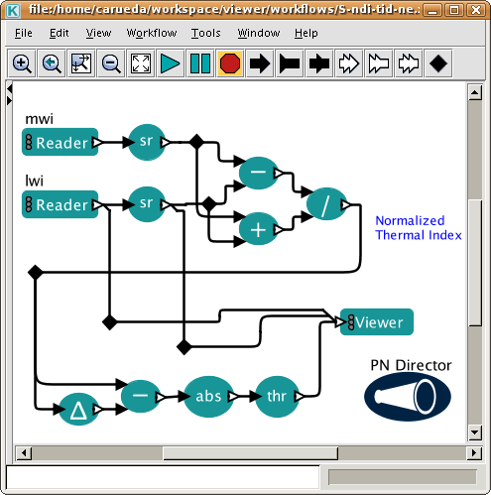
  Image stream processing:
  A prototype using Kepler (1)
Imports a remote stream
stream operators
Example: Change detection using a temporal image difference technique applied on the normalized thermal index, which is computed on the midwave and longwave infrared channels
Data from GOES West satellite in real-time
stream viewer
Spatially-aware delay operator

Slide 5
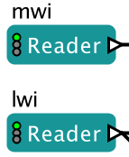
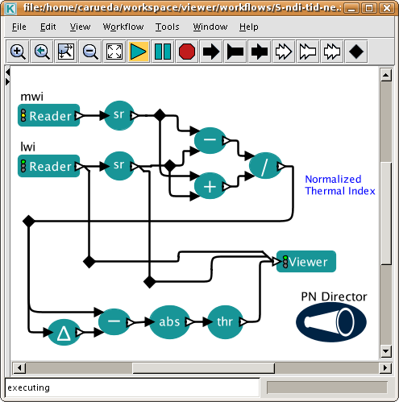
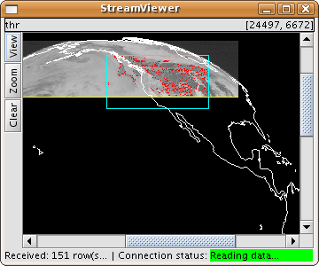

  Image stream processing:
  A prototype using Kepler (2)
Icons for monitoring purposes
Visualization actor

Slide 6
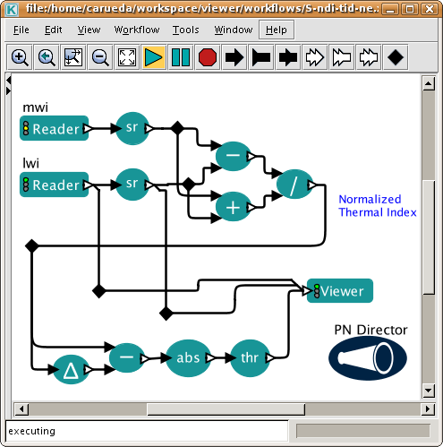
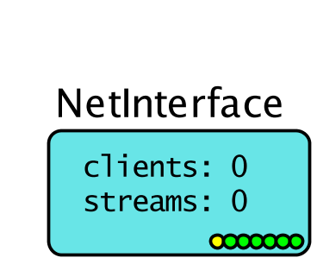
  Image stream processing:
  A prototype using Kepler (3)
“Net-enabling” a workflow
for inter-workflow composition
  NetInterface
  Special component that makes the streams in the workflow available to remote clients, including other workflows.

Slide 7
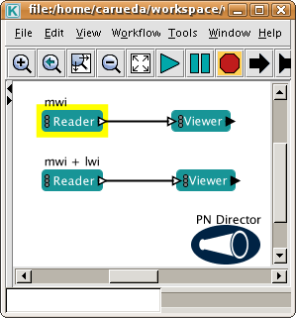
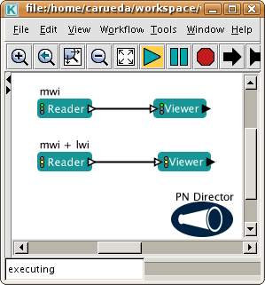
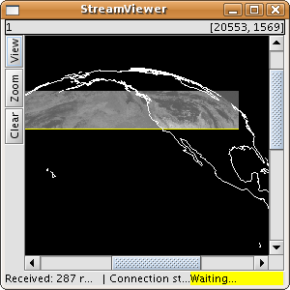
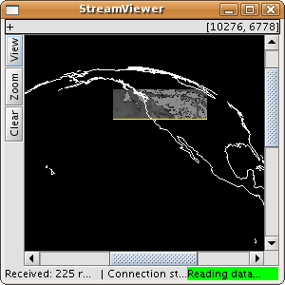
  Image stream processing:
  A prototype using Kepler (4)
a client workflow
a server workflow
image streams

Slide 8
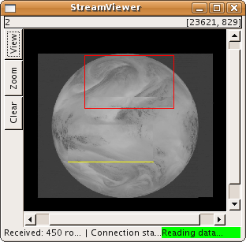
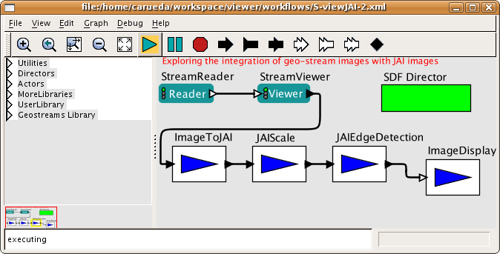
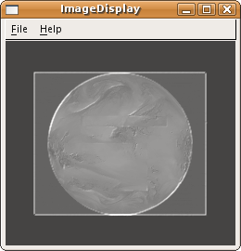
Image stream processing:
A prototype using Kepler (5)
Integration with standard
image processing actors
Composed image in stream viewer is output in an AWTImageToken upon each firing
Example:
Edge detection
using JAI

Slide 9
Summary
Actors for image stream processing
Components for net-enabling workflows
Real-time visualization of image streams
Enhanced icons for monitoring
Integration with standard image processing actors (JAI, ImageJ) --Ptolemy II

