Slide 1
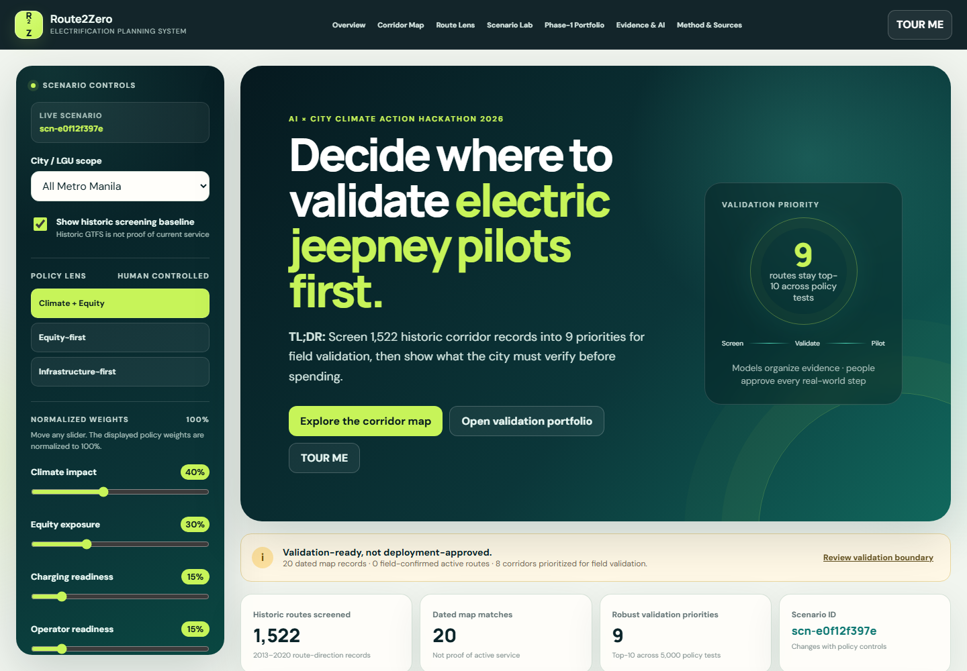
GitHub: https://github.com/qjmre23/Route2Zero
Live: https://route2zero.netlify.app/
Route2Zero 2.1
Prototype Demonstration
Screen 1,522 historic corridor records into 9 priorities for field validation — then show what the city must verify before spending.
BUILD
r2z-d4c8d4cc709a
MODEL
service-v1-266e0b1d
SCENARIO
scn-e0f12f397e
GENERATED
24 Aug 2026 · 16:13 UTC
Values shown are generated from the linked build and scenario — not manually entered.
r2z-d4c8d4cc709a · scn-e0f12f397e · prt-fd6de9d793
01
Notes:
Frame this as proof of a reproducible working build.
[Sources]
https://route2zero.netlify.app/
https://github.com/qjmre23/Route2Zero

Slide 2
GitHub: https://github.com/qjmre23/Route2Zero
Live: https://route2zero.netlify.app/
DEMO DECISION
What this demonstration will prove.
Which corridors remain strong when climate, equity, charging, operator evidence, and uncertainty are tested together?
01
02
03
04
05
06
07
Open network
Select flagship
Inspect evidence
Stress-test
Build portfolio
Ask what next
Export pack
Scenario scn-e0f12f397e
r2z-d4c8d4cc709a · scn-e0f12f397e · prt-fd6de9d793
02
Notes:
Use one scenario throughout so screenshots and assistant responses remain consistent.

Slide 3
GitHub: https://github.com/qjmre23/Route2Zero
Live: https://route2zero.netlify.app/
SYSTEM OVERVIEW
The final city decision cockpit.
1
1,522 screened · 20 dated matches
2
Scenario and build state
3
Map, Route Lens, feasibility
r2z-d4c8d4cc709a · scn-e0f12f397e · prt-fd6de9d793
03
Notes:
The 2.1 interface keeps the city decision, evidence state, and next action in one workflow.
[Sources]
https://route2zero.netlify.app/
https://github.com/qjmre23/Route2Zero

Slide 4
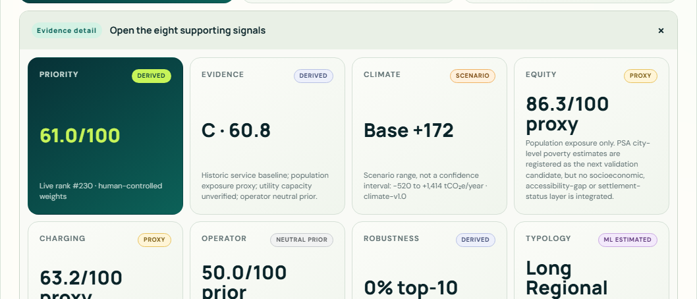
GitHub: https://github.com/qjmre23/Route2Zero
Live: https://route2zero.netlify.app/
DATED EXTERNAL MAP RECORD
A dated map record shows its source, review date, and observed geometry.
1
OBSERVED map and geometry claim
2
OSM relation 11521406
3
Reviewed 24 Aug 2026
r2z-d4c8d4cc709a · scn-e0f12f397e · prt-fd6de9d793
04
Notes:
The dated OSM relation supports the route and geometry claim; active service and franchise authority remain uncertain.
[Sources]
data/processed/osm_route_validation.csv
data/processed/osm_route_geometry.geojson

Slide 5
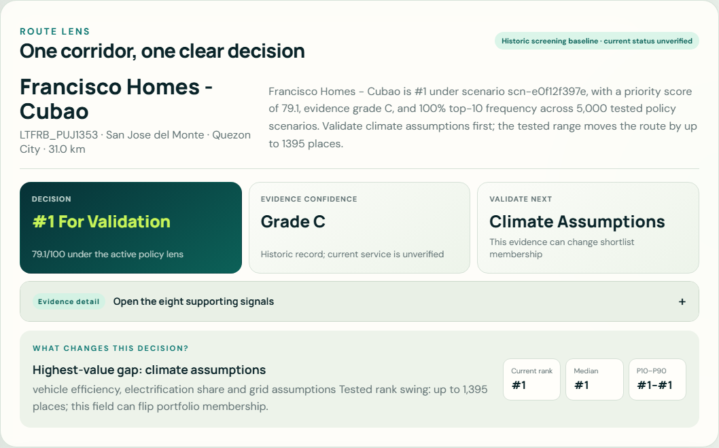
GitHub: https://github.com/qjmre23/Route2Zero
Live: https://route2zero.netlify.app/
FLAGSHIP ROUTE LENS
Flagship corridor: Francisco Homes–Cubao.
1
Validation rank
2
Evidence confidence
3
Validate next
r2z-d4c8d4cc709a · scn-e0f12f397e · prt-fd6de9d793
05
Notes:
The default view leads with three decisions. Eight supporting signals are available through progressive disclosure.
[Sources]
data/processed/flagship_route.json

Slide 6
GitHub: https://github.com/qjmre23/Route2Zero
Live: https://route2zero.netlify.app/
ML SERVICE INTENSITY
The machine-learning layer produces a real route-level estimate.
Historic: MISSING
ML: 6,657
LTFRB_PUJ2451 is the only route where ML supplies the climate activity input. It is not current service or ridership.
GROUPKFOLD(5)
NO RANK LEAKAGE
r2z-d4c8d4cc709a · scn-e0f12f397e · prt-fd6de9d793 · service-v1-266e0b1d
06
Notes:
The model target is a historic schedule-based service proxy, not passenger demand.
[Sources]
data/processed/model_metrics.json

Slide 7
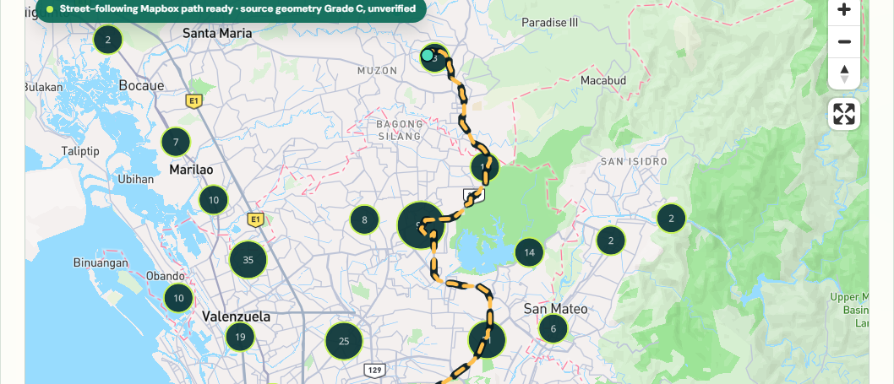
GitHub: https://github.com/qjmre23/Route2Zero
Live: https://route2zero.netlify.app/
CORRIDOR TYPOLOGY
Typology is a descriptive comparison aid, not a prediction.
1
Layer: Corridor typology
2
Three overlapping groups
3
K = 3 · silhouette 0.373
r2z-d4c8d4cc709a · scn-e0f12f397e · prt-fd6de9d793
07
Notes:
The modest silhouette indicates overlapping structure. Typology adds no policy points and predicts no outcome.
[Sources]
data/processed/corridor_typology.csv
data/processed/model_metrics.json

Slide 8
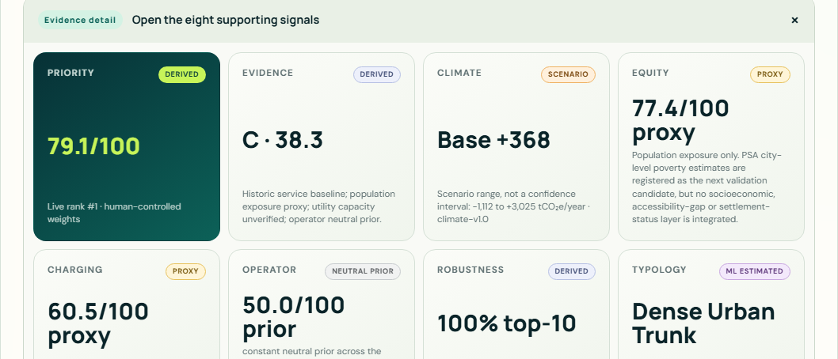
GitHub: https://github.com/qjmre23/Route2Zero
Live: https://route2zero.netlify.app/
CLIMATE + ENERGY
Lead with the base climate case; keep the scenario range beside it.
1
Base +368 tCO₂e/year
2
Scenario range · not a CI
3
Negative-low explanation
r2z-d4c8d4cc709a · scn-e0f12f397e · prt-fd6de9d793
08
Notes:
The low case turns negative when a carbon-intensive grid is paired with an inefficient EV assumption. The low-high range is a scenario bound, not a statistical confidence interval.
[Sources]
data/processed/climate_impact.csv
config/climate_scenarios.json

Slide 9
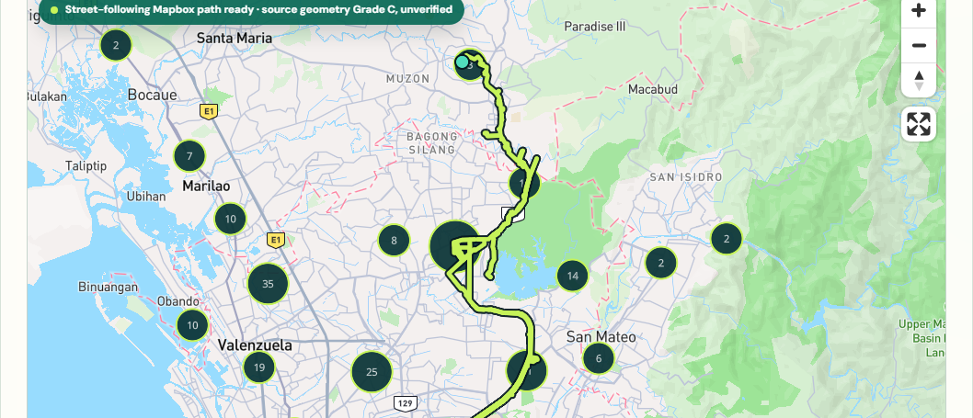
GitHub: https://github.com/qjmre23/Route2Zero
Live: https://route2zero.netlify.app/
EQUITY + ACCESSIBILITY
The climate recommendation is tested against who and where it serves.
1
Layer: Equity / exposure
2
Population exposure
3
PROXY · second layer MISSING
r2z-d4c8d4cc709a · scn-e0f12f397e · prt-fd6de9d793
09
Notes:
Current build uses population exposure only. PSA city-level poverty estimates are registered as the next validation candidate; no poverty or settlement-status inference is made.
[Sources]
data/processed/equity_v2.csv

Slide 10
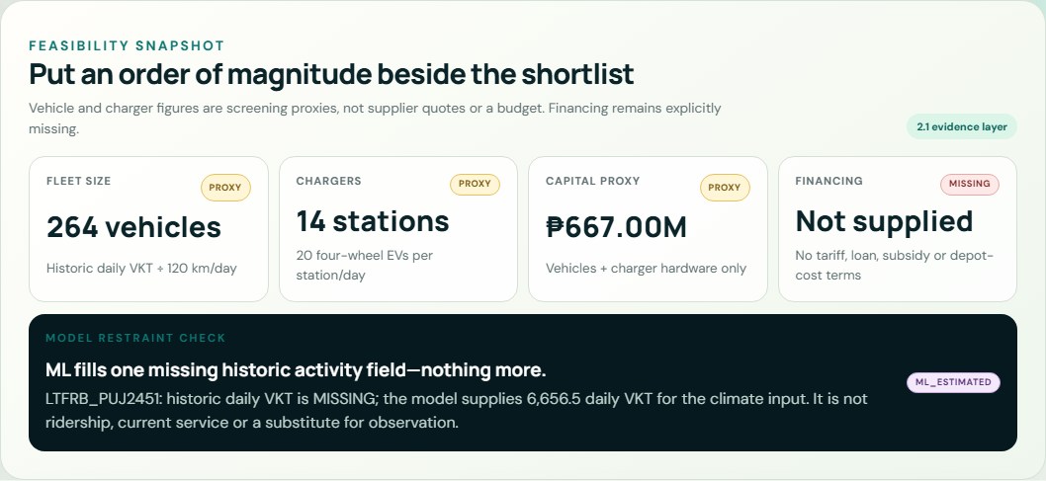
GitHub: https://github.com/qjmre23/Route2Zero
Live: https://route2zero.netlify.app/
FEASIBILITY + MODEL RESTRAINT
Feasibility is visible as a proxy — never disguised as a budget.
1
Fleet and charger PROXY
2
Capital proxy
3
Financing MISSING
r2z-d4c8d4cc709a · scn-e0f12f397e · prt-fd6de9d793
10
Notes:
The live panel exposes order-of-magnitude fleet and hardware figures, excluded costs, and the single route that uses ML.
[Sources]
data/processed/feasibility_cost_scenarios.json
data/processed/model_metrics.json

Slide 11
GitHub: https://github.com/qjmre23/Route2Zero
Live: https://route2zero.netlify.app/
EVIDENCE CONFIDENCE
Priority, evidence quality, and stability are different questions.
1
Priority 79.07
2
Evidence 38.34 · grade C
3
Stability 100% top-10
r2z-d4c8d4cc709a · scn-e0f12f397e · prt-fd6de9d793
11
Notes:
A route can be high priority and still require more evidence.
[Sources]
data/processed/evidence_confidence.csv
data/processed/sensitivity.csv

Slide 12
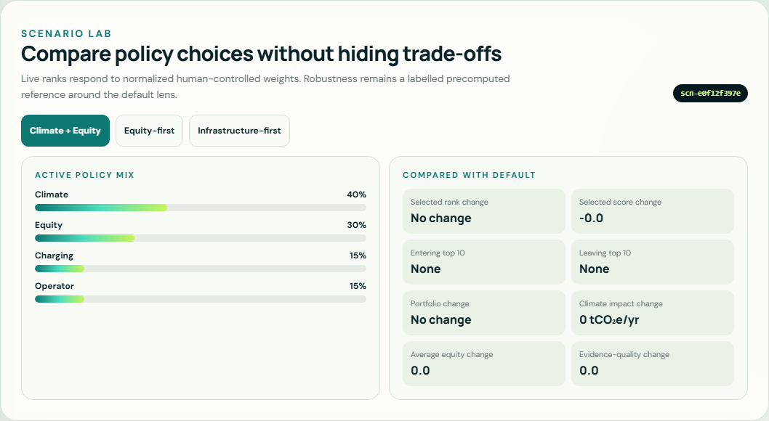
GitHub: https://github.com/qjmre23/Route2Zero
Live: https://route2zero.netlify.app/
5,000-SCENARIO MONTE CARLO
Does the recommendation survive changing policy priorities?
Flagship
P10–P90 rank
1 → 1
Top-10 probability
100%
ROBUST
Binangonan–JRC
P10–P90 rank
9 → 24
Top-10 probability
40.7%
DEPENDENT
r2z-d4c8d4cc709a · scn-e0f12f397e · prt-fd6de9d793 · seed 20260820 · 5,000 simulations
12
Notes:
Rank stability is resilience to the tested policy weights, not predictive accuracy.
[Sources]
data/processed/sensitivity.csv

Slide 13
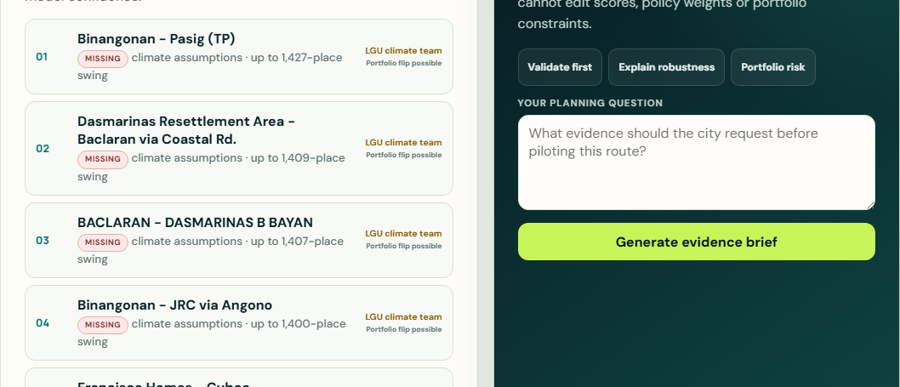
GitHub: https://github.com/qjmre23/Route2Zero
Live: https://route2zero.netlify.app/
VALUE OF INFORMATION
What could change this decision?
1
Climate assumptions: rank swing 1,395
2
Portfolio flip possible
3
Field validation action
r2z-d4c8d4cc709a · scn-e0f12f397e · prt-fd6de9d793
13
Notes:
The queue is precomputed by deterministic perturbation.
[Sources]
data/processed/validation_priorities.json

Slide 14
GitHub: https://github.com/qjmre23/Route2Zero
Live: https://route2zero.netlify.app/
SCENARIO COMPARISON
A city can change priorities without hiding the trade-off.
1
Named policy preset
2
Weights normalized to 100%
3
Scenario ID updates
r2z-d4c8d4cc709a · scn-e0f12f397e · prt-fd6de9d793
14
Notes:
The policy scenario is explicit and auditable; the assistant cache is keyed by route, scenario, and build.
[Sources]
config/policy_model.json

Slide 15
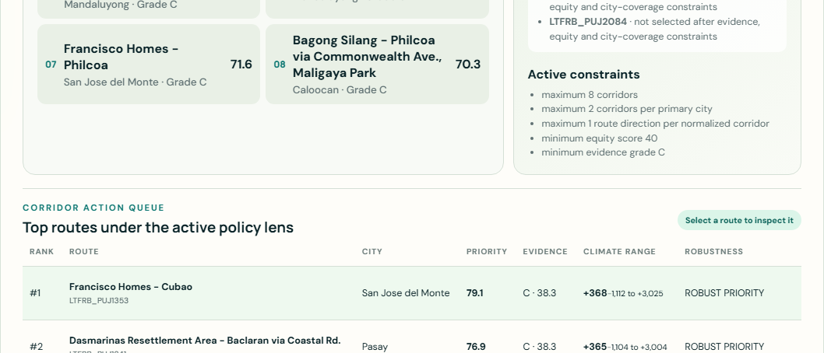
GitHub: https://github.com/qjmre23/Route2Zero
Live: https://route2zero.netlify.app/
PHASE-1 PORTFOLIO INPUTS
Now move from ranking to a city validation program.
1
Maximum eight corridors
2
Evidence and equity constraints
3
Cost is visible, not optimized
r2z-d4c8d4cc709a · scn-e0f12f397e · prt-fd6de9d793
15
Notes:
The deterministic shortlist uses evidence and diversity constraints. The new feasibility proxy informs validation but is not presented as a verified budget constraint.
[Sources]
config/optimization_scenarios.json
data/processed/feasibility_cost_scenarios.json

Slide 16
GitHub: https://github.com/qjmre23/Route2Zero
Live: https://route2zero.netlify.app/
OPTIMIZED RESULT
The optimized portfolio is not simply the top eight routes.
1
Four routes added by constraints
2
Portfolio scenario range
3
Binding constraints + exclusions
r2z-d4c8d4cc709a · scn-e0f12f397e · prt-fd6de9d793
16
Notes:
The optimizer changes four routes while selecting one route direction per normalized corridor.
[Sources]
data/processed/portfolio_scenarios.json

Slide 17
GitHub: https://github.com/qjmre23/Route2Zero
Live: https://route2zero.netlify.app/
PLANNING & EVIDENCE ASSISTANT
AI explains the evidence and tells the city what to verify next.
1
Question grounded in portfolio
2
Evidence-backed answer
3
Scenario + source + provider status
r2z-d4c8d4cc709a · scn-e0f12f397e · prt-fd6de9d793
17
Notes:
The assistant never writes scores, rankings, climate values, weights, or portfolio membership.
[Sources]
data/processed/route_planner_cache.json
netlify-site/netlify/functions/explain.mjs

Slide 18
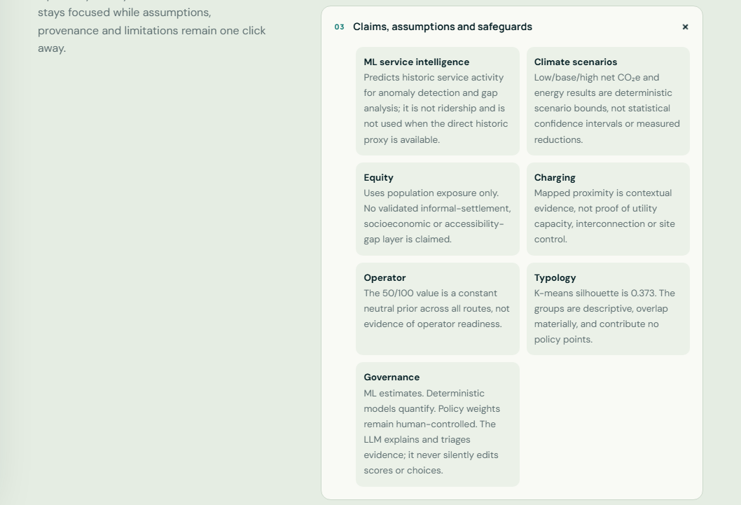
GitHub: https://github.com/qjmre23/Route2Zero
Live: https://route2zero.netlify.app/
REPRODUCIBILITY + CLOSE
The decision can be reproduced, exported, challenged, and rerun.
BUILD
r2z-d4c8d4cc709a
SCENARIO
scn-e0f12f397e
MODEL
service-v1-266e0b1d
SIMULATIONS
5,000 · fixed seed
TOUR VOICE
14 recorded MP3 · 1 live response
TESTS
pipeline · freshness · Netlify build
Team Larpers · John Marwin Ebona · Isaac Marcus · Andrei Dela Cruz · Russel Mendez
Joaquin Sarmiento · Prince Marl Mirasol · Carl Nueva · JOSEPH CLARENCE PARAYAOAN
SOURCE EVIDENCE → ML → CLIMATE / EQUITY / READINESS → CONFIDENCE → POLICY → SENSITIVITY → PORTFOLIO → VALIDATION
Route2Zero is not asking the city to trust one score. It shows what remains true when assumptions are challenged.
r2z-d4c8d4cc709a · scn-e0f12f397e · prt-fd6de9d793
18
Notes:
Close on auditability and human control.
[Sources]
https://route2zero.netlify.app/
https://github.com/qjmre23/Route2Zero

