Slide 1
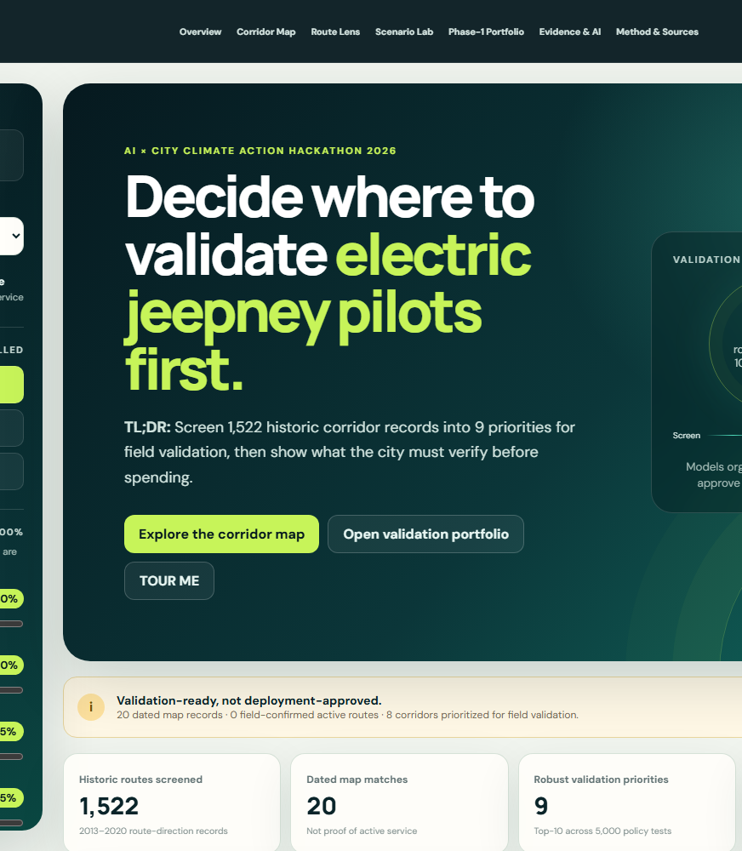
GitHub: https://github.com/qjmre23/Route2Zero
Live: https://route2zero.netlify.app/
ROUTE2ZERO
AI/ML-assisted planning for a just e-jeepney transition.
Screens 1,522 historic corridor records into 9 priorities for field validation — then shows what the city must verify before spending.
1,522
9
20
route-direction records screened
robust-priority corridors
dated OSM map records
Team Larpers · Metro Manila · AI x City Climate Action Hackathon 2026
r2z-a7181752a17d · scn-e0f12f397e · prt-fd6de9d793
01
Notes:
Open with the city decision: this is a transportation planning system, not vehicle hardware and not a generic chatbot.
[Sources]
https://github.com/qjmre23/Route2Zero
https://route2zero.netlify.app/

Slide 2
GitHub: https://github.com/qjmre23/Route2Zero
Live: https://route2zero.netlify.app/
WHY THIS MATTERS
Transport electrification is a climate opportunity — prioritization is the bottleneck.
34%
80%
NATIONAL DIRECTION
50% EV adoption by 2040
of Philippine GHG emissions came from transport in 2015
of transport emissions were attributed to road transport
A roadmap target — not an achieved value and not route-level proof.
Cities still must decide where limited validation, planning, charging, and transition support create the strongest public value first.
2025 DOE direction: distribution utilities integrate EV charging demand into development planning.
Sources: DOE CREVI (2023); DOE DC2025-08-0012 and official 2025 releases.
r2z-a7181752a17d · scn-e0f12f397e · prt-fd6de9d793
02
Notes:
Establish the national climate and grid-planning context, then return to the city corridor decision.
[Sources]
https://doe.gov.ph/site/eumb/articles/group/roadmaps?category=Energy+Efficiency+and+Conservation&display_type=Card
https://doe.gov.ph/site/eumb/articles/group/laws-and-issuances-eumb?display_type=Department+Circular&maincat=Issuances&subcategory=Department+Circular

Slide 3
GitHub: https://github.com/qjmre23/Route2Zero
Live: https://route2zero.netlify.app/
THE PLANNING GAP
The evidence for one corridor decision lives in different systems.
Route + service
Climate + energy
Equity + access
Evidence does not agree by default.
historic schedules, current status
vehicle, grid, and operating assumptions
population and validated area evidence
High activity can still mean weak charging evidence.
High equity can rest on outdated service records.
A top score can move when policy priorities change.
Charging
Operators
Uncertainty
mapped proximity versus verified capacity
fleet, depot, finance, governance
data quality and policy sensitivity
Route2Zero integrates the evidence — it does not erase disagreement.
r2z-a7181752a17d · scn-e0f12f397e · prt-fd6de9d793
03
Notes:
Show why another map or another static ranking is not enough.

Slide 4
GitHub: https://github.com/qjmre23/Route2Zero
Live: https://route2zero.netlify.app/
DECISION FRAME
Route2Zero answers one city decision.
Which corridors should Metro Manila validate and prioritize for e-jeepney transition — and how robust is that recommendation?
Where is the climate value?
Who benefits — and what evidence supports that?
Can charging and operators support the transition?
Does the recommendation survive changing assumptions?
Users: LGUs · DOTr/LTFRB · operators · energy partners · finance · riders and communities
Output: priority · evidence · climate range · stability · portfolio status · next validation action
r2z-a7181752a17d · scn-e0f12f397e · prt-fd6de9d793
04
Notes:
The system does not authorize funding. It produces an auditable validation and prioritization decision.

Slide 5
GitHub: https://github.com/qjmre23/Route2Zero
Live: https://route2zero.netlify.app/
PRODUCT PROMISE
From a leaderboard to a city electrification decision laboratory.
01
02
03
04
05
06
Screen
Estimate
Quantify
Test
Stress-test
Assemble
1,522 route directions
one missing service input
climate + energy scenarios
equity, charging, operators
rank stability + evidence
constrained Phase-1 portfolio
Planning & Evidence Assistant
Humans decide
Explains precomputed evidence, compares scenarios, and turns missing evidence into a fieldwork queue.
Policy weights, constraints, evidence acceptance, and implementation remain explicit city choices.
r2z-a7181752a17d · scn-e0f12f397e · prt-fd6de9d793
05
Notes:
This is the first full solution view: screen, quantify, stress-test, validate, and act.

Slide 6
GitHub: https://github.com/qjmre23/Route2Zero
Live: https://route2zero.netlify.app/
AI / ML BOUNDARY
AI accelerates evidence triage; the city keeps decision authority.
MACHINE LEARNING
DETERMINISTIC MODELS
LLM PLANNING ASSISTANT
Historic gap completion
Residual anomaly flags
Descriptive route typology
Climate + energy
Evidence confidence
Sensitivity + constrained selection
Interrogate route evidence
Compare scenarios
Draft validation questions
AI compresses sparse evidence and speeds interrogation. It never writes a score, constraint, or portfolio choice.
The assistant never writes scores, rankings, climate values, weights, or portfolio membership.
r2z-a7181752a17d · scn-e0f12f397e · prt-fd6de9d793
06
Notes:
Clarify three distinct roles: ML estimation, deterministic computation, and LLM explanation.

Slide 7
GitHub: https://github.com/qjmre23/Route2Zero
Live: https://route2zero.netlify.app/
DATA, PROVENANCE, VALIDATION
Every recommendation carries an evidence trail.
7 PRIMARY SOURCE FAMILIES
VISIBLE FIELD STATUS
Historic Sakay GTFS
VERIFIED
OBSERVED
20
WorldPop 2020
dated OSM matches
DERIVED
ML_ESTIMATED
DOE climate + feasibility
22
OSM routes + infrastructure
PROXY
SCENARIO
LTFRB planning sources
source geometries
NEUTRAL PRIOR
MISSING
Operator references + ledgers
18
Validation + governance records
registered source records
MIT code · OSM data © contributors, ODbL · build r2z-a7181752a17d
r2z-a7181752a17d · scn-e0f12f397e · prt-fd6de9d793
07
Notes:
Seven primary families are represented by 18 registered, dated source records. Claim status is assigned field by field.
[Sources]
data/processed/source_manifest.json
data/processed/build_manifest.json
NOTICE.md
LICENSE

Slide 8
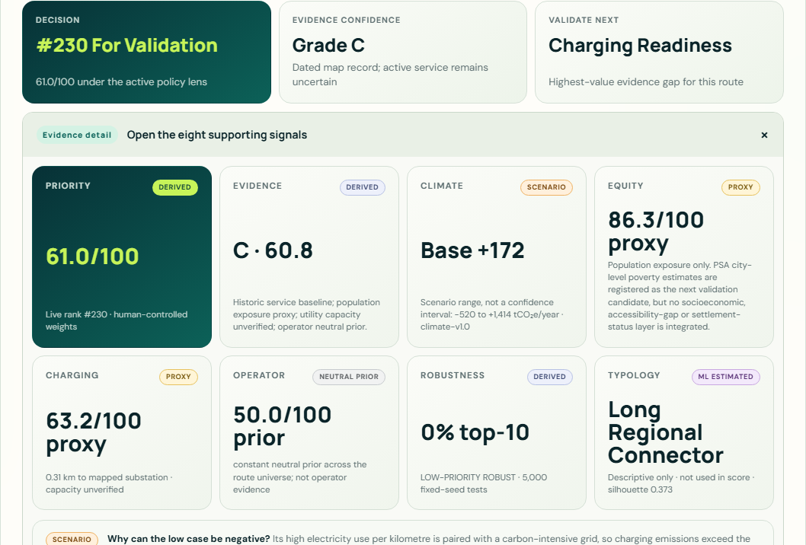
GitHub: https://github.com/qjmre23/Route2Zero
Live: https://route2zero.netlify.app/
DATED EXTERNAL MAP RECORDS
A dated external map record changes the evidence state — without claiming active service.
HISTORIC ONLY
1,522-route screening baseline
↓ fuzzy endpoint review + one-to-one relation acceptance
OBSERVED
20 corridors with dated OSM route relations
route=share_taxi convention
edited 2023-01-01 or later
actual member-way geometry
active service remains uncertain
Example: LTFRB_PUJ1034 · OSM relation 11521406 · reviewed 24 Aug 2026
r2z-a7181752a17d · scn-e0f12f397e · prt-fd6de9d793
08
Notes:
A dated external map record supports the route and geometry claim. It does not certify active operations or franchise authority.
[Sources]
data/processed/osm_route_validation.csv
data/processed/osm_route_geometry.geojson
https://www.openstreetmap.org/relation/11521406

Slide 9
GitHub: https://github.com/qjmre23/Route2Zero
Live: https://route2zero.netlify.app/
ML SERVICE INTELLIGENCE
Machine learning estimates service intensity where evidence is incomplete.
HistGradientBoostingRegressor
TARGET
Historic schedule-based vehicle-km/day proxy
VALIDATION
GroupKFold(5) by normalized corridor
ROWS
1,521 training records · 714 corridor groups
METRICS
MAE 267.70 · RMSE 574.14 · R² 0.9907
VERSION
service-v1-266e0b1d
Only LTFRB_PUJ2451 uses ML: historic activity is MISSING; the model supplies 6,657 vehicle-km/day for the climate input. It is not headway, current service, or ridership.
Source: model_metrics.json · grouped corridor validation · no score/rank leakage features
r2z-a7181752a17d · scn-e0f12f397e · prt-fd6de9d793
09
Notes:
The ML target is service activity, never passenger demand. Validated observations override the model.
[Sources]
data/processed/model_metrics.json

Slide 10
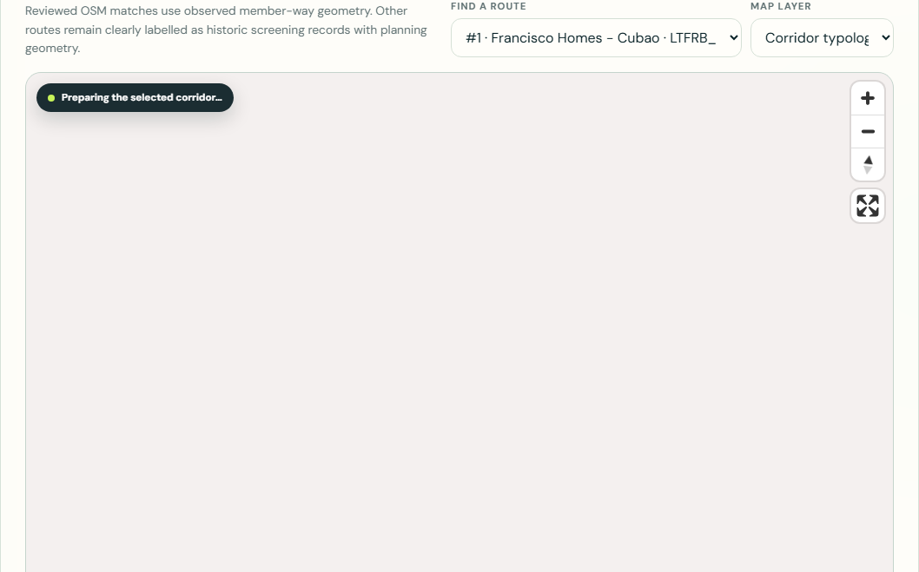
GitHub: https://github.com/qjmre23/Route2Zero
Live: https://route2zero.netlify.app/
CORRIDOR TYPOLOGY
Typology is descriptive, not predictive.
SELECTED K = 3
Silhouette 0.373
KMeans · typology-v1-ab8203c9
Modest separation · comparison aid only · no policy points.
r2z-a7181752a17d · scn-e0f12f397e · prt-fd6de9d793
10
Notes:
A silhouette of 0.373 indicates overlapping structural groups. The flagship is a Dense Urban Trunk and an outlier within that cluster. Typology never predicts outcomes or infers vulnerability or settlement status.
[Sources]
data/processed/corridor_typology.csv
data/processed/model_metrics.json

Slide 11
GitHub: https://github.com/qjmre23/Route2Zero
Live: https://route2zero.netlify.app/
CLIMATE + ENERGY IMPACT
The system estimates climate outcomes — not an ‘emissions score.’
+368
31,585
50%
−1,112 to +3,025
→
→
→
base tCO₂e/year
historic daily VKT
base electric share
scenario range · not a CI
BASE CASE FIRST · SCENARIO
The low case turns negative when a carbon-intensive grid is paired with an inefficient EV assumption. In that combination, electricity emissions exceed avoided diesel emissions.
Dominant sensitivity: vehicle efficiency, together with grid intensity.
Flagship: Francisco Homes–Cubao · climate-v1.0 · DOE context + explicit scenario assumptions
r2z-a7181752a17d · scn-e0f12f397e · prt-fd6de9d793
11
Notes:
Do not hide the negative low case. The result depends on grid and vehicle-efficiency assumptions and must be validated.
[Sources]
https://doe.gov.ph/sites/default/files/pdf/e_ipo/2024-Energy-Investment-Kit.pdf
data/processed/climate_impact.csv

Slide 12
GitHub: https://github.com/qjmre23/Route2Zero
Live: https://route2zero.netlify.app/
EQUITY + ACCESSIBILITY
Climate value is not enough if access is left behind.
77.42
25 / 100
PROXY
population-exposure score
equity evidence confidence
claim status
What exists
What does not yet exist
WorldPop population exposure
Route-level spatial overlap
Transparent missing-data policy
Validated socioeconomic layer
Accessibility-gap or transit-dependence layer
Settlement-status evidence
Next candidate: PSA Small Area Poverty Estimates at city level. It is registered but MISSING from scoring until route-city geometry and aggregation rules are validated.
r2z-a7181752a17d · scn-e0f12f397e · prt-fd6de9d793
12
Notes:
The current equity view is intentionally narrow. The pilot expands it only with validated area-level evidence.
[Sources]
data/processed/equity_v2.csv
WorldPop PHL 2020 1 km population raster

Slide 13
GitHub: https://github.com/qjmre23/Route2Zero
Live: https://route2zero.netlify.app/
CHARGING + OPERATOR READINESS
A climate opportunity is not implementation-ready without infrastructure and operators.
CHARGING EVIDENCE
OPERATOR EVIDENCE
60.45
1 / 8
readiness score · PROXY
named desk reference
Energy need
13.16 MWh/day · base
Named reference
PUJ1405
Nearest mapped substation
0.56 km
Consent-based readiness
0 / 8
Nearest mapped charger
0.65 km
Evidence confidence
5 / 100
Candidate terminals
2 · unverified
Readiness status
NEUTRAL PRIOR
UTILITY CAPACITY: NOT VERIFIED — mapped proximity is not capacity, site control, or interconnection approval.
r2z-a7181752a17d · scn-e0f12f397e · prt-fd6de9d793
13
Notes:
All eight Phase-1 operator searches are recorded. One named cooperative reference was found, but none satisfies the consent-based readiness threshold, so the neutral prior remains.
[Sources]
data/processed/charging_readiness.csv
data/processed/operator_readiness_v2.csv
config/operator_reference_search.json

Slide 14
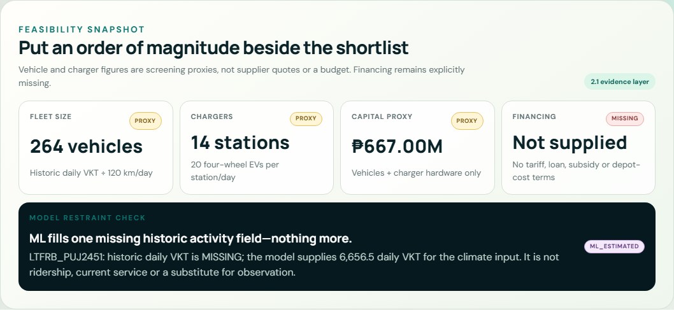
GitHub: https://github.com/qjmre23/Route2Zero
Live: https://route2zero.netlify.app/
FEASIBILITY + COST / FLEET SNAPSHOT
Put an order of magnitude beside the shortlist — without calling it a budget.
1,943
102
vehicles
chargers
₱4.91B
MISSING
vehicle + charger proxy
financing terms
PROXY assumptions
120 km/vehicle-day · ₱2.5M/vehicle · 20 vehicles/charger-day · ₱0.5M/charger
Excluded: land/depot, civil works, grid upgrades, interconnection, battery replacement, taxes, insurance, financing, and O&M. Confirm fleet, duty cycle, tariff, depot, and financing before any decision.
r2z-a7181752a17d · scn-e0f12f397e · prt-fd6de9d793
14
Notes:
These figures are an order-of-magnitude validation scenario, not a supplier quote, procurement estimate, or budget.
[Sources]
data/processed/feasibility_cost_scenarios.json
config/feasibility_cost_config.json

Slide 15
GitHub: https://github.com/qjmre23/Route2Zero
Live: https://route2zero.netlify.app/
HUMAN-CONTROLLED POLICY MODEL
The policy trade-offs stay visible.
Climate
40%
DEFAULT SCENARIO
Climate + Equity
Equity
30%
scn-e0f12f397e
Charging
15%
Named alternatives
Equity-first: 25 / 50 / 15 / 10
Infrastructure-first: 25 / 20 / 35 / 20
Operator
15%
Weights are normalized to 100%. They are a city choice — never presented as objectively correct.
r2z-a7181752a17d · scn-e0f12f397e · prt-fd6de9d793
15
Notes:
The scenario ID is stable and travels into assistant responses and exports.
[Sources]
config/policy_model.json

Slide 16
GitHub: https://github.com/qjmre23/Route2Zero
Live: https://route2zero.netlify.app/
UNCERTAINTY + RANK STABILITY
A recommendation is stronger when it survives changing assumptions.
5,000
fixed-seed policy-weight simulations
Francisco Homes–Cubao
100% top-10
rank 1
ROBUST PRIORITY
P10 1 · P90 1
Binangonan–JRC via Angono
40.7% top-10
rank 11
SCENARIO-DEPENDENT
P10 9 · P90 24
Rank stability measures resilience to tested policy weights — not model accuracy.
r2z-a7181752a17d · scn-e0f12f397e · prt-fd6de9d793
16
Notes:
Contrast a robust route with a scenario-dependent route. The fixed seed makes the test reproducible.
[Sources]
data/processed/sensitivity.csv
config/sensitivity_config.json

Slide 17
GitHub: https://github.com/qjmre23/Route2Zero
Live: https://route2zero.netlify.app/
VALUE OF INFORMATION
Route2Zero tells the city which missing evidence is worth collecting first.
Climate assumptions
rank swing up to 1,395
Portfolio flip possible
Equity population exposure
rank swing up to 7
Validate area evidence
Charging readiness
rank swing up to 3
Request utility/site evidence
Operator readiness
rank swing up to 3
Interview operator/cooperative
Next action: calibrate vehicle efficiency, electrification share, and grid assumptions before treating the flagship climate case as decision-ready.
r2z-a7181752a17d · scn-e0f12f397e · prt-fd6de9d793
17
Notes:
The values are deterministic field perturbations, not LLM estimates.
[Sources]
data/processed/validation_priorities.json

Slide 18
GitHub: https://github.com/qjmre23/Route2Zero
Live: https://route2zero.netlify.app/
CONSTRAINED PHASE-1 PORTFOLIO
Cities pilot programs, not leaderboards.
SIMPLE TOP 8
CONSTRAINED 8
PUJ1352 removed
PUJ1638 added
PUJ1240 removed
→
PUJ1153 added
PUJ2084 removed
PUJ1350 added
PUJ1157 removed
PUJ1405 added
MAX 8
MAX 2 / CITY
MAX 1 DIRECTION / CORRIDOR
EQUITY ≥ 40
EVIDENCE ≥ C
BASE CASE
+2,711 tCO₂e/year
Bounded low–high: −8,191 to +22,288 · avg equity 73.9 · all 8 grade C
r2z-a7181752a17d · scn-e0f12f397e · prt-fd6de9d793
18
Notes:
The constrained portfolio changes four of the simple top-eight routes because it enforces corridor and city diversity constraints.
[Sources]
data/processed/portfolio_scenarios.json

Slide 19
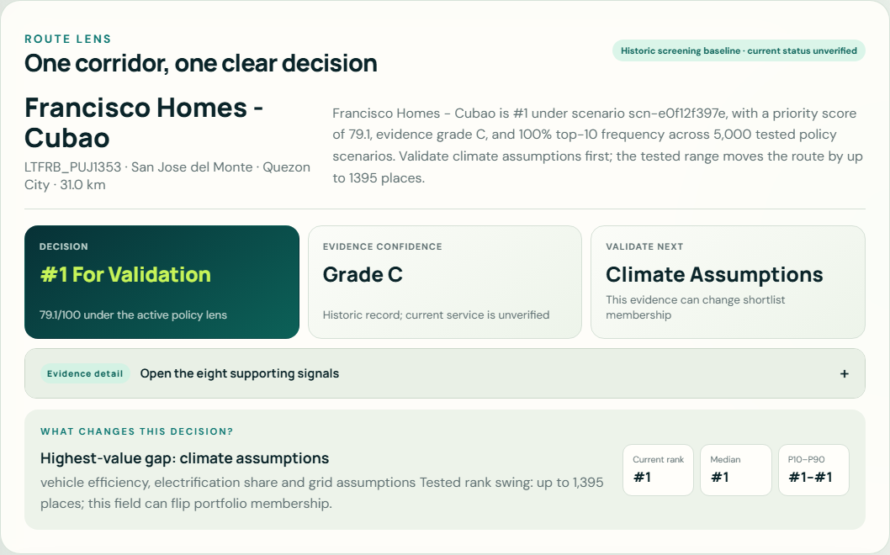
GitHub: https://github.com/qjmre23/Route2Zero
Live: https://route2zero.netlify.app/
FLAGSHIP · FRANCISCO HOMES–CUBAO
One corridor, from raw evidence to pilot decision.
RANK / PRIORITY
1 / 79.07
EVIDENCE
C · 38.34
STABILITY
100% top-10
CLIMATE BASE
+368 tCO₂e/y
RANGE
−1,112 to +3,025
CURRENT STATUS
historic-only
GEOMETRY
DERIVED approximation
PORTFOLIO
Selected
Proceed to pilot validation — not procurement.
r2z-a7181752a17d · scn-e0f12f397e · prt-fd6de9d793
19
Notes:
The flagship is selected by a documented rule. It is deliberately not mislabeled as currently operating or geometrically verified.
[Sources]
data/processed/flagship_route.json

Slide 20
GitHub: https://github.com/qjmre23/Route2Zero
Live: https://route2zero.netlify.app/
PILOT · IMPACT · DIFFERENTIATION · SCALE
Six months to turn a defensible shortlist into city-owned evidence.
M1
M2
M3
M4
M5
M6
baseline
ground truth
model + route
grid + operator
co-design
handover
EXPECTED IMPACT
WHY ROUTE2ZERO
HOW IT SCALES
8 corridors enter deeper validation
Base +2,711 tCO₂e/year scenario
Evidence improvement is measured
Not one black-box score
Field-level status + uncertainty
Humans control policy
Metro Manila is the deep pilot
Local source adapters
Every city recalibrates
Team Larpers
John Marwin Ebona · Isaac Marcus · Andrei Dela Cruz · Russel Mendez
Joaquin Sarmiento · Prince Marl Mirasol · Carl Nueva · JOSEPH CLARENCE PARAYAOAN
MIT-licensed code · data licenses remain source-specific · OpenStreetMap © contributors, ODbL
r2z-a7181752a17d · scn-e0f12f397e · prt-fd6de9d793
20
Notes:
Close by asking for a six-month validation partnership, not trust in one score.
[Sources]
https://github.com/qjmre23/Route2Zero
https://route2zero.netlify.app/
LICENSE
NOTICE.md

