Slide 1











Grooving
Team Members
Qianjin Wu
Ridhima Sawhney
Neha Panchal

Slide 2


Contents
Problem Statement
Requirements
Technologies
Features
Future Scope

Slide 3







Problem Statement
To manage the infrastructure of microservice application with Kubernetes on AWS and Azure
We have worked on a music website – “Grooving” where the user can play the song from this site

Slide 4





Requirements
User selects a song
User can view/collapse lyrics for the chosen song
User can play song video
User can navigate to spotify,NetEase Cloud Music
User can navigate to YouTube

Slide 5



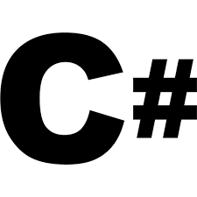
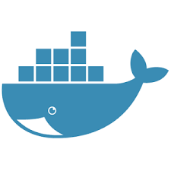
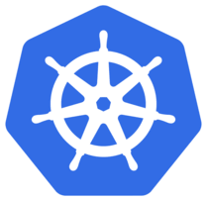

Technologies
IDE: Visual Studio Code,Visual Stuido community 2019
Softwares: Docker, Kubernetes
Cloud: Azure, AWS
Programming Language: C#
Framework: ASP.Net Core

Slide 6

How we Implemented?
Created the server-side (webapi) and client-side website using asp.net core
Setting up the infrastructure on Azure and AWS using terraform
Made docker image and pushed it to docker
Deployed pods from docker image(webapi)
on k8s/Azure
Deployed pods from docker image(webclient)on k8s/aws
Webclient gets the data from webapi so that the pods can communicate with each other from separate clouds
Implementation of Autoscaling

Slide 7
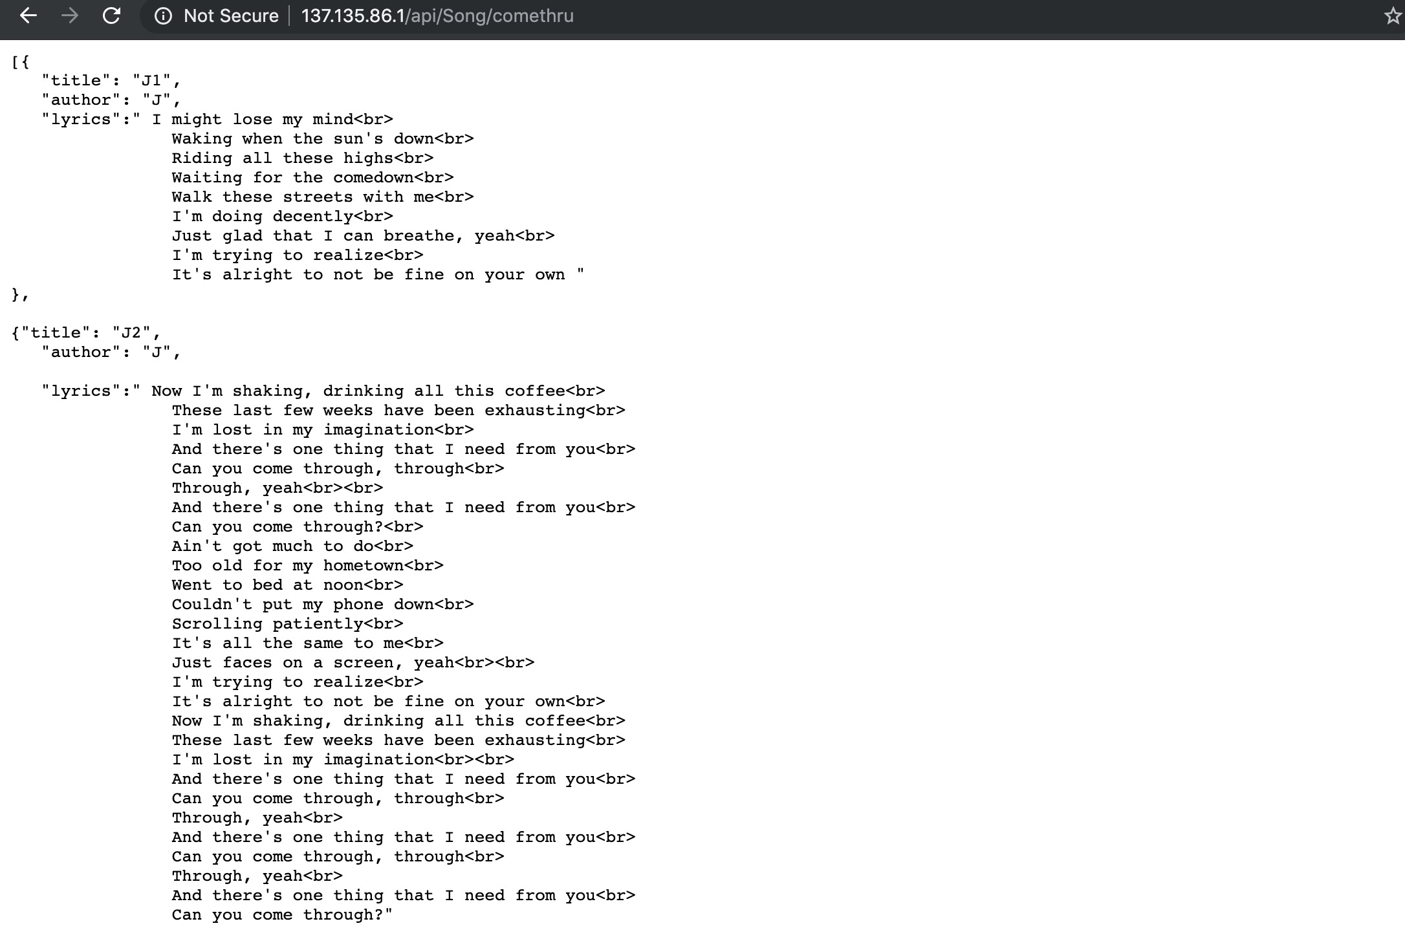
webapi endpoint demo

Slide 8
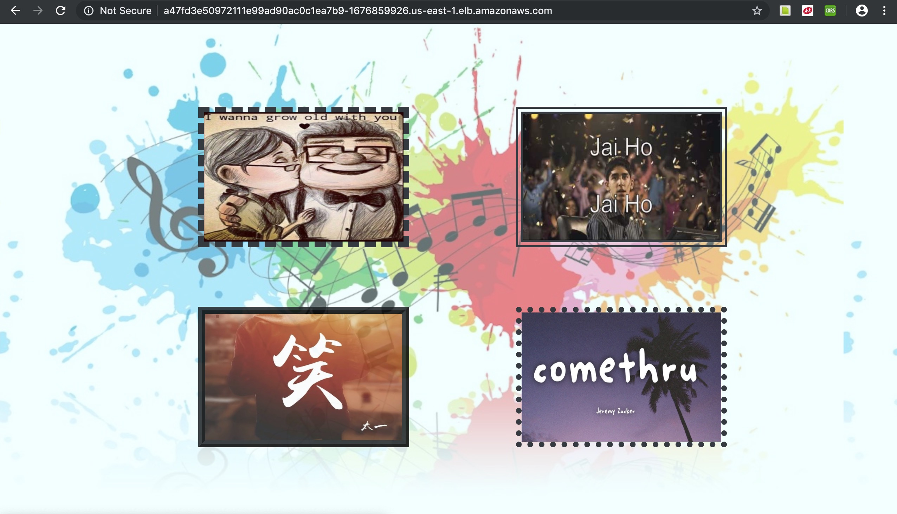
Features

Slide 9
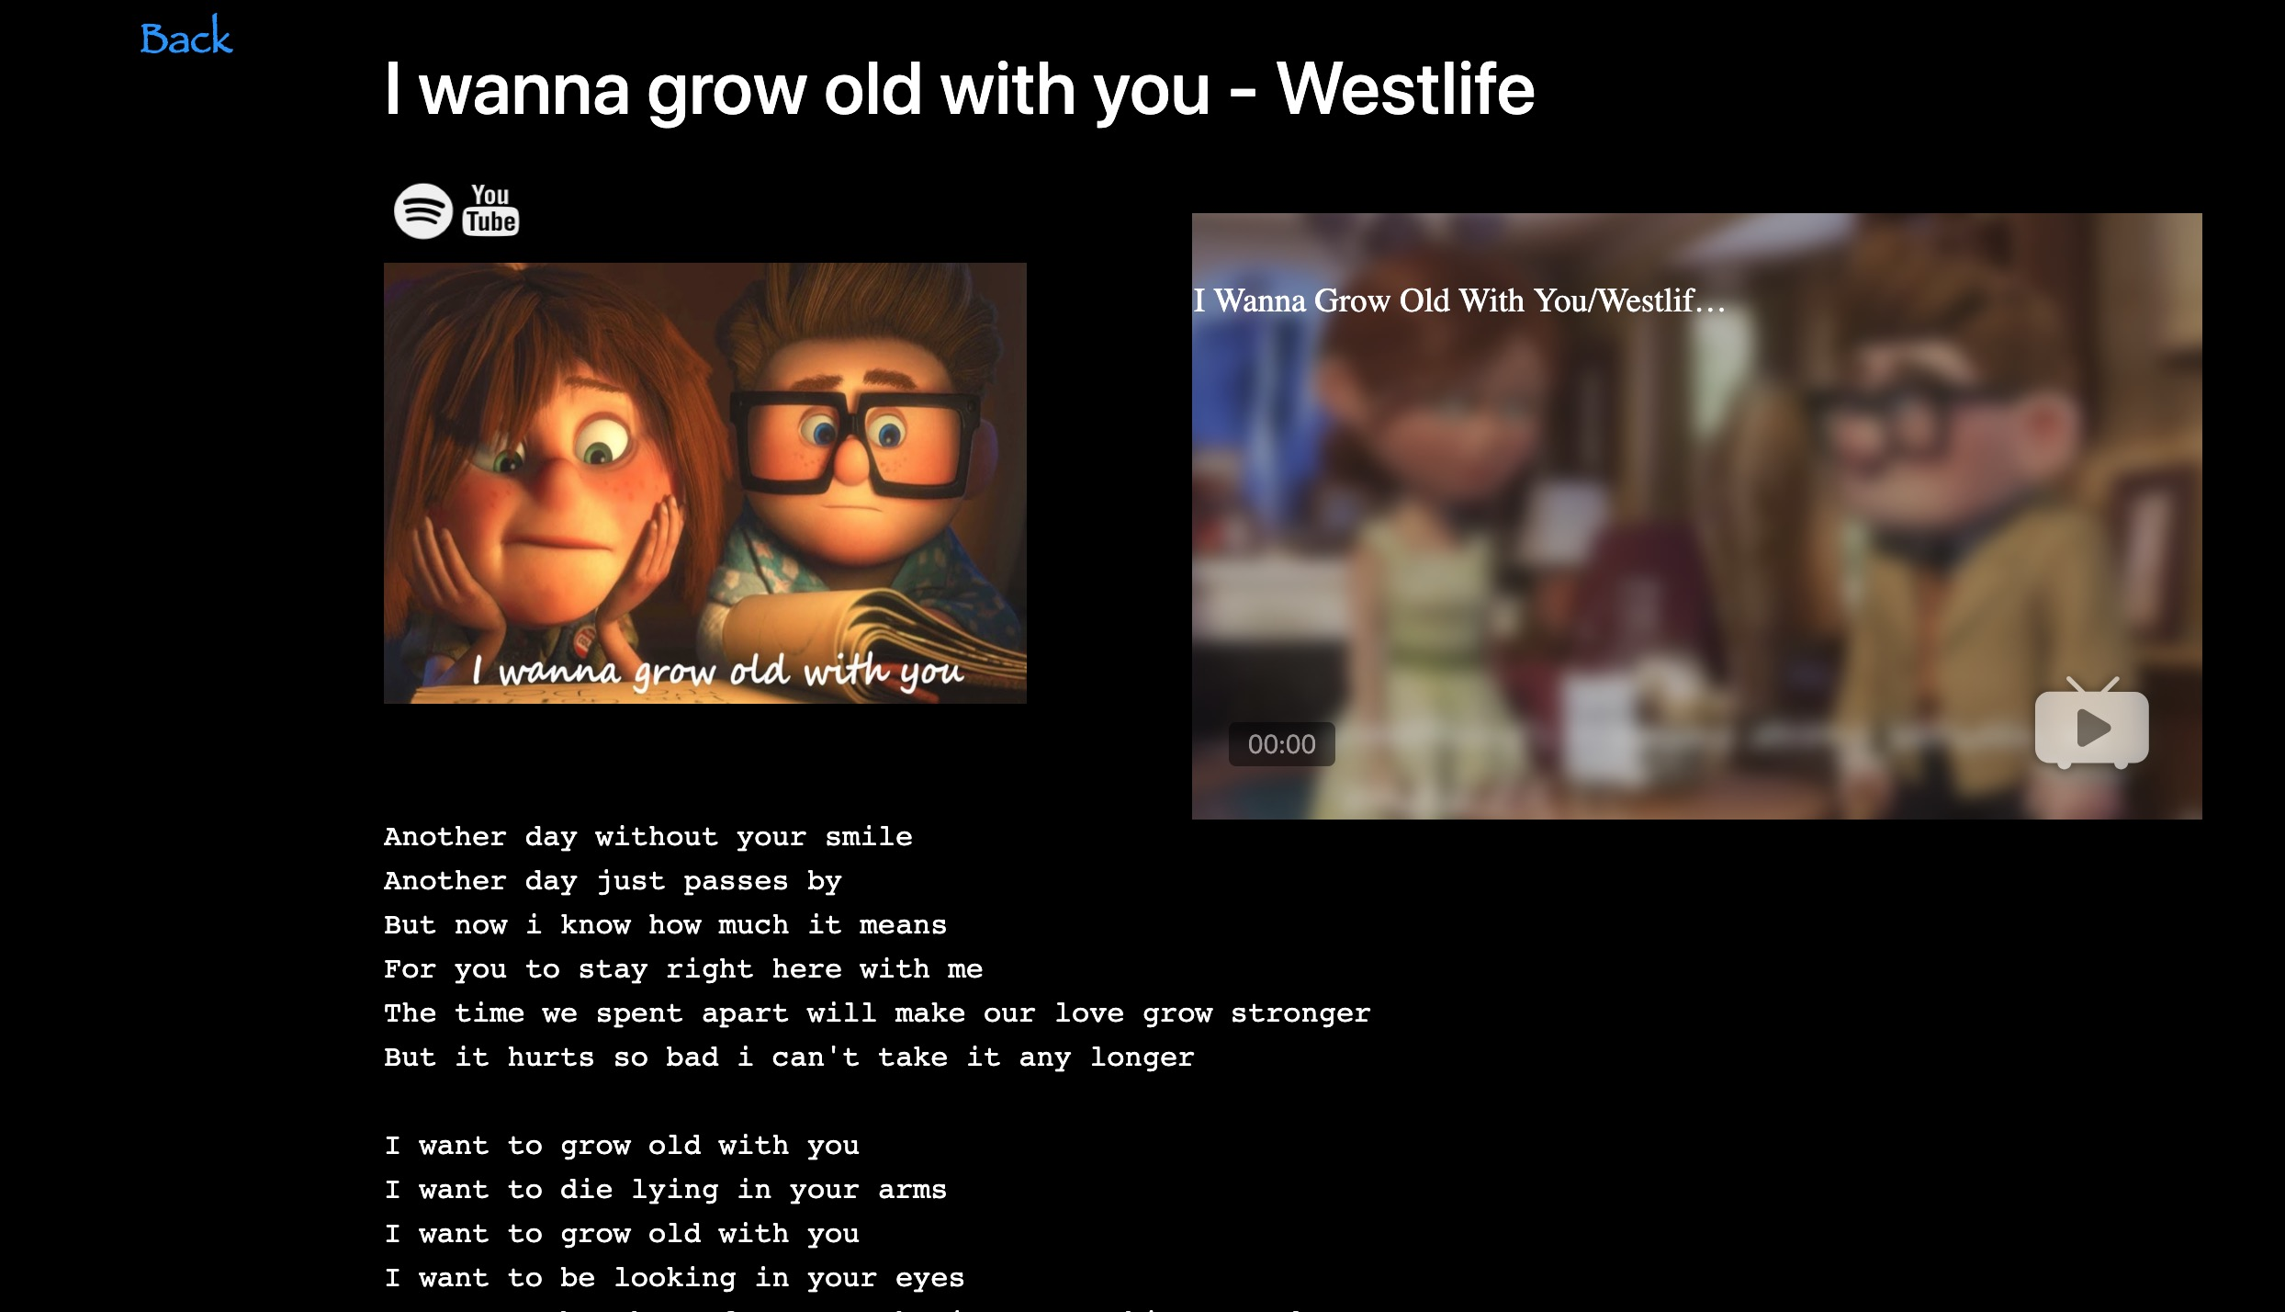
Song page

Slide 10
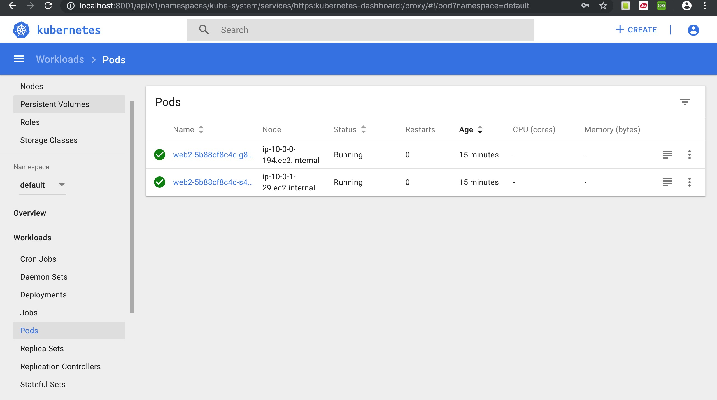
EKS Running Pods

Slide 11
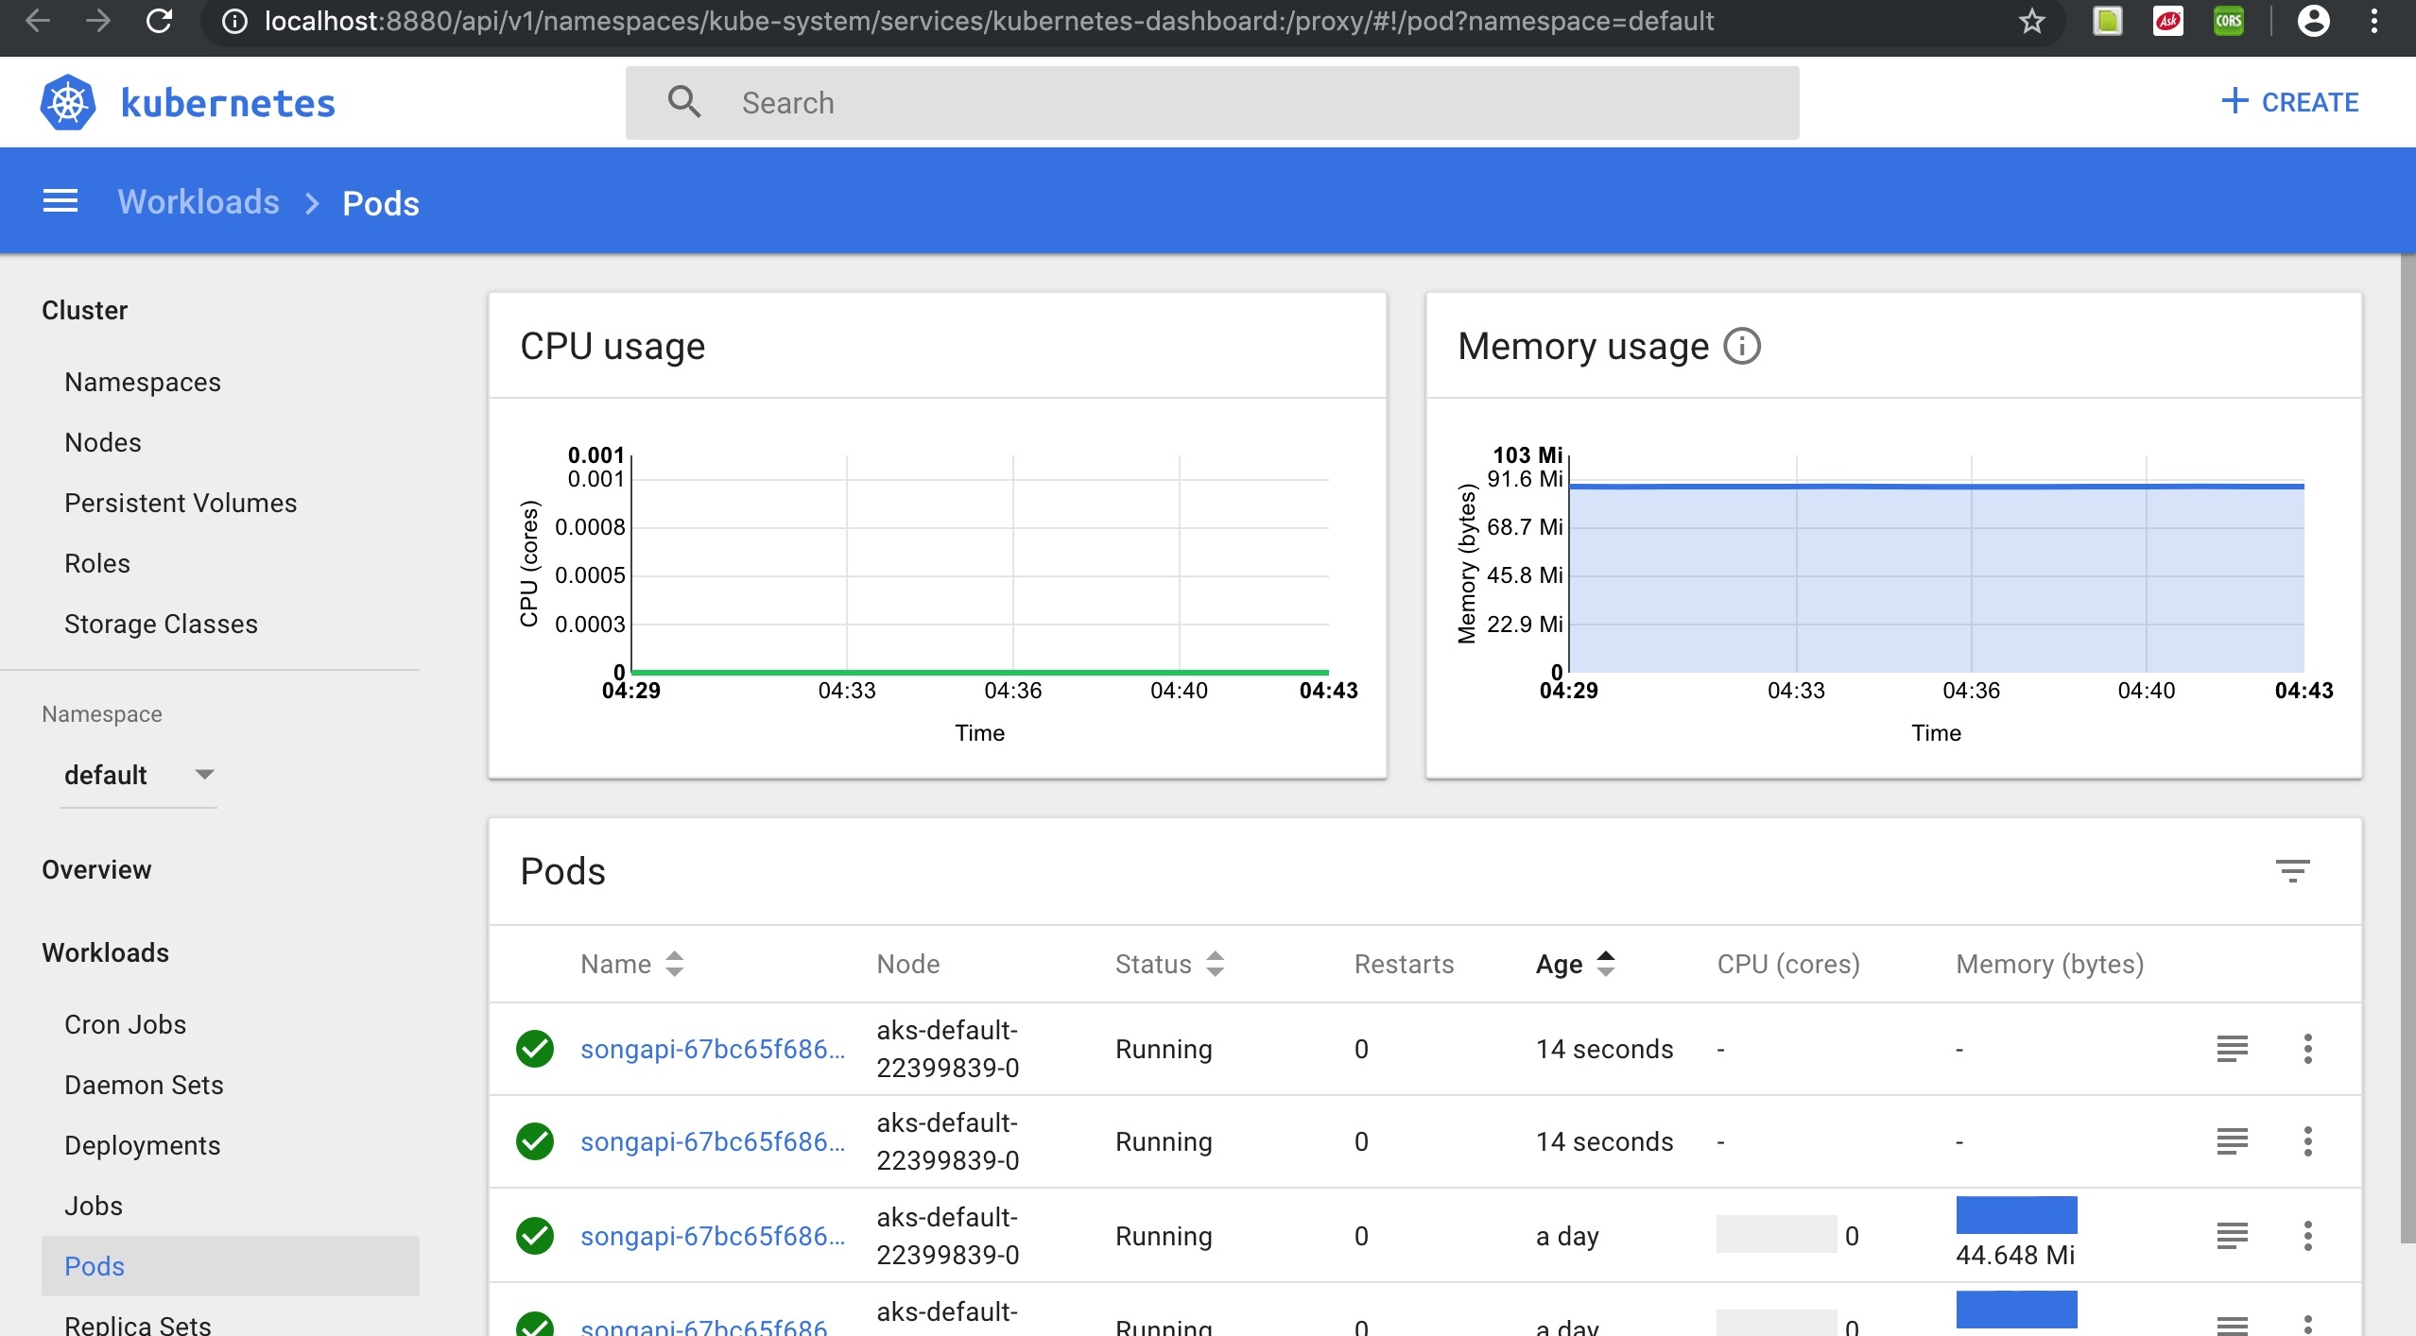
AKS Running Pods

Slide 12
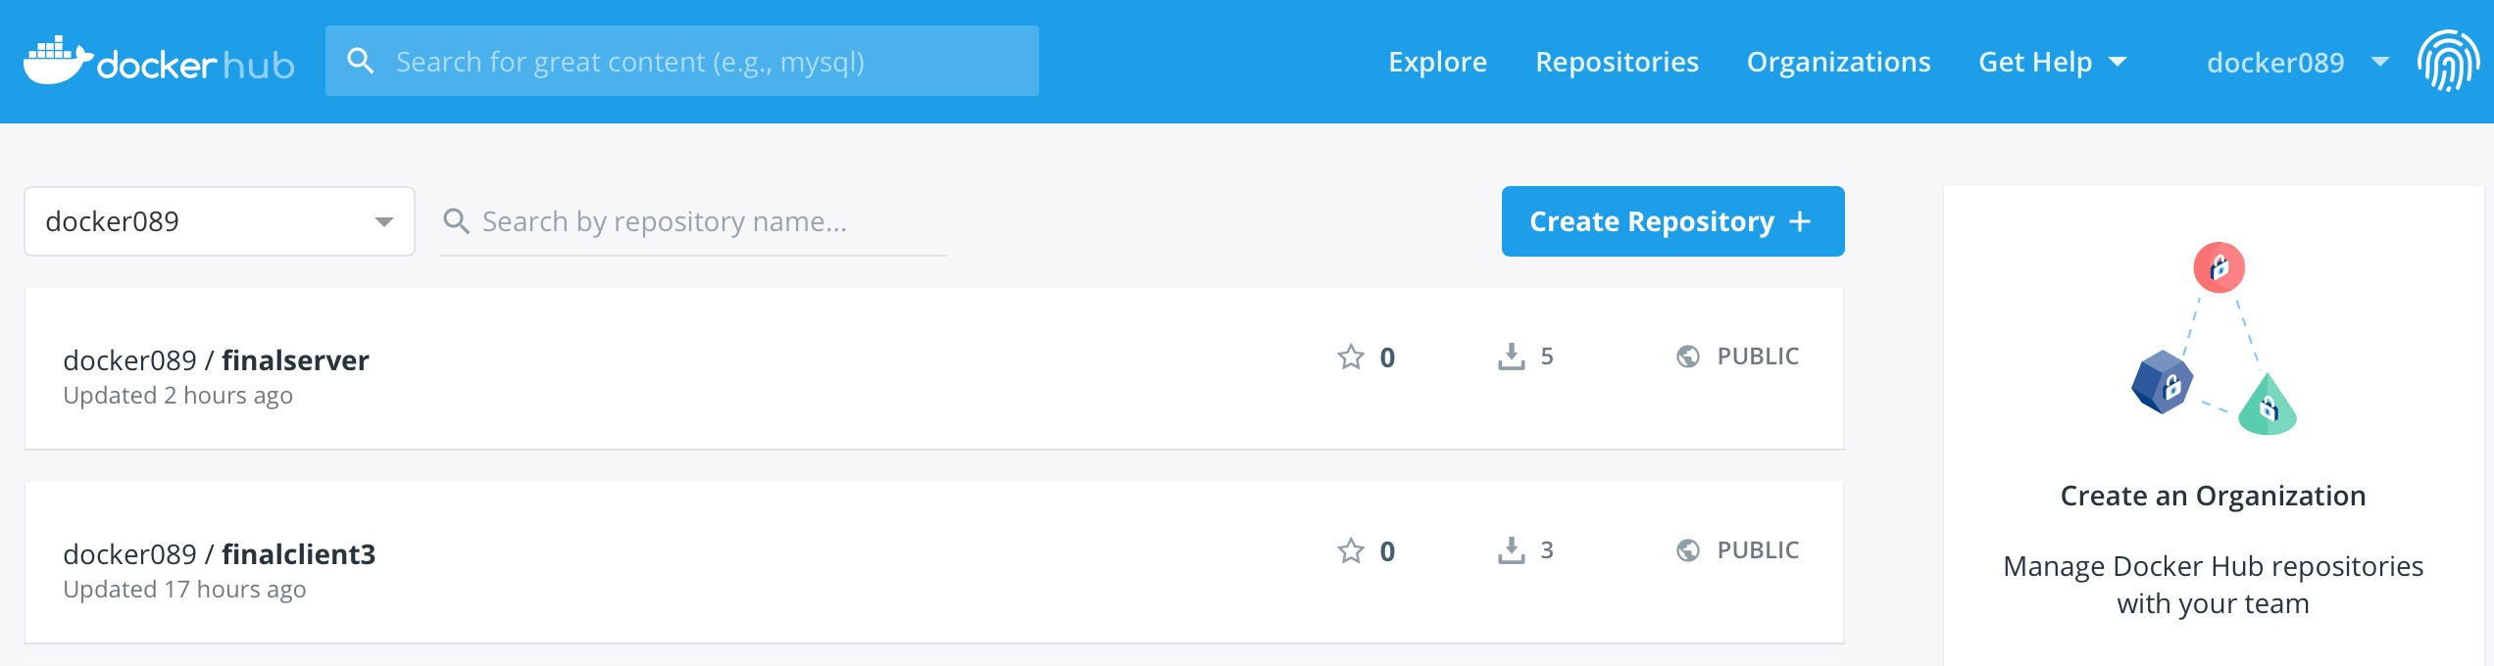
Docker images

Slide 13
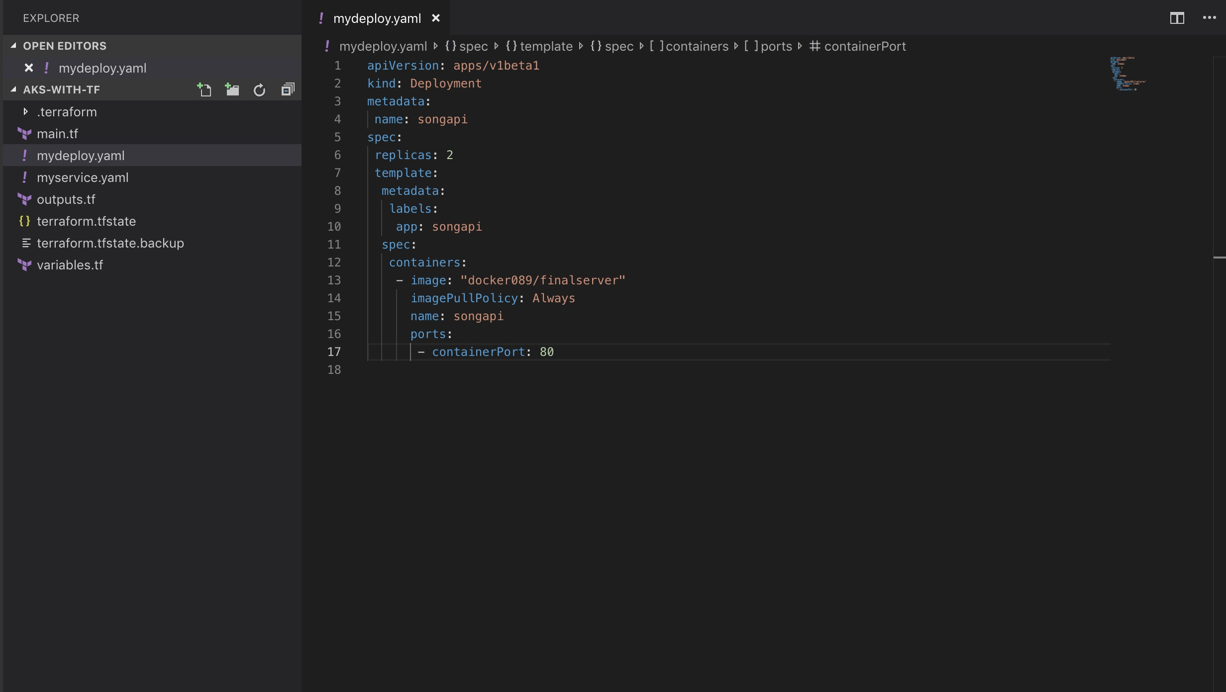
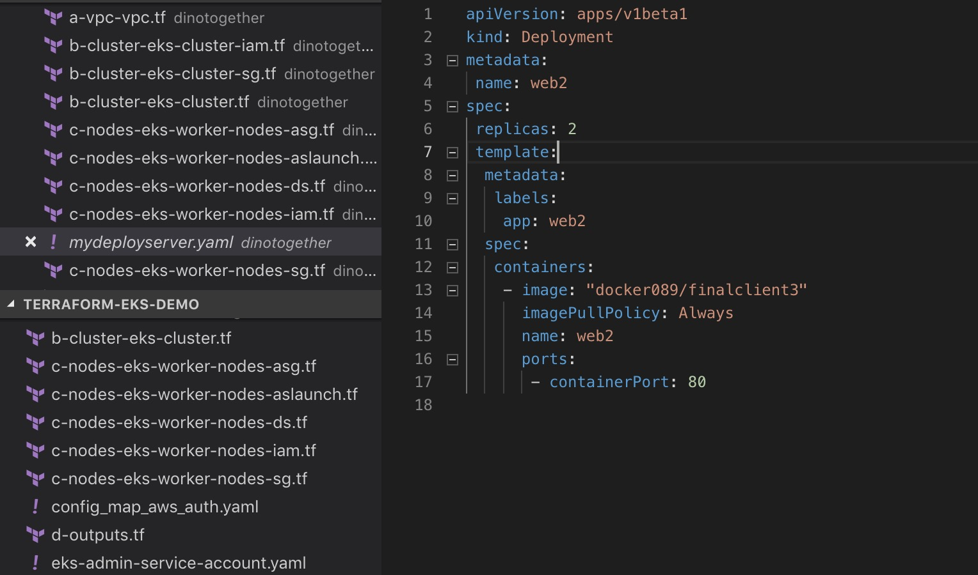
Pods Deployment

Slide 14
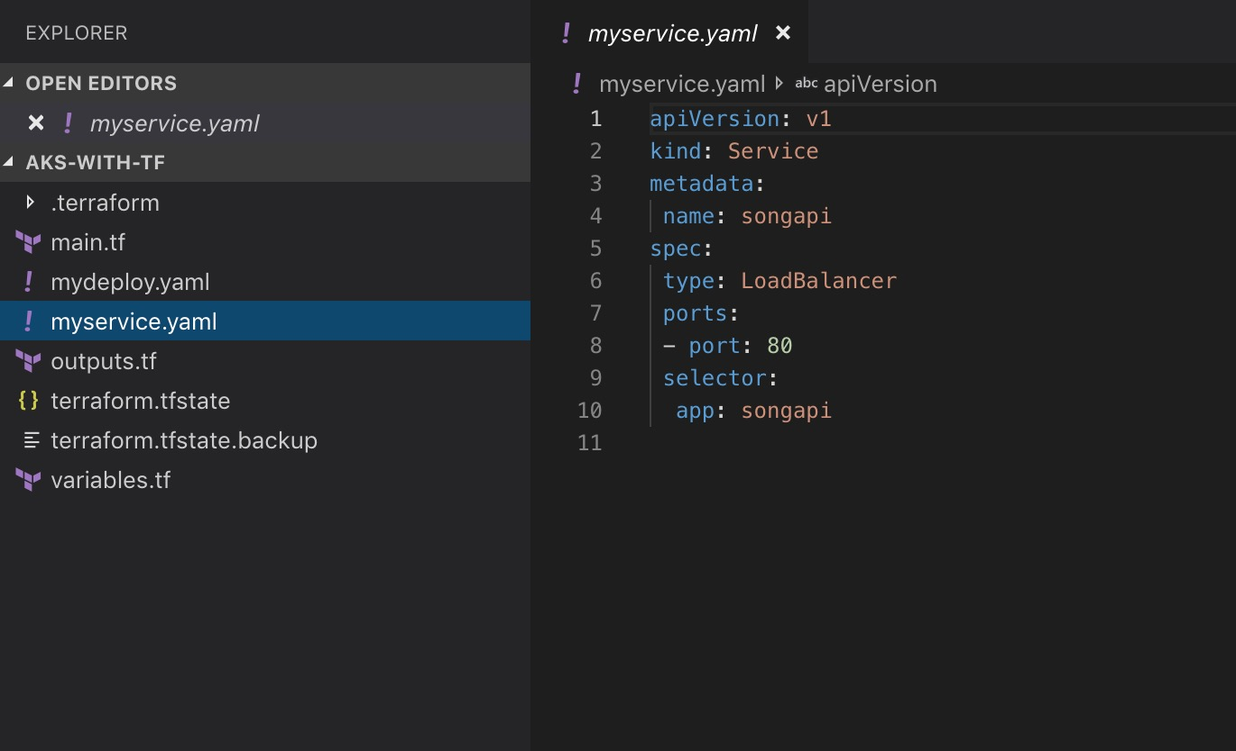
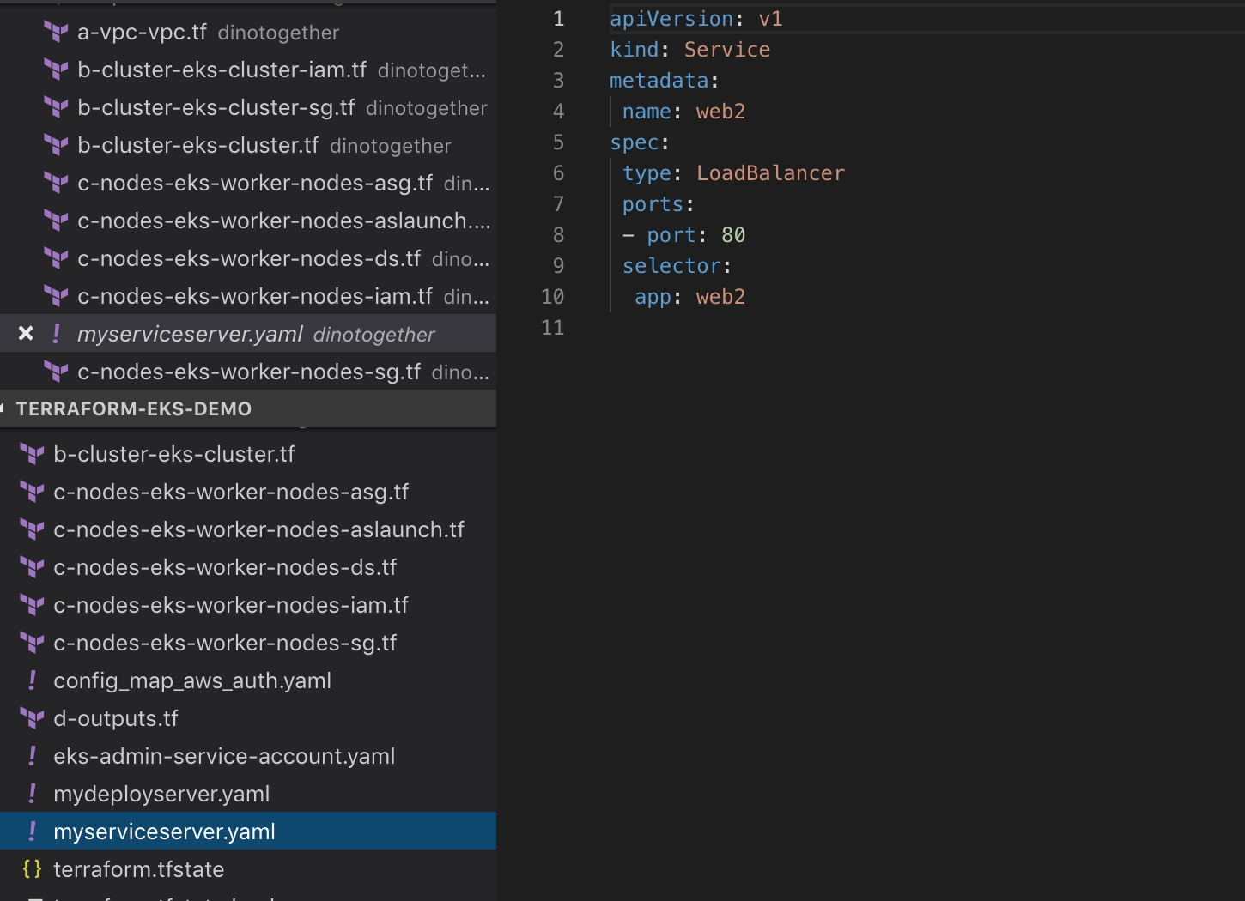
Services

Slide 15

Future Scope
Convert the website from static to dynamic
Scope of Website can be increased by adding more microservices
-Purchase songs
-Subscribe to songs

Slide 16


THANKYOU!
Special Thanks to ~
Professor - Dino Konstantopoulos
TA’s - Yibei Guo | Meven Edwin DCunha

