Slide 1

明日安寧
安寧緩和醫療最適化分析
—以台大醫院為例

Slide 2



想成為更好的一個人
家中長輩最近昏倒住院
很想改進點什麼，
讓他們能即使在病痛中也擁有尊嚴。
OUR
MOTIVATION
真的想插管度過人生最後一程嗎？

Slide 3
Outline
Introduction of Hospice Palliative care
Problem Definition & Goals
Research Source
Analytical Method & Flow
Phased Achievement & Difficulties
Future Goal

Slide 4


Introduction of Hospice Palliative Care(HPC)
Problem & Goals
Data Source
Future Goal
Introduction
Analytical
Method & Flow
Phased Achievements
& Difficulties
HPC: mitigatory and supportive medical care
Relieve terminal illness patients from physical , mental and spiritual pain
To improve their quality of life.
安寧病房
末期病患
安寧團隊
專門之硬體環境與＆全面之照護
安寧共照
原醫療團隊
+
安寧團隊
原本病房＆安寧團隊定期探訪

Slide 5
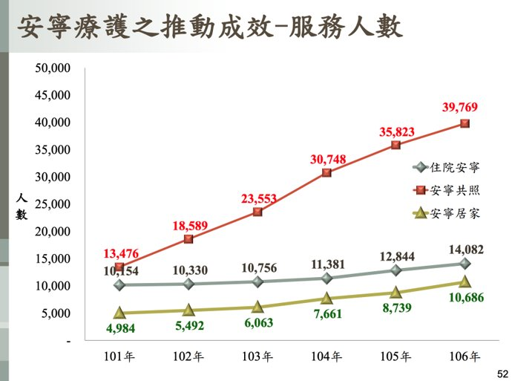
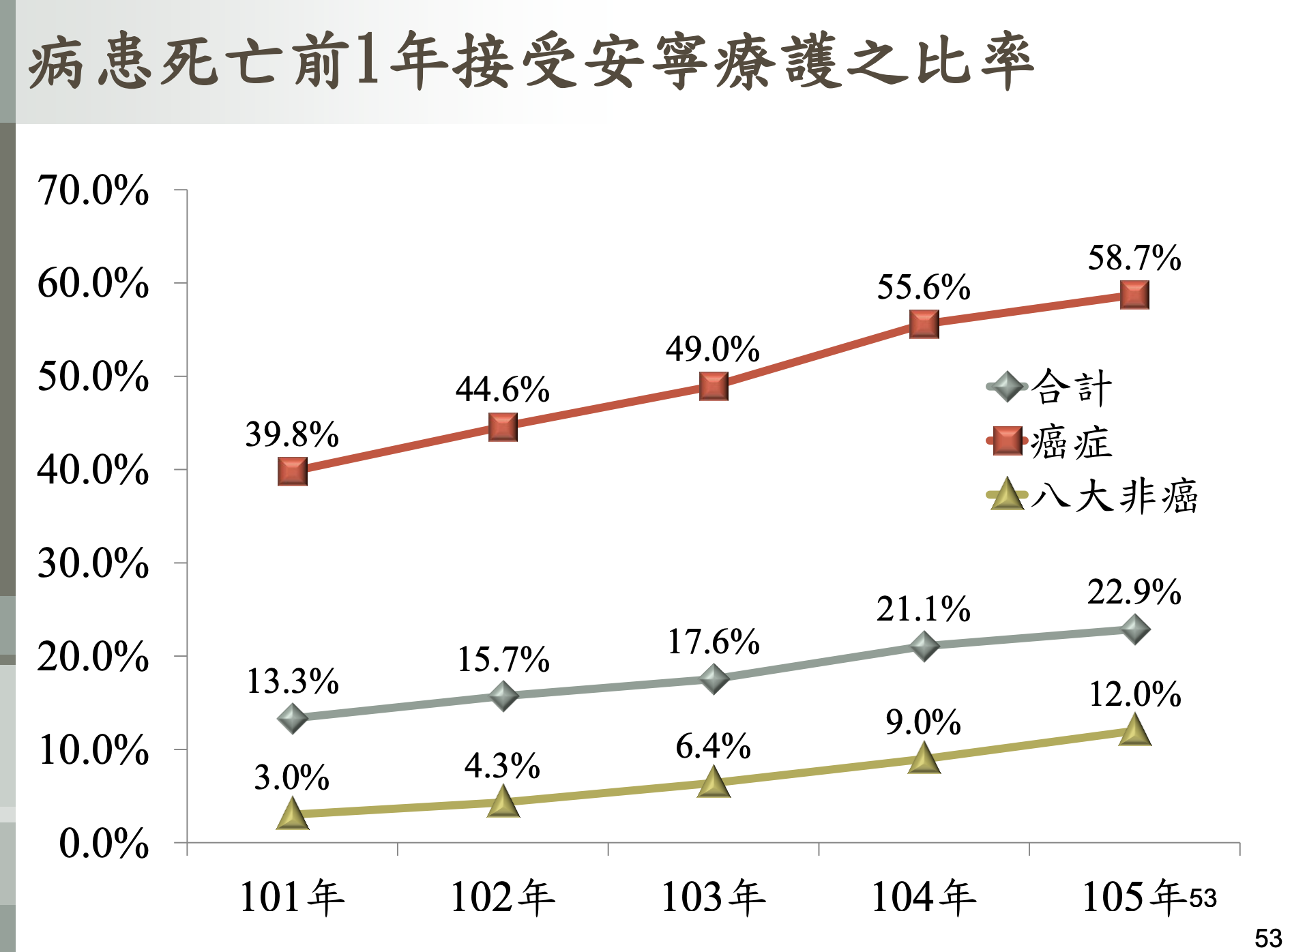
1. 安寧共照是主流--> 好嗎？ 2. 八大非癌接受安寧之成長較緩
Source: 中央健康保險署 106年各總額部門執行報告

Slide 6
Problem Definition & Goals
Introduction
Problem & Goals
Data Source
Future Goal
Analytical
Method & Flow
Phased Achievements
& Difficulties
Problem:
→ 整體安寧流程再前端及後端人員及資源配置並無結構化的模式
Goal1: Clinical decision support
→Assist inidentification of possible end-of-life care patients
Goal 2: Predict possible hospive patients

Slide 7
Conclusion 檢視現行醫護成效與醫療資源配置
Improve
the quality of
Hospice care
Reduce
Patient
Suffering

Slide 8
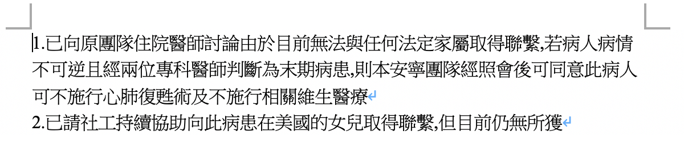
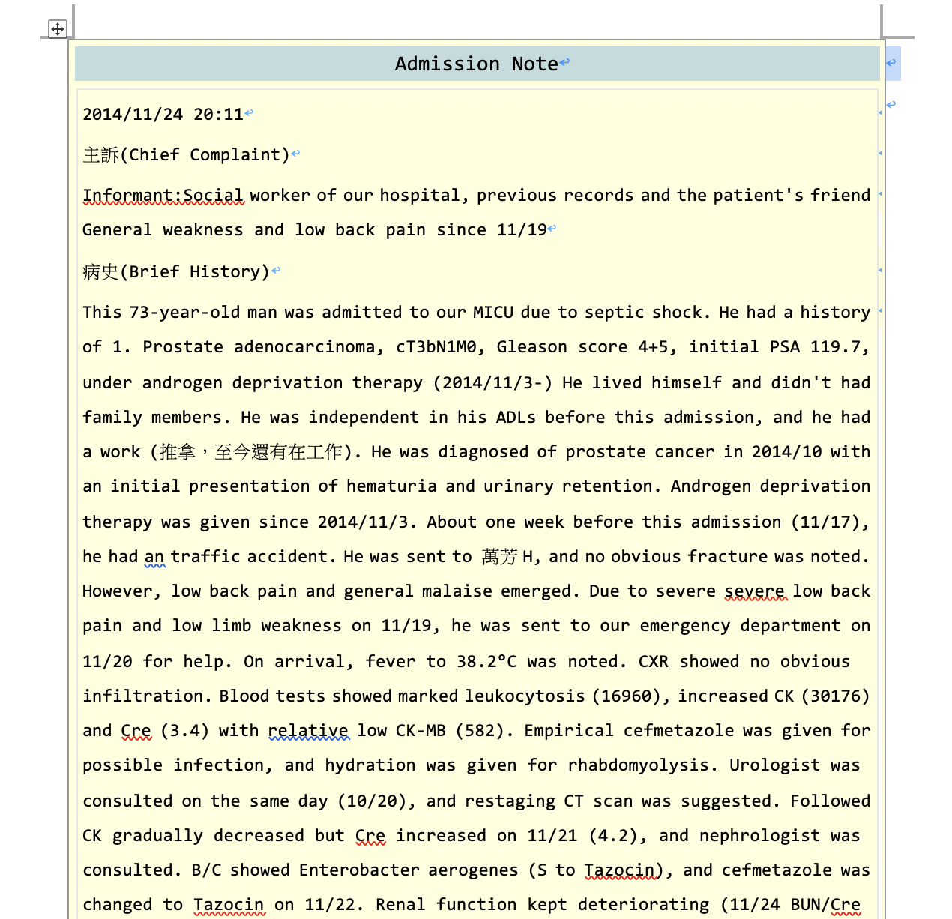
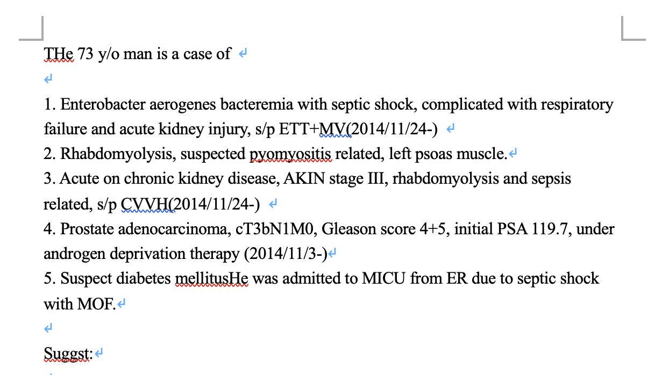
Introduction
Problem & Goals
Data Source
Analytical
Method & Flow
Phased Achievements
& Difficulties
Future Goal
Unsctructured, Bilingual Data
VS notes
Admission notes
Social Worker notes
Hospice Combined team notes

Slide 9

Introduction
Problem & Goals
Data Source
Analytical
Method & Flow
Phased Achievements
& Difficulties
Future Goal
Statitically analyzing
Correlation between different info’s
Cluster
“Kmeans” clustering
Predict possible end-of-life patients
Reduce patient suffering
Improve the quality of Hospice care
Preprocessing
Visualization
NTU
Hospital
Cleansing
Sentence splitting
Tokenization
Classification
Define medical index
Discretization of continuous data
WordCloud
By groups
Cluster
Drug
Treatment
Analyzing
Conclusion

Slide 10

Analytical methds -Preprocessing
依病人編號做整合歸檔
檔案整理
1-all.txt
2-all.txt
3-all.txt
定義數值標準
4-all.txt
5-all.txt
6-all.txt
存活天數依10天分組
c1 = 活了0-10天者
c11 = 活了11-20天者…
依字詞分類醫學標籤
Jieba切詞
live0110.txt
live1120.txt
live30.txt

Slide 11
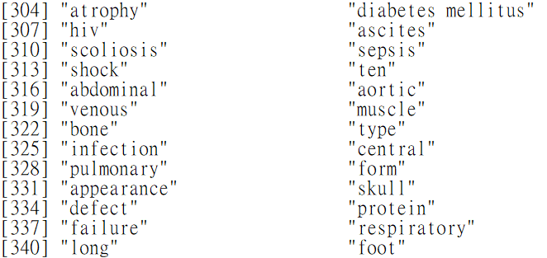
Analytical methds -Preprocessing
建立不同類群keyword 字典
檔案整理
treatments.csv
symptoms.csv
drug.csv
定義數值標準
disease.csv
disease-expand.csv
dfall.csv
依字詞分類醫學標籤
JiebaR, strsplit切詞

Slide 12
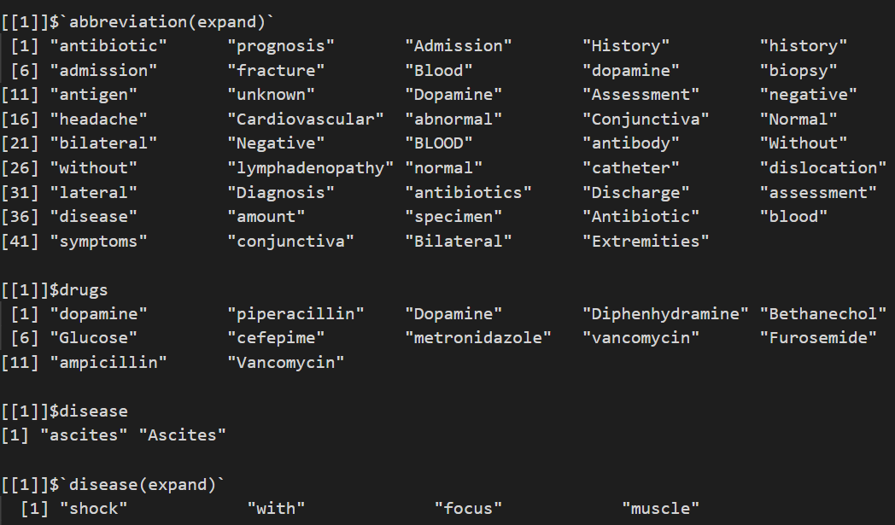
Analytical methds -Preprocessing
依照所建立之字典進行切詞
Ex.病人1
檔案整理
定義數值標準
依字詞分類醫學標籤
Jieba,strsplit切詞

Slide 13
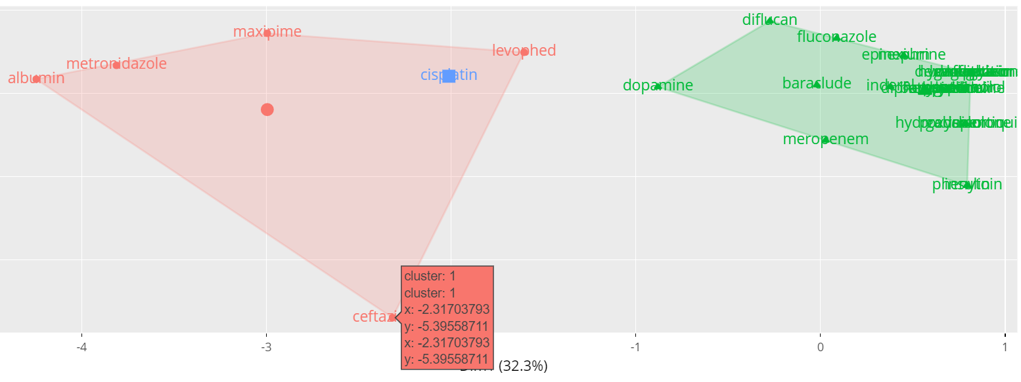
Analytical methds -Analysis
依存活天數分類Kmeans 分群
Wordcloud
Cluster
Visualization
解釋關聯性

Slide 14
Analytical methds -Analysis
Wordcloud
DRUGS
Cluster
DISEASE
PATIENTS
SYMPTOMS
Visualization
解釋關聯性

Slide 15
Introduction
Problem & Goals
Data Source
Analytical
Method & Flow
Phased Achievements
& Difficulties
Future Goal
加入分析進入安寧及非進入患者之同類疾病資訊，能夠更有效辨識出未來會進入安寧風險。.
樣本數不足
缺乏關鍵資訊
、回測指標
明確的入院、提及時間點、進入安寧治療、家屬陪伴狀況、病人家屬滿意度調查…
不同領域專業人員加入
專業知識加強

Slide 16
Introduction
Problem & Goals
Data Source
Analytical
Method & Flow
Phased Achievements
& Difficulties
Future Goal
分析病患入安寧之可能性
改善服務流程及品質
協助醫師分析及治療病患

