Slide 2

Product line 추가 가능

Slide 3

In and out 기능

Slide 4
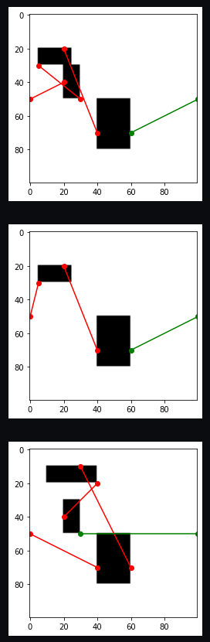

시각화

Slide 5


거리 계산

Slide 6
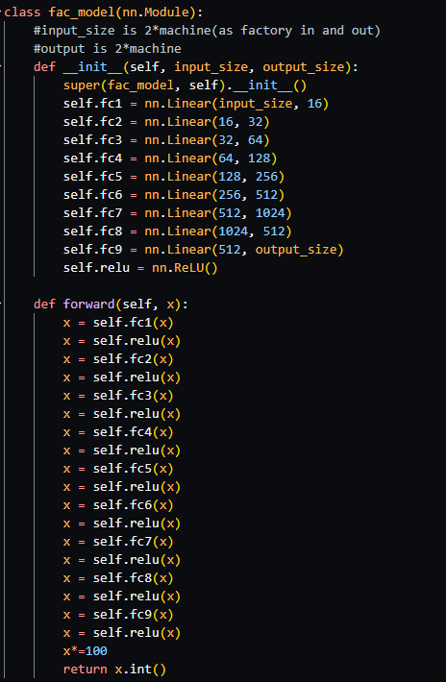
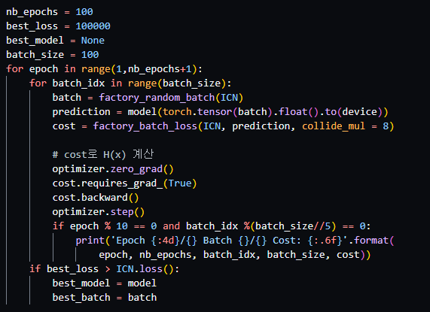
case1
Epoch 10/100 Batch 0/100 Cost: 5451.048551
Epoch 10/100 Batch 20/100 Cost: 5367.516536
Epoch 10/100 Batch 40/100 Cost: 5451.048551
Epoch 10/100 Batch 60/100 Cost: 5453.227149
Epoch 10/100 Batch 80/100 Cost: 5453.227149
Epoch 20/100 Batch 0/100 Cost: 5453.227149
Epoch 20/100 Batch 20/100 Cost: 5453.227149
Epoch 20/100 Batch 40/100 Cost: 5455.447099
Epoch 20/100 Batch 60/100 Cost: 5455.447099
Epoch 20/100 Batch 80/100 Cost: 5455.447099
Epoch 30/100 Batch 0/100 Cost: 5451.048551
Epoch 30/100 Batch 20/100 Cost: 5453.227149
Epoch 30/100 Batch 40/100 Cost: 5455.447099
Epoch 30/100 Batch 60/100 Cost: 5302.741826
Epoch 30/100 Batch 80/100 Cost: 5451.048551
Epoch 40/100 Batch 0/100 Cost: 5295.956133
Epoch 40/100 Batch 20/100 Cost: 5455.447099
Epoch 40/100 Batch 40/100 Cost: 5300.437852
Epoch 40/100 Batch 60/100 Cost: 5451.048551
Epoch 40/100 Batch 80/100 Cost: 5455.447099
Epoch 50/100 Batch 0/100 Cost: 5455.447099
Epoch 50/100 Batch 20/100 Cost: 5451.048551
Epoch 50/100 Batch 40/100 Cost: 5455.447099
Epoch 50/100 Batch 60/100 Cost: 5455.447099
Epoch 50/100 Batch 80/100 Cost: 5453.227149
Epoch 60/100 Batch 0/100 Cost: 5369.688755
Epoch 60/100 Batch 20/100 Cost: 5460.012842
Epoch 60/100 Batch 40/100 Cost: 5300.437852
Epoch 60/100 Batch 60/100 Cost: 5453.227149
Epoch 60/100 Batch 80/100 Cost: 5451.048551
Epoch 70/100 Batch 0/100 Cost: 5451.048551
Epoch 70/100 Batch 20/100 Cost: 5457.708868
Epoch 70/100 Batch 40/100 Cost: 5451.048551
Epoch 70/100 Batch 60/100 Cost: 5457.708868
Epoch 70/100 Batch 80/100 Cost: 5448.910764
Epoch 80/100 Batch 0/100 Cost: 5300.437852
Epoch 80/100 Batch 20/100 Cost: 5460.012842
Epoch 80/100 Batch 40/100 Cost: 5457.708868
Epoch 80/100 Batch 60/100 Cost: 5460.012842
Epoch 80/100 Batch 80/100 Cost: 5300.437852
Epoch 90/100 Batch 0/100 Cost: 5457.708868
Epoch 90/100 Batch 20/100 Cost: 5300.437852
Epoch 90/100 Batch 40/100 Cost: 5455.447099
Epoch 90/100 Batch 60/100 Cost: 5298.176083
Epoch 90/100 Batch 80/100 Cost: 5455.447099
Epoch 100/100 Batch 0/100 Cost: 5451.048551
Epoch 100/100 Batch 20/100 Cost: 5453.227149
Epoch 100/100 Batch 40/100 Cost: 5298.176083
Epoch 100/100 Batch 60/100 Cost: 5298.176083
Epoch 100/100 Batch 80/100 Cost: 5460.012842

Slide 7
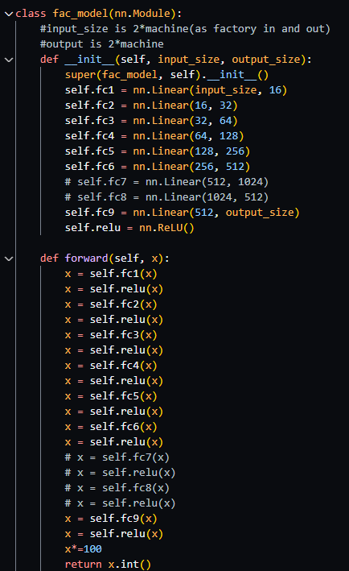
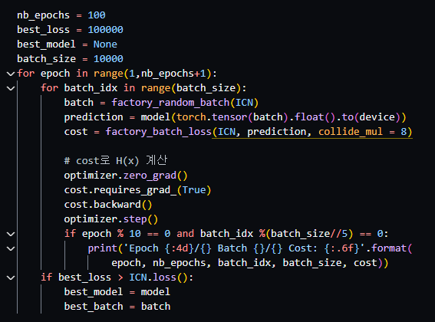
case2
Epoch 10/100 Batch 0/10000 Cost: 5374.618182
Epoch 10/100 Batch 2000/10000 Cost: 4531.396853
Epoch 10/100 Batch 4000/10000 Cost: 4307.550149
Epoch 10/100 Batch 6000/10000 Cost: 4543.114492
Epoch 10/100 Batch 8000/10000 Cost: 3891.381701
Epoch 20/100 Batch 0/10000 Cost: 3903.512688
Epoch 20/100 Batch 2000/10000 Cost: 4835.802248
Epoch 20/100 Batch 4000/10000 Cost: 3878.588832
Epoch 20/100 Batch 6000/10000 Cost: 4621.303462
Epoch 20/100 Batch 8000/10000 Cost: 4618.691449
Epoch 30/100 Batch 0/10000 Cost: 3945.040328
Epoch 30/100 Batch 2000/10000 Cost: 3570.216473
Epoch 30/100 Batch 4000/10000 Cost: 3648.185934
Epoch 30/100 Batch 6000/10000 Cost: 4537.203233
Epoch 30/100 Batch 8000/10000 Cost: 3463.032273
Epoch 40/100 Batch 0/10000 Cost: 3412.212866
Epoch 40/100 Batch 2000/10000 Cost: 5080.439008
Epoch 40/100 Batch 4000/10000 Cost: 3341.935664
Epoch 40/100 Batch 6000/10000 Cost: 4000.104719
Epoch 40/100 Batch 8000/10000 Cost: 4541.647161
Epoch 50/100 Batch 0/10000 Cost: 4297.351005
Epoch 50/100 Batch 2000/10000 Cost: 3731.309608
Epoch 50/100 Batch 4000/10000 Cost: 4309.463679
Epoch 50/100 Batch 6000/10000 Cost: 4768.606897
Epoch 50/100 Batch 8000/10000 Cost: 3587.373743
Epoch 60/100 Batch 0/10000 Cost: 4855.919910
Epoch 60/100 Batch 2000/10000 Cost: 4305.102351
Epoch 60/100 Batch 4000/10000 Cost: 3801.002909
Epoch 60/100 Batch 6000/10000 Cost: 3865.563804
Epoch 60/100 Batch 8000/10000 Cost: 4771.822563
Epoch 70/100 Batch 0/10000 Cost: 3753.332206
Epoch 70/100 Batch 2000/10000 Cost: 5323.450102
Epoch 70/100 Batch 4000/10000 Cost: 5242.050694
Epoch 70/100 Batch 6000/10000 Cost: 3600.358993
Epoch 70/100 Batch 8000/10000 Cost: 4387.674672
Epoch 80/100 Batch 0/10000 Cost: 4765.713582
Epoch 80/100 Batch 2000/10000 Cost: 4709.301012
Epoch 80/100 Batch 4000/10000 Cost: 4310.529181
Epoch 80/100 Batch 6000/10000 Cost: 3775.783503
Epoch 80/100 Batch 8000/10000 Cost: 3696.666997
Epoch 90/100 Batch 0/10000 Cost: 3763.906568
Epoch 90/100 Batch 2000/10000 Cost: 4878.300153
Epoch 90/100 Batch 4000/10000 Cost: 4701.232086
Epoch 90/100 Batch 6000/10000 Cost: 4453.086214
Epoch 90/100 Batch 8000/10000 Cost: 4000.104719
Epoch 100/100 Batch 0/10000 Cost: 3504.557635
Epoch 100/100 Batch 2000/10000 Cost: 4763.450156
Epoch 100/100 Batch 4000/10000 Cost: 4770.868814
Epoch 100/100 Batch 6000/10000 Cost: 3266.212593
Epoch 100/100 Batch 8000/10000 Cost: 3826.493628

Slide 8
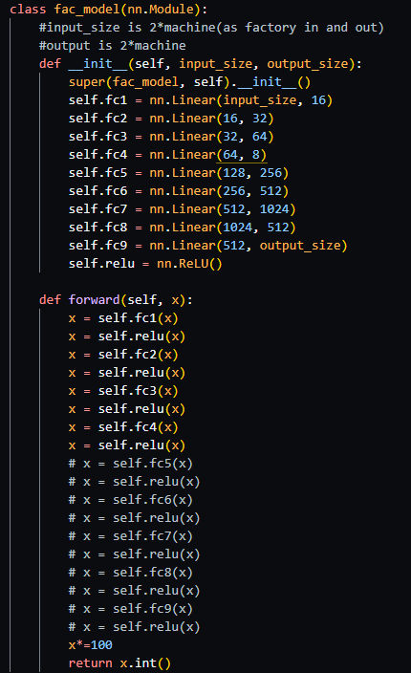
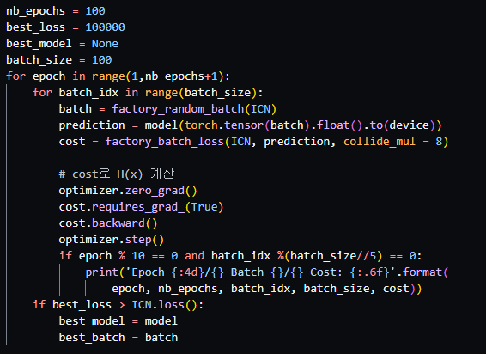
Case 3
Epoch 10/100 Batch 0/100 Cost: 10000.000000
Epoch 10/100 Batch 20/100 Cost: 10000.000000
Epoch 10/100 Batch 40/100 Cost: 10000.000000
Epoch 10/100 Batch 60/100 Cost: 10000.000000
Epoch 10/100 Batch 80/100 Cost: 10000.000000
Epoch 20/100 Batch 0/100 Cost: 10000.000000
Epoch 20/100 Batch 20/100 Cost: 10000.000000
Epoch 20/100 Batch 40/100 Cost: 10000.000000
Epoch 20/100 Batch 60/100 Cost: 10000.000000
Epoch 20/100 Batch 80/100 Cost: 10000.000000
Epoch 30/100 Batch 0/100 Cost: 10000.000000
Epoch 30/100 Batch 20/100 Cost: 10000.000000
Epoch 30/100 Batch 40/100 Cost: 10000.000000
Epoch 30/100 Batch 60/100 Cost: 10000.000000
Epoch 30/100 Batch 80/100 Cost: 10000.000000
Epoch 40/100 Batch 0/100 Cost: 10000.000000
Epoch 40/100 Batch 20/100 Cost: 10000.000000
Epoch 40/100 Batch 40/100 Cost: 10000.000000
Epoch 40/100 Batch 60/100 Cost: 10000.000000
Epoch 40/100 Batch 80/100 Cost: 10000.000000
Epoch 50/100 Batch 0/100 Cost: 10000.000000
Epoch 50/100 Batch 20/100 Cost: 10000.000000
Epoch 50/100 Batch 40/100 Cost: 10000.000000
Epoch 50/100 Batch 60/100 Cost: 10000.000000
Epoch 50/100 Batch 80/100 Cost: 10000.000000
Epoch 60/100 Batch 0/100 Cost: 10000.000000
Epoch 60/100 Batch 20/100 Cost: 10000.000000
Epoch 60/100 Batch 40/100 Cost: 10000.000000
Epoch 60/100 Batch 60/100 Cost: 10000.000000
Epoch 60/100 Batch 80/100 Cost: 10000.000000
Epoch 70/100 Batch 0/100 Cost: 10000.000000
Epoch 70/100 Batch 20/100 Cost: 10000.000000
Epoch 70/100 Batch 40/100 Cost: 10000.000000
Epoch 70/100 Batch 60/100 Cost: 10000.000000
Epoch 70/100 Batch 80/100 Cost: 10000.000000
Epoch 80/100 Batch 0/100 Cost: 10000.000000
Epoch 80/100 Batch 20/100 Cost: 10000.000000
Epoch 80/100 Batch 40/100 Cost: 10000.000000
Epoch 80/100 Batch 60/100 Cost: 10000.000000
Epoch 80/100 Batch 80/100 Cost: 10000.000000
Epoch 90/100 Batch 0/100 Cost: 10000.000000
Epoch 90/100 Batch 20/100 Cost: 10000.000000
Epoch 90/100 Batch 40/100 Cost: 10000.000000
Epoch 90/100 Batch 60/100 Cost: 10000.000000
Epoch 90/100 Batch 80/100 Cost: 10000.000000
Epoch 100/100 Batch 0/100 Cost: 10000.000000
Epoch 100/100 Batch 20/100 Cost: 10000.000000
Epoch 100/100 Batch 40/100 Cost: 10000.000000
Epoch 100/100 Batch 60/100 Cost: 10000.000000
Epoch 100/100 Batch 80/100 Cost: 10000.000000

Slide 9
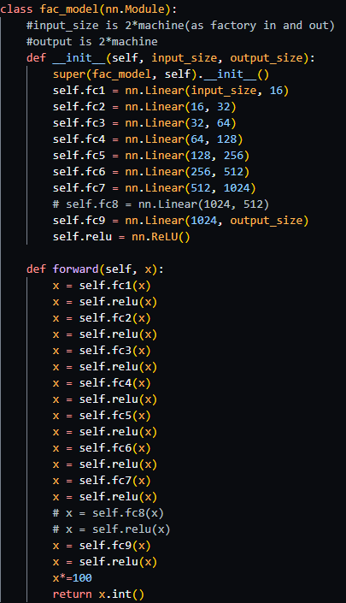
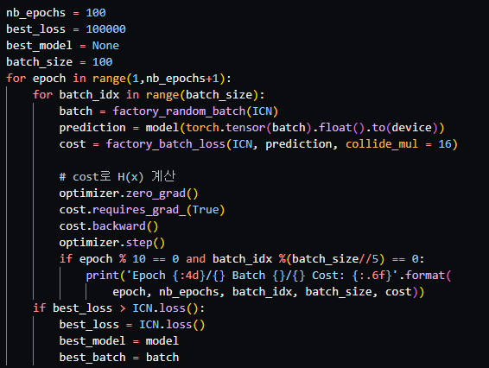
Case4
Epoch 10/100 Batch 0/100 Cost: 4942.784821
Epoch 10/100 Batch 20/100 Cost: 5154.558477
Epoch 10/100 Batch 40/100 Cost: 5013.004878
Epoch 10/100 Batch 60/100 Cost: 5172.686604
Epoch 10/100 Batch 80/100 Cost: 4980.839075
Epoch 20/100 Batch 0/100 Cost: 5257.031527
Epoch 20/100 Batch 20/100 Cost: 4719.688768
Epoch 20/100 Batch 40/100 Cost: 4701.416395
Epoch 20/100 Batch 60/100 Cost: 4976.727166
Epoch 20/100 Batch 80/100 Cost: 5098.534983
Epoch 30/100 Batch 0/100 Cost: 3972.442324
Epoch 30/100 Batch 20/100 Cost: 4935.102841
Epoch 30/100 Batch 40/100 Cost: 5172.766163
Epoch 30/100 Batch 60/100 Cost: 4883.829116
Epoch 30/100 Batch 80/100 Cost: 5070.507692
Epoch 40/100 Batch 0/100 Cost: 5020.270494
Epoch 40/100 Batch 20/100 Cost: 5108.270660
Epoch 40/100 Batch 40/100 Cost: 4980.839075
Epoch 40/100 Batch 60/100 Cost: 5150.979796
Epoch 40/100 Batch 80/100 Cost: 5128.443237
Epoch 50/100 Batch 0/100 Cost: 5009.920528
Epoch 50/100 Batch 20/100 Cost: 5154.970910
Epoch 50/100 Batch 40/100 Cost: 5104.277433
Epoch 50/100 Batch 60/100 Cost: 5096.063611
Epoch 50/100 Batch 80/100 Cost: 4979.638464
Epoch 60/100 Batch 0/100 Cost: 5173.874512
Epoch 60/100 Batch 20/100 Cost: 4744.451381
Epoch 60/100 Batch 40/100 Cost: 4940.363186
Epoch 60/100 Batch 60/100 Cost: 4757.483689
Epoch 60/100 Batch 80/100 Cost: 5042.211753
Epoch 70/100 Batch 0/100 Cost: 5233.721715
Epoch 70/100 Batch 20/100 Cost: 4987.146389
Epoch 70/100 Batch 40/100 Cost: 4219.558140
Epoch 70/100 Batch 60/100 Cost: 4899.962285
Epoch 70/100 Batch 80/100 Cost: 5291.218437
Epoch 80/100 Batch 0/100 Cost: 5258.550841
Epoch 80/100 Batch 20/100 Cost: 4608.978780
Epoch 80/100 Batch 40/100 Cost: 5362.198886
Epoch 80/100 Batch 60/100 Cost: 5201.238827
Epoch 80/100 Batch 80/100 Cost: 4780.323770
Epoch 90/100 Batch 0/100 Cost: 4485.473337
Epoch 90/100 Batch 20/100 Cost: 5020.270494
Epoch 90/100 Batch 40/100 Cost: 5012.440537
Epoch 90/100 Batch 60/100 Cost: 5239.986815
Epoch 90/100 Batch 80/100 Cost: 4829.440462
Epoch 100/100 Batch 0/100 Cost: 4316.668478
Epoch 100/100 Batch 20/100 Cost: 4979.638464
Epoch 100/100 Batch 40/100 Cost: 4701.698554
Epoch 100/100 Batch 60/100 Cost: 5154.970910
Epoch 100/100 Batch 80/100 Cost: 4876.549827

Slide 10
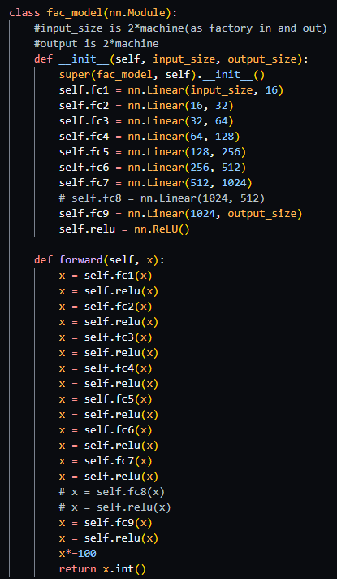
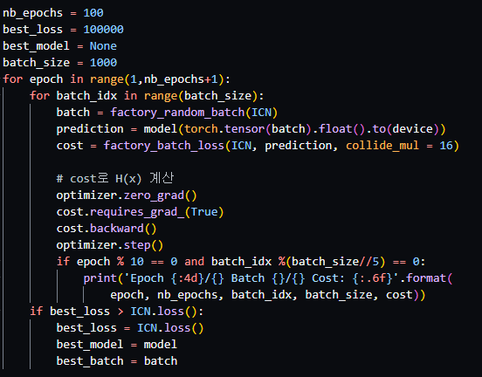
Case5
Epoch 10/100 Batch 0/1000 Cost: 4642.755236
Epoch 10/100 Batch 200/1000 Cost: 4119.861927
Epoch 10/100 Batch 400/1000 Cost: 5172.766163
Epoch 10/100 Batch 600/1000 Cost: 5201.238827
Epoch 10/100 Batch 800/1000 Cost: 5274.855302
Epoch 20/100 Batch 0/1000 Cost: 5130.133226
Epoch 20/100 Batch 200/1000 Cost: 5273.383931
Epoch 20/100 Batch 400/1000 Cost: 4548.713075
Epoch 20/100 Batch 600/1000 Cost: 4723.658160
Epoch 20/100 Batch 800/1000 Cost: 4474.005053
Epoch 30/100 Batch 0/1000 Cost: 4425.857711
Epoch 30/100 Batch 200/1000 Cost: 5148.280250
Epoch 30/100 Batch 400/1000 Cost: 4539.387571
Epoch 30/100 Batch 600/1000 Cost: 4537.298358
Epoch 30/100 Batch 800/1000 Cost: 5017.090301
Epoch 40/100 Batch 0/1000 Cost: 4525.402827
Epoch 40/100 Batch 200/1000 Cost: 4821.404235
Epoch 40/100 Batch 400/1000 Cost: 5242.301753
Epoch 40/100 Batch 600/1000 Cost: 5036.811370
Epoch 40/100 Batch 800/1000 Cost: 4707.272387
Epoch 50/100 Batch 0/1000 Cost: 4868.432747
Epoch 50/100 Batch 200/1000 Cost: 5176.921995
Epoch 50/100 Batch 400/1000 Cost: 4900.733822
Epoch 50/100 Batch 600/1000 Cost: 5148.280250
Epoch 50/100 Batch 800/1000 Cost: 4682.481736
Epoch 60/100 Batch 0/1000 Cost: 4974.415609
Epoch 60/100 Batch 200/1000 Cost: 5024.212958
Epoch 60/100 Batch 400/1000 Cost: 4954.329377
Epoch 60/100 Batch 600/1000 Cost: 4937.972414
Epoch 60/100 Batch 800/1000 Cost: 4676.481023
Epoch 70/100 Batch 0/1000 Cost: 5097.431113
Epoch 70/100 Batch 200/1000 Cost: 4782.704452
Epoch 70/100 Batch 400/1000 Cost: 3718.735507
Epoch 70/100 Batch 600/1000 Cost: 5289.801980
Epoch 70/100 Batch 800/1000 Cost: 4203.119789
Epoch 80/100 Batch 0/1000 Cost: 5006.397282
Epoch 80/100 Batch 200/1000 Cost: 4447.134568
Epoch 80/100 Batch 400/1000 Cost: 5010.128557
Epoch 80/100 Batch 600/1000 Cost: 4975.455245
Epoch 80/100 Batch 800/1000 Cost: 4679.375293
Epoch 90/100 Batch 0/1000 Cost: 4530.035917
Epoch 90/100 Batch 200/1000 Cost: 4323.007839
Epoch 90/100 Batch 400/1000 Cost: 5276.550227
Epoch 90/100 Batch 600/1000 Cost: 4940.015006
Epoch 90/100 Batch 800/1000 Cost: 4378.598989
Epoch 100/100 Batch 0/1000 Cost: 4201.908971
Epoch 100/100 Batch 200/1000 Cost: 4101.706932
Epoch 100/100 Batch 400/1000 Cost: 4701.725272
Epoch 100/100 Batch 600/1000 Cost: 4414.258243
Epoch 100/100 Batch 800/1000 Cost: 4707.587644

Slide 11
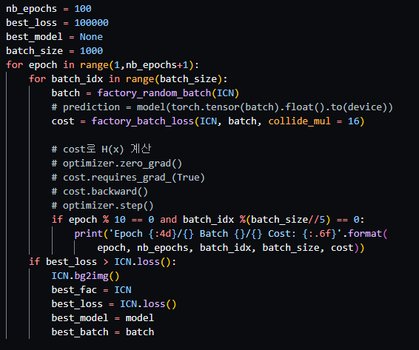
그냥 random approach
Epoch 10/100 Batch 0/1000 Cost: 865.852181
Epoch 10/100 Batch 200/1000 Cost: 1290.612315
Epoch 10/100 Batch 400/1000 Cost: 835.554292
Epoch 10/100 Batch 600/1000 Cost: 1694.073797
Epoch 10/100 Batch 800/1000 Cost: 858.693991
Epoch 20/100 Batch 0/1000 Cost: 662.802283
Epoch 20/100 Batch 200/1000 Cost: 827.656501
Epoch 20/100 Batch 400/1000 Cost: 919.186547
Epoch 20/100 Batch 600/1000 Cost: 2008.271667
Epoch 20/100 Batch 800/1000 Cost: 787.395424
Epoch 30/100 Batch 0/1000 Cost: 669.918073
Epoch 30/100 Batch 200/1000 Cost: 2184.346487
Epoch 30/100 Batch 400/1000 Cost: 1547.727437
Epoch 30/100 Batch 600/1000 Cost: 826.230852
Epoch 30/100 Batch 800/1000 Cost: 819.137249
Epoch 40/100 Batch 0/1000 Cost: 772.572806
Epoch 40/100 Batch 200/1000 Cost: 991.326491
Epoch 40/100 Batch 400/1000 Cost: 1253.154816
Epoch 40/100 Batch 600/1000 Cost: 894.570780
Epoch 40/100 Batch 800/1000 Cost: 818.278884
Epoch 50/100 Batch 0/1000 Cost: 844.728937
Epoch 50/100 Batch 200/1000 Cost: 1526.744644
Epoch 50/100 Batch 400/1000 Cost: 2086.662308
Epoch 50/100 Batch 600/1000 Cost: 864.382281
Epoch 50/100 Batch 800/1000 Cost: 3649.012393
Epoch 60/100 Batch 0/1000 Cost: 938.163900
Epoch 60/100 Batch 200/1000 Cost: 992.495209
Epoch 60/100 Batch 400/1000 Cost: 765.158426
Epoch 60/100 Batch 600/1000 Cost: 1298.039274
Epoch 60/100 Batch 800/1000 Cost: 1537.056156
Epoch 70/100 Batch 0/1000 Cost: 1814.892097
Epoch 70/100 Batch 200/1000 Cost: 857.539201
Epoch 70/100 Batch 400/1000 Cost: 714.671779
Epoch 70/100 Batch 600/1000 Cost: 1811.374095
Epoch 70/100 Batch 800/1000 Cost: 1507.082157
Epoch 80/100 Batch 0/1000 Cost: 1162.074749
Epoch 80/100 Batch 200/1000 Cost: 2852.044704
Epoch 80/100 Batch 400/1000 Cost: 911.770207
Epoch 80/100 Batch 600/1000 Cost: 705.188701
Epoch 80/100 Batch 800/1000 Cost: 701.845990
Epoch 90/100 Batch 0/1000 Cost: 1843.421145
Epoch 90/100 Batch 200/1000 Cost: 677.253200
Epoch 90/100 Batch 400/1000 Cost: 1115.523666
Epoch 90/100 Batch 600/1000 Cost: 938.636699
Epoch 90/100 Batch 800/1000 Cost: 821.324358
Epoch 100/100 Batch 0/1000 Cost: 624.148796
Epoch 100/100 Batch 200/1000 Cost: 1582.454333
Epoch 100/100 Batch 400/1000 Cost: 757.532502
Epoch 100/100 Batch 600/1000 Cost: 1022.466273
Epoch 100/100 Batch 800/1000 Cost: 1619.374400

Slide 12
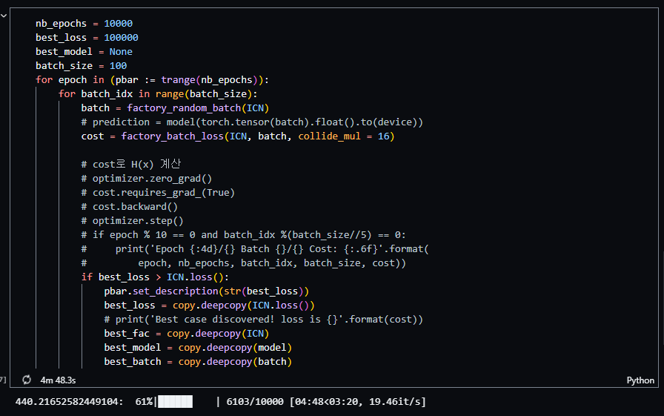
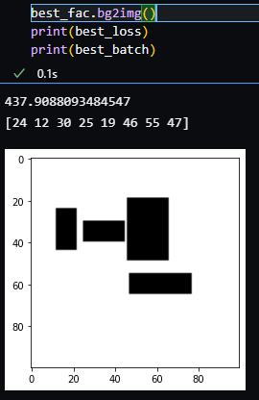
RA2

Slide 13
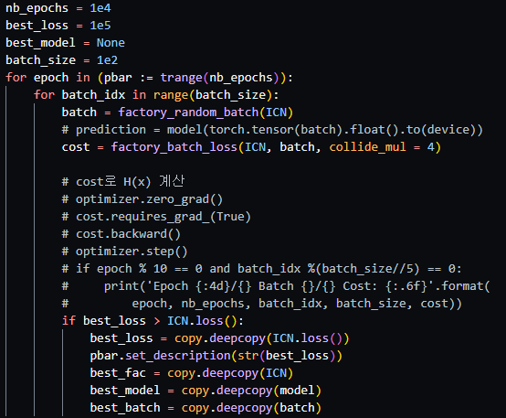
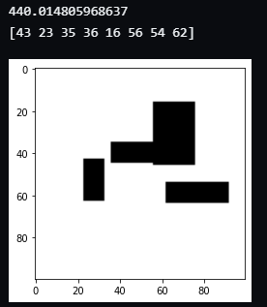
RA3

Slide 14
요약
처음부터 FC NN로 학습시킨다는 것 자체가 무리수, NN은 전체 과정을 학습하지 못한다.
Random approach를 활용하여 가능한 초기 값들을 정렬한 이후에 minor한 변화들을 NN으로 학습시키는 방법 (6/28)
가능하다면 reinforcement learning을 사용해보기(6/28)

